Slide 1
Da Phuc primary school
Welcome to my class
Teacher: Do Tra Giang
Class: 4A3

Slide 4
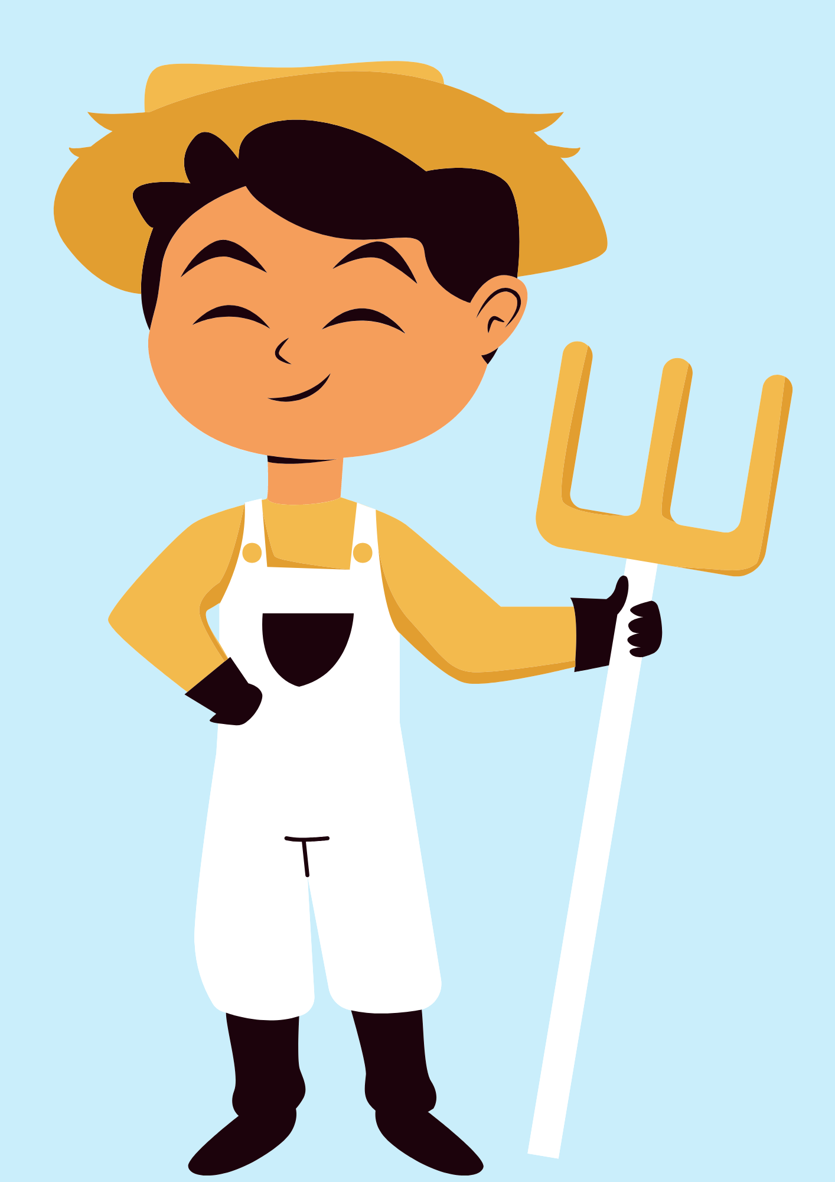
GUESS THE JOB!
a farmer

Slide 5

GUESS THE JOB!
an office worker

Slide 6
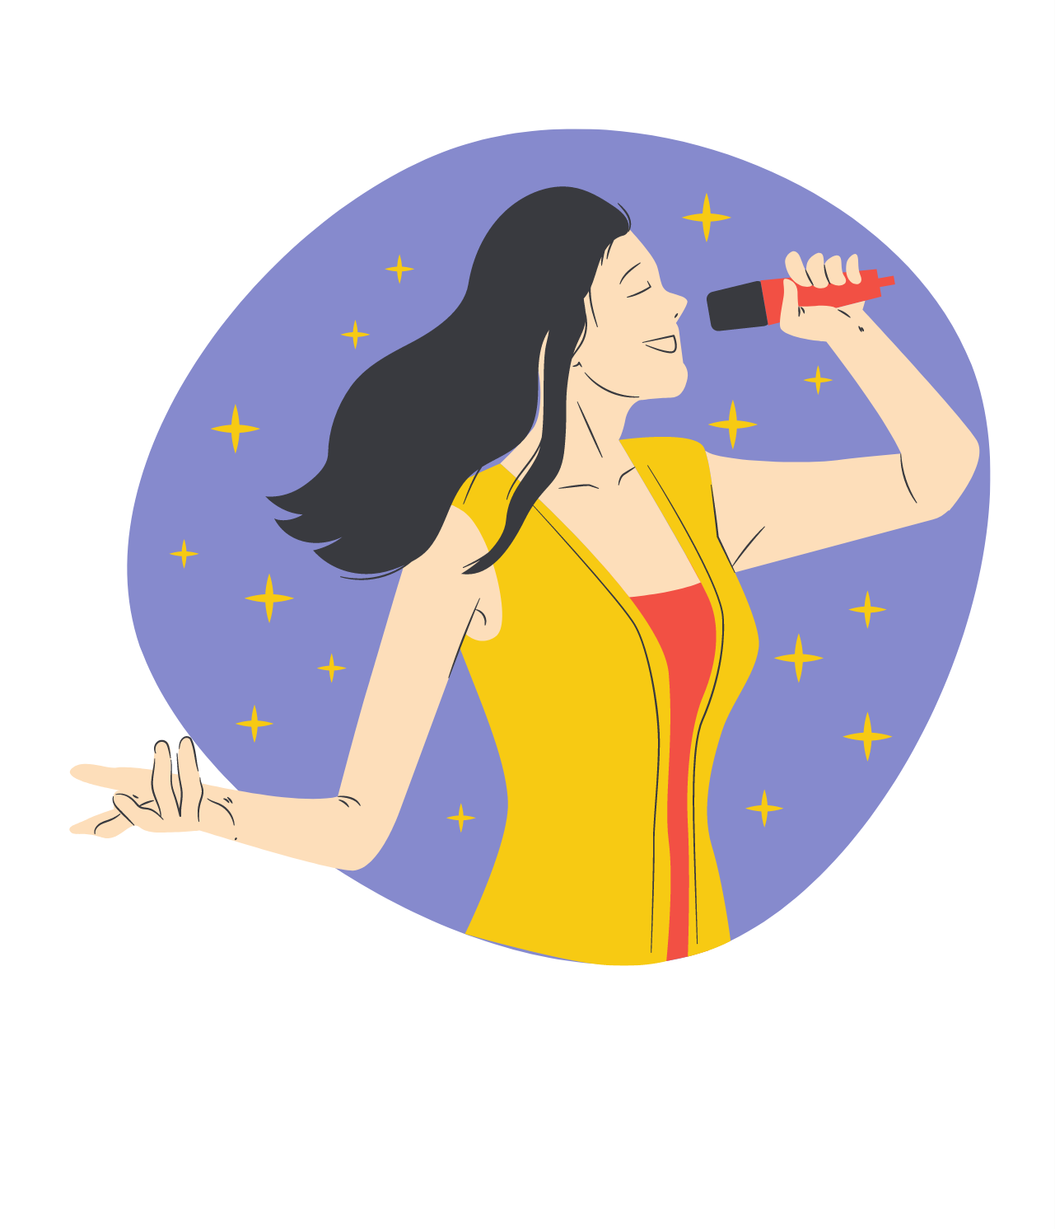
GUESS THE JOB!
a singer

Slide 7
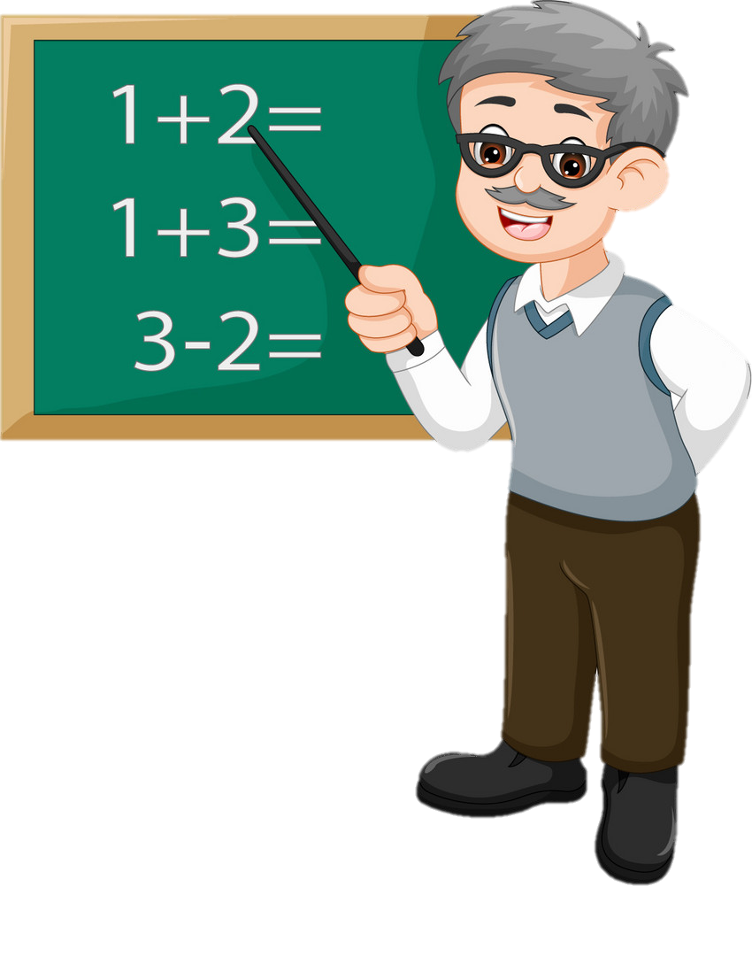
GUESS THE JOB!
a teacher

Slide 8

GUESS THE JOB!
a nurse

Slide 9
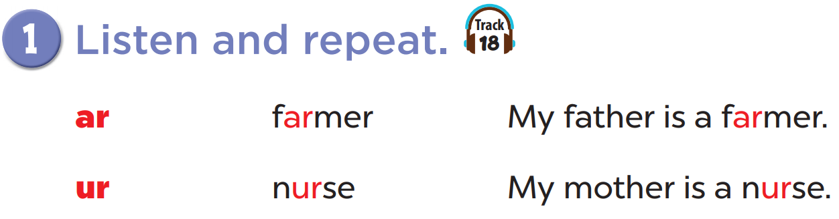


Slide 10
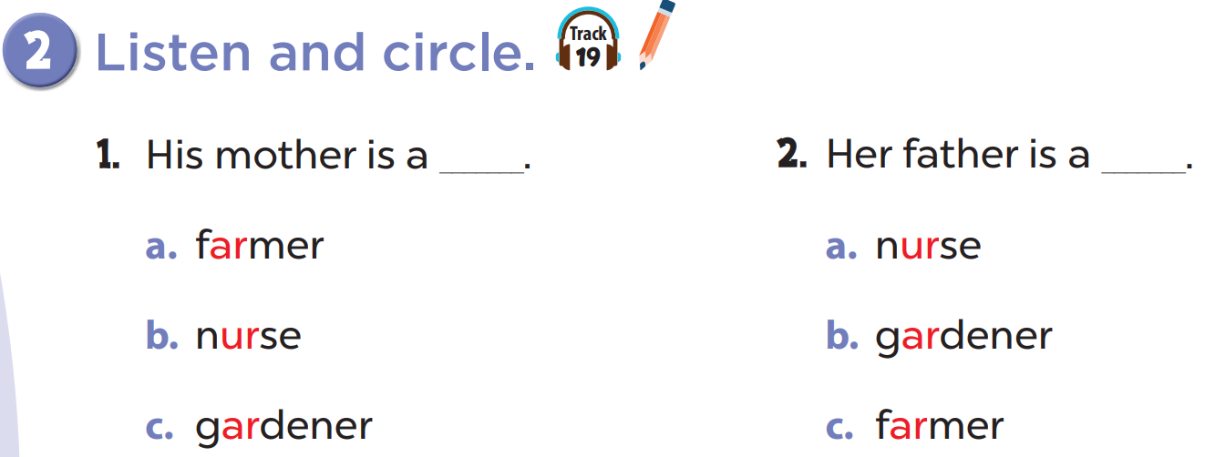

Slide 12
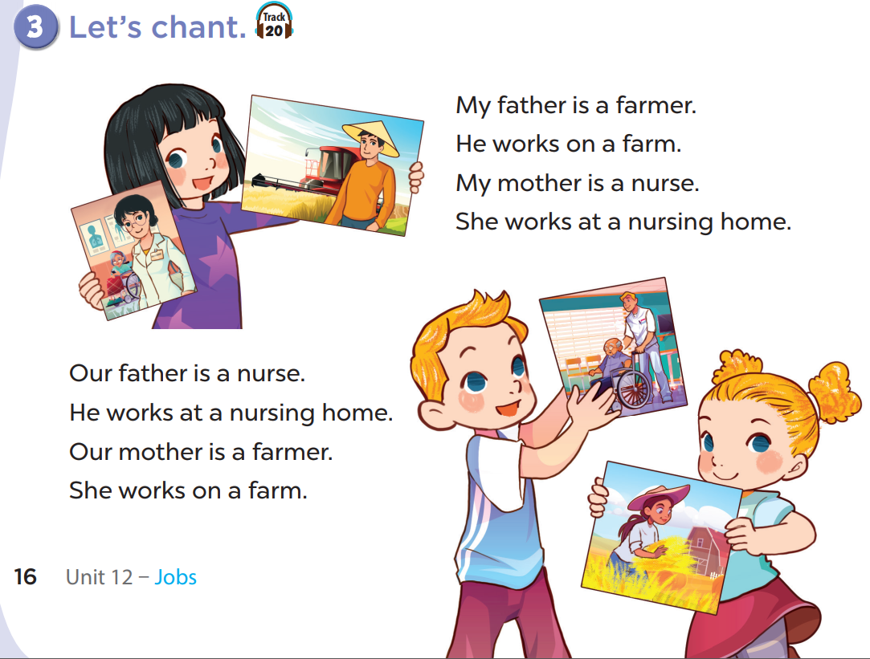

Slide 15
Write your own chant about your family!
My father is...
He works...
My mother is...
She works...

