Slide 1







12
LESSON 3 – Period 5

Slide 2

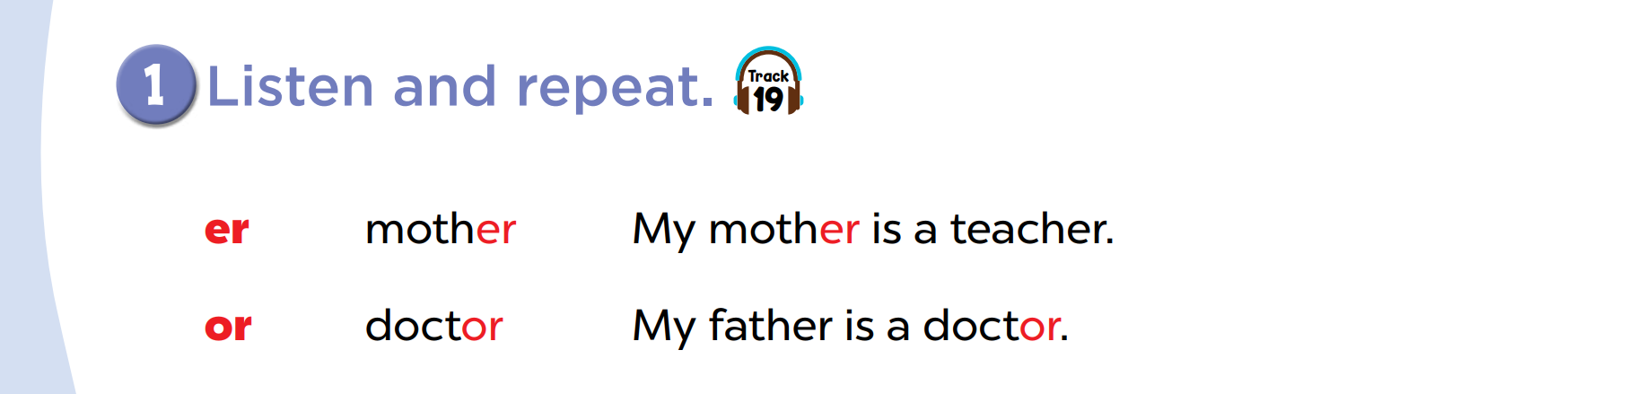

Slide 3
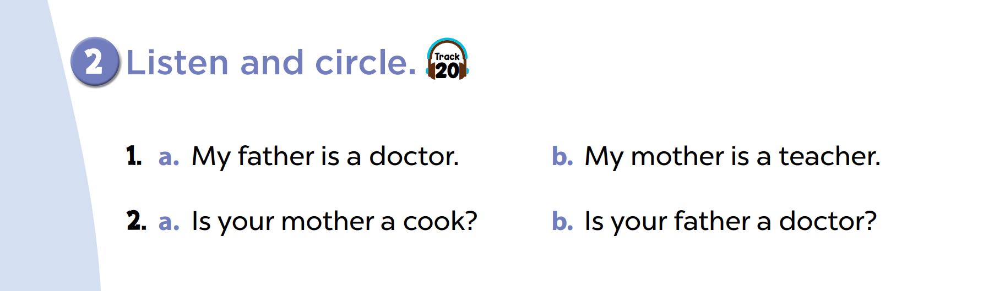

Slide 5
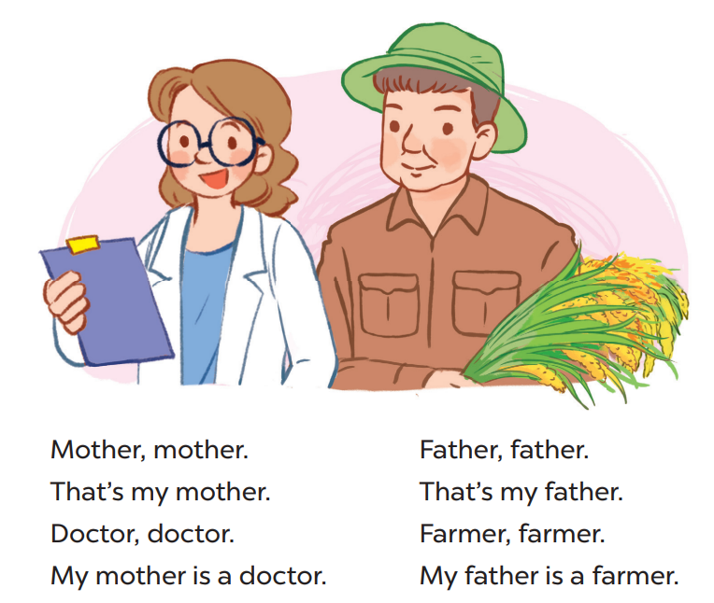

Slide 6

Website: hoclieu.vn
Fanpage: facebook.com/www.tienganhglobalsuccess.vn

