Slide 1
Da Phuc Primary school
Welcome to my class
Teacher: Do Tra Giang
Class: 4a1

Slide 2
Unit 13
Appearance
Lesson 1 - Period 1

Slide 3
Warm-up
01
Complete the family tree!
Options:
Easy
Advanced

Slide 4

Grandfather
Grandmother
Grandmother
Grandfather
Father
Mother
Brother
Sister

Slide 5

Grandfather
Grandmother
Father
Mother
Uncle
Aunt
Sister
Brother
Cousin

Slide 6
02
Look, listen and repeat.

Slide 7

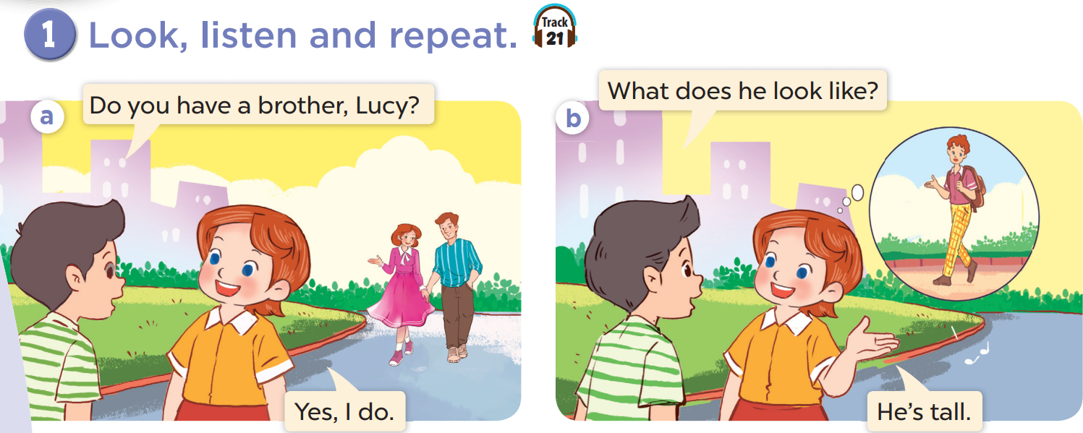
Who is he? Who is she?
Look at Lucy's brother. Is he tall or short?

Slide 8
03
Listen, point and say.

Slide 9
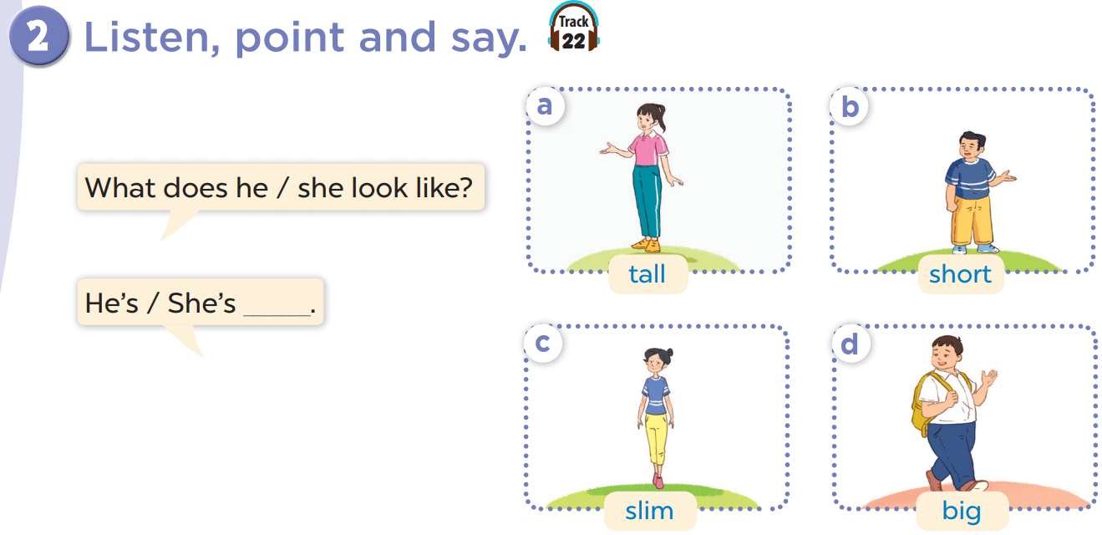
Listen, point and say.
Work in pairs. Practise.
Notes:
Click on the Speaker Icon to play the audio.

Slide 10
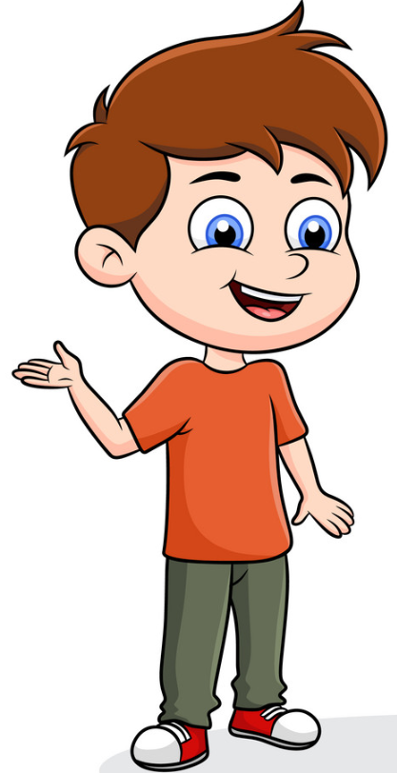


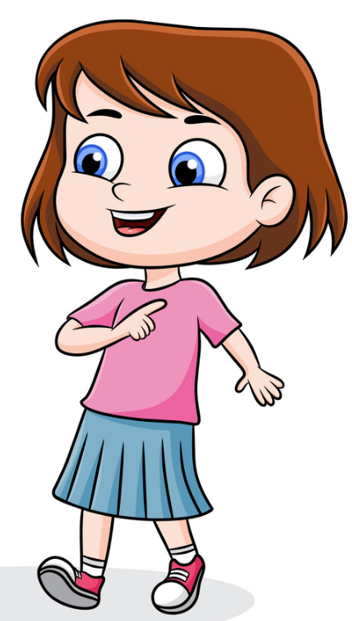
What does she look like?
She is slim.

Slide 11
What does he/she look like?
He/She is _____.

Slide 12
04
Let's talk.

Slide 13
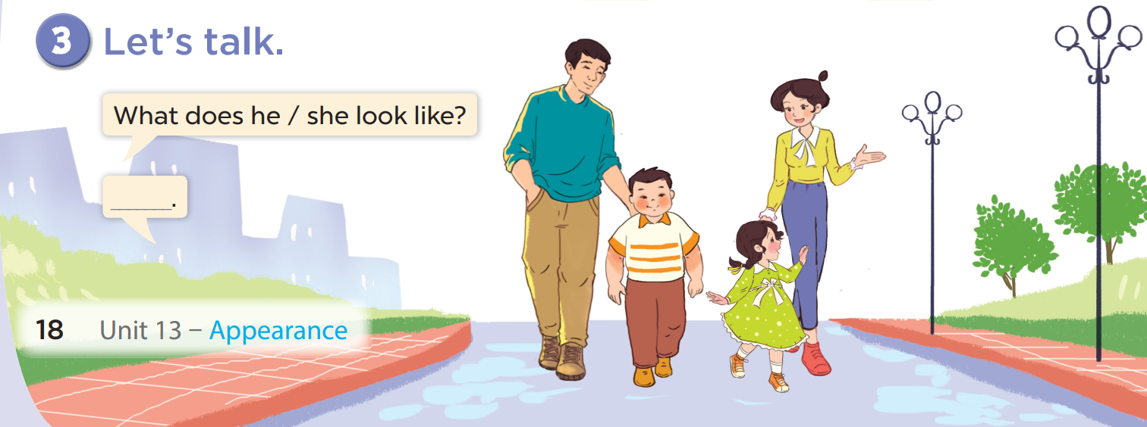

Slide 14
Fun corner and wrap-up
05

Slide 15

Choose a number and answer
Sound file is in me!
1.
2.
3.
4.
5.
6.
7.
8.
9.
10.
Notes:
Main question slide.

Slide 16

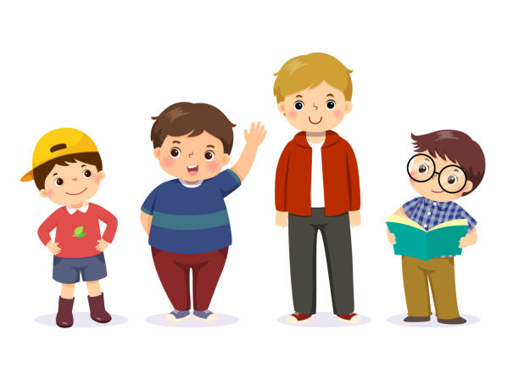

What does Tim look like?
Tim
Ben
He is tall.

Slide 17
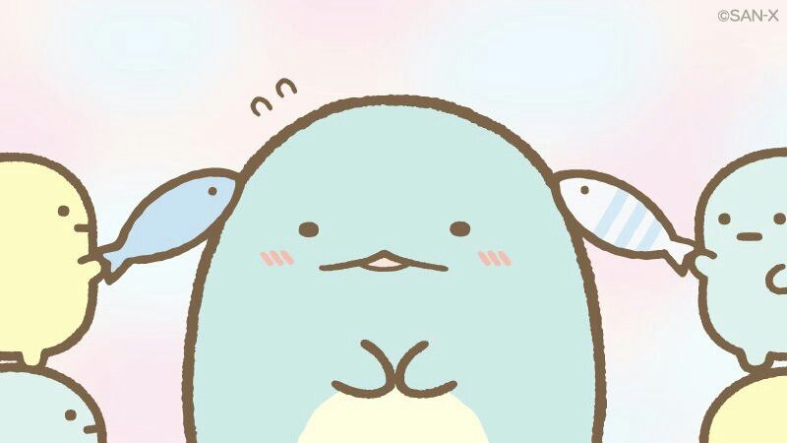





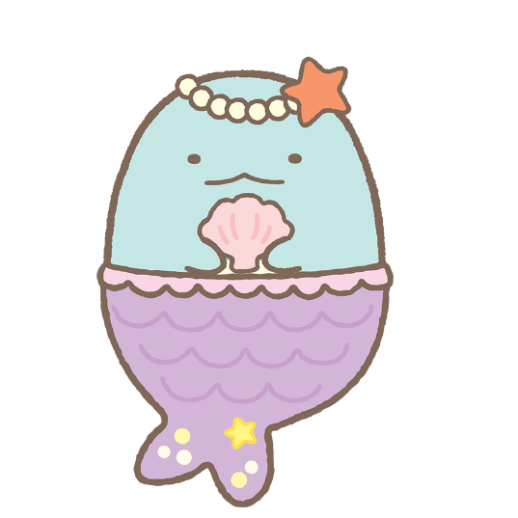



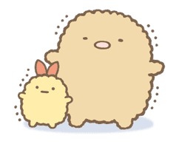



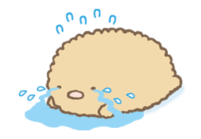
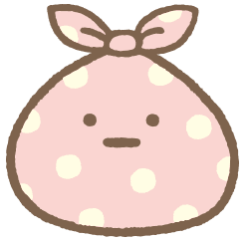
Sound file is in me!
1.
2.
Change points
+7
-3
+7
3.
4.
Notes:
Choice slide. Click on the character in the bottom right hand corner to go to the points counter.

Slide 18
What does Ben look like?
Tim
Ben
He is short.
Notes:
Question two.

Slide 19

Sound file is in me!
+3
Notes:
Click on the character in the bottom right hand corner to go to the points counter slide.

Slide 20
What does he look like?
He is big.
Notes:
Question three.

Slide 21

Sound file is in me!
+5
Notes:
Click on the character in the bottom right hand corner to go to the points counter slide.

Slide 22
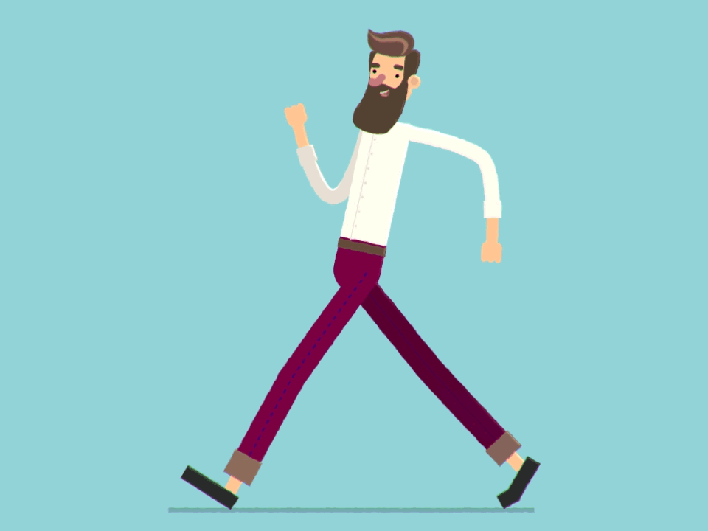
What does he look like?
He is tall and slim.
Notes:
The answers can vary: He is tall. / He is slim. / He is tall and slim.

Slide 23
Sound file is in me!
1.
2.
-3
Change points
+7
+7
3.
4.
Notes:
Choice slide. Click on the character in the bottom right hand corner to go to the points counter slide.

Slide 24
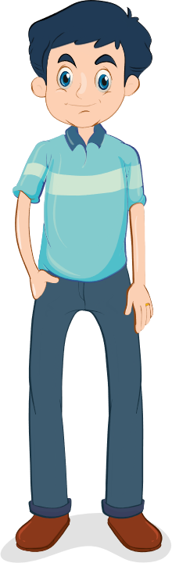
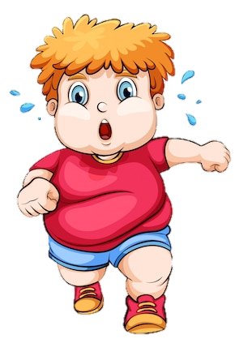
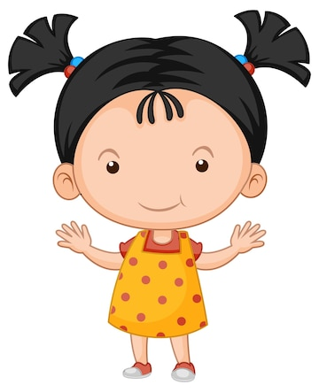
What does your father look like?
He is tall.
Notes:
Question five.

Slide 25

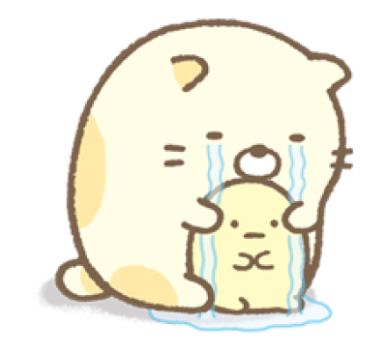
Sound file is in me!
-3
Notes:
Minus three points. Click on the crying cat to go to the points counter slide.

Slide 26
What does your mother look like?
She is slim.
Notes:
Question six.

Slide 27
Sound file is in me!
+7
Notes:
Click on the character in the bottom right hand corner to go to the points counter slide.

Slide 28
What does your brother look like?
He is big.
Notes:
Question seven.

Slide 29
Sound file is in me!
1.
2.
-3
+7
-3
+7
3.
4.
Notes:
Choice slide. Click on the character in the bottom right hand corner to go to the points counter slide.

Slide 30
What does your sister look like?
She is short.
Notes:
Question eight.

Slide 31
Sound file is in me!
+6
Notes:
Click on the character in the bottom right hand corner to go to the points counter slide.

Slide 32
What does he say?
.......................?
He is tall.
What does he look like?
Notes:
Question nine.

