Slide 1



13
MY house
LESSON 1 - PERIOD 1

Slide 2

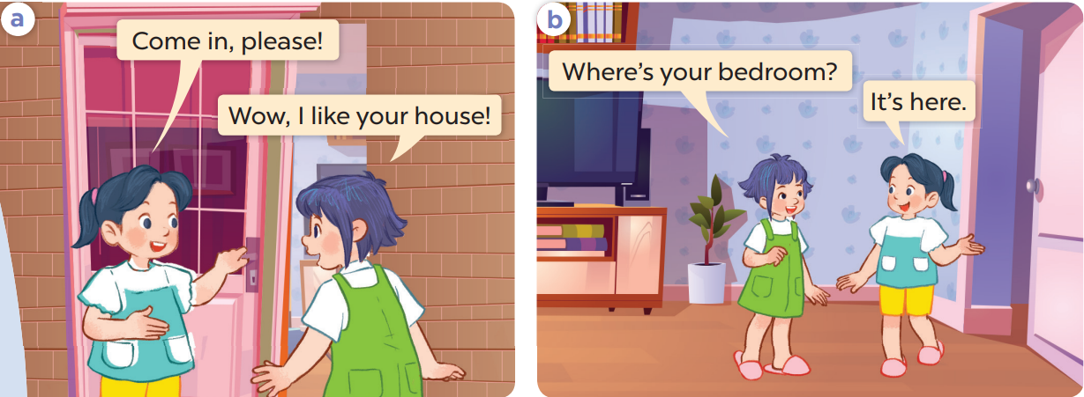
Work in pairs and repeat.

Slide 3
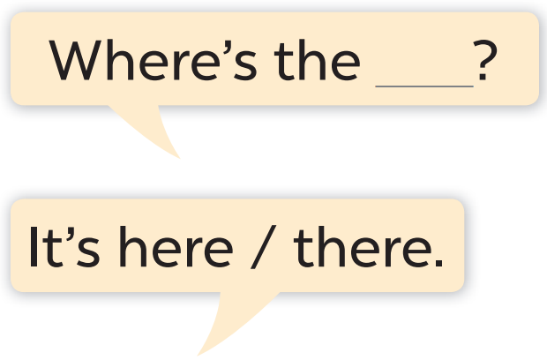
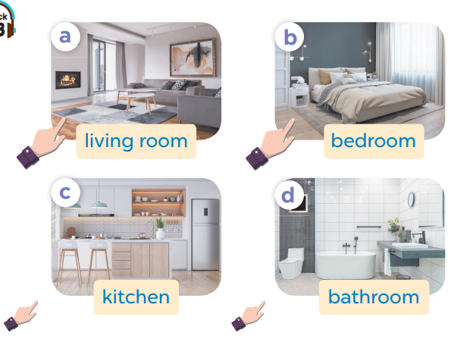

Slide 4
Work in pairs.
Ask and answer.

Slide 5
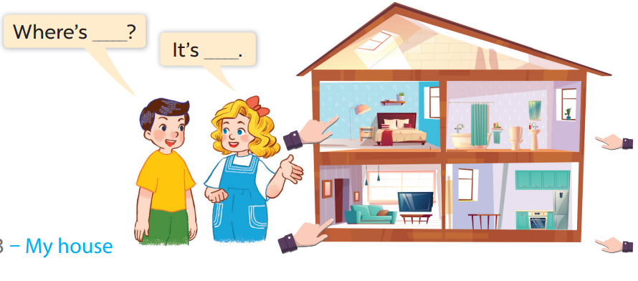
Work in pairs.
Ask and answer.

