Slide 1



13
My house
LESSON 2 - PERIOD 3

Slide 2
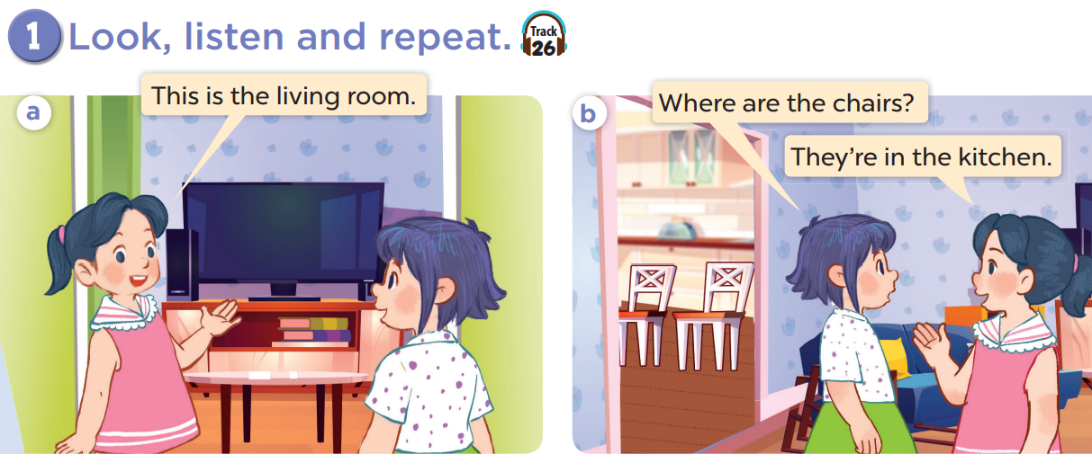


Slide 3
Work in pairs and act.

Slide 4
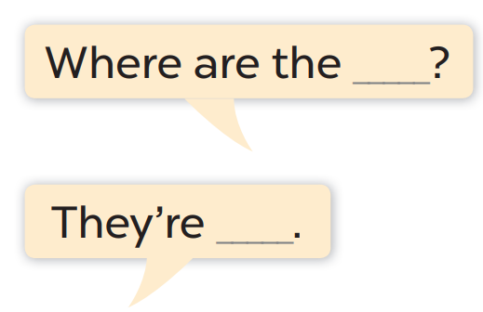
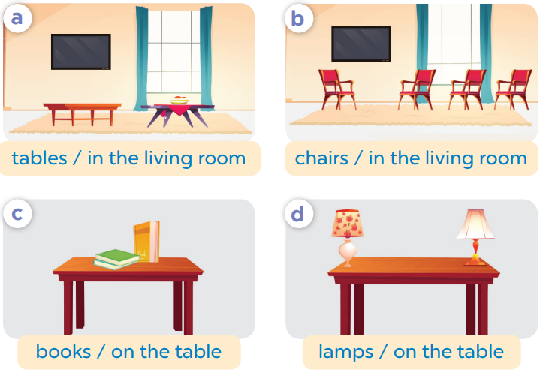
Work in pair, ask and answer.

Slide 5
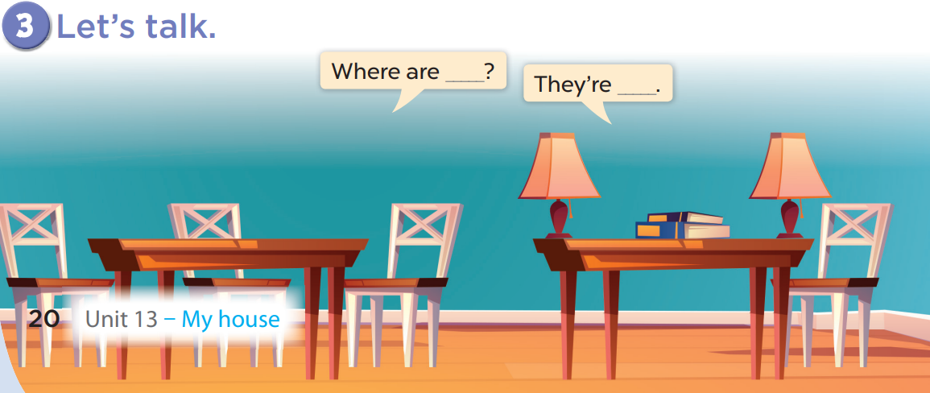
Work in pairs, ask and answer.

