Slide 1

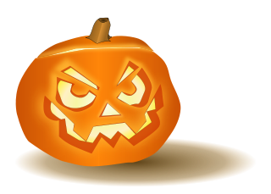
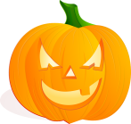

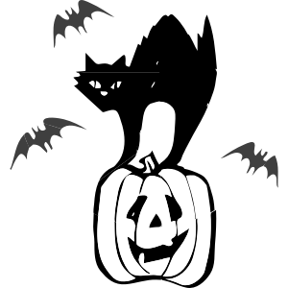
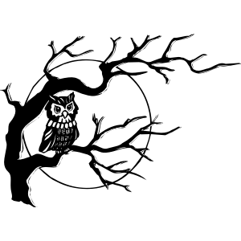

Slide 2

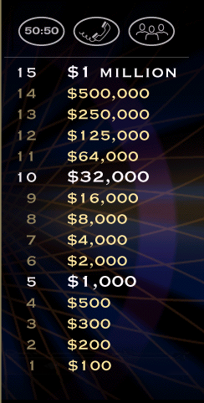

Slide 3





Halloween is celebrated on…
A.) the last Saturday
of October
B.) November 1
C.) correct answer
C.) 31 October
D.) the fourth Thursday
of November
L
F

Slide 5
Which of the following is NOT normally
associated with Halloween?
A.) correct answer
A.) a rabbit
B.) a bat
C.) a black cat
D.) a crow
L
F

Slide 7
What do people, especially in the US,
normally carve for Halloween?
A.) turnips
B.) correct answer
B.) pumpkins
C.) potatoes
D.) beets
L
F

Slide 9
What do people normally put
inside a jack-o’-lantern ?
A.) correct answer
A.) a candle
B.) presents
C.) coins
D.) candy corn
L
F

Slide 11
“Trick or Treat. Trick or Treat. Give me
something ______ to eat.”
A.) sweet
B.) tasty
C.) good
D.) nourishing
C.) correct answer
L
F

Slide 13
The name “jack-o’-lantern” comes from
an Irish folktale about a man named…
A.) Jack the Lad
B.) correct answer
B.) Stingy Jack
C.) Jack of all trades
D.) Jack the Ripper
L
F

Slide 15
When Jack died, the Devil gave him
_________ to light his way.
A.) an oil lamp
B.) a lantern
C.) a candle
D.) correct answer
D.) a burning coal
L
F

Slide 17
What is Halloween NOT associated with?
A.) souling
B.) correct answer
B.) egg hunting
C.) apple bobbing
D.) guising
L
F

Slide 19
In the game of apple bobbing players try
to catch apples floating on water
with __________.
A.) their feet
B.) a stick
C.) correct answer
C.) their teeth
D.) a spear
L
F

Slide 21
Halloween’s origins date back to the ancient
_______ festival of Samhain, which marked
the end of the harvest season.
A.) Indian
B.) Viking
C.) Roman
D.) correct answer
D.) Celtic
L
F

Slide 23
The druids were…
A.) farmers
B.) warriors
C.) hunters
D.) correct answer
D.) priests
L
F

Slide 25
Originally, All Souls Day (Nov. 2nd) was
celebrated with …
A.) singing and dancing
B.) correct answer
B.) big bonfires and
parades
C.) pranks and games
D.) public prayers
L
F

Slide 27
On All Souls’ Day poor citizens would beg
for food and families would give them …
A.) ginger cookies
B.) apple pies
C.) pumpkin pudding cakes
D.) pastries called soul cakes
D.) correct answer
L
F

Slide 29
Hundreds of years ago on Halloween, to keep
ghosts away from their houses, people would place
_________ outside their homes.
A.) scarecrows
B.) broomsticks
C.) bowls of food
D.) pumpkins
C.) correct answer
L
F

Slide 31
It is estimated that Americans spend more
than _______ on costumes annually.
A.) correct answer
A.) $2.5 billion
B.) $250 million
C.) $15 billion
D.) $1.5 billion
L
F

Slide 32


Congratulations!
Thank-you for playing…
Notes:
Correct

Slide 33
http://www.teachthemenglish.com/2015/04/games-for-the-language-classroom-who-wants-to-be-a-millionaire/
http://areti-aroundtheworldinenglish.blogspot.gr/

