Slide 1








DIGITAL GAME PRESENTATION
Let’s play
bingo!
Start Now!

Slide 2

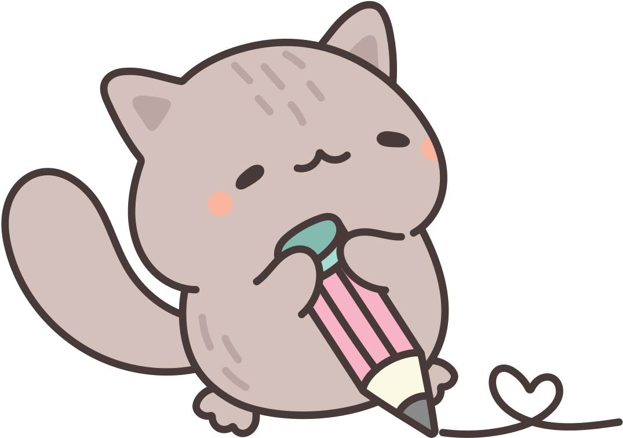
B
I
N
G
O
2
16
32
46
61
4
19
36
49
63
9
24
free
51
65
13
29
40
54
73
14
30
43
59
74

Slide 3
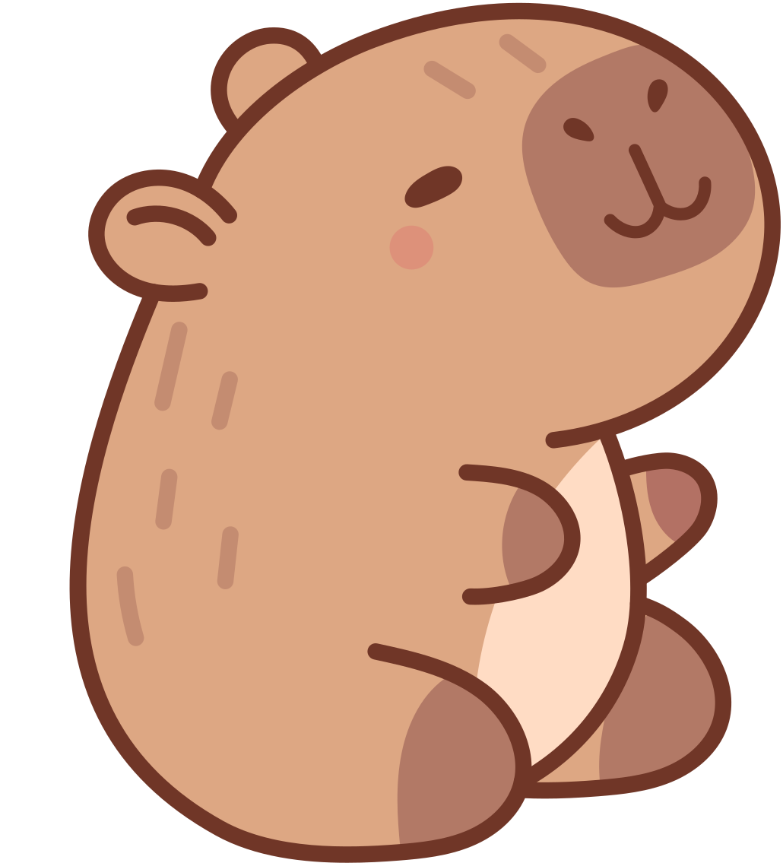
INSTRUCTIONS
Assign a bingo caller who will select the numbers, call them out, and verify winning bingo cards.
There can be as many players as possible in a round.
The bingo caller will also decide the winning pattern in a round. It could be five in a row, four corners, or a total blackout, to name a few.
Players should make their own bingo cards. Once the number is called, players should recolor the box to mark it.

Slide 4






MEET THE PLAYERS!
Donna
Aaron
Estelle
Hannah

Slide 5
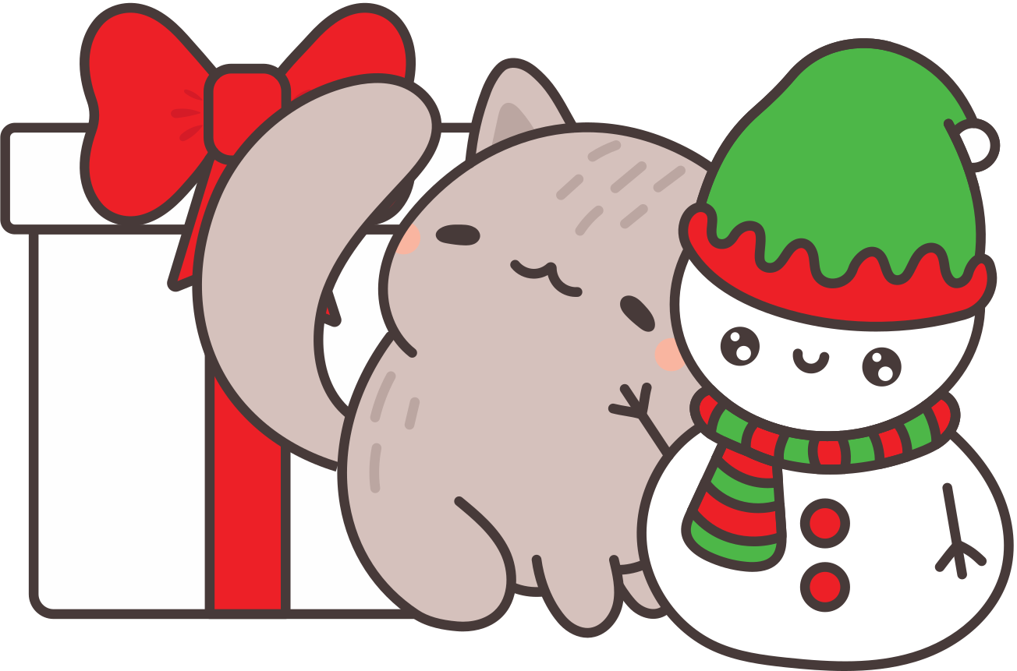
THIS CARD BELONGS TO...
(1-15)
(16-30)
(31-45)
(46-60)
(61-75)
B
I
N
G
O
-
-
-
-
-
-
-
-
-
-
-
-
free
-
-
-
-
-
-
-
-
-
-
-
-
Aaron

Slide 6

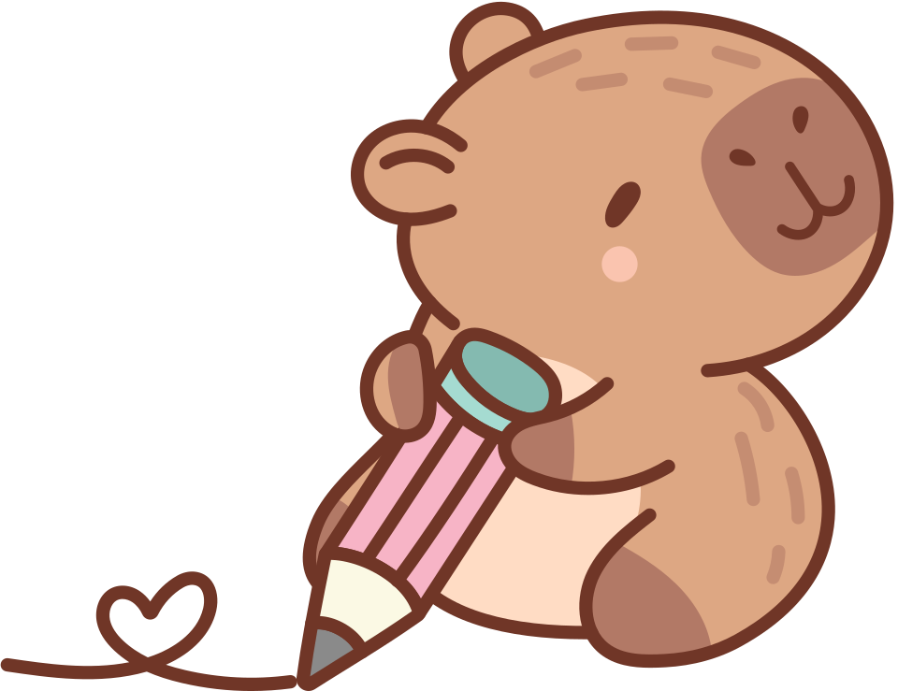
LET’S PLAY
BINGO!
Download this background and use it in the online call with your friends for a complete gaming experience.
Kindly delete this note after editing this page.

Slide 7

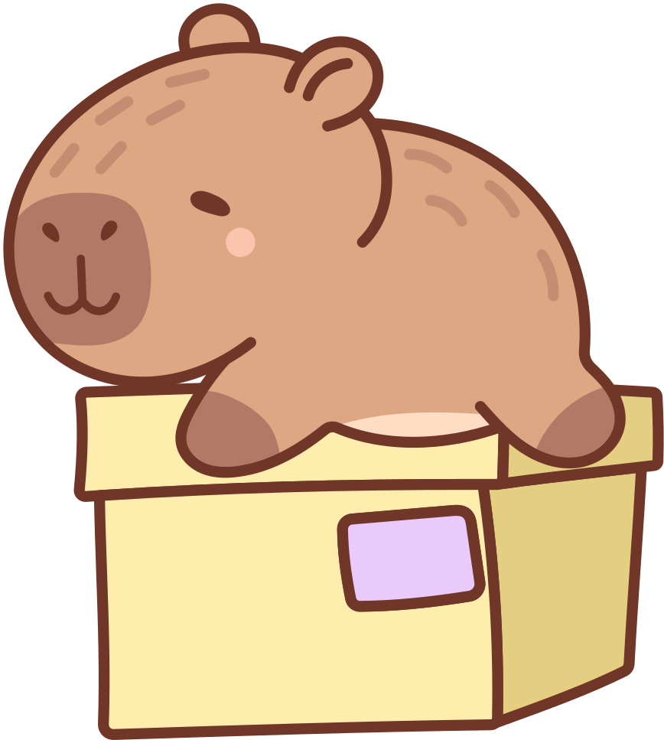
FIVE IN A ROW!
B
I
N
G
O
B
I
N
G
O
B
I
N
G
O
Vertical Line
Horizontal Line
Diagonal Line
Rules
Form any five-in-a-row pattern. It can be diagonal, straight line across, or straight line down. The first player to form a five-in-a-row pattern wins the round.

Slide 8
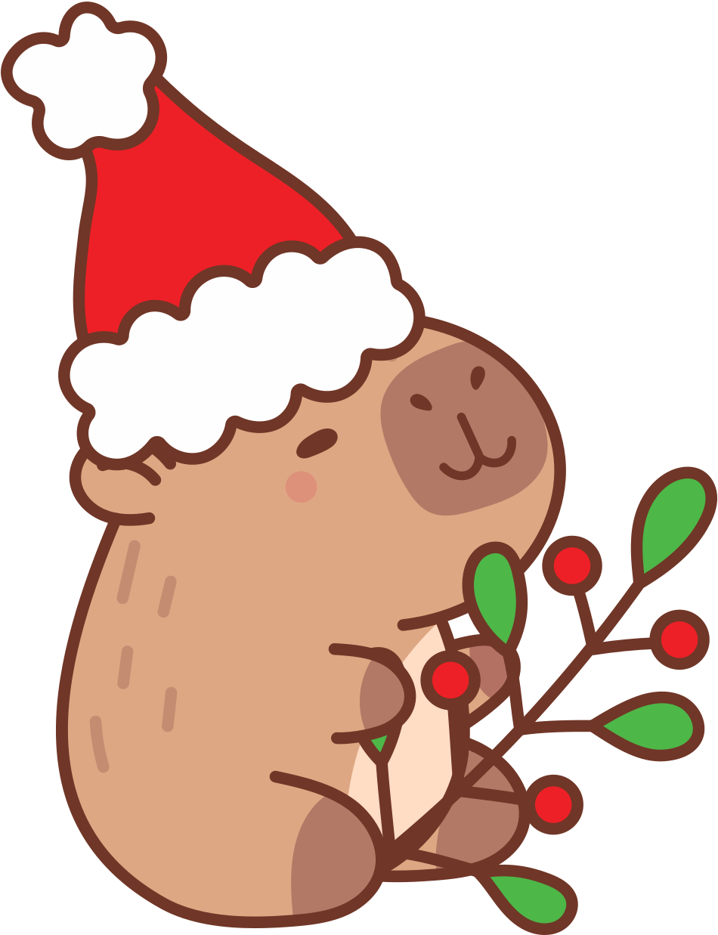

ARE YOU READY
TO WIN?
Shout "Bingo" if you get five in a row!

Slide 9


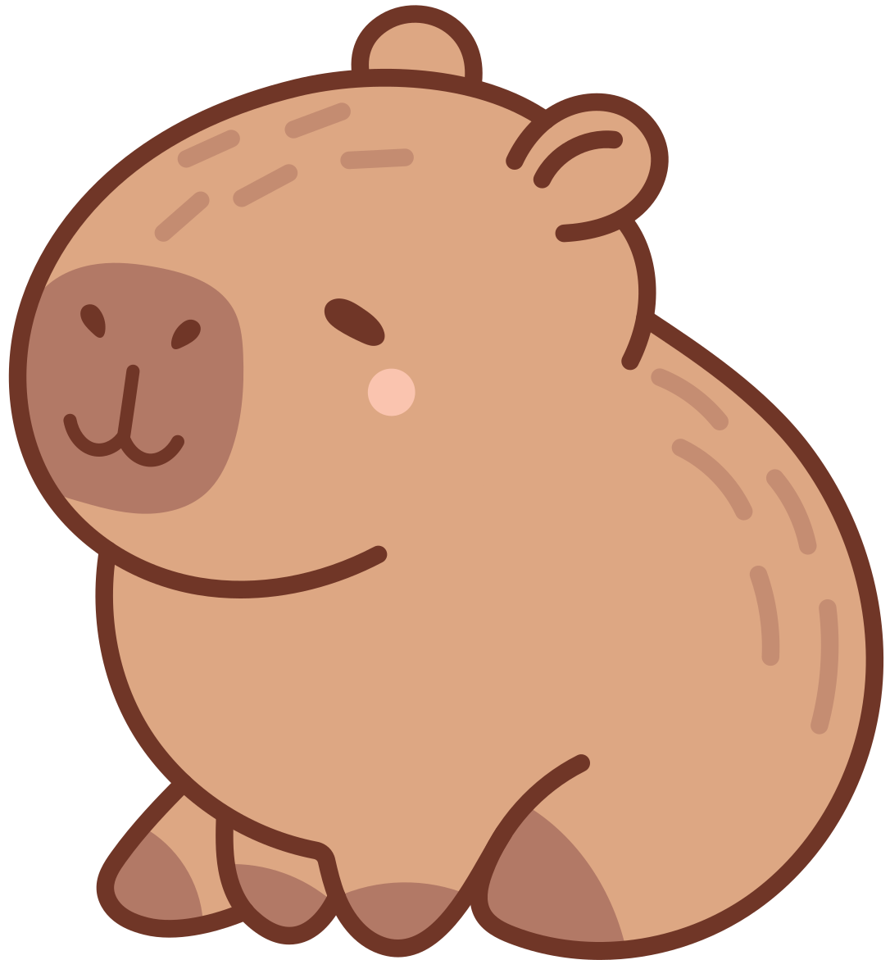
OUR WINNER IS...
Estelle

Slide 10
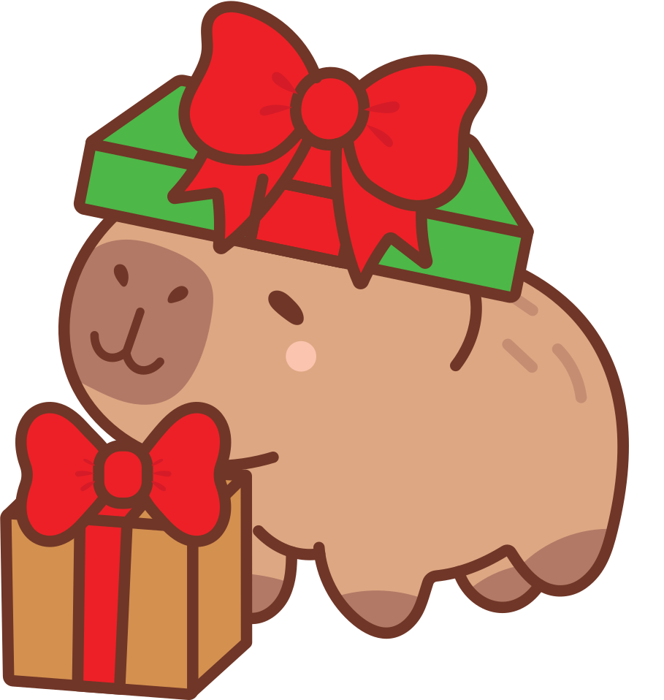



Thank you
for Playing!
See you next time!

