Slide 1


Slide 2



Slide 3

REVIEW 3
Notes:
Greet the students.
Divide class into groups.
Tell the students that they are going to learn lesson review 3.

Slide 4






REVIEW 3
Notes:
Review the numbers from 16 to 20.

Slide 5
REVIEW 3
Look and choose
A. sixteen
B. seventeen

Slide 6
REVIEW 3
Look and choose
A. twenty
B. seventeen

Slide 7
REVIEW 3
Look and choose
A. sixteen
B. nineteen
Notes:
Today, We have some activities to review our lessons.
Do you remember Units 1, 2,and 3 about Letters A,B and C?
Get ready to start!

Slide 8
REVIEW 3
Look and choose
A. twenty
B. twelve
Notes:
Today, We have some activities to review our lessons.
Do you remember Units 1, 2,and 3 about Letters A,B and C?
Get ready to start!

Slide 9
REVIEW 3
Look and choose
A. eighteen
B. eight
Notes:
Today, We have some activities to review our lessons.
Do you remember Units 1, 2,and 3 about Letters A,B and C?
Get ready to start!

Slide 10
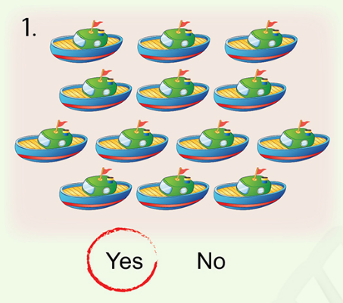

Review 3
1. Listen and circle YES or NO
Notes:
Here are all the pictures.
Let’s say again.

Slide 11
Review 3
1. Listen and circle YES or NO
Notes:
Here are all the pictures.
Let’s say again.

Slide 12
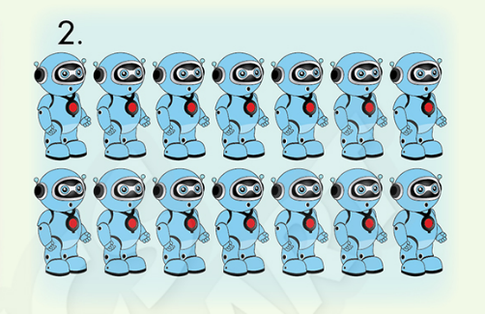
Review 3
1. Listen and circle YES or NO
Yes No
Notes:
Here are all the pictures.
Let’s say again.

Slide 13

Review 3
1. Listen and circle YES or NO
Yes No

Slide 14
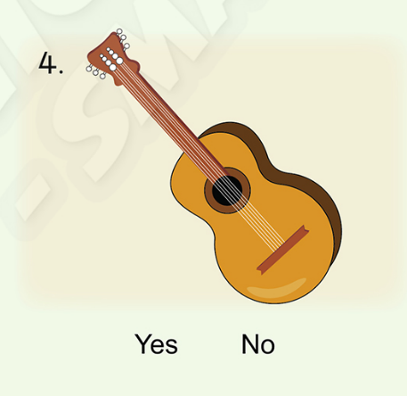
Review 3
1. Listen and circle YES or NO
Yes No

Slide 15
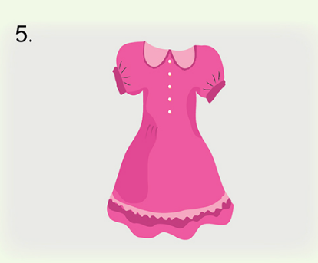
Review 3
1. Listen and circle YES or NO
Yes No

Slide 16
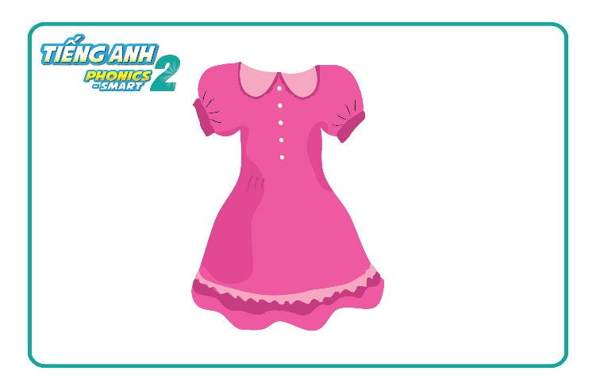

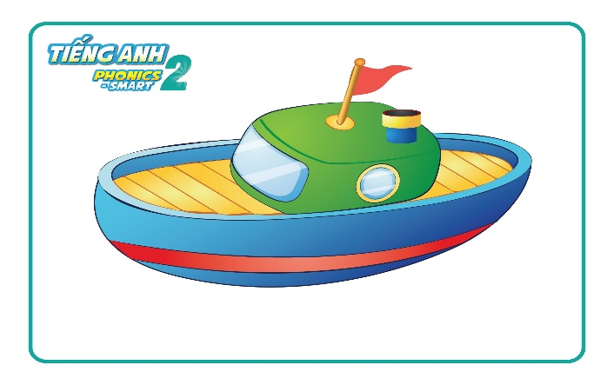
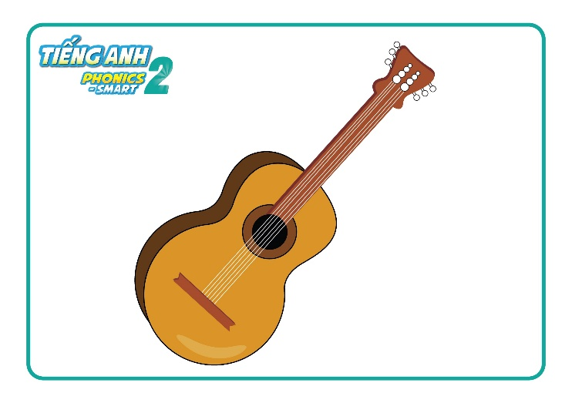
Review 3

Slide 17


CÔNG TY CỔ PHẦN PHÁT TRIỂN GIÁO DỤC
VIỆT NAM VPBOX
Hà Nội
Biệt thự G2&G28, Làng Quốc Tế Thăng Long,
Quận Cầu Giấy, Hà Nội.
ĐT: (024) 3 3793 2405
phonics.hanoi@vpbox.edu.vn
Thành Phố Hồ Chí Minh
Số 29 Mai Thị Lựu, Quận 1, TP. HCM.
ĐT: (028) 3 820 5934
phonics.hcm@vpbox.edu.vn
www.vpbox.edu.vn

