Slide 1


Slide 2



Slide 3

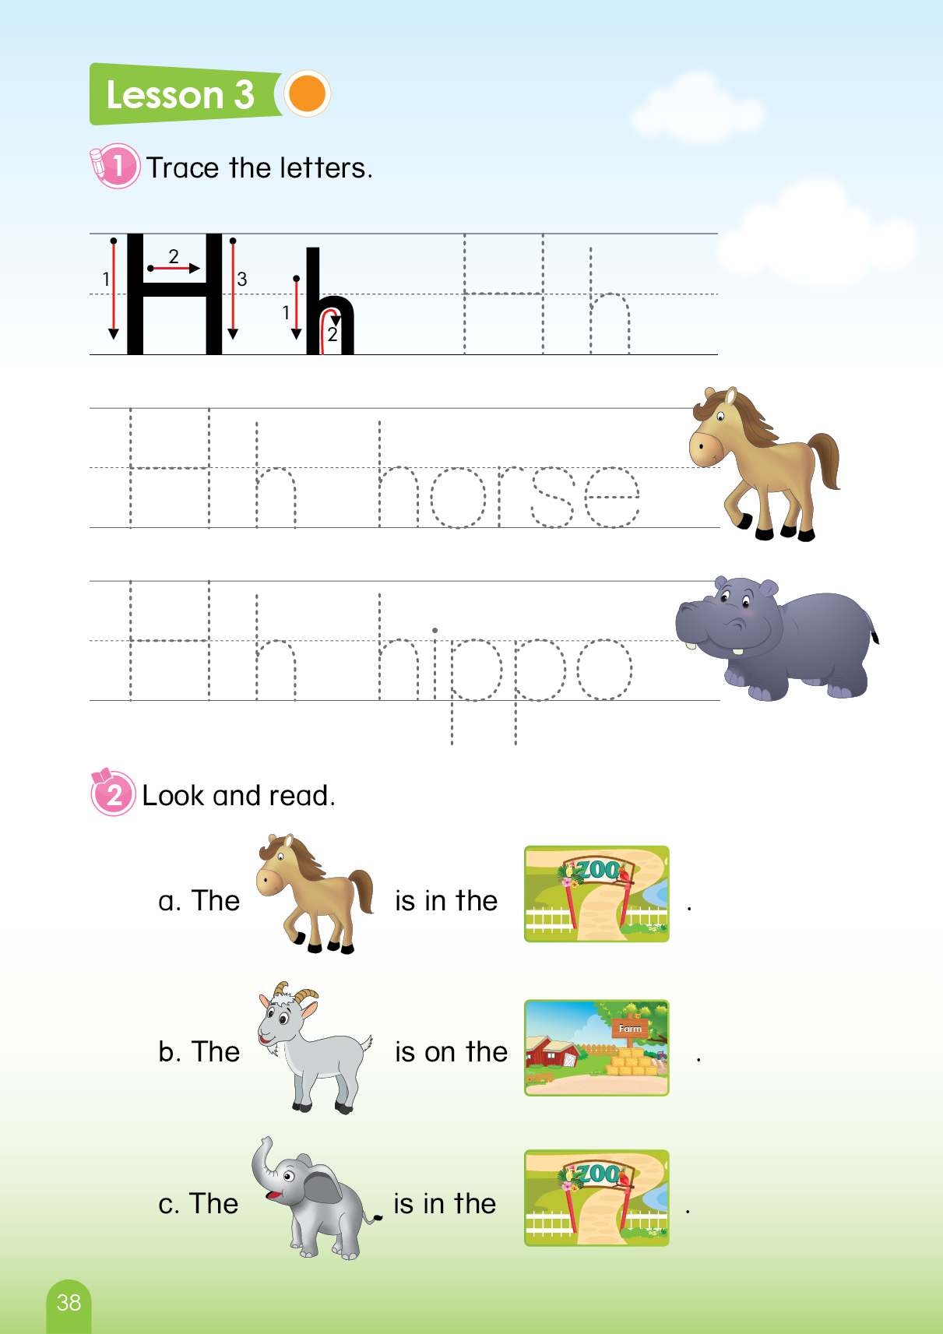


Let’s play game
“Complete the sentence!
Notes:
T says “ Hello, everyone. How are you? How’s the weather? Is it sunny? Great!
Warm up: “Let’s play a game called “ Complete the sentence!”
Split the class into 2 groups – “Today, we will have 2 groups – group 1 and group 2. You are group 1, you are Group 2.”
Introduce the game : “Where?”
T says ”you can see number 1 & number 2. you need to choose the number to find the animals.”

Slide 4
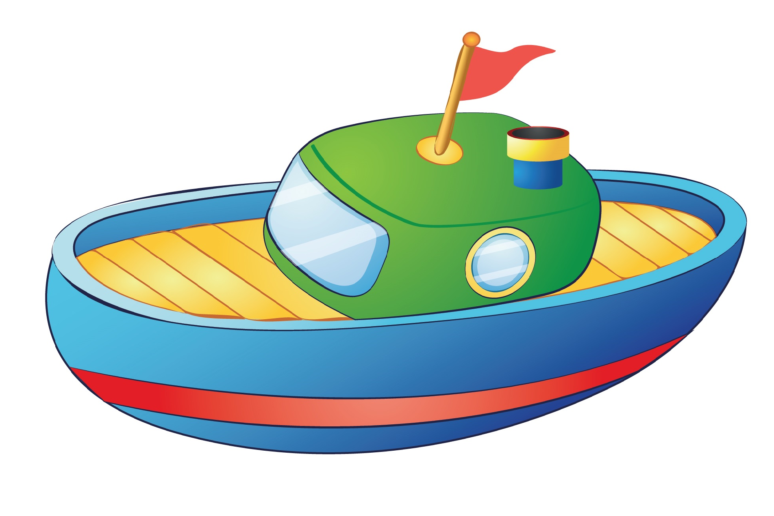
This is my
Complete the sentence
Notes:
Teacher asks : “ look at the picture and guess (click on the shape covering the picture) “What is it?”
A Boat? Yes. It is a boat. And we say “ This is my … .”
2. Then the students to complete the sentence. “This is my boat.”
3. Keep doing that for other questions.
4. Teacher gives stars for the correct answers.

Slide 5

This is my
Complete the sentence

Slide 6
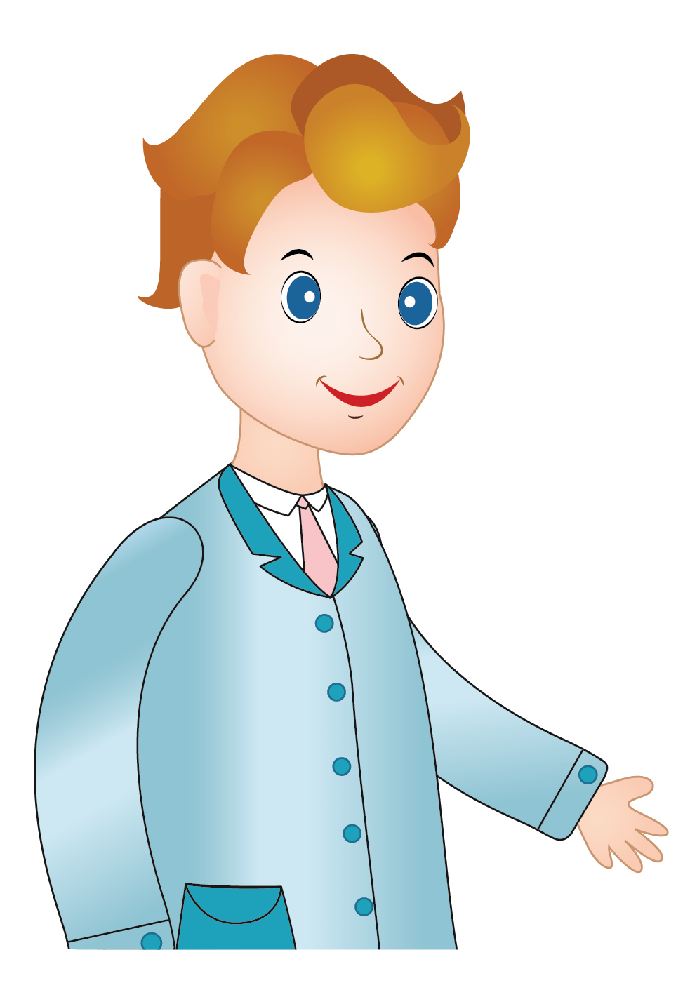
This is my
Complete the sentence

Slide 7

This is my
Complete the sentence

Slide 8

This is my
Complete the sentence

Slide 9



Slide 10


UNIT 8: LESSON 3
Notes:
Introduction:
T says: “Welcome to the lesson today: Unit 8– Lesson 3”

Slide 11

Unit 8: Lesson 3 Uu
1. Trace the letters.
Page 40
Notes:
T says: “Let’s go to part 1: Trace the letters”

Slide 12

Unit 8: Lesson 3 Uu
1. Trace the letters.
Page 40
Notes:
Teacher asks the students to look at the screen.
Guide the students how to trace
Ask the students to trace the letters in their book.
T says : “Look at the screen. This is how to trace.
With big U: There are 1 strokes. Like this(click 3 times)
With small u: There are 2 strokes. (click 2 times)
4. T says: “Show me your finger. Ok, trace the letter U like this(teacher will trace in the air).
It’s very easy. Now your turn, trace the letters in your book page 40, please.”

Slide 13
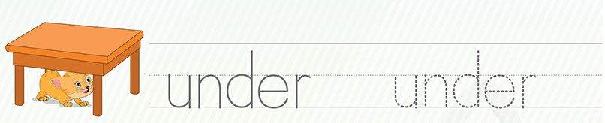
Unit 8: Lesson 3 Uu
1. Trace the letters.
under
Page 40
Notes:
1. Trace the word ”under”.
2. Guide the students use fingers to trace in the air. then trace the words in their books
3. Then show the screen and ask them to read.
4. Ok, trace the word “under” in your book page 40, please.
→Good Job!”

Slide 14

Unit 8: Lesson 3 Uu
1. Trace the letters.
uncle
Page 38
Notes:
1. Trace the word ”under”.
2. Guide the students use fingers to trace in the air. then trace the words in their books
3. Then show the screen and ask them to read.
4. Ok, trace the word “uncle” in your book page 40, please.
→Good Job!”

Slide 15
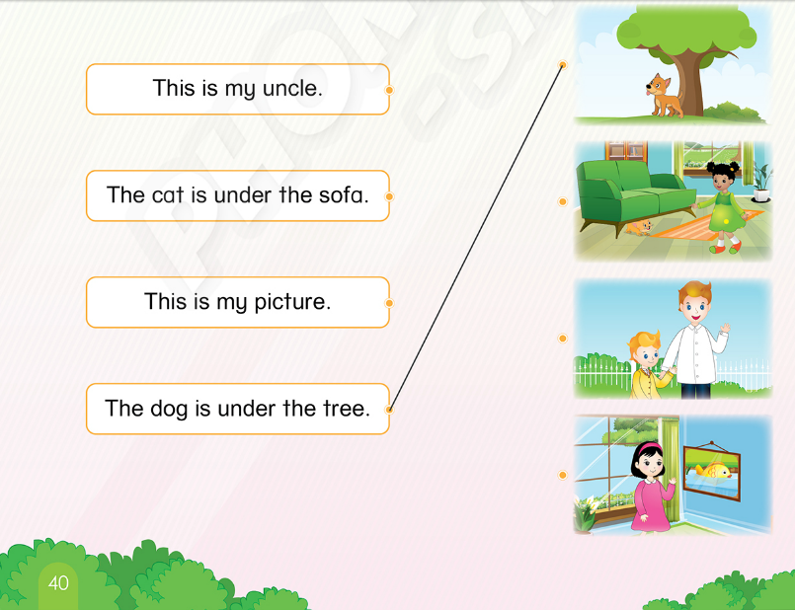
Unit 8: Lesson 3 Uu
2. Read and match.
Notes:
Part 2: Look and read
T says: “Let’s go to part 2: Read and match”

Slide 16




Unit 8: Lesson 3 Uu
2. Read and match.
1. This is my uncle.
a.
2. The cat is under the sofa.
b.
3. This is my picture.
c.
4. The dog is under the tree.
d.
Notes:
Part 2: Look and read
Teacher asks students about the pictures first to remind them.
Teacher points to the picture a. and asks students “What is it? – Yes, a dog. So Where is the dog? Under the tree. A dog is under the tree.
T says: “Now match the picture a. and the sentence “A dog is under the tree.”
Can you see the line?
T asks students to read aloud in groups, whole class and individual.
T points picture by picture and guide the students to identify the correct sentence.
T gives time for students to do the task.
T checks and corrects the answers.
9.

Slide 17
Unit 8: Lesson 3 Uu
2. Read and match.
1. This is my uncle.
2. The cat is under the sofa.
3. This is my picture.
4. The dog is under the tree.
Notes:
T asks students to look and read in group, whole class and individually.

Slide 18
Unit 8: Lesson 3 Uu
2. Look and read.
Open your book, please
Notes:
Book using
Ask the students to work in pairs and read the sentences in their book

Slide 19
Unit 8: Lesson 3 Uu
Look and say.
The dog is under the tree.
Notes:
1. This activity helps students remember the sentence.
2. Teacher will point and ask the students” Where is the dog?
3. Students raise hands to answer.
3. Yes. The dog is under the tree. (click to show the sentence)
4. T gives star for the correct answers.
5. T asks students to repeat the sentence.
6. Continue with the rest of the pictures and the sentences.

Slide 20
Unit 8: Lesson 3 Uu
Look and say.
The cat is under the sofa.

Slide 21
Unit 8: Lesson 3 Uu
Look and say.
This is my picture.

Slide 22
Unit 8: Lesson 3 Uu
Look and say.
This is my uncle.

Slide 23

Notes:
Good job

Slide 24


CÔNG TY CỔ PHẦN PHÁT TRIỂN GIÁO DỤC
VIỆT NAM VPBOX
Hà Nội
Biệt thự G2&G28, Làng Quốc Tế Thăng Long,
Quận Cầu Giấy, Hà Nội.
ĐT: (024) 3 3793 2405
phonics.hanoi@vpbox.edu.vn
Thành Phố Hồ Chí Minh
Số 29 Mai Thị Lựu, Quận 1, TP. HCM.
ĐT: (028) 3 820 5934
phonics.hcm@vpbox.edu.vn
www.vpbox.edu.vn

