Slide 1


Slide 2



Slide 3

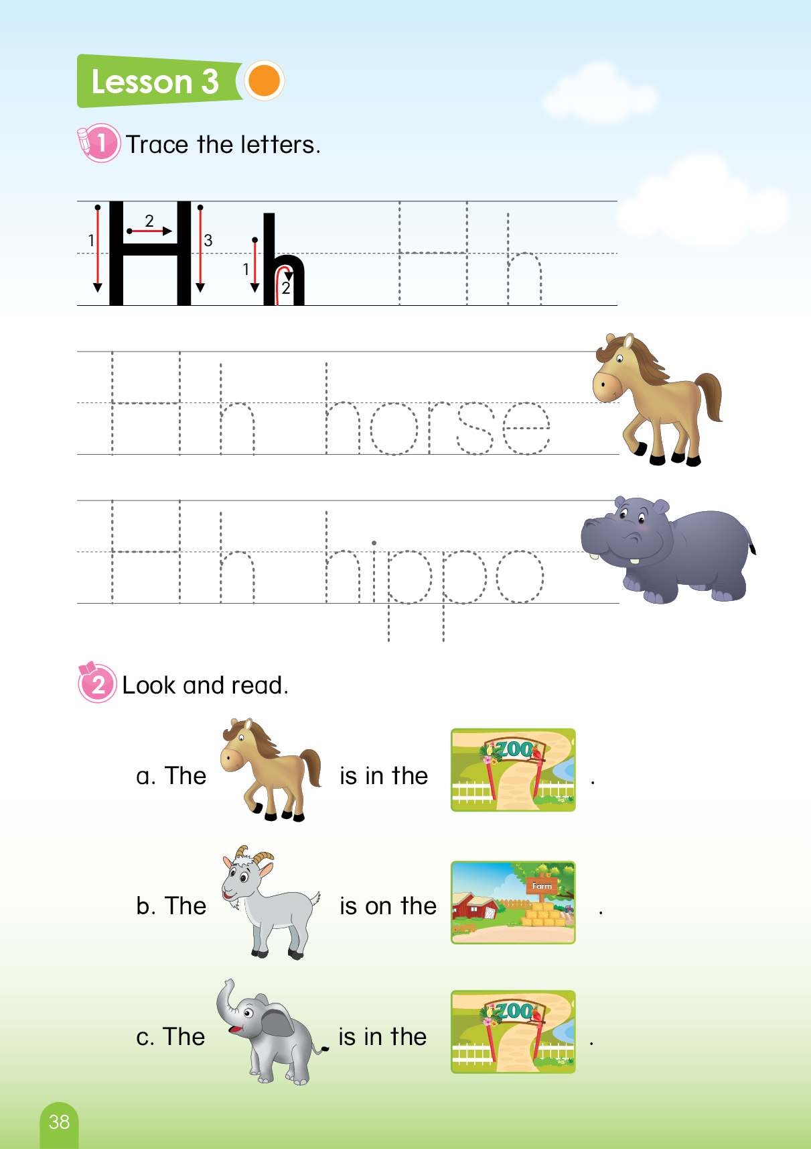

Let’s play game
“Where…?
Notes:
T says “ Hello, everyone. How are you? How’s the weather? Is it sunny? Great!
Warm up: “Let’s play a game called “ Where?”
Split the class into 2 groups – “Today, we will have 2 groups – group 1 and group 2. You are group 1, you are Group 2.”
Introduce the game : “Where?”
T says ”you can see number 1 & number 2. you need to choose the number to find the animals.”

Slide 4


Where is my uncle?
1
2
Notes:
1. Teacher asks : “ Where is my uncle? Number 1 or number 2?”
2. Then the students choose the number.
3. Keep doing that for other questions.
4. T says: “ Where is my uncle? Number 1 or number 2?”
Number 2. Ok (click), Oh, There is no hippo here. Uncle is in the number 1?
Ok let’s check. (click) .(Click the sound to say yeah)
Here is my uncle.”
Continue the rest of the game.

Slide 5

Where is my grandma?
1
2
Notes:
1.T says: “Where is grandma? Number 1 or 2?”
“Number 2 (click) –Yeah this is grandma”
(Click the sound to say yeah)

Slide 6
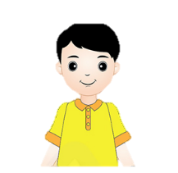
Where is my brother?
1
2

Slide 7

Where is my grandpa?
1
2

Slide 8



Slide 9



UNIT 9
LESSON 1
Notes:
T says” Welcome to Unit 9, lesson 1 today.”

Slide 10



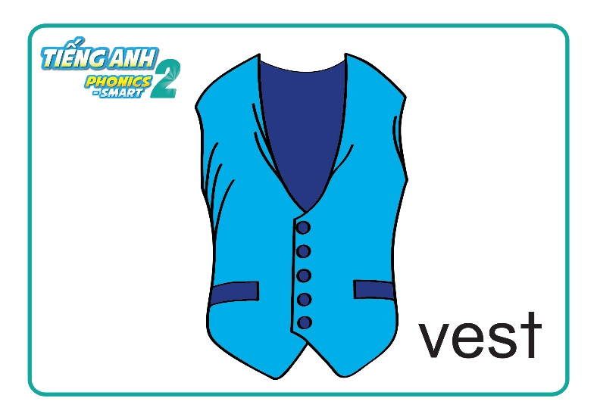
Unit 9:
Lesson 1
Vv
1. Look, listen and repeat.
v
Vv
Notes:
Part 1: Look, listen and repeat
-Teacher asks Sts to listen the audio file 2 – 3 times for each.
Then asks them to repeat
T says: “Now, we go to part 1: Look, listen and repeat”
Letter Vv – click the first sound icon 2 times , then T says: ““listen and repeat, please”. – Vv – good”
Sound /v/ – click the second sound icon 2 times , then T says: “listen and repeat, please” /v/ very good”
violin – click the third sound icon2 times , then T says: “listen and repeat, please”. vest – excellent. What color is the ink? Purple. Good”
violin– click the fourth sound icon 2 times , then T says: “listen and repeat, please”. vest – well done. “

Slide 11

Unit 9: Lesson 1 Vv
1. Look, listen and repeat.
Vv
v
Notes:
Part 1: Look, listen and repeat
Teacher asks Sts to listen the audio file 2 – 3 times for each.
Then asks them to repeat.
Letter Vv – click the first sound icon 2 times , then T says: “listen and repeat, please”. – Vv – good “
Sound /v/ – click the second sound icon 2 times , thenT says: “listen and repeat, please” /v/ very good”

Slide 12


Unit 9: Lesson 1 Vv
1. Look, listen and repeat.
Notes:
Part 1: Look, listen and repeat
Teacher asks Sts to listen the audio file 2 – 3 times for each.
Then asks them to repeat
violin – click the third sound icon 2 times , then T says: “listen and repeat, please”. violin – excellent. What color is the violin? Pink. Good “
vest– click the fourth sound icon 2 times , then T says: “listen and repeat, please”. vest – well done. “

Slide 13
Unit 9: Lesson 1 Vv
1. Look, listen and repeat.
What’s missing?
?
Vv
v
Notes:
Game “ What’s missing?”
Work in groups
There is a missing picture. Students say aloud the missing picture.
T says: “What is missing? - /v/ (click) – Excellent.”
Teacher checks if it is right → That team gets 1 point.

Slide 14

Unit 9: Lesson 1 Vv
1. Look, listen and repeat.
What’s missing?
?
Notes:
Game “ What’s missing?”
Work in groups
T says: “What is missing? - /violin/ (click) – Excellent.”
Teacher checks if it is right → That team gets 1 point.

Slide 15



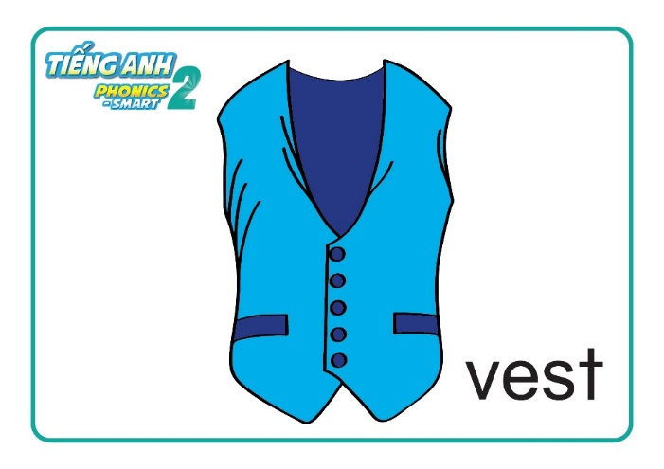
Unit 9: Lesson 1 Vv
1. Look, listen and repeat.
What’s missing?
v
Vv
v
?
Notes:
Game “ What’s missing?”
Work in groups
T says: “What is missing? –vest (click) – Yes, it’s right.”
Teacher checks if it is right → That team gets 1 point.

Slide 16


Slide 17
Unit 9: Lesson 1 Vv
v
Vv
Notes:
Part 1: Look, listen and repeat
-Teacher asks Sts to listen the audio file 2 – 3 times for each.
Then asks them to repeat
T says: “Now, we go to part 1: Look, listen and repeat”
Letter Vv – click the first sound icon 2 times , then T says: ““listen and repeat, please”. – Vv – good”
Sound /v/ – click the second sound icon 2 times , then T says: “listen and repeat, please” /v/ very good”
violin – click the third sound icon2 times , then T says: “listen and repeat, please”. violin – excellent.
vest– click the fourth sound icon 2 times , then T says: “listen and repeat, please”. vest – well done. “

Slide 18
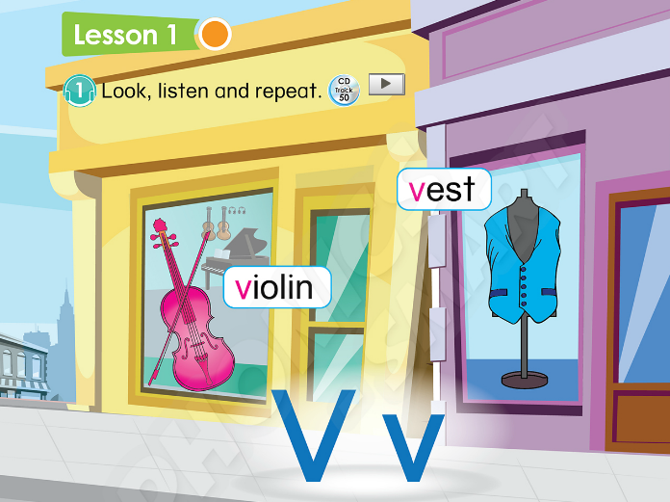
Unit 9: Lesson 1 Vv
Page 42
Notes:
Book using: Look, point and say
Teacher guides the students use the book. Look, point and say
Work in pairs or in individual
The students can use their fingers point and say.
T says:” Look at your book page 42, please. Point and say with your friends.”

Slide 19
Unit 9: Lesson 1 Vv
2. Let’s chant.
Let’s chant the sound of V
v v v
v in vest.
V in violin.
v v v
v is the sound of V.
Notes:
Part 2: Let’s chant
-Teacher will play the audio file twice and asks the students to listen.(click the blue sound icon)
After that, The whole class will repeat sentence by sentence.(click the sound icon in each line)
Teacher can ask the students to chant in teams and put them in a competition.
Or Teacher can change the style of the chant, for example: Clap hands, using instruments.
2. T says: “Let’s go to part 2: Let’s chant”
Now we will listen the chant 2 times. Listen. (click the icon 2 times) Ok
Now listen and repeat.

Slide 20
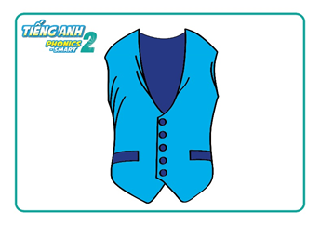

Next Slide
Vv
v
Remove Box
Notes:
T tells the students that they are going to play game.
T click on “Remove box” to move the cover boxes.
T asks students to say a loud the words.
T gives the stars to the fastest group which get the correct answers.
T asks students to review the words.

Slide 21
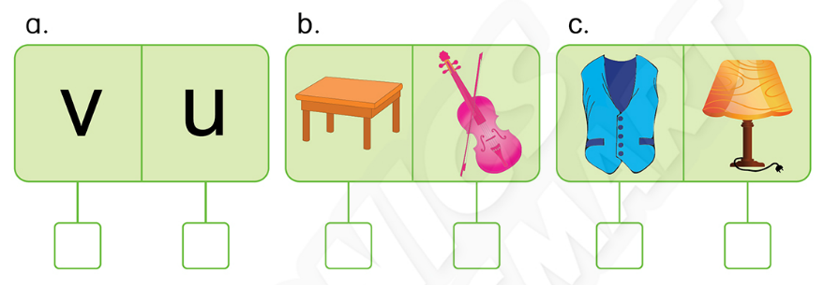
Next Slide
Unit 9: Lesson 1 Vv
Activity Book
1. Listen and tick (✓).
✓
✓
✓
Notes:
T asks students to review the words.

Slide 22
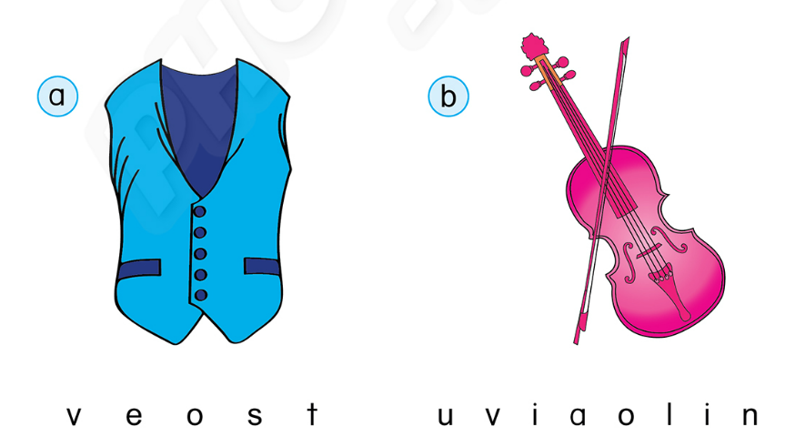
Next Slide
Unit 9: Lesson 1 Vv
2. Circle and say.
Notes:
T guides students to do the task.

Slide 23
Next Slide
Unit 9: Lesson 1 Vv
2. Circle and say.
vest
violin
Notes:
T asks students to review the words.

Slide 24


CÔNG TY CỔ PHẦN PHÁT TRIỂN GIÁO DỤC
VIỆT NAM VPBOX
Hà Nội
Biệt thự G2&G28, Làng Quốc Tế Thăng Long,
Quận Cầu Giấy, Hà Nội.
ĐT: (024) 3 3793 2405
phonics.hanoi@vpbox.edu.vn
Thành Phố Hồ Chí Minh
Số 29 Mai Thị Lựu, Quận 1, TP. HCM.
ĐT: (028) 3 820 5934
phonics.hcm@vpbox.edu.vn
www.vpbox.edu.vn

