Slide 1


Slide 2



Slide 3

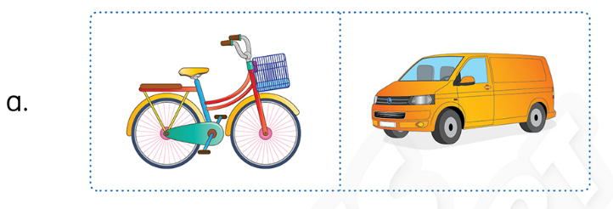
Unit 9
Look, circle and say.
I’d like a new bike.
Notes:
Good morning children. How are you today? Are you great?
What’s the weather today.
Yes, it is sunny today.
First of all, I’ll divide class into two teams. Team 1 and team 2.
Where are team 1? Good! How about team 2? Great!
Let’s review.
Look at the two pictures. What are they?
Good! A bike and a van.
Now, look at the sentence “I’d like a new bike?
So which one will you circle.
Yes, circle a bike.
Look at the picture and say again “I’d like a new bike.
You work in group to play the game. After I show the sentence, please raise your hands to get your turn.

Slide 4
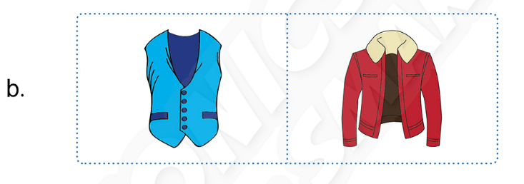
Unit 9 Lesson 2
Listen and circle.
I’d like a new jacket.
Notes:
Ok! Look at the pictures. What are they?
Now look at the sentence.
Which one will you circle?
Ok. Read aloud the sentence, please!
One star for group … .
Continue the rest of the game.

Slide 5
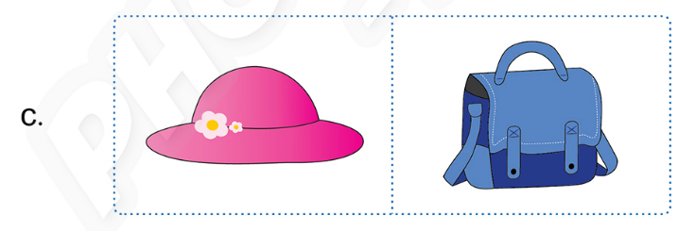
Unit 9 Lesson 2
Listen and circle.
I’d like a new bag.

Slide 6
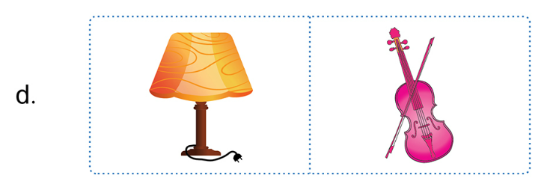
Unit 9 Lesson 2
Listen and circle.
I’d like a new violin.

Slide 7
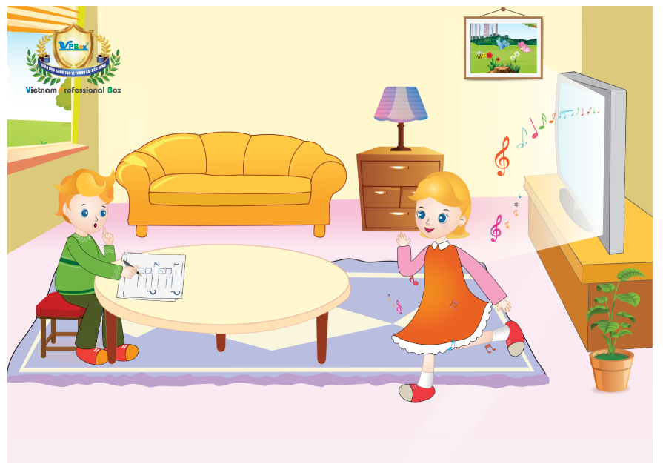
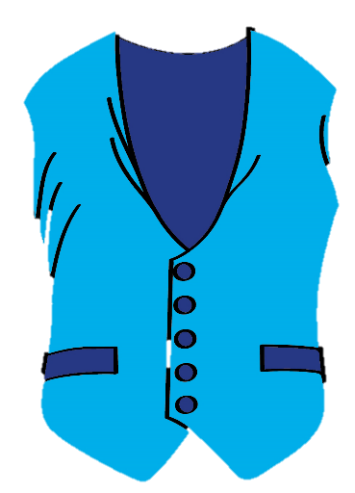


Unit 9
Lesson 3
Notes:
Teacher introduces and gives students some hints of today’s lesson:
+ “Today we will learn Unit 9, Lesson 3.”
+ “Look! What can you see?

Slide 8


Unit 9:
Lesson 3:
V v
1. Trace the letters.
What is it?
Vv
v
Notes:
Teacher reviews the letter and sound:
+ “What is it? Do you remember?”
+ “That’s right. Letter V , and sound v. Good job.’’

Slide 9
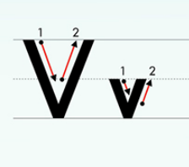
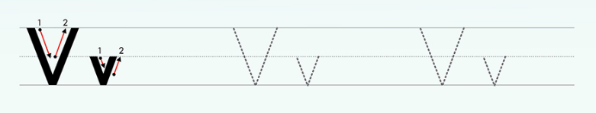
Unit 9:
Lesson 3:
V v
1. Trace the letters.
Notes:
Teacher leads to the tracing part of letters V and v:
+ “OK. Let’s trace letter V. Now, where is your finger?”
+ “Good job. Now, follow me. One. Two.”
+ “One more time. One. Two.”
+ “The last one. One. Two.”
Teacher asks students to practice:
+ “OK. Now can you write the letter V on the table?”
+ “Good job.”

Slide 10
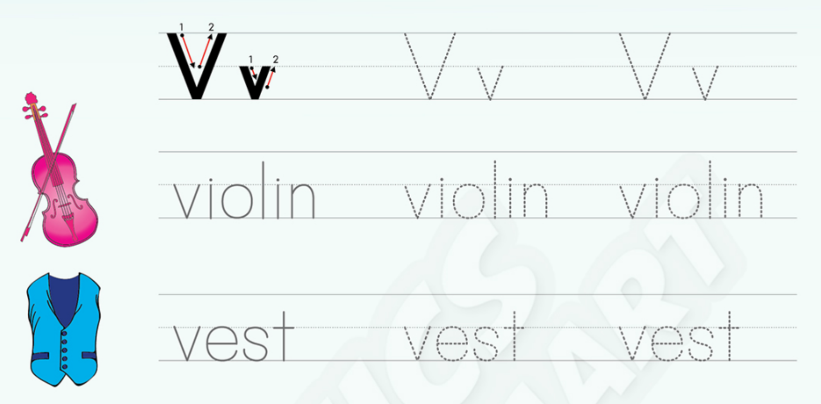
Unit 9:
Lesson 3:
V v
1. Trace the letters.
Notes:
Teacher asks students to open their books and trace the letter V, v and the words violin and vest:
+ “Now, open your book page 44. Trace the letter V, v in your book in 3 minutes.”

Slide 11


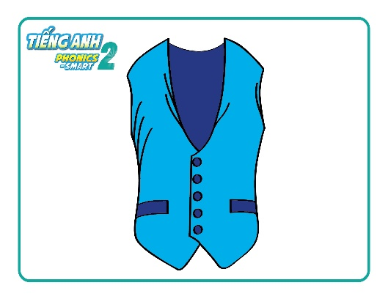
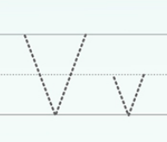
Unit 9:
Lesson 3:
V v
1. Trace the letters.
Activity: Drawing!
Notes:
Teacher asks students to write letters V and v below the drawings.
+ “Now write letters V and v under the your picture.”
+ “Well done.”

Slide 12

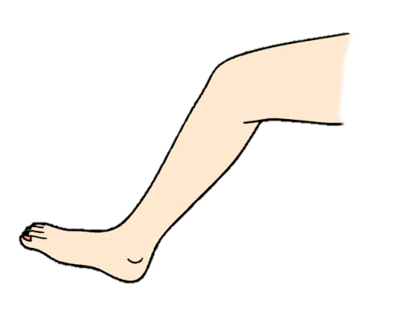
Unit 9:
Lesson 3:
V v
1. Trace the letters.
Activity: Can you trace?
Notes:
Teacher calls some students to go to the board and use their body parts (arm and leg) to write letters V and v.
+ “Now, we have a game. I need two students up here.”
+ “I need you to write letter V by your arm. Great job.”
+ “And now can your write letter v by your leg? Well done.”

Slide 13


Unit 9:
Lesson 3:
V v
1. Trace the letters.
Notes:
Teacher gives praises.
+ “Well done.”

Slide 14
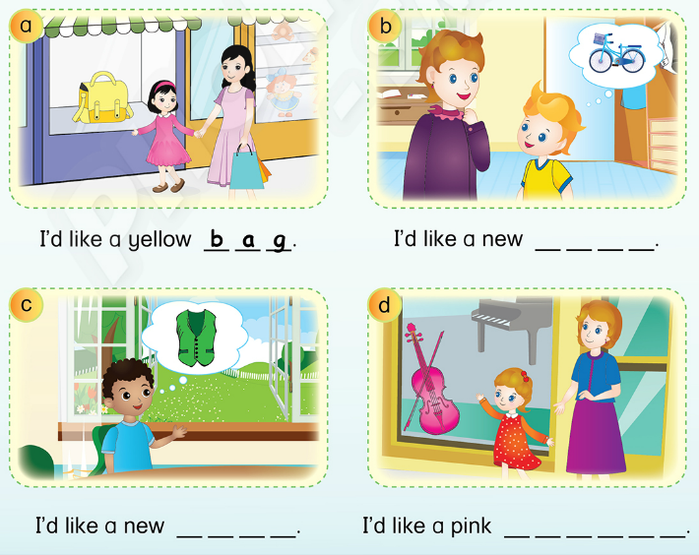
Unit 9:
Lesson 3:
V v
2. Look, write and say.
Notes:
Teacher gives instructions of part 2:
+ “We move to part 2. Now, look at the four picture. What would they like?

Slide 15
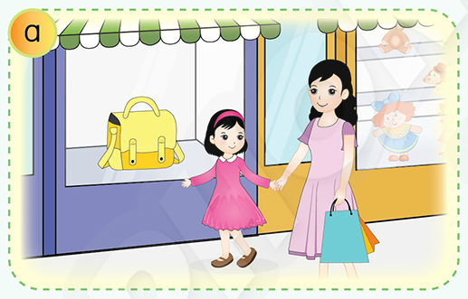
Unit 9:
Lesson 3:
V v
2. Look, write and say.
I’d like a yellow _ _ _ .
Notes:
Look at the picture a. What would ha Linh like?
A yellow bag.
Now, look at the sentence and write the missing word.
Ok, let’s say aloud the sentence.
T gives time for students to do the task.
T checks and correct students’ answers then asks them to say the sentences.

Slide 16
Unit 9:
Lesson 3:
V v
2. Look, write and say.
I’d like a yellow b a g .

Slide 17
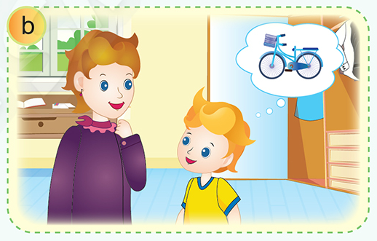
Unit 9:
Lesson 3:
V v
2. Look, write and say.
I’d like a new _ _ _ _ .

Slide 18
Unit 9:
Lesson 3:
V v
2. Look, write and say.
I’d like a new b i k e.

Slide 19
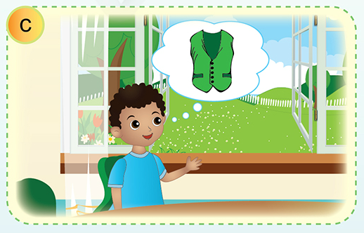
Unit 9:
Lesson 3:
V v
2. Look, write and say.
I’d like a new _ _ _ _ .

Slide 20
Unit 9:
Lesson 3:
V v
2. Look, write and say.
I’d like a new v e s t .

Slide 21
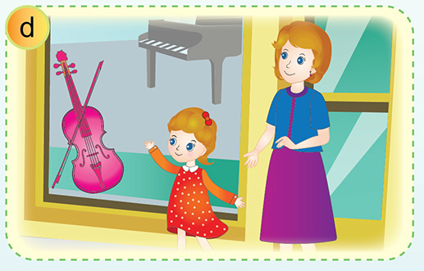
Unit 9:
Lesson 3:
V v
2. Look, write and say.
I’d like a pink _ _ _ _ _ _ .

Slide 22
Unit 9:
Lesson 3:
V v
2. Look, write and say.
I’d like a pink v i o l i n .

Slide 23
V v
Unit 9:
Lesson 3:
2. Look, write and say.
Notes:
T asks the students review all the sentences.

Slide 24
V v
Unit 9:
Lesson 3:
Game: Lucky number
1
1
1
2
2
2
3
3
3
4
4
4
5
5
6
6
6
7
7
7
Notes:
Let’s play game: Lucky number.
Students play in groups. Each group takes turns to choose 1 number then look at the picture and say “I’d like a … .
Teacher gives stars for the correct answers.
If students choose the lucky number, they get 1 star.
Click on the number to move into the picture.
Click on the “➔” to finish the game.

Slide 25
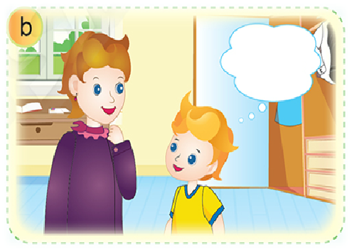

Unit 9:
Lesson 3:
V v
1
Notes:
Click on the star to turn back slide 24

Slide 26

Unit 9:
Lesson 3:
V v
2

Slide 27

Lucky number

Slide 28

Unit 9:
Lesson 3:
V v
4

Slide 29

Unit 9:
Lesson 3:
V v
5

Slide 30
Lucky number

Slide 31

Unit 9:
Lesson 3:
V v
7

Slide 32
Unit 9:
Lesson 3:
V v
2. Listen, circle and say.
Notes:
Teacher gives praises to the whole class.
+ “Very good.”

Slide 33

Unit 9:
Lesson 3:
V v
Let’s review!
Notes:
Teacher reviews the lesson.
+ “Now, what have we learned today?”
+ “OK. Write letter V. Good job.”
+ “Now write letter v. Well done.”
Teacher gives comment of the class’s performance.
+ “You did so well today. High five.”

Slide 34
Unit 9:
Lesson 3:
V v
Let’s review!
I’d like _____.
Notes:
Teacher reviews the lesson.
+ “Now, what is it?”
+ “Good job. It is violin. Let’s say: I’d like a violin”
+ “And I’d like a vest. Well done.”

Slide 35

Unit 9:
Lesson 3:
V v
Let’s review!
Notes:
Teacher reviews the lesson.
+ “Now, what is it?”
+ “Good job. It is an inkpot.”
+ “And what is it? Ink. Well done.”

Slide 36
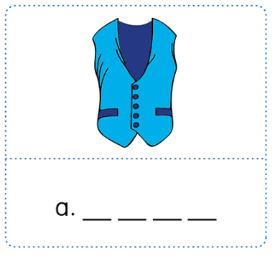
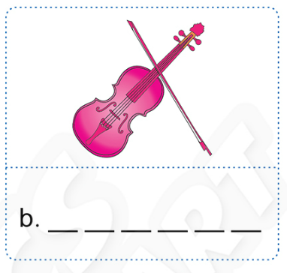
Unit 9:
Lesson 3:
V v
Activity Book
1. Look, write and say.

Slide 37
Unit 9:
Lesson 3:
V v
1. Look, write and say.
v e s t

Slide 38
Unit 9:
Lesson 3:
V v
1. Look, write and say.
v i o l i n

Slide 39


Unit 9:
Lesson 3:
V v
1. Read and stick (✓) or cross (✗).
a.
I’d like a new jacket.
✓
b.
I’d like a new violin.
✓
c.
I’d like a new bag.
✗

Slide 40

Unit 9:
Lesson 3:
V v
Notes:
Teacher reviews the lesson.
+ “Now, what is it?”
+ “Good job. It is an inkpot.”
+ “And what is it? Ink. Well done.”

Slide 41


CÔNG TY CỔ PHẦN PHÁT TRIỂN GIÁO DỤC
VIỆT NAM VPBOX
Hà Nội
Biệt thự G2&G28, Làng Quốc Tế Thăng Long,
Quận Cầu Giấy, Hà Nội.
ĐT: (024) 3 3793 2405
phonics.hanoi@vpbox.edu.vn
Thành Phố Hồ Chí Minh
Số 29 Mai Thị Lựu, Quận 1, TP. HCM.
ĐT: (028) 3 820 5934
phonics.hcm@vpbox.edu.vn
www.vpbox.edu.vn
Notes:
Teacher gives comment of the class’s performance.
+ “You did so well today. High five.”
Teacher says Goodbye.
+ “It’s time to say Goodbye. See you.”

