Slide 1
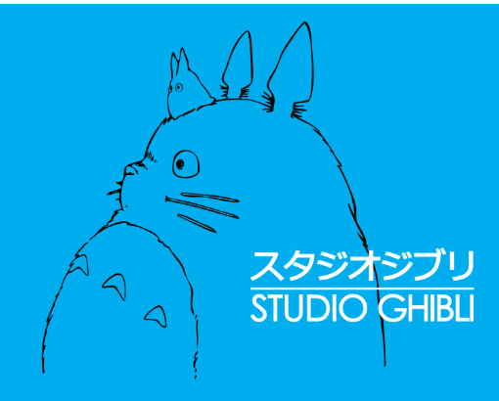

Listen and read about Studio Ghibli

Slide 2
What is Studio Ghibli?

Slide 3
What is it famous for?

Slide 4

Studio Ghibli is a Japanese film company.
company

Slide 5
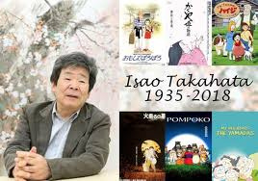
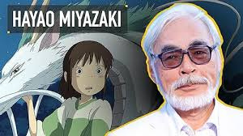
Japanese directors,
Isao Takahata and Hayao Miyazaki,

Slide 6
opened the Studio in 1985.

Slide 7
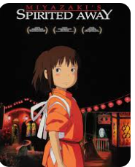
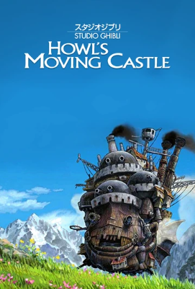
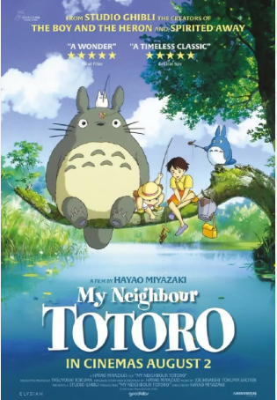
The company makes short films and TV cartoons,

Slide 8
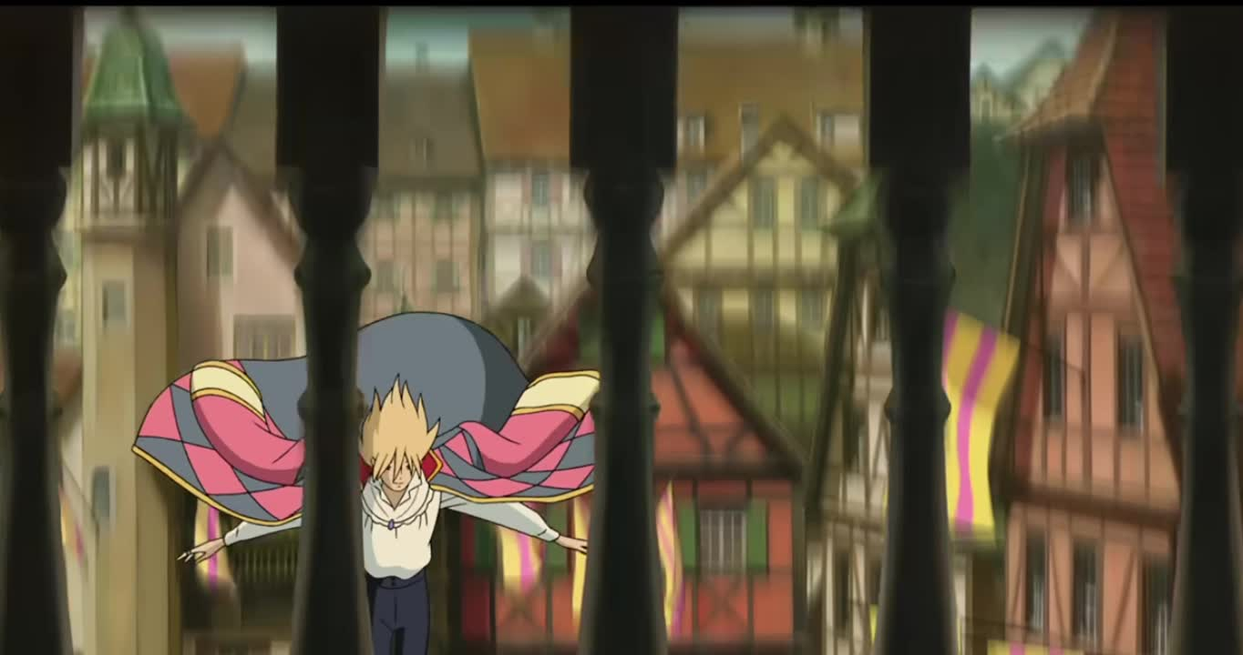
but it’s very famous for its beautiful anime films

Slide 9
such as My Neighbor Totoro, Spirited Away

Slide 10
Howl’s Moving Castle.

Slide 11

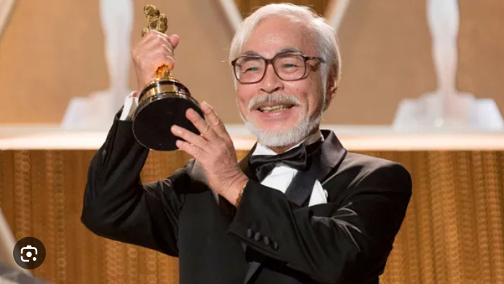
These films won awards in Japan and
around the world.
award

Slide 12
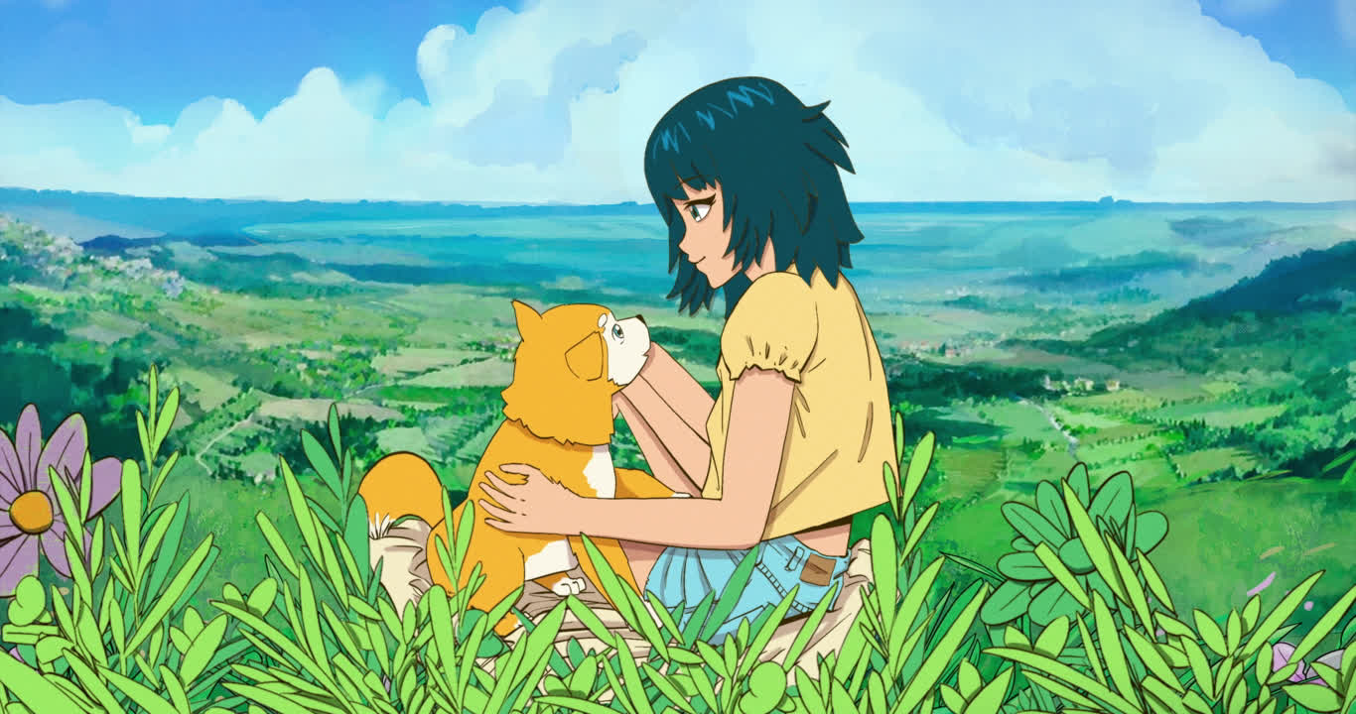
Anime is a style of Japanese cartoon

Slide 13
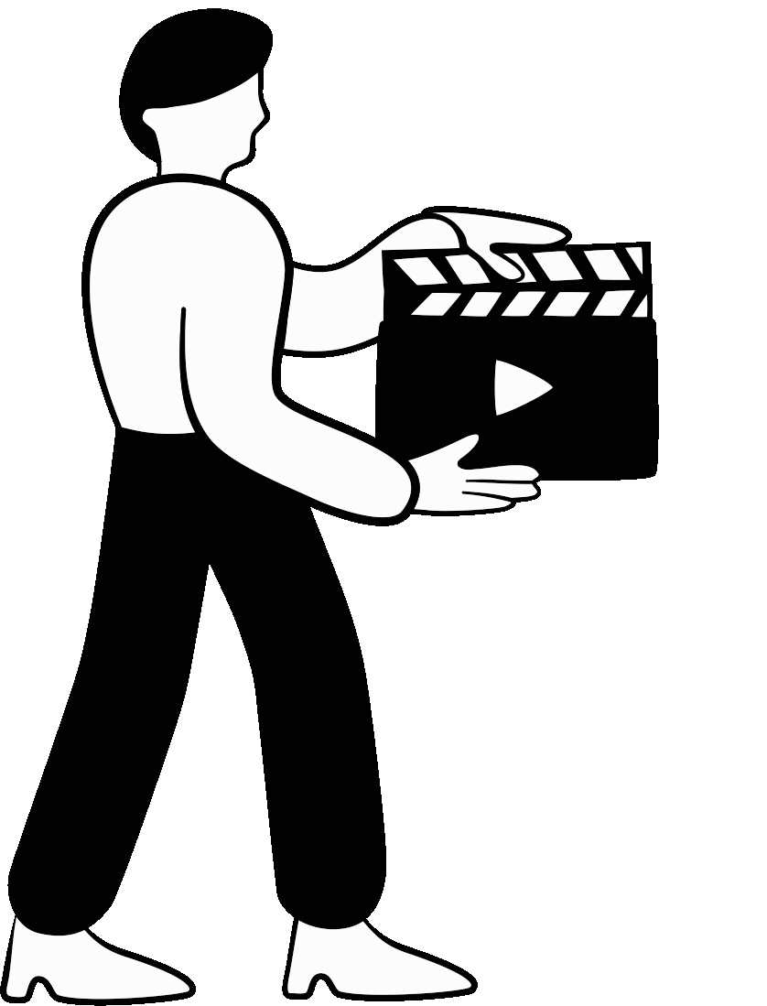
with adventurous characters and a lot of action.
action

Slide 14
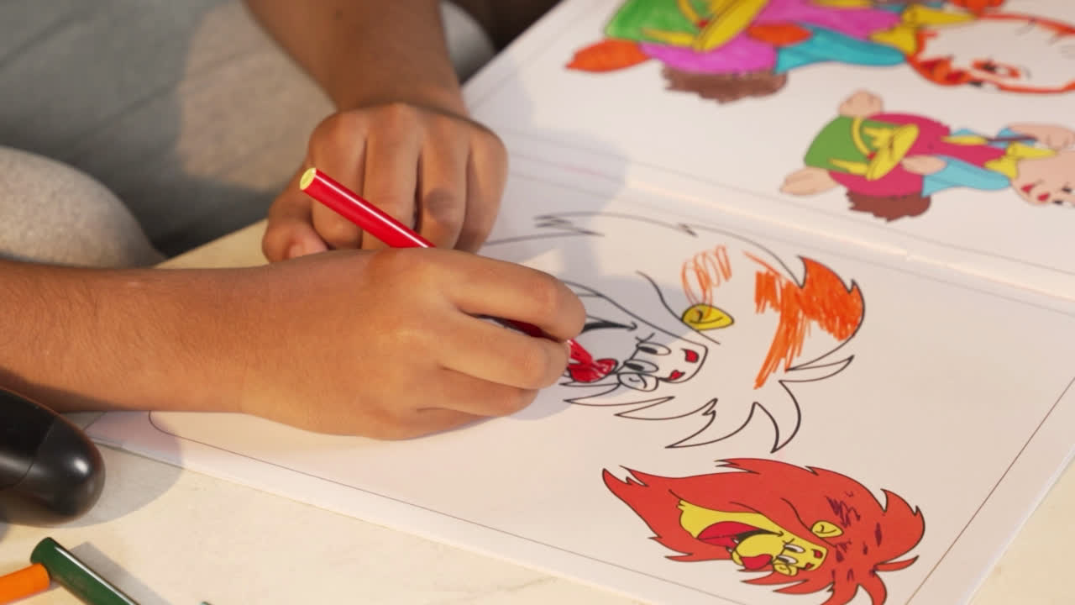
Artists drew anime characters by hand.

Slide 15

Today, studios also use computers to make films.

Slide 16
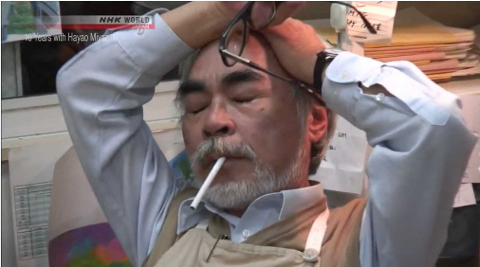
Miyazaki was nervous.

Slide 17
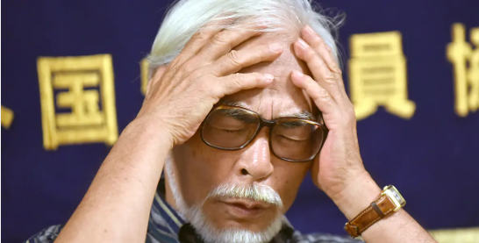
So, what did he do?

Slide 18
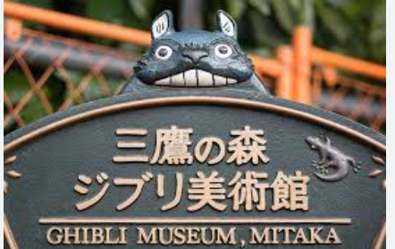
He opened the Studio Ghibli museum.

Slide 19
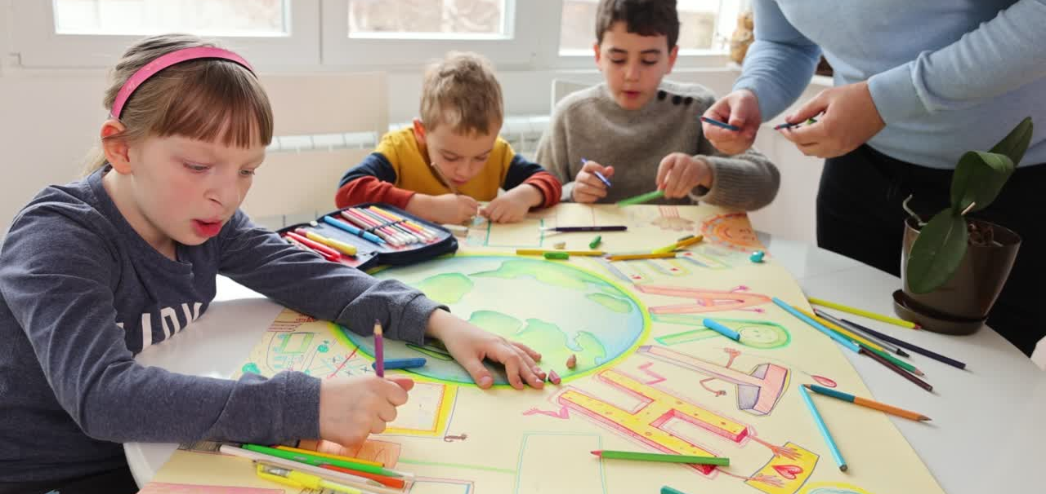
He wanted visitors to learn about anime.

Slide 20
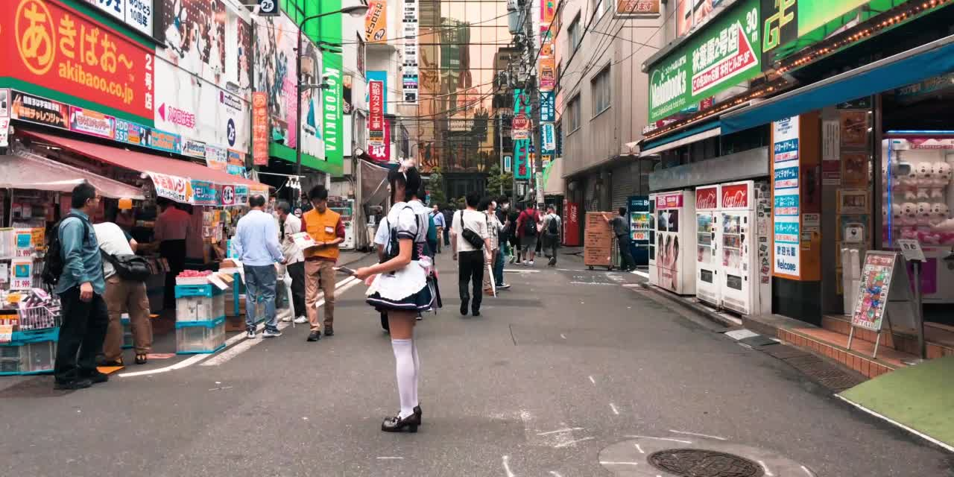
Anime films then continue to be popular.

