Slide 1
What am I?
Mr Greg’s English Cloud

Slide 2
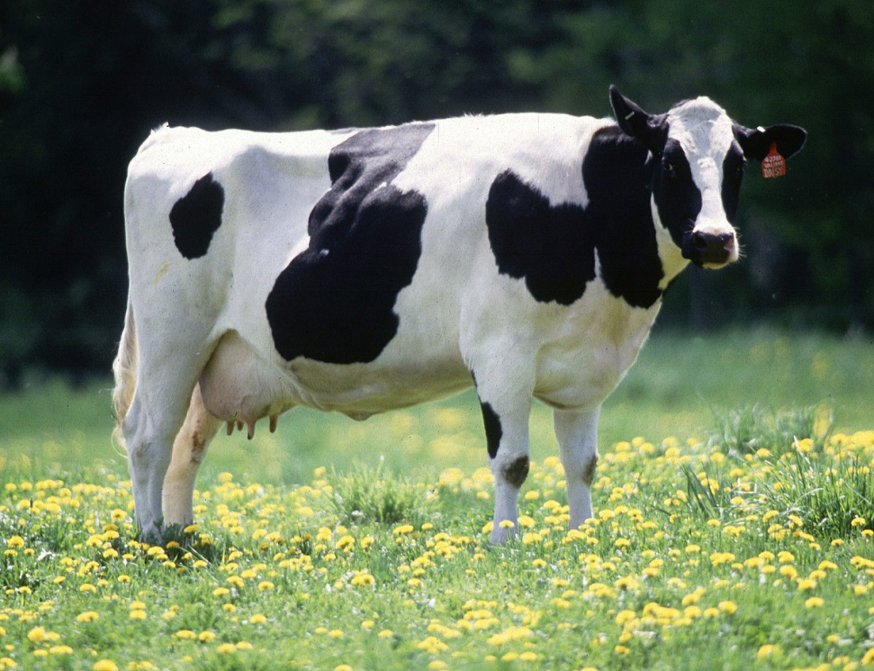
What am I?
I have four legs.
I am black and white.
I can make milk.
I like to eat grass.
Moo!
I am a cow!

Slide 3
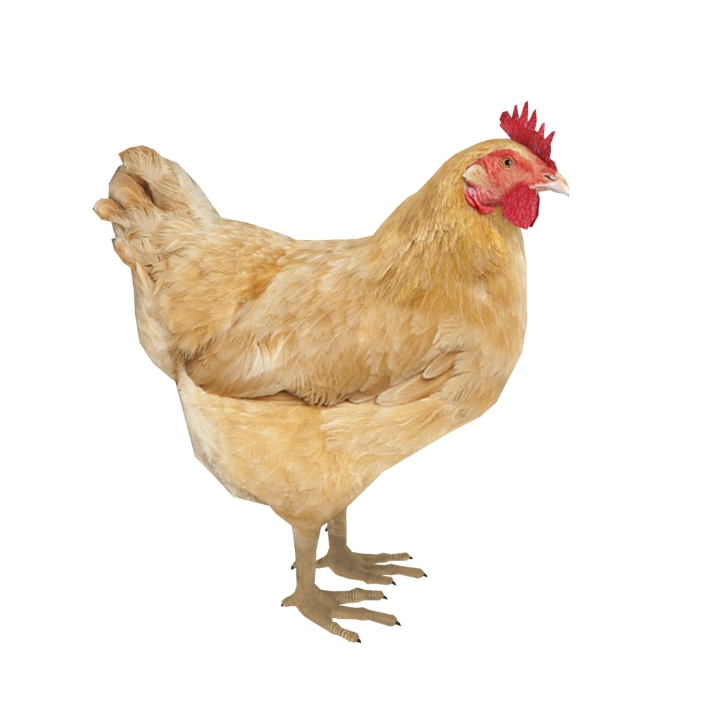
What am I?
I have two legs.
I have two wings.
I have many feathers.
I can lay eggs.
Cluck!
I am a hen!

Slide 4
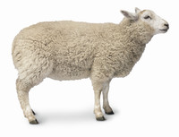
What am I?
I have four legs.
I am white.
I make wool.
I like to eat grass.
Baa!
I am a sheep!

Slide 5
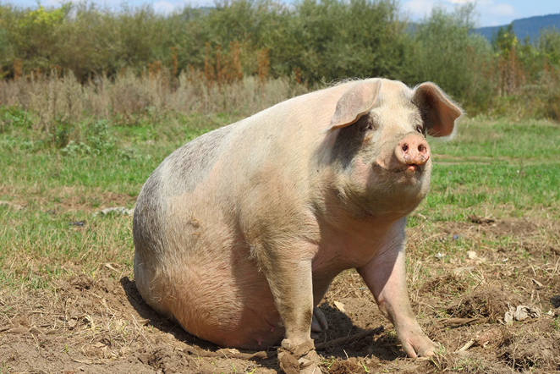
What am I?
I have four legs.
I am pink.
I am big.
I like to eat anything!
Oink!
I am a pig!

Slide 6
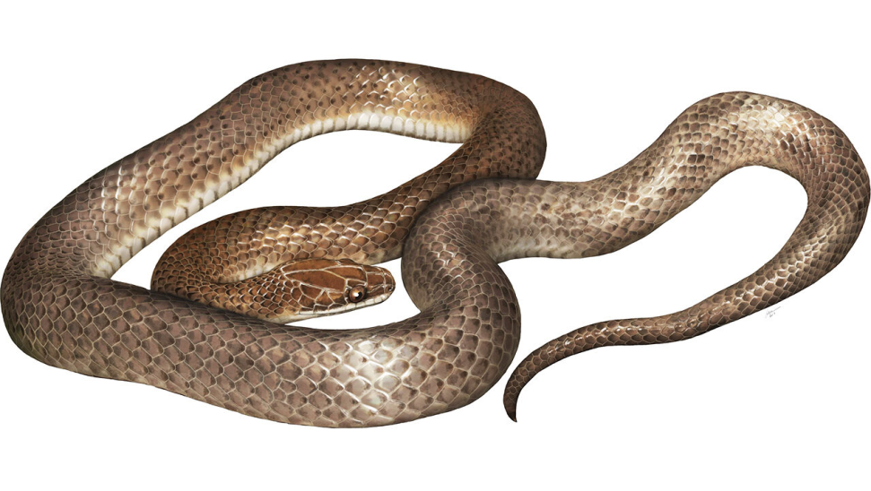
What am I?
I have no legs.
I have a long body.
I have a tail.
I like to eat small animals.
Ssss!
I am a snake!

Slide 7
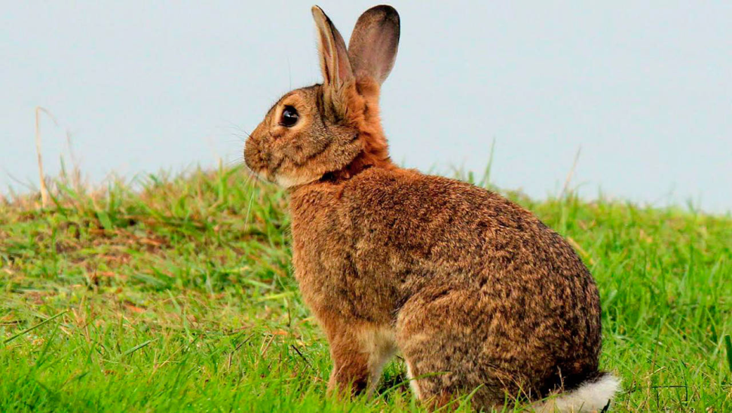
What am I?
I have four legs.
I have long ears.
I can jump very high.
I like to eat carrots.
Squeak!
I am a rabbit!

Slide 8
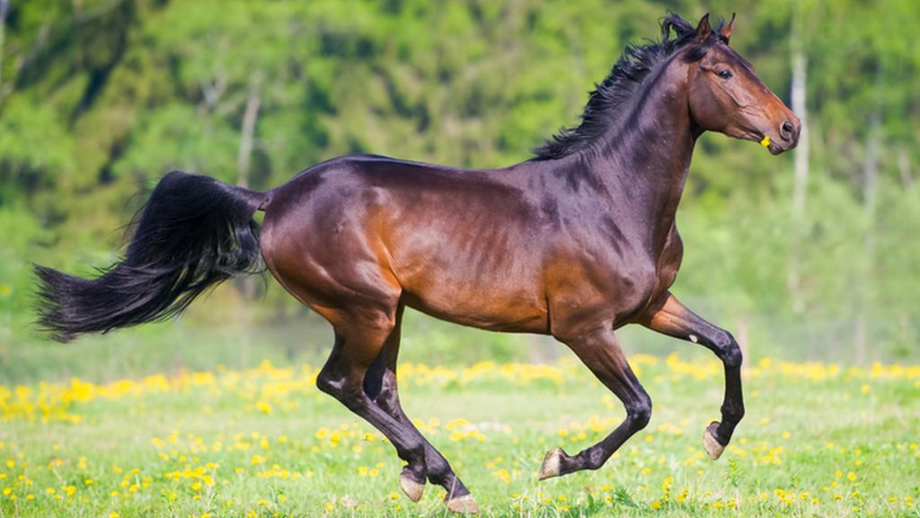
What am I?
I have four legs.
I can run fast
I like to eat hay.
You can ride me.
Neigh!
I am a horse!

Slide 9
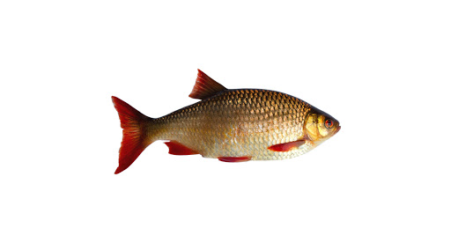
What am I?
I have no legs.
I have no arms.
I can swim well.
I like to eat worms and plants.
Blub!
I am a fish!

Slide 10
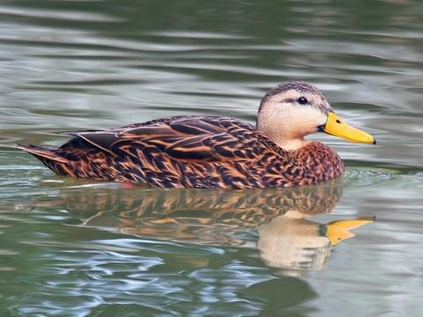
What am I?
I have two legs.
I have two wings.
I like to eat bread and fish.
I can swim.
Quack!
I am a duck!

