Slide 1












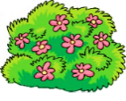
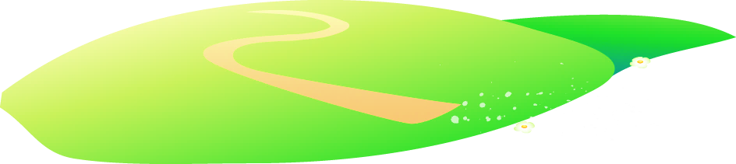







Unit 3 Animal Lesson 1 – Task 1,2,3
Notes:
Để nguyên trang bìa như này, chỉ thay đổi tên bài trong quá trình làm. Logo của sách Wonderful World

Slide 2

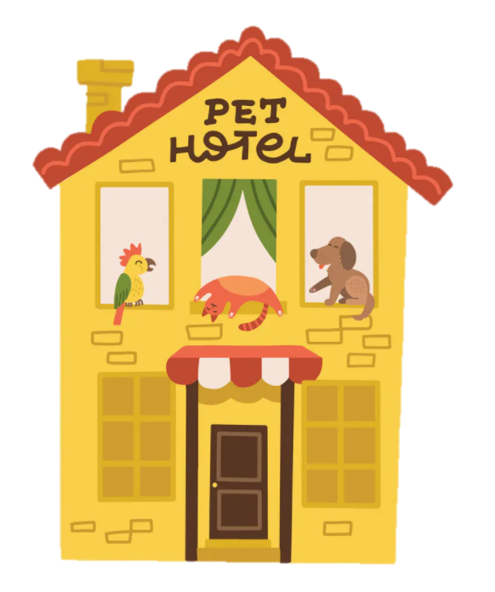
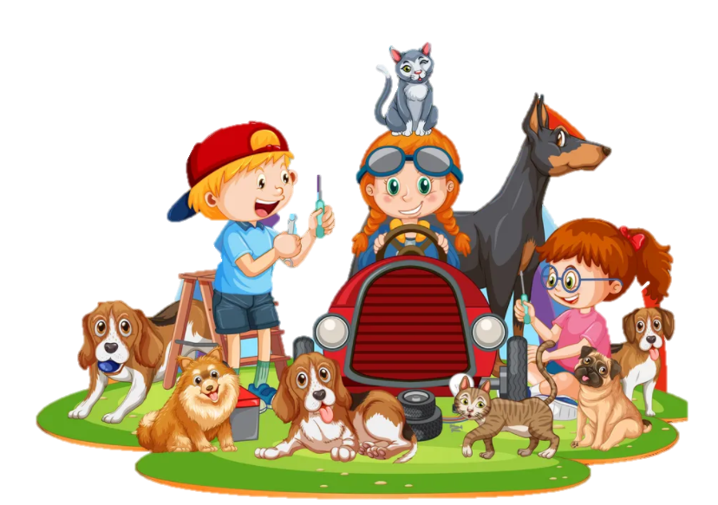

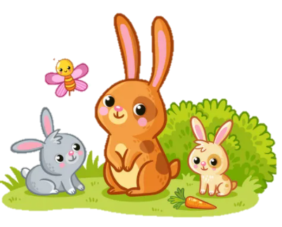
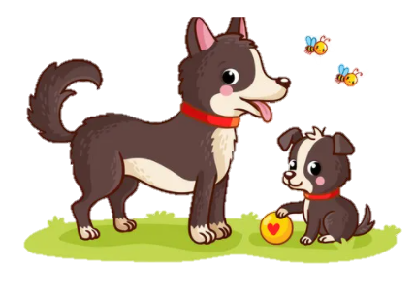
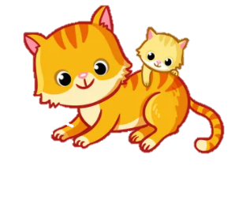

1 Warm Up
Listen to the song

Slide 3
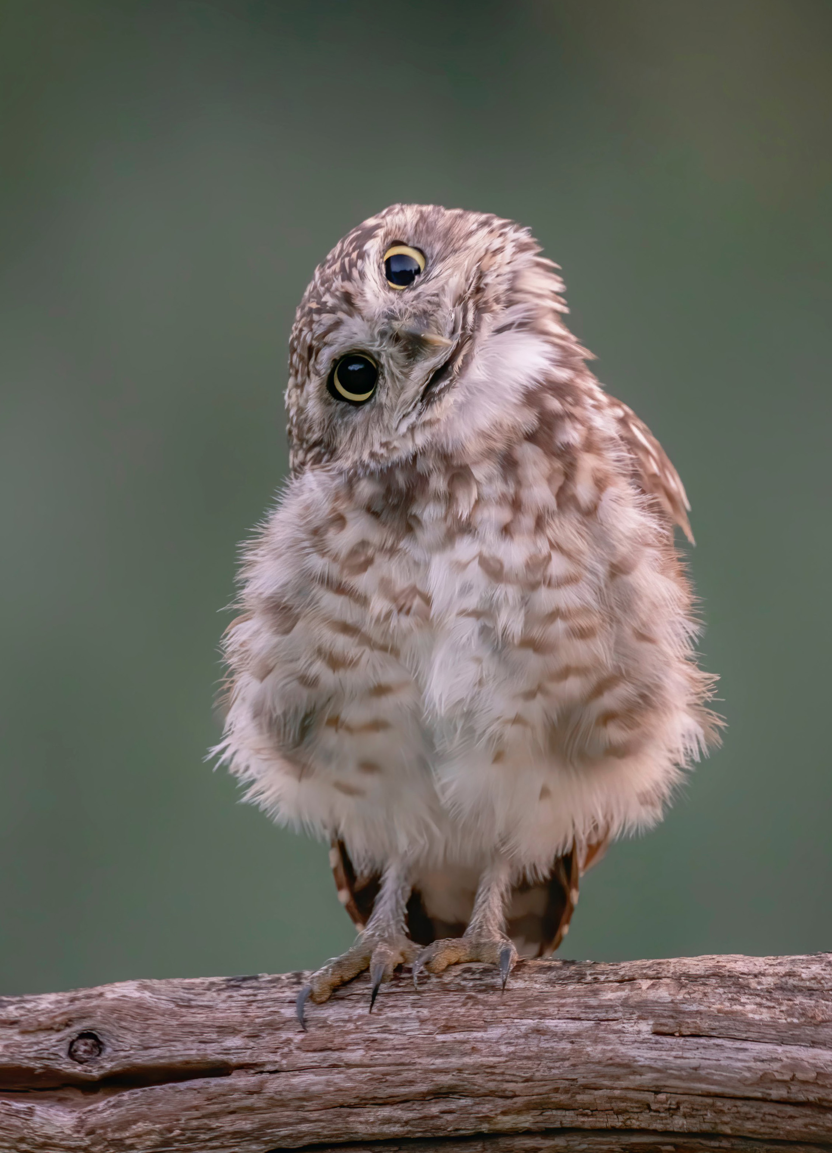
A funny burrowing owl
White
Black
Look. Tick the color you see?
✓
black
red
✓
white
blue

Slide 4
2 Presentation
Listen and guess

Slide 5
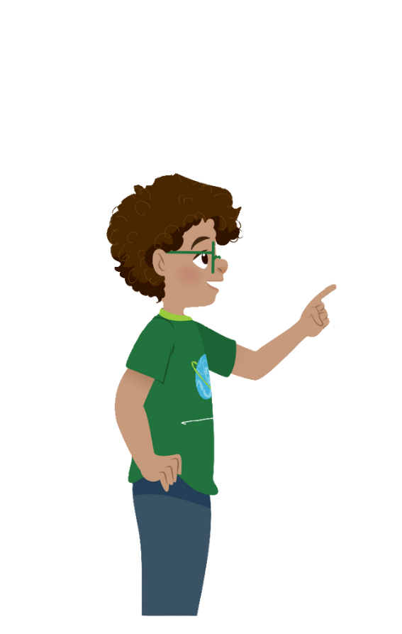

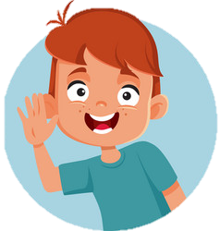
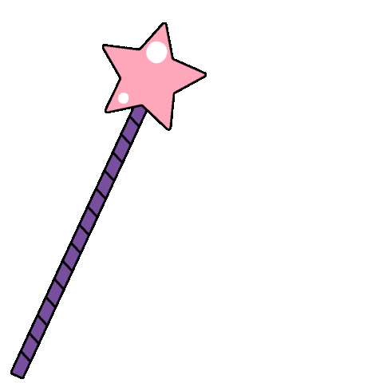


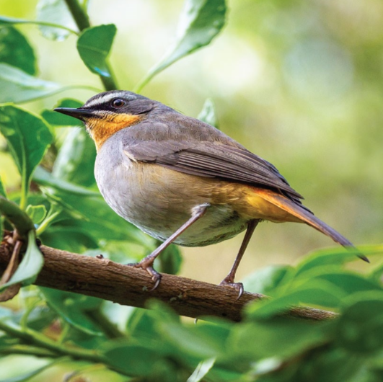
bird
Notes:
Bấm vào phần âm thanh nghe sound trước, sau đó hỏi hs “ What animal is it?

Slide 6
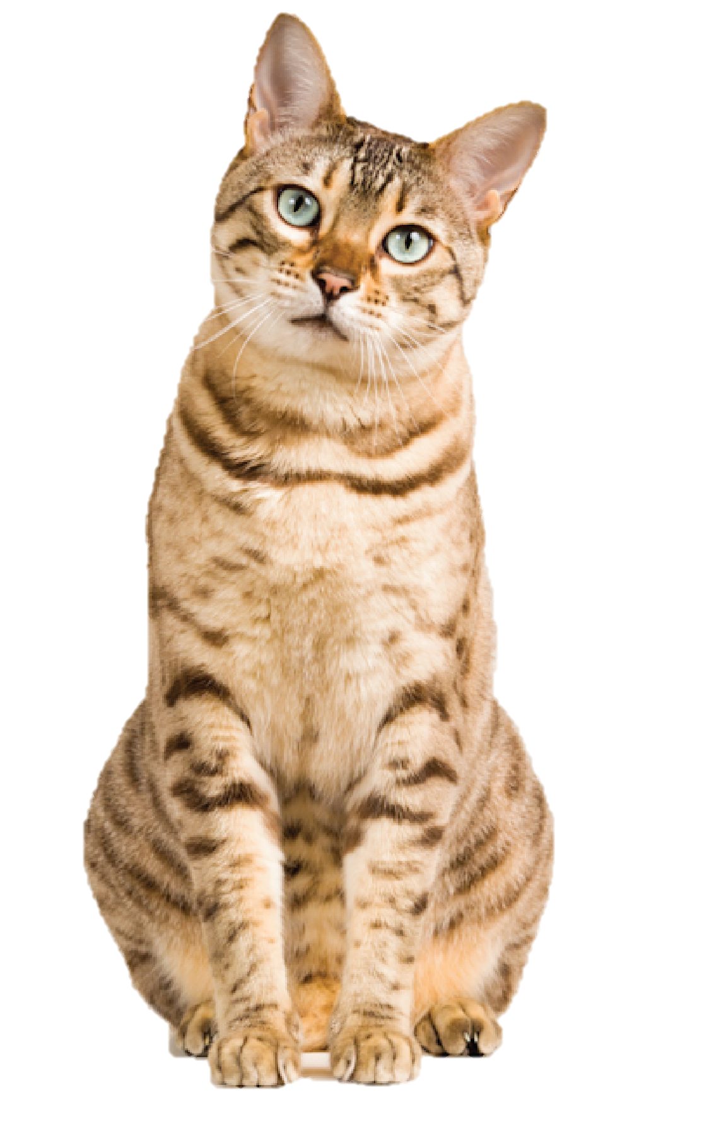
cat
Notes:
Bấm vào phần âm thanh nghe sound trước, sau đó hỏi hs “ What animal is it?

Slide 7
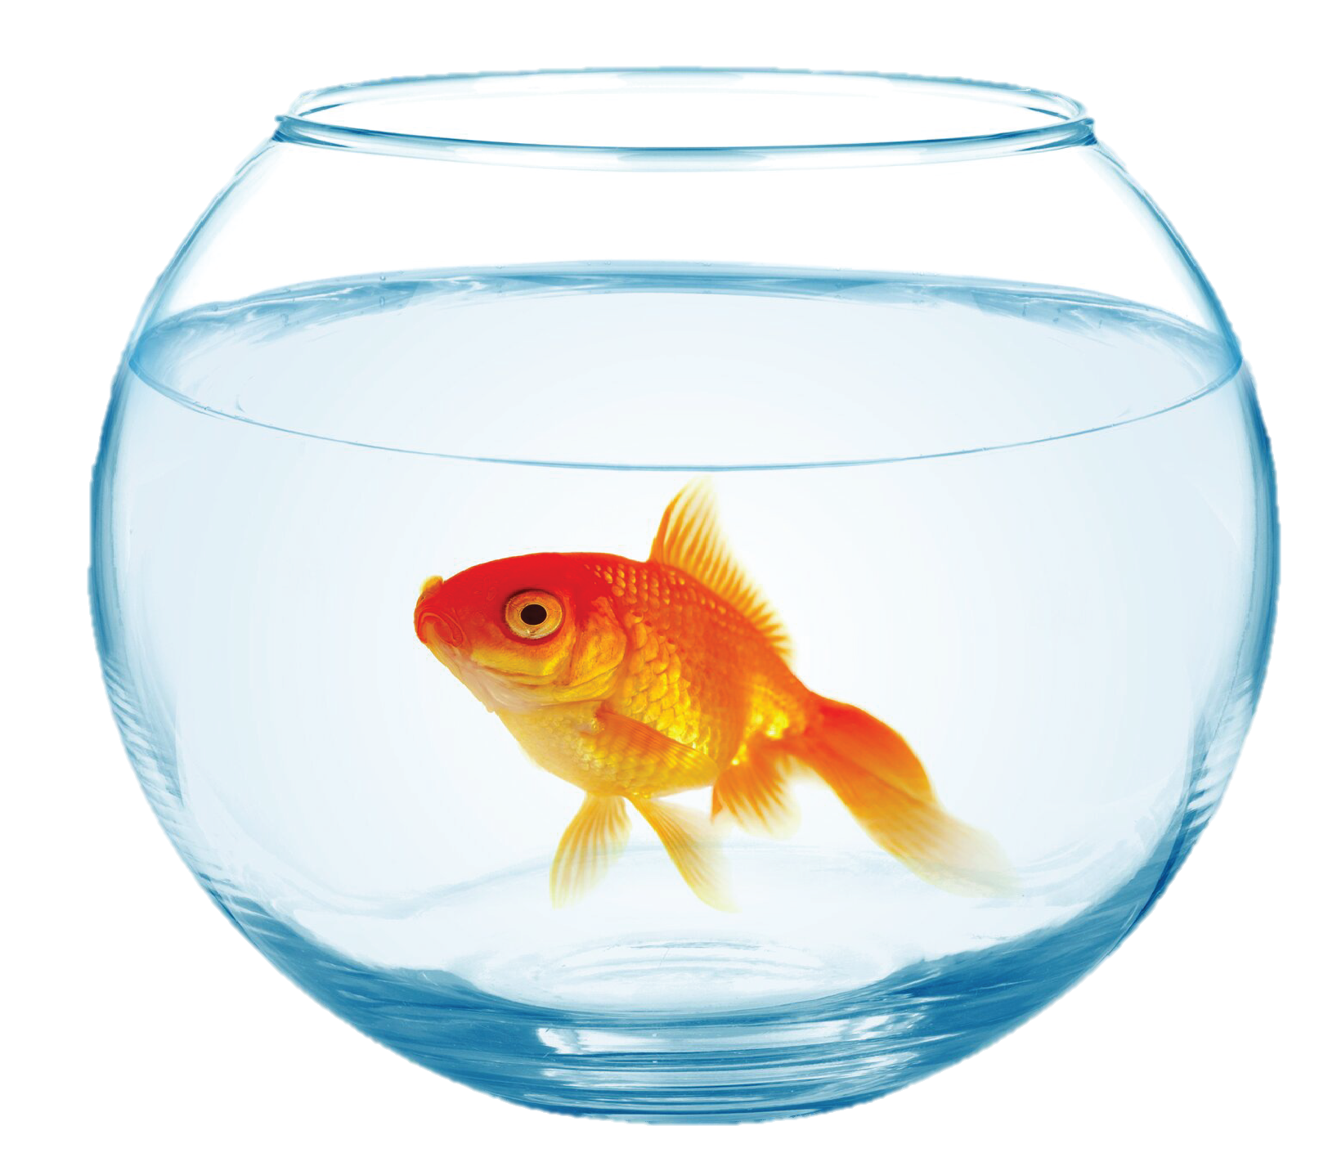
fish

Slide 8
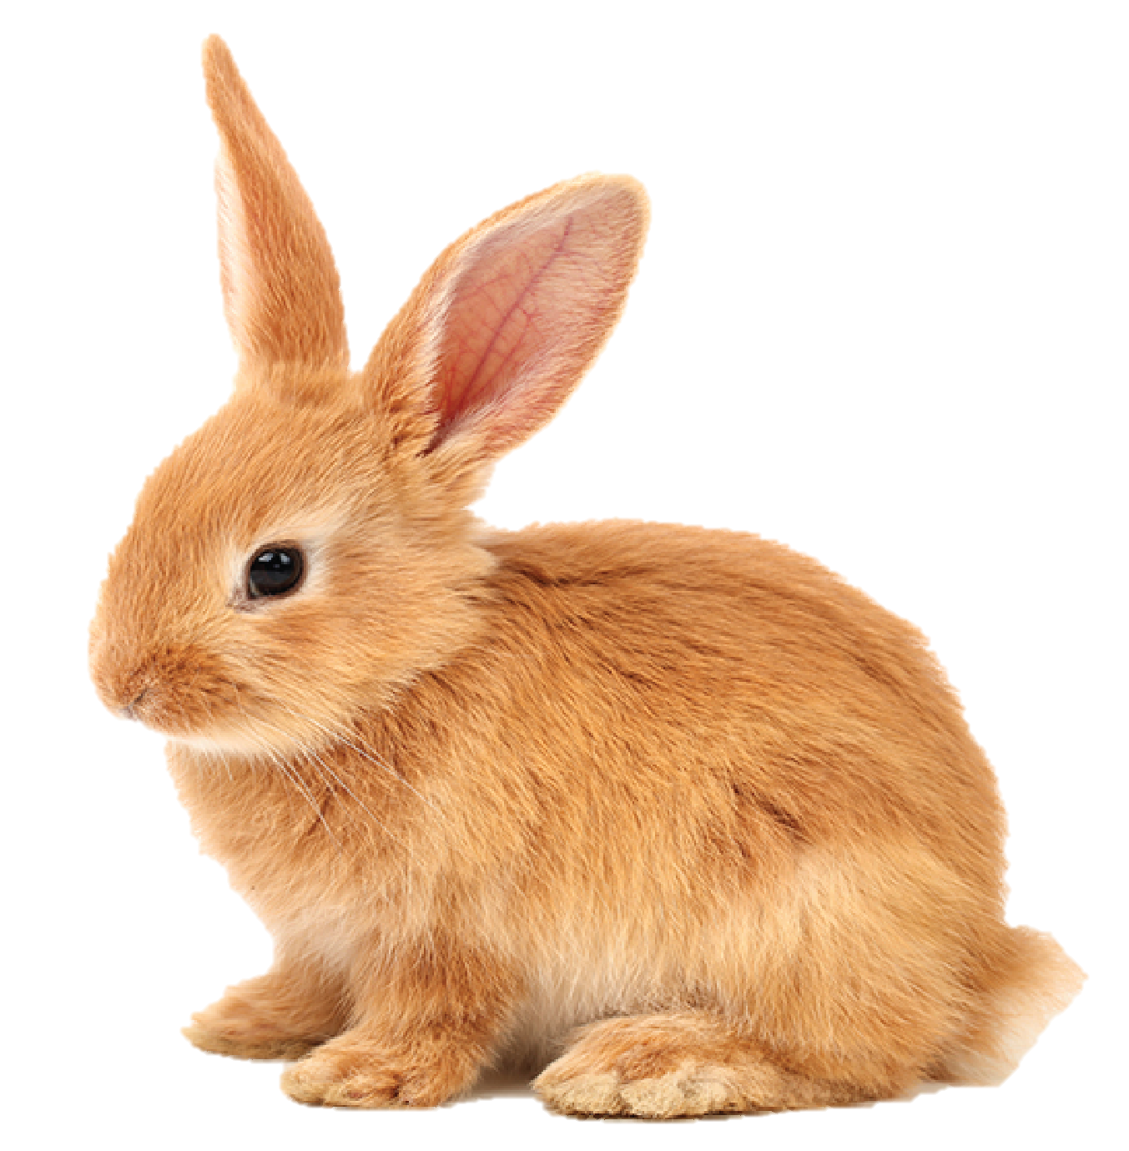
rabbit

Slide 9
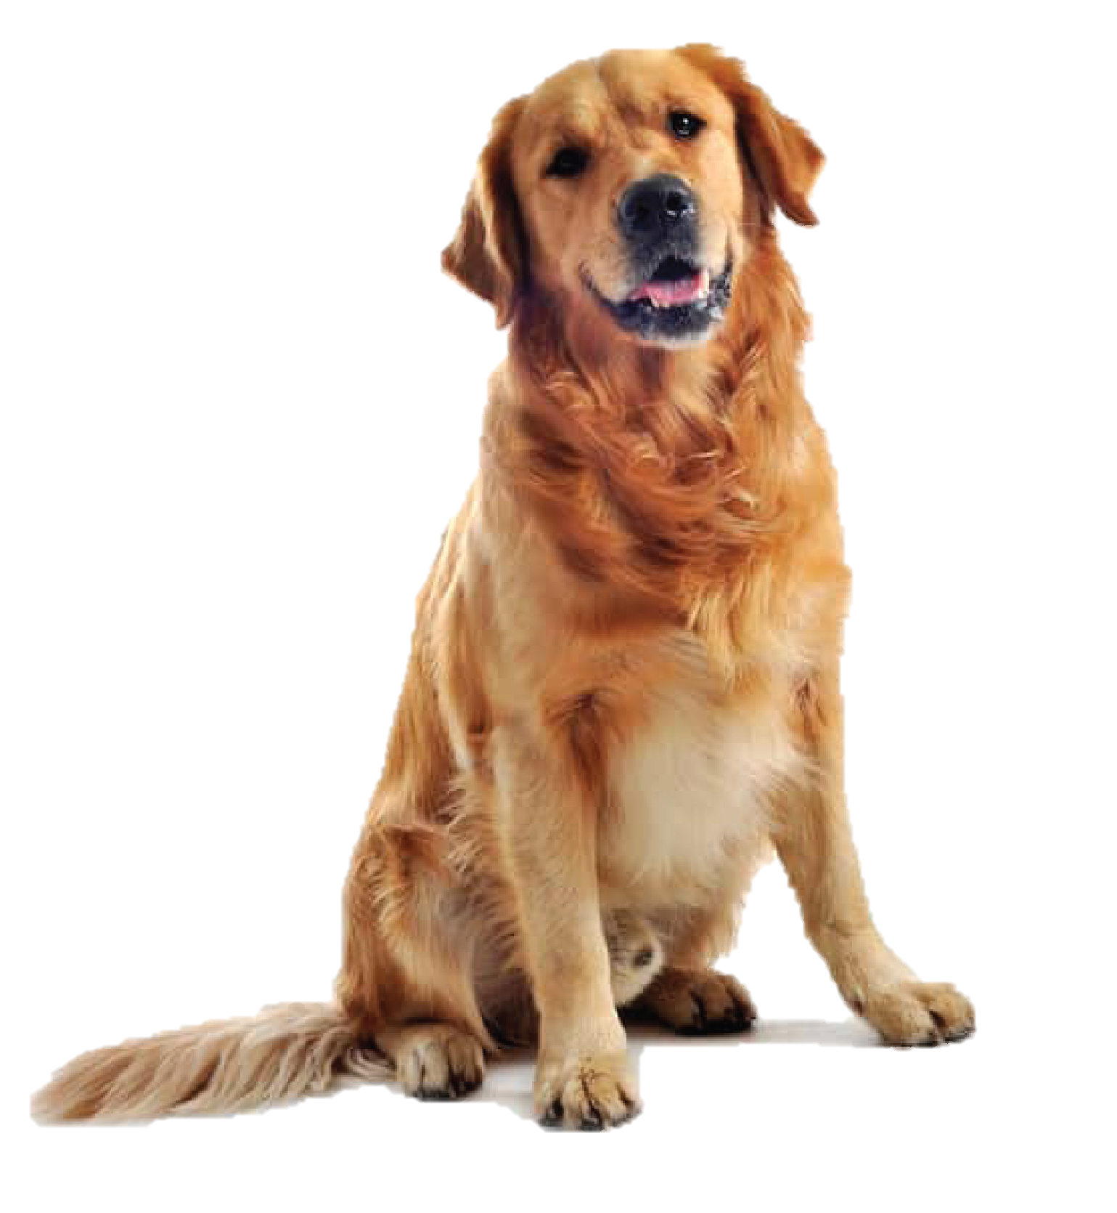
dog

Slide 10



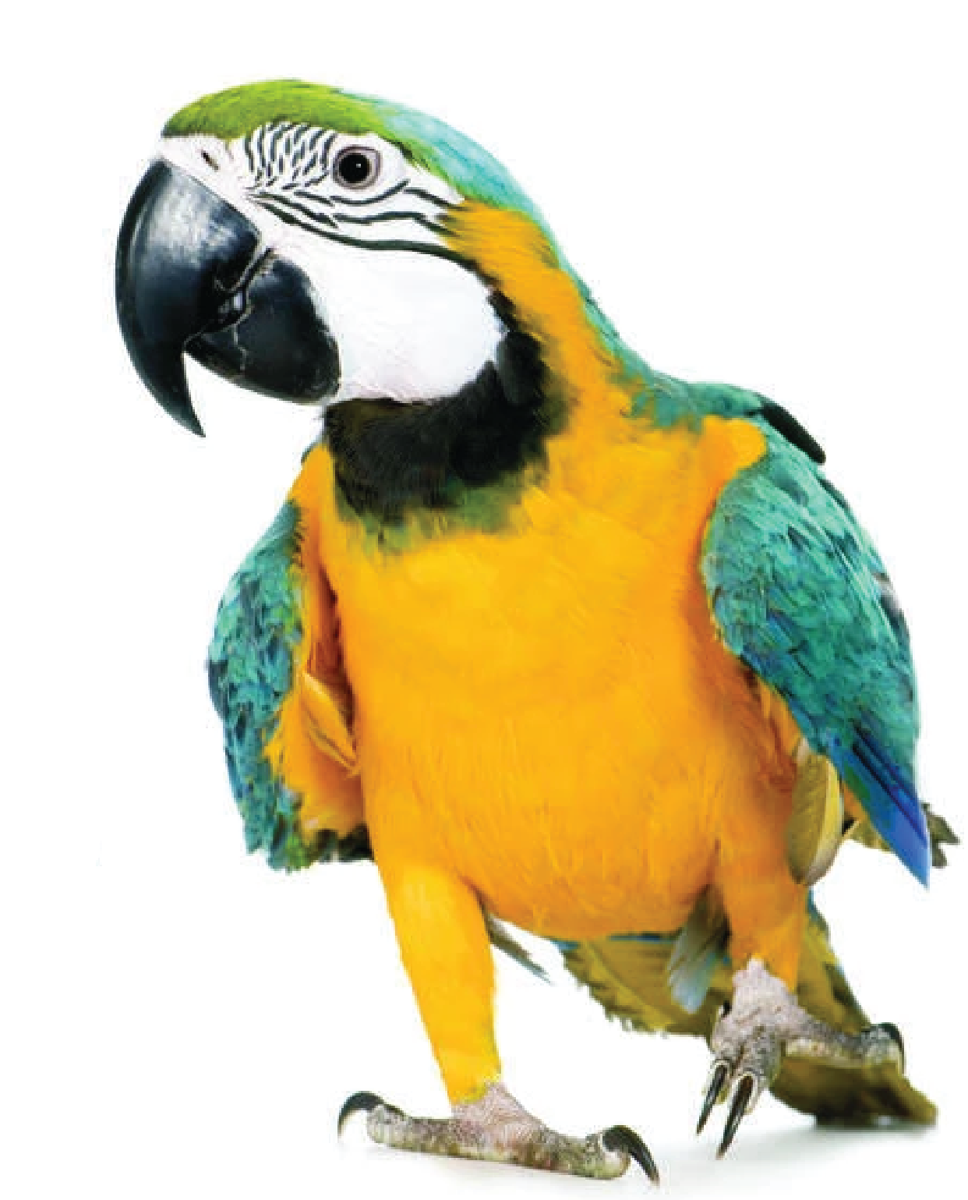
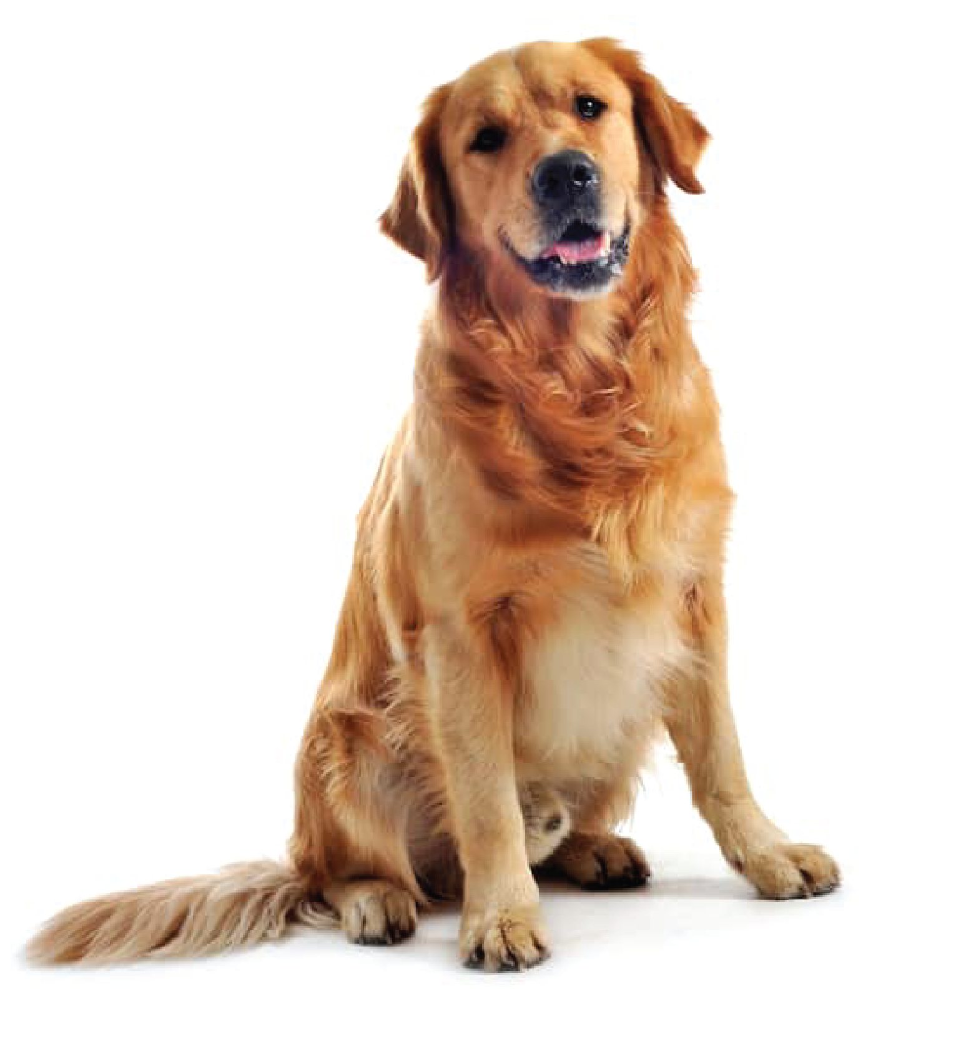
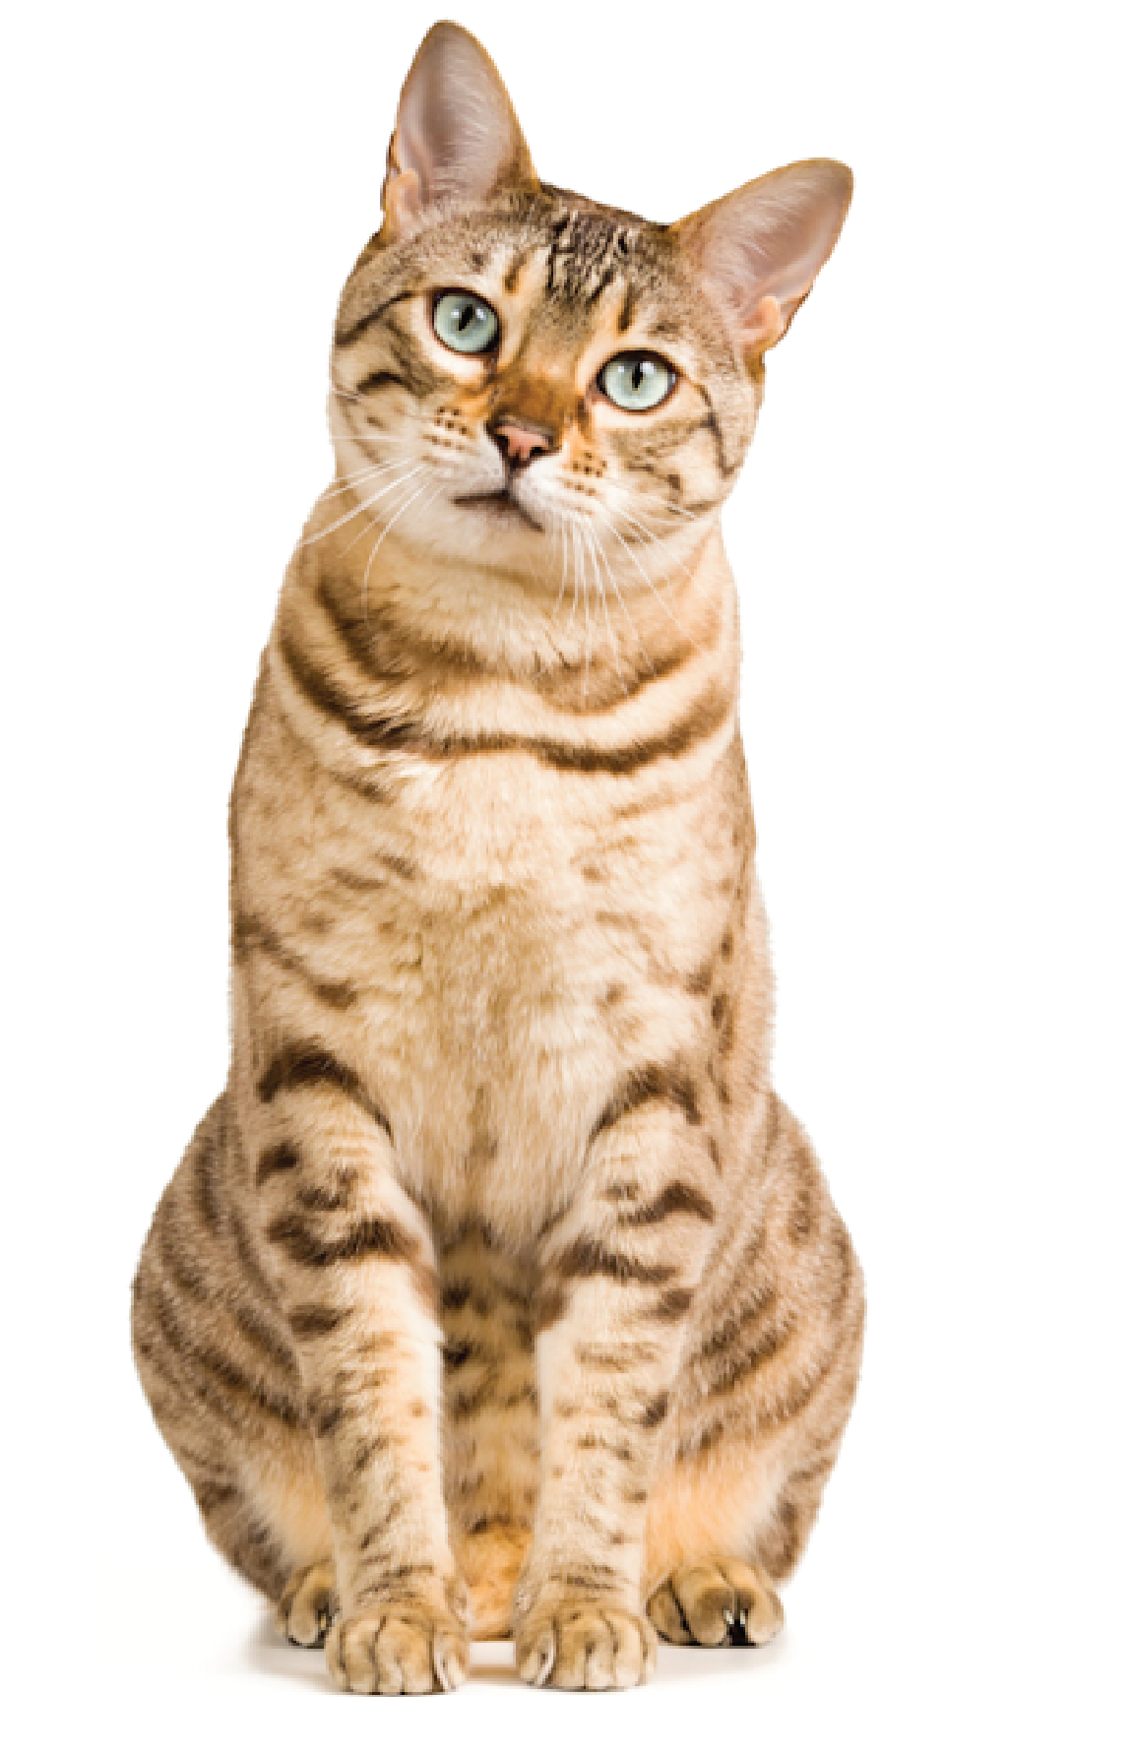
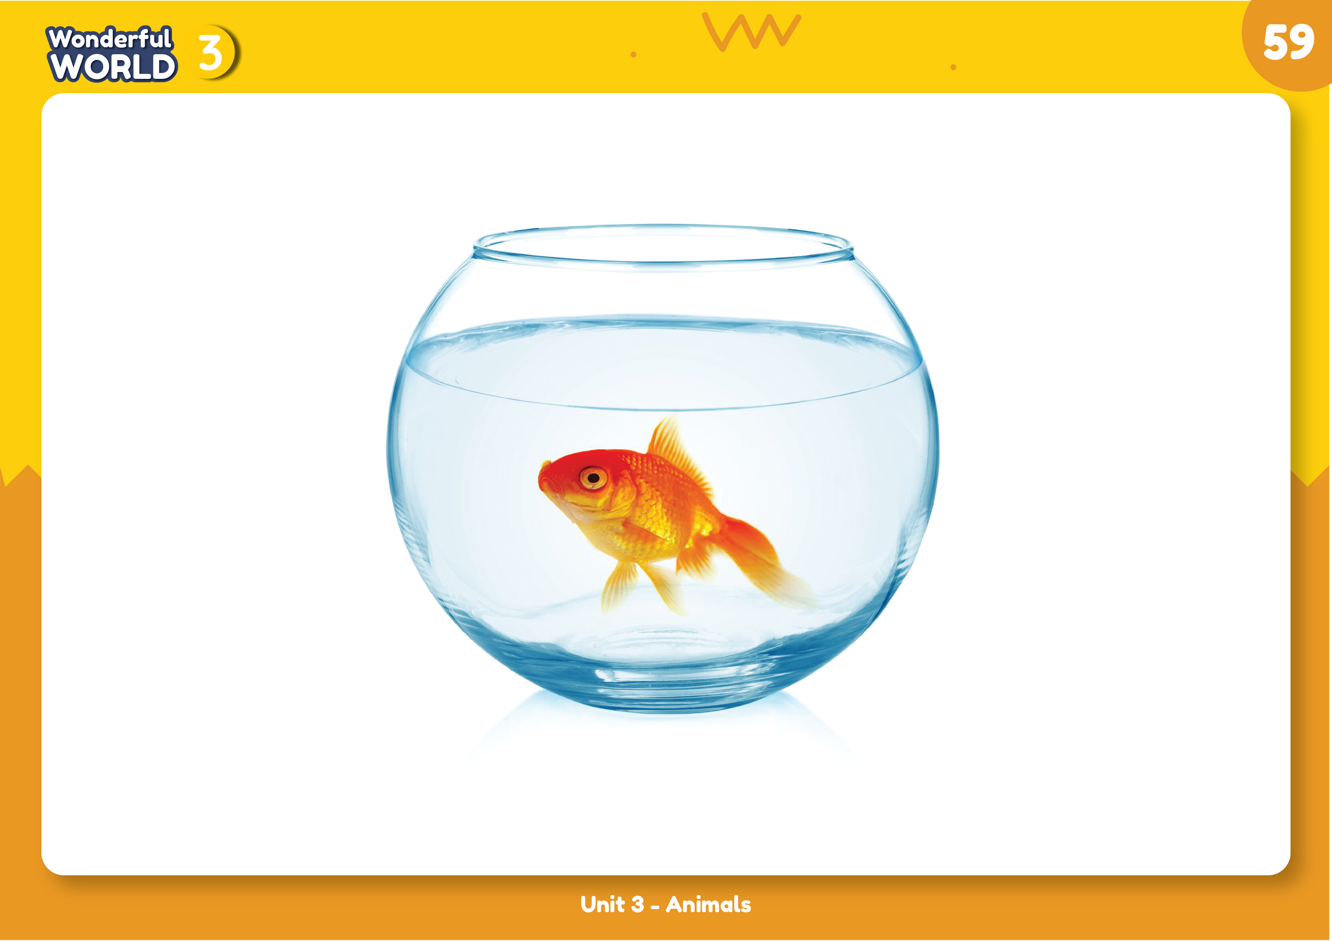
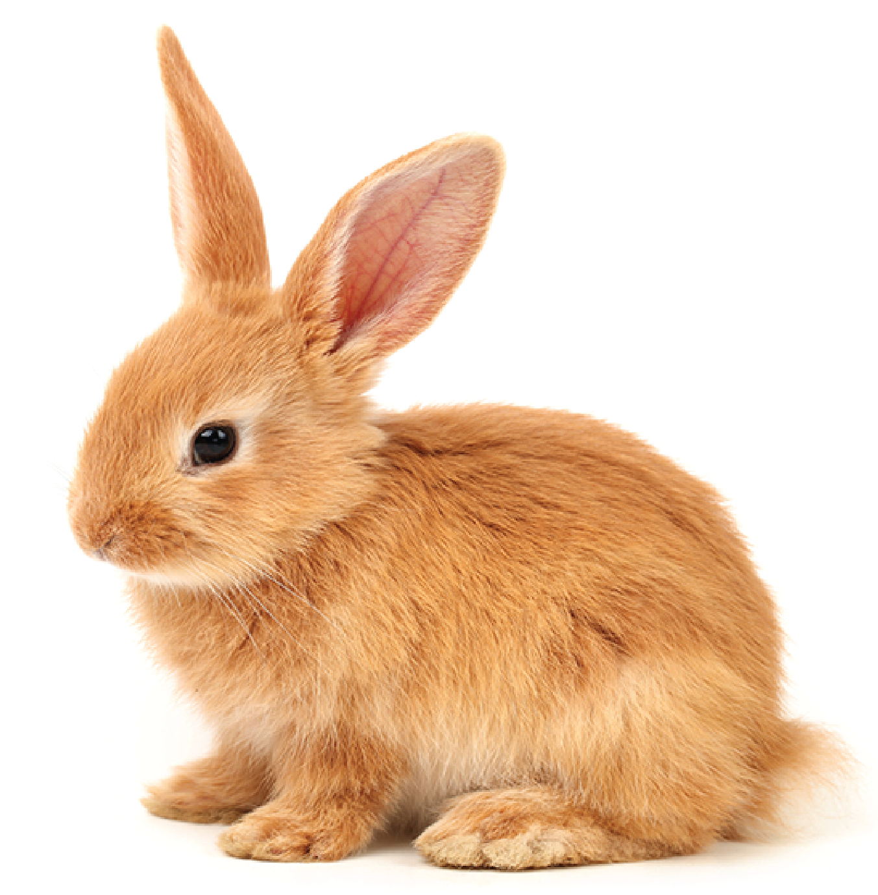
1 Listen and point. Repeat
dog
bird
cat
fish
rabbit

Slide 11
3 Practice

Slide 12

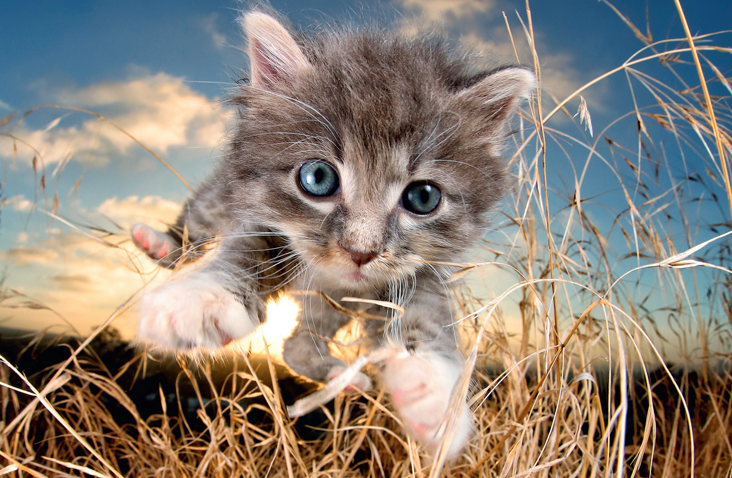
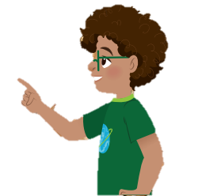

2 Listen and tick
Look! A cat!
Yeah. It’s a cat. It’s in the garden.
Oh, it’s funny

Slide 13
VOCABULARY CHECKING Listen and tick
✓
Look. It’s a
✓
It’s
cool
funny
Notes:
THIẾT KẾ HOẠT ĐỘNG TƯƠNG TÁC KÈM FILE NGHE:
CÂU HỎI:
Look. It’s a ____. It’s ____.
cat/ funny
dog/ cool

Slide 14
3 Look and say
Look! It’s a bird. It’s green and yellow. It’s nice.
blue
yellow
orange
red
nice
brown
cool
black
funny
white
great
green
Notes:
Gv chỉ vào con vật & hỏi theo thứ tự sau:
What is it? It’s a………
What color is the…….? It’s …… and ……
How is the …….? It’s cute / nice.

Slide 15
Look and match
blue
yellow
orange
red
nice
brown
cool
black
funny
white
great
green
Notes:
Gv chỉ vào con vật & hỏi theo thứ tự sau:
What is it? It’s a………
What color is the…….? It’s …… and ……
How is the …….? It’s cute / nice.

Slide 16
4 Production

Slide 17
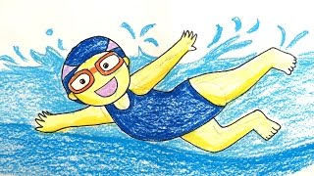
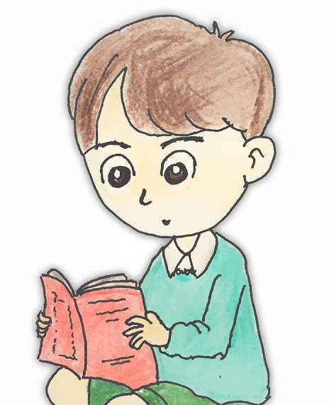
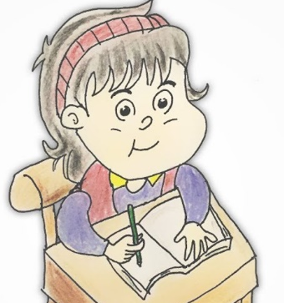
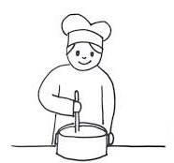

What we can do?

Slide 18
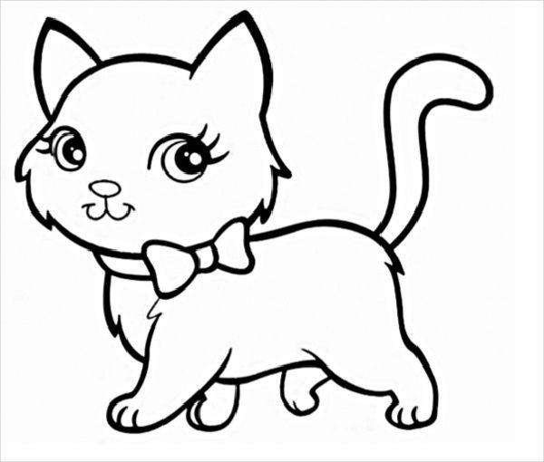
My favourite cat

Slide 19
5 Assessment

Slide 20



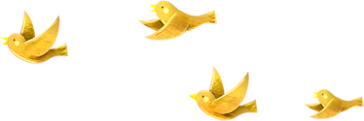
Good bye.
See you again!

