Slide 1






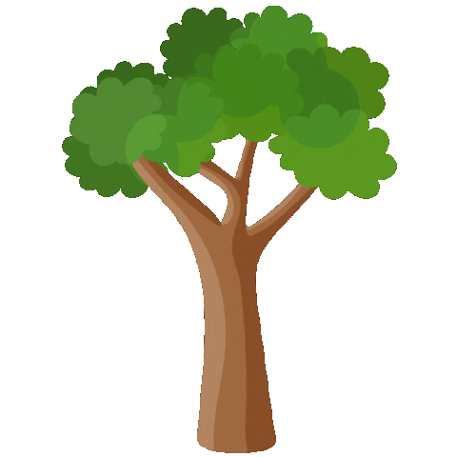

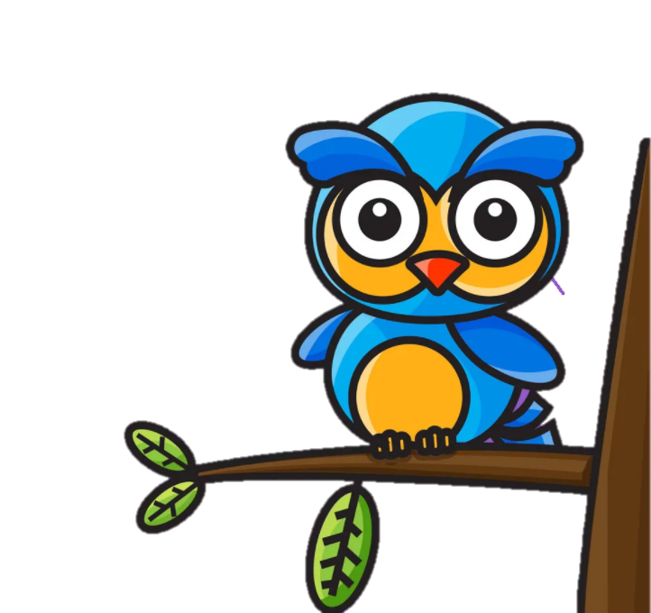





UNIT 4
Lesson 3: Part 4,5,6

Slide 2






01
Warm-up
Table of contents
02
03
Presentation
Practice
05
04
Wrap-up & Assessment
Production

Slide 3
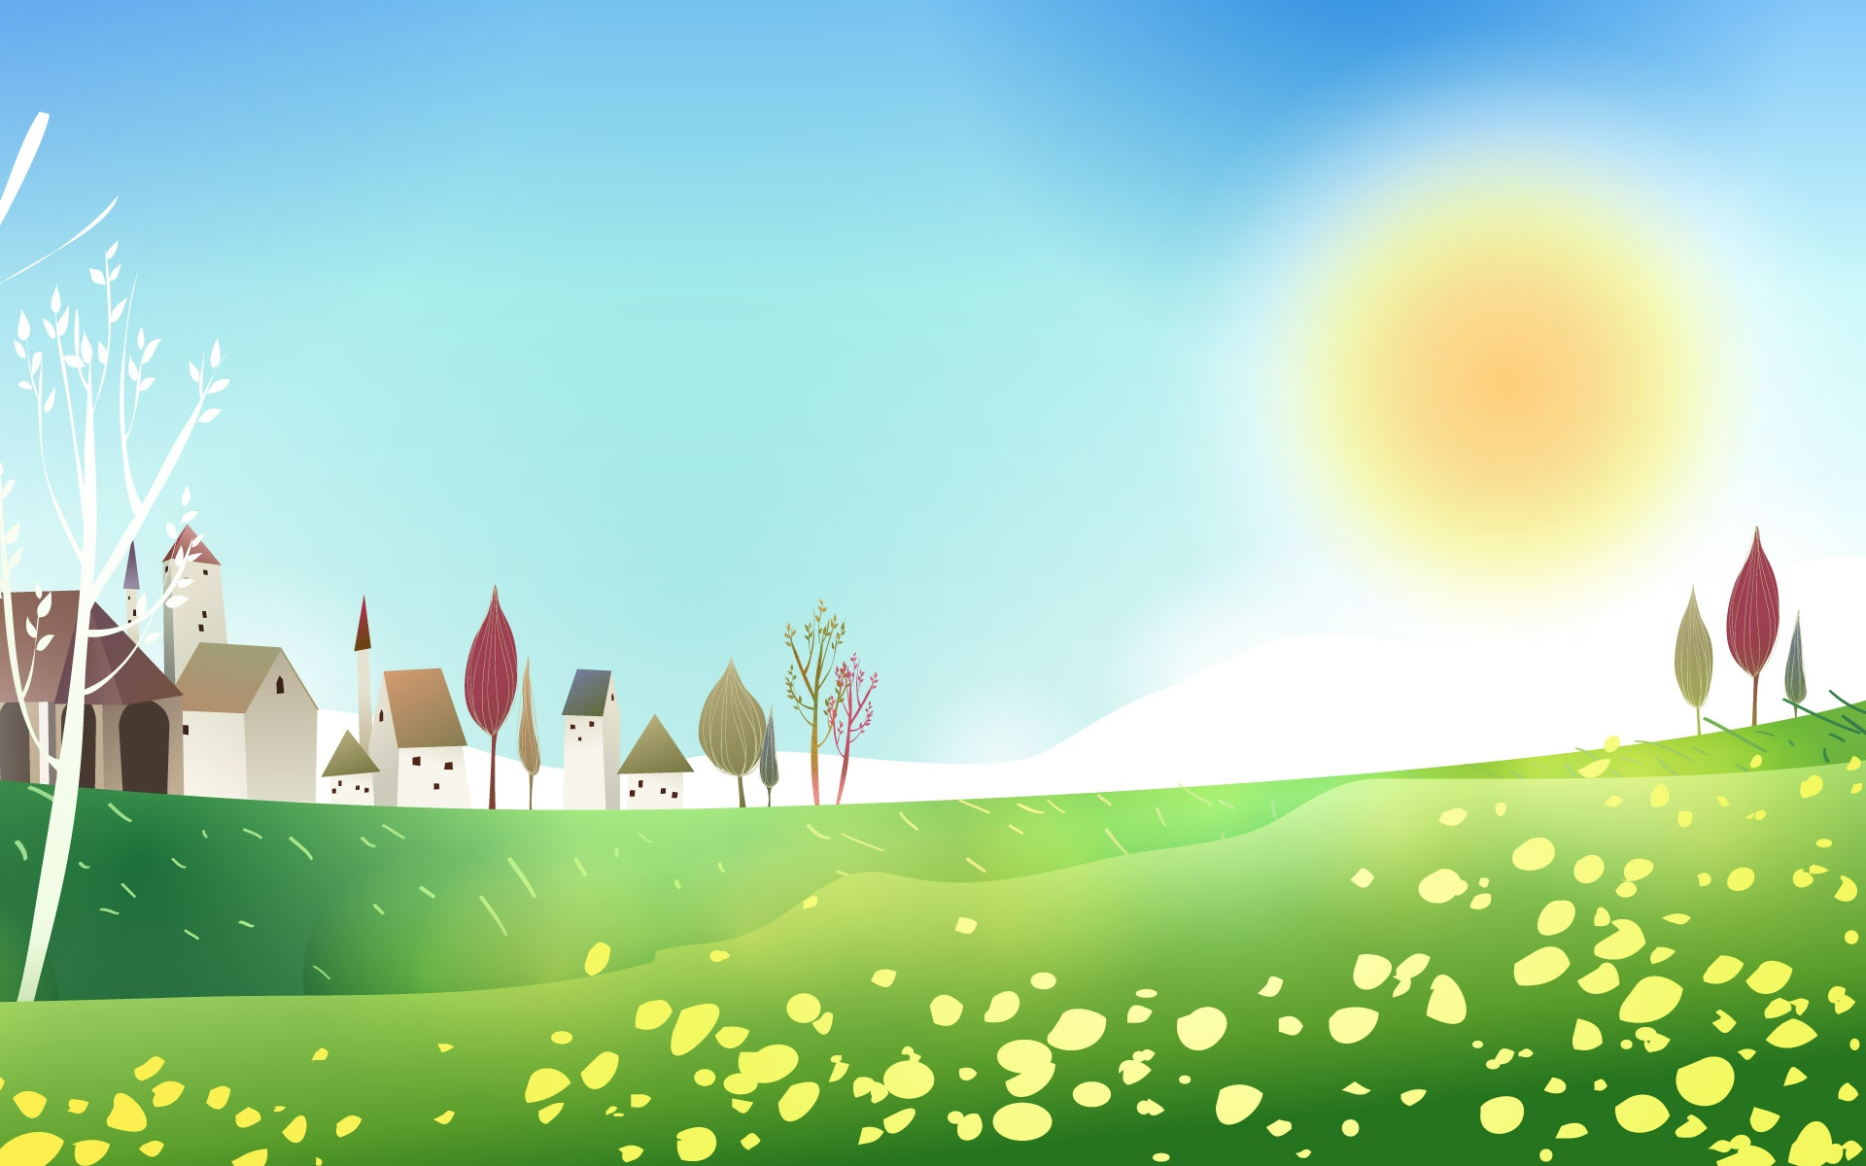
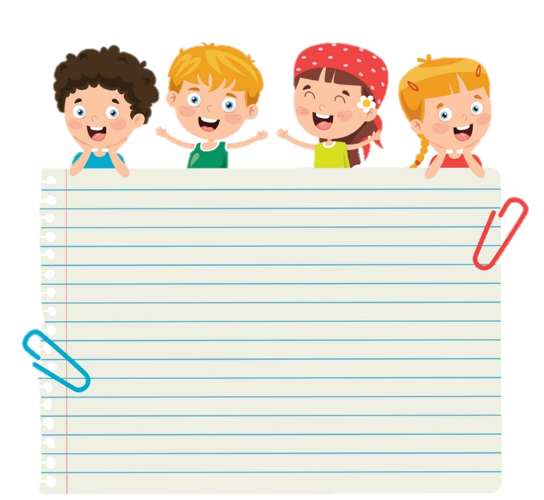




1 Warm-up
Let’s dance

Slide 4
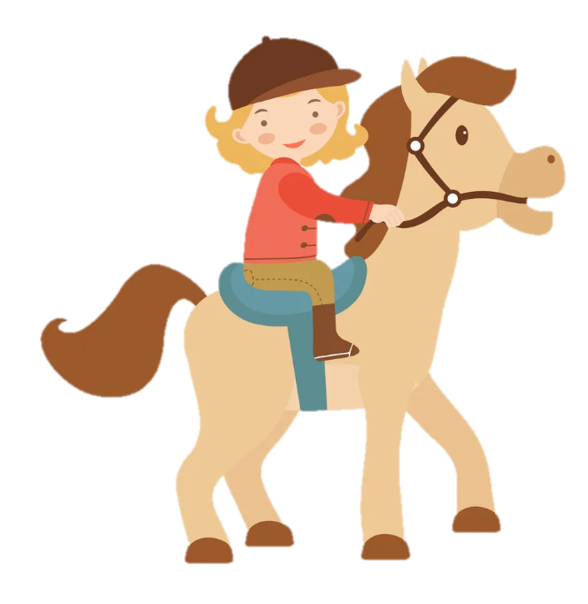
Review
Let’s play!

Slide 5

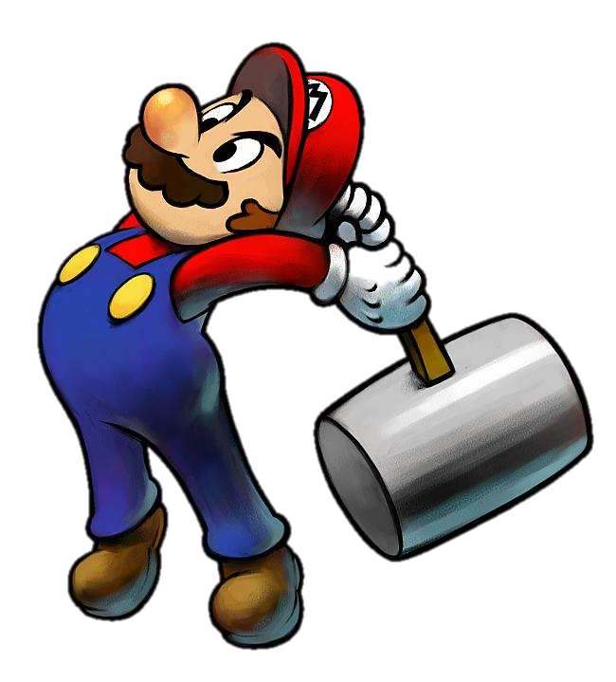
START
What’s behind the wall?
BRICKS DOWN

Slide 6
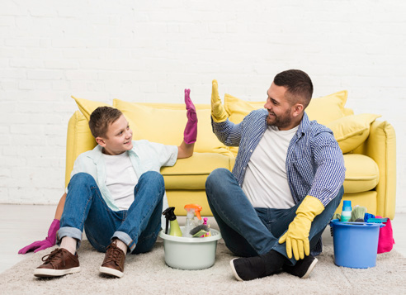
help Dad
NEXT
CHECK

Slide 7
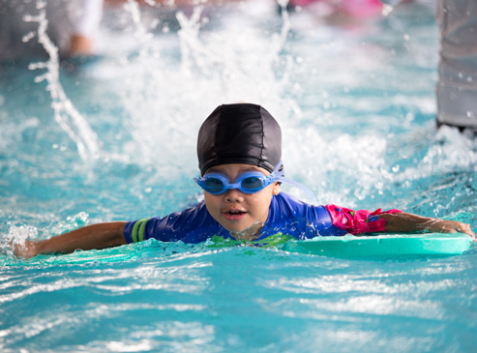
go swimming
NEXT
CHECK

Slide 8
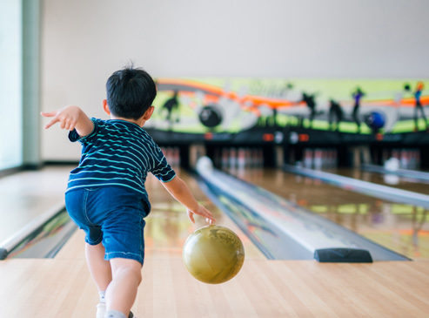
go bowling
NEXT
CHECK

Slide 9
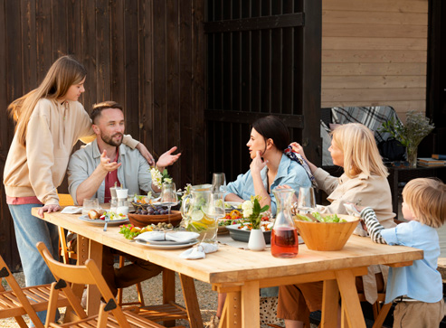
have dinner
NEXT
CHECK

Slide 10
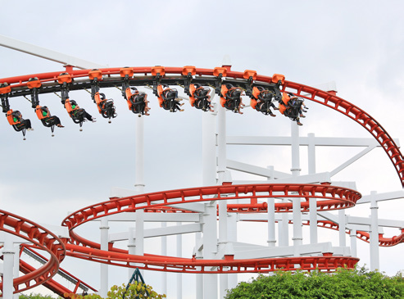
ride the roller coaster
NEXT
CHECK

Slide 11
2
PRESENTATION

Slide 12
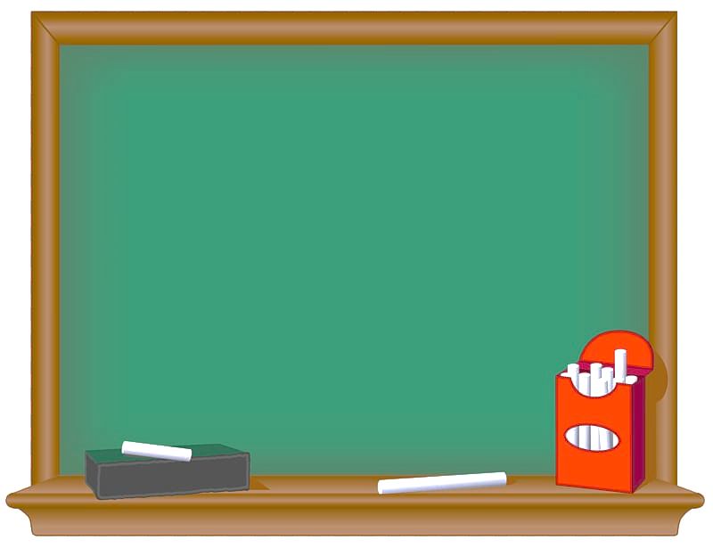

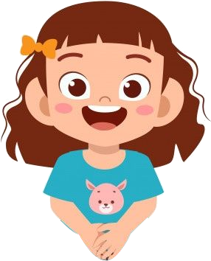
Grammar
đ
Verb forms (gerund and infinitive).
Gerunds
like
good at + V-ing
enjoy
Examples
1. I like (play) ______ sports.
2. She is good at (dance) _____.
3. I enjoy (go) _____ fishing.
playing
dancing
going

Slide 13
Grammar
đ
Verb forms (gerund and infinitive).
Infinitive
can + V
Examples
1. I can (do) _______ my homework.
2. She can (sing) _______ well.
do
sing

Slide 14
Task 4
Read and circle the correct answer. Then listen and check. (track 4.9)

Slide 15

Hello, my name is Minh and I’m 11 years old. I live in Hue City with my parents and my brother, Quang. He’s six years old.
I’m good at (1) swim / swimming, and it’s my favourite activity. I often (2) go / going swimming with my mum on Saturday evenings. Sometimes, when my mum is busy, I go (3) swim / swimming alone. I like (4) swim / swimming because it’s fun.

Slide 16
My brother is quite young, so he often stays at home. He can (5) watch / watching TV or
(6) playing / play football with my dad. My brother is really good at (7) playing / play sports. He also enjoys (8) make / making things.

Slide 17
03
PRACTICE

Slide 18
đ
Task 5
Read the text in Activity 4 again.
Ask and answer.
Hello, my name is Minh and I’m 11 years old. I live in Hue City with my parents and my brother, Quang. He’s six years old.
I’m good at swimming, and it’s my favourite activity. I often go swimming with my mum on Saturday evenings. Sometimes, when my mum is busy, I go swimming alone. I like swimming because it’s fun.
My brother is quite young, so he often stays at home. He can watch TV or play football with my dad. My brother is really good at playing sports. He also enjoys making things.

Slide 19
đ
How old is Minh?
- He’s 11 years old.
2 Where does he live?
He lives in ___________________________.
3 What is Minh’s hobby?
He likes _____________________________.
4 When does he go swimming?
He often ____________________________.
5 Who does he often go swimming with?
___________________________________.
6 Why does he like swimming?
- Because _____________________________.
Hue City
swimming
goes swimming on Saturday evenings
He often goes swimming with his mum
it is fun

Slide 20
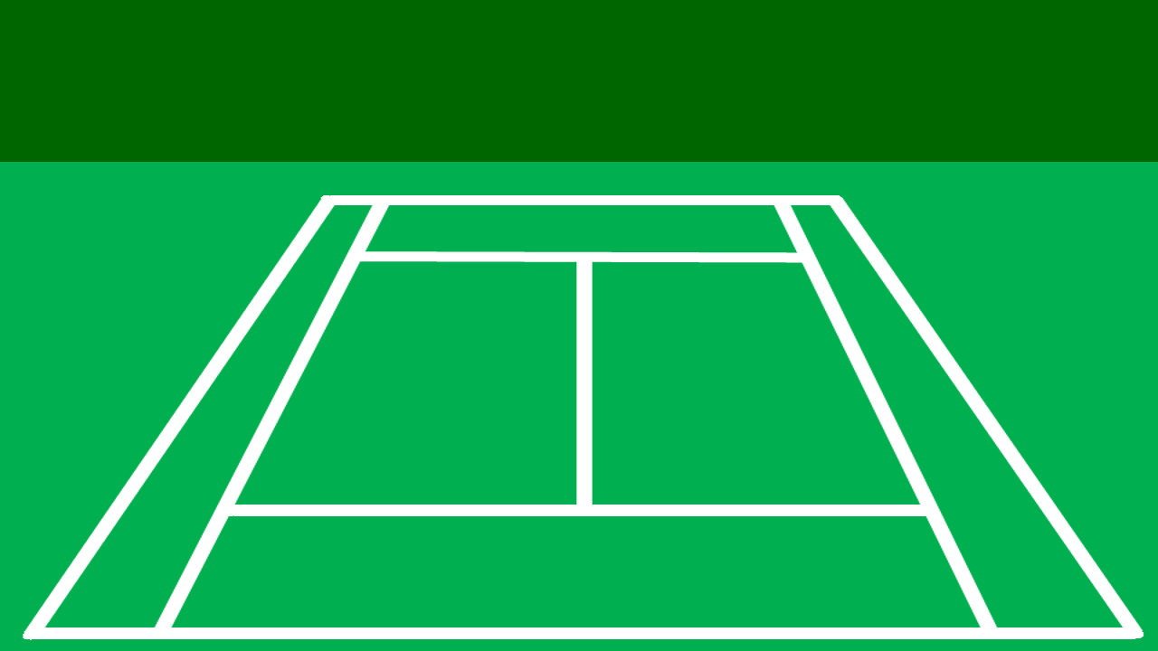

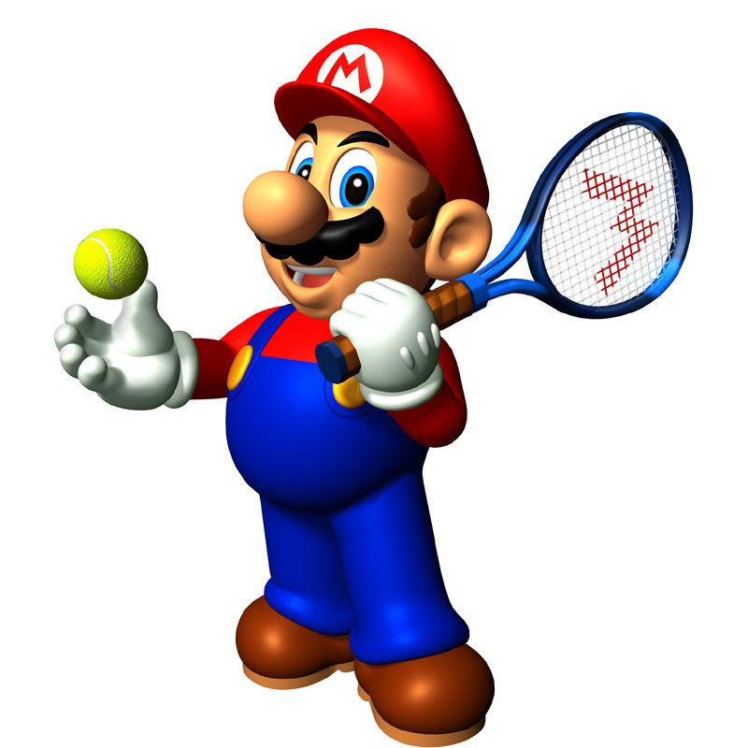





Slide 21
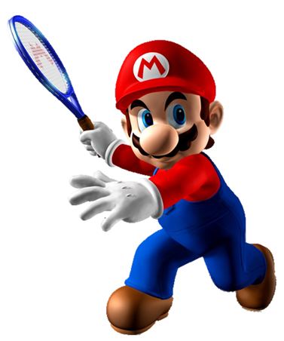
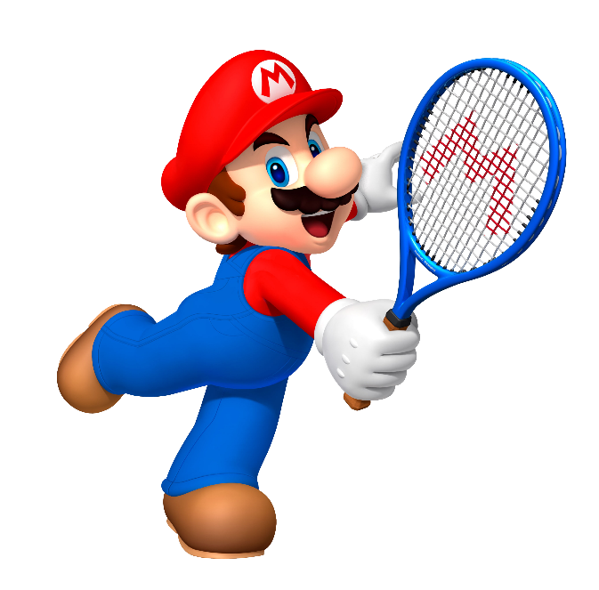
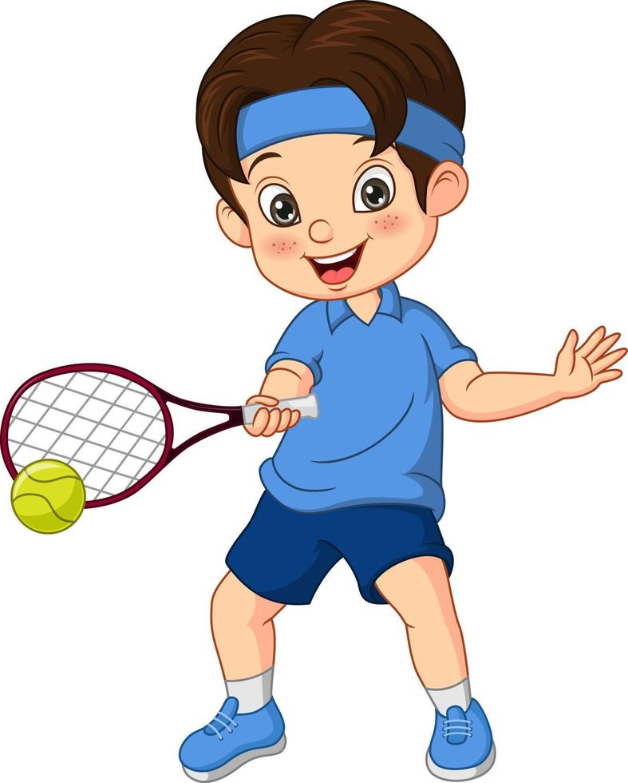

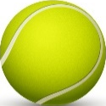
plays tennis
playing tennis
What is he good at?
- He is good at_____.
play tennis

Slide 22
help my Dad
helping my Dad
What can you do?
- I can _____.
helps my Dad

Slide 23
rides
ride
She enjoys _____ the roller coaster.
riding

Slide 24
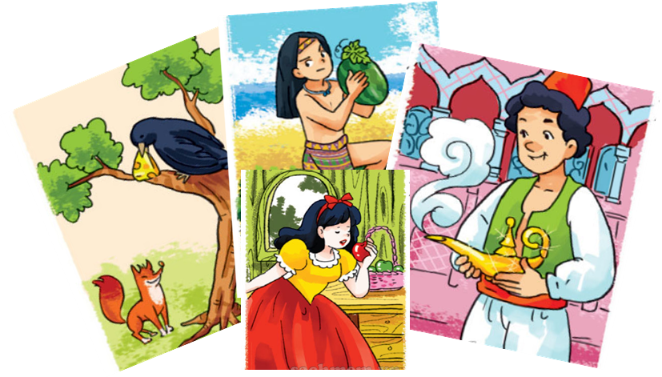
read
reads
What do you like?
- I like ________ comic books.
reading

Slide 25
go - buying
go - buy
Let’s _____ to the supermarket to _____ something.
going - buy

Slide 26
Time’s up!

Slide 27
04
PRODUCTION

Slide 28

TASK 3 WRITE
đ
My hobby
Write about your hobby.
Use the questions to help you.
• What’s your name?
• How old are you?
• Where do you live?
• What’s your hobby?
• When do you do that activity?
• Are you good at it?
• Why do you like it?

Slide 29
05
Wrap-up & Assessment

Slide 30

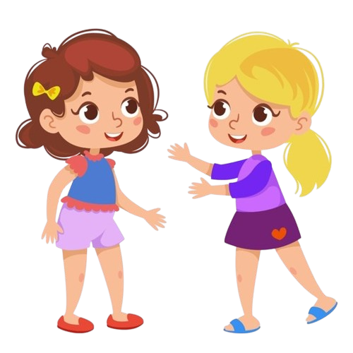
Choose the correct word.
1. I don’t do / play a musical instrument.
2. Tom likes surfing the computer / the Net.
3. Jane enjoys doing / playing gymnastics.
4. We go for a film / a walk on Sunday evenings.
5. I’m keen on watching / doing sports on TV.

Slide 31
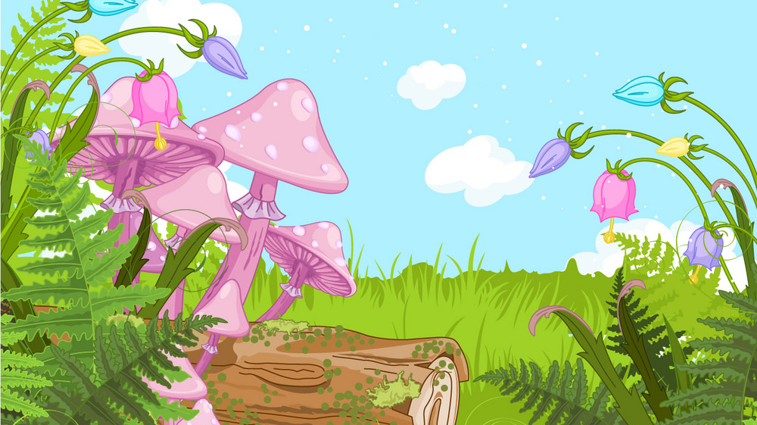
Wrap-up
What we have learnt today:
Vocabulary Review:
go bowling, ride the roller coaster, and other words/terms about hobbies
Grammar:
Verb forms (gerund and infinitive)

Slide 32




Thank you & goodbye!

