Slide 1









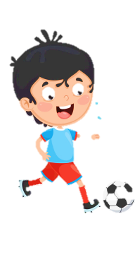












Slide 2





Table of contents
01
02
Warm - up
Presentation
05
04
Production
03
Practice
Wrap-up & Assessment

Slide 3

01
Warm up
Game “Memory”

Slide 4




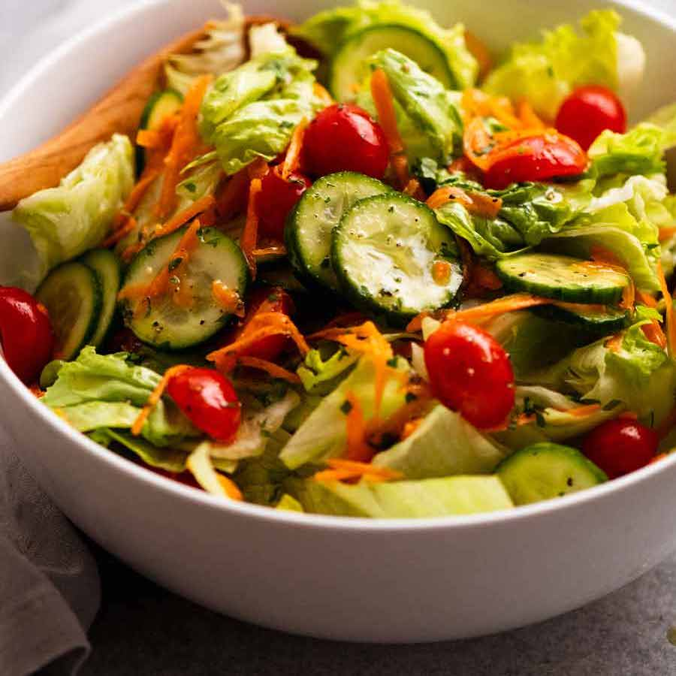
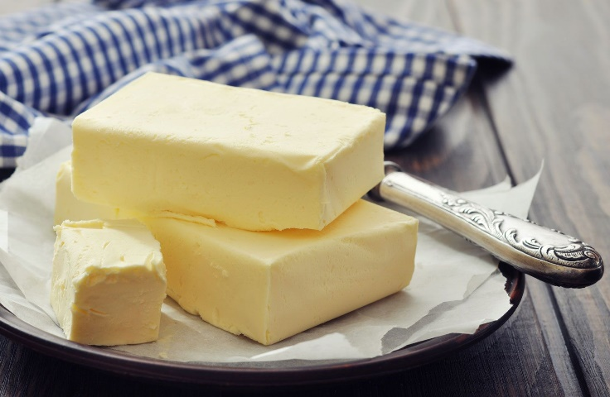


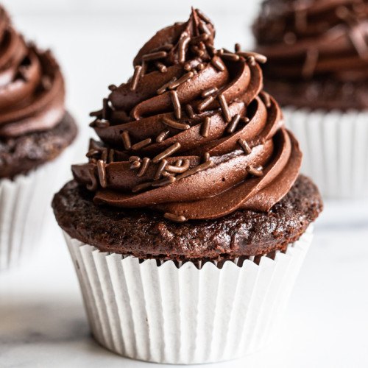
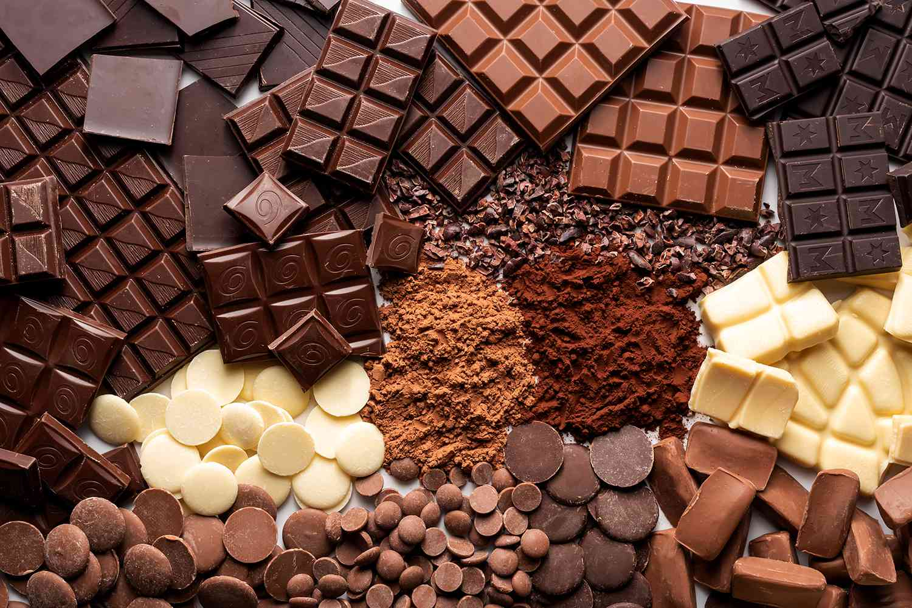



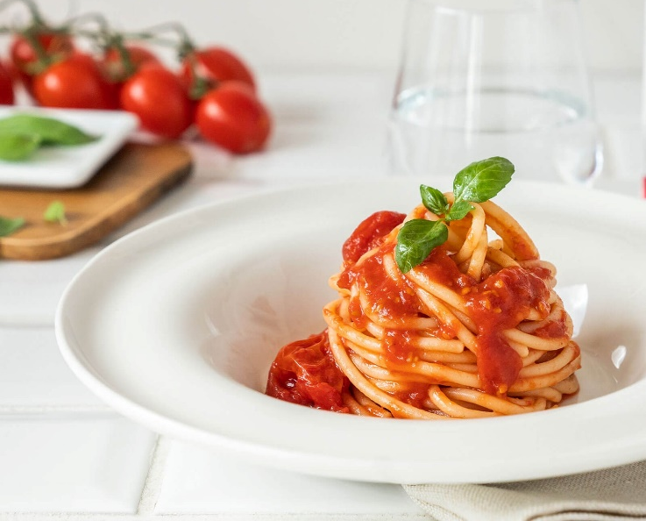
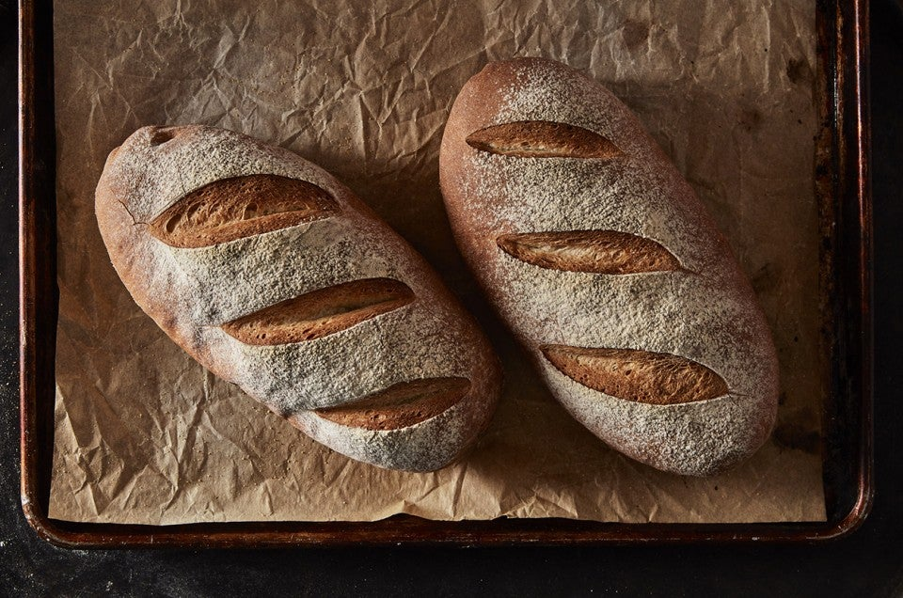
A
B
C
D
butter
spaghetti
CA
E
F
G
H
bread
salad
I
J
K
L
cupcake
chocolate
Notes:
Click vào ảnh đánh dấu trang để làm mất các cặp chính xác
LAM: BUTTER
LÁ: SPAGHETTI
CAM: SALAD
ĐỎ: CHOCOLATE
NÂU: CUPCAKE
TÍM: BREAD

Slide 5
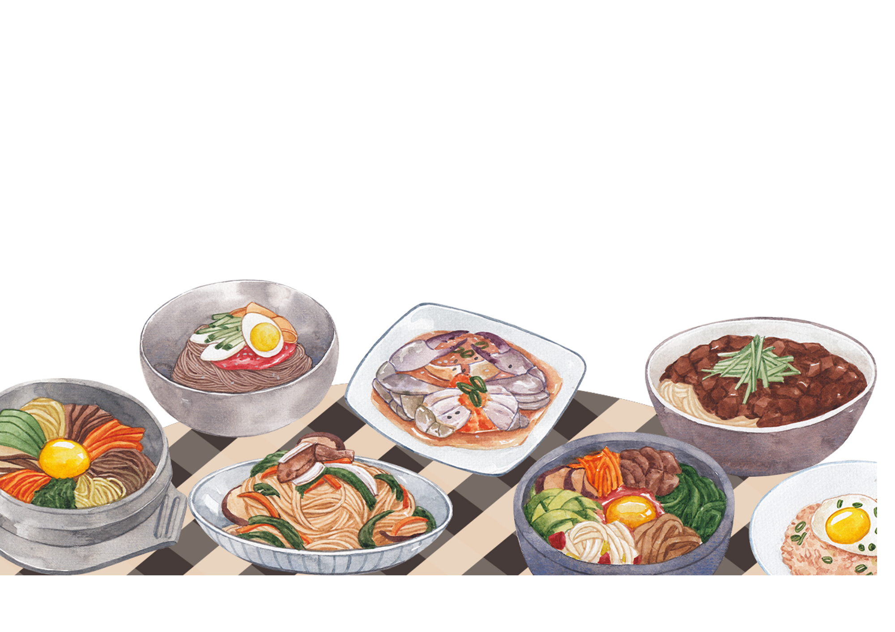
Unit 6: FOOD
Lesson 1 – Task 4, 5, 6

Slide 6

02
PRESENTATION

Slide 7
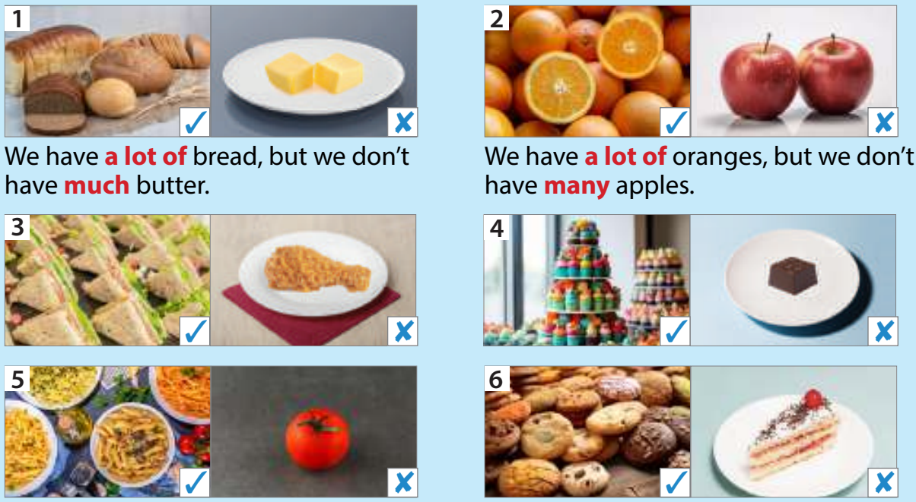
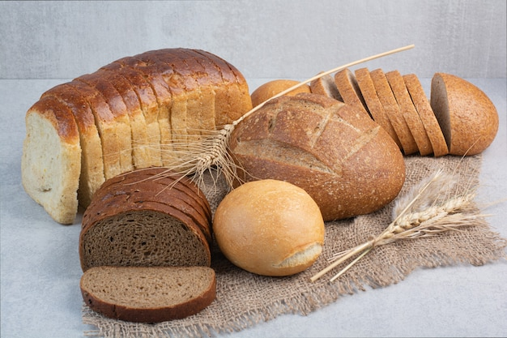
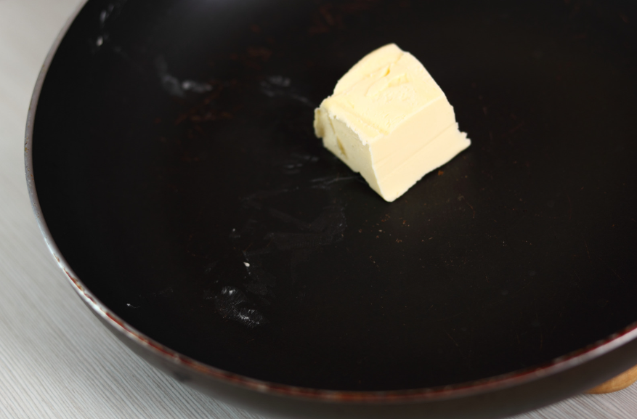
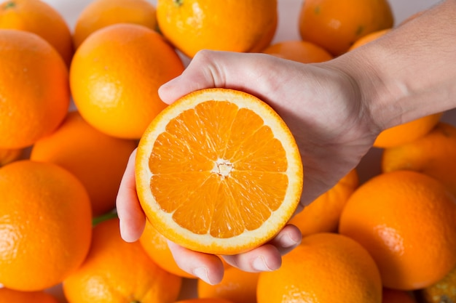
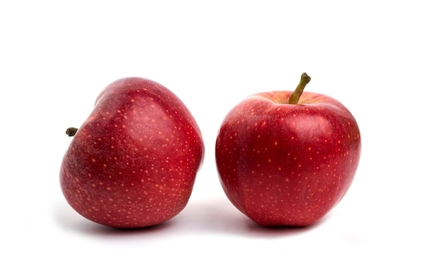


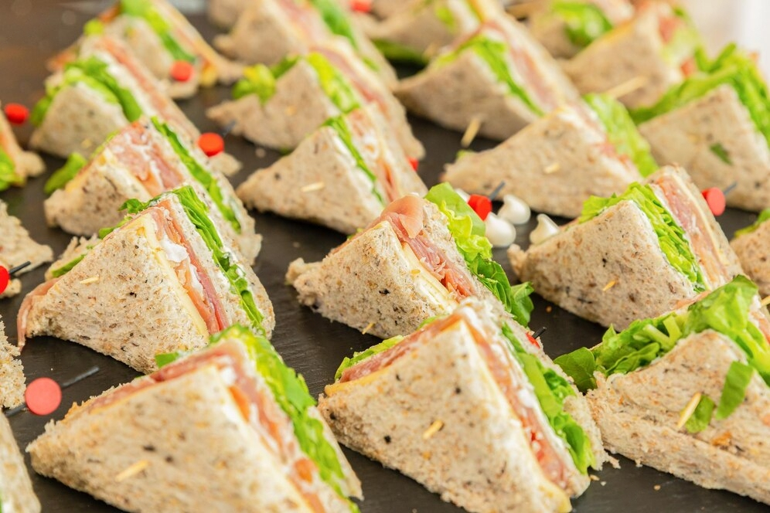
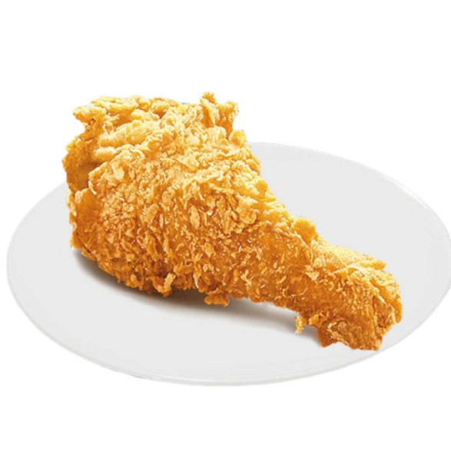
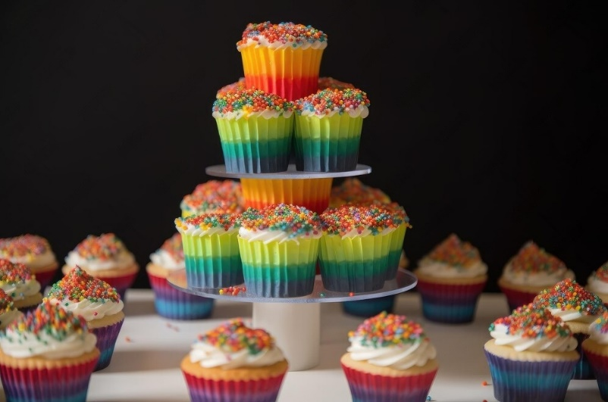
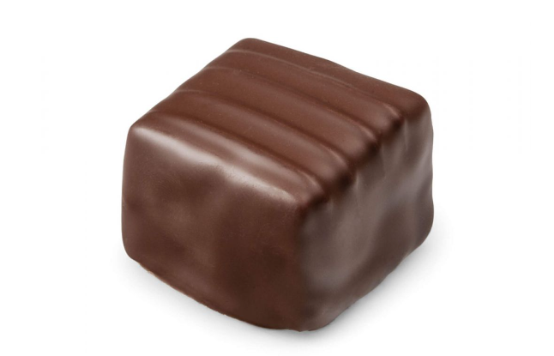
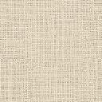
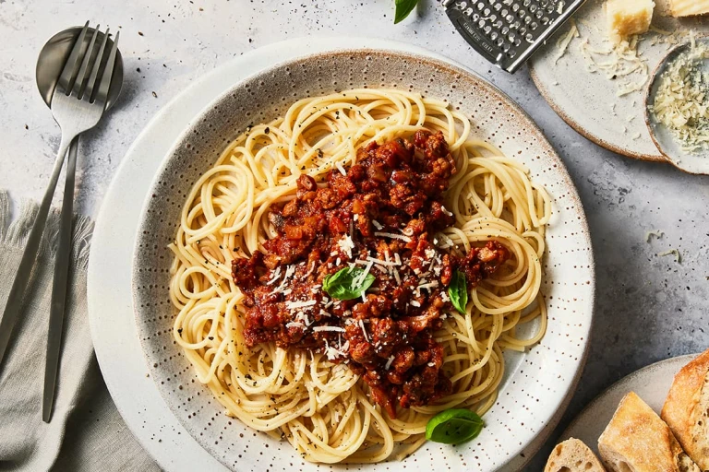
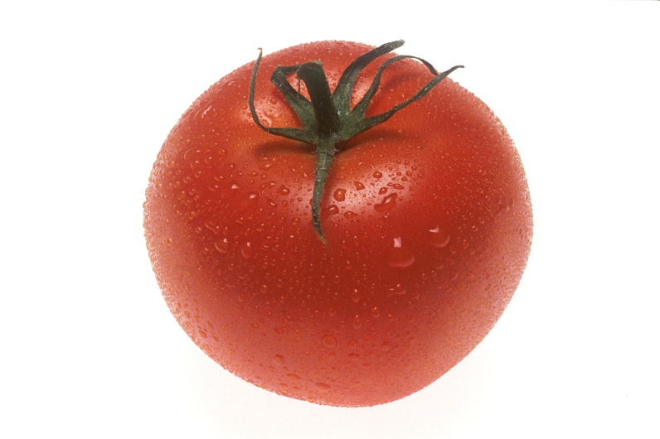
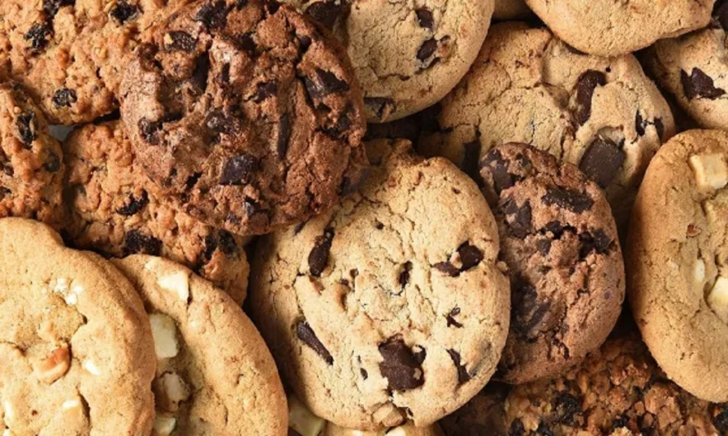
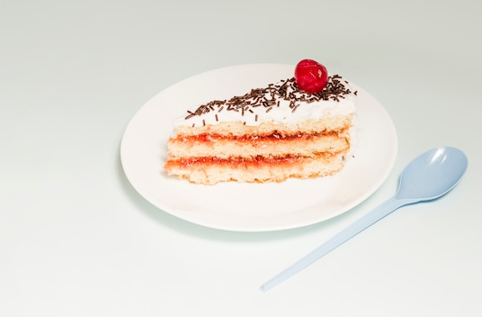
4 Listen and read. Then point and say.
1
2
✓

✓

3
4
✓

✓

5
6
✓

✓

Notes:
Answer:
a We have a lot of sandwiches but we don’t have much chicken.
b We have a lot of cupcakes but we don’t have much chocolate.
c We have a lot of spaghetti but we don’t have many tomatoes.
d We have a lot of cookies but we don’t have many cakes.

Slide 8
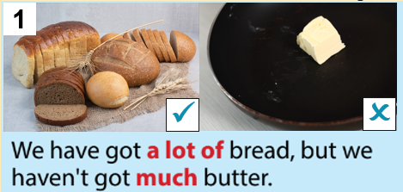
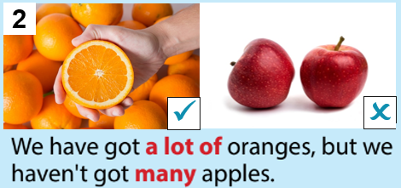
uncountable nouns
countable nouns
Notes:
Answer:
a We have a lot of sandwiches but we don’t have much chicken.
b We have a lot of cupcakes but we don’t have much chocolate.
c We have a lot of spaghetti but we don’t have many tomatoes.
d We have a lot of cookies but we don’t have many cakes.

Slide 9

GRAMMAR: MANY, MUCH, A LOT OF
 | Uncountable nouns | Countable nouns
many
much
a lot of
Notes:
Answer:
a We have a lot of sandwiches but we don’t have much chicken.
b We have a lot of cupcakes but we don’t have much chocolate.
c We have a lot of spaghetti but we don’t have many tomatoes.
d We have a lot of cookies but we don’t have many cakes.

Slide 10
FOOD SORTING
many | much | a lot of
milk
cakes
milk
cakes
rice
rice
melons
sugar
melons
sugar
candies
candies
Notes:
Answer:
a We have a lot of sandwiches but we don’t have much chicken.
b We have a lot of cupcakes but we don’t have much chocolate.
c We have a lot of spaghetti but we don’t have many tomatoes.
d We have a lot of cookies but we don’t have many cakes.

Slide 11
GRAMMAR: MANY, MUCH, A LOT OF
 | Affirmative (+) | Negative (-) | Question (?)
many
much | ít dùng
a lot of
Notes:
Answer:
a We have a lot of sandwiches but we don’t have much chicken.
b We have a lot of cupcakes but we don’t have much chocolate.
c We have a lot of spaghetti but we don’t have many tomatoes.
d We have a lot of cookies but we don’t have many cakes.

Slide 12
4 Listen and read. Then point and say.
1
2
✓

✓

3
4
✓

✓

5
6
✓

✓

Notes:
Answer:
a We have a lot of sandwiches but we don’t have much chicken.
b We have a lot of cupcakes but we don’t have much chocolate.
c We have a lot of spaghetti but we don’t have many tomatoes.
d We have a lot of cookies but we don’t have many cakes.

Slide 13
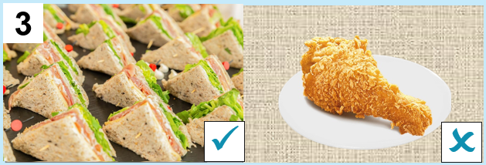
4 Listen and read. Then point and say.
We have a lot of sandwiches but we don’t have much chicken.
Notes:
answer:
a We have a lot of sandwiches but we don’t have much chicken.
b We have a lot of cupcakes but we don’t have much chocolate.
c We have a lot of spaghetti but we don’t have many tomatoes.
d We have a lot of cookies but we don’t have many cakes.

Slide 14
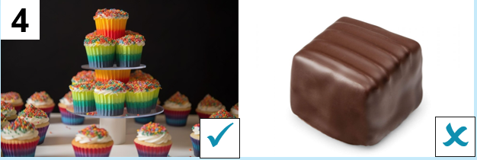
4 Listen and read. Then point and say.
We have a lot of cupcakes but we don’t have much chocolate.
Notes:
answer:
a We have a lot of sandwiches but we don’t have much chicken.
b We have a lot of cupcakes but we don’t have much chocolate.
c We have a lot of spaghetti but we don’t have many tomatoes.
d We have a lot of cookies but we don’t have many cakes.

Slide 15
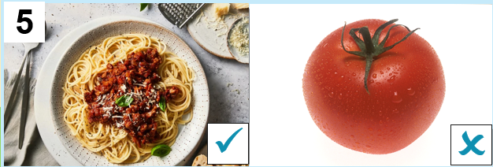
4 Listen and read. Then point and say.
We have a lot of spaghetti but we don’t have many tomatoes.
Notes:
answer:
a We have a lot of sandwiches but we don’t have much chicken.
b We have a lot of cupcakes but we don’t have much chocolate.
c We have a lot of spaghetti but we don’t have many tomatoes.
d We have a lot of cookies but we don’t have many cakes.

Slide 16
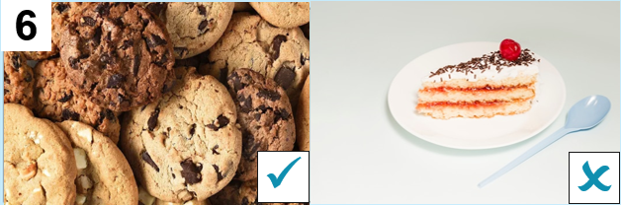
4 Listen and read. Then point and say.
We have a lot of cookies but we don’t have many cakes.
Notes:
answer:
a We have a lot of sandwiches but we don’t have much chicken.
b We have a lot of cupcakes but we don’t have much chocolate.
c We have a lot of spaghetti but we don’t have many tomatoes.
d We have a lot of cookies but we don’t have many cakes.

Slide 17
03
PRACTICE

Slide 18
I am made from milk.
5 Circle and say.
1 A: How much / many bread have we got?
B: We haven’t got much / many. Just some.
2 There isn’t much / many food in my lunchbox.
3 A: How many / much cupcakes has Tom got?
B: Tom hasn’t got many / much. Just three.
4 I haven’t got much / many water in my bottle.
5 There are much / many pineapples in this bag.
I am yellow.
I can be eaten with bread.

Slide 19
04
PRODUCTION
6 Let’s play

Slide 20
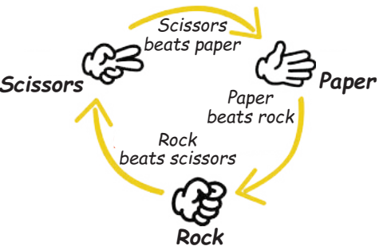



GAME RULES
Make a sentence with much / many
Make a sentence with a lot of
Make a question with How much / How many
Notes:
- Click số để quay về trang đầu.

Slide 21
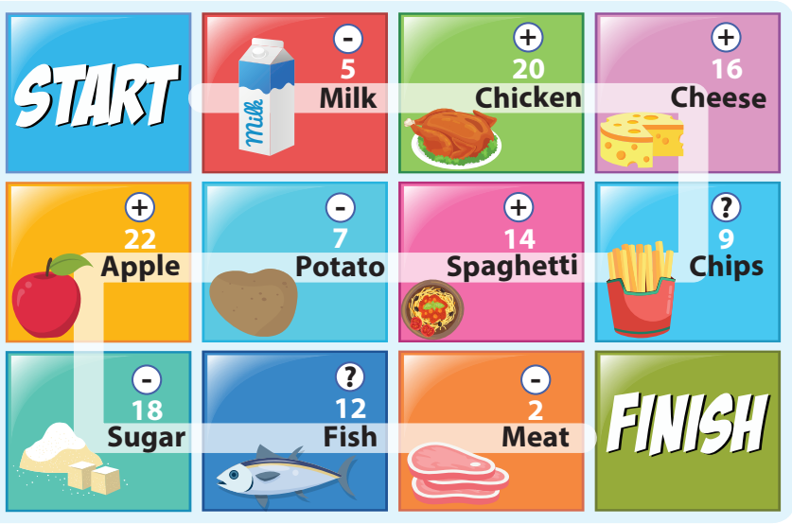
Notes:
- Click số để quay về trang đầu.

Slide 22
05
WRAP-UP & ASSESSMENT

Slide 23
I am made from milk.
Put the words in the correct order to make sentences or questions.
isn’t/ left/ chocolate/ There/ much/.
-----------------------------------------
I am yellow.
I can be eaten with bread.
There isn’t much chocolate left.
2. a lot of/ I’ve/ in/ candies/ my/ got/ bag.
-----------------------------------------
I’ve got a lot of candies in my bag.

Slide 24
I am made from milk.
Put the words in the correct order to make sentences or questions.
3. many/ have/ does/ mangoes/ How/ she/?
-----------------------------------------
I am yellow.
I can be eaten with bread.
How many mangoes does she have?
4. coffee/ is/ in/ a lot of/ There/ his/ sugar.
-----------------------------------------
There is a lot of sugar in his coffee.

Slide 25
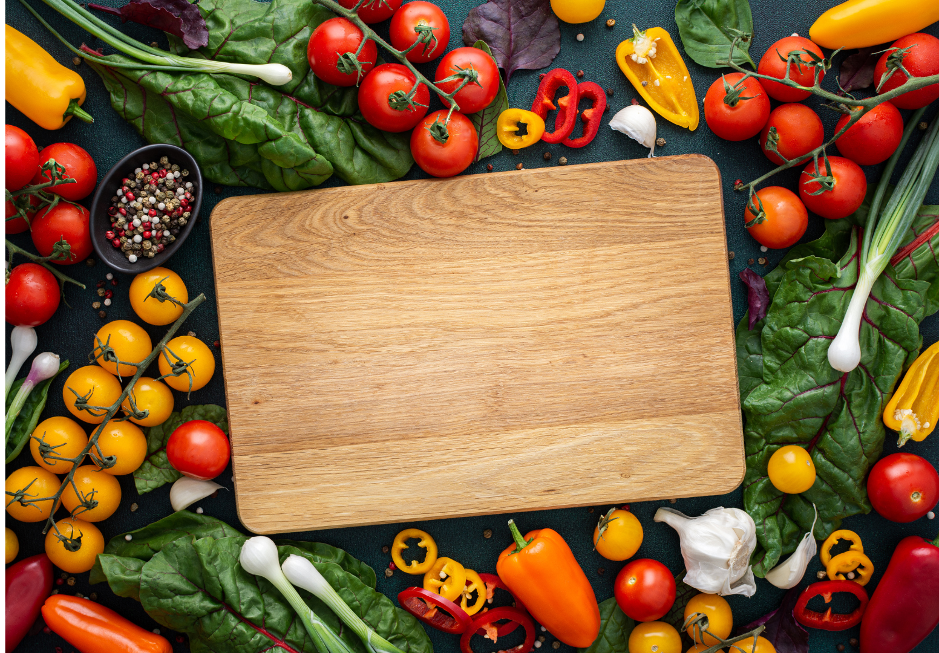
Unit 6: Food Lesson 1 – Part 4,5,6
What have we learnt today?
1. Review vocabulary: bread, butter, chocolate, cupcake, salad, spaghetti.
2. Grammar: a lot of, much, many
- We have a lot of bread, but we don’t have much butter.
- We don’t have many apples here.

Slide 26

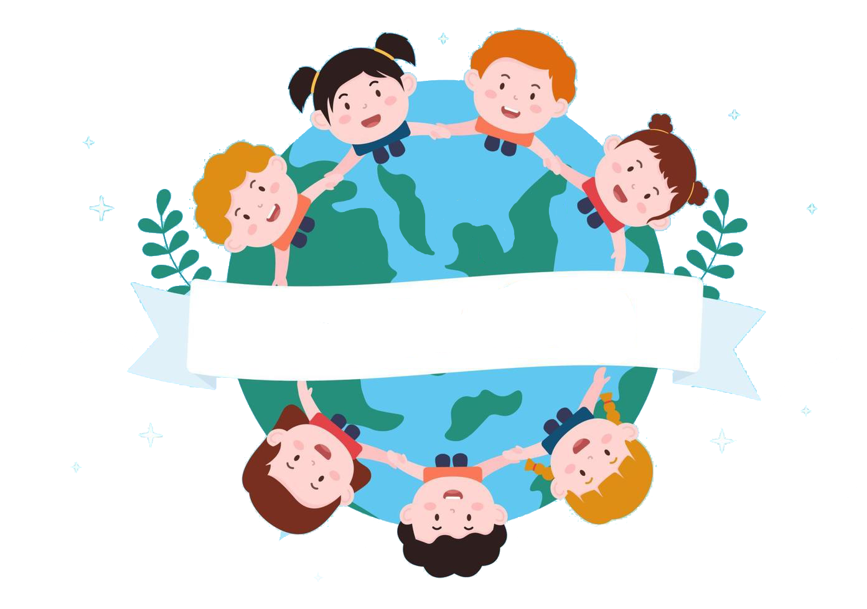
Thank you
& goodbye!

