Slide 1


RACING GAME

Slide 2



Click to Make Yellow Car Move
Click to Make Blue Car Move
Click to Make Orange Car Move

Slide 3
RACING GAME
RACING GAME
1
2
3
4
5
6

Slide 4
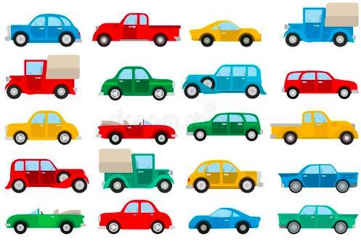
How many cars?
2.
Twenty cars.

Slide 5
4.
+2

Slide 6
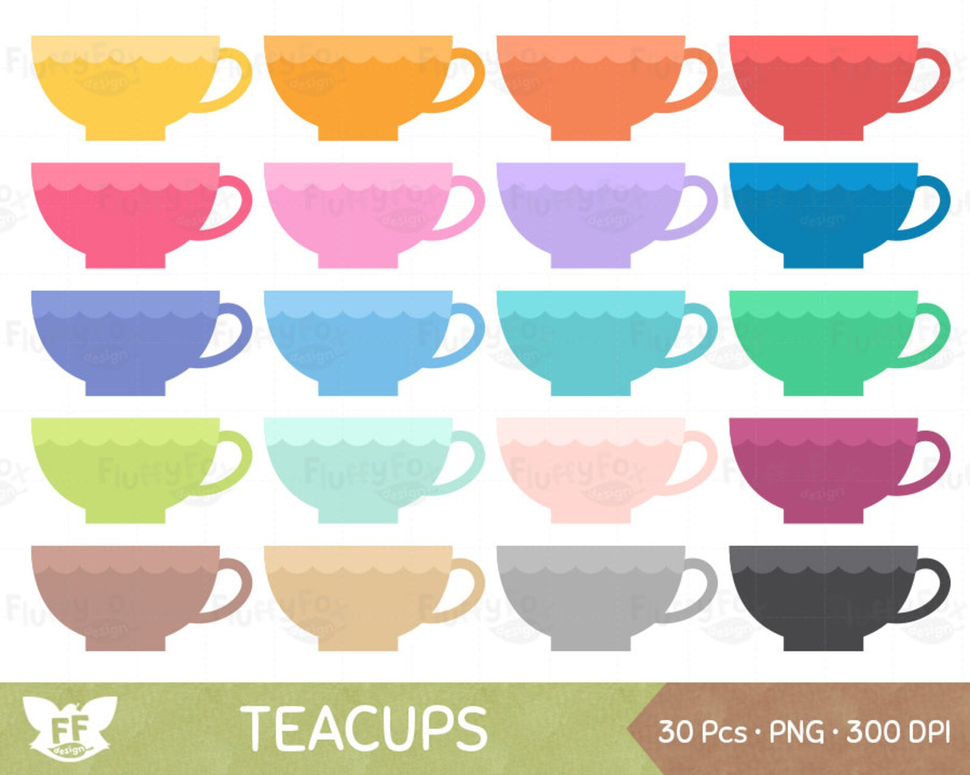
How many cups?
1.
Sixteen cups.

Slide 7

How many pencils ?
3.
Eighteen pencils.

Slide 8
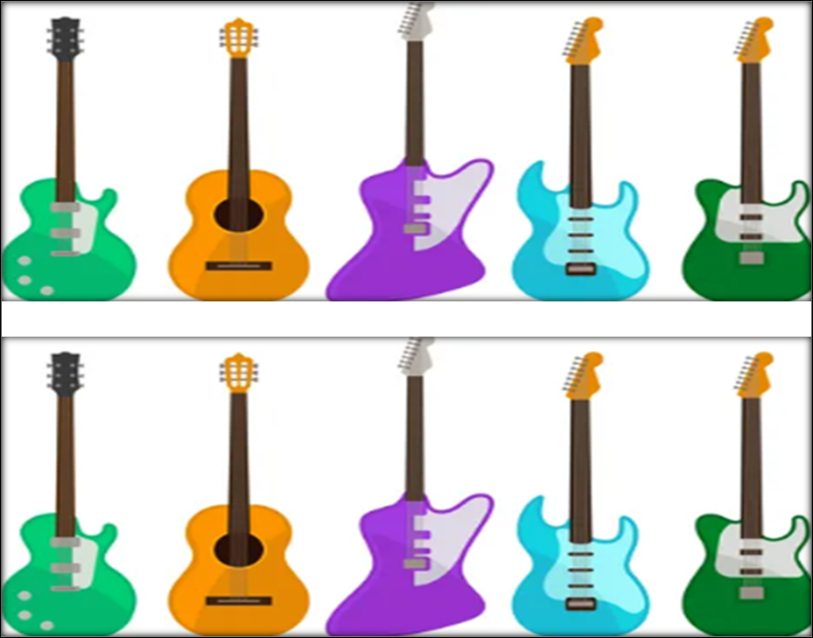
How many guitars ?
5.
Ten guitars.

Slide 9
6.
+1

