Slide 1

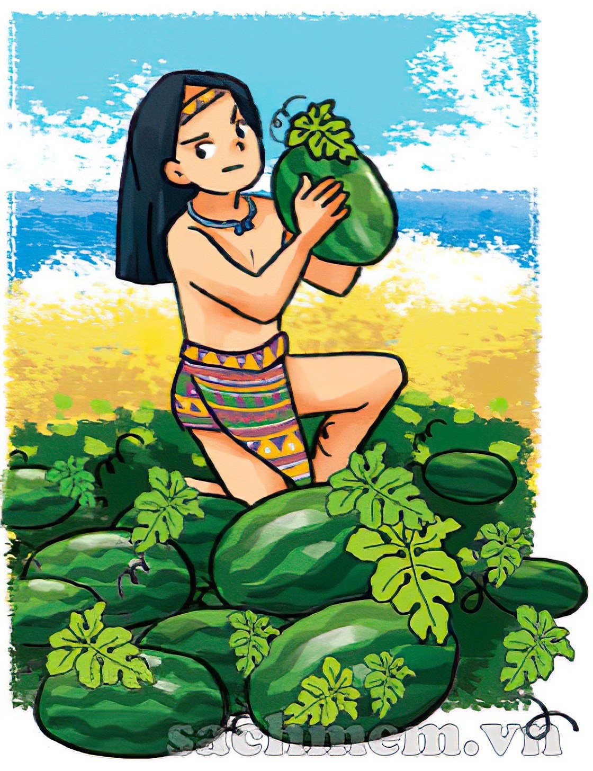
1
2
3
The story of Mai An Tiem
4
5
6
7
8
9
Show answer

Slide 2
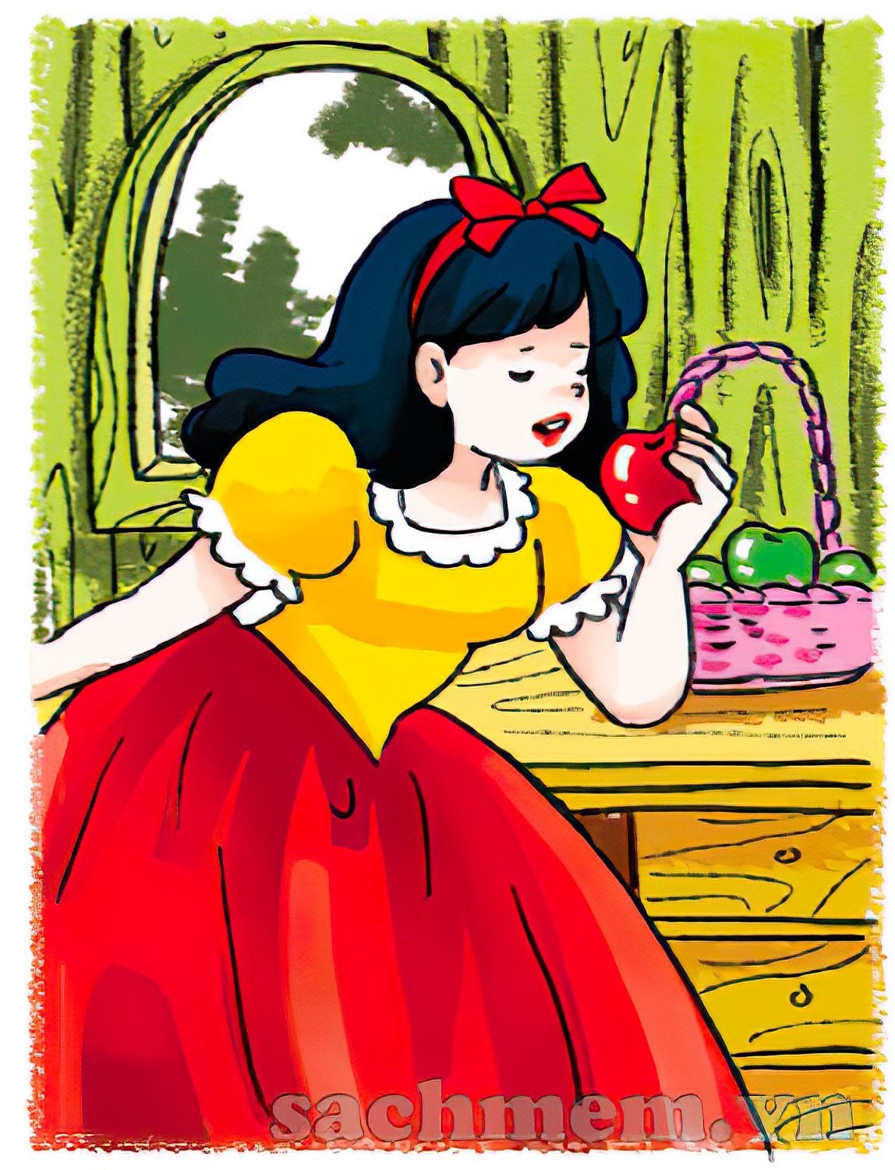
1
2
3
Snow White and the Seven Dwarfs
4
5
6
7
8
9
Show answer

Slide 3
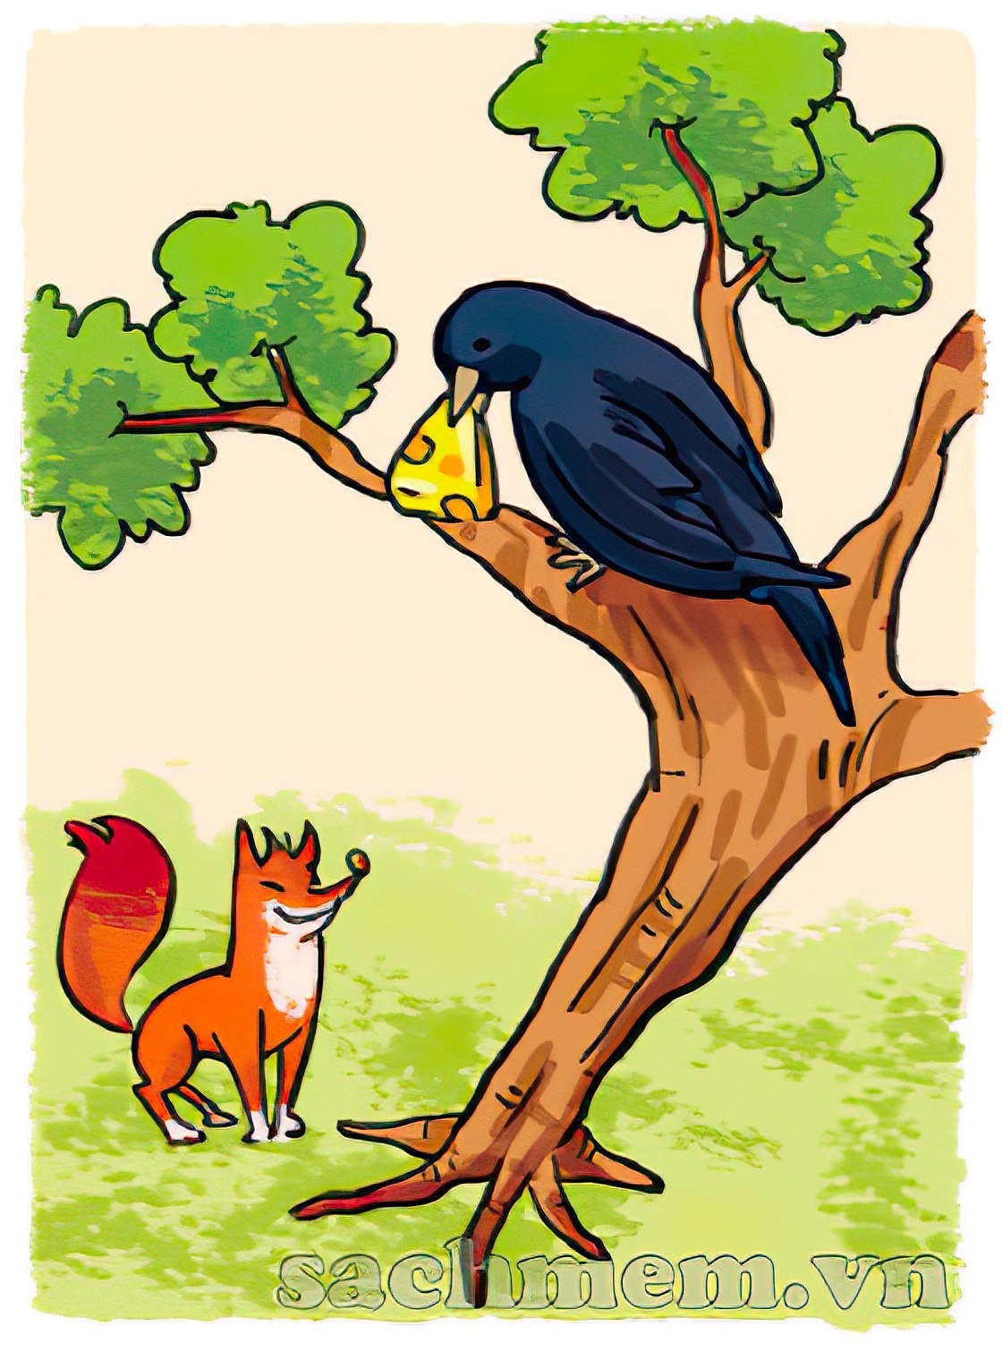
1
2
3
The Fox and the Crow
4
5
6
7
8
9
Show answer

Slide 4
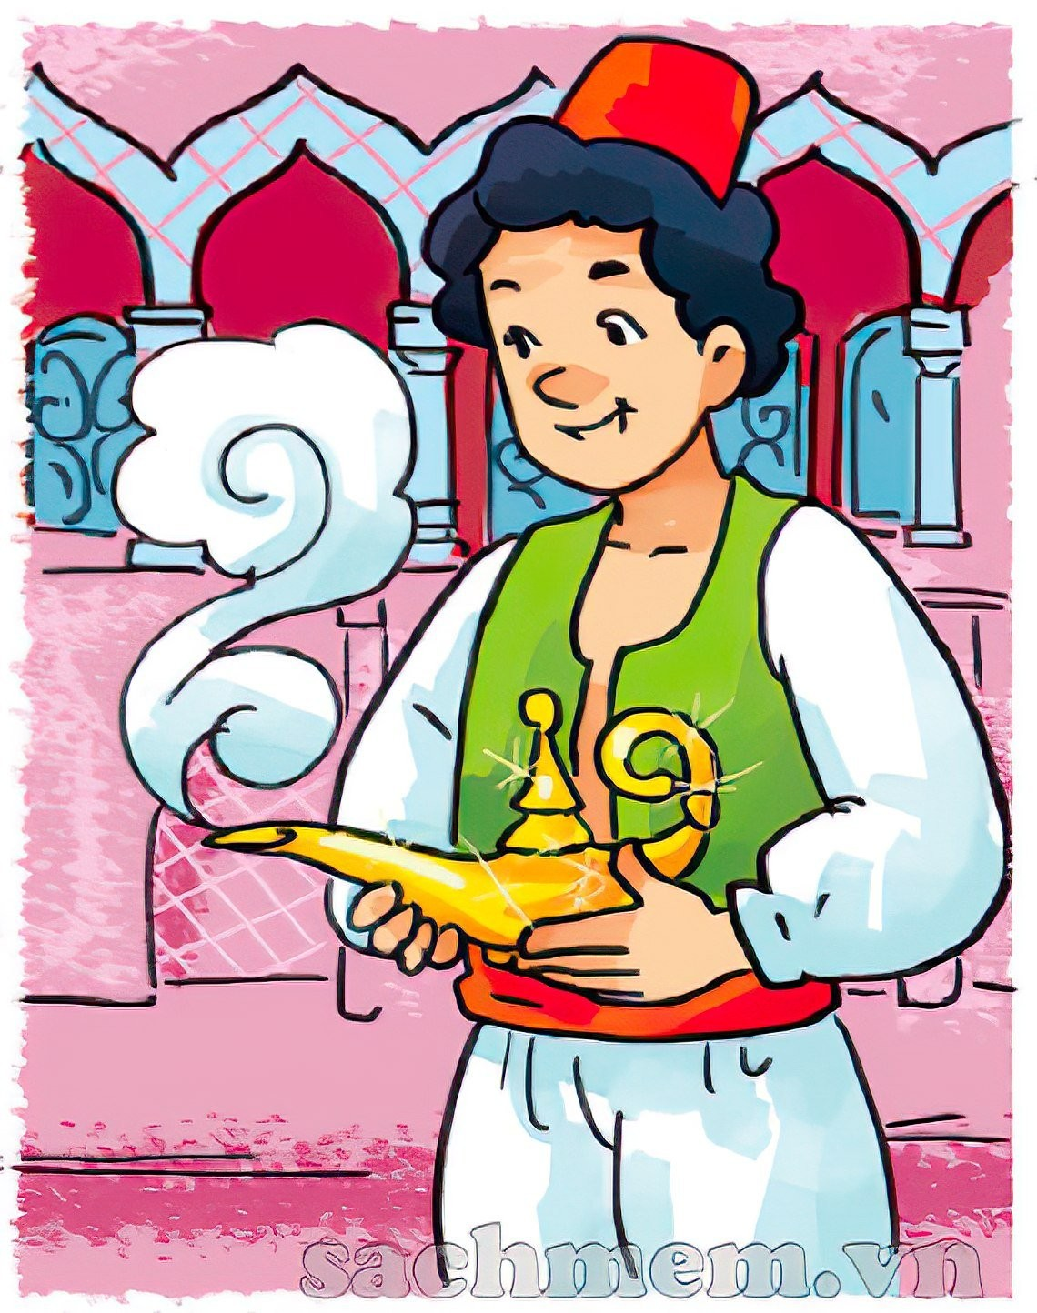
1
2
3
Aladdin and the Magic Lamp
4
5
6
7
8
9
Show answer

