Slide 1


Slide 2



Let’s play

Slide 3
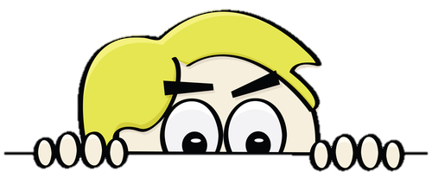

START
What’s behind the wall?
BRICKS DOWN

Slide 4


action
NEXT
CHECK

Slide 5
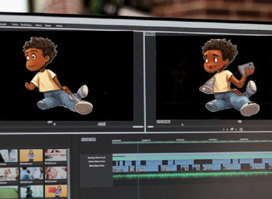
animated
NEXT
CHECK

Slide 6
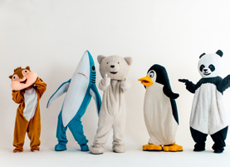
character
NEXT
CHECK

Slide 7

company
NEXT
CHECK

Slide 8

director
NEXT
CHECK

