Slide 1



Who wants to be a Millionaire Template Tutorial
Thank you for downloading our template! Please read this short tutorial as a guide to show you how to get the best quizzing experience!
Version A – Play with SlideLizard
RECOMMENDED
Playing with SlideLizard has many benefits – you can add live quizzes and let your participants vote via smartphone and see the results! You can download SlideLizard for free here: https://slidelizard.com/download
Once you downloaded it, you need to connect this presentation with SlideLizard. If you need help, please watch our tutorial video: https://www.youtube.com/watch?v=yid-YsoIOe8
On the next slide, you‘ll learn how to create questions that will be shown directly in the right boxes on the slides.

Slide 2
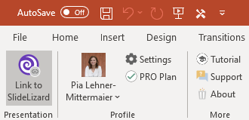
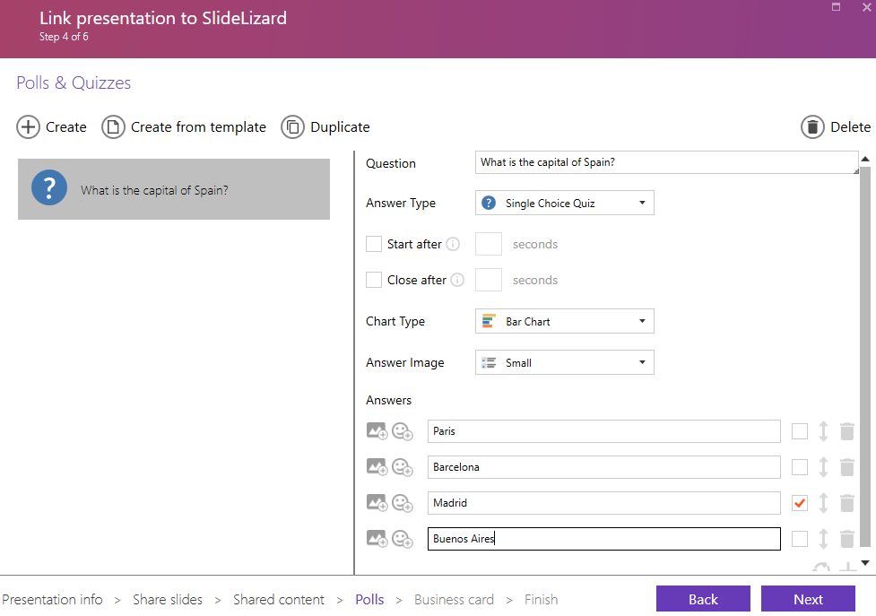

1. Click Link to SlideLizard
2. Under Polls and Quizzes, you can create quiz questions. Create as many questions as there are in the template (that is 14)
Your created questions will appear here
Always use „Single Choice Quiz“
Type in exactly 4 answers and tick the correct one

Slide 3
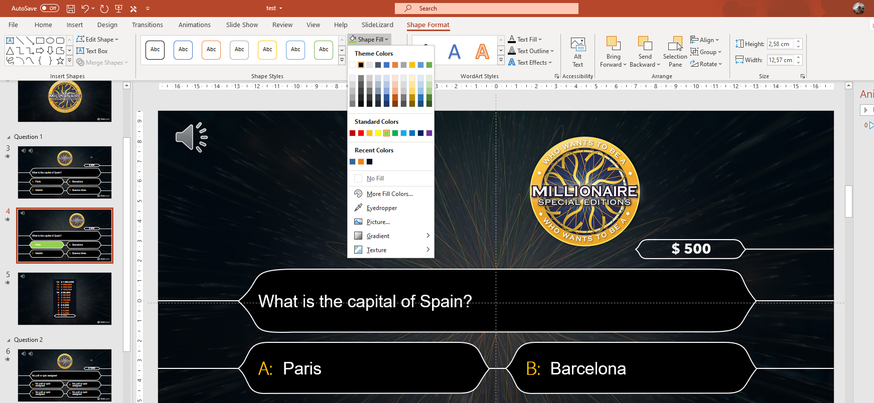
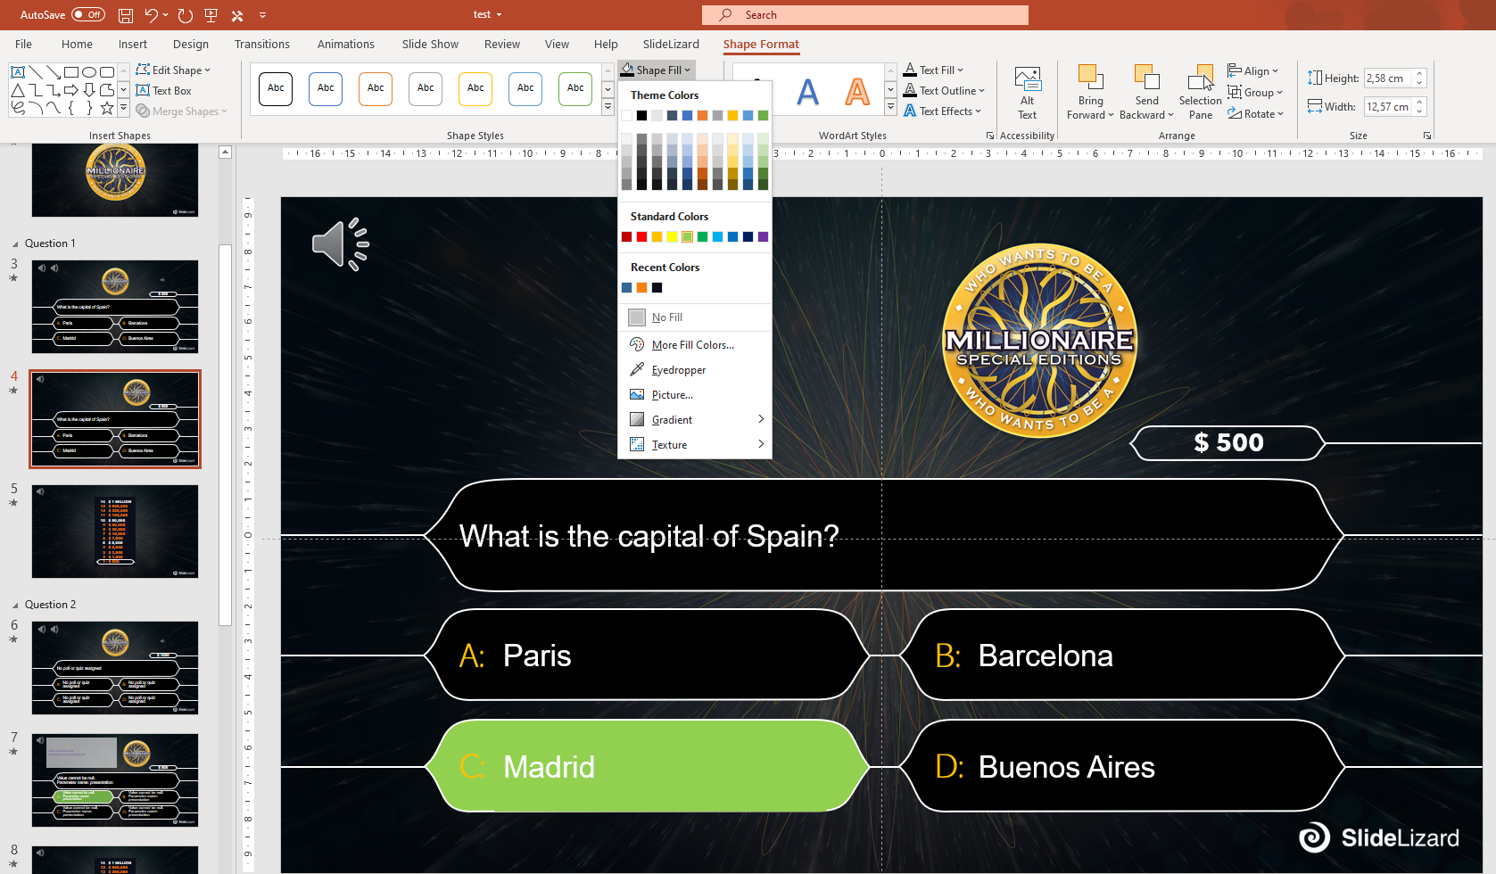
3. Mark the correct answer
3.1 Go to an answer slide. Click on the box with the answer that is preset as green. Go to Shape Format and under Shape Fill, select the black color.
3.2 Click on the box that contains the right answer. Under Shape Fill, select the light green color
Previously green box, now filled black

Slide 4
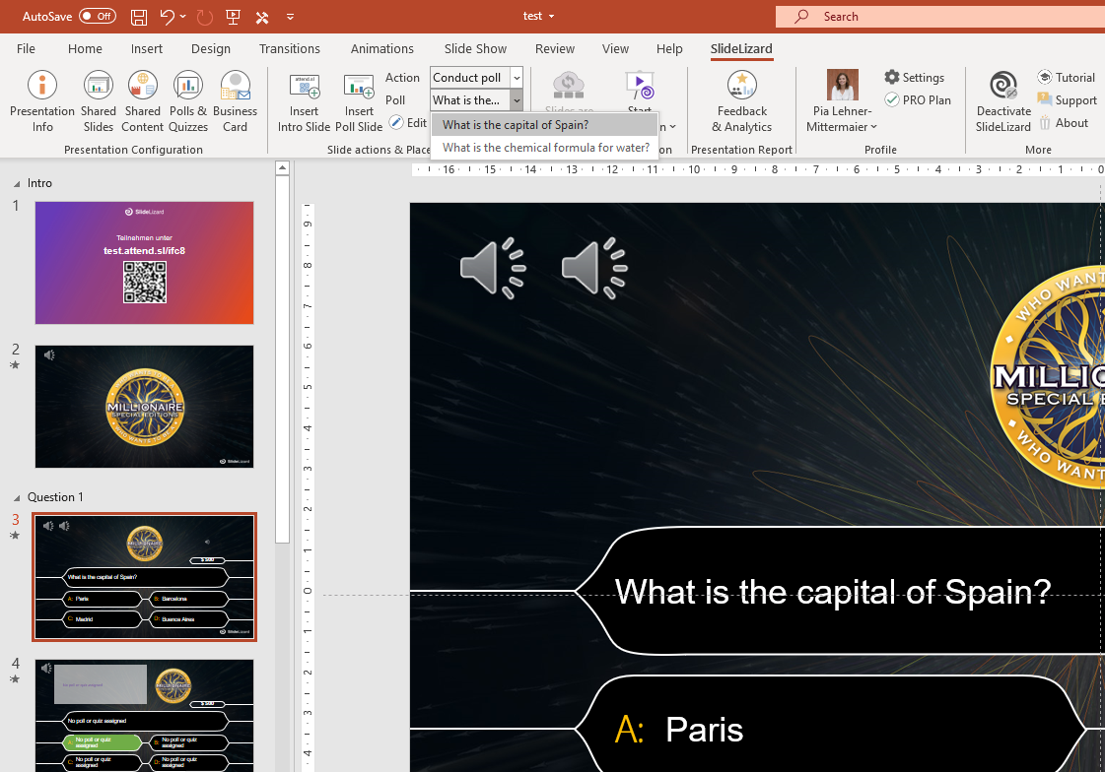
4. Go to the slide where you want to add your question, set Action: Conduct poll; Poll: pick one of the questions you previously created here
5. On the next slide (answer slide!), set Action: Show poll results; Poll: pick the question from the previous slide
6. Now it‘s time to play! If you need help on how to conduct the presentation, please watch: https://www.youtube.com/watch?v=xJNWM34J-YA
4. This is where all your created polls appear. Choose the one you want, click on it and your question + answers will be added automatically!

Slide 5
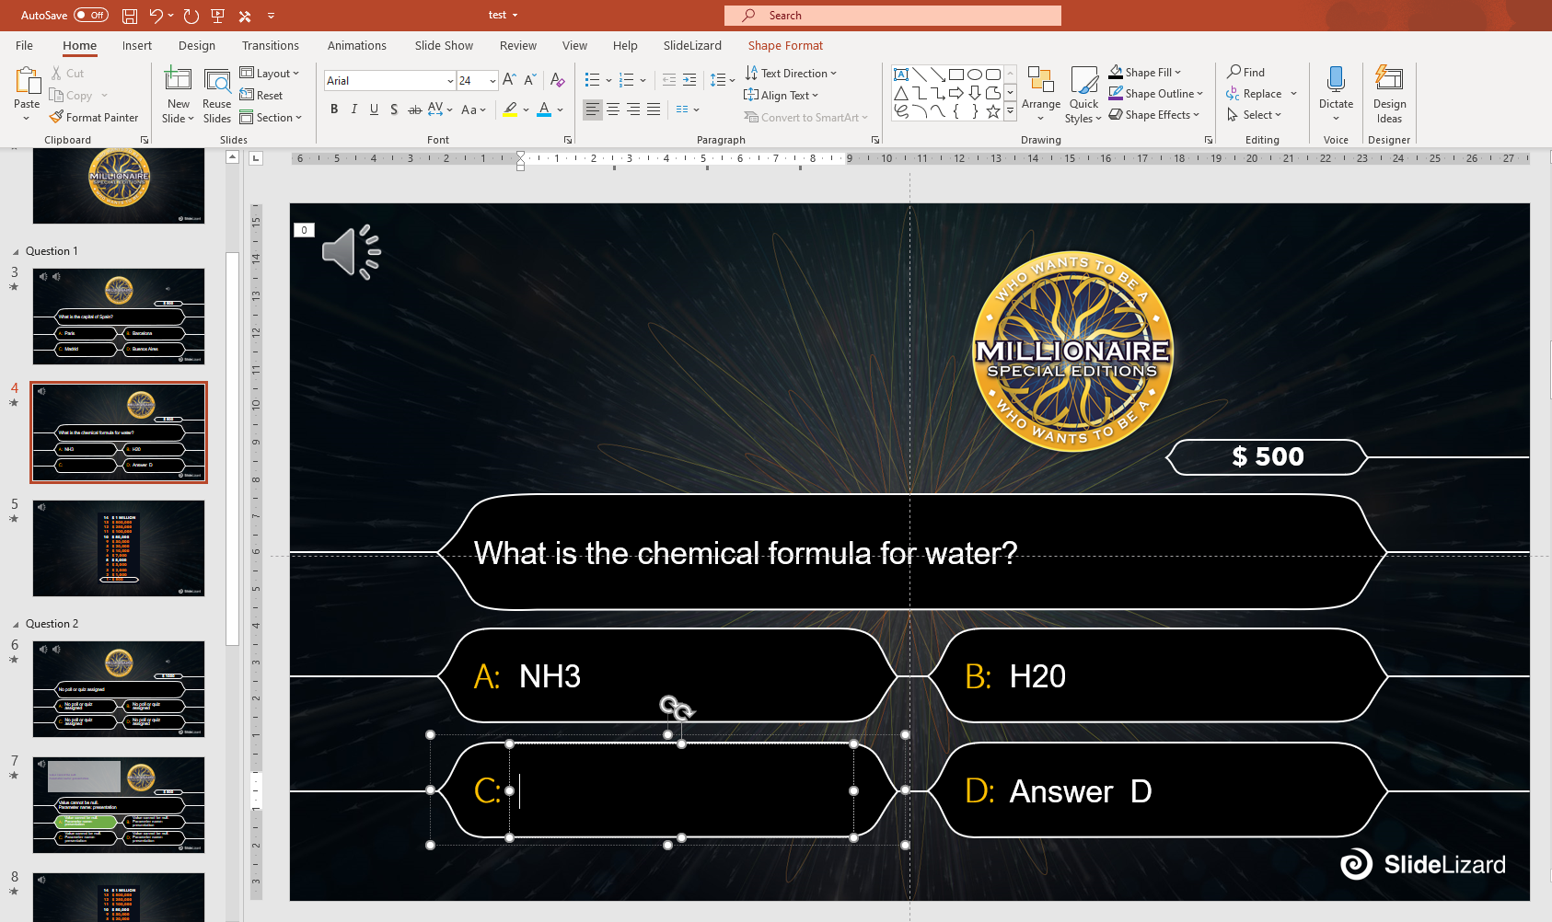
Version B – Play without SlideLizard
You can do the quiz without SlideLizard as well. To do so, click on the predefined Slides and change the Text in the question and answer boxes manually.
To learn how to mark the correct answer, go to slide 3 (Point 3) of Version A.

Slide 6
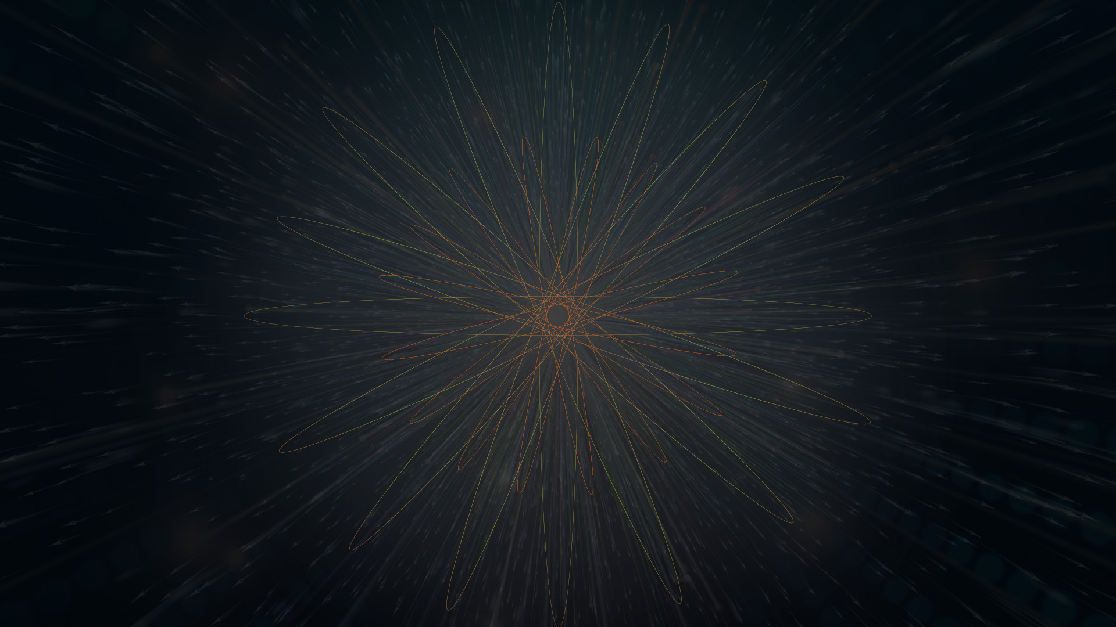



Slide 7
$ 500
Question 1
Answer A
Answer B
A:
B:
Answer C
Answer D
C:
D:

Slide 8
Audience results are shown here if you use SlideLizard
$ 500
Question 1
Answer A
Answer B
A:
B:
Answer C
Answer D
C:
D:

Slide 9
14
13
12
11
10
9
8
7
6
5
4
3
2
1
$ 1 MILLION
$ 500,000
$ 250,000
$ 100,000
$ 50,000
$ 30,000
$ 20,000
$ 10,000
$ 7,000
$ 5,000
$ 3,000
$ 2,000
$ 1,000
$ 500

Slide 10
$ 1000
Question 2
Answer A
Answer B
A:
B:
Answer C
Answer D
C:
D:

Slide 11
Audience results are shown here if you use SlideLizard
$ 1000
Question 2
Answer A
Answer B
A:
B:
Answer C
Answer D
C:
D:

Slide 12
14
13
12
11
10
9
8
7
6
5
4
3
2
1
$ 1 MILLION
$ 500,000
$ 250,000
$ 100,000
$ 50,000
$ 30,000
$ 20,000
$ 10,000
$ 7,000
$ 5,000
$ 3,000
$ 2,000
$ 1,000
$ 500

Slide 13
$ 2000
Question 3
Answer A
Answer B
A:
B:
Answer C
Answer D
C:
D:

Slide 14
Audience results are shown here if you use SlideLizard
$ 2000
Question 3
Answer A
Answer B
A:
B:
Answer C
Answer D
C:
D:

Slide 15
14
13
12
11
10
9
8
7
6
5
4
3
2
1
$ 1 MILLION
$ 500,000
$ 250,000
$ 100,000
$ 50,000
$ 30,000
$ 20,000
$ 10,000
$ 7,000
$ 5,000
$ 3,000
$ 2,000
$ 1,000
$ 500

Slide 16
$ 3000
Question 4
Answer A
Answer B
A:
B:
Answer C
Answer D
C:
D:

Slide 17
Audience results are shown here if you use SlideLizard
$ 3000
Question 4
Answer A
Answer B
A:
B:
Answer C
Answer D
C:
D:

Slide 18
14
13
12
11
10
9
8
7
6
5
4
3
2
1
$ 1 MILLION
$ 500,000
$ 250,000
$ 100,000
$ 50,000
$ 30,000
$ 20,000
$ 10,000
$ 7,000
$ 5,000
$ 3,000
$ 2,000
$ 1,000
$ 500

Slide 19
$ 5000
Question 5
Answer A
Answer B
A:
B:
Answer C
Answer D
C:
D:

Slide 20
Audience results are shown here if you use SlideLizard
$ 5000
Question 5
Answer A
Answer B
A:
B:
Answer C
Answer D
C:
D:

Slide 21
14
13
12
11
10
9
8
7
6
5
4
3
2
1
$ 1 MILLION
$ 500,000
$ 250,000
$ 100,000
$ 50,000
$ 30,000
$ 20,000
$ 10,000
$ 7,000
$ 5,000
$ 3,000
$ 2,000
$ 1,000
$ 500

Slide 22
$ 7000
Question 6
Answer A
Answer B
A:
B:
Answer C
Answer D
C:
D:

Slide 23
Audience results are shown here if you use SlideLizard
$ 7000
Question 6
Answer A
Answer B
A:
B:
Answer C
Answer D
C:
D:

Slide 24
14
13
12
11
10
9
8
7
6
5
4
3
2
1
$ 1 MILLION
$ 500,000
$ 250,000
$ 100,000
$ 50,000
$ 30,000
$ 20,000
$ 10,000
$ 7,000
$ 5,000
$ 3,000
$ 2,000
$ 1,000
$ 500

Slide 25
$ 10,000
Question 7
Answer A
Answer B
A:
B:
Answer C
Answer D
C:
D:

Slide 26
Audience results are shown here if you use SlideLizard
$ 10,000
Question 7
Answer A
Answer B
A:
B:
Answer C
Answer D
C:
D:

Slide 27
14
13
12
11
10
9
8
7
6
5
4
3
2
1
$ 1 MILLION
$ 500,000
$ 250,000
$ 100,000
$ 50,000
$ 30,000
$ 20,000
$ 10,000
$ 7,000
$ 5,000
$ 3,000
$ 2,000
$ 1,000
$ 500

Slide 28
$ 20,000
Question 8
Answer A
Answer B
A:
B:
Answer C
Answer D
C:
D:

Slide 29
Audience results are shown here if you use SlideLizard
$ 20,000
Question 8
Answer A
Answer B
A:
B:
Answer C
Answer D
C:
D:

Slide 30
14
13
12
11
10
9
8
7
6
5
4
3
2
1
$ 1 MILLION
$ 500,000
$ 250,000
$ 100,000
$ 50,000
$ 30,000
$ 20,000
$ 10,000
$ 7,000
$ 5,000
$ 3,000
$ 2,000
$ 1,000
$ 500

Slide 31
$ 30,000
Question 9
Answer A
Answer B
A:
B:
Answer C
Answer D
C:
D:

Slide 32
Audience results are shown here if you use SlideLizard
$ 30,000
Question 9
Answer A
Answer B
A:
B:
Answer C
Answer D
C:
D:

Slide 33
14
13
12
11
10
9
8
7
6
5
4
3
2
1
$ 1 MILLION
$ 500,000
$ 250,000
$ 100,000
$ 50,000
$ 30,000
$ 20,000
$ 10,000
$ 7,000
$ 5,000
$ 3,000
$ 2,000
$ 1,000
$ 500

Slide 34
$ 50,000
Question 10
Answer A
Answer B
A:
B:
Answer C
Answer D
C:
D:

Slide 35
Audience results are shown here if you use SlideLizard
$ 50,000
Question 10
Answer A
Answer B
A:
B:
Answer C
Answer D
C:
D:

Slide 36
14
13
12
11
10
9
8
7
6
5
4
3
2
1
$ 1 MILLION
$ 500,000
$ 250,000
$ 100,000
$ 50,000
$ 30,000
$ 20,000
$ 10,000
$ 7,000
$ 5,000
$ 3,000
$ 2,000
$ 1,000
$ 500

Slide 37
$ 100,000
Question 11
Answer A
Answer B
A:
B:
Answer C
Answer D
C:
D:

Slide 38
Audience results are shown here if you use SlideLizard
$ 100,000
Question 11
Answer A
Answer B
A:
B:
Answer C
Answer D
C:
D:

Slide 39
14
13
12
11
10
9
8
7
6
5
4
3
2
1
$ 1 MILLION
$ 500,000
$ 250,000
$ 100,000
$ 50,000
$ 30,000
$ 20,000
$ 10,000
$ 7,000
$ 5,000
$ 3,000
$ 2,000
$ 1,000
$ 500

Slide 40
$ 250,000
Question 12
Answer A
Answer B
A:
B:
Answer C
Answer D
C:
D:

Slide 41
Audience results are shown here if you use SlideLizard
$ 250,000
Question 12
Answer A
Answer B
A:
B:
Answer C
Answer D
C:
D:

Slide 42
14
13
12
11
10
9
8
7
6
5
4
3
2
1
$ 1 MILLION
$ 500,000
$ 250,000
$ 100,000
$ 50,000
$ 30,000
$ 20,000
$ 10,000
$ 7,000
$ 5,000
$ 3,000
$ 2,000
$ 1,000
$ 500

Slide 43
$ 500,000
Question 13
Answer A
Answer B
A:
B:
Answer C
Answer D
C:
D:

Slide 44
Audience results are shown here if you use SlideLizard
$ 500,000
Question 13
Answer A
Answer B
A:
B:
Answer C
Answer D
C:
D:

Slide 45
14
13
12
11
10
9
8
7
6
5
4
3
2
1
$ 1 MILLION
$ 500,000
$ 250,000
$ 100,000
$ 50,000
$ 30,000
$ 20,000
$ 10,000
$ 7,000
$ 5,000
$ 3,000
$ 2,000
$ 1,000
$ 500

Slide 46
$ 1 MILLION
Question 14
Answer A
Answer B
A:
B:
Answer C
Answer D
C:
D:

Slide 47
Audience results are shown here if you use SlideLizard
$ 1 MILLION
Question 14
Answer A
Answer B
A:
B:
Answer C
Answer D
C:
D:

Slide 48
14
13
12
11
10
9
8
7
6
5
4
3
2
1
$ 1 MILLION
$ 500,000
$ 250,000
$ 100,000
$ 50,000
$ 30,000
$ 20,000
$ 10,000
$ 7,000
$ 5,000
$ 3,000
$ 2,000
$ 1,000
$ 500

Slide 49
Who wants to be a Millionaire– Links for Sound Download
https://millionaire.fandom.com/wiki/Music_scores
Main Theme: https://www.soundboard.com/sb/sound/904527
Wrong answer: https://www.soundboard.com/sb/sound/904547
Right answer: https://www.soundboard.com/sb/sound/904544
Call a friend: https://www.soundboard.com/sb/sound/904546
1.000.000 music: https://www.soundboard.com/sb/sound/904542
500.000 music: https://www.soundboard.com/sb/sound/904541
125.000 music: https://www.soundboard.com/sb/sound/904540
64.000 music: https://www.soundboard.com/sb/sound/904539
2.000 – 30.000 music: https://www.soundboard.com/sb/sound/904538
50 – 1000 music: https://www.soundboard.com/sb/sound/904537
Start sound: https://www.soundboard.com/sb/sound/904536

Slide 50


Additional Game Elements, Lifelines
15
14
13
12
11
10
9
8
7
6
5
4
3
2
1
$ 1 MILLION
$ 500.000
$ 125.000
$ 64.000
$ 32.000
$ 16.000
$ 8.000
$ 4.000
$ 2.000
$ 1.000
$ 500
$ 300
$ 200
$ 100
$ 50
Phone a Friend
Ask the Audience
50/50
50/50

Slide 51
Who wants to be a millinaire – Read our blogpost:
https://slidelizard.com/blog/who-wants-to-be-a-millionaire-powerpoint-template

Slide 52

Download now for free at
https://slidelizard.com

