Slide 1



13
My house
LESSON 3 - PERIOD 6

Slide 2
1
Warm-up and review

Slide 3







TEAM 1
TEAM 2
TEAM 3
Notes:
- Divide the class into 3 teams.
- Each team takes turn choosing a number.

Slide 4




= 10 points
= - 20 points
= 50 points

Slide 5
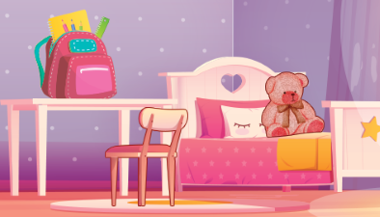
Where is the teddy bear?
It’s on the bed.

Slide 6

Where are the chairs?
They’re next to the table.

Slide 7
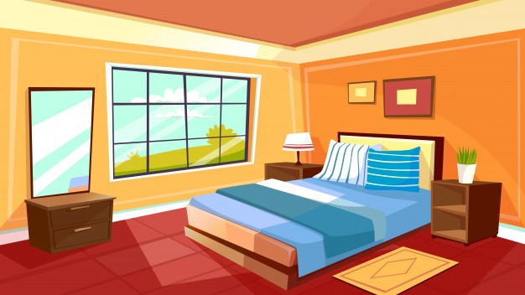
Where is the bed?
It’s in the bedroom.

Slide 8

Where is the bedroom?
It’s here.

Slide 9
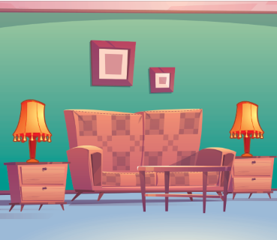
Where is the sofa?
It’s between the lamps.

Slide 10
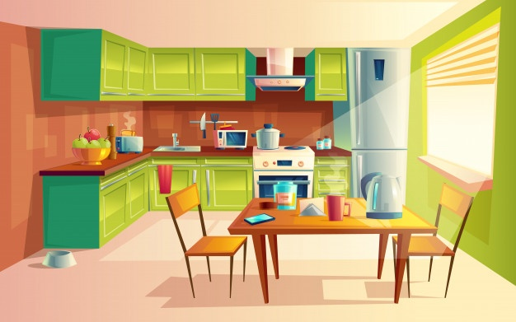
Where is the kitchen?
It’s there.

Slide 11
2
Read and complete.

Slide 12
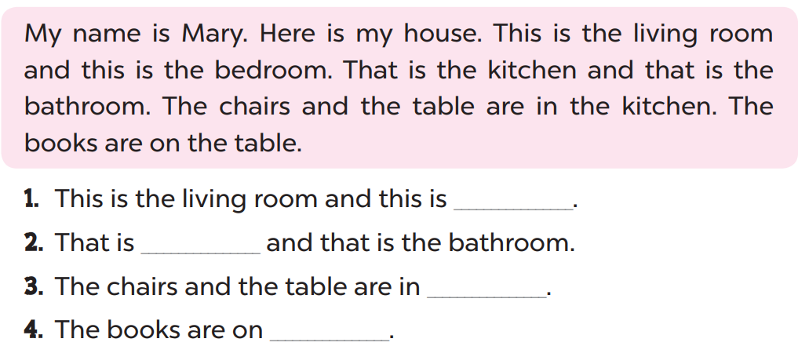
the bedroom
the kitchen
the kitchen
the table

Slide 13
3
Let’s write.

Slide 14
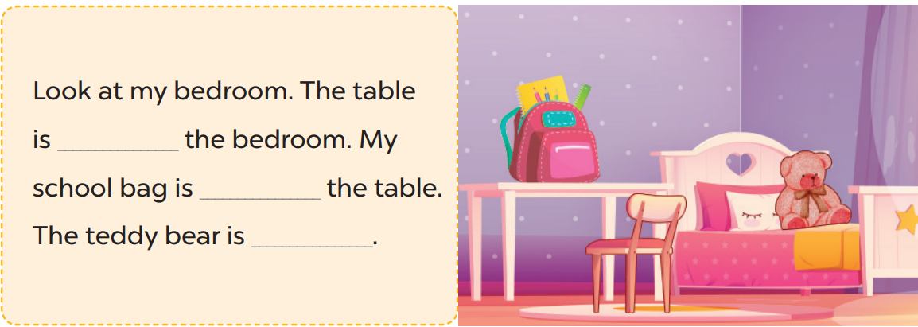
next to
on
on the bed

Slide 15
4
Project

Slide 16
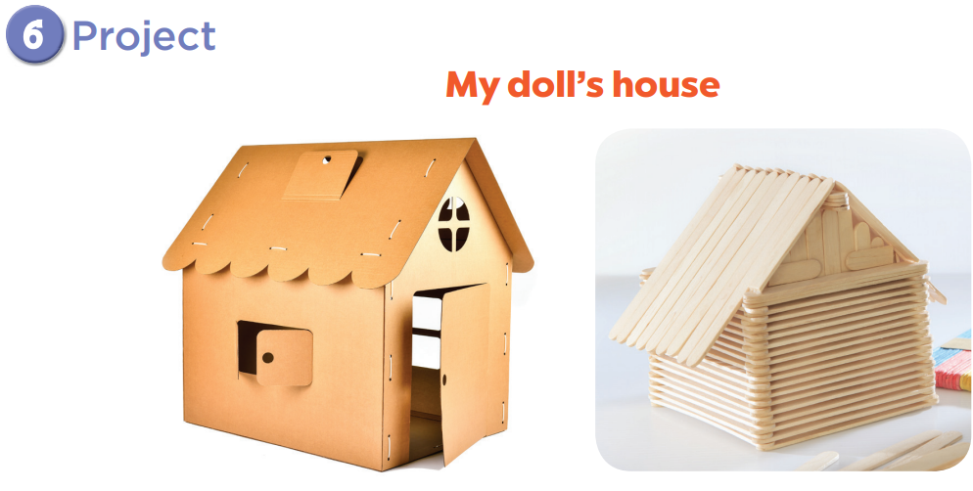

Slide 17

Website: hoclieu.vn
Fanpage: facebook.com/www.tienganhglobalsuccess.vn

