Slide 1




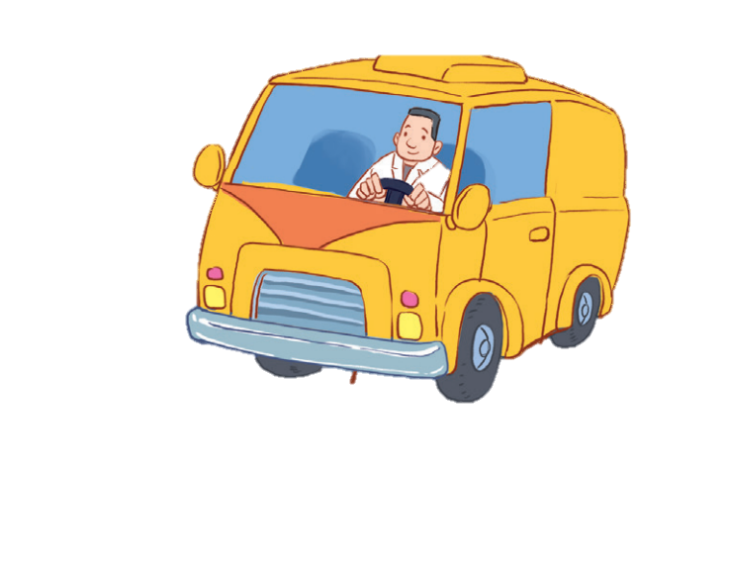


12
LESSON 3 – Period 6

Slide 2
1
Warm-up and review

Slide 3

teacher
What’s her job?
She’s a ____.
Get your present here!

Slide 4

doctor
What’s his job?
He’s a ______.
Get your present here!

Slide 5

worker
What’s his job?
He’s a ______.
Get your present here!

Slide 6
2
Read and complete.

Slide 7
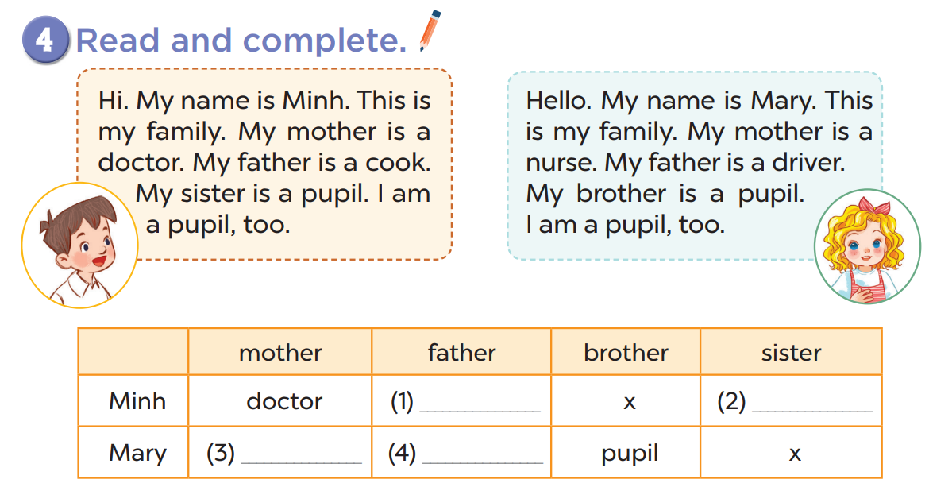
cook
pupil
nurse
driver

Slide 8
3
Let’s write.

Slide 9
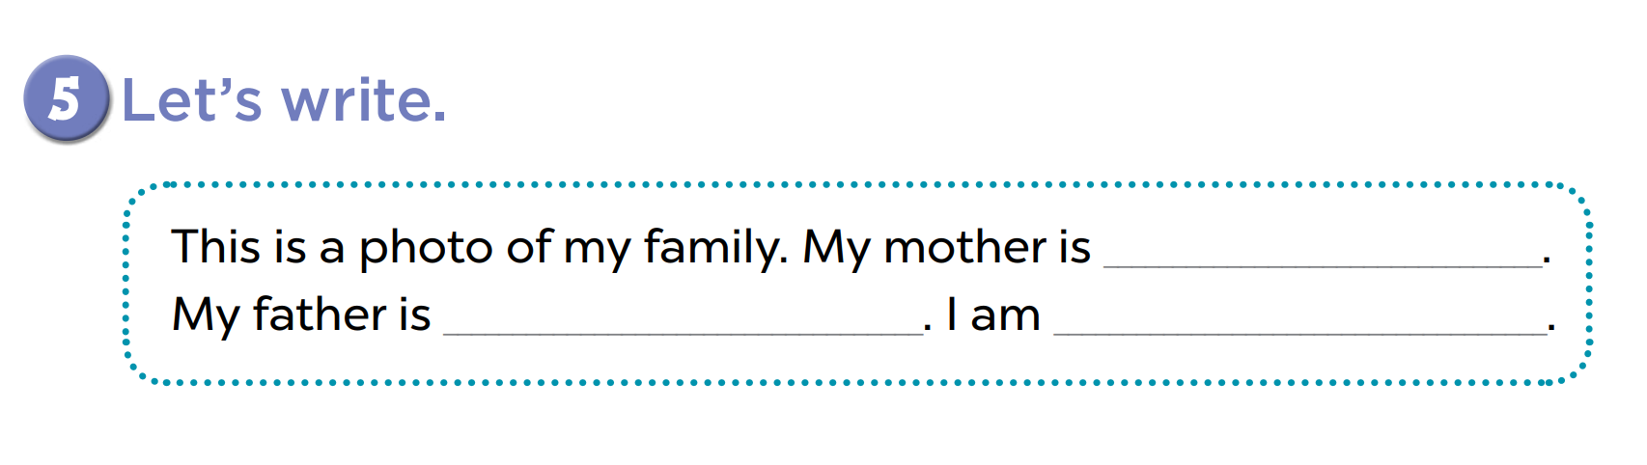

Slide 10
4
Project

Slide 11
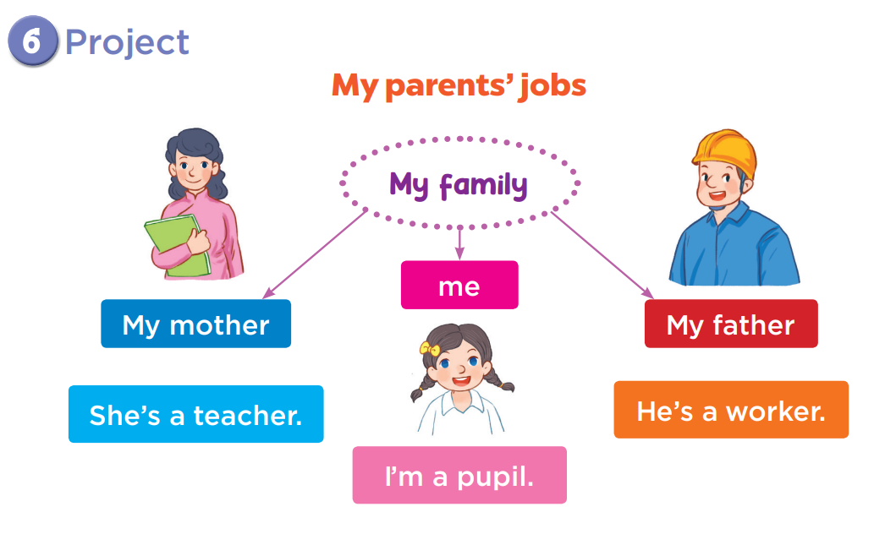

Slide 12
5
Fun corner and wrap-up
Notes:
Game: Guessing game
Step 1: Divide the class into 4 teams.
Step 2: Invite 1 pupil from each team to come to the board and do action about a job.
Step 3: Pupils from other teams will guess what the job is.
Step 4: Give points for the teams.

