Slide 2

FUN TIME 4
Period 2

Slide 3

Table of contents
01
Warm-up and Review
02
Activity 3. Write and say.
03
Activity 4. Let’s play.
04
Fun corner and Wrap-up

Slide 4


01
Warm-up and Review

Slide 5

Matching
GAME

Slide 6








Matching.
banana
noodles
top
teddy bear
turtle
nuts
tiger

Slide 7
Review
banana
noodles
top
teddy bear
turtle
nuts
tiger

Slide 8
02
Activity 3. Write and say.

Slide 9
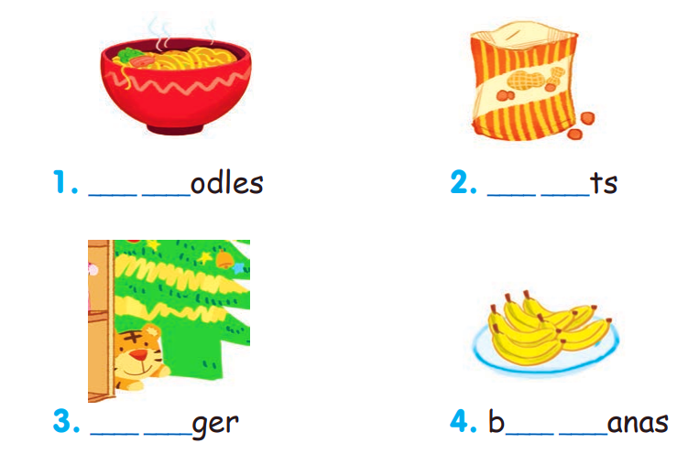
Write and say.

Slide 10

Write and say.
n o

Slide 11
Write and say.
n u

Slide 12
Write and say.
t i

Slide 13
Write and say.
a n

Slide 14
Write and say.
n o
n u
t i
a n

Slide 15
03
Activity 4. Let’s play.

Slide 16

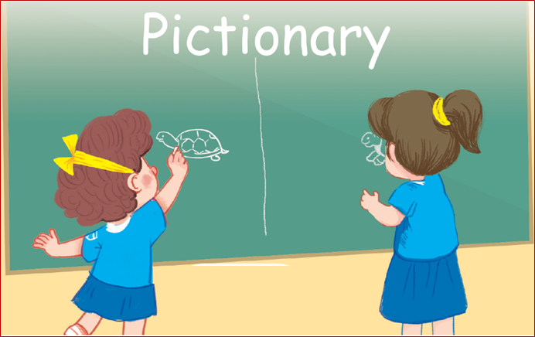
Let’s play.

Slide 17




Pictionary
Point
Team Tiger
Point
Team Teddy
Notes:
GV nháy vào biểu tượng của đội chơi để tính điểm cho các đội. Mỗi lần nháy 1 ngôi sao xuất hiện.

Slide 18
04
Fun corner and wrap-up

Slide 19
GUESSING GAME

Slide 20
Choose the correct answer.
t_ _ tle
a
b
c
trutle
tultle
turtle

Slide 21

Choose the correct answer.
l_ _ons
a
b
c
temons
lemons
lenons

Slide 22

Choose the correct answer.
_ _af
a
b
c
leaf
teaf
elaf

Slide 23

Choose the correct answer.
_ake
a
b
c
nake
take
lake

Slide 24

Choose the correct answer.
m_ _se
a
b
c
mouse
muose
moose

Slide 25

Choose the correct answer.
m_ _ key
a
b
c
mokey
monkey
munkey

Slide 26

Choose the correct answer.
_ a _go
a
b
c
namgo
mango
margo

Slide 27

Very Good!

Slide 28
Website: hoclieu.vn
Fanpage: https://www.facebook.com/tienganhglobalsuccess.vn/

