Slide 2

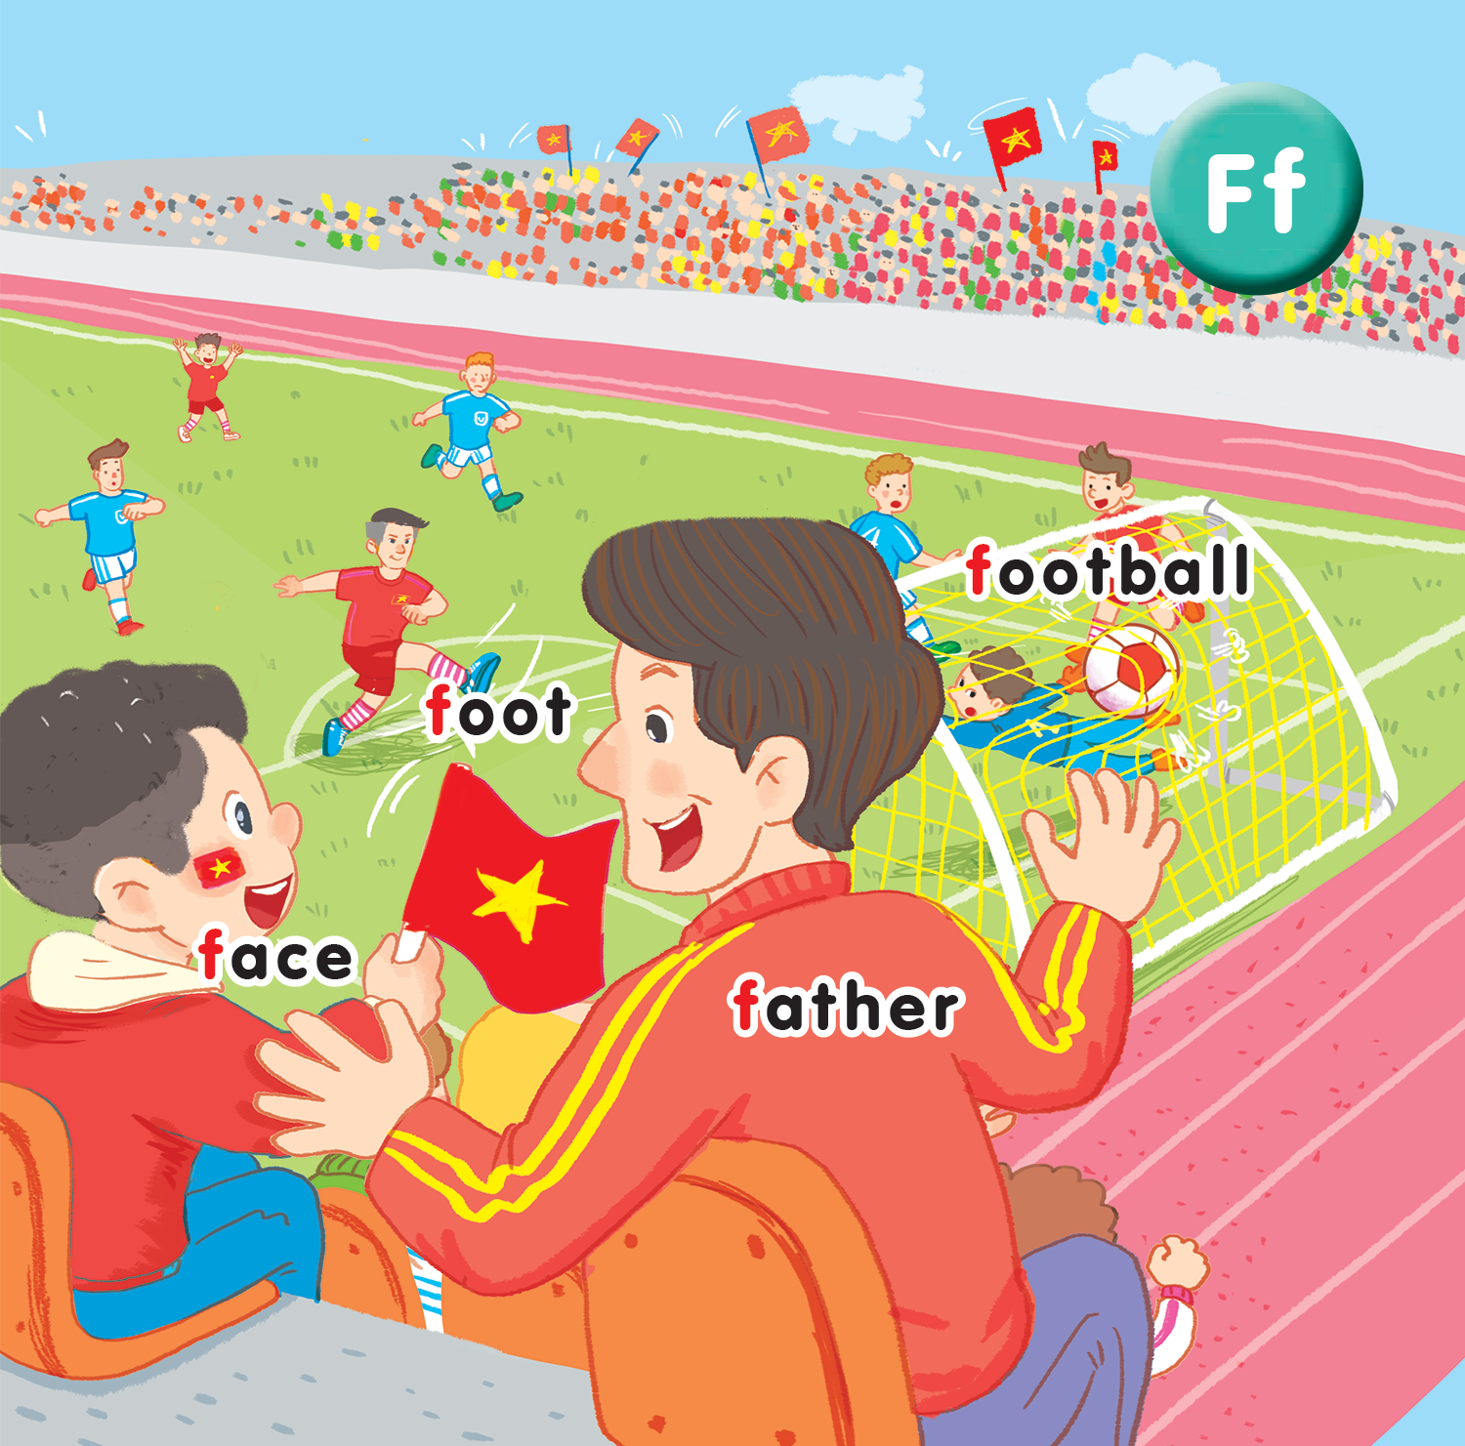
Unit 15
At the football match
Lesson 2
Notes:
By the end of the lesson pupils will be able to:
- say the sound of the letter F/f, the words football, foot, father, face in a chant.
- listen, recognize the words and tick the correct boxes.
- trace the letter F/f and complete the words

Slide 3






A
B
C
D
E
F
G
H
I
J
K
L
M
O
P
Q
R
S
T
U
tekhnologic
Notes:
Warm up
Goal: Warm up the class and review the words of previous lessons
Time: 4 minutes
Pupil from each group take turn to choose a letter
They have to say a word beginning with the letter
If they say correctly, their group will get points in the letter

Slide 4

Listen and chant
Notes:
Step 1
Goal: Pupils will be able to listen, chant and clap along.
Time: 4 minutes
Play the recording
Round 1. Have pupils listen and clap along.
Round 2. Have pupils listen and repeat to the chant.
Repeat each round 2 to 3 several times.
Step 2
Goal: Pupils will be able to chant with TPR.
Time: 3 minutes
Have people practice chanting in groups.
Then group members create their own TPR.
Group present their chant with TPR to get stars for their groups.
Step 3 (optional)
Goal: Pupils will be able to create their own chant.
Time: 3 minutes
If possible, have group of people create their own chant lyrics by replacing some words of the chant.

Slide 5
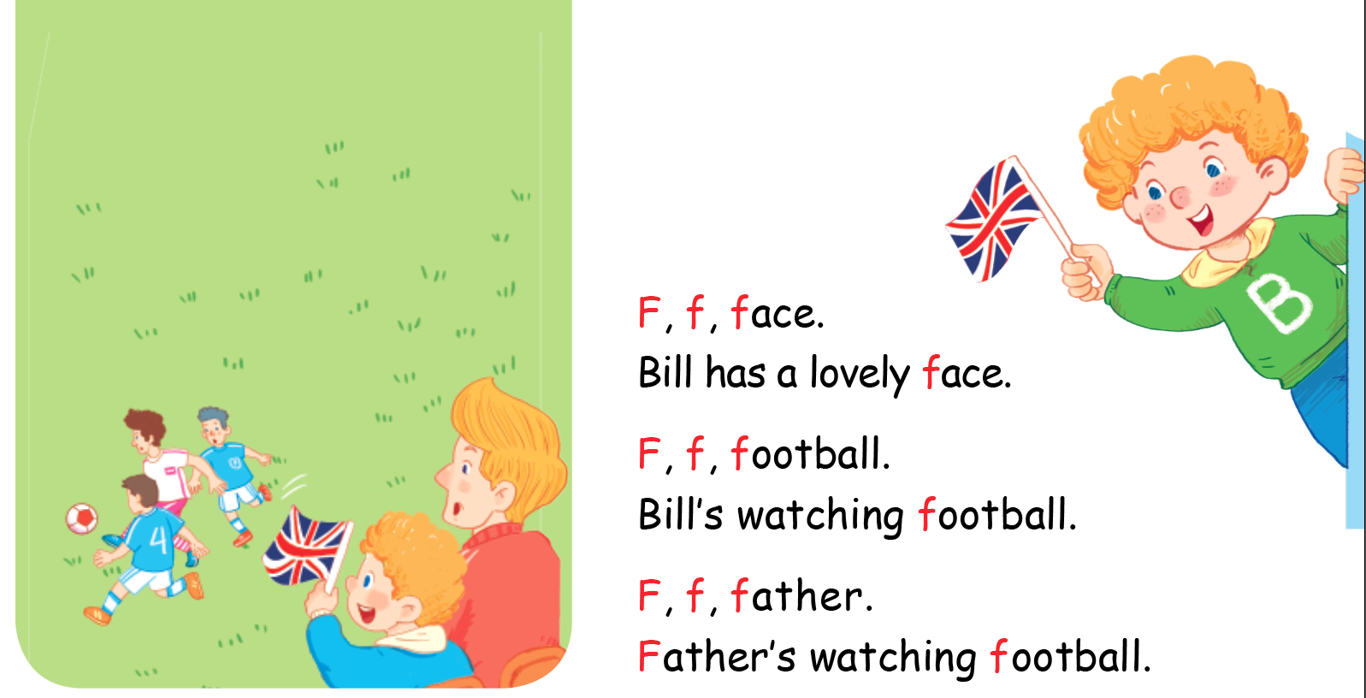

Listen and chant

Slide 6


Listen and tick
Notes:
Listen and tick is divided into 2 steps.
Step 1
Goal: Pupils will be able to listen and choose the correct pictures.
Time: 5 minutes
Say Listen and tick with the TPR actions.
Play the recording and demonstrate the example.
Play the recording and have pupils do the task.
Step 2
Goal: Check
Time: 5 minutes
Play the recording and have pupils say the answer.
Play the recording again and have pupils repeat then give correct answer.

Slide 7
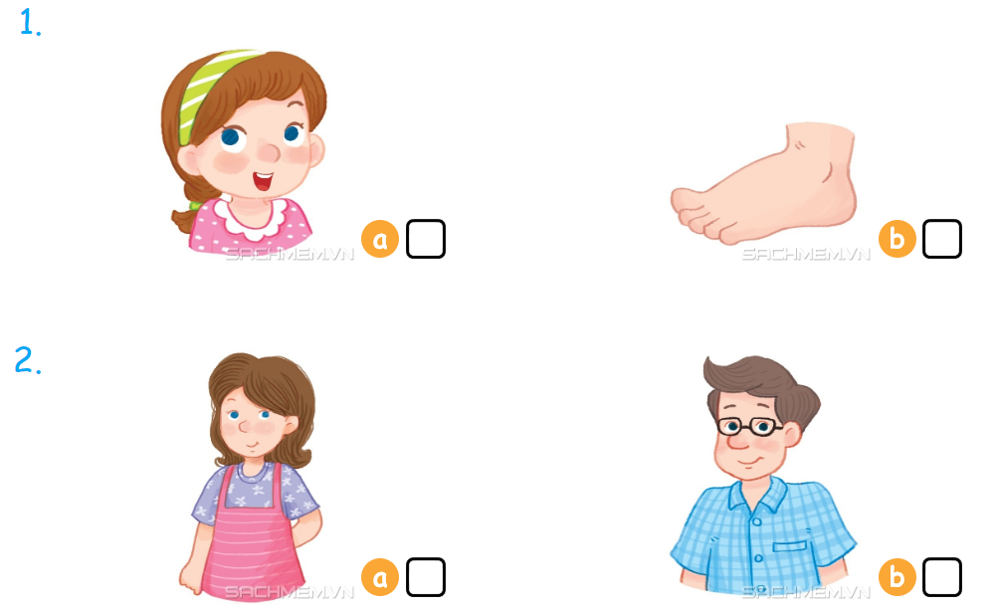

Listen and tick

Slide 8



Look, trace and write
Notes:
Goal: Pupils will be able to trace the letter.
Time: 5 minutes
Have pupils write the word by air tracing and say the word.
Demonstrate how to trace the word and have pupils do the task.

Slide 9
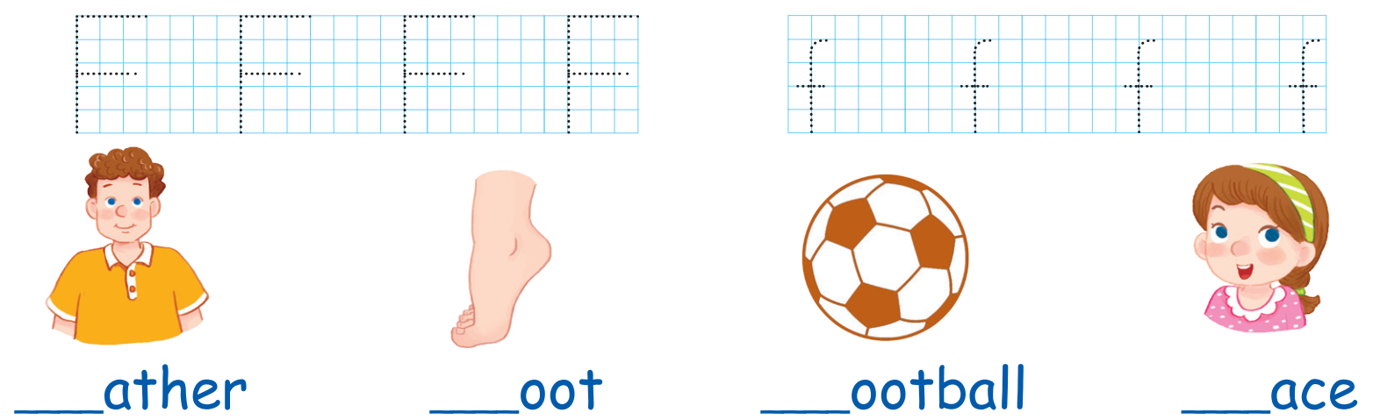

Slide 10
Game
Notes:
Goal: Revise the words learnt
Time: 5 minutes
Game: Score a goal
Have pupils to play the game in groups.
Each group takes turn to choose word to shoot into the net.
Correct shoot will give score to the group.

Slide 11
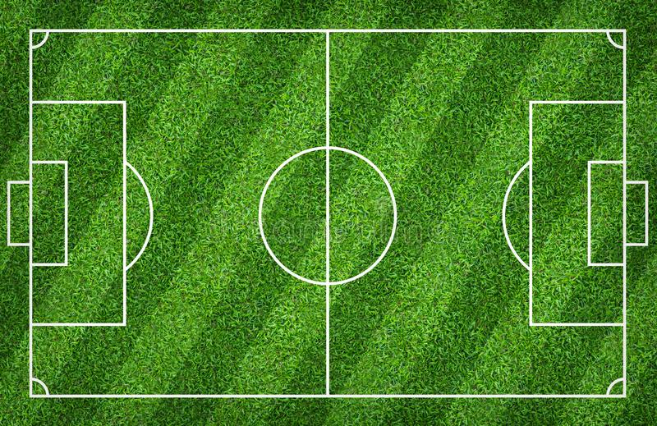

TEAM 1
TEAM 2

Slide 12
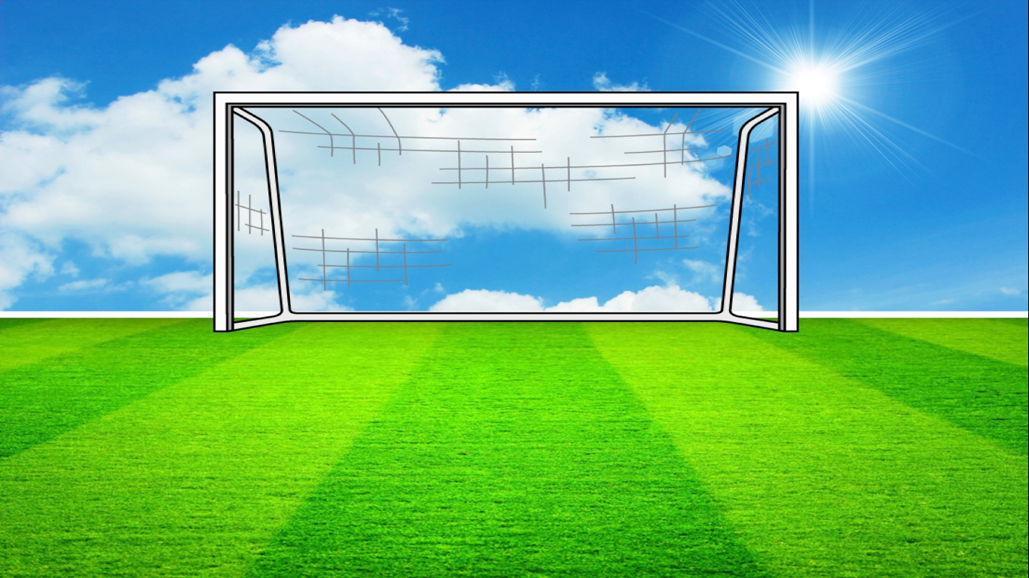
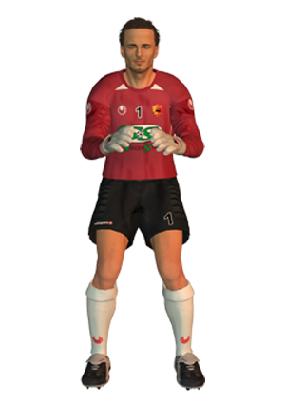




Q1.
frog
GOAL!!
SAVED…
MISSED..

Slide 13

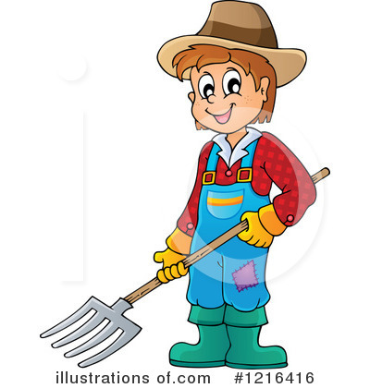

Q2.
Farmer
GOAL!!
SAVED…
MISSED..

Slide 14

Q3.
fish
GOAL!!
SAVED…
MISSED..

Slide 15
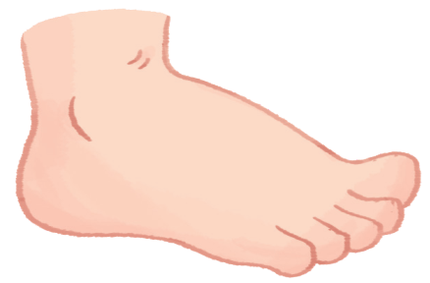
Q4.
face
GOAL!!
SAVED…
MISSED..

Slide 16
Q5.
foot
GOAL!!
SAVED…
MISSED..

Slide 17
Q6.
family
GOAL!!
SAVED…
MISSED..

Slide 18
Q7.
father
GOAL!!
SAVED…
MISSED..

Slide 19
Q8.
fire truck
GOAL!!
SAVED…
MISSED..

Slide 20
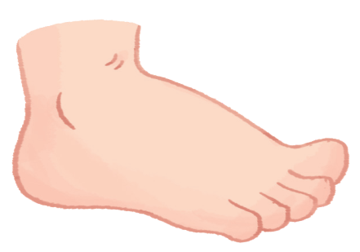
Goodbye
Notes:
Teacher shows the vocabulary of the lesson on slide.
Pupils say goodbye.

Slide 21

Goodbye

Slide 22

Goodbye

Slide 23
Goodbye

Slide 24
Website: hoclieu.vn
Fanpage: facebook.com/www.tienganhglobalsuccess.vn

