Slide 1





Hai Thanh Primary school
Welcome to our class !
Teacher: Mai Hong Phuong

Slide 2


Daily Activities
14
Lesson 1 – Period 2

Slide 3
01
Warm-up
Guessing Game

Slide 4
Make a guess

Slide 5
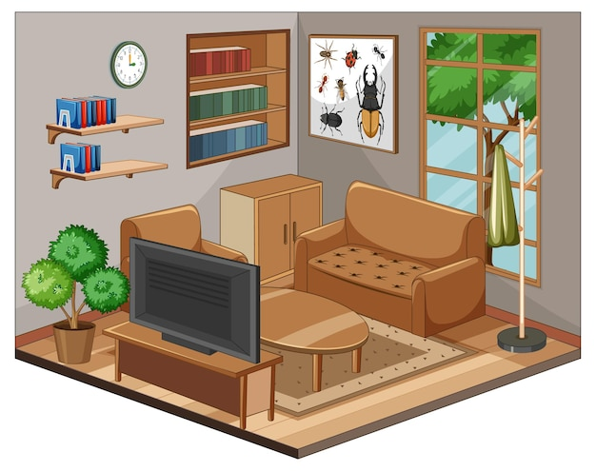


watch TV

Slide 6



do the housework

Slide 7



listen to music

Slide 8



read books

Slide 9



do homework

Slide 10
02
Activity 4
Listen and tick or cross

Slide 11
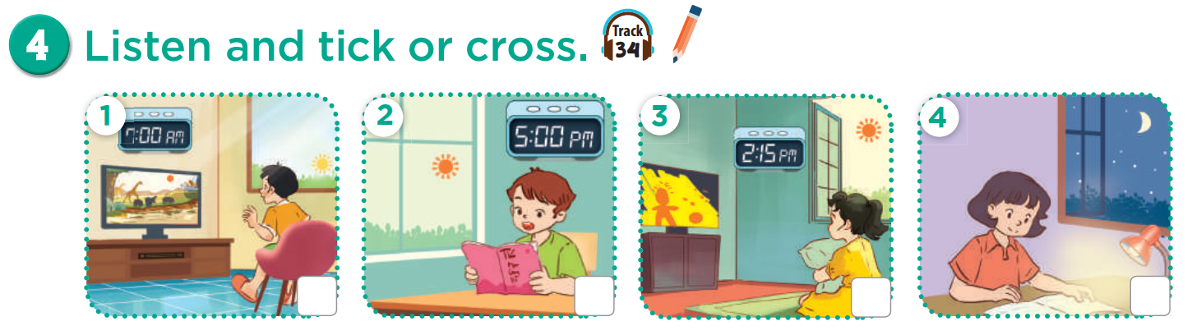

Slide 12
watch TV
in the morning

Slide 13
read books
in the afternoon

Slide 14
watch TV
in the afternoon

Slide 15
do homework
in the evening

Slide 16



Listen and tick or cross.
Listen and check.

Slide 17
03
Activity 5
Look, complete and read

Slide 18
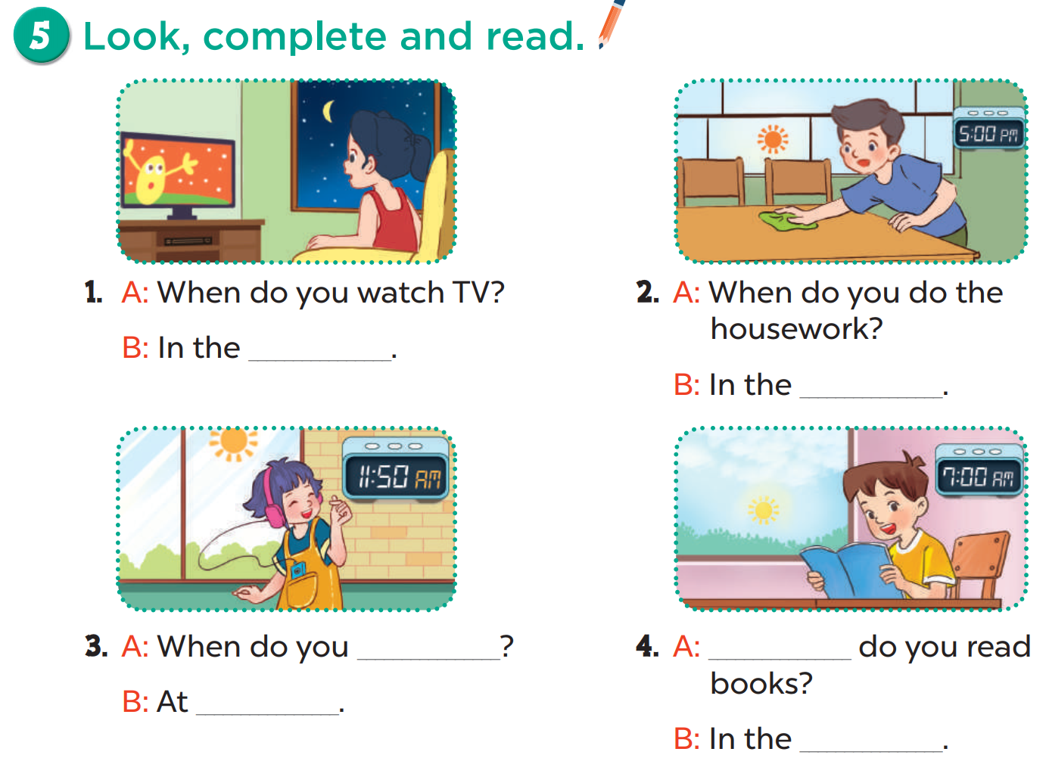

Slide 19
evening

Slide 20
afternoon

Slide 21
listen to music
noon

Slide 22
When
morning

Slide 23
04
Activity 6
Let’s sing

Slide 24
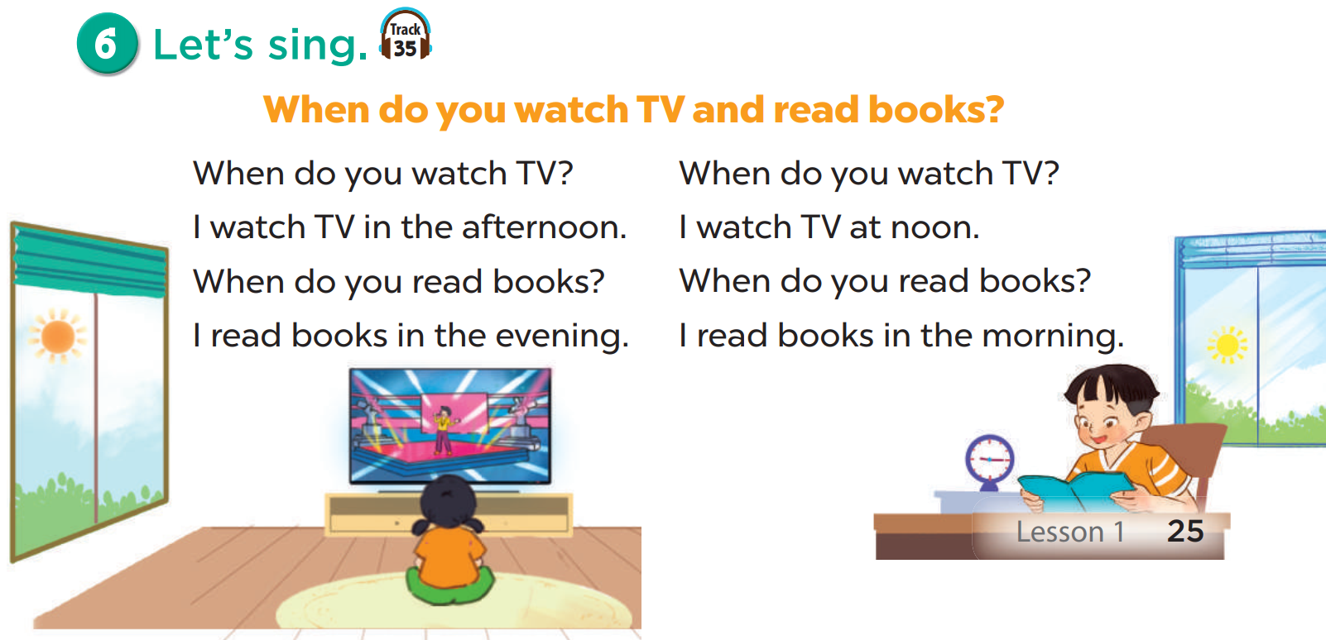
Listen.

Slide 25
Listen and fill in the blank.
1
5
2
6
3
7
4
8

Slide 26
05
Fun Time
Pokémon game

Slide 27

This is a team game.
Answer questions for points.
If you run into Team Rocket,
be careful.
They may not be nice.

Slide 28










Z
B

Slide 29
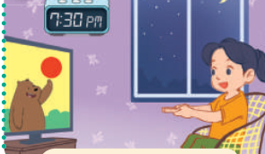



When do you watch TV ?
In the evening.

Slide 30
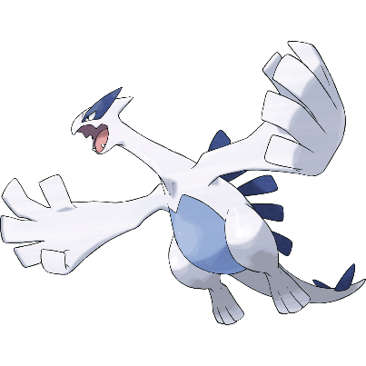
When do you listen to music?
At noon.

Slide 31
When do you do the housework?
In the afternoon.

Slide 32

When do you read books?
In the morning.

Slide 33

do/ I/ my/ in/homework/ evening/the/ .
I do my homework in the evening.

Slide 34

___ do you play football?
In the morning.
When

Slide 35
When ___ you go to school?
In the afternoon.
do

Slide 36
When do you ____ books?
read

Slide 37
When do you listen ___ music?
to

Slide 38
When do you watch TV?
___ the evening.
In

Slide 40

1

Slide 42
2

Slide 44
3

Slide 46
4

Slide 48
5

Slide 50




Choose your pokéball
-5 points
Change Points
8 points

Slide 52
Choose your pokéball
-7 points
Steal 3 points
4 points

Slide 54
Choose your pokéball
All teams lose all points
-10 points
-2 points

