Slide 1





Hai Thanh Primary school
Welcome to our class !
Teacher: Mai Hong Phuong

Slide 2


Daily Activities
14
Lesson 2 – Period 4

Slide 3
Table of Contents
Warm-up
Activity 5
01
02
Activity 4
Activity 6
03
04
Listen and draw
Look, complete and read
Listen and number
Let’s play
Fun time
05
Marvel game

Slide 4
01
Warm-up
Listen and draw

Slide 5
Listen and draw

Slide 6
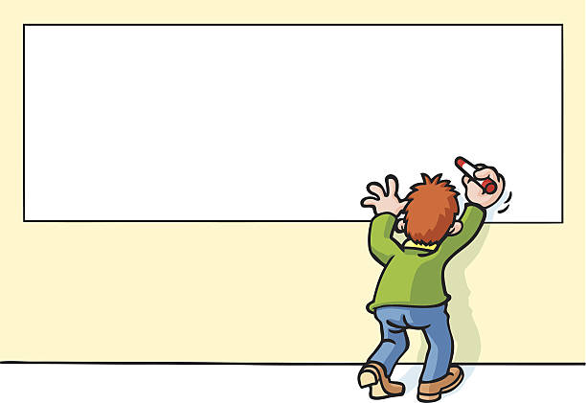

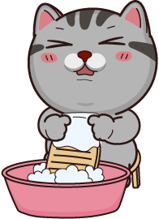

Slide 7
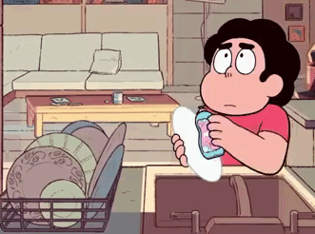

Slide 8
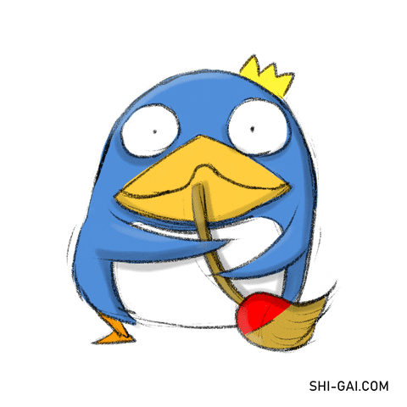

Slide 9
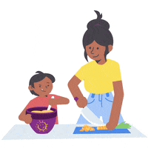

Slide 10
02
Activity 4
Listen and number

Slide 11
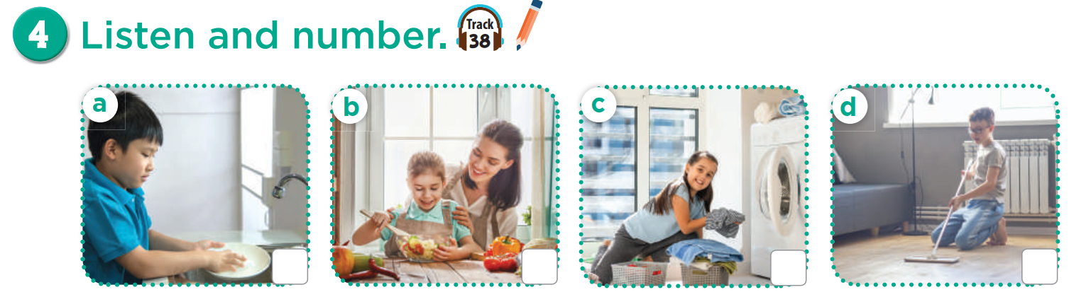

Slide 12
wash the dishes

Slide 13
help with the cooking

Slide 14
wash the clothes

Slide 15
clean the floor

Slide 16
Listen and number.
Listen and check.
2
4
1
3

Slide 17

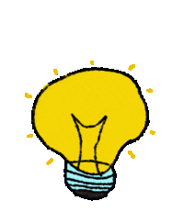
Listen again and answer the questions.

Slide 18

I wash the clothes in the morning.
TRUE
FALSE

Slide 19
I watch TV at noon.
True
False

Slide 20
When do you help mum with the cooking?
In the afternoon.
In the evening.

Slide 21
What do you do in the afternoon?
clean the floor
read books

Slide 22
03
Activity 5
Look, complete and read

Slide 23
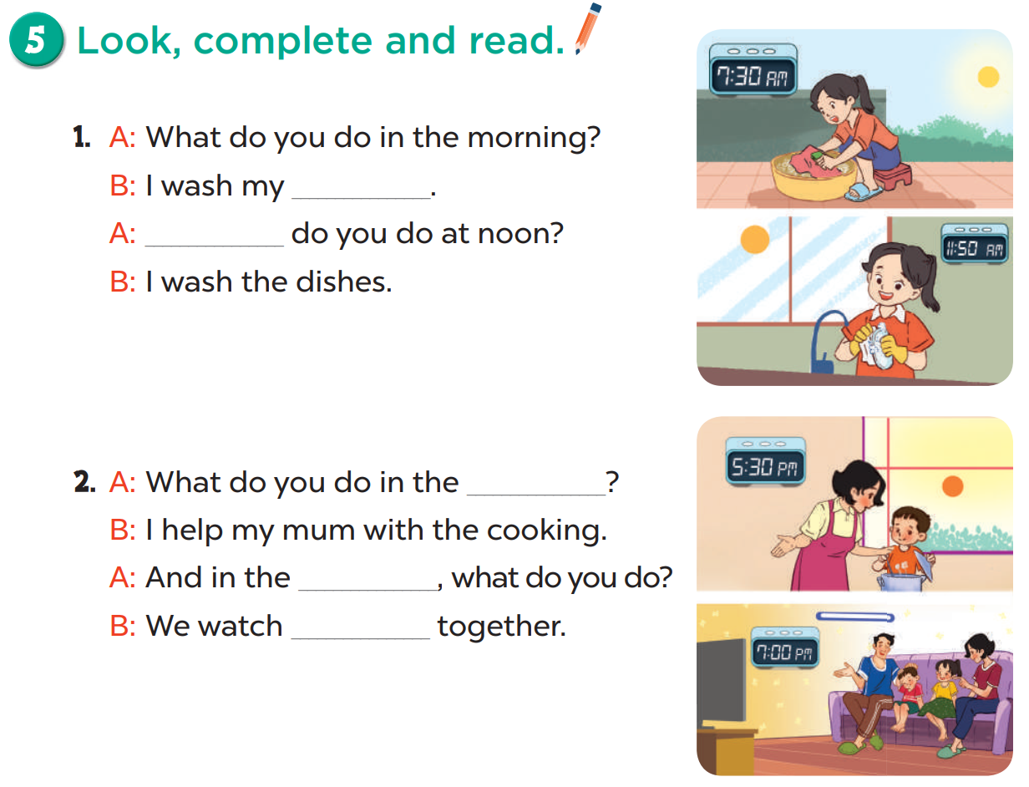

Slide 24
clothes
What

Slide 25
afternoon
evening
TV

Slide 26
04
Activity 6
Let’s play

Slide 27
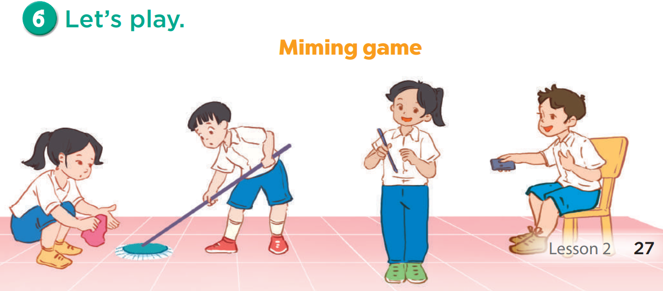
Notes:
Option 1: Teacher says the activity, students act.
Option 2: Invite a student to come to the front and act out. Have the class guess the activity.
Option 3: Write each activity on a piece of paper. Divide class into 3 teams. Invite one person from each team takes turn to act out the activities on the pieces of paper and the other students from their team guess. Each team has 2 minutes to act and guess. Which team has more activities guessed out is the winner.

Slide 28
05
Fun Time
game

Slide 29
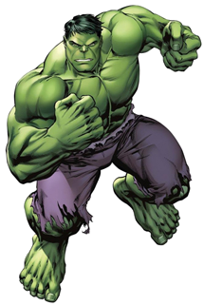
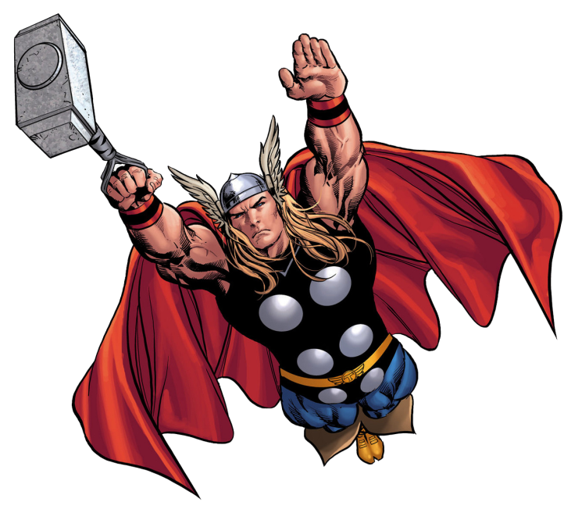

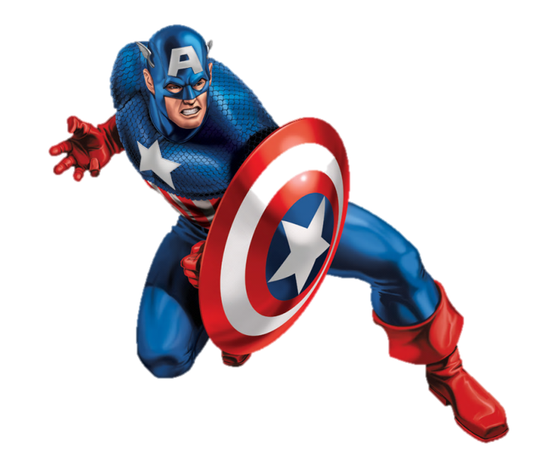
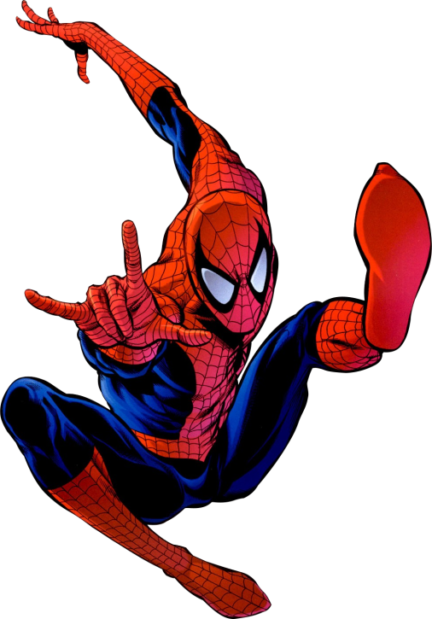
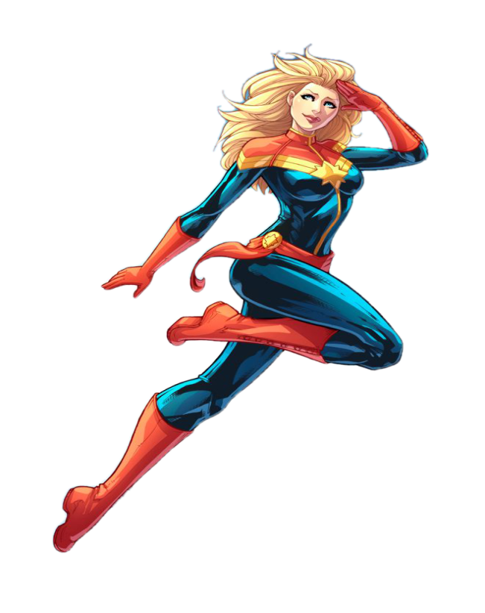
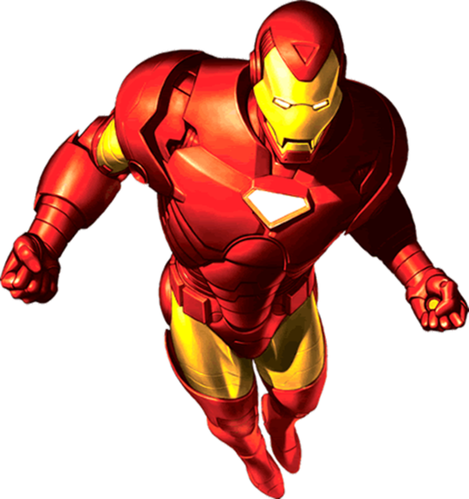
Notes:
© Copyright Showeet.com

Slide 30
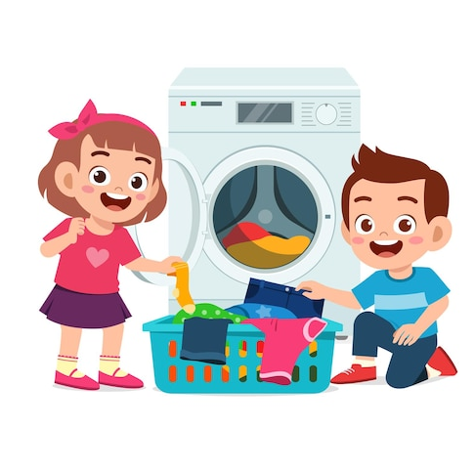

I wash the ____ at noon.
A. clothes
B. dishes
Notes:
© Copyright Showeet.com

Slide 31
____ do you read books? I read in the afternoon.
A. What
B. When
Notes:
© Copyright Showeet.com

Slide 32

I ____ the dishes in the evening.
A. watch
B. wash
Notes:
© Copyright Showeet.com

Slide 33
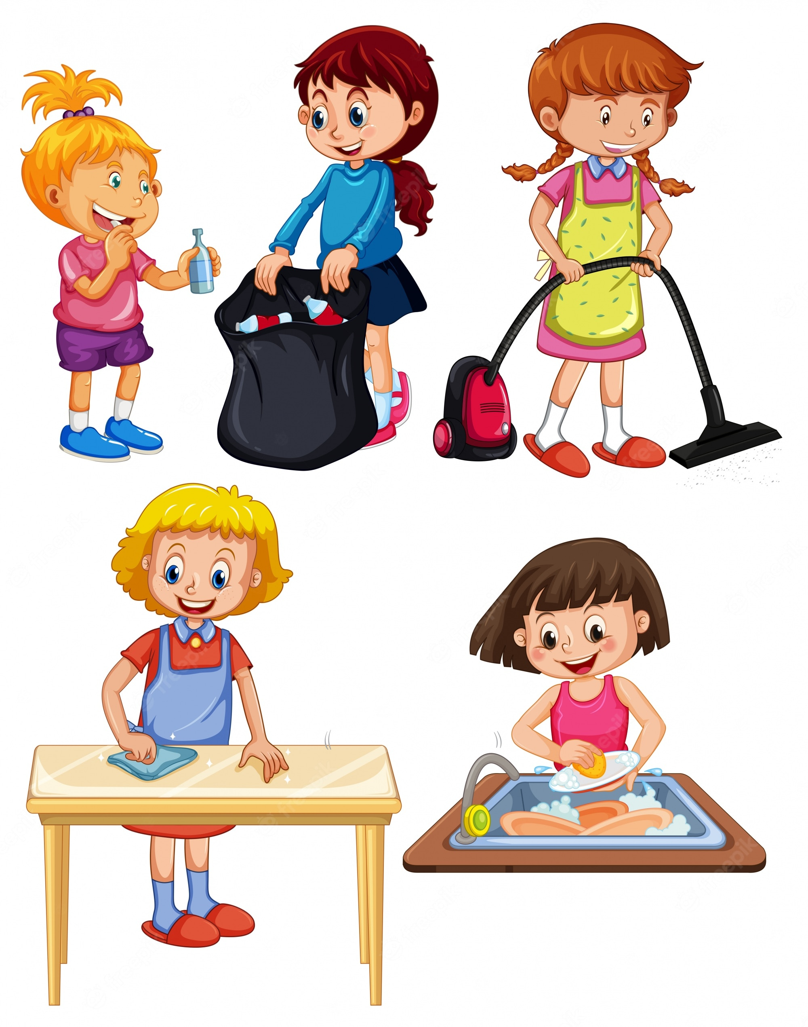
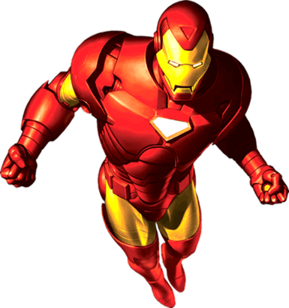
I do the ______ in the morning.
A. homework
B. housework
Notes:
© Copyright Showeet.com

Slide 34

When do you play?
A. football
B. at noon
Notes:
© Copyright Showeet.com

Slide 35

What do you play?
A. the piano
B. in the afternoon
Notes:
© Copyright Showeet.com

Slide 36



Slide 38


Slide 40


Change stars with another team

Slide 41
Change stars with another team

