Slide 1





Hai Thanh Primary school
Welcome to our class !
Teacher: Mai Hong Phuong

Slide 2


Daily Activities
14
Lesson 3 – Period 5

Slide 3
01
Warm-up
Pass the bomb

Slide 4


Pass the Bomb!

Slide 5
Ready?
Start!

Slide 6
16s

Slide 7
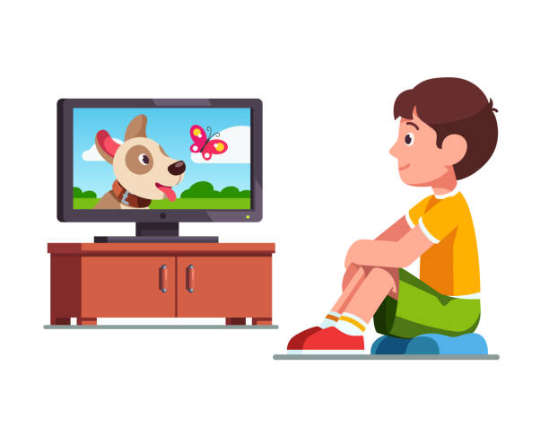
What is this activity?
watch TV

Slide 8
12s

Slide 9
When do you watch TV?
In the .../ at...

Slide 10
12s

Slide 11

What do you do in the morning?
I go to school.

Slide 12
12s

Slide 13
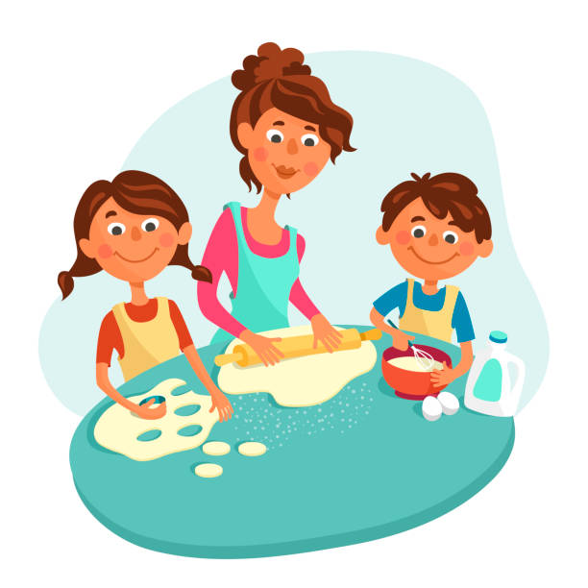
What do you do in the evening?
I help mum with the cooking

Slide 14
12s

Slide 15
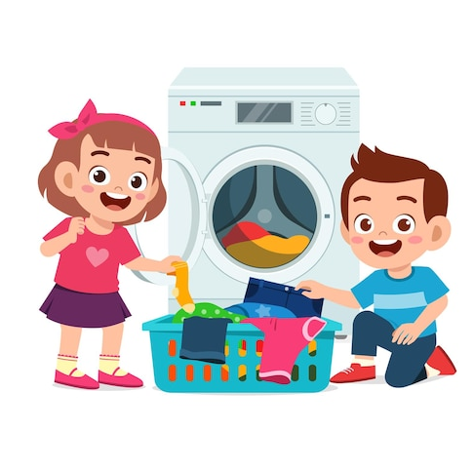
What do you do in the afternoon?
I wash the clothes.

Slide 16
12s

Slide 17
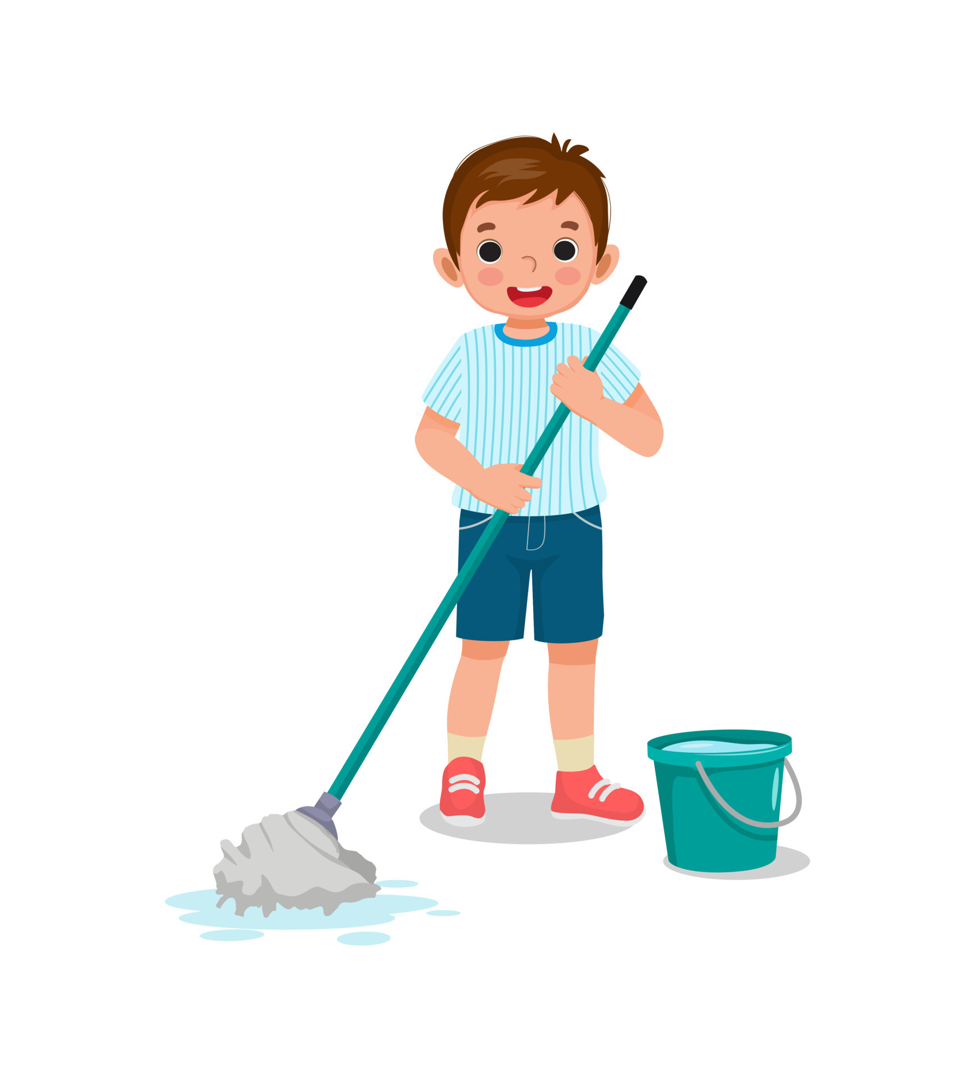
When do you clean the floor?
In the .../ At...

Slide 18
12s

Slide 19
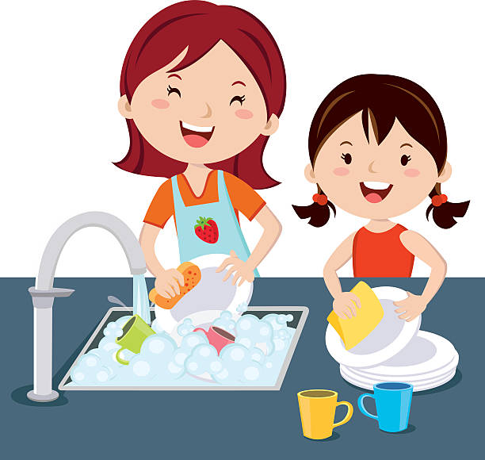

Do they was the clothes at noon?
No, they don’t.

Slide 20
12s

Slide 21
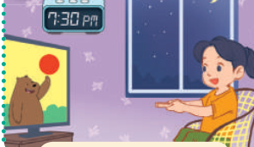
Does she watch TV in the morning?
No, she doesn’t.

Slide 22
17s

Slide 23
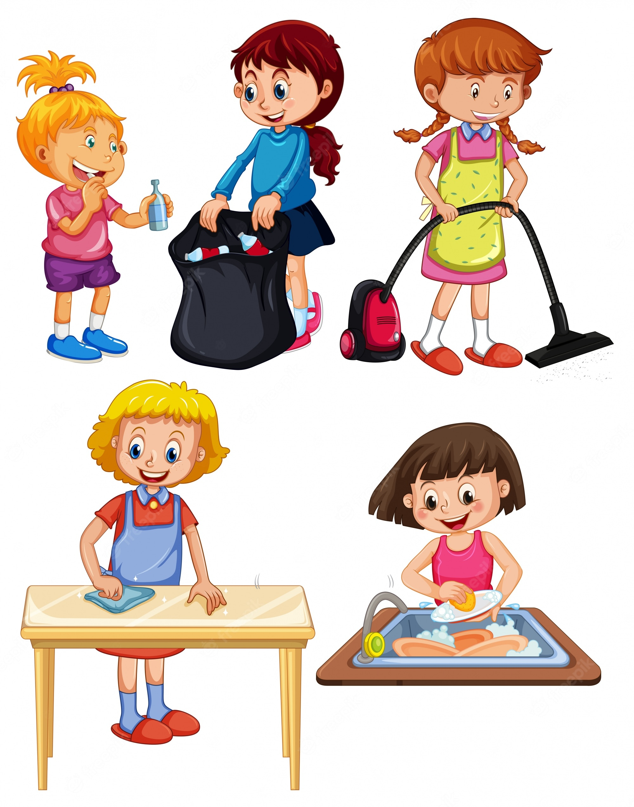
Do you do the housework in the evening?
Yes, I do. / No, I don’t.

Slide 24
10s

Slide 25
What do you do at noon?
I wash the dishes.

Slide 26
02
Activity 1
Listen and repeat

Slide 27

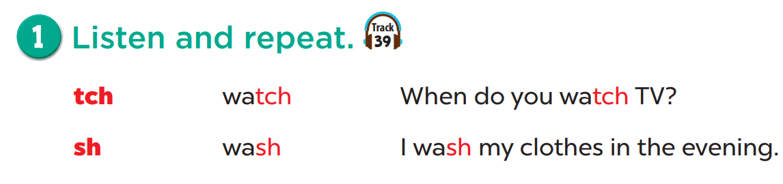

Slide 28
03
Activity 2
Listen and circle

Slide 29
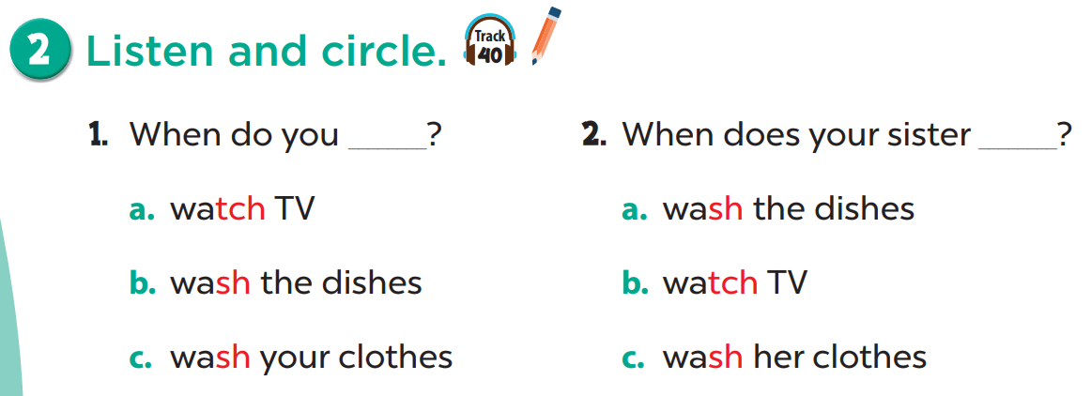

Slide 30
Listen and check.

Slide 31
Listen and check.

Slide 32
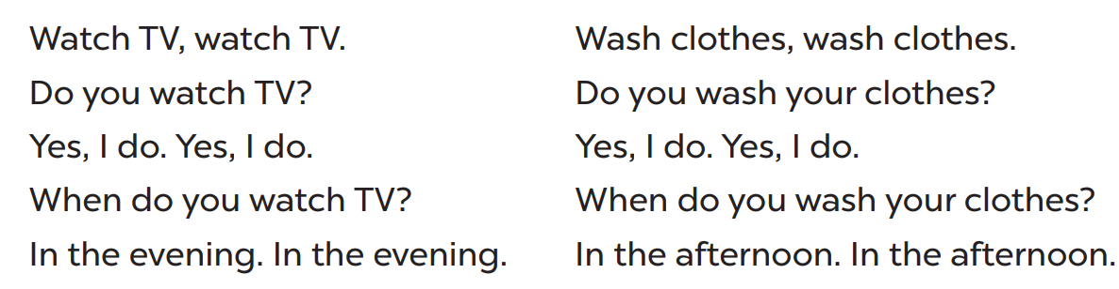
Read. Circle watch and underline wash.

Slide 33
04
Activity 3
Let’s chant

Slide 34
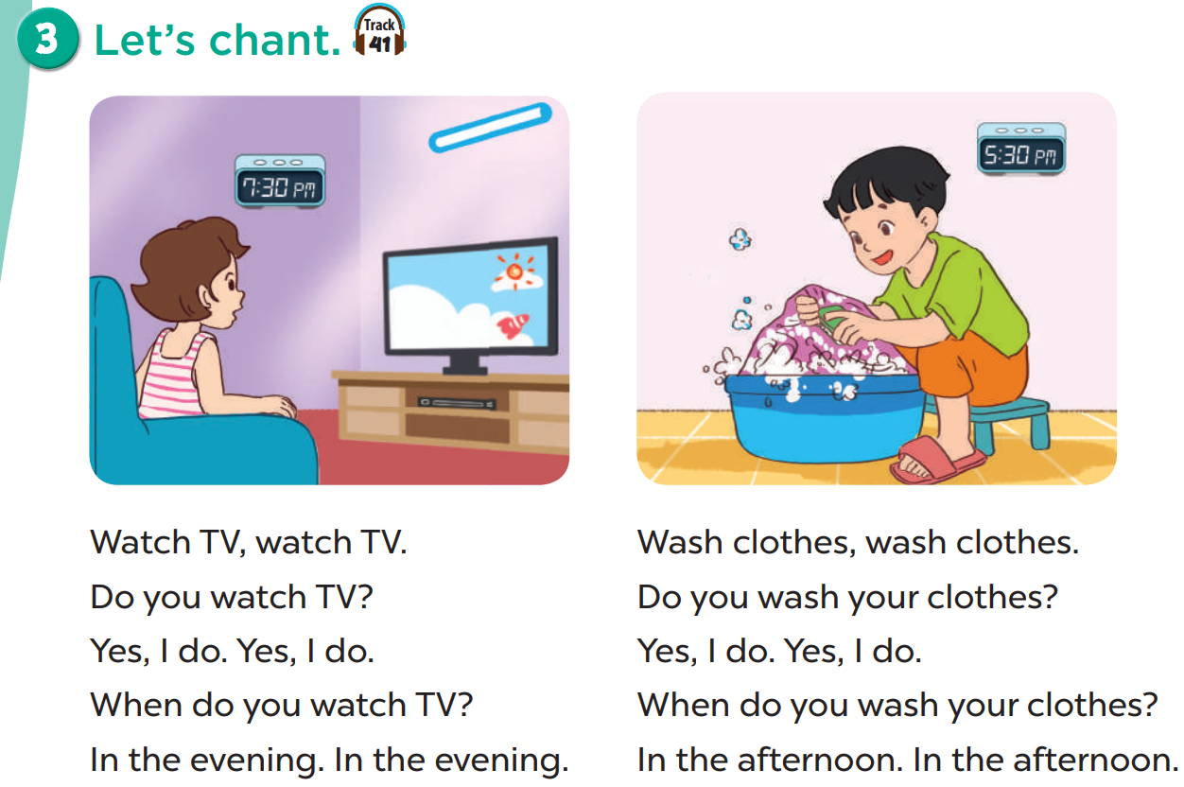

Slide 35
Write your own version
_______________ , ________________.
Do you _____________?
Yes, I do. Yes, I do.
When do you _____________?
In the __________. In the ____________.
Draw your activity.

Slide 36
05
Fun Time
Board Racing

Slide 37
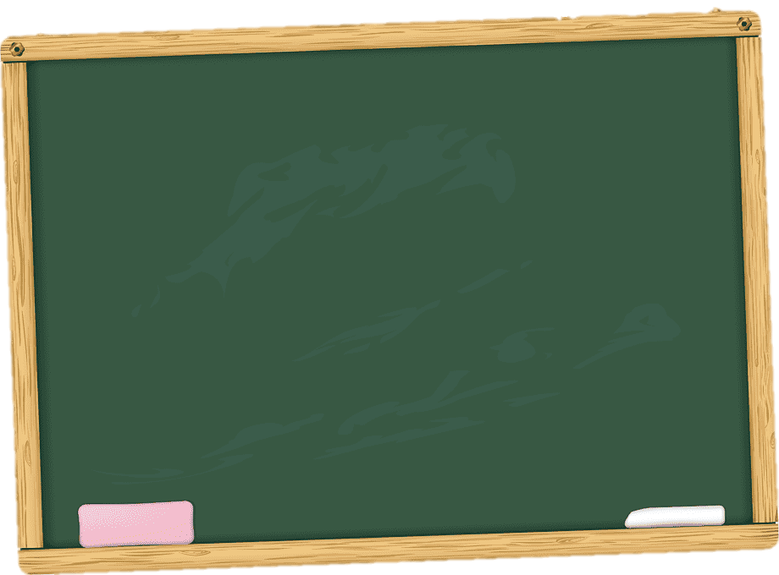
ch
sh
watch
March
wash
wish
catch
match
fish
bush
beach
peach
brush
crush
lunch
touch
dish
flash

