Slide 1





Hai Thanh Primary school
Welcome to our class !
Teacher: Mai Hong Phuong

Slide 2


Daily
Activities
14
Lesson 3 – Period 6

Slide 3
01
Warm-up
Let’s chant

Slide 4

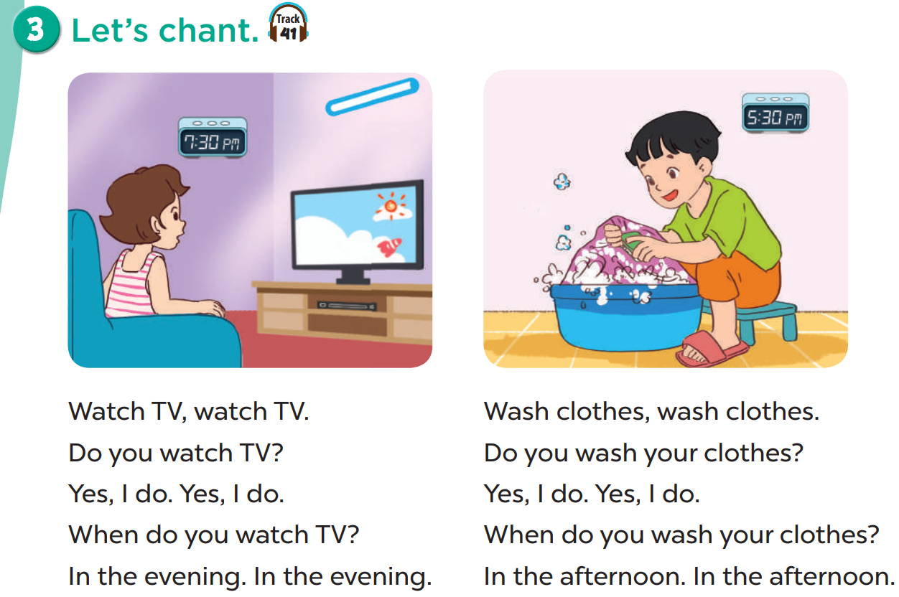

Slide 5
02
Activity 4
Read and match

Slide 6
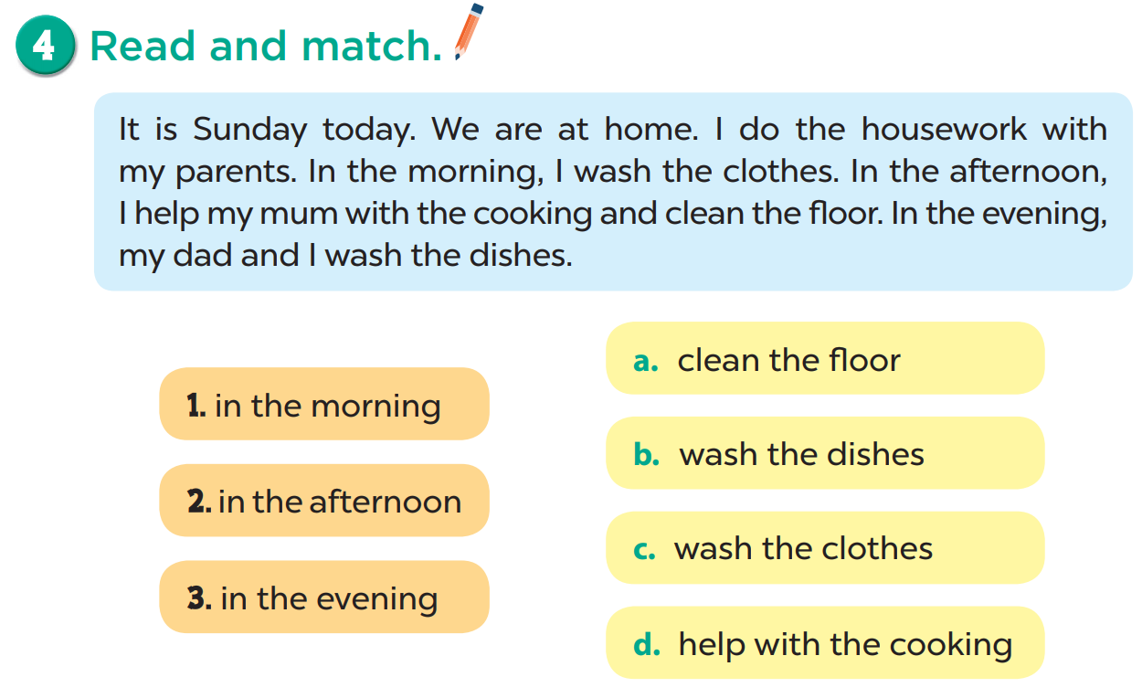

Slide 7
Let’s read.

Slide 8
Reading Challenge!
1
1. Sunday

Slide 9
Reading Challenge!
1
2
1. Sunday
2. at home

Slide 10
Reading Challenge!
1
2
3
1. Sunday
3. with
2. at home

Slide 11
Reading Challenge!
1
2
3
4
1. Sunday
3. with
4. morning
2. at home

Slide 12
Reading Challenge!
1
2
3
4
5
1. Sunday
5. help
3. with
4. morning
2. at home

Slide 13
Reading Challenge!
1
2
3
4
5
6
1. Sunday
5. help
3. with
4. morning
2. at home
6. dishes

Slide 15
03
Activity 5
Let’s write

Slide 16
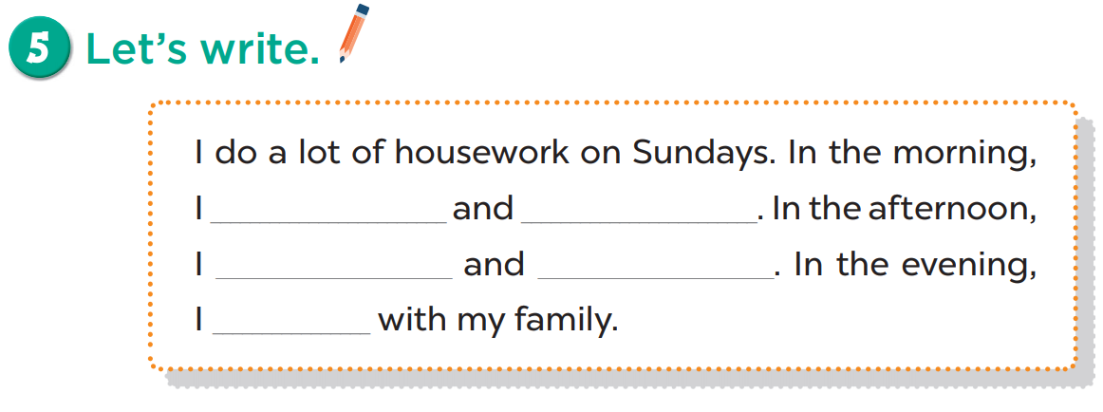
clean the floor wash the clothes wash the dish
help with the cooking watch TV read books

Slide 17
04
Activity 6
Project

Slide 18
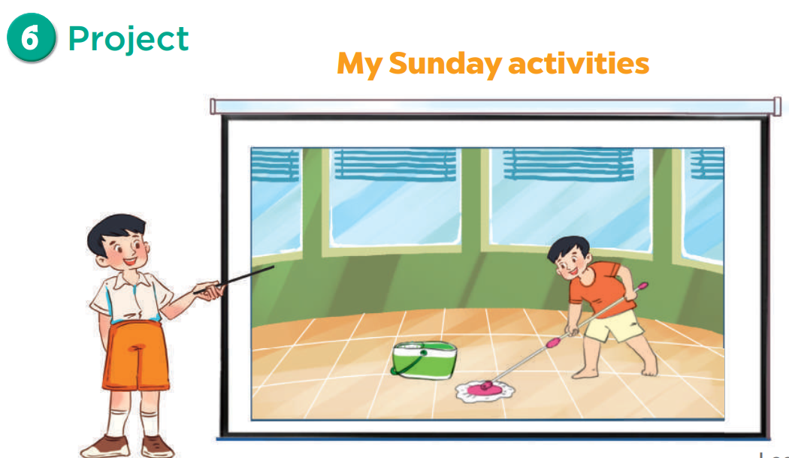

Slide 19
Draw a picture for your writing in ACTIVITY 5 and share it.
Draw here.

Slide 20
05
Fun Time
Mario Game

Slide 21
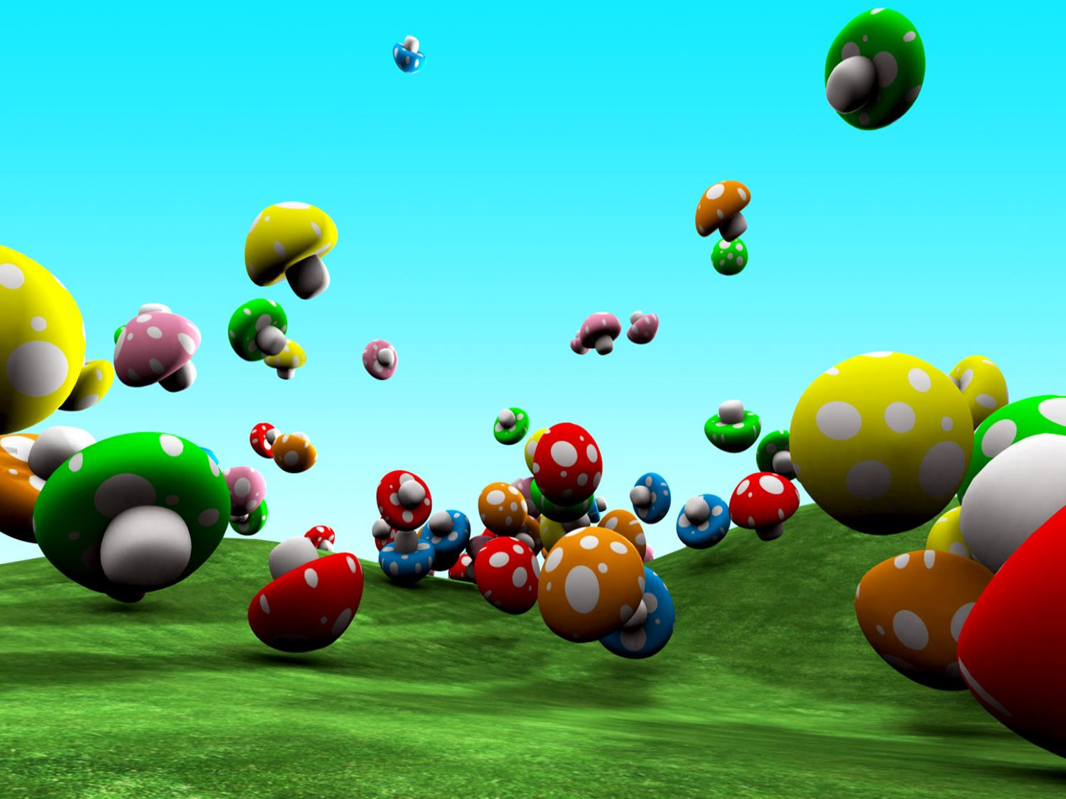












End game

Slide 22


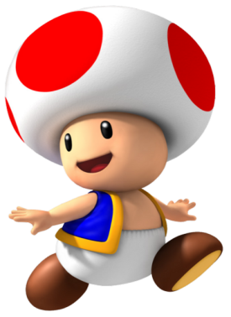
What do you do in the evening?
I watch TV.

Slide 23
When do you wash the clothes ?
In the afternoon.

Slide 24
What ___ you do at noon?
I take a nap.
do

Slide 25
What ___ your mother do in the evening?
She cleans the floor.
does

Slide 26
My father ____ my mum with the cooking in the evening.
helps

Slide 27
I listen to ____ in the morning.
music

Slide 28
I ____ books in the evening.
read

Slide 29
_____ do you wash the dishes?
In the afternoon.
When

Slide 30
____ do you do in the evening?
I read books.
What

Slide 31
What do you do in the morning?

Slide 32
What do you do in the afternoon?

Slide 33
What do you do in the evening?

Slide 34



Slide 39
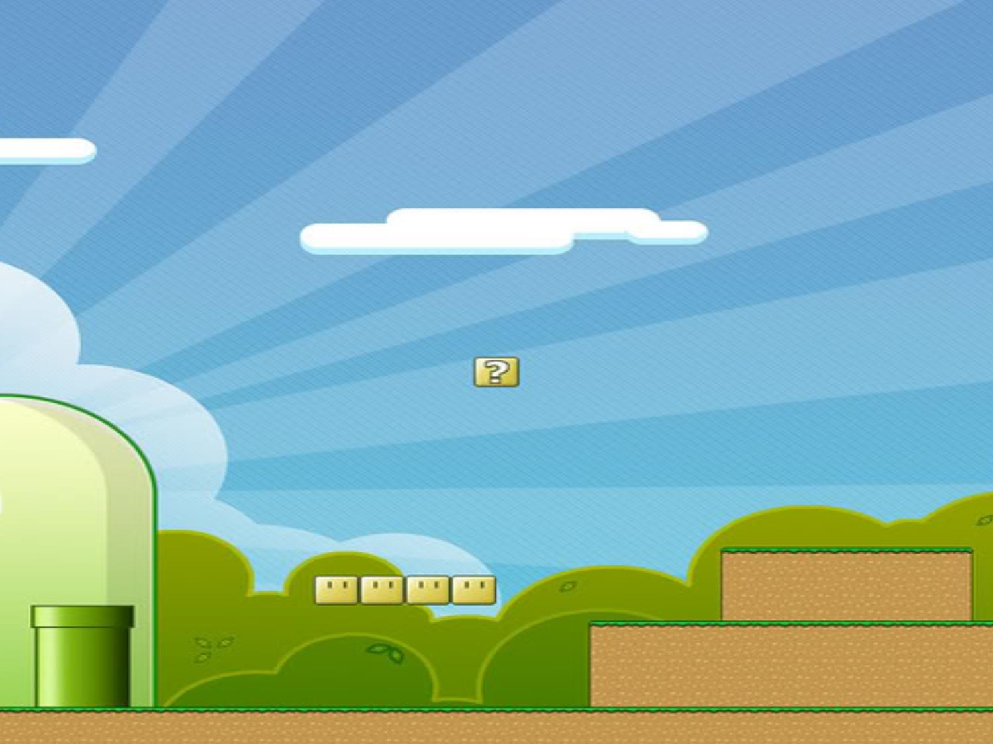







Slide 40
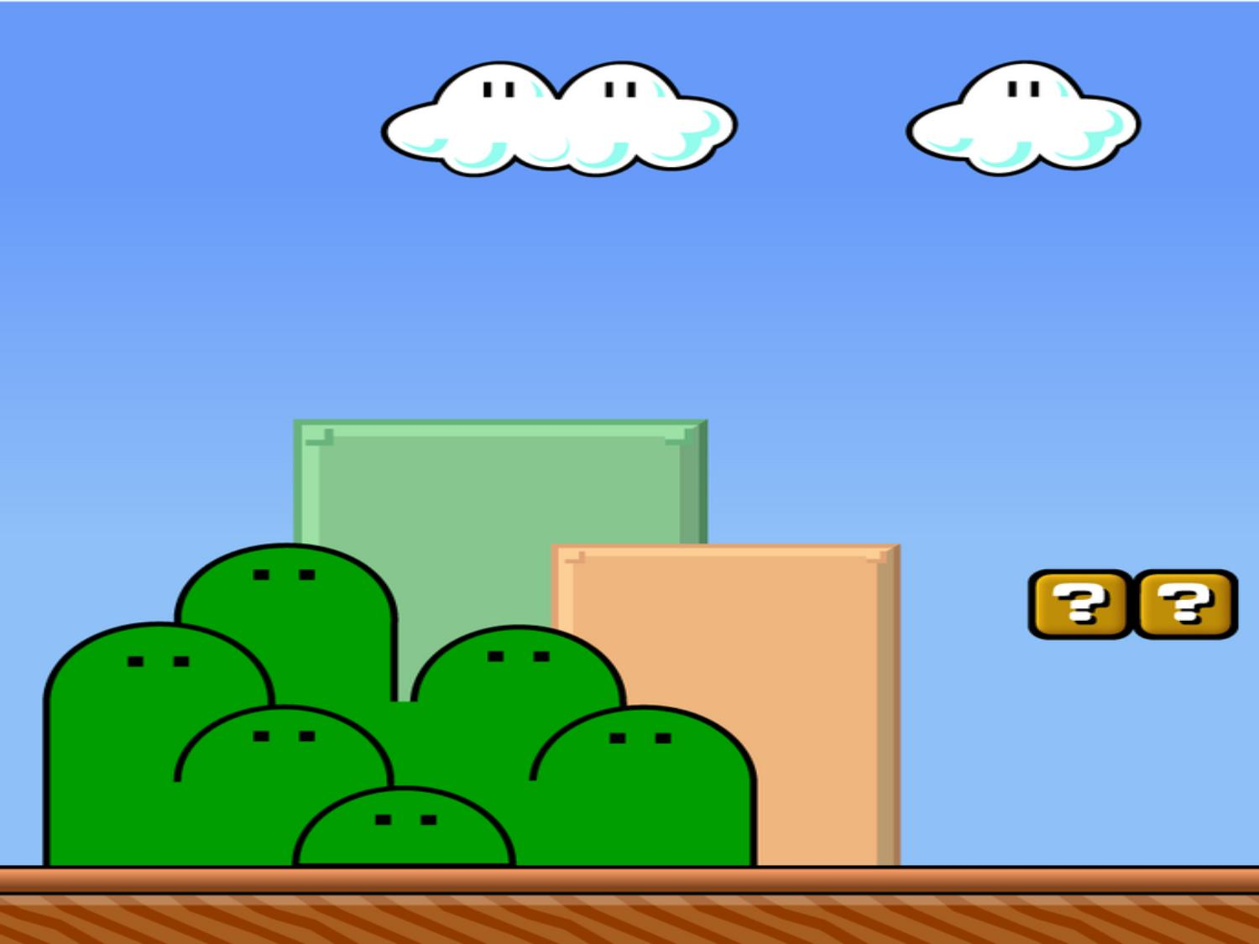
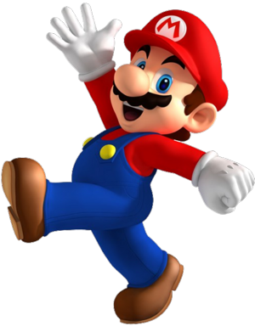




Score x 2

Slide 41

Give all your points to another team!

Slide 42
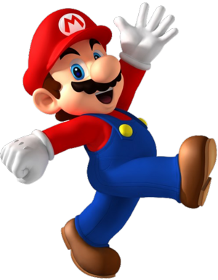


Level up!
7 points!

Slide 43
Give all your points to another team!

Slide 44



Slide 45
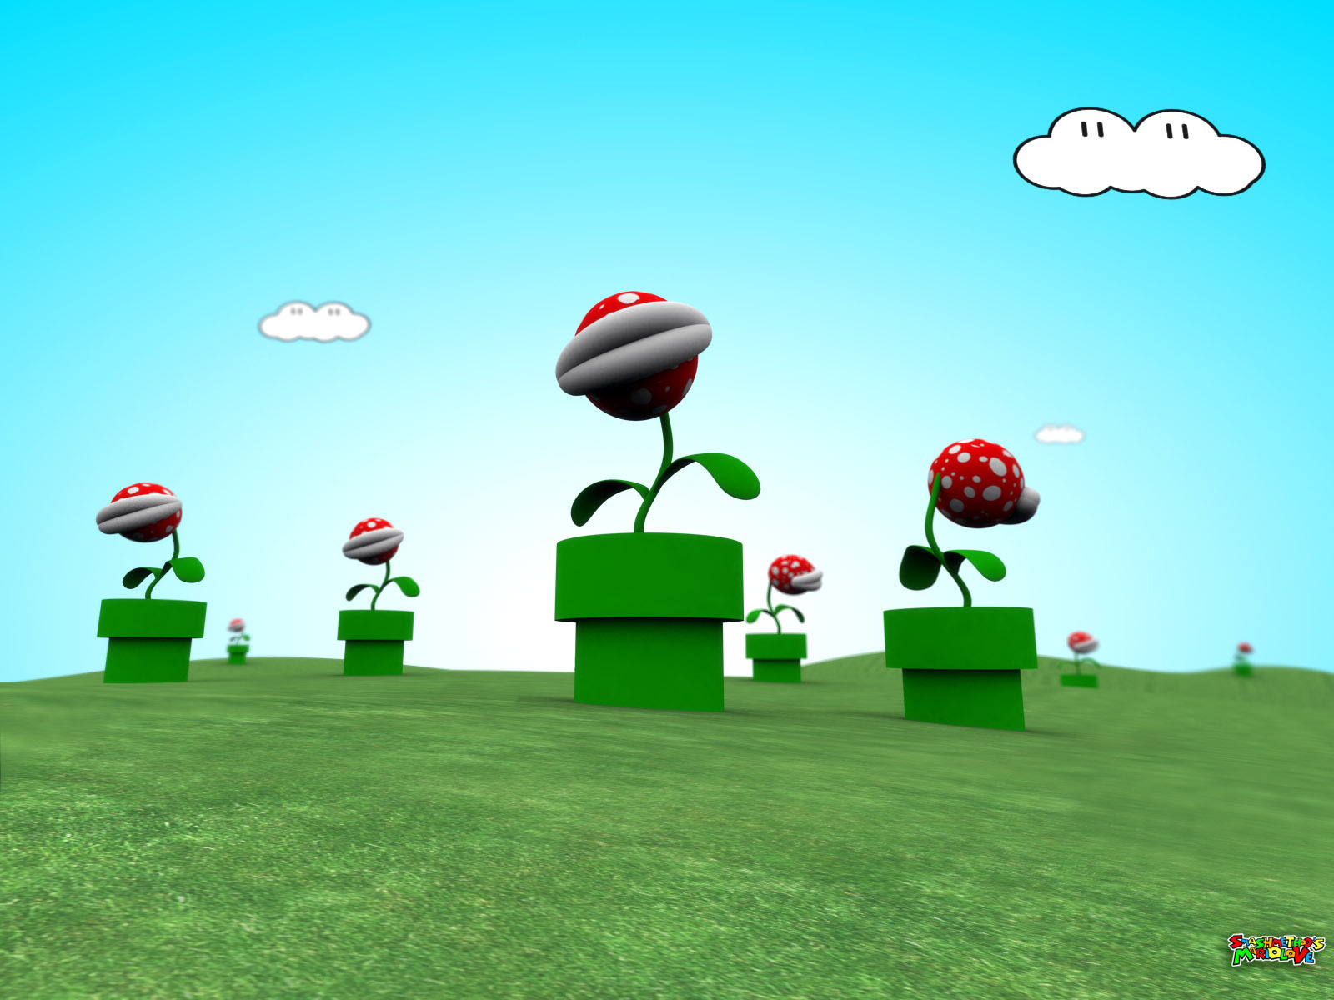
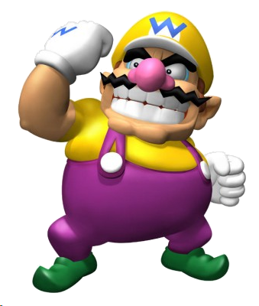

Steal 1 point from every team!

Slide 46
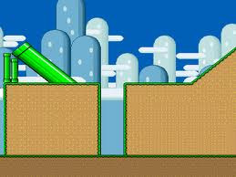
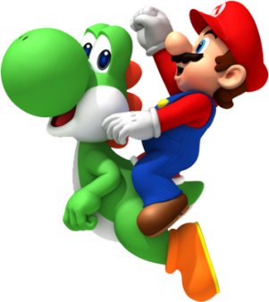
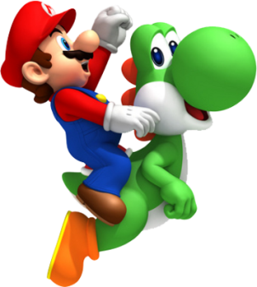
Change points with the team with the least points.

Slide 47
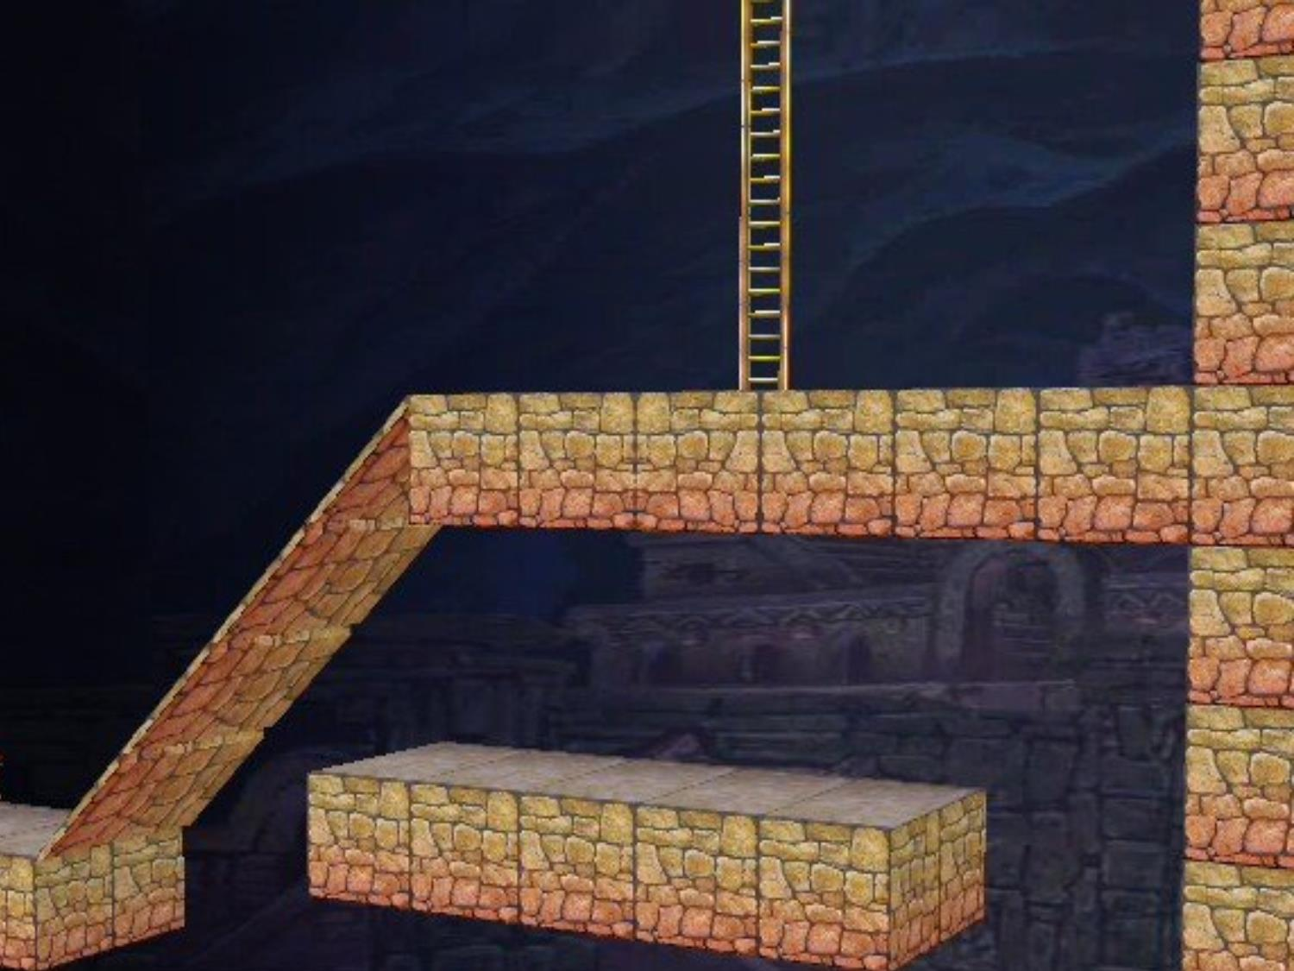
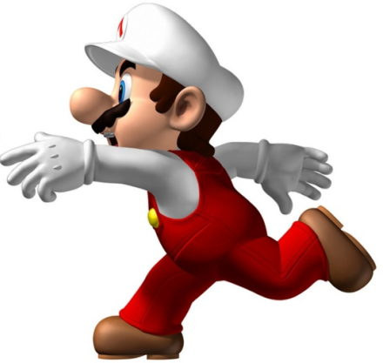

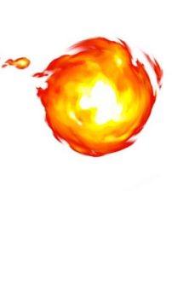
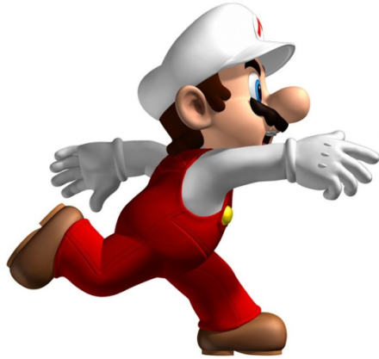
Level up!
6 points!

Slide 48




Slide 49




Swap points with another team!

Slide 50
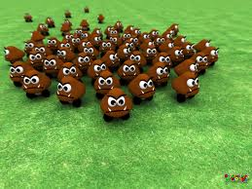


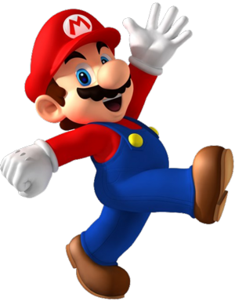
Level up!
6 points!

Slide 51
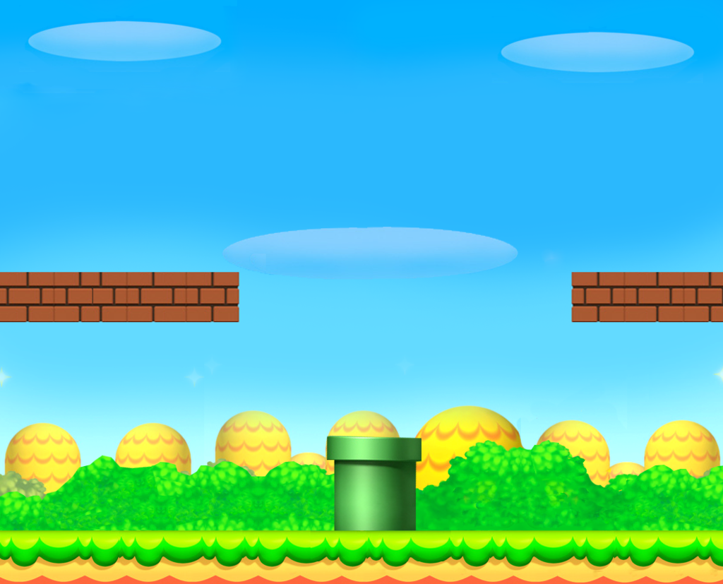

Level up!
7 points!

