Slide 1





Hai Thanh Primary school
Welcome to our class !
Teacher: Mai Hong Phuong

Slide 2
Unit 7: Our timetable
Lesson 1 - period 1

Slide 3
Table of Contents
01
02
03
04
Look, listen and repeat.
Warm-up
Listen, point and say.
Let’s talk.
fun conner & wrap-up
05

Slide 4
01
Warm-up

Slide 5

Notes:
https://www.youtube.com/watch?v=JoDm0RC5gk8

Slide 6
02
Look, listen and repeat.

Slide 7
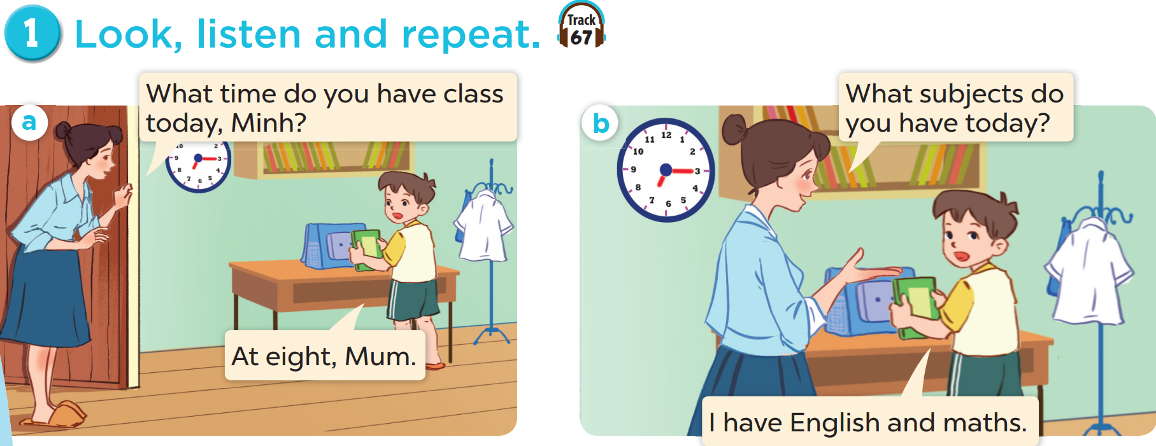


Slide 8
03
Listen, point and say.

Slide 9
vocabulary

Slide 10


Slide 11


Slide 12


Slide 13


Slide 14

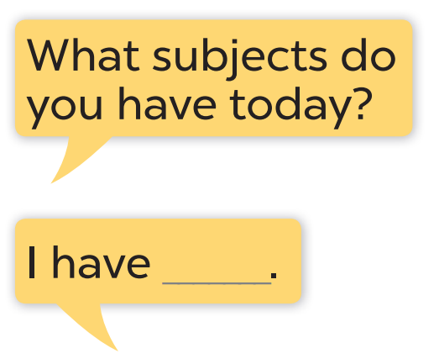
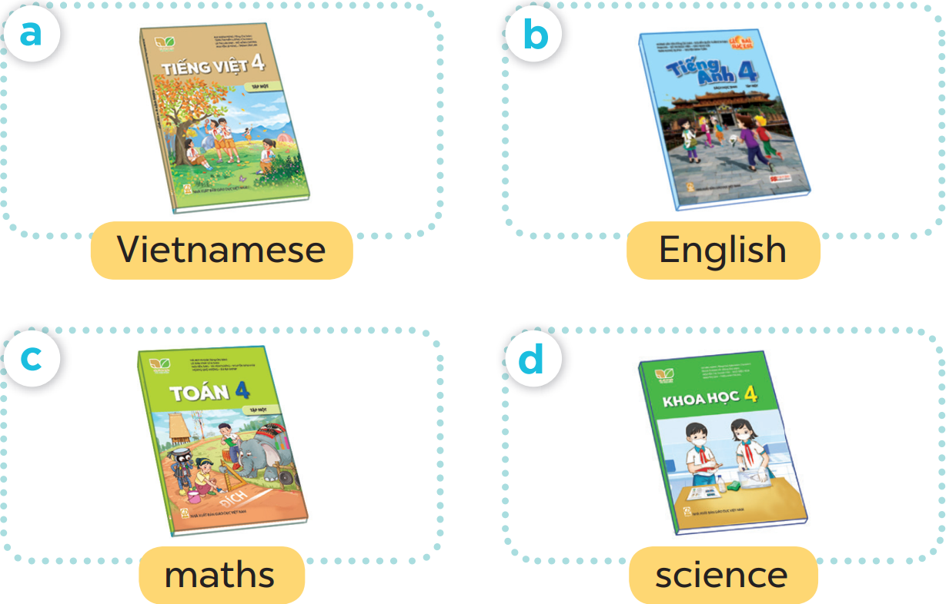

Slide 15
What subject do you have today?
I have Vietnamese.

Slide 16
04
Let’s talk.

Slide 17
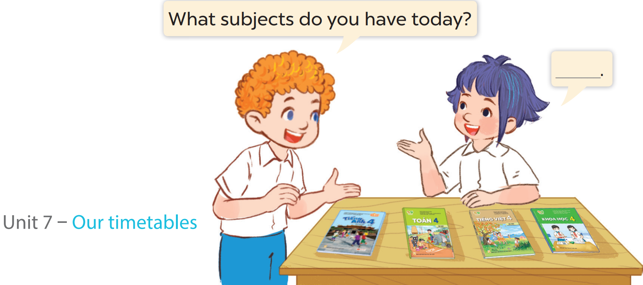

Slide 18
05
Fun corner & wrap-up

Slide 19
Answer the question
Play
MsPham-0936082789

Slide 20
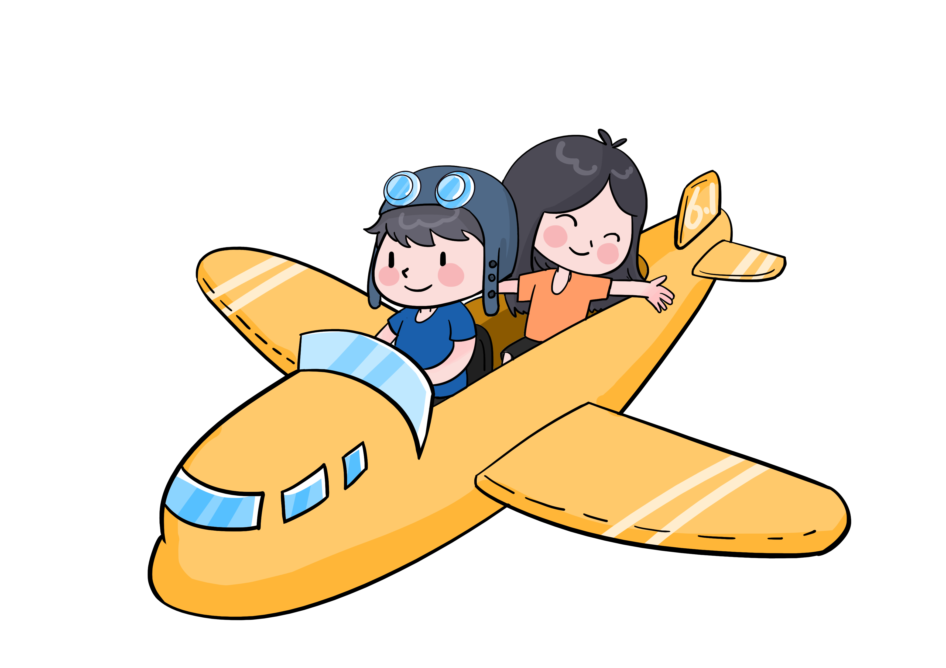

What subjects do you have today?
English (+5)
Check
Next

Slide 21

What subjects do you have today?
Science (+10)
Check
Next

Slide 22

What subjects do you have today?
Vietnamese (+6)
Check
Next

Slide 23

What subjects do you have today?
Maths (+7)
Check
Next

Slide 24
What have you learnt today? 2. What the core value of the lesson?

