Slide 1





Hai Thanh Primary school
Welcome to our class !
Teacher: Mai Hong Phuong

Slide 2
Unit 7: Our timetable
Lesson 1 - period 2

Slide 3
Table of Contents
01
02
03
04
Listen and tick or cross.
Warm-up
Look, complete and read.
Let’s play.
fun corner & wrap-up
05

Slide 4
01
Warm-up

Slide 5

Notes:
https://www.youtube.com/watch?v=JoDm0RC5gk8

Slide 6
02
Listen and tick.

Slide 7


Slide 8


Slide 9




Slide 10



Slide 11
03
Look, complete and read.

Slide 12

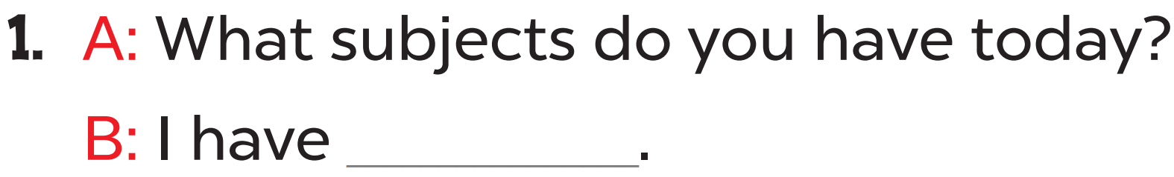
Vietnamese

Slide 13
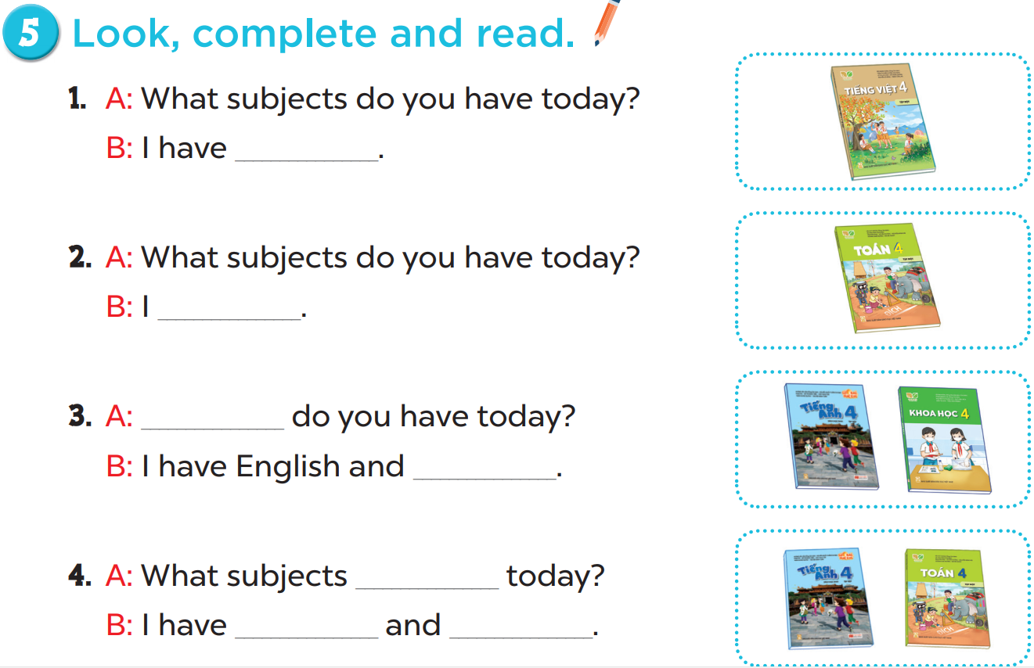

Slide 14
Vietnamese.
have maths
What subjects
science
do you have
English
maths

Slide 15
04
Let’s play.

Slide 16
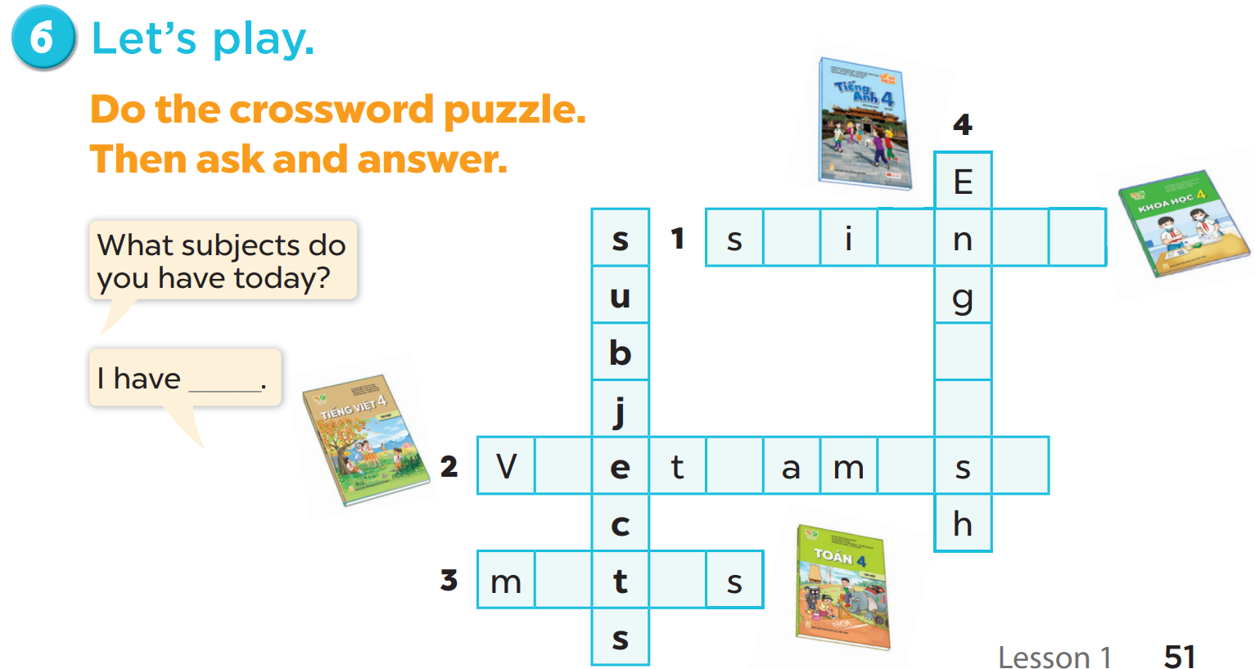
c
e
c
e
l
i
i
n
e
e
a
h

Slide 17
05
fun corner & wrap-up

Slide 18







Slide 19


What ______do you have today?
subjects
subject
Ms Huyền Phạm
0936.082.789

Slide 20
_____subjects do you have today?
What
How
Ms Huyền Phạm
0936.082.789

Slide 21
I have________.
Vietnam
Vietnamese
Ms Huyền Phạm
0936.082.789

Slide 22
I have________.
England
English
Ms Huyền Phạm
0936.082.789

Slide 23
I have Maths and ______.
scienec
science
Ms Huyền Phạm
0936.082.789

Slide 24
I have________.
Matht
Maths
Ms Huyền Phạm
0936.082.789

Slide 25
What have you learnt today?
2. What the core value of the lesson?

