Slide 1





Hai Thanh Primary school
Welcome to our class !
Teacher: Mai Hong Phuong

Slide 2
Unit 7: Our timetable
Lesson 3 - period 5

Slide 3
Table of Contents
01
02
03
04
Listen and repeat.
Warm-up
Listen and circle.
Let’s chant.
fun corner & wrap-up
05

Slide 4
01
Warm-up

Slide 5


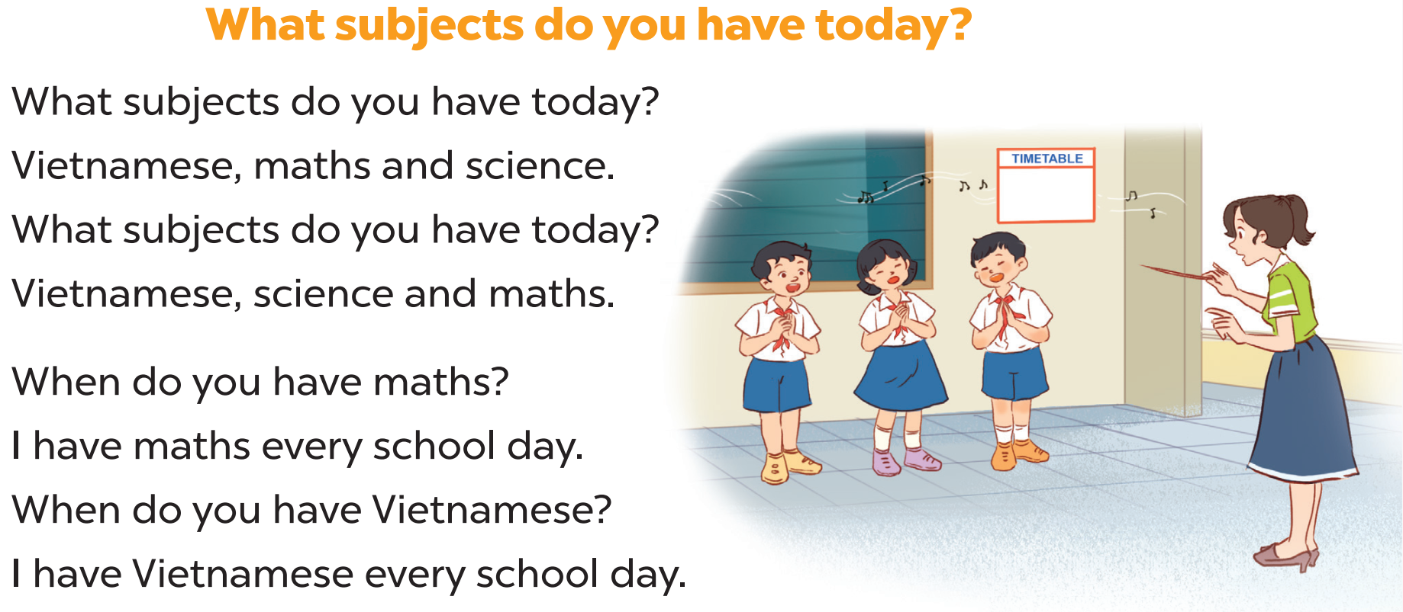

Slide 6
02
Listen and repeat.

Slide 7
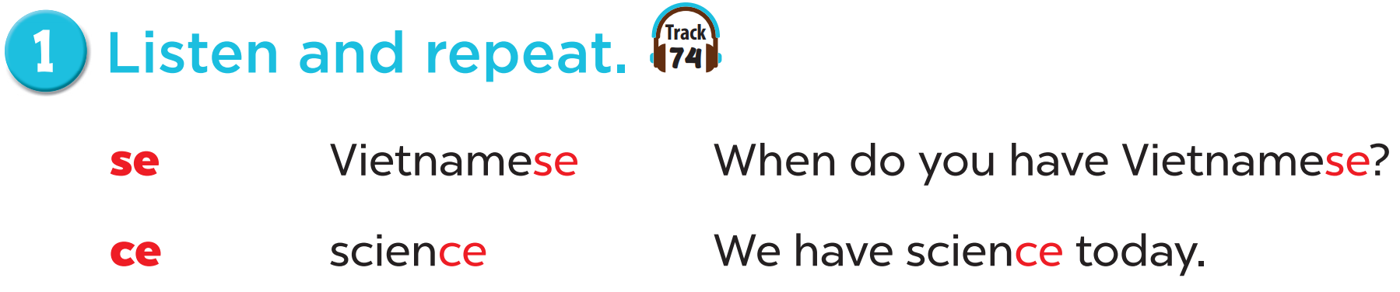

Slide 8
03
Listen and circle.

Slide 9
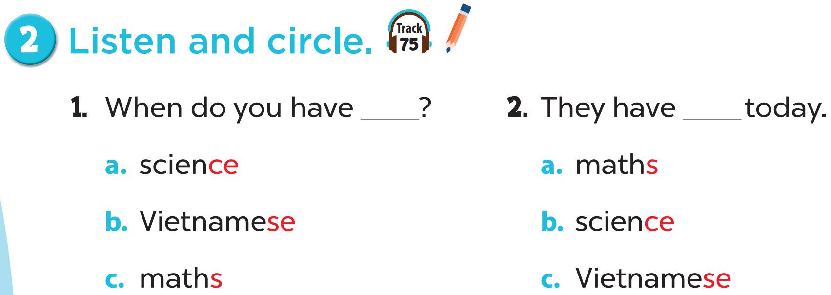

Slide 10


Slide 11
04
Let’s chant.

Slide 12

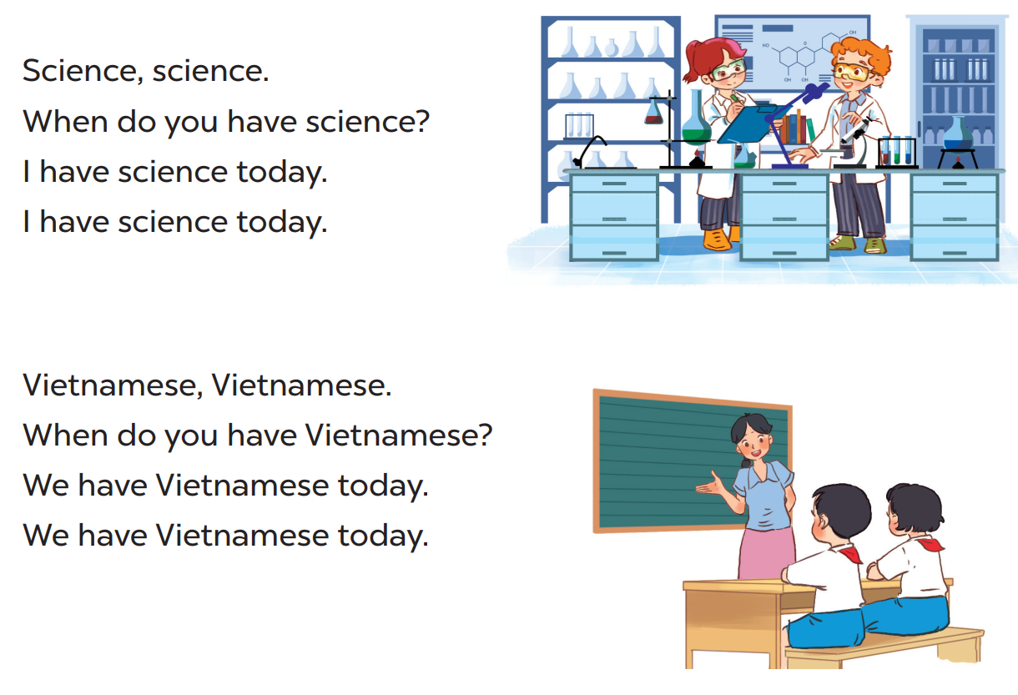

Slide 13
05
fun corner & wrap-up

Slide 14
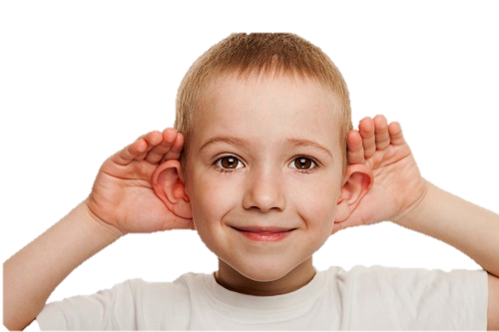

Listen and clap
Notes:
Listen to the sound /s/ and clap if not don’t clap. Ex: Science /s/, “clap”, Maths /z/ “no clap”, Vietnamese /s/ “clap”…….

Slide 15
What have you learnt today?
2. What the core value of the lesson?

