Slide 1





Hai Thanh Primary school
Welcome to our class !
Teacher: Mai Hong Phuong

Slide 2
Unit 7: Our timetable
Lesson 3 - period 6

Slide 3
Table of Contents
01
02
03
04
Read and circle.
Warm-up
Let’s write.
Project
fun corner & wrap-up
05

Slide 4
01
Warm-up

Slide 5


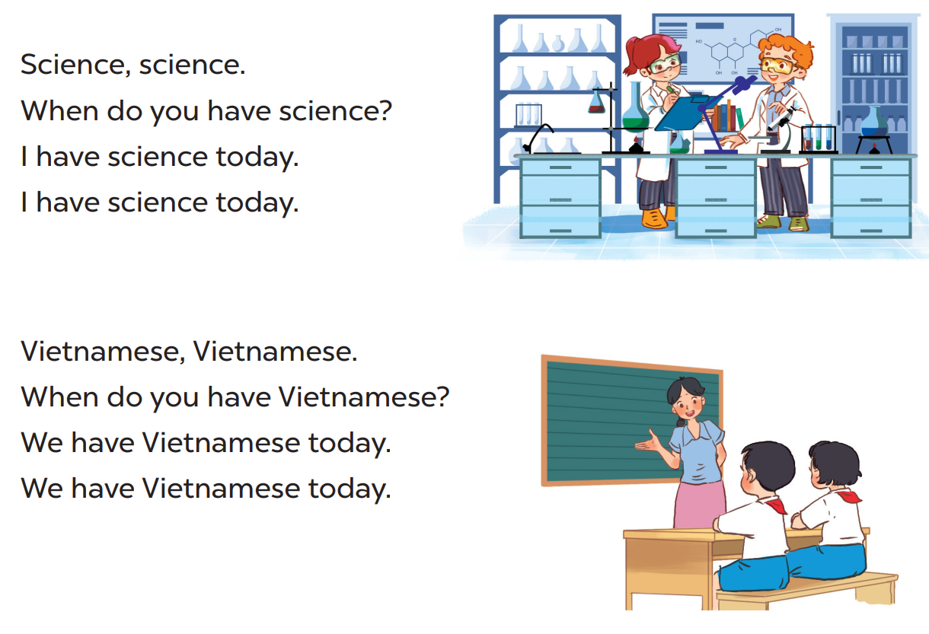

Slide 6
02
Read and circle.

Slide 7
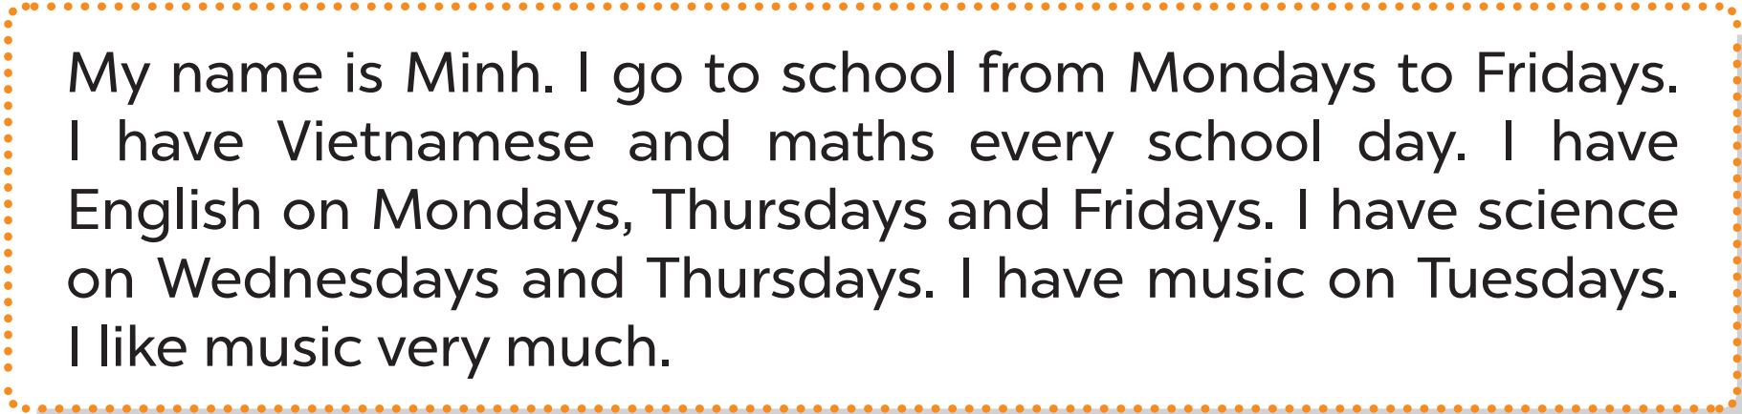

Slide 8
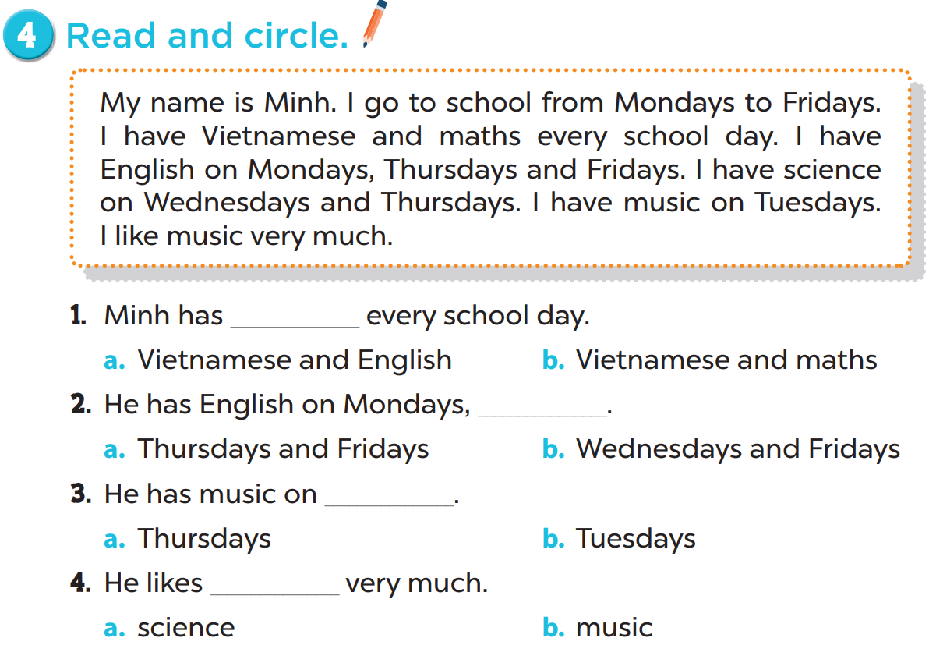

Slide 9


Slide 10
03
Let’s write.

Slide 11
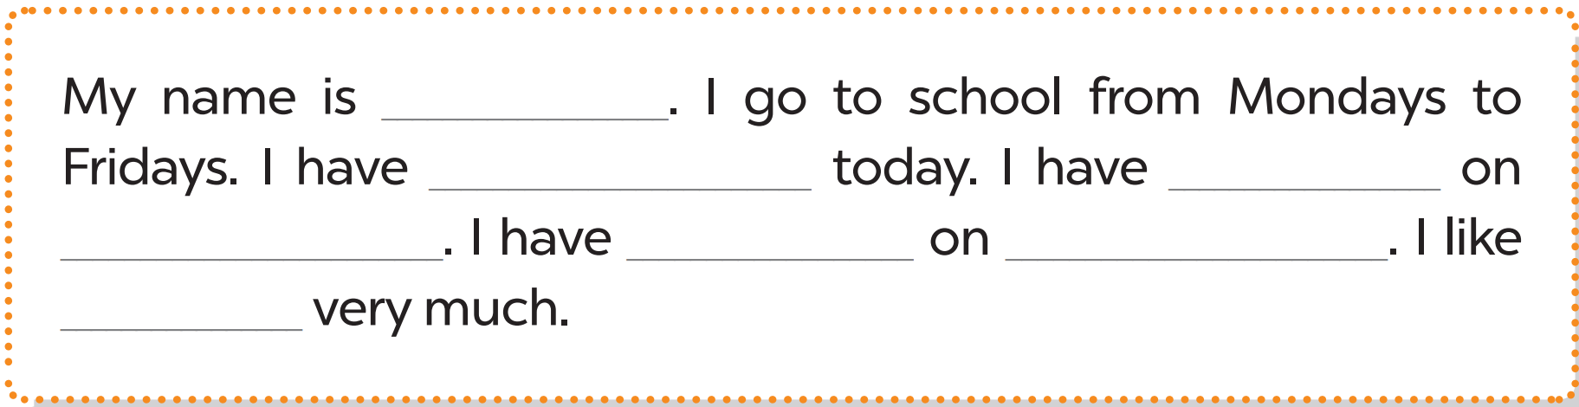
Lucy
English
science
Tuesdays
music
Fridays
music

Slide 12


Slide 13
04
Project

Slide 14
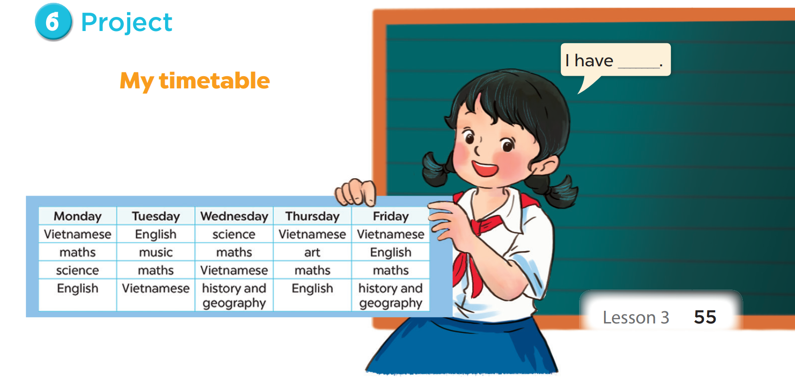

Slide 15
05
Fun corner & wrap-up

Slide 16

Fridays./Mondays/ I/to/
school/go/from
I go to school from Mondays to Fridays.

Slide 17
every/day./I/maths/have
I have maths every day.

Slide 18
Fridays./and/have/science
Mondays/I/on
I have science on Mondays and Fridays.

Slide 19
much./ like/I/science/very
I like science very much.

Slide 20
What have you learnt today? 2. What the core value of the lesson?

