Slide 1





Slide 2





Hai Thanh Primary school
Welcome to our class !
Teacher: Mai Hong Phuong

Slide 5

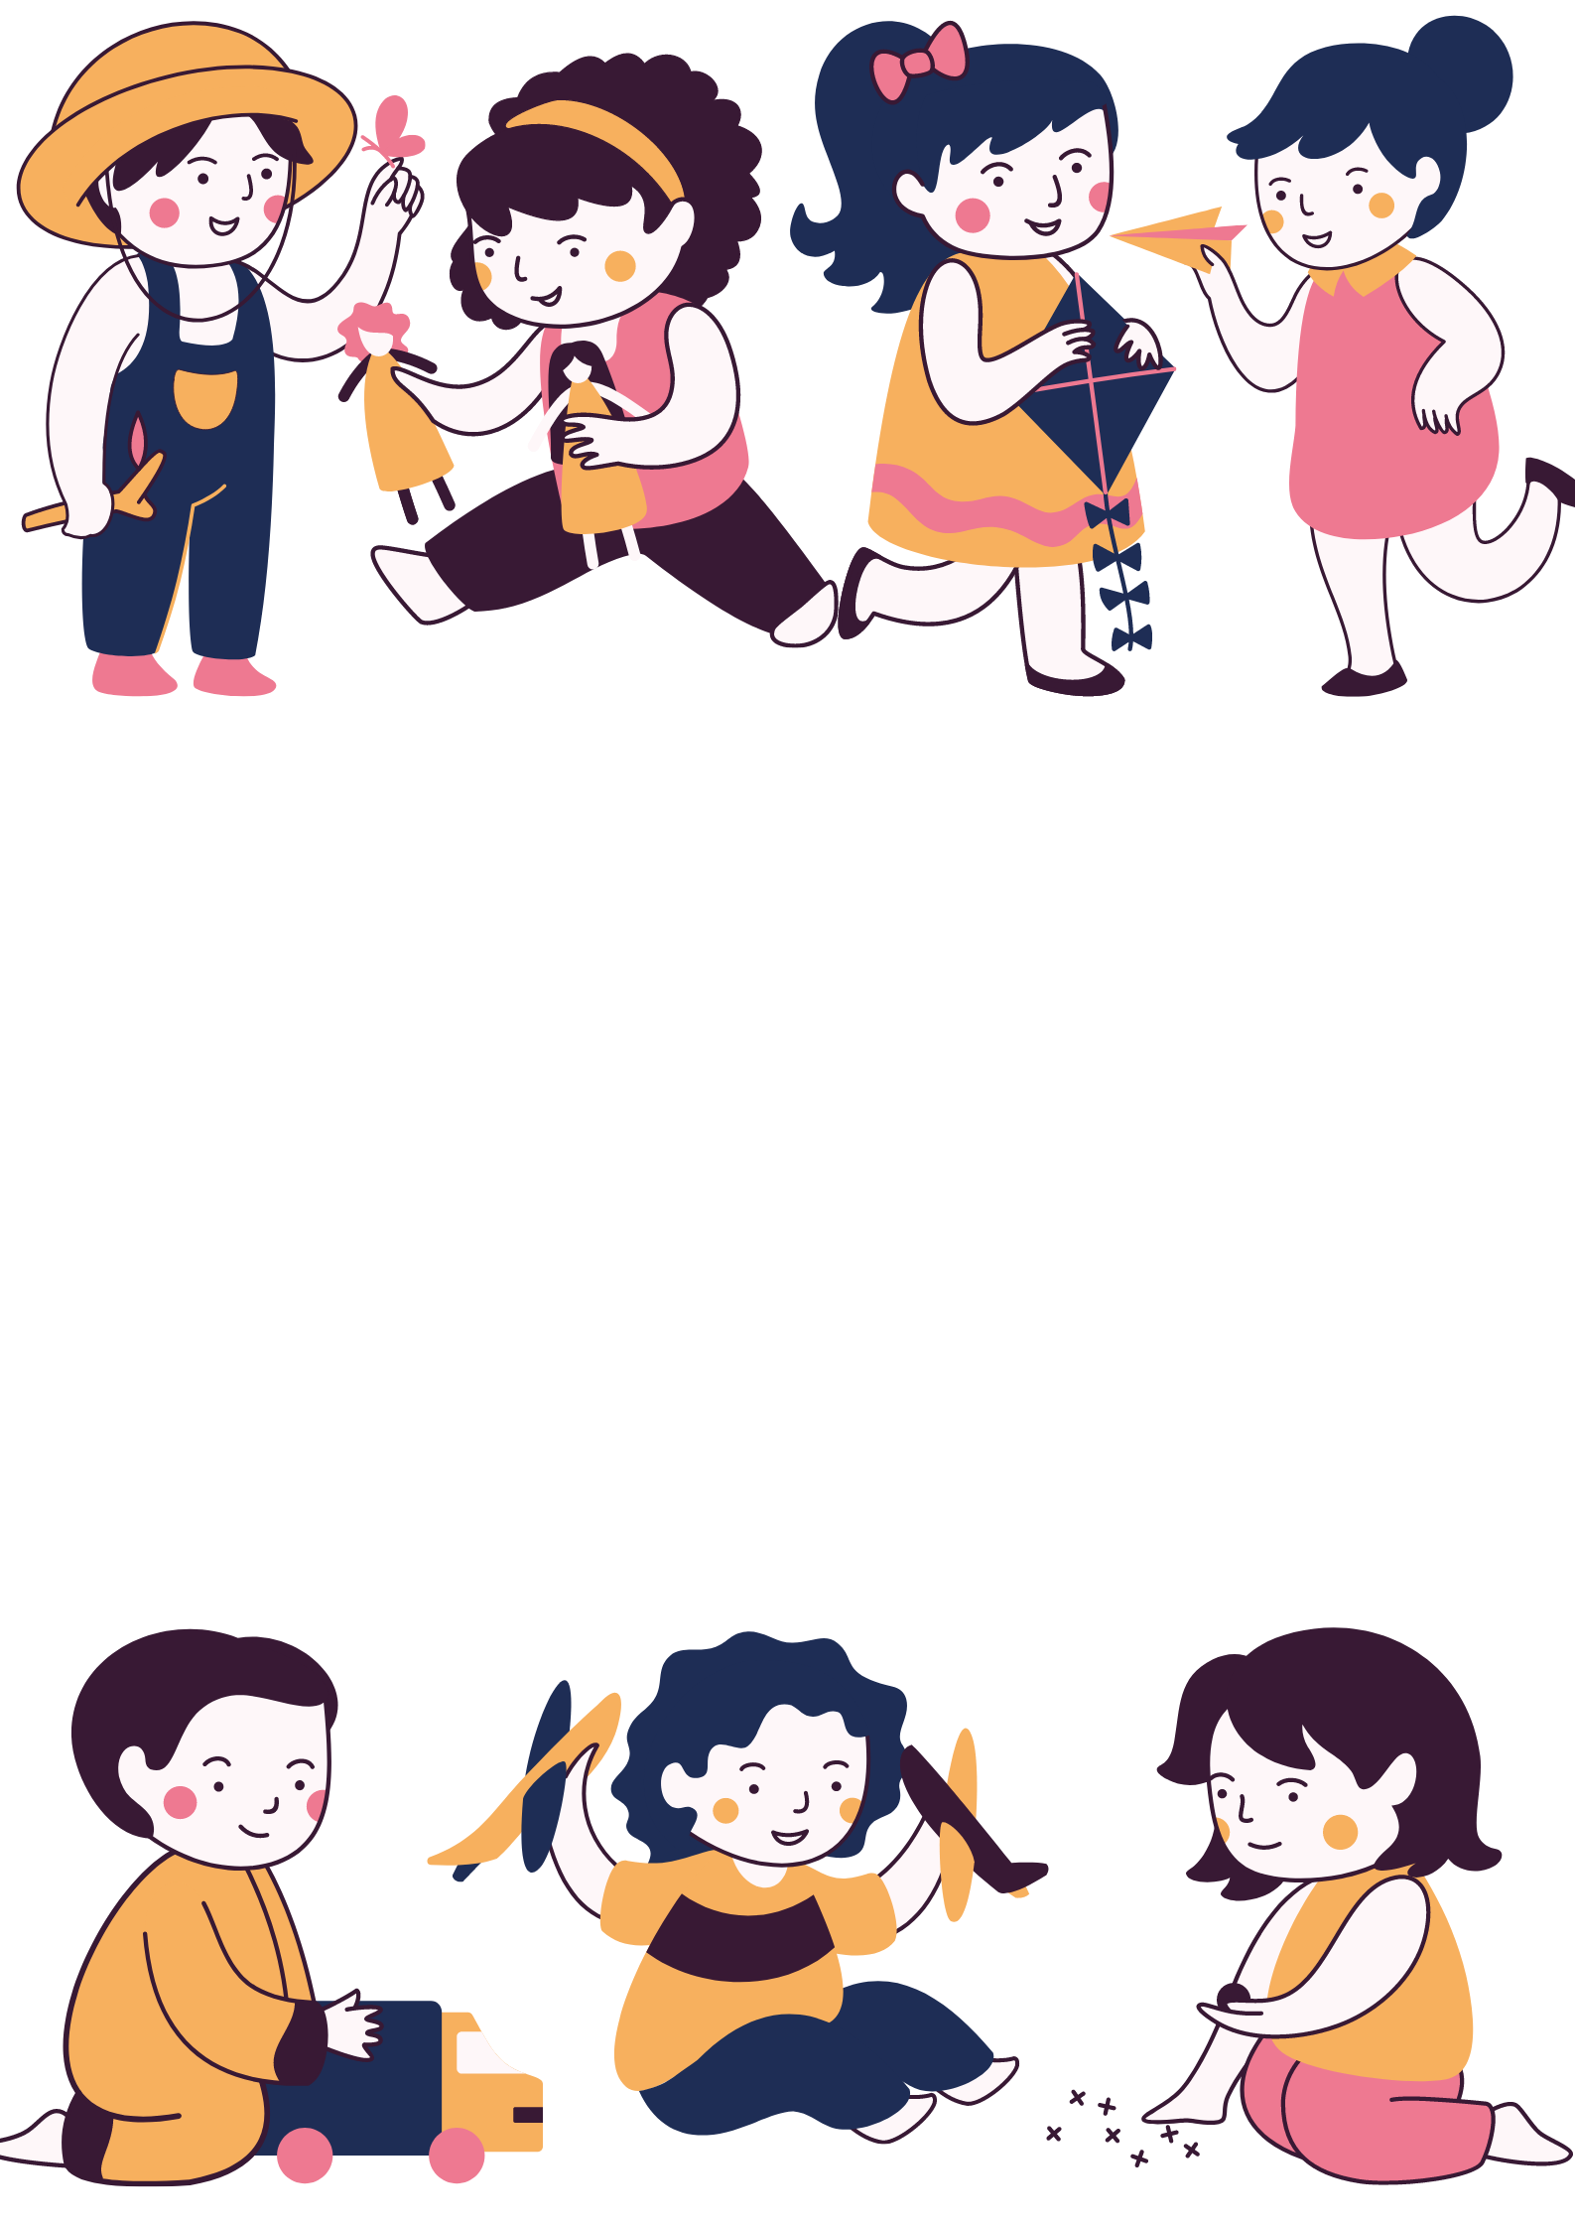
I LIKE…
Notes:
WHO’S FASTER?
DIVIDE PUPILS INTO SMALL GROUPS, ASK THEM TO LOOK AT THE SCREEN,
TEACHER FLASHES THE CARDS AND THE PUPIL SAYS FIRST GETS ONE POINT, WHO GETS HIGHEST POINTS CAN GET FUN STICKERS
COUNT BEFORE FLASHING THE CARD
DO THE SAME WITH ALL WARM-UP SLIDES
PIC 1: SINGING
PIC 2: COMPUTERS

Slide 6


I LIKE…
MY FAVOURITE SUBJECT IS
Notes:
PIC 1: DRAWING
PIC 2: SINGING

Slide 7


Notes:
THIS SLIDE PUPILS MUST TRY TO SAY THE WHOLE SENTENCE ”I LIKE….” “MY FAVOURITE SUBJECT IS…”
PIC 1: COMPUTERS- I LIKE COMPUTERS- MY FAVOURITE SUBJECT IS IT
PIC 2: PE- I LIKE RUNNING- MY FAVOURITE SUBJECT IS PE

Slide 8
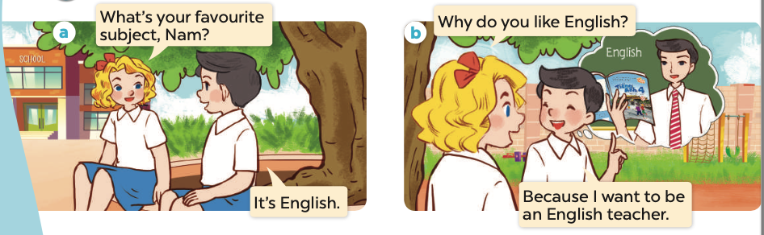

Slide 9


Slide 10
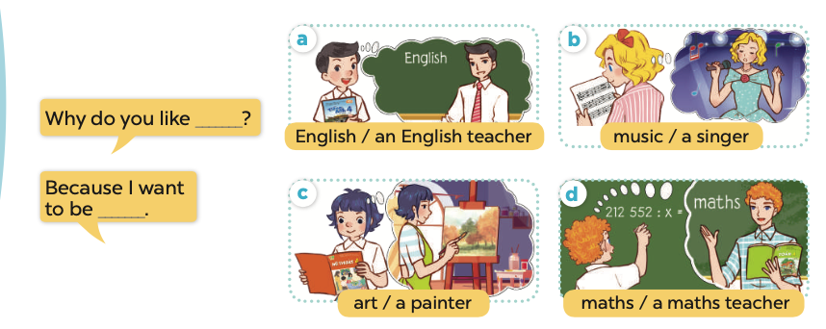
Notes:
request all pupils to stand up and sing with TPR technique/ read the lesson plan for details

Slide 11
Notes:
request all pupils to stand up and sing with TPR technique/ read the lesson plan for details

Slide 12
WHY DO YOU LIKE___?
BECAUSE I WANT TO BE___
Notes:
TEACH THE STRUCTURE, ASK PUPILS TO REPEAR SEVERAL TIMES BEFORE PRACTISING WITH THE FLASHCARDS

Slide 13


WHY DO YOU LIKE___?
BECAUSE I WANT TO BE___
Notes:
TEACH THE STRUCTURE, ASK PUPILS TO REPEAR SEVERAL TIMES BEFORE PRACTISING WITH THE FLASHCARDS

Slide 14

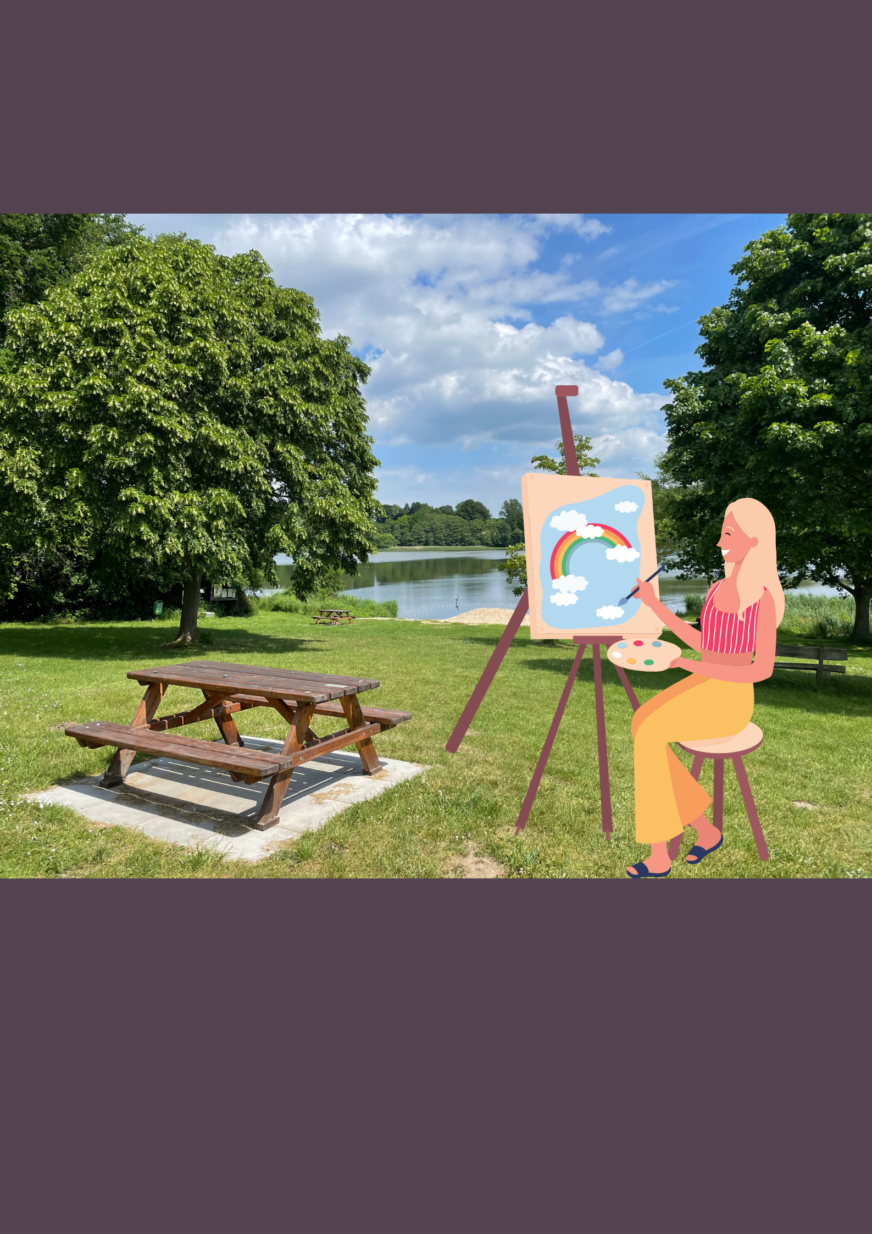
WHY DO YOU LIKE___?
BECAUSE I WANT TO BE___
Notes:
TEACH THE STRUCTURE, ASK PUPILS TO REPEAR SEVERAL TIMES BEFORE PRACTISING WITH THE FLASHCARDS

Slide 16
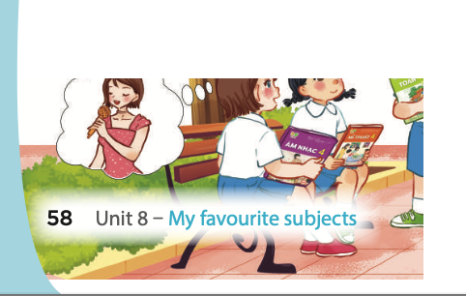

Slide 17



Slide 18



Slide 19
GUESSING GAMES

Slide 20
SHOW

Slide 21
SHOW

Slide 22
SHOW

Slide 23


