Slide 1


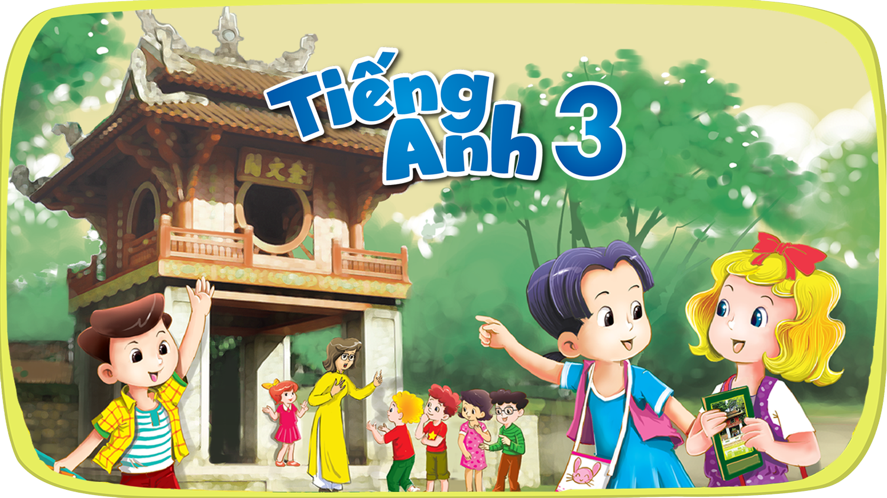


Slide 2





Hai Thanh Primary school
Welcome to our class !
Teacher: Mai Hong Phuong

Slide 3
Hai Thanh Primary school
Welcome to our class !
Teacher: Mai Hong Phuong

Slide 6


I LIKE…
Notes:
PIC 1: COMPUTER- I LIKE COMPUTERS
PIC 2: PE- I LIKE PE

Slide 7


SINGING CONTEST
Notes:
PLAY THE SONG ONCE TO HELP PUPILS RECALL THE RYTHMS AND LYRICS
PLAY “I LIKE” PAUSE, MIMING AN ACTION, GUIDE PUPILS TO SING, SING WITH THEM
REPEAT SEVERAL ACTIONS
LET SOME GROUPS TO COMPETE IF POSSIBLE

Slide 8


Slide 9
Notes:
BDAC

Slide 10
Notes:
BDAC

Slide 11
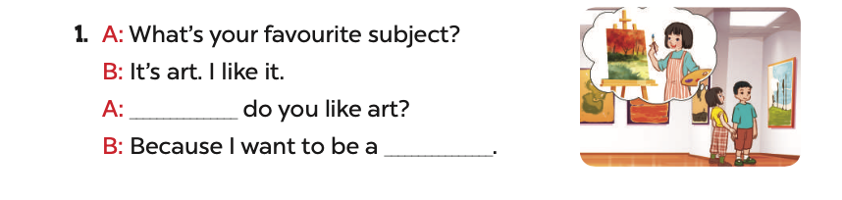
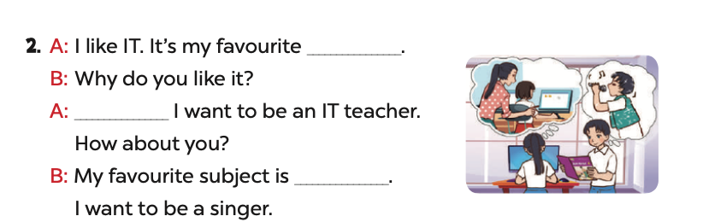

Slide 12
Why
painter

Slide 13
subject
Because
music

Slide 14
Notes:
read out loud together, correct pronunciation if necessary

Slide 15
Notes:
let pupils think and give answer: music- singer; picture- painter- chalk- teacher- computer- IT teacher/ IT

Slide 16
Notes:
explain the rule
cover again to practice making sentences
use unit flashcards to FLASH randomly, reversely and repeatedly to practice making sentences

Slide 17

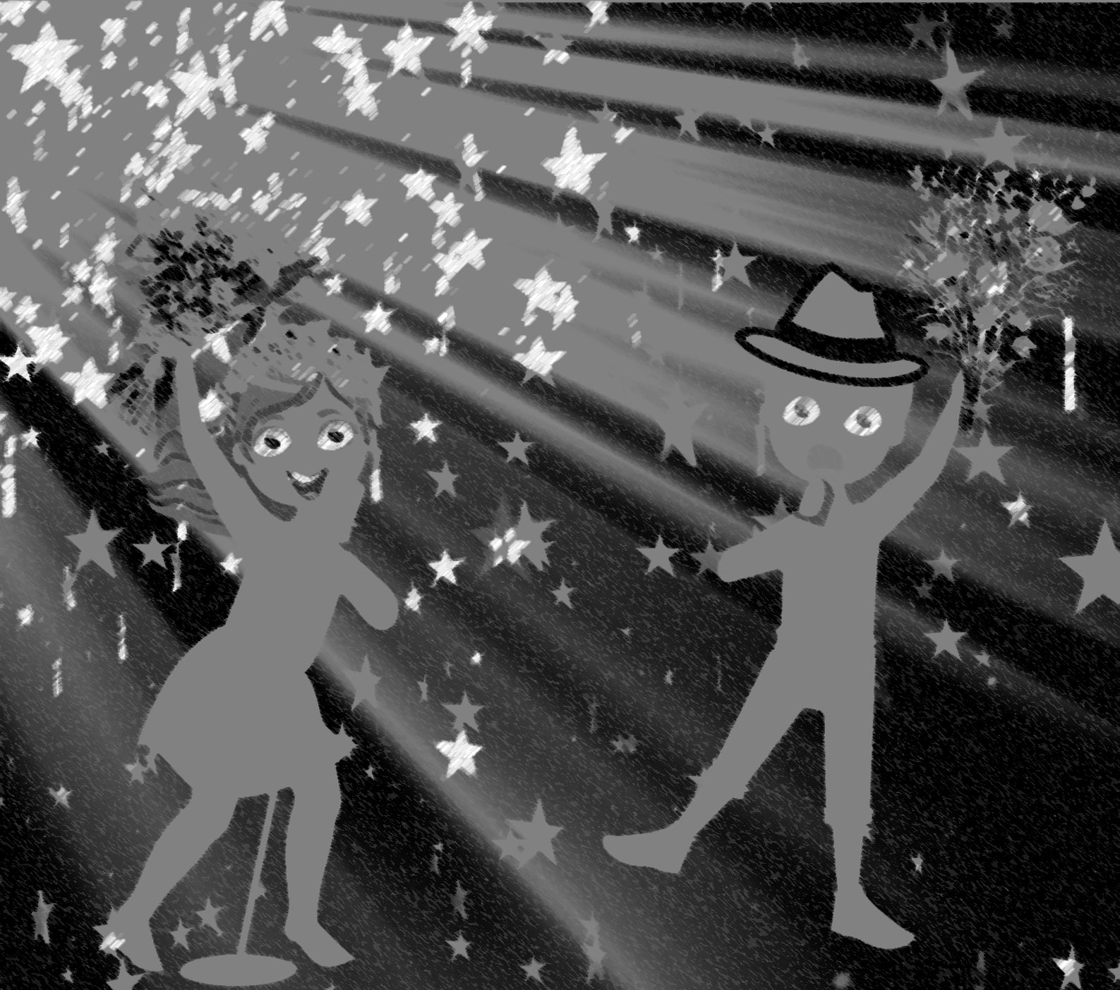
a maths teacher
Notes:
let pupils guess the job to practice saying “I ile music because I want to be a singer”

Slide 18


Notes:
music- singer
if time allowed, let pupils play the game to practice the structure
https://learnenglishkids.britishcouncil.org/word-games/jobs-1

Slide 19


