Slide 1





Hai Thanh Primary school
Welcome to our class !
Teacher: Mai Hong Phuong

Slide 2
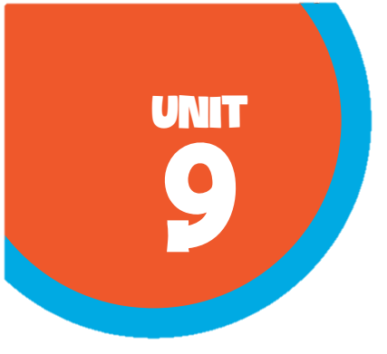
Unit 4 Our Sports Day
Lesson 1 - Period 2

Slide 3
TABLE OF CONTENTS
01
02
03
04
Warm-up & Review
Activity 1
Activity 2
Activity 3
05
Fun Time

Slide 4
01
Warm-up
Guess the month of the year!

Slide 5
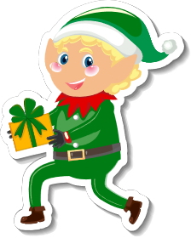
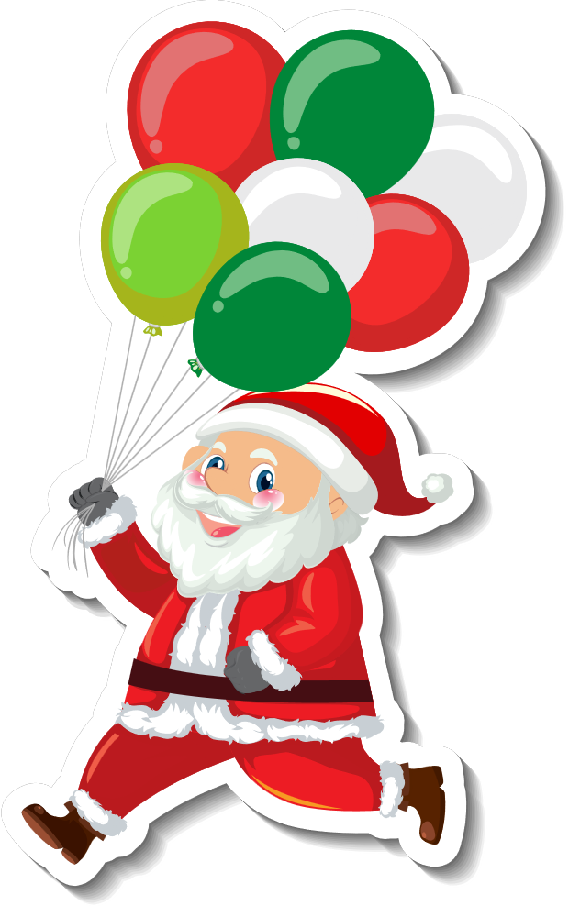




In which month can you see these?

Slide 6
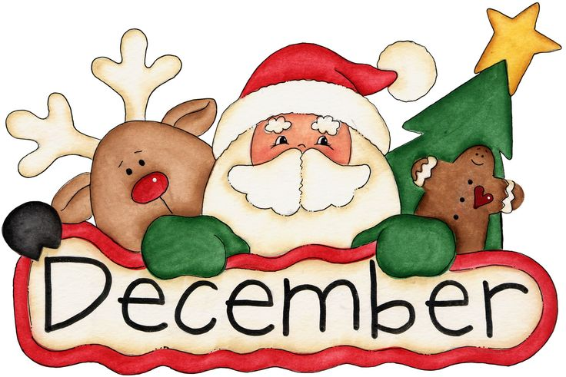
The 12th month of the year

Slide 7


American Independence Day
Summer Holiday

Slide 8

The 7th month of the year

Slide 9

Summer holiday
starts

Slide 10

The 6th month of the year

Slide 11


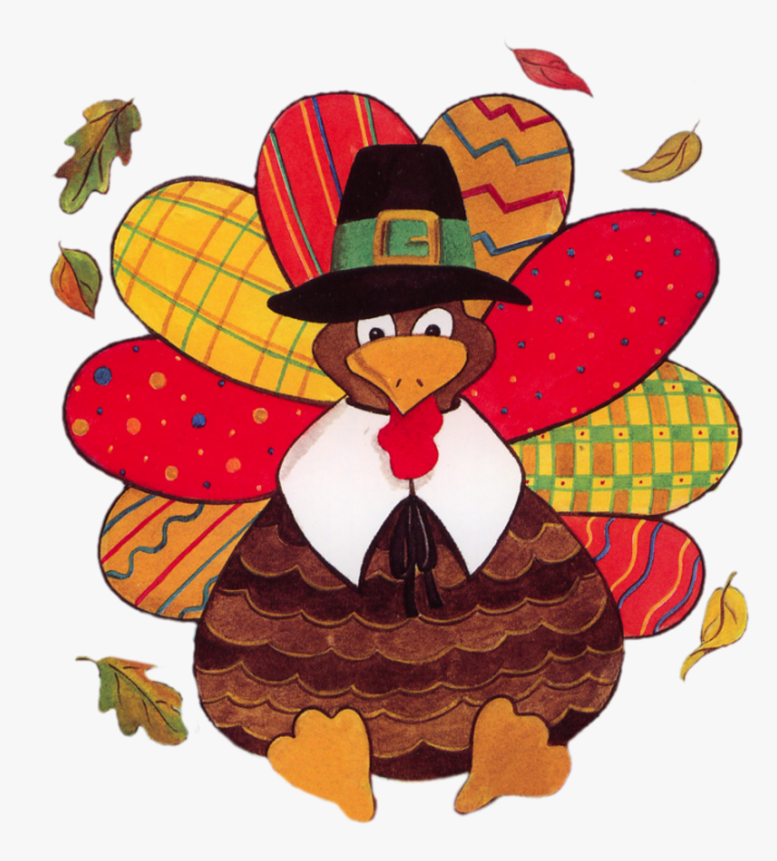

Slide 12

The 11th month of the year

Slide 13



Slide 14
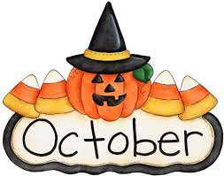
The 10th month of the year

Slide 15


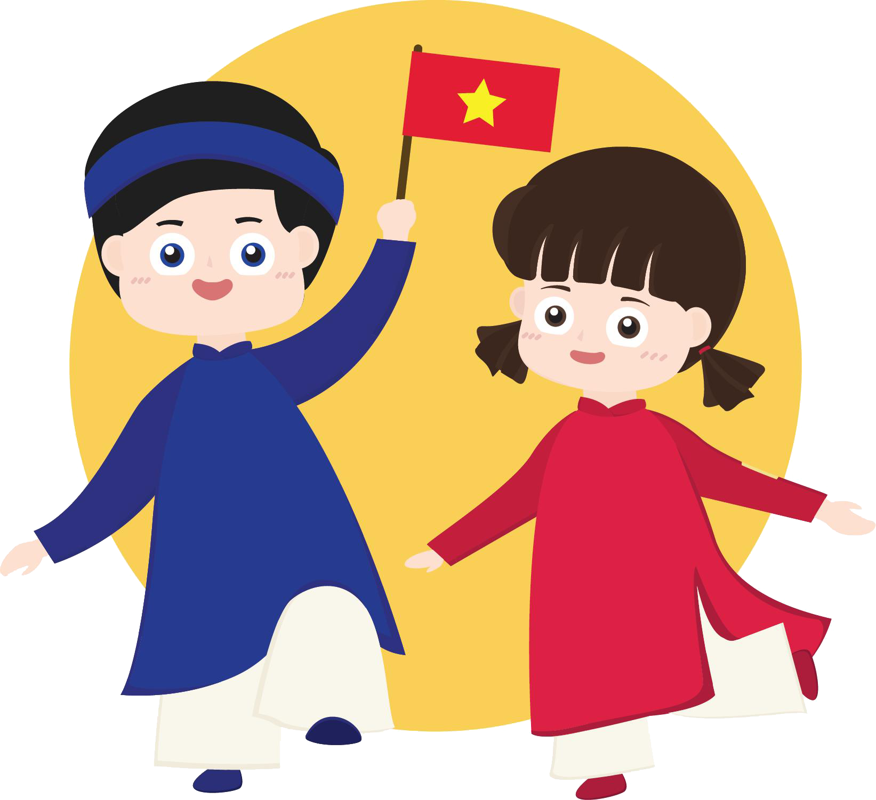

Slide 16

The 9th month of the year

Slide 17
02
Activity 1
Look, listen and repeat.

Slide 18
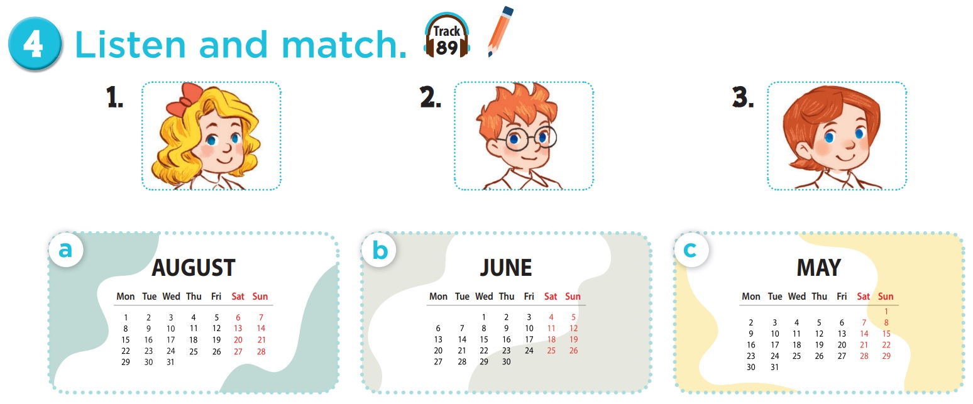

Who is she? Who is he?

Slide 19
Which month do you see?

Slide 20


Slide 21
03
Activity 2
Look, complete and read.

Slide 22
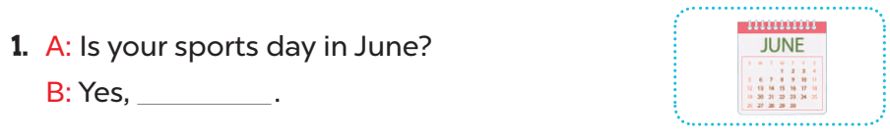
Read. What's the missing word?
it is

Slide 23
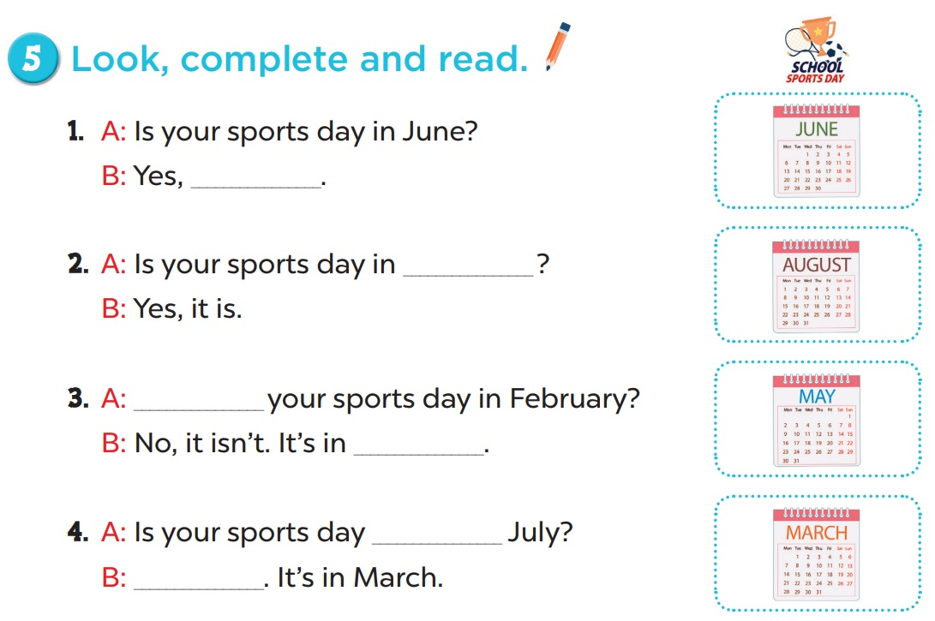
it is
August
Is
May
in
No, it isn't

Slide 24
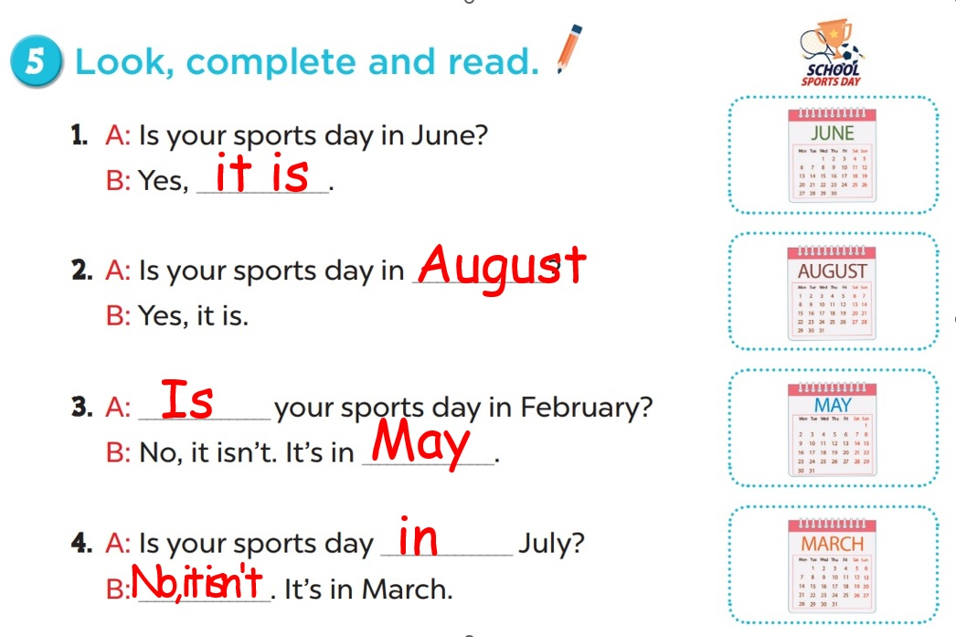
Practice in pairs.

Slide 25
04
Activity 3
Let's sing.

Slide 26
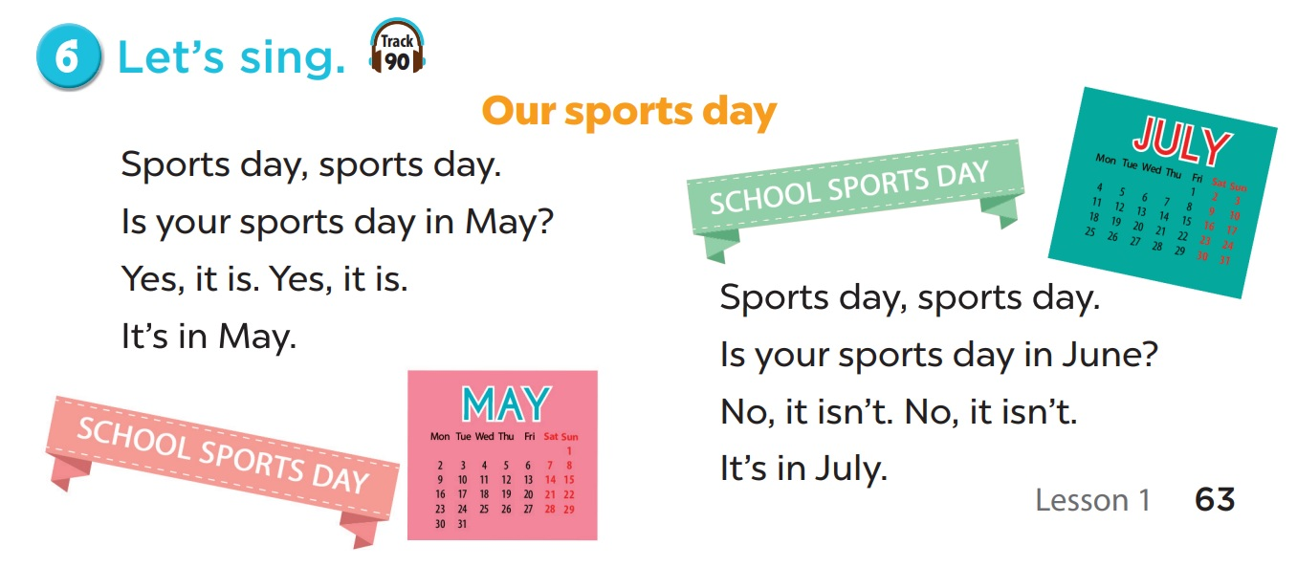
Read the lyrics.

Slide 27
Listen.
Sing the song.
Practise line by line.

Slide 28
05
Fun time
Let's play a game.

Slide 29



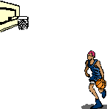
All-Star

Slide 30

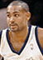
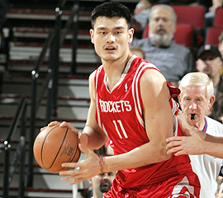

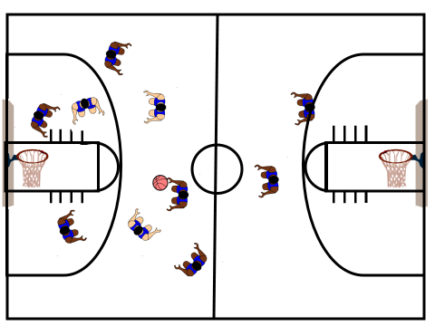
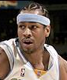
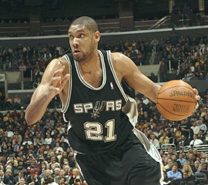


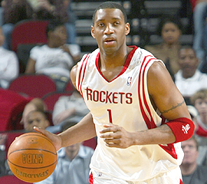

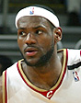

Scoreboard
Grant Hill
Yao Ming
Pippin
Tim Duncan
Allen
Michael Jordan
Grady
Nick
James

Slide 31
Is your sports day _____ June?
in
B
A. on
B. in
C. at
D. for

Slide 32


Slam Dunk
Slam Dunk

Slide 33
___ your sports day in May?
A
A. Is
B. It

Slide 34
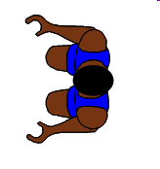
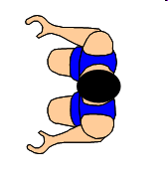

No point!

Slide 35

Is your sports day
in April?
B
A. Yes, it is.
B. No, it isn't.
Notes:
Encourage students to say "It's in March."

Slide 36

Slam Dunk
Slam Dunk

Slide 37

Is your sports day in July?
C
A. Yes, it isn't.
B. No, it isn't.
C. Yes, it is.
D. No, it is.

Slide 38

Slam Dunk
Slam Dunk

Slide 39

A: Is your sports day
in ___?
B: Yes, it is.
A
A. March
B. May

Slide 40
Slam Dunk
Slam Dunk

Slide 41
A: Is your sports day
in ___?
B: No, it isn't.
B
A. March
B. May

Slide 42
No point!

Slide 43
A: Is your sports day
in February?
B: Yes, _____.
A
A. it is
B. it isn't

Slide 44

Slam Dunk
Slam Dunk

Slide 45
A: Is your sports day in September?
B: No, _____.
B
A. it is
B. it isn't

Slide 46

Slam Dunk
Slam Dunk

Slide 47
A: Is your sports day
in January?
B: _____. It's in March.
C
A. Yes, it isn't.
B. Yes, it is.
C.No, it isn't.
D. No, it is.

Slide 48
Slam Dunk
Slam Dunk

