Slide 1





Hai Thanh Primary school
Welcome to our class !
Teacher: Mai Hong Phuong

Slide 2

Unit 4
Our Sports Day
Lesson 2 - Period 4

Slide 3
TABLE OF CONTENTS
01
02
03
04
Warm-up
Activity 1
Activity 2
Activity 3
05
Fun Time

Slide 4
01
Warm-up

Slide 5

Notes:
Link: https://youtu.be/SSl-SbVz2oA

Slide 6
Unscramble the letters.
Notes:
- Divide pupils into teams.
- Show the scrambled letters. Have pupils think and whisper the answer to their friend.
- Teacher calls out the representatives to race to the board and write the answer.
- Teacher gives stars/ points to the team with correct answer. Give extra stars/ points to the fast team(s).

Slide 7





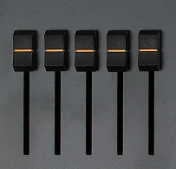




M D B E E E C R
DECEMBER
Notes:
Click on the red button to reveal the answer.

Slide 8
B E O R T O C
OCTOBER
Notes:
Click on the red button to reveal the answer.

Slide 9
Y J U A R A N
JANUARY
Notes:
Click on the red button to reveal the answer.

Slide 10
U S A T U G
AUGUST
Notes:
Click on the red button to reveal the answer.

Slide 11
T E M B S E R E P
SEPTEMBER
Notes:
Click on the red button to reveal the answer.

Slide 12
V M B E N O E R
NOVEMBER
Notes:
Click on the red button to reveal the answer.

Slide 13
03
Activity 1
Look, listen and repeat.

Slide 14
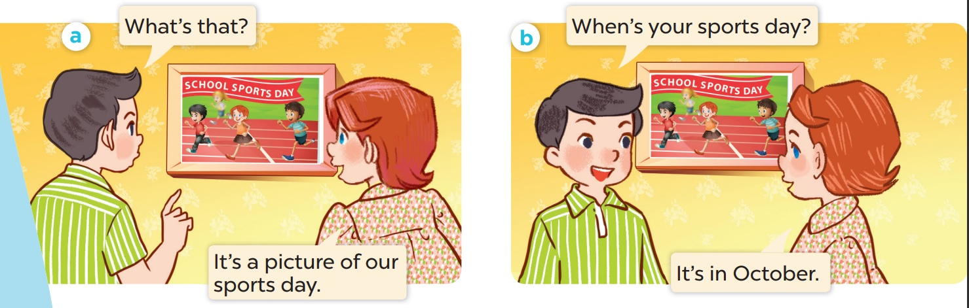
Who is the girl? Who is the boy?

Slide 15

Look, listen and repeat.

Slide 16
Work in pairs. Practise.

Slide 17
03
Activity 2
Listen, point and say.

Slide 18


When's your sports day?
When is your sports day?
It's in May.

Slide 19


When's your sports day?
When is your sports day?
NOVEMBER
It's in November.

Slide 20
When's your sports day?
When is your sports day?
It's in _____.

Slide 21
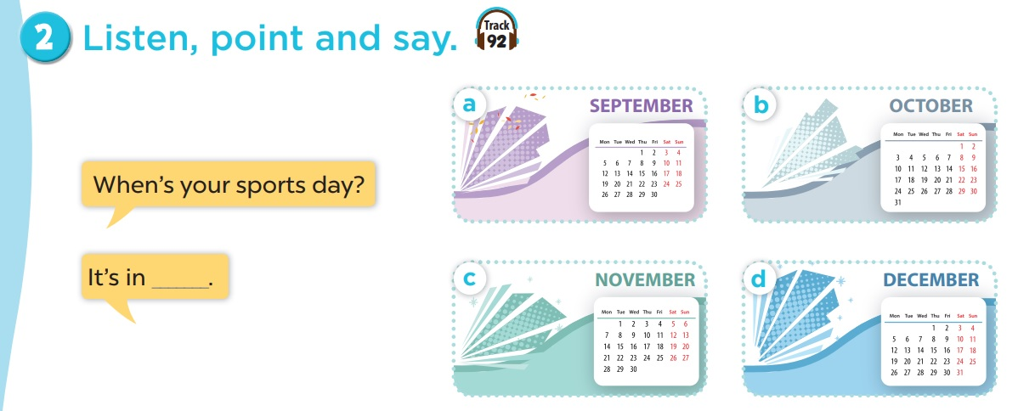
Listen, point and say.
Work in pairs. Practise.
Notes:
Click on the Speaker Icon to play the audio.

Slide 22
04
Activity 3
Let's talk.

Slide 23
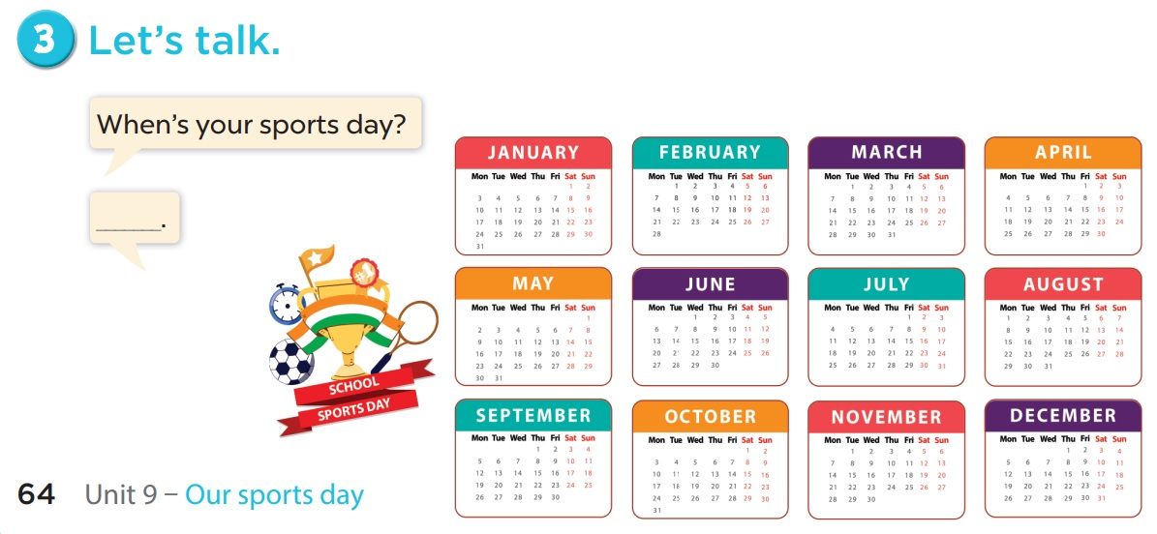

Slide 24
06
Fun time
Choose a number.
Ask and Answer.
Have fun.

Slide 25

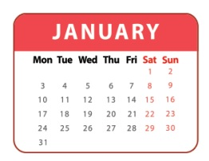

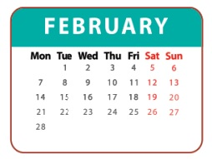
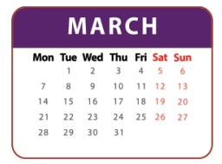

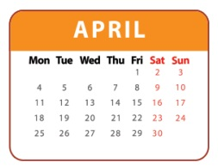
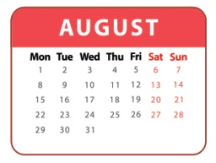
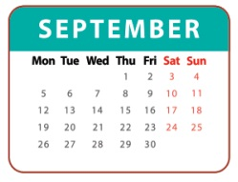
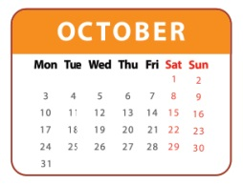
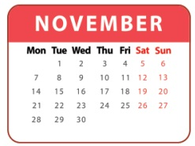
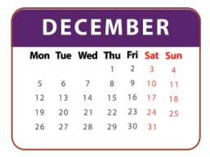
1
2
3
= +1 point
4
5
6
= lose 2 points
= rock, paper, scissors
(winner takes 2)
7
8
9
Notes:
- Divide the class into 3 teams.
- Pupils from each team choose a number (or throw sticky ball on the grid to choose the number), then have 2 pupils from each team ask and answer with the picture in that number.
- Pupils or teacher clicks on the month to reveal the icons indicating the points for that team.
- After 9 numbers, the team with the most points is the winner.

