Slide 1





Hai Thanh Primary school
Welcome to our class !
Teacher: Mai Hong Phuong

Slide 2
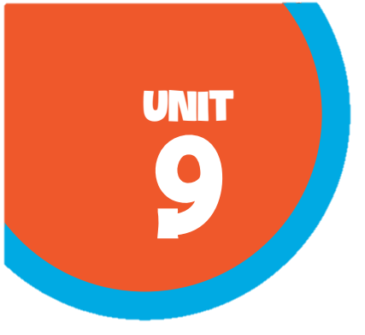
Unit 4 Our Sports Day
Lesson 2 - Period 4

Slide 3
TABLE OF CONTENTS
01
02
03
04
Warm-up & Review
Activity 4
Activity 5
Activity 6

Slide 4
01
Warm -up & Review

Slide 5
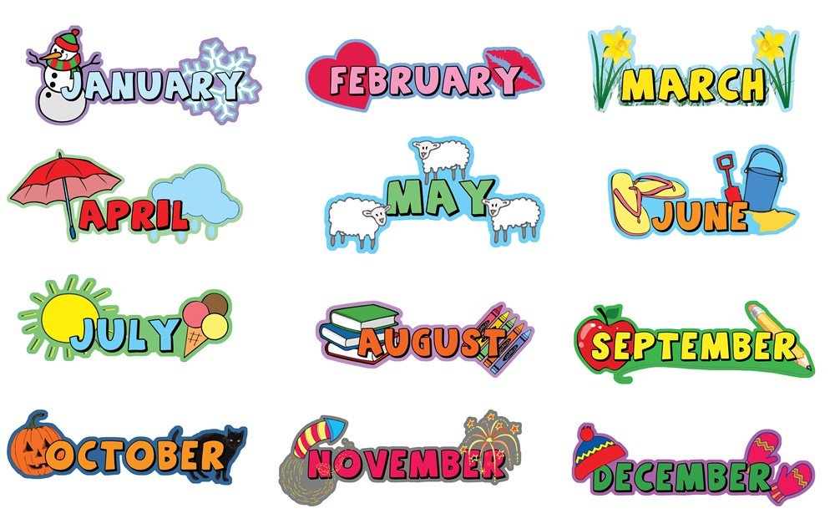
12 months of the year

Slide 6

Is your sports day in ___?
Yes, it is.
No, it isn't. It's in ____.

Slide 7
When's your sports day?
When is your sports day?
It's in _____.

Slide 8

1
2
3
THE
FOOTBALL GAME
4
5
6
7
8
9
Activity 4

Slide 9

_____ your sports day?
When's
A. When
B. Whens
C. When's

Slide 10
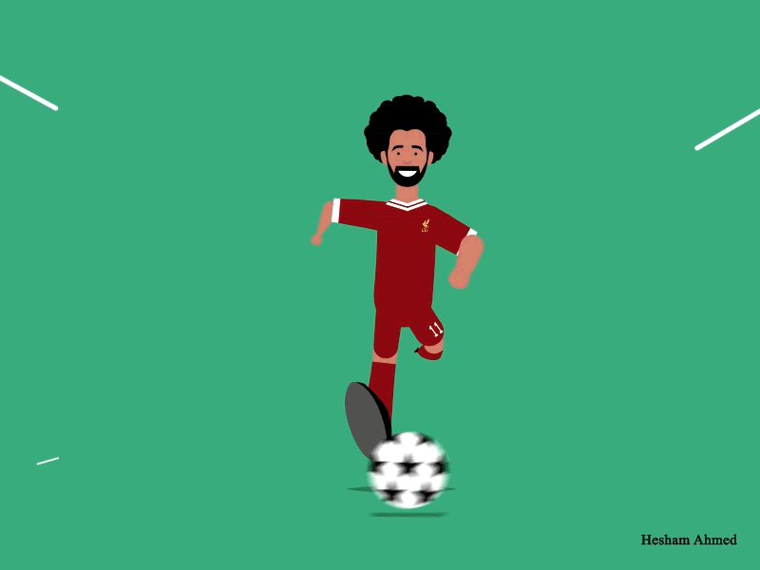

+ 3 points

Slide 11
Is
____ your sports day in June?
A. Are
B. Is
C. It

Slide 12
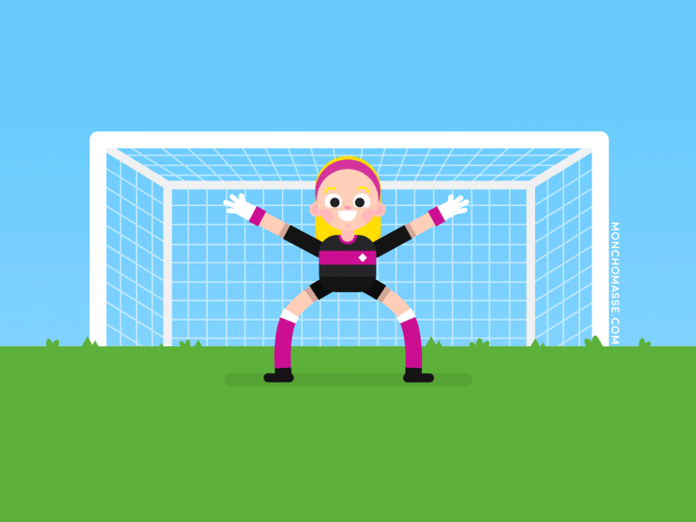
+ 5 points

Slide 13
When's your sports day?
A. It
B. It's
C. Is
___ in February.
It's

Slide 14
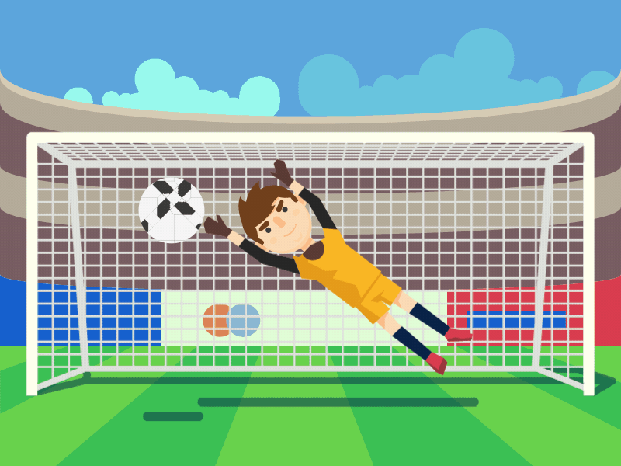
+ 2 points

Slide 15
Is your sports day
in May?
A. it is
B. it's
C. it isn't
Yes, _____.
it is

Slide 16
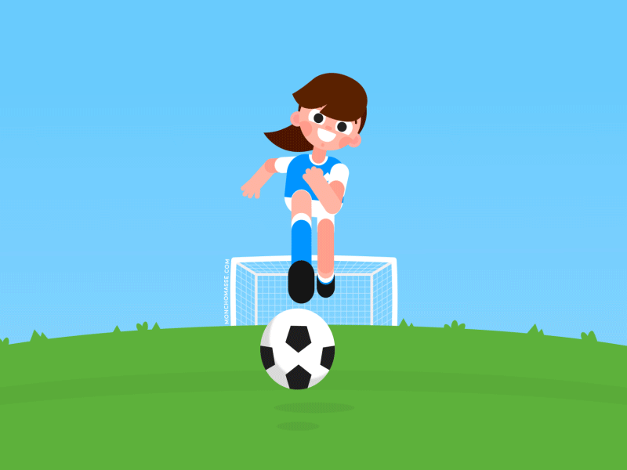
Take 2 points from another team

Slide 17
Is your sports day
in December?
A. it not
B. it's
C. it isn't
No, _____.
it isn't

Slide 18
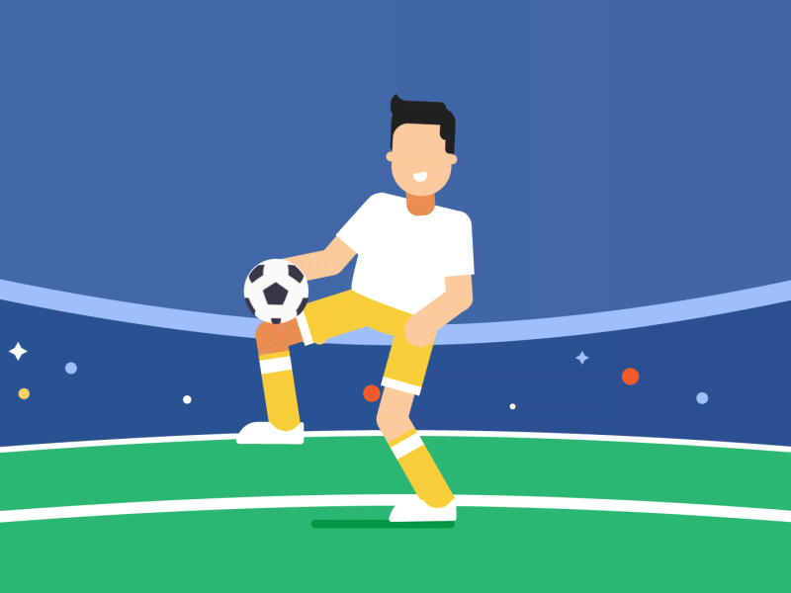
Change points with another team

Slide 19


When's your sports day?
It's in _______.
December

Slide 20
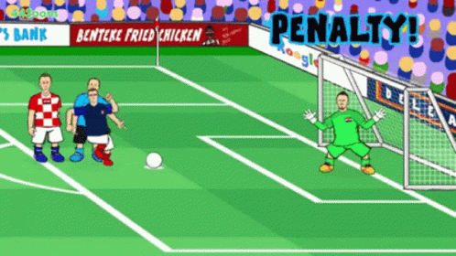
Oh no!
-3 points

Slide 21


When's your sports day?
Jun
It's in _______ .
June

Slide 22
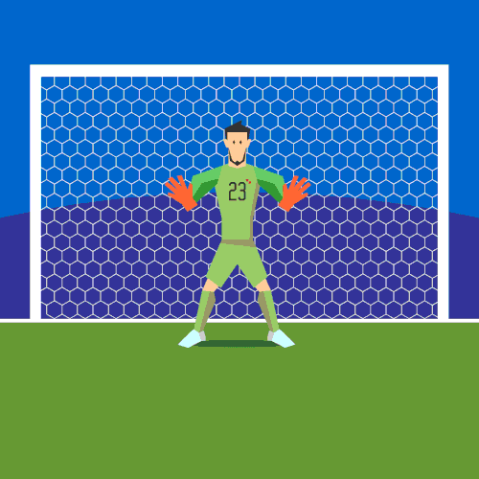
+ 4 points

Slide 23
When's your sports day?
Feb
It's in _______ .
February

Slide 24
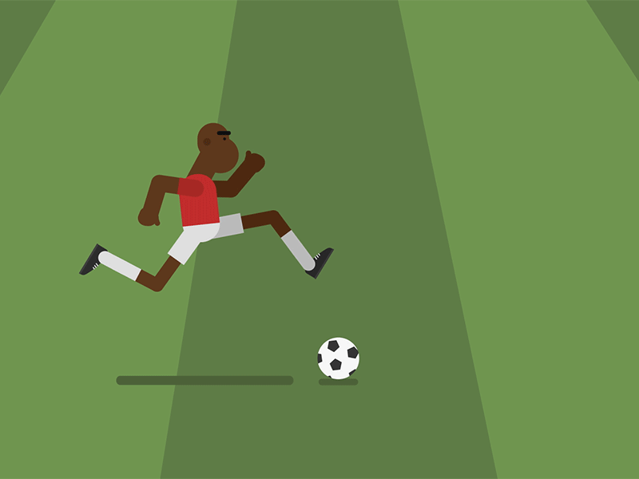
Too slow!
-2 points

Slide 25
Is your sports day
in June?
Jul
No, it isn't. It's in July.

Slide 26
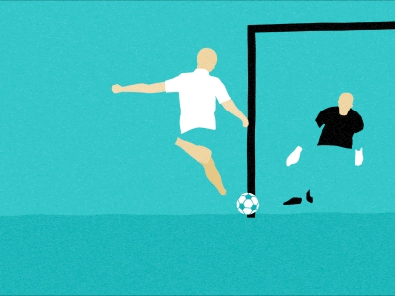
Oops!
-3 points

Slide 27
02
Activity 4
Listen and tick.

Slide 28
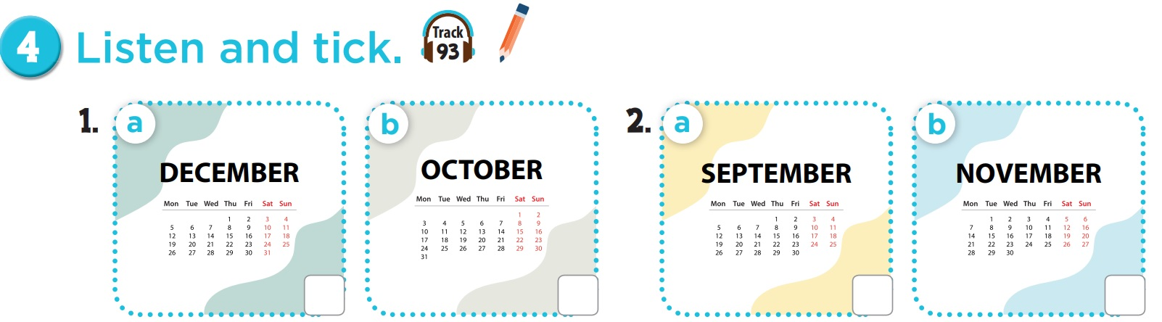
Look and read the months.

Slide 29
Listen and tick.



Slide 30
03
Activity 5
Look, complete and read.

Slide 31
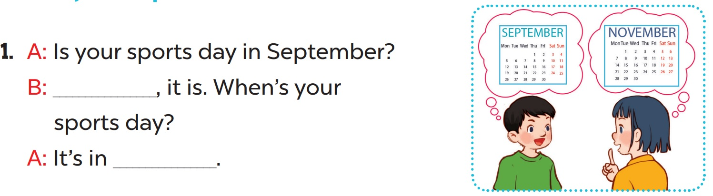
Yes
November

Slide 32
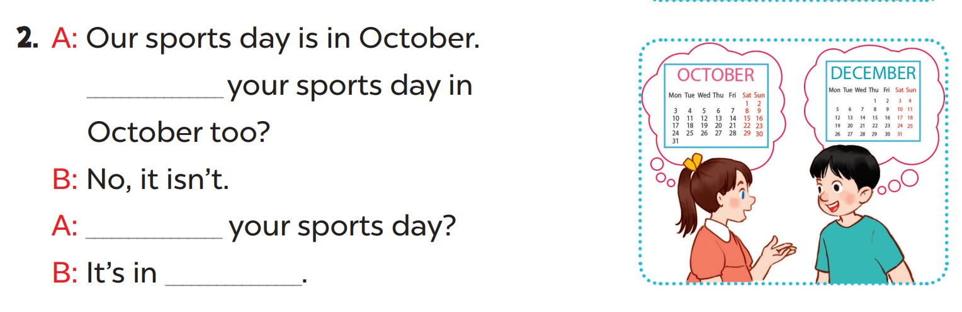
Is
When
December

Slide 33
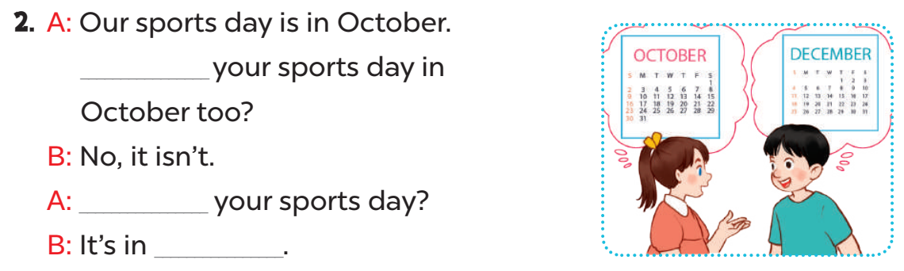
Is
When
December

Slide 34
04
Activity 6
Let's play.

Slide 35
