Slide 1





Hai Thanh Primary school
Welcome to our class !
Teacher: Mai Hong Phuong

Slide 2

Unit 4
Our Sports Day
Lesson 3 - Period 6

Slide 3
TABLE OF CONTENTS
01
02
03
04
REVIEW (chant)
Read and tick True or False
Let’s write
Project
05
Fun time

Slide 4
01
Let’s review.

Slide 5
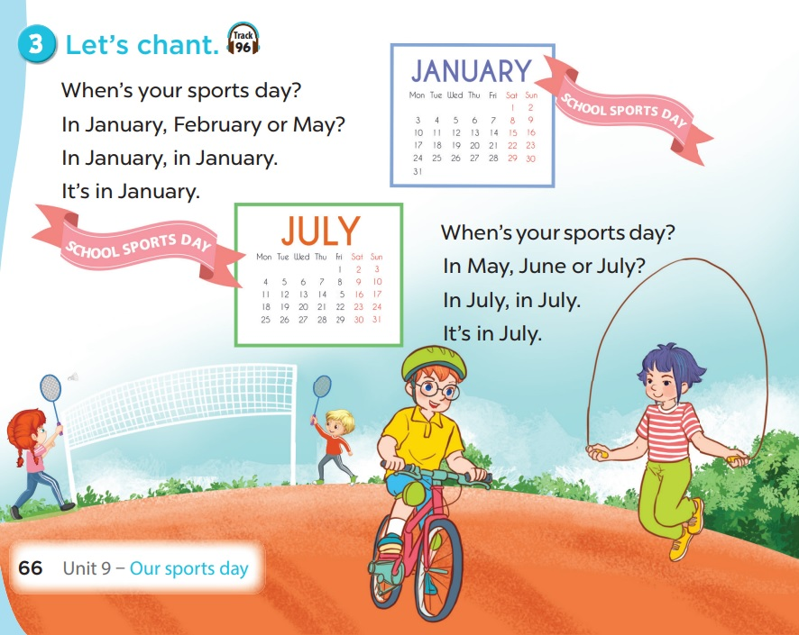


Slide 6
02
Read and tick True or False.

Slide 7
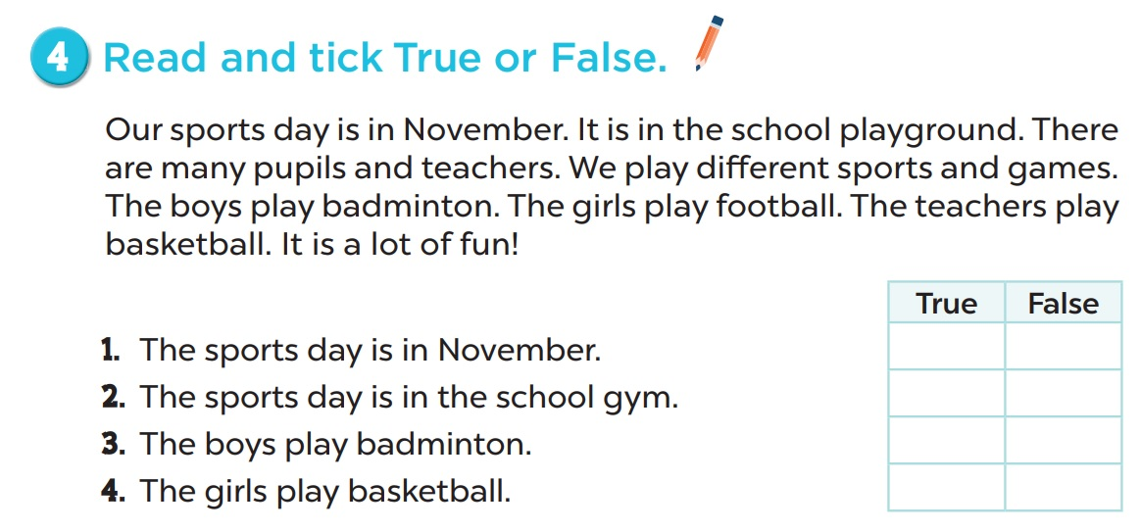








Slide 8
03
Let’s write.

Slide 9
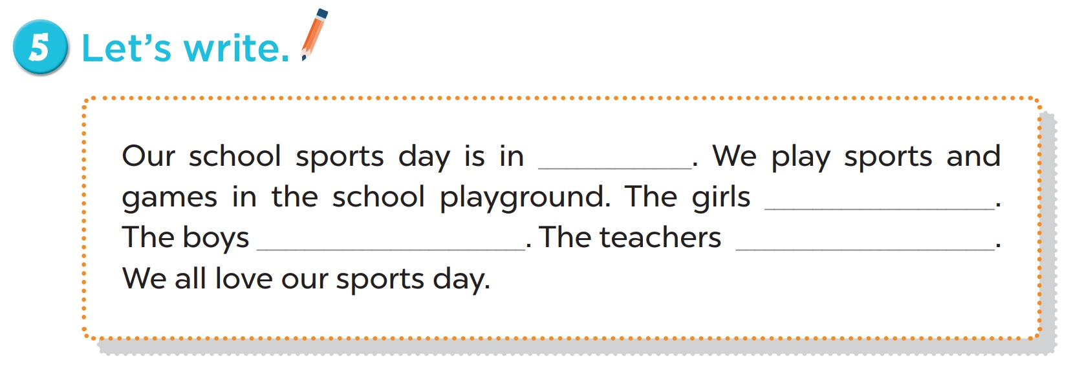

Slide 10
04
Project

Slide 11
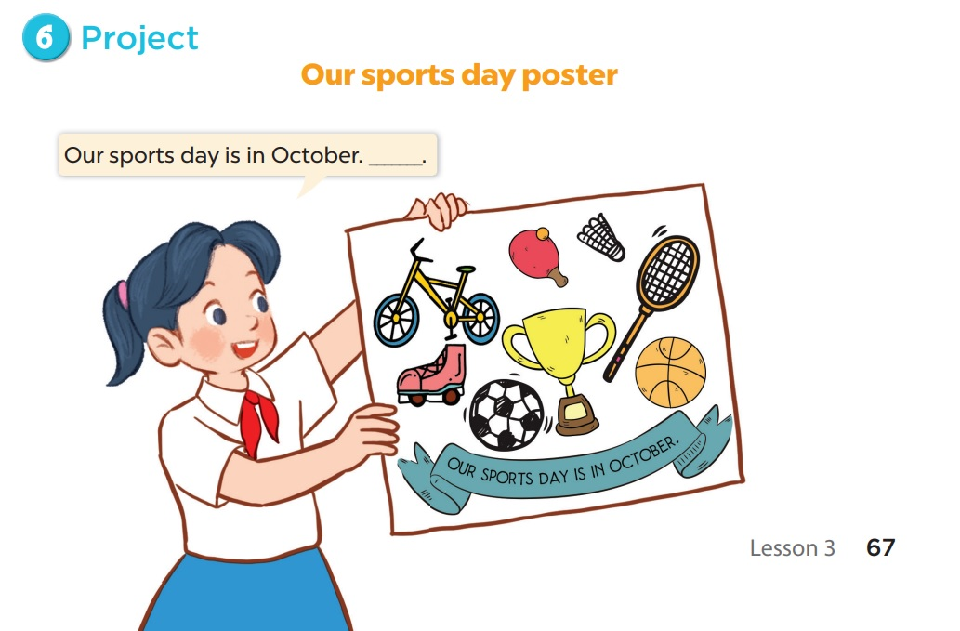

Slide 12
05
Fun time

Slide 13




Notes:
Visit
http://www.waygook.org/index.php/topic,36278.0.html
http://www.eslhero.com/lessonplans.php?categoryid=19
For more

Slide 14



A
B
C
1
2
3
4
Notes:
24 Questions

Slide 15





Slide 16


When’s your sports day?
It’s in August.

Slide 17
When’s your sports day?
It’s in September.

Slide 18
Is your sports day in June?
No, it isn’t. It’s in May.
Notes:
Students fill in the blank

Slide 19
When’s your sports day?
It’s in November.
Notes:
Students fill in the blank

Slide 20
Our …………..…… in July.
sport days
sports day
Notes:
Students fill in the blank

Slide 21
My …………..……is in December.
birth day
birthday
Notes:
Students fill in the blank

Slide 22
When’s your sports day?
It’s in April.
Notes:
Teacher says the first sentence. Student replies using the new structure. Click the rabbit to go back to question slide.

Slide 23
When’s your birthday?
It’s in …….
Notes:
Teacher says the first sentence. Student replies using the new structure. Click the rabbit to go back to question slide.

Slide 24
Our sports day is ……… March.
in
on
Notes:
Teacher says the first sentence. Student replies using the new structure. Click the rabbit to go back to question slide.

Slide 25
Our sports day is on November.
True
False
Notes:
Teacher says the first sentence. Student replies using the new structure. Click the rabbit to go back to question slide.

Slide 26
Our sports day is in ………...
July
August
Notes:
Teacher says the first sentence. Student replies using the new structure. Click the rabbit to go back to question slide.

Slide 27
Our sports day is in February.
True
False
Notes:
Students answer the questions. Click one of the Pokémon to go to sailboat slide

