Slide 1









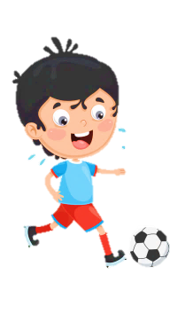













Slide 2
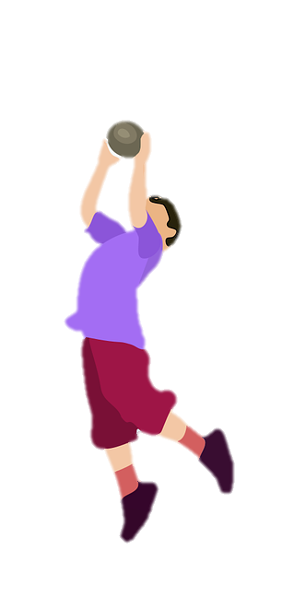
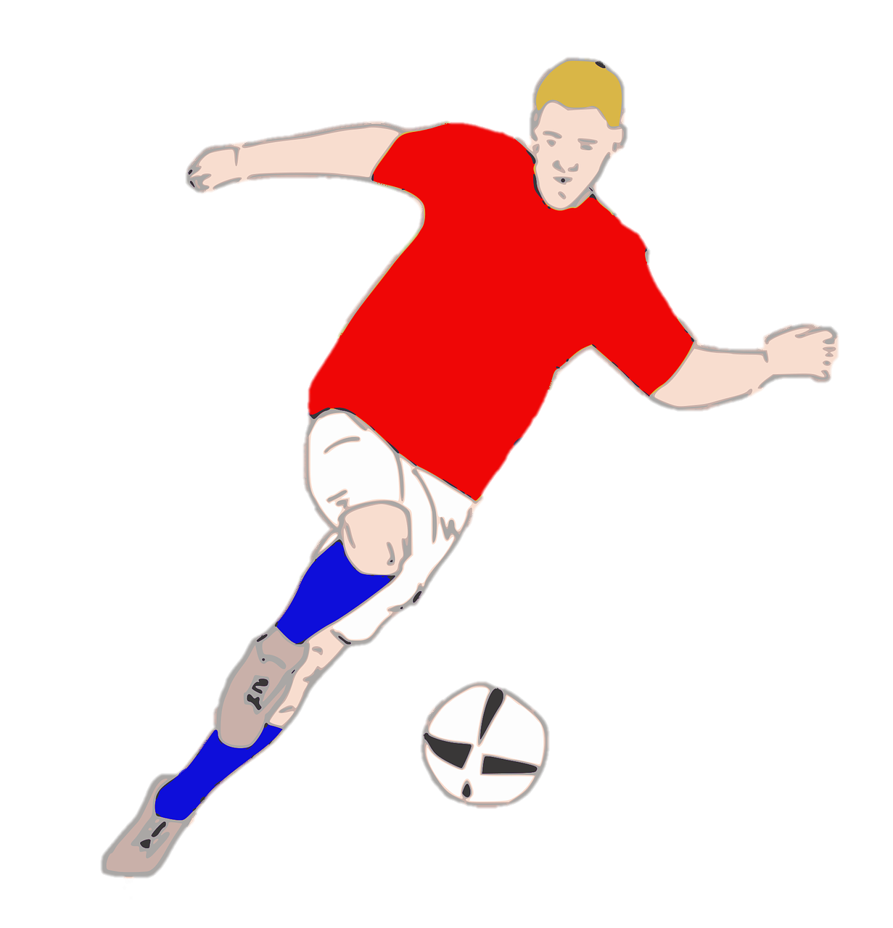
Unit 7:
SPORTS
Lesson 2 – Part 4,5,6

Slide 3





Table of contents
01
02
Warm-up
Presentation
04
05
Production
Wrap-up &
Assessment
03
Practice

Slide 4


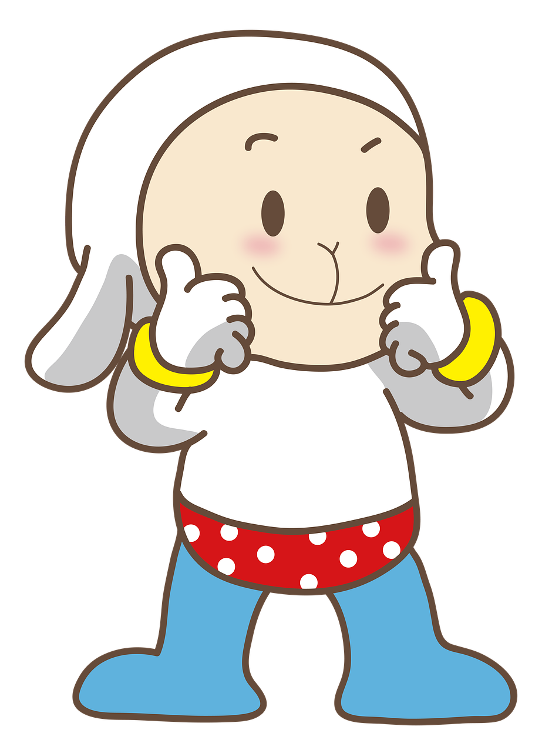
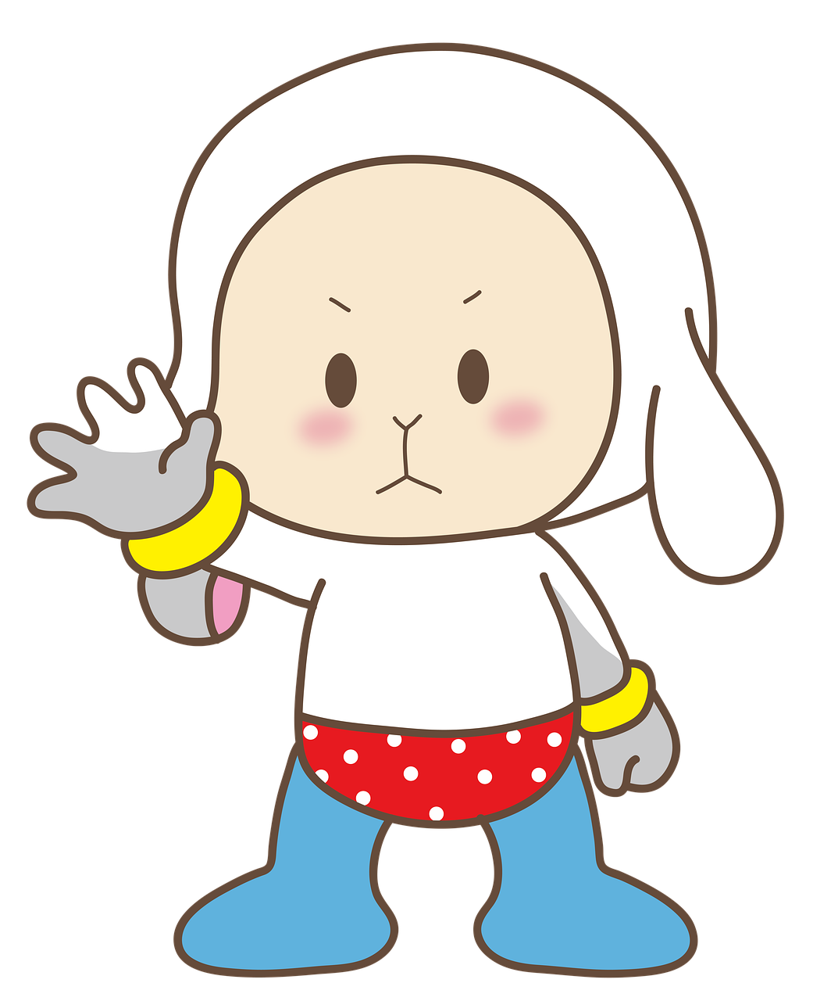
1
Warm-up

Slide 5

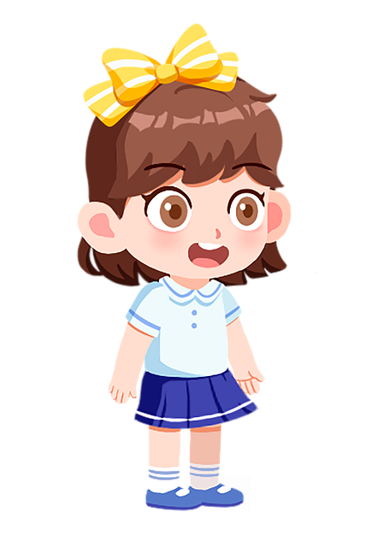
Let’s play
Crossword Puzzle!

Slide 6
2
c
o
n
t
r
o
l
5
f
i
g
h
t
1
4
n
i
m | i | n | d
n
i
k | i | c | k
3
o
o
t
m |  | v | e | m | e | n | t
t
Next
Notes:
T clicks the number to show the question (image clue), clicks the puzzle to show the answer (the word).

Slide 7
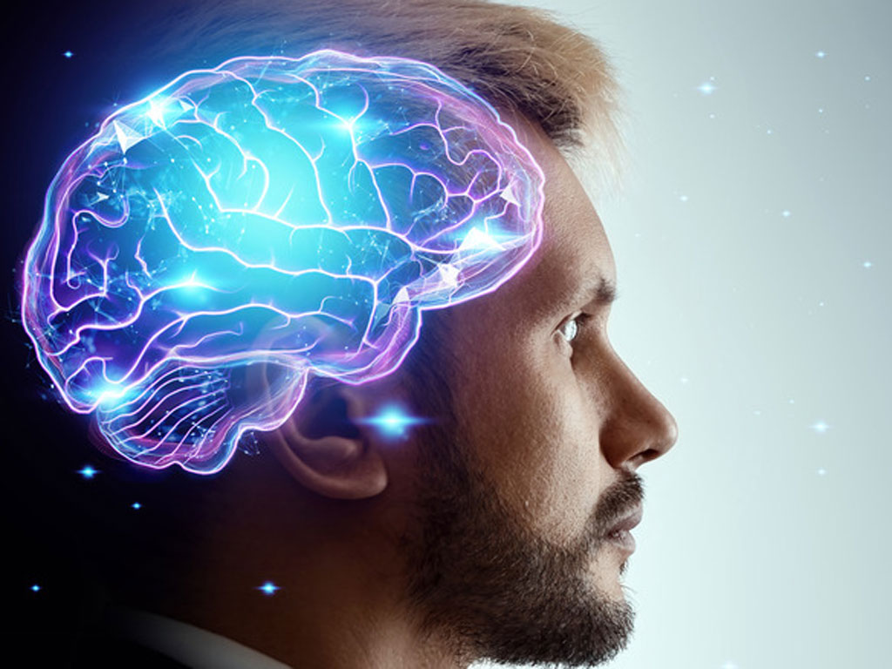
1
_ _ _ _
mind
back

Slide 8

2
_ _ _ _ _ _
control
back

Slide 9
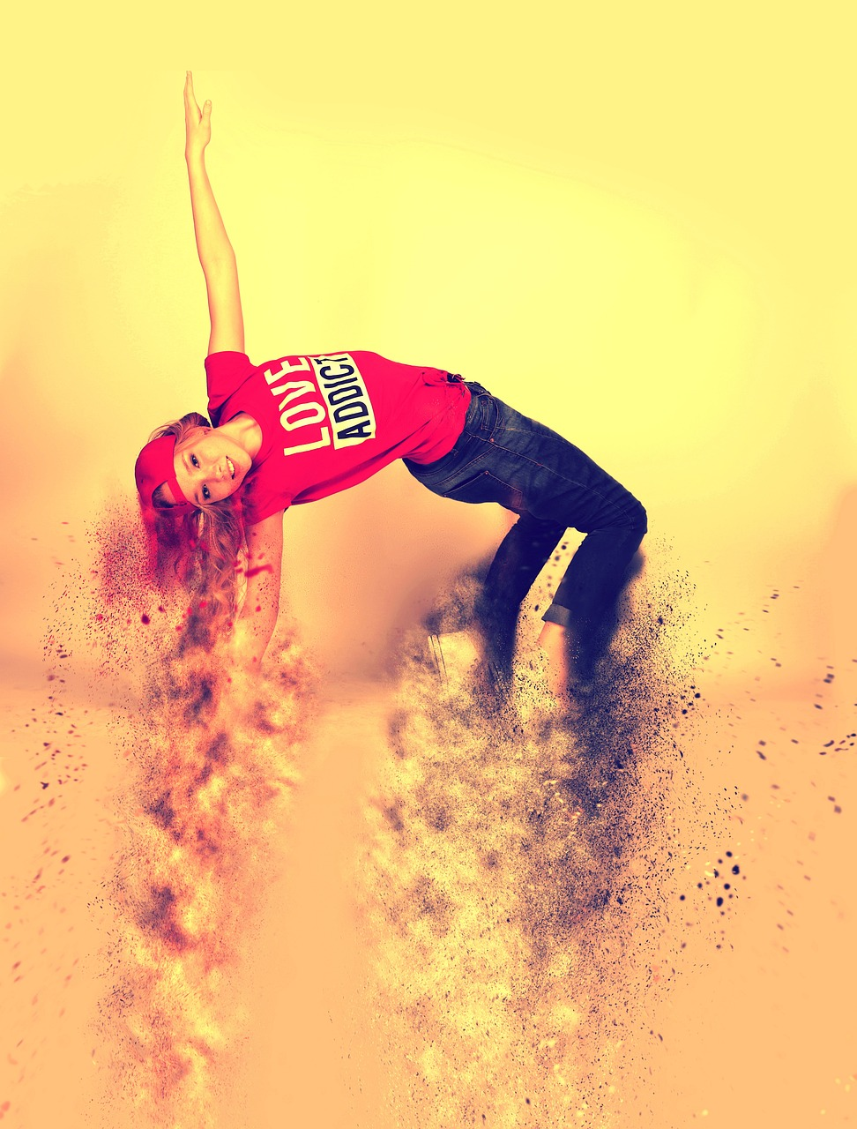
3
movement
_ _ _ _ _ _ _ _
back

Slide 10
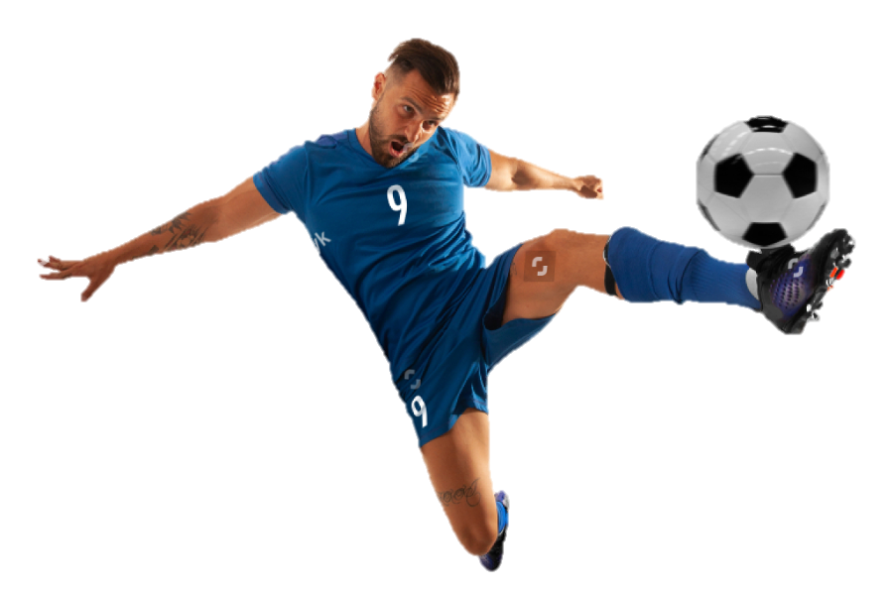
4
_ _ _ _
kick
back

Slide 11
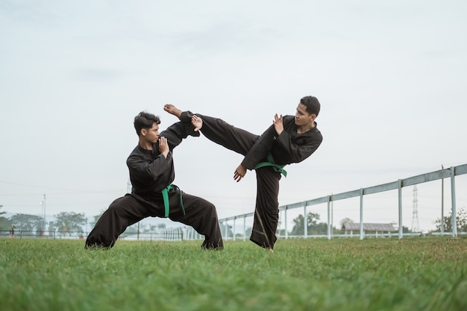
5
_ _ _ _ _
fight
back

Slide 12
2
Presentation

Slide 13
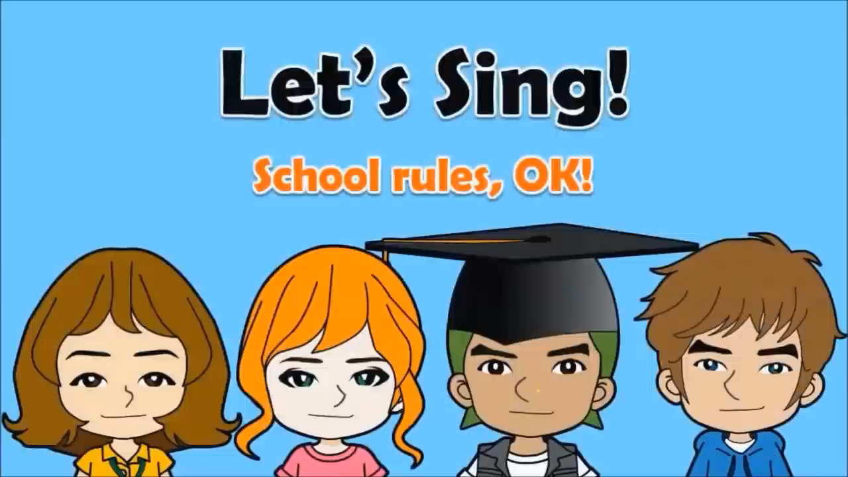

Slide 14


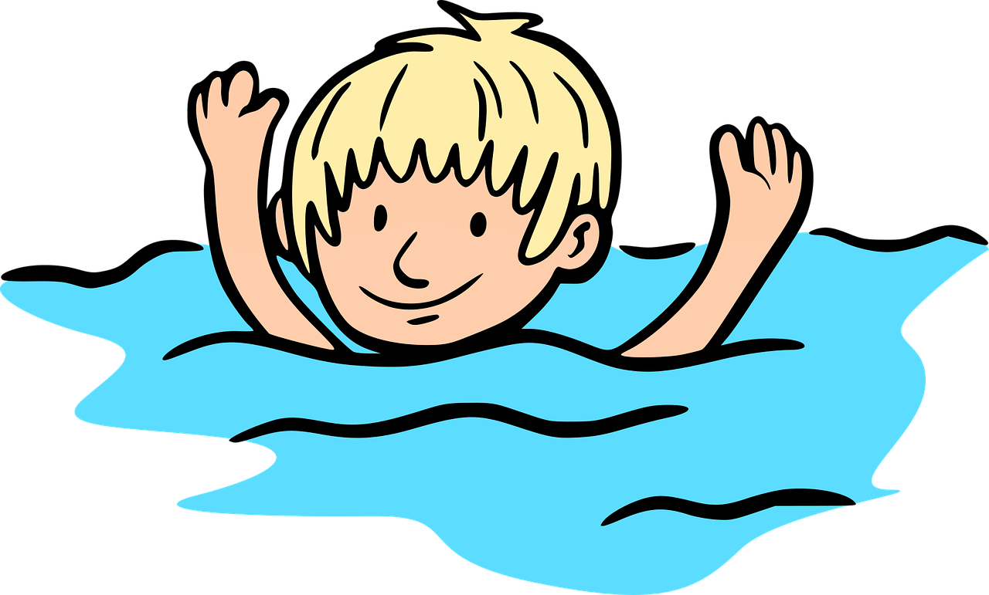

‘should’ or ‘shouldn’t’?
shouldn’t
You _______ swim alone in the river.

Slide 15


‘should’ or ‘shouldn’t’?
should
You ______ do your homework.

Slide 16
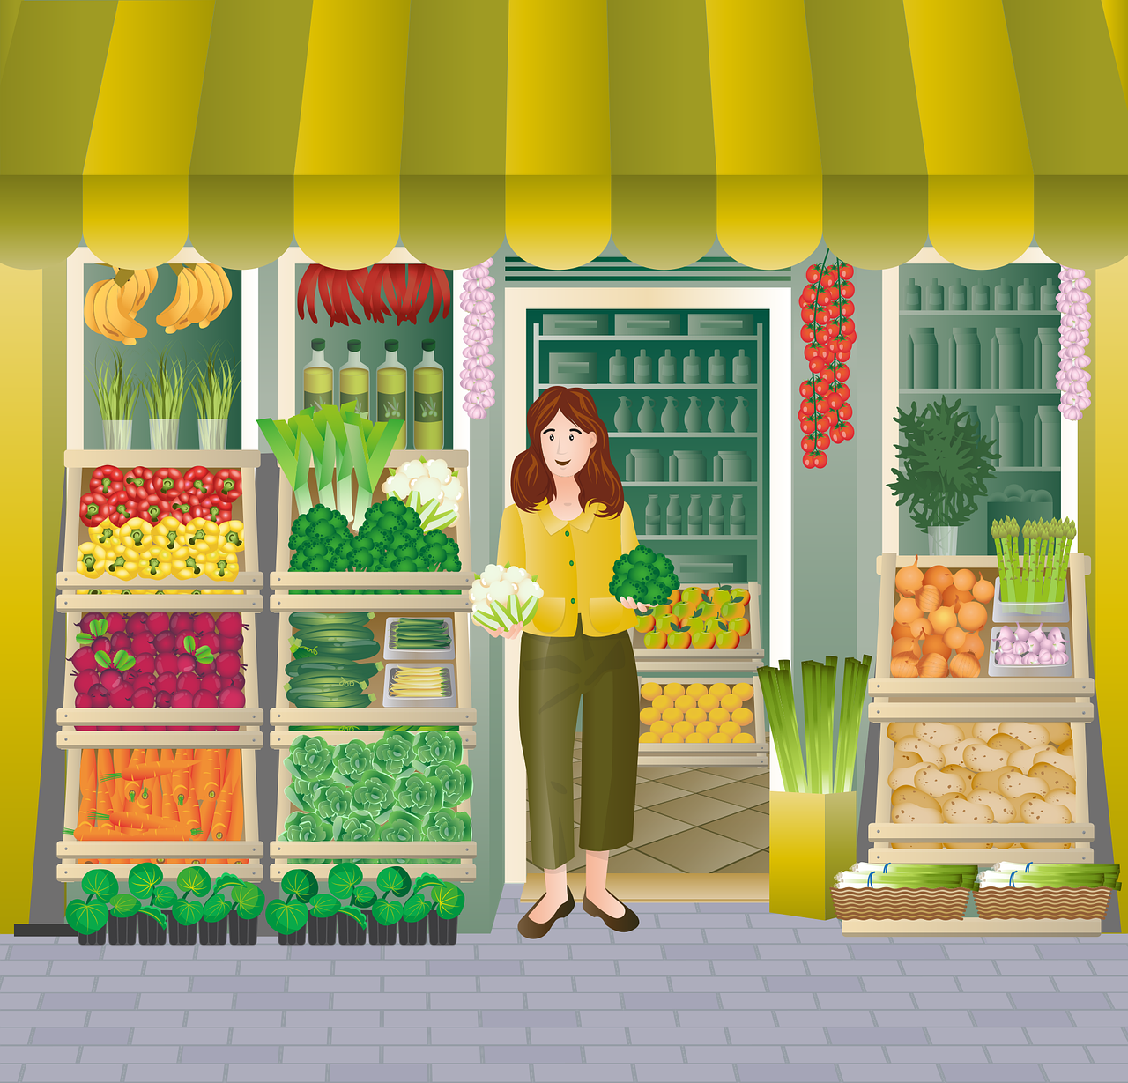
‘should’ or ‘shouldn’t’?
We _____ eat a lot of vegetables.
should

Slide 17
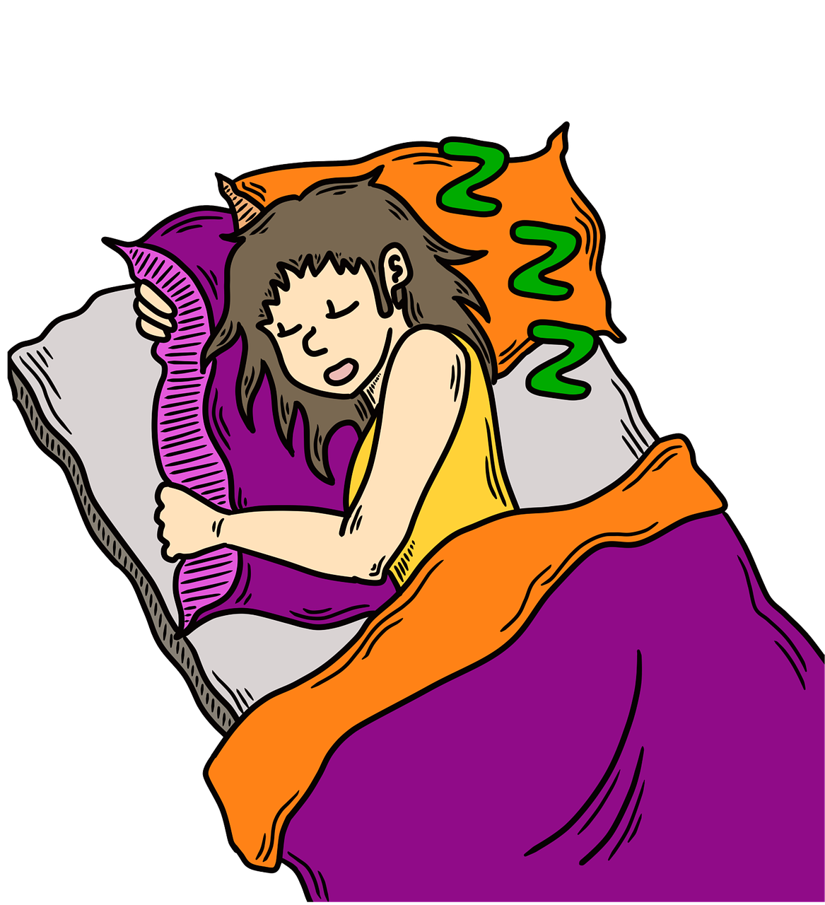
‘should’ or ‘shouldn’t’?
You ________ go to bed late.
shouldn’t

Slide 18
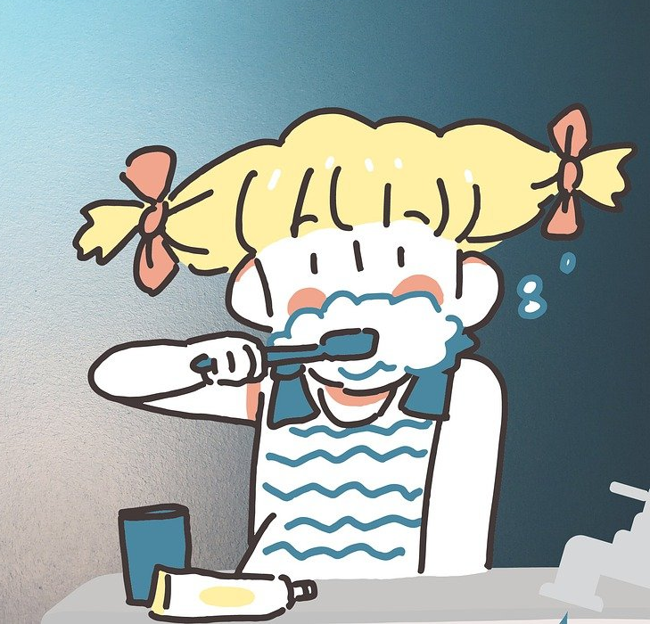
‘should’ or ‘shouldn’t’?
We _____ brush our teeth twice a day.
should

Slide 19

‘should’ or ‘shouldn’t’?
We _______ run in the library.
shouldn’t

Slide 20
‘should’ or ‘shouldn’t’?
We use should and shouldn’t to give advice or to talk about what we think is right or wrong.
We use should to encourage others to do something.
We use shouldn’t (should not) to encourage others not to do something.

Slide 21
3
Practice

Slide 22
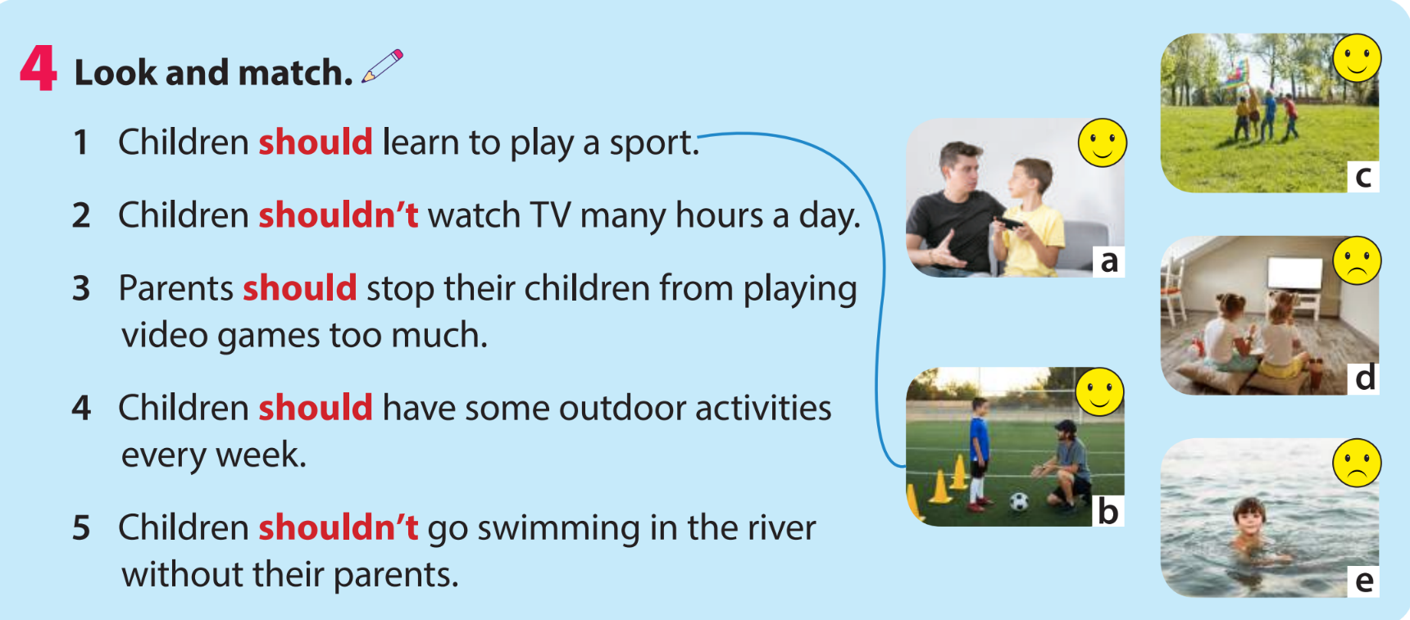

Slide 23

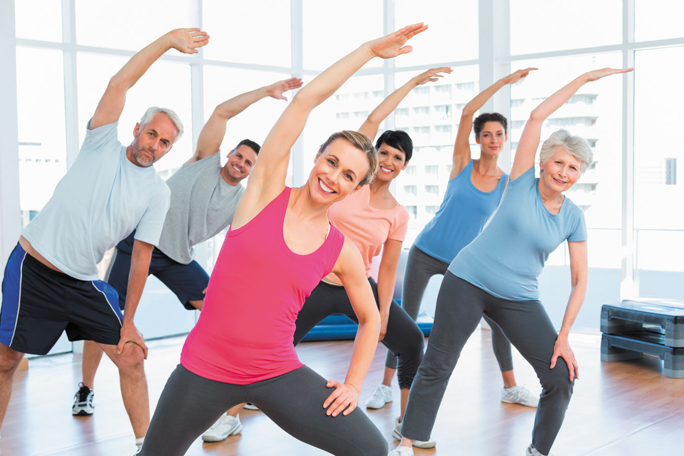
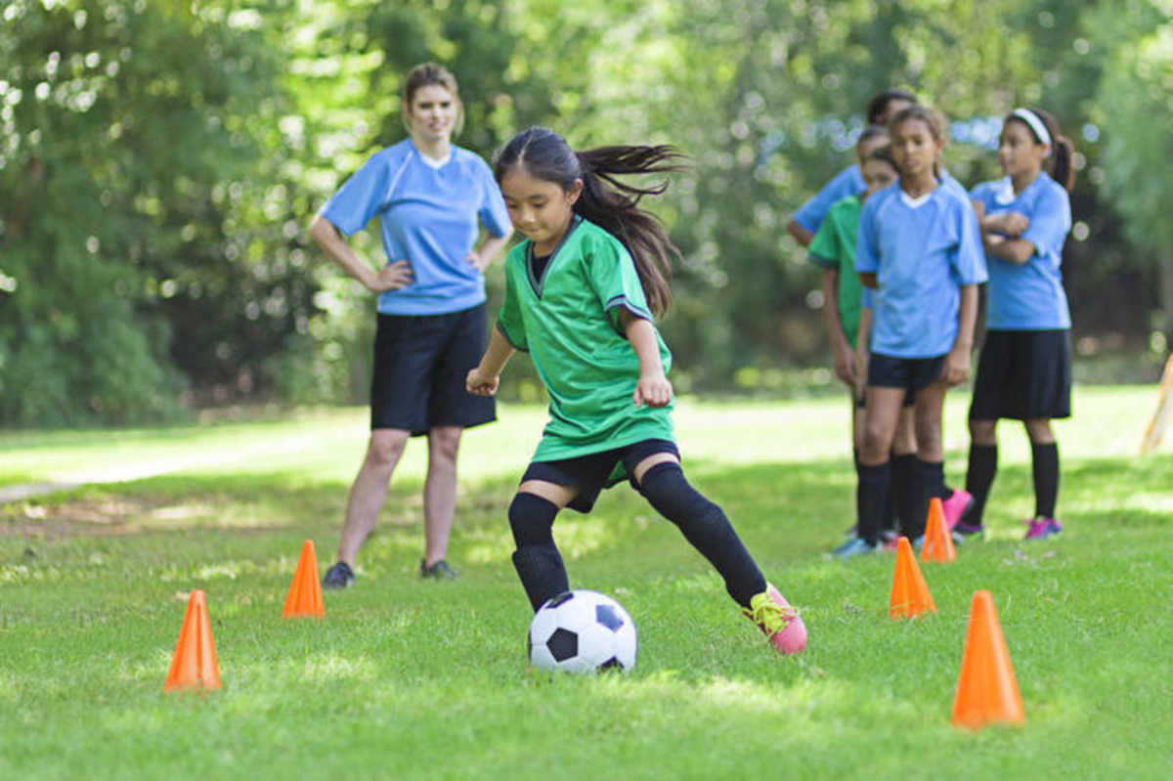
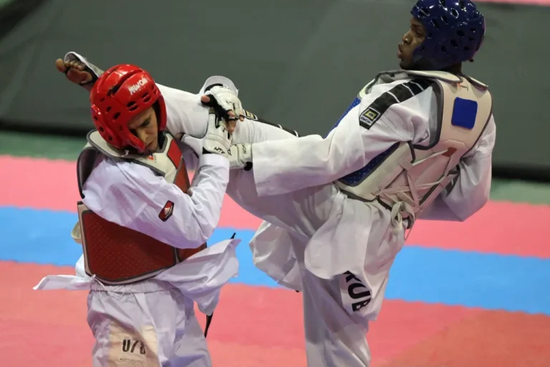
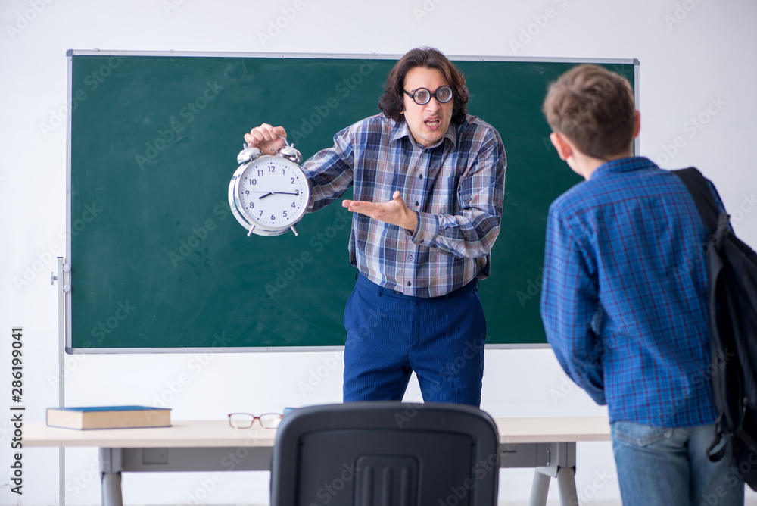
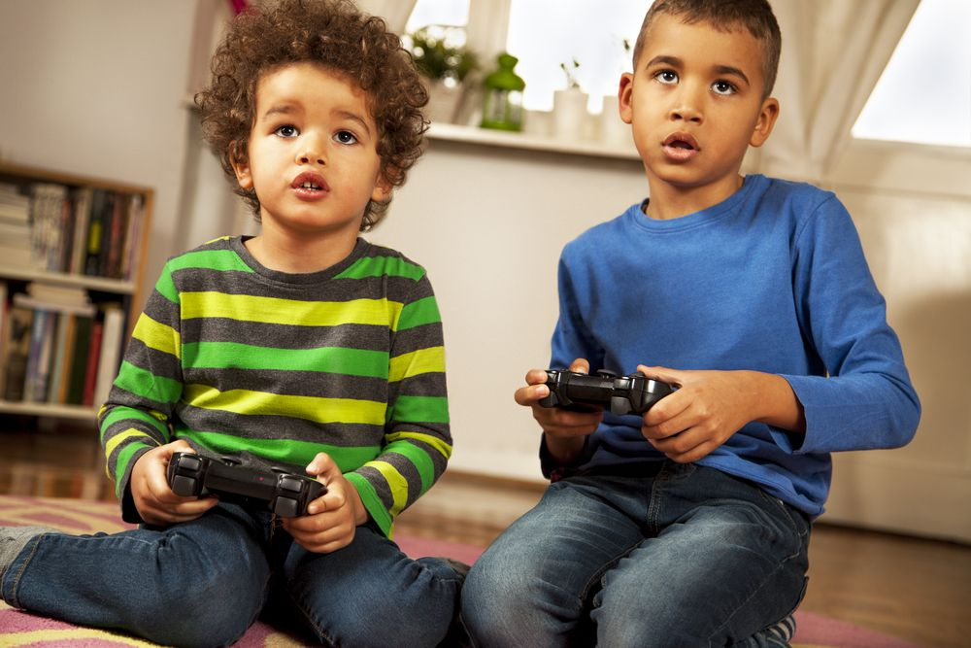
5 Make sentences using should or shouldn’t.
People should do exercise every day.
People / do exercise / every day.
______________________________________________
Children / learn / sports.
______________________________________________
In taekwondo / people / control / movements.
______________________________________________
Students / not / be late / school.
______________________________________________
Young people / not / play / video games / too much.
______________________________________________
Children should learn sports.
In taekwondo, people should control (their) movements.
Students should not be late for school.
Young people should not play video games too much.

Slide 24
4
Production

Slide 25
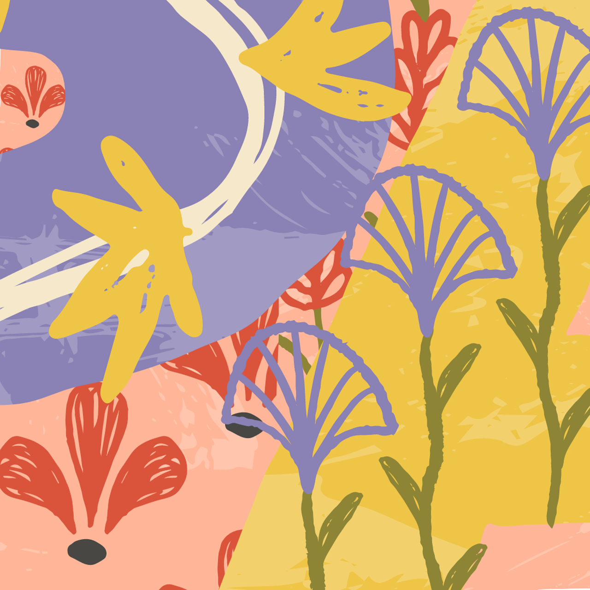
Ask your friend, tick (✓) or cross (×).
What should we do to stay healthy?
What shouldn’t we do to stay healthy?
We shouldn’t watch TV many hours.
We should do exercise everyday.
do exercise everyday | watch TV many hours
✓ | ×

Slide 26

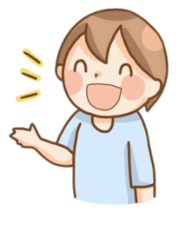
6 Let’s talk.
What should we do to stay healthy?
We should do exercise every day.

Slide 27
5
Wrap-up &
Assessment

Slide 28
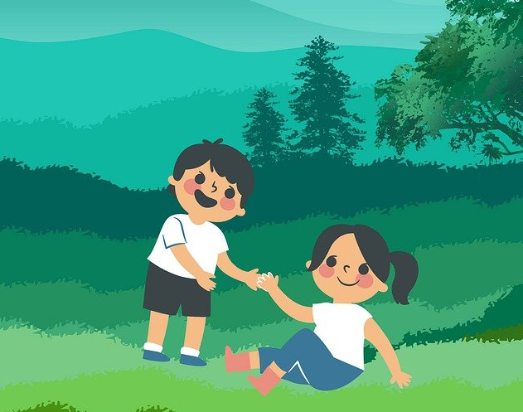
Reorder the words to make a meaningful sentence.
should / we / other / help / people
=> We should help other people.

Slide 29
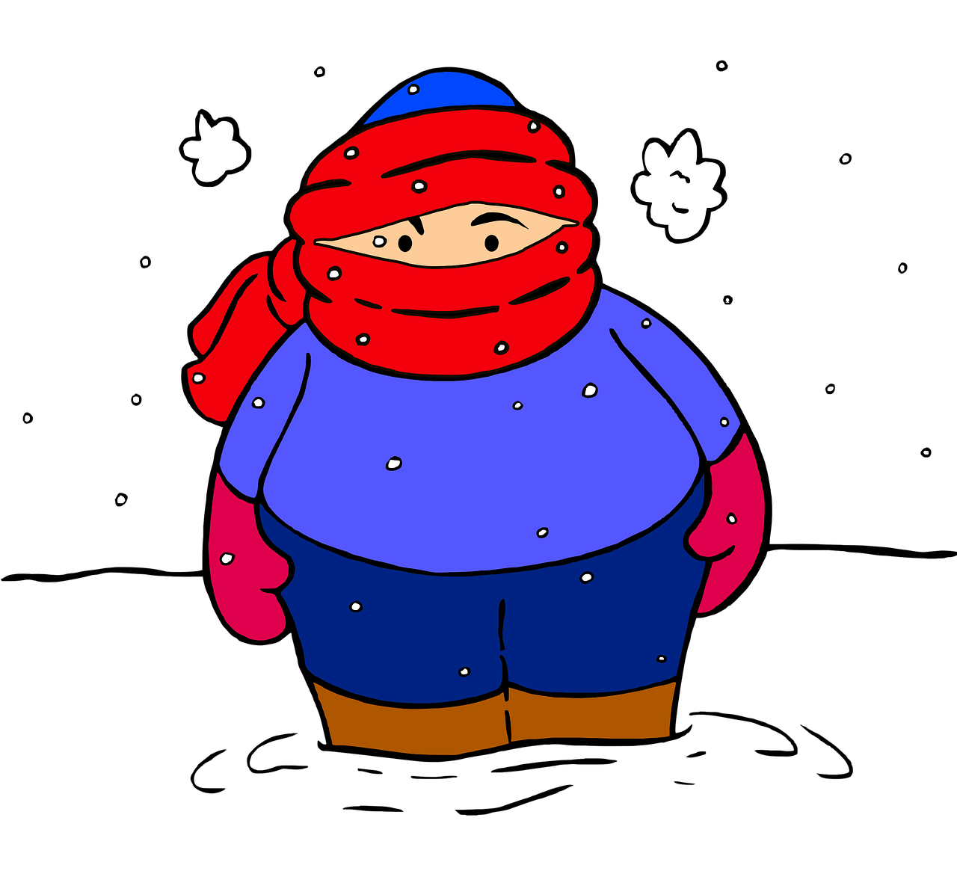
Reorder the words to make a meaningful sentence.
warm / in / weather / should / you / clothes / wear / cold
=> You should wear warm clothes in cold weather.

Slide 30
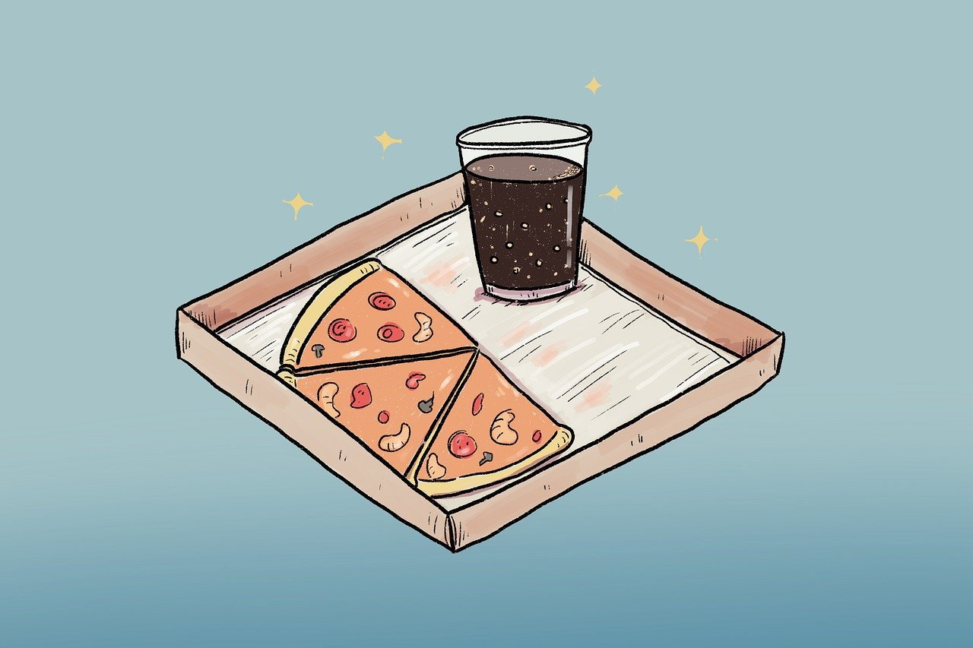
Reorder the words to make a meaningful sentence.
eat / and / shouldn’t / people / fast food / soft drinks / every day / drink
=> People shouldn’t eat fast food and drink soft drinks
every day.

Slide 31
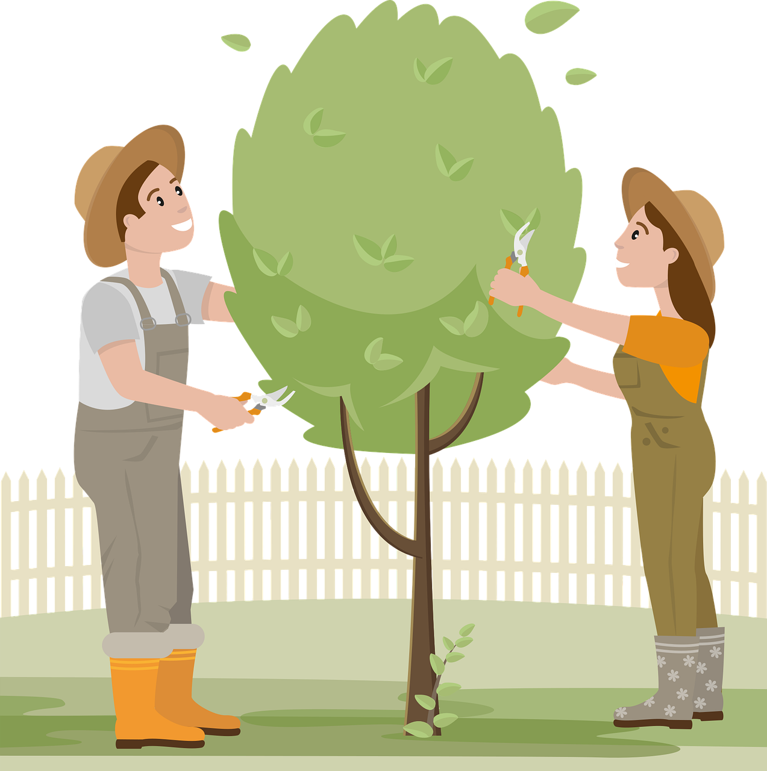
Reorder the words to make a meaningful sentence.
plant / protect / environment / should / to / we / more / trees / the
We should plant more trees to protect
the environment.

Slide 32

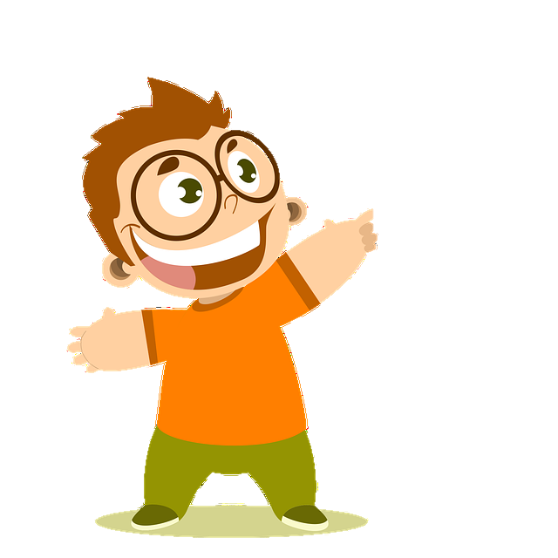
Wrap-up
Unit 7: Sports
Lesson 2 – Part 4,5,6
What have we learnt today?
Vocabulary Review: control, mind, movement, kick, fight
Grammar: should, shouldn’t

Slide 33

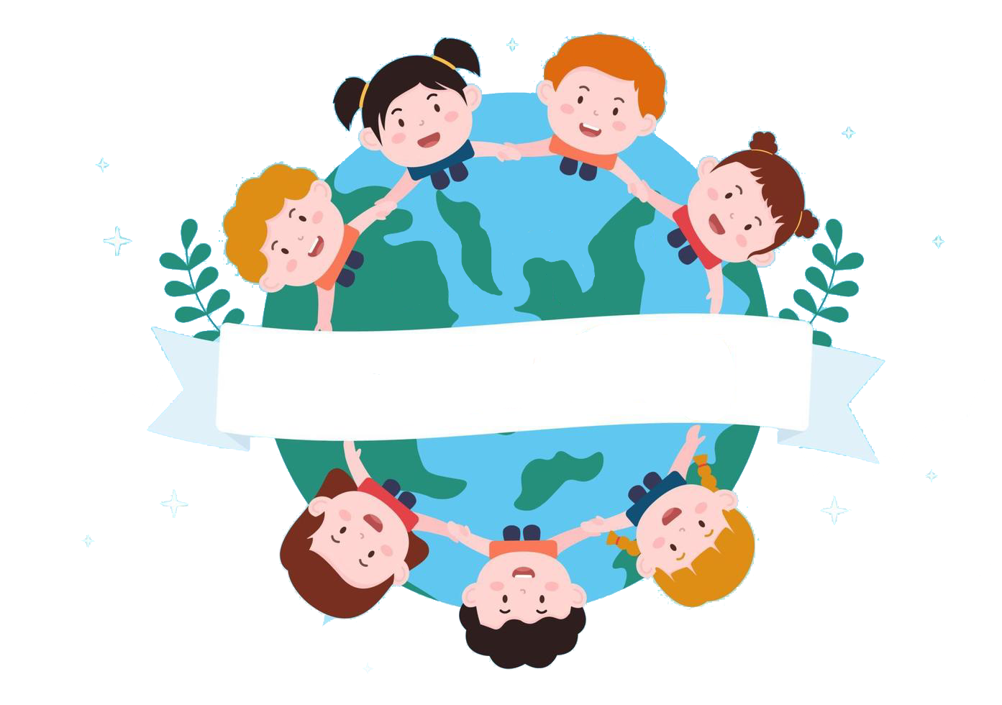
Thank you
& goodbye!

