Slide 1























Slide 2

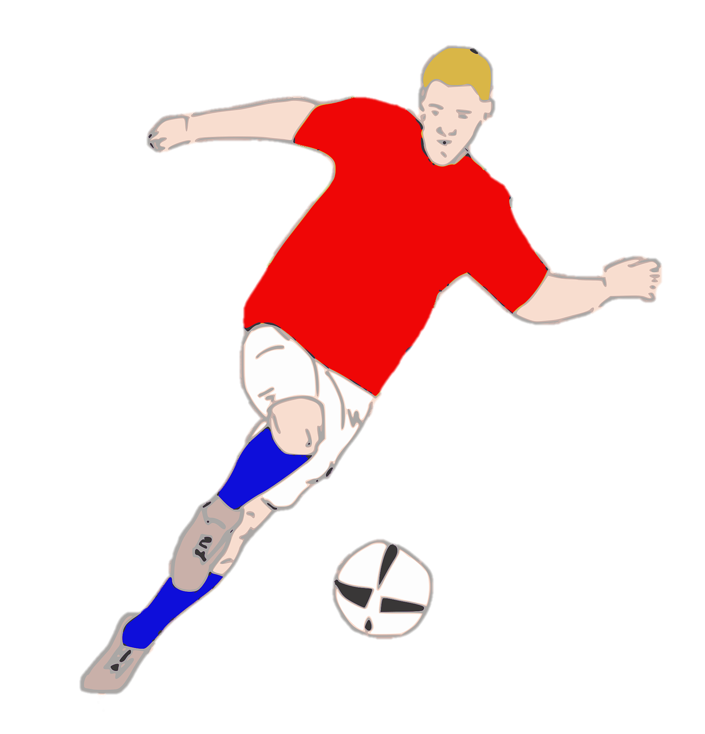
Unit 7:
SPORTS
Fun time & Project

Slide 3




Table of contents
01
Warm-up&
Review
03
04
Wrap-up &
Assessment
Production
02
Practice

Slide 4




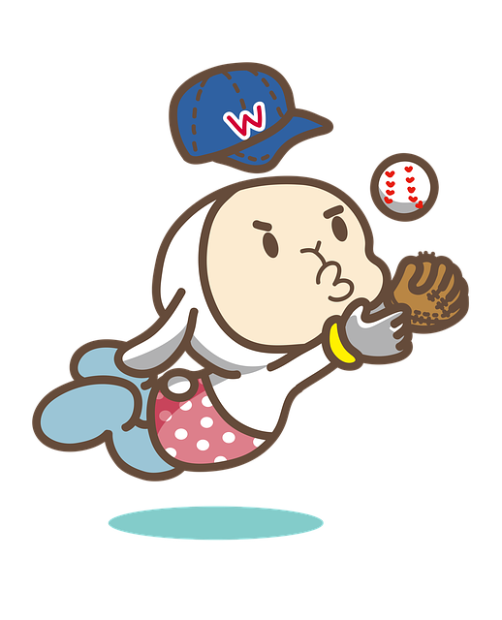
1
Warm-up &
Review

Slide 5
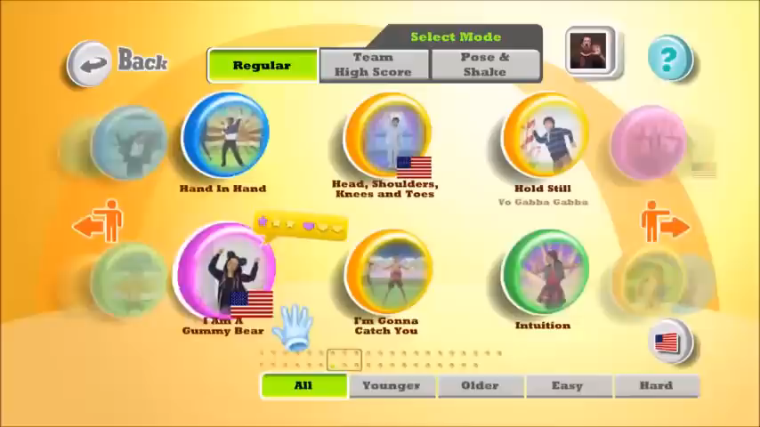

Slide 6
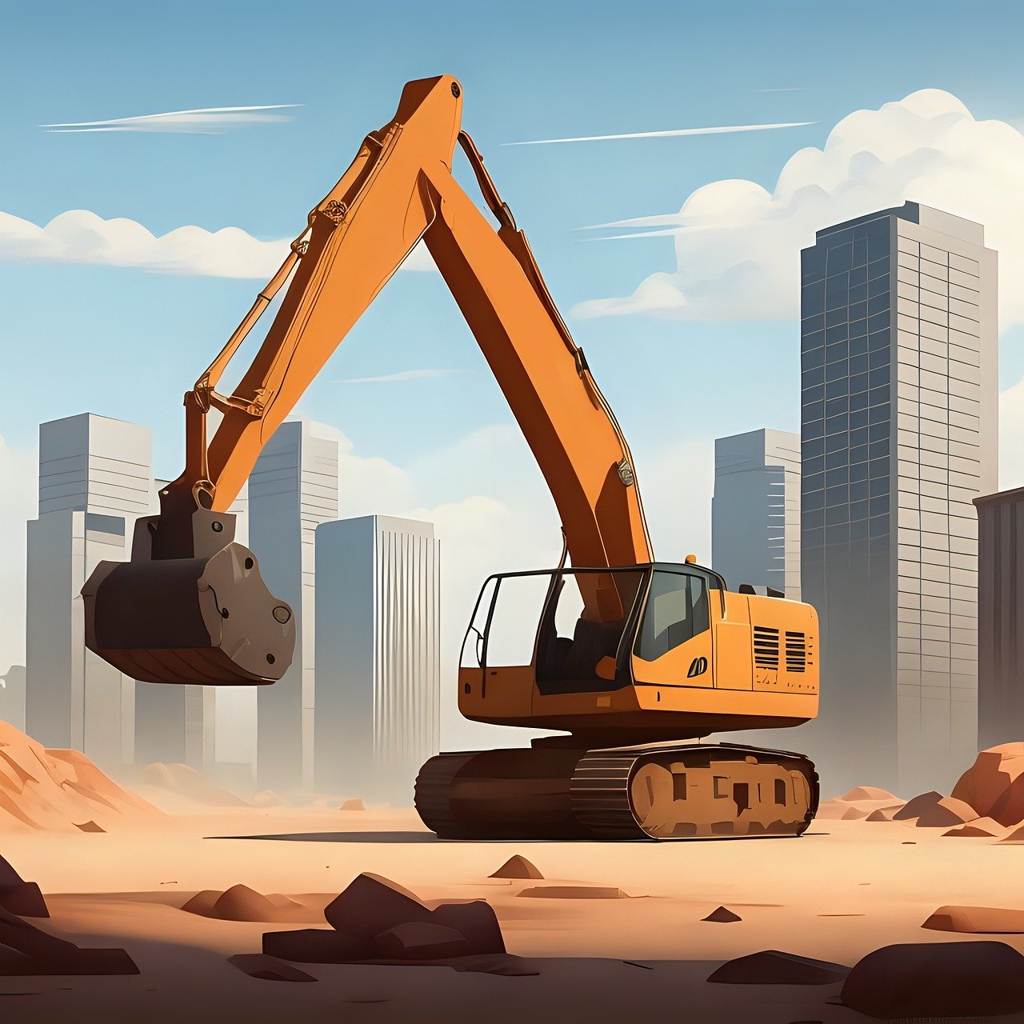


What sport is it?
It’s running.
Break all bricks
Notes:
T clicks a brick to break this brick, show a piece of the picture, clicks “Break all bricks” to show the whole picture at once.

Slide 7
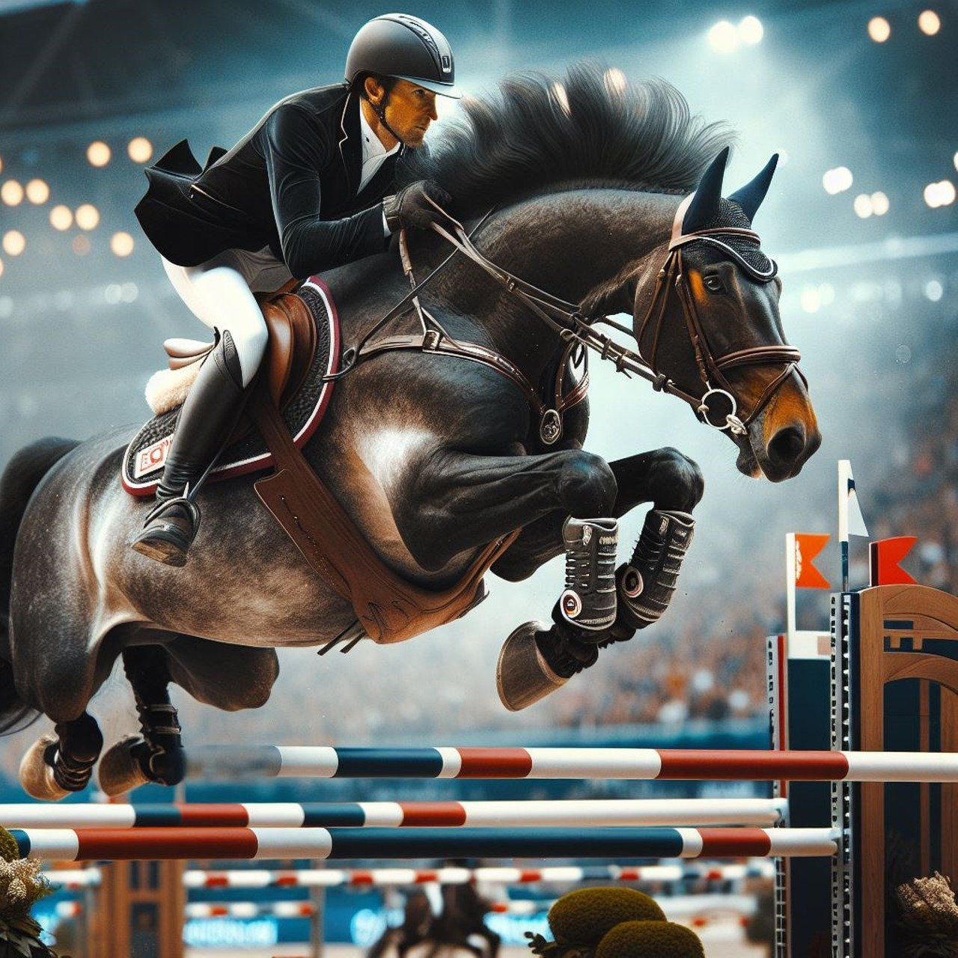
What sport is it?
It’s horse riding.
Break all bricks

Slide 8
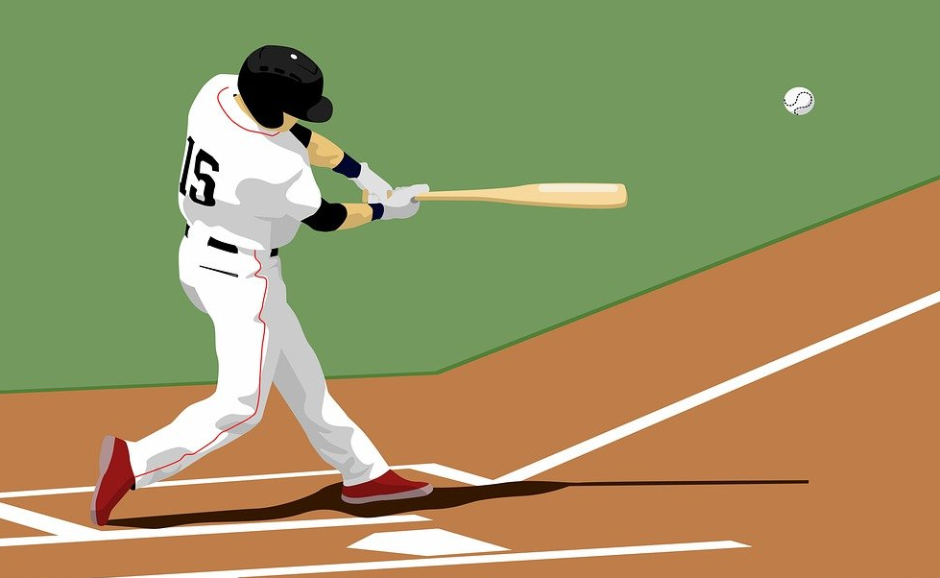
What sport is it?
It’s baseball.
Break all bricks

Slide 9
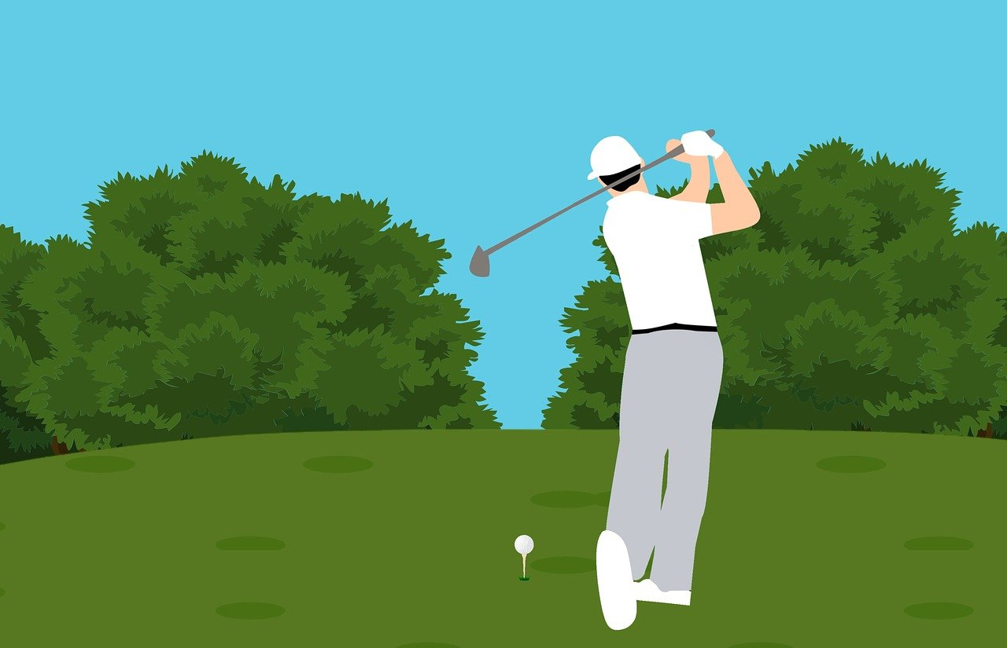
What sport is it?
It’s golf.
Break all bricks

Slide 10
2
Practice

Slide 11

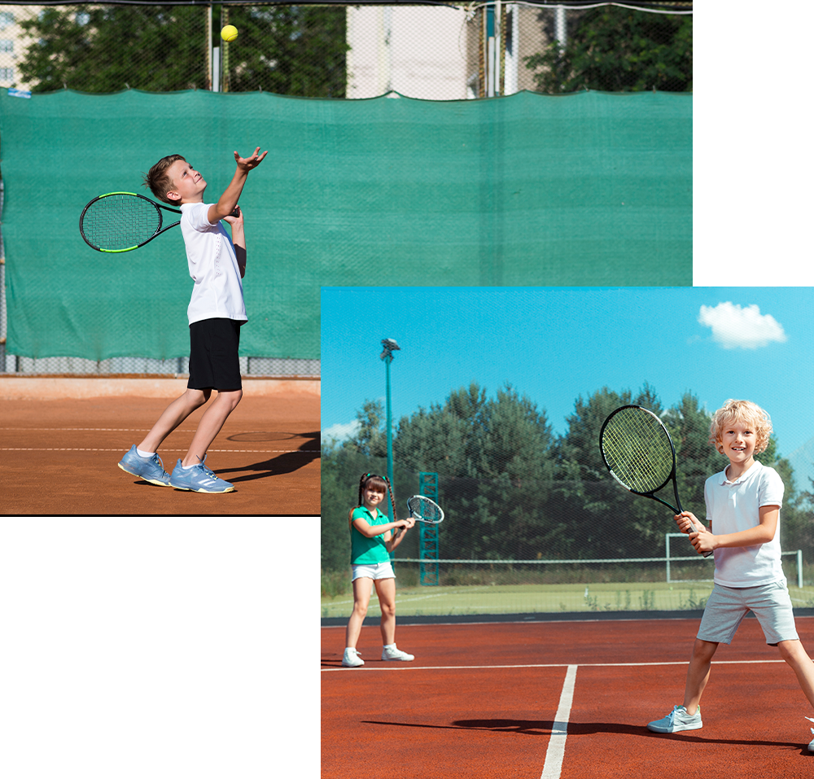
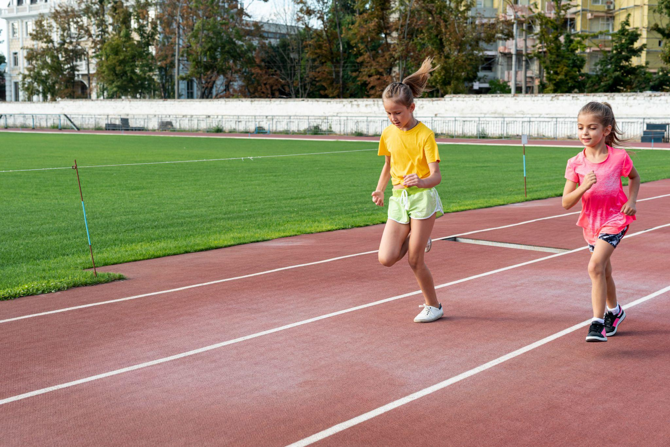
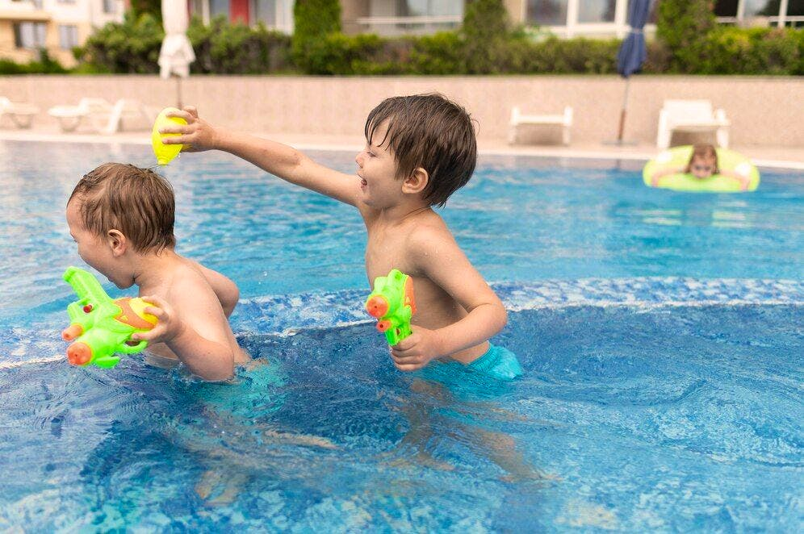
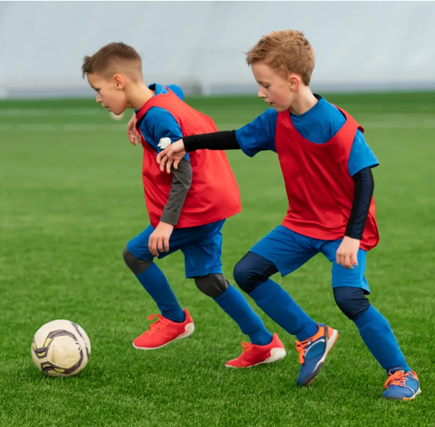
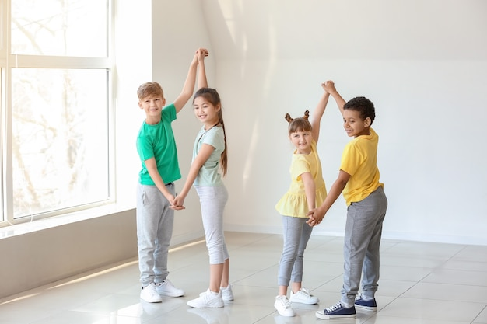
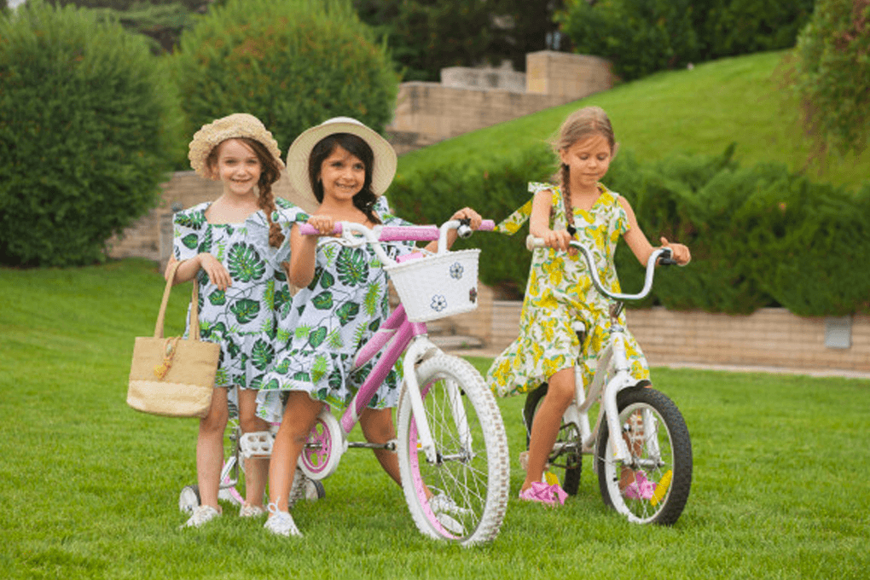
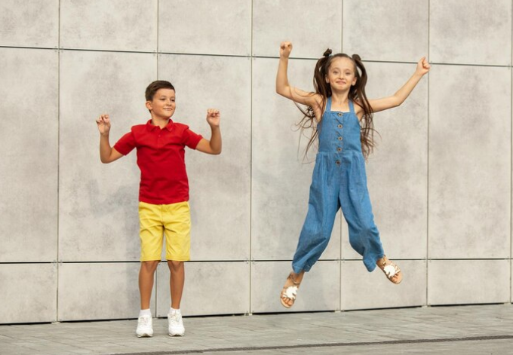

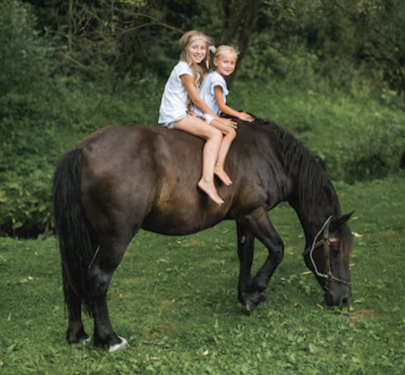
a. Playing football b. Horse riding c. Cycling d. Jumping e. Swimming f. Playing tennis g. Dancing h. Going to school i. Running
Write the letters of the correct answers in the pictures
e
f
i
3 -
1 -
2 -
a
g
c
4 -
5 -
6 -
d
h
b
7-
8 -
9 -

Slide 12


Tick 5 pictures.
Then listen and cross one out.
Let’s see who has the bingo first!
Are you ready?
Dancing
Jumping
Playing tennis
Cycling
Swimming
Horse riding
Playing football
Going to school
Running
Playing tennis
Running
Swimming
Playing football
Dancing
Cycling
Jumping
Going to school
Horse riding

Slide 13

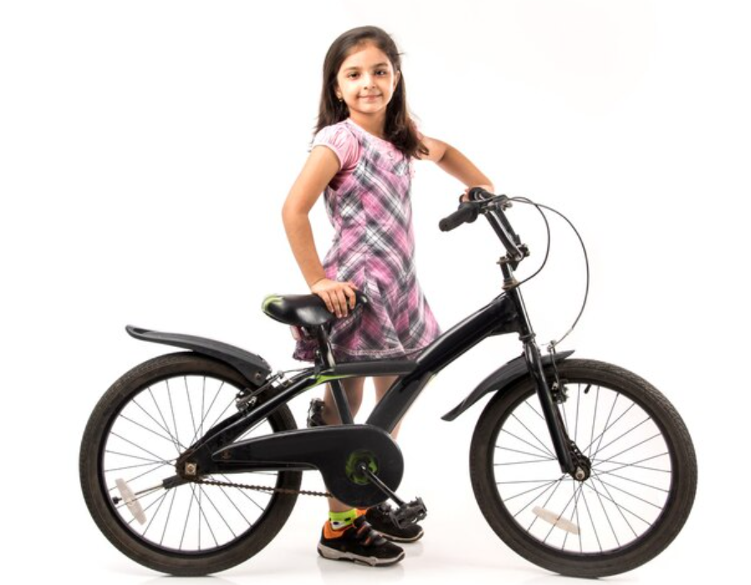

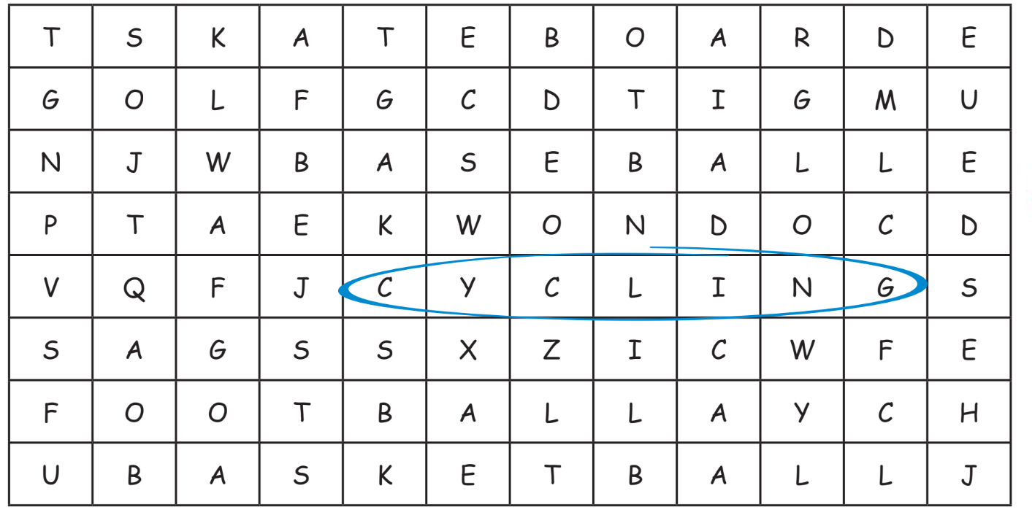
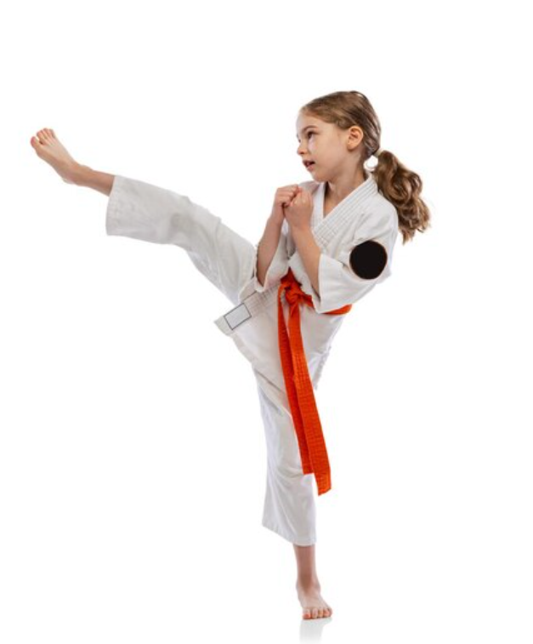
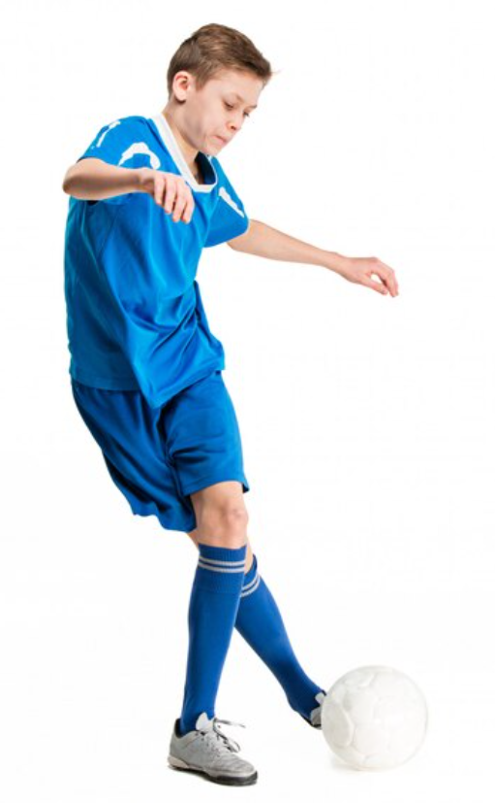
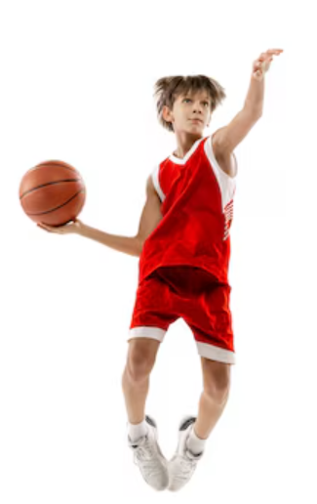
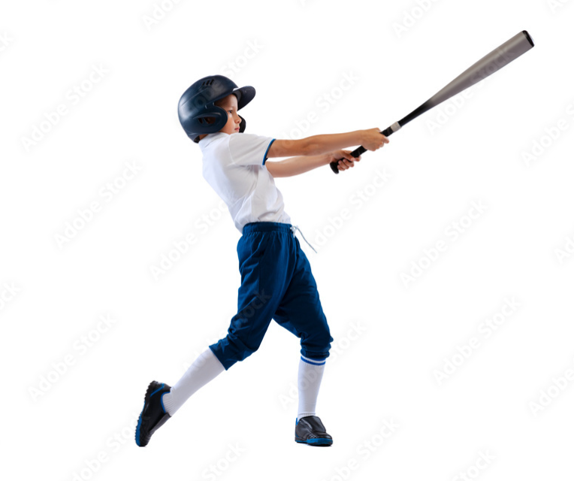
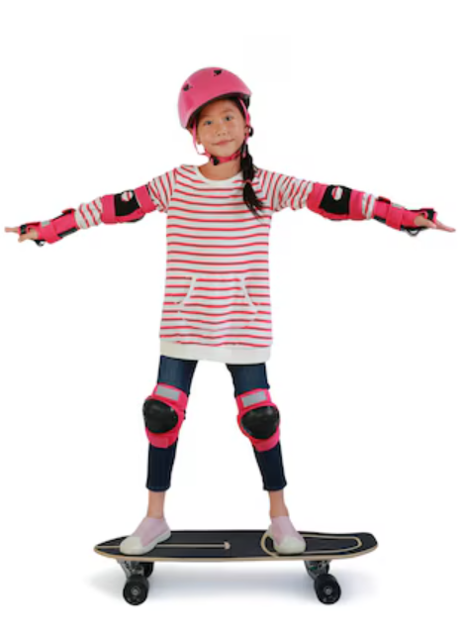

1
5
2
6
3
7
4

Slide 14
3
Production

Slide 15
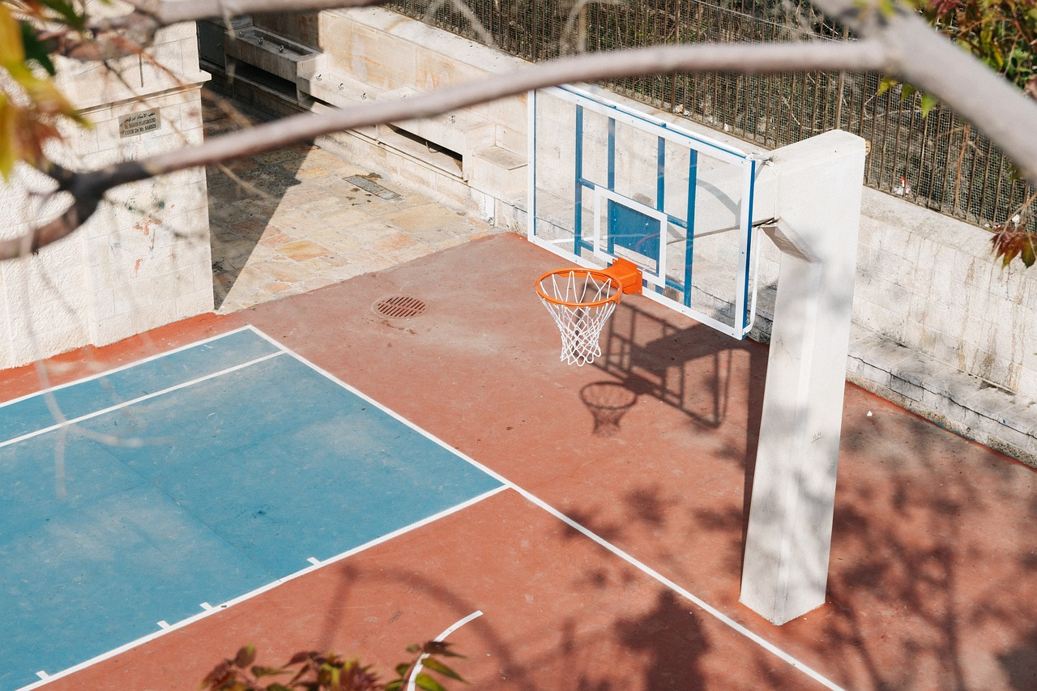

How much do you know about sports?
Let’s check!
Choose a number to answer the question.
1
2
3
4
5
6
Next

Slide 16
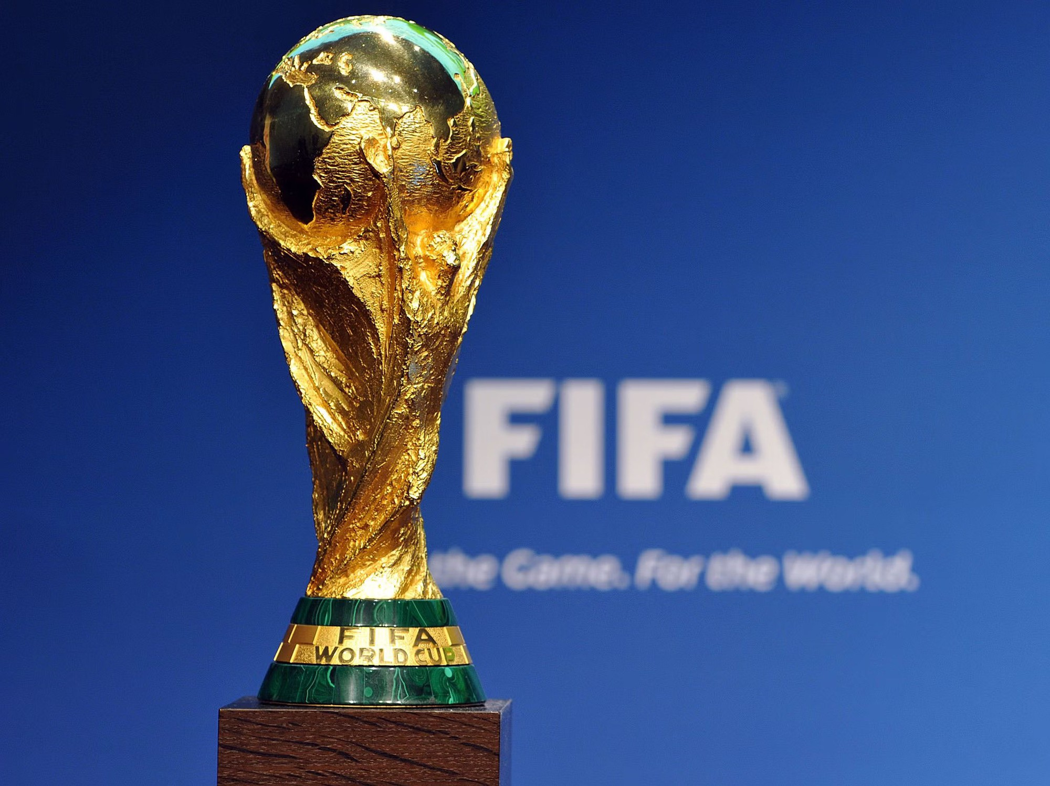
What is the largest football competition
in the world?
It’s World Cup.
Back

Slide 17

In this sport, two teams use their hands to hit a large ball over a high net. What sport is it?
It’s volleyball.
Back

Slide 18

Which country is the founder of Taekwondo?
It’s South Korea.
Back

Slide 19
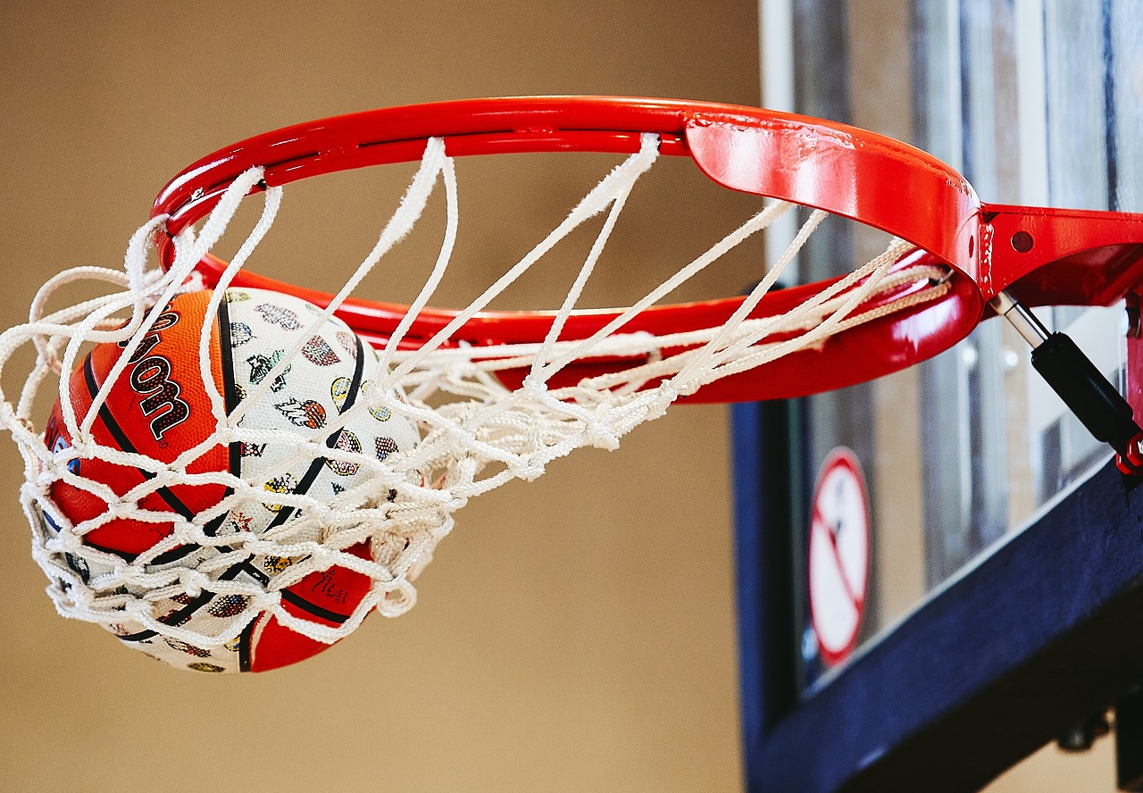
In this sport, two teams get the points by throwing a large ball through a hoop .
What sport is it?
It’s basketball.
Back

Slide 20
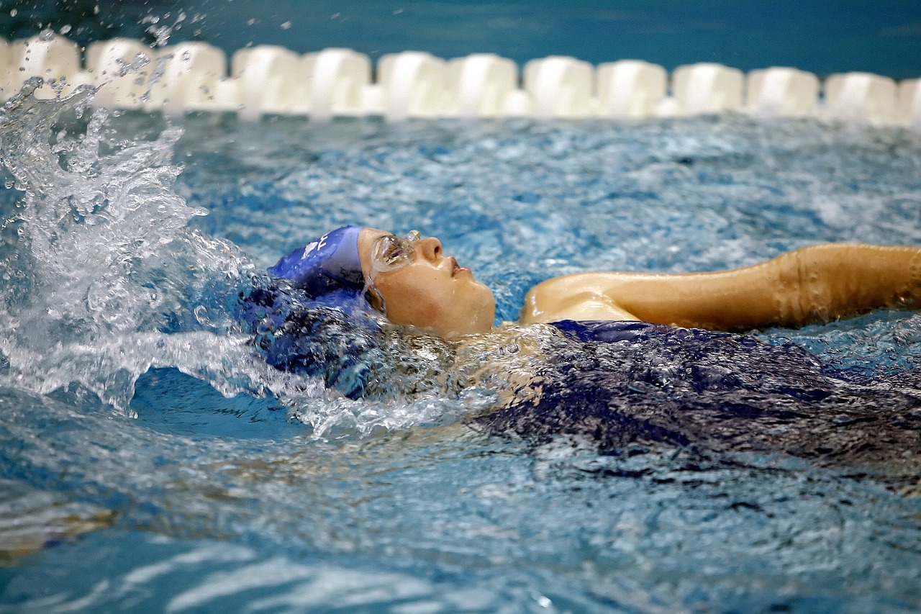
In this sport, people move through water by moving their bodies. What sport is it?
It’s swimming.
Back

Slide 21
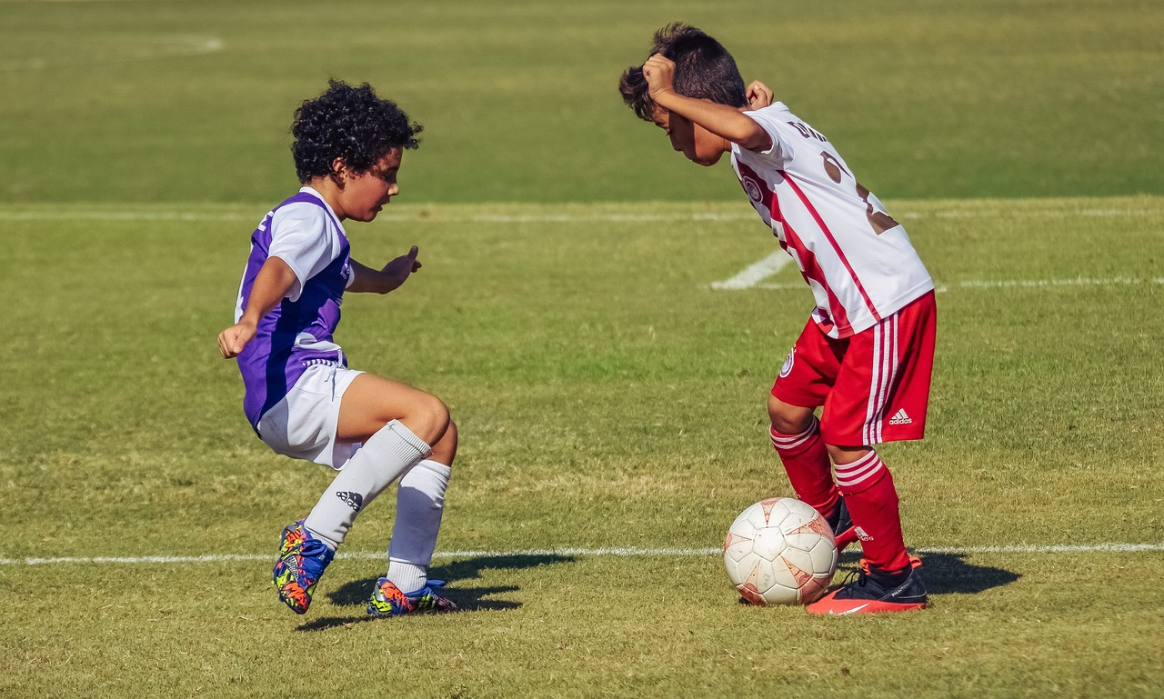
Which sport is the king of sports in Vietnam?
It’s football.
Back

Slide 22
4
Wrap-up &
Assessment

Slide 23

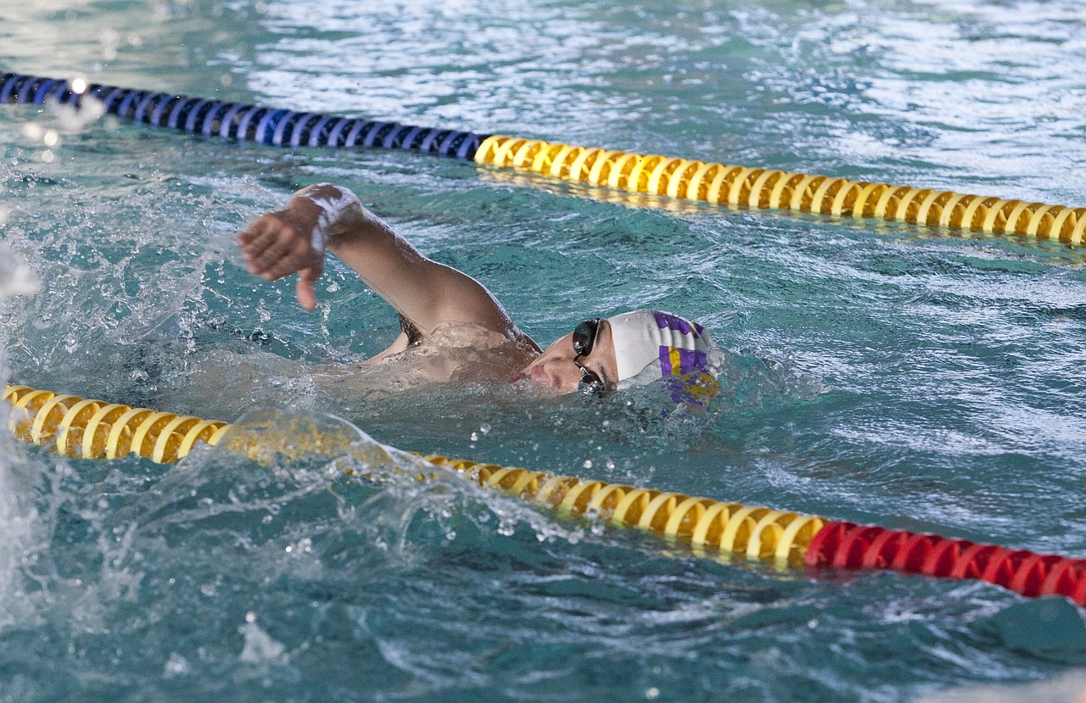
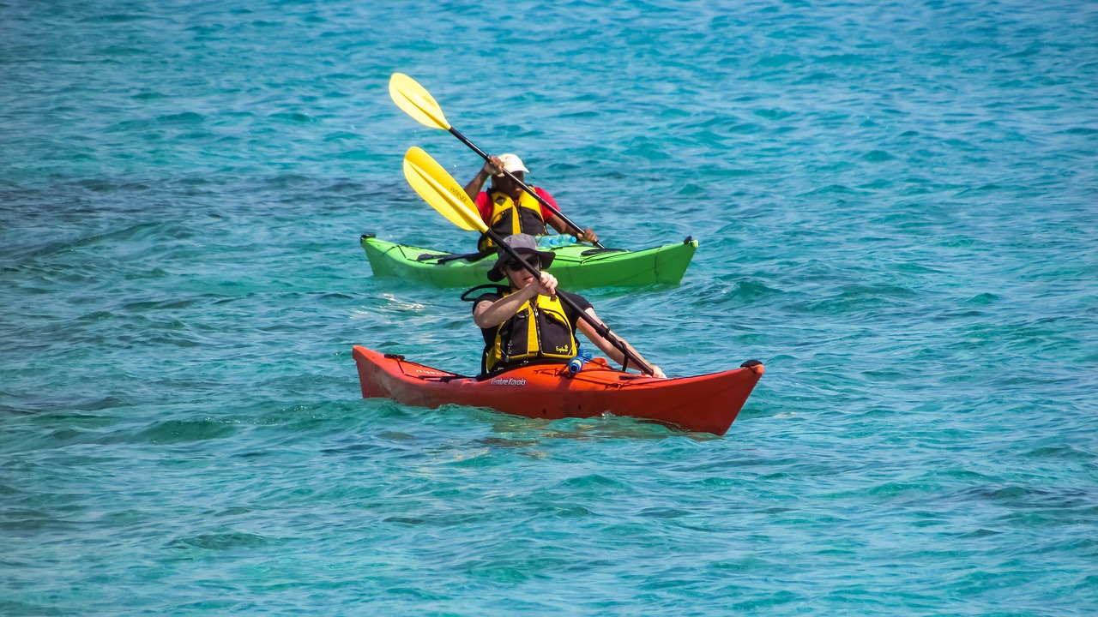
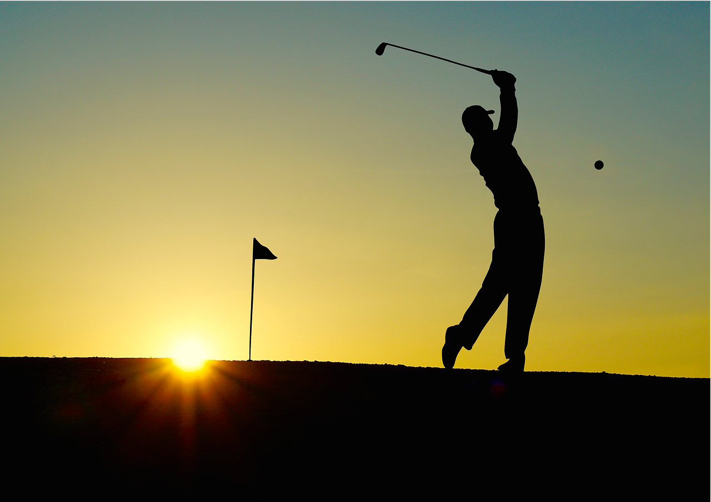
Odd one out
1.
diving
2. swimming
3. kayaking
4. golf

Slide 24
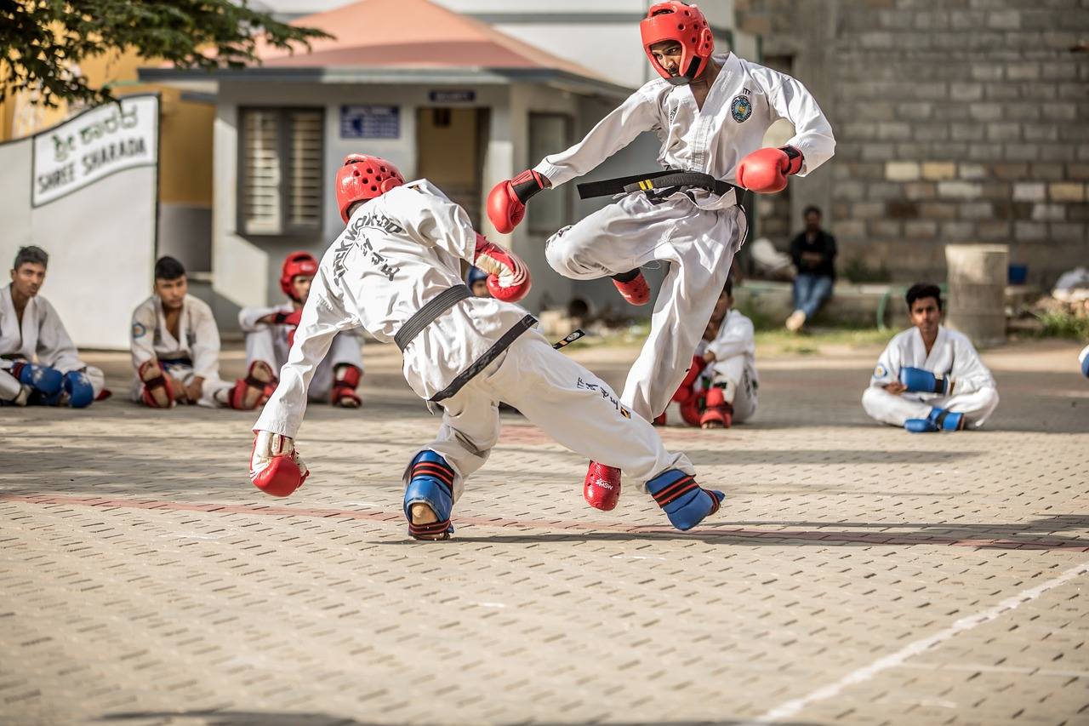
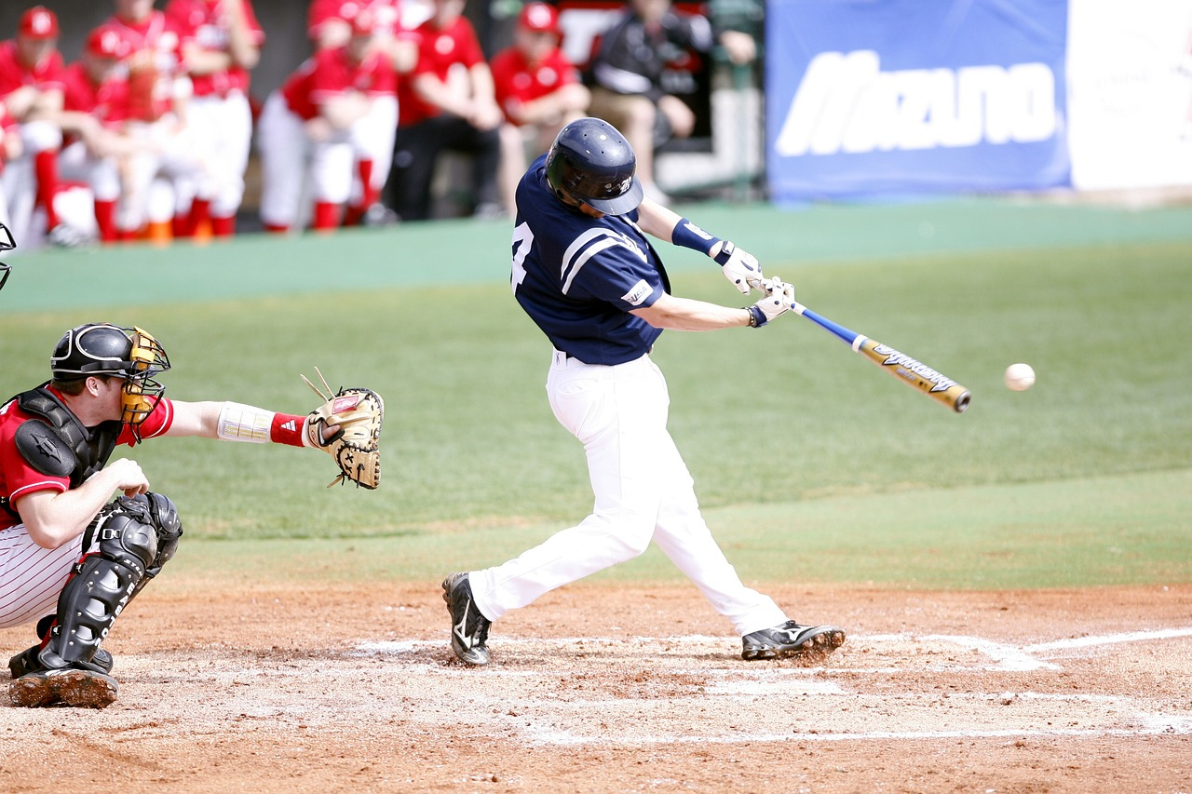
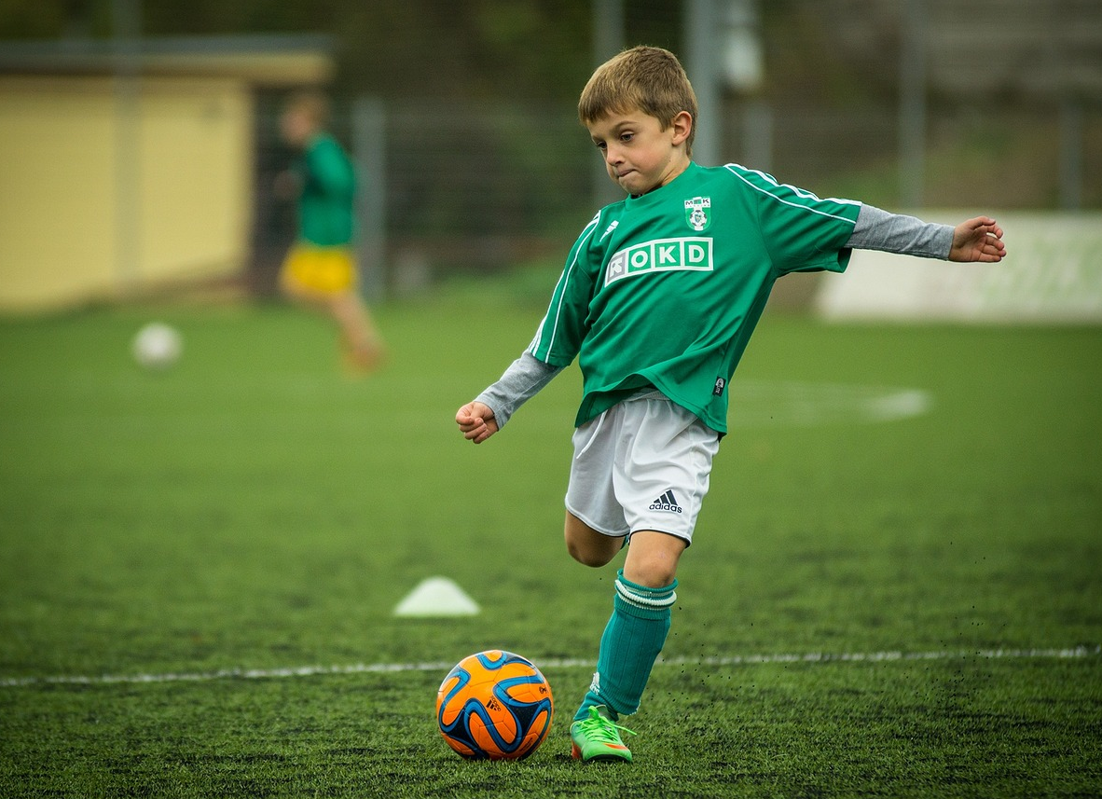
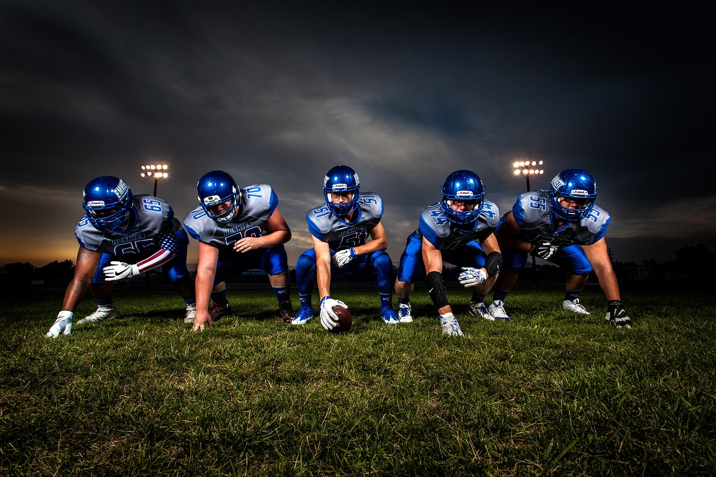
Odd one out
1.
taekwondo
2. baseball
3. football
4. rugby

Slide 25
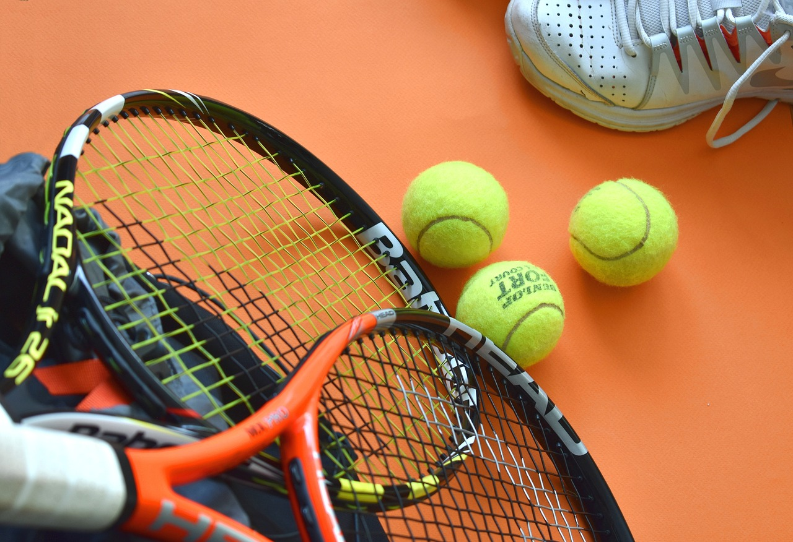
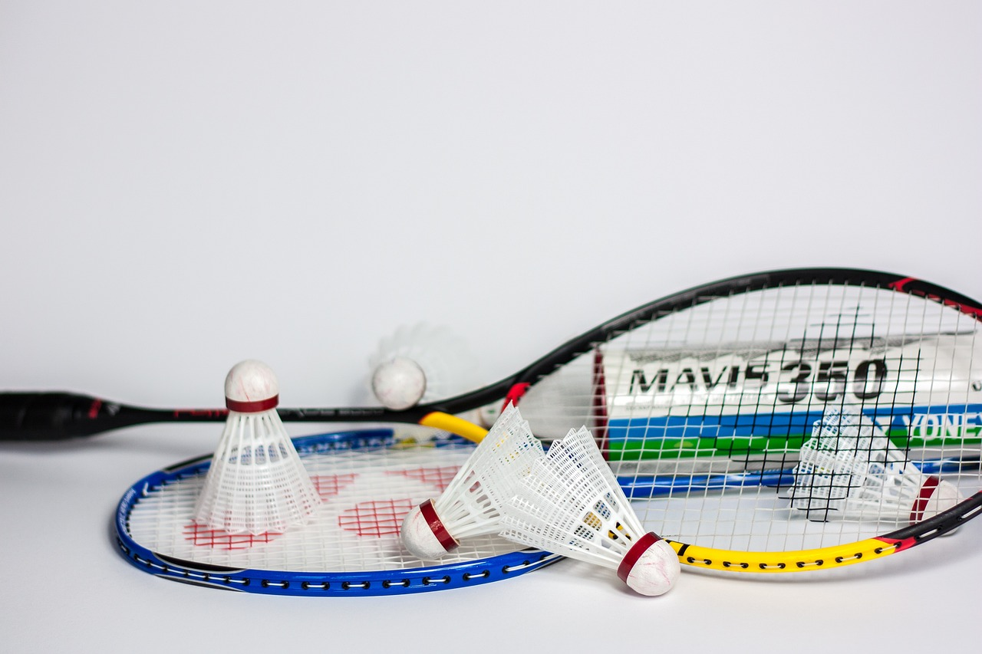
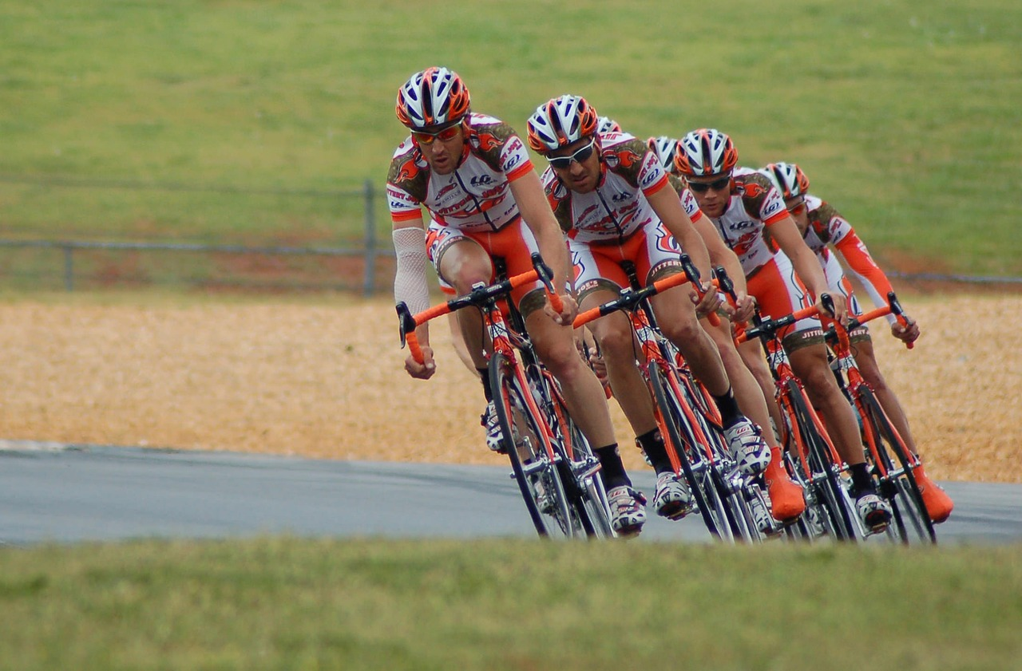
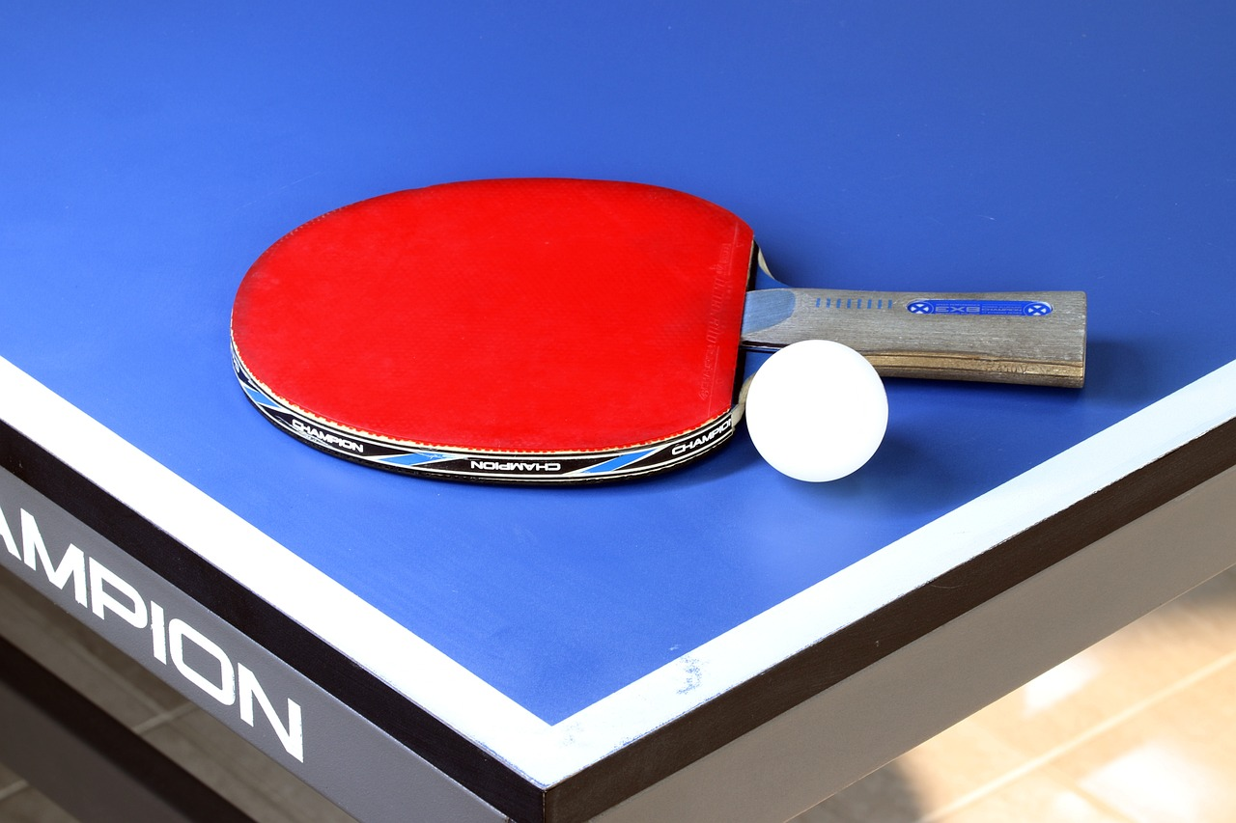
Odd one out
1. tennis
2. badminton
3. cycling
4. table tennis

Slide 26
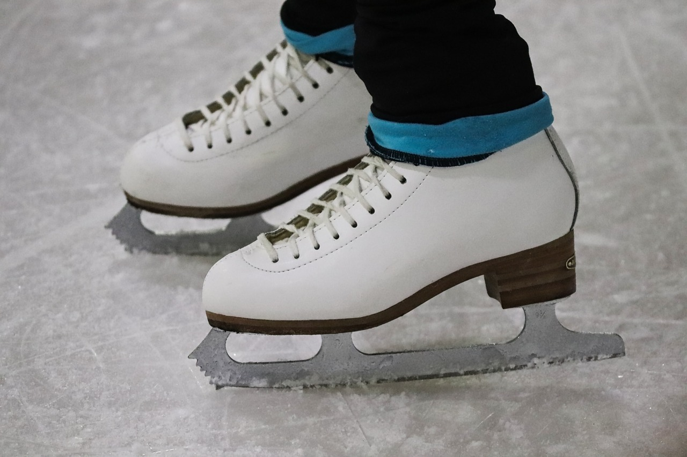
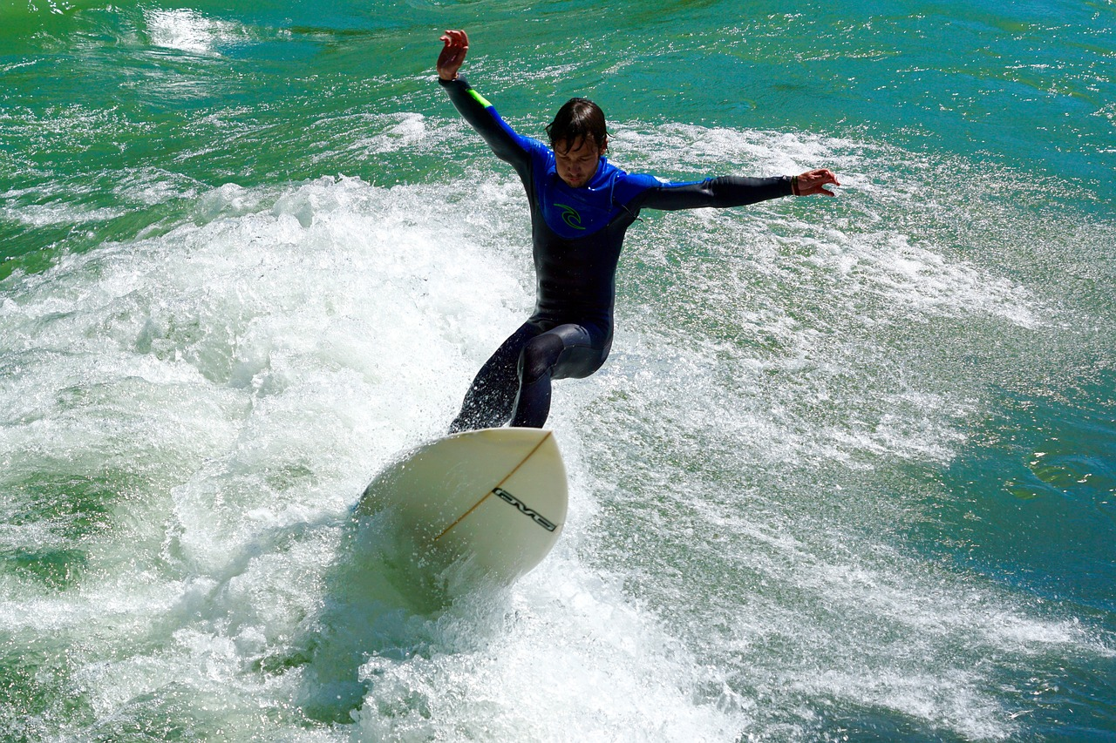
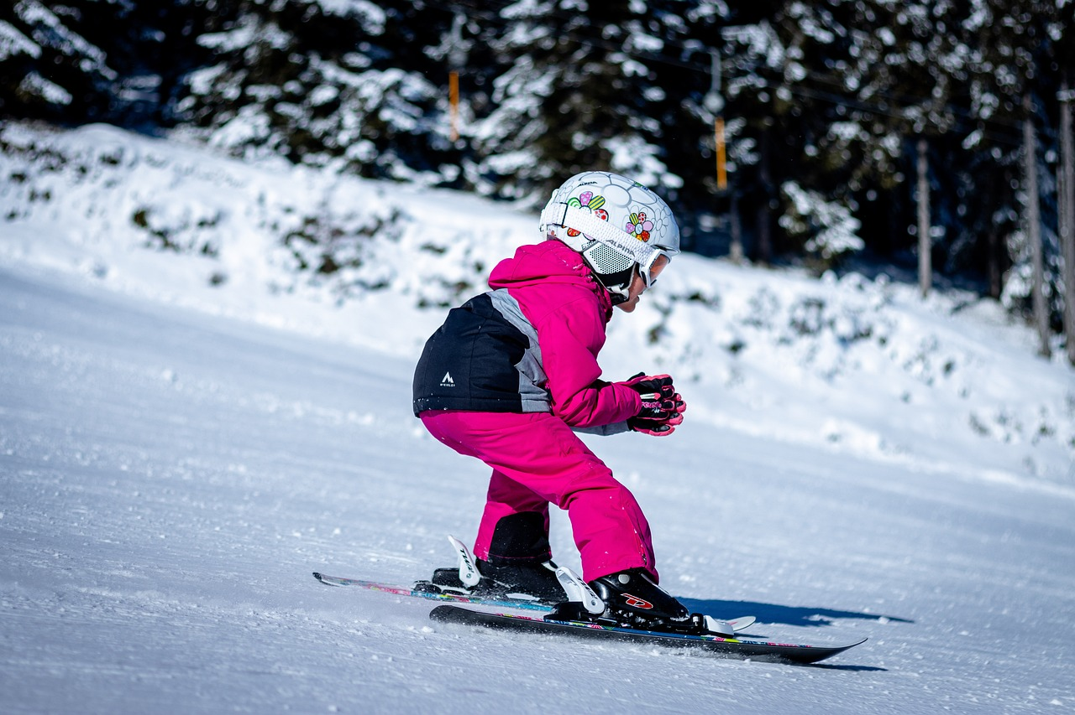
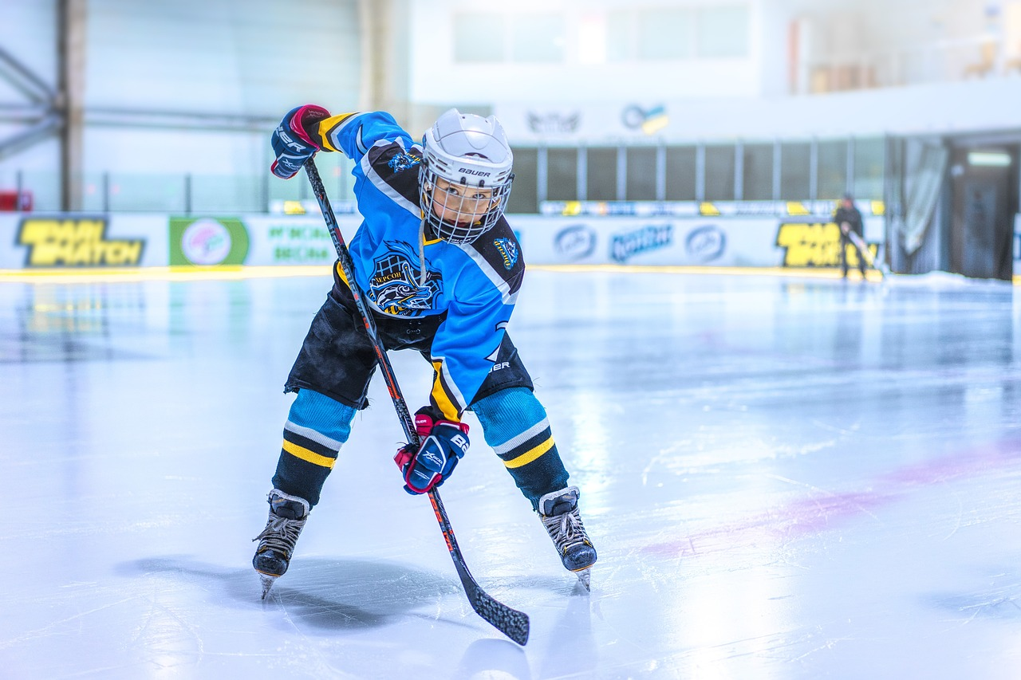
Odd one out
1.
ice-skating
2.
surfing
3. skiing
4. hockey

Slide 27


Wrap-up
Unit 7: Sports
Fun time & Project
What have we learnt today?
Review vocabulary about sports

Slide 28


Thank you
& goodbye!

