Slide 1









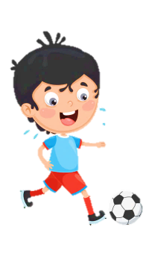











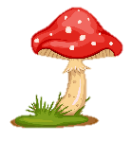

Slide 2
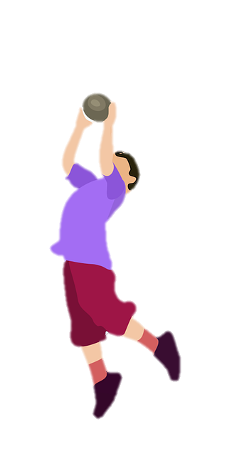
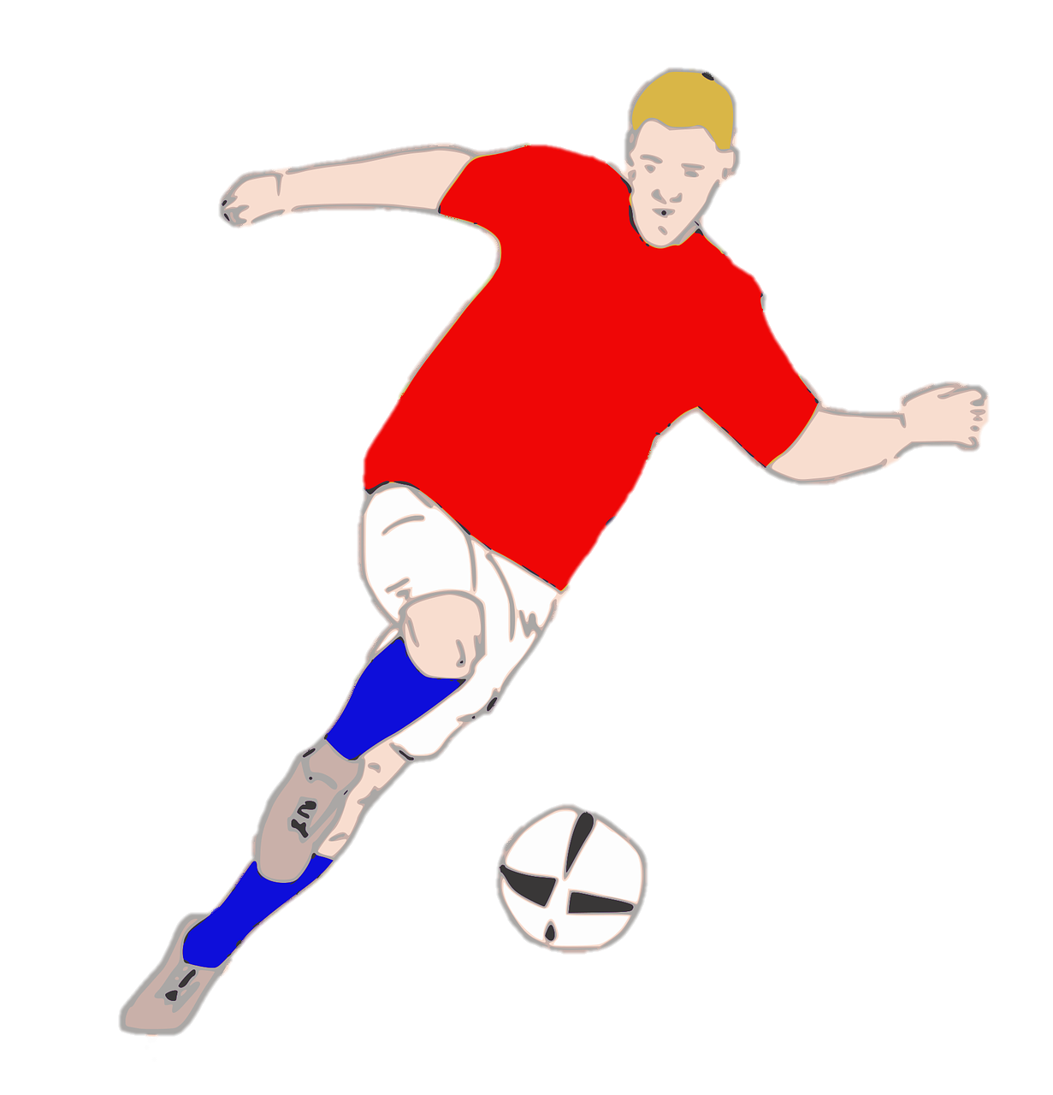
Unit 7:
SPORTS
Fun time & Project

Slide 3




Table of contents
01
Warm-up&
Review
03
04
Wrap-up &
Assessment
Production
02
Practice

Slide 4
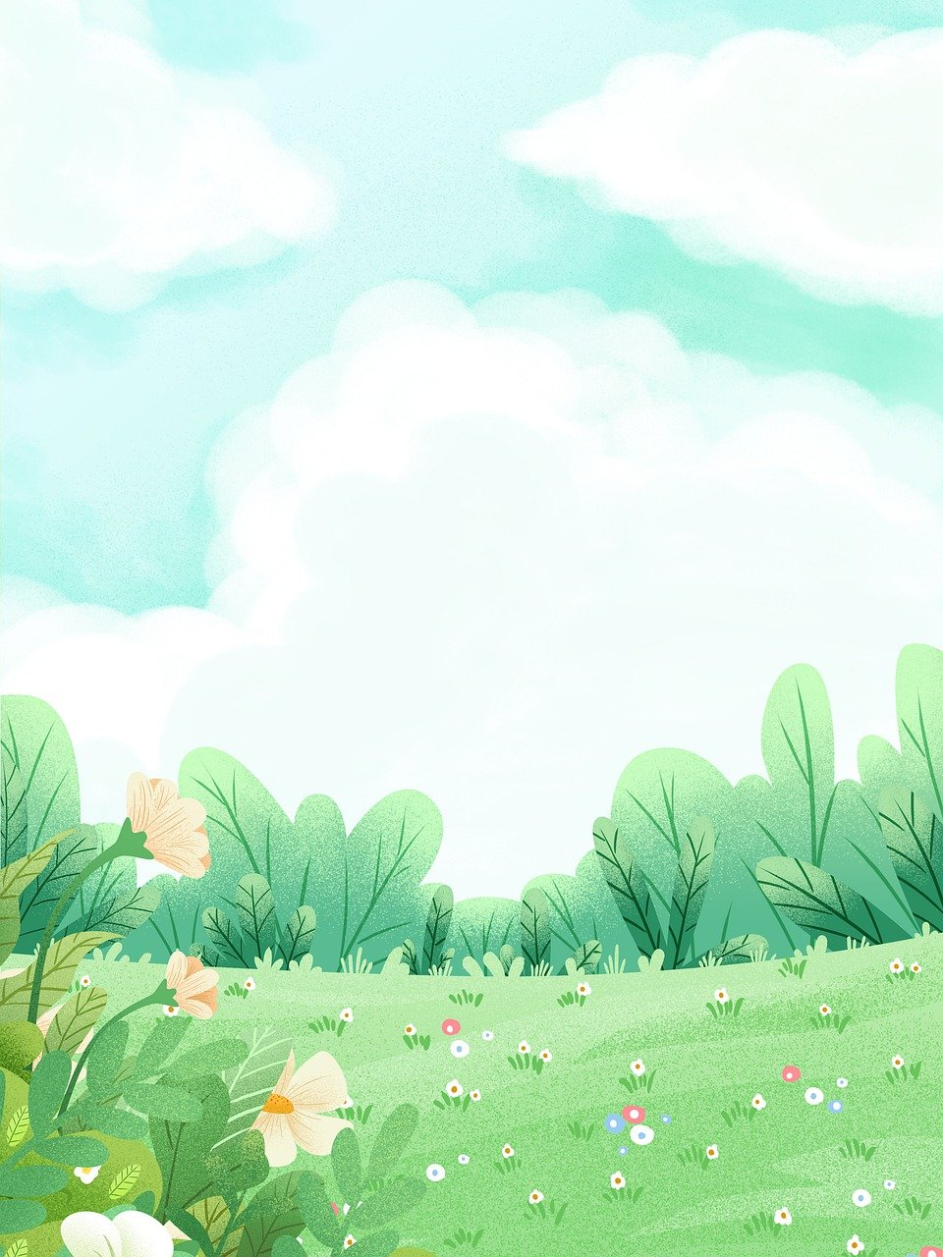
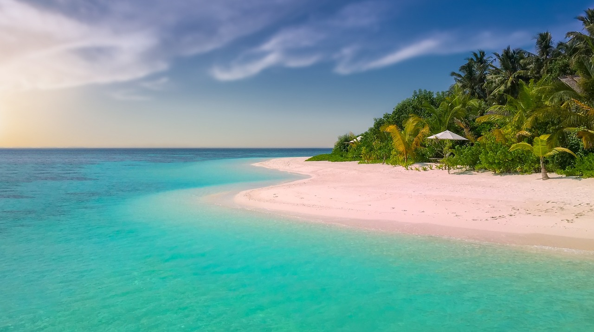
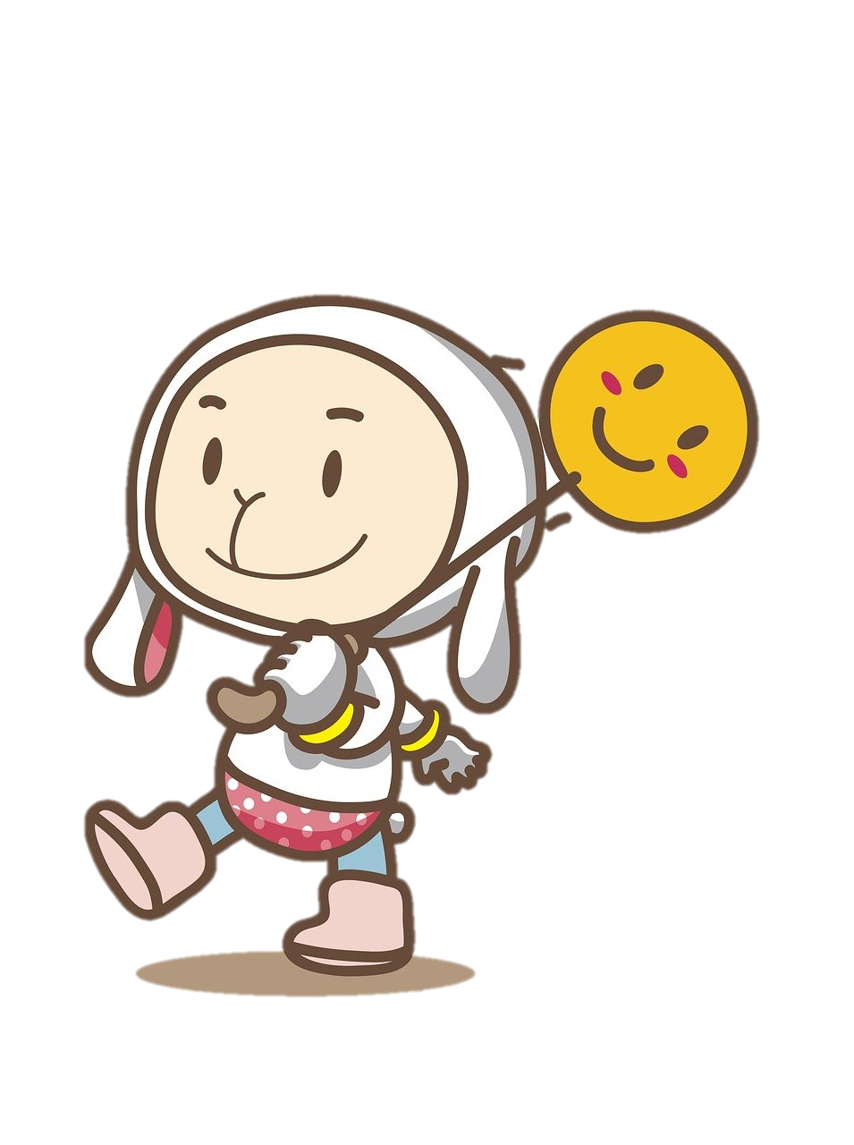
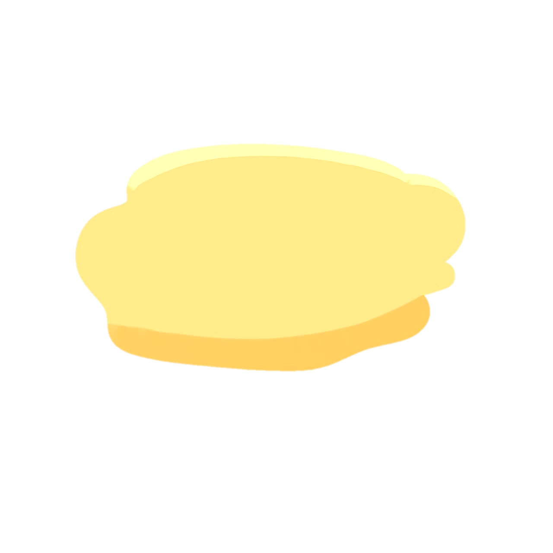
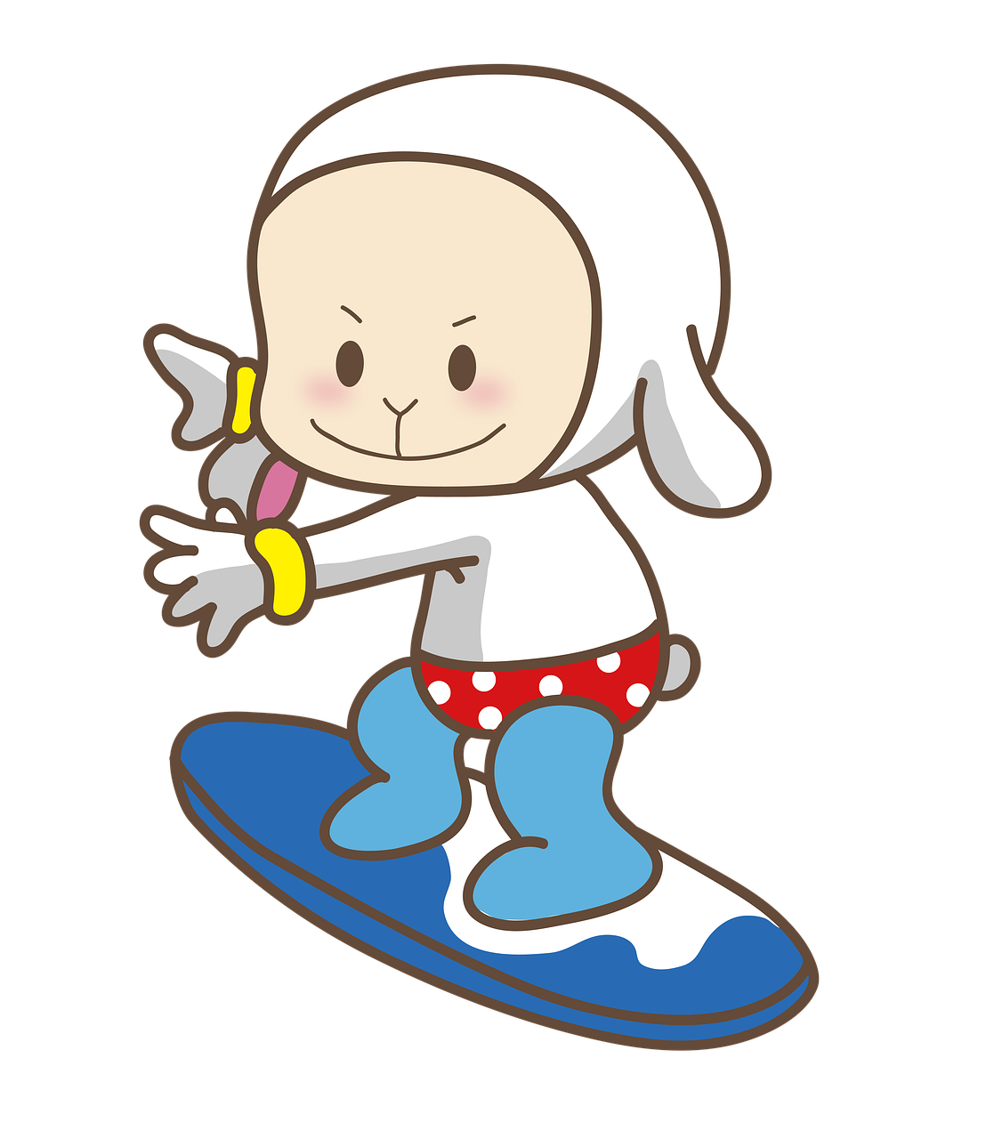
1
Warm-up &
Review

Slide 5


Slide 6

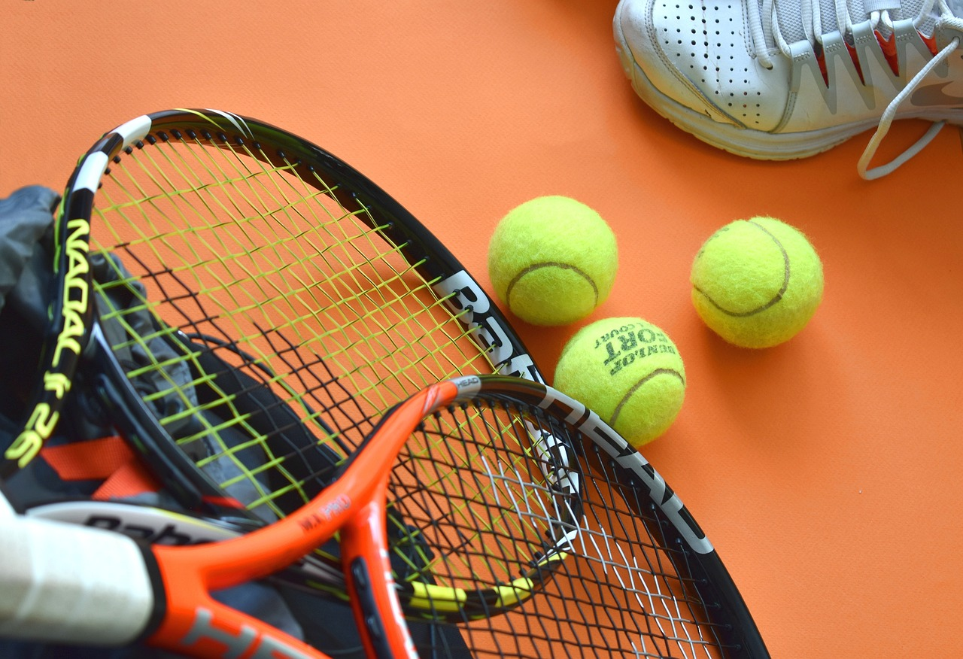
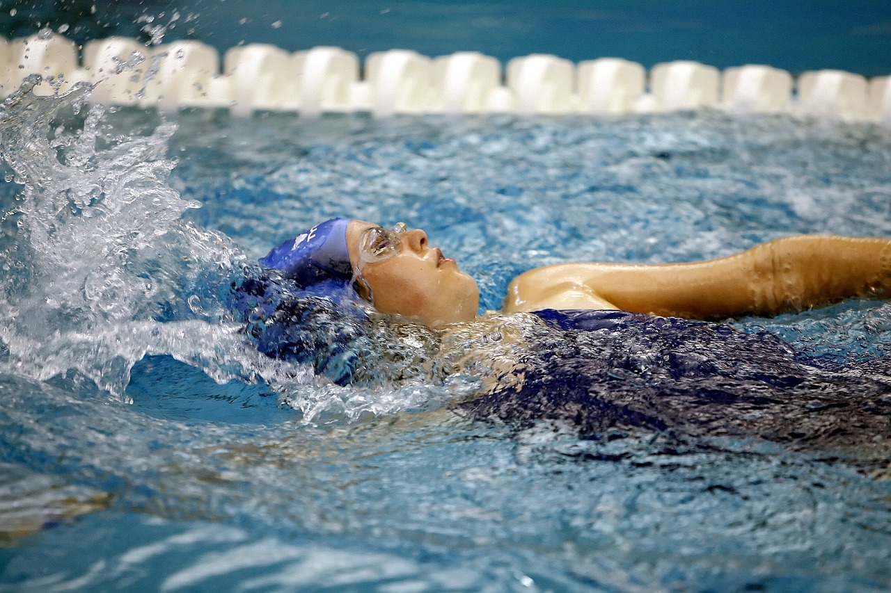
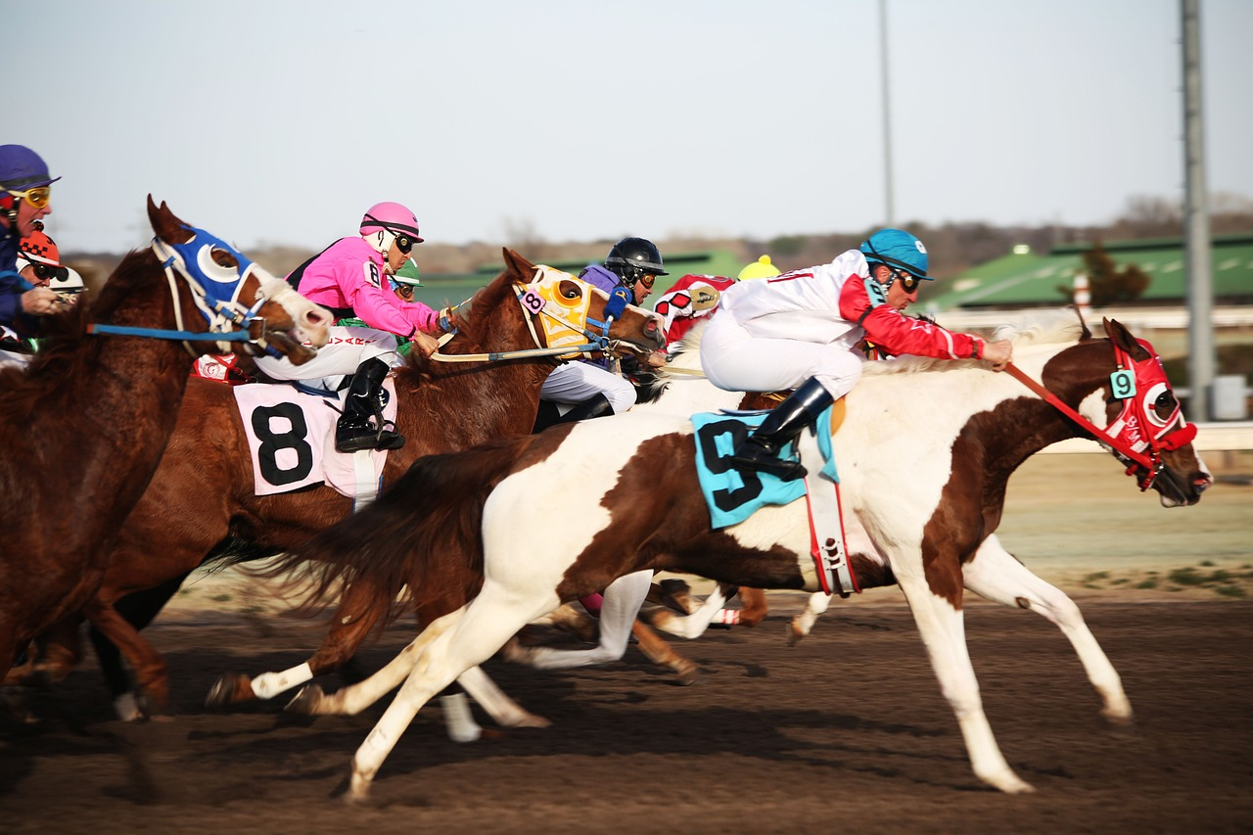
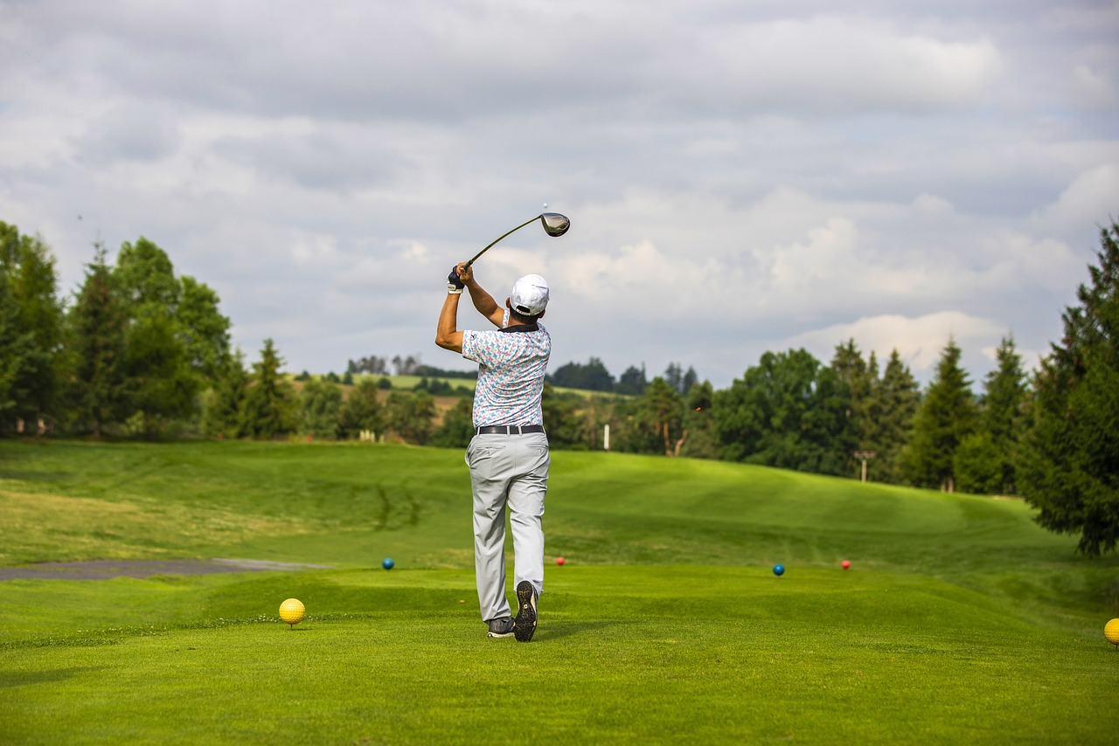
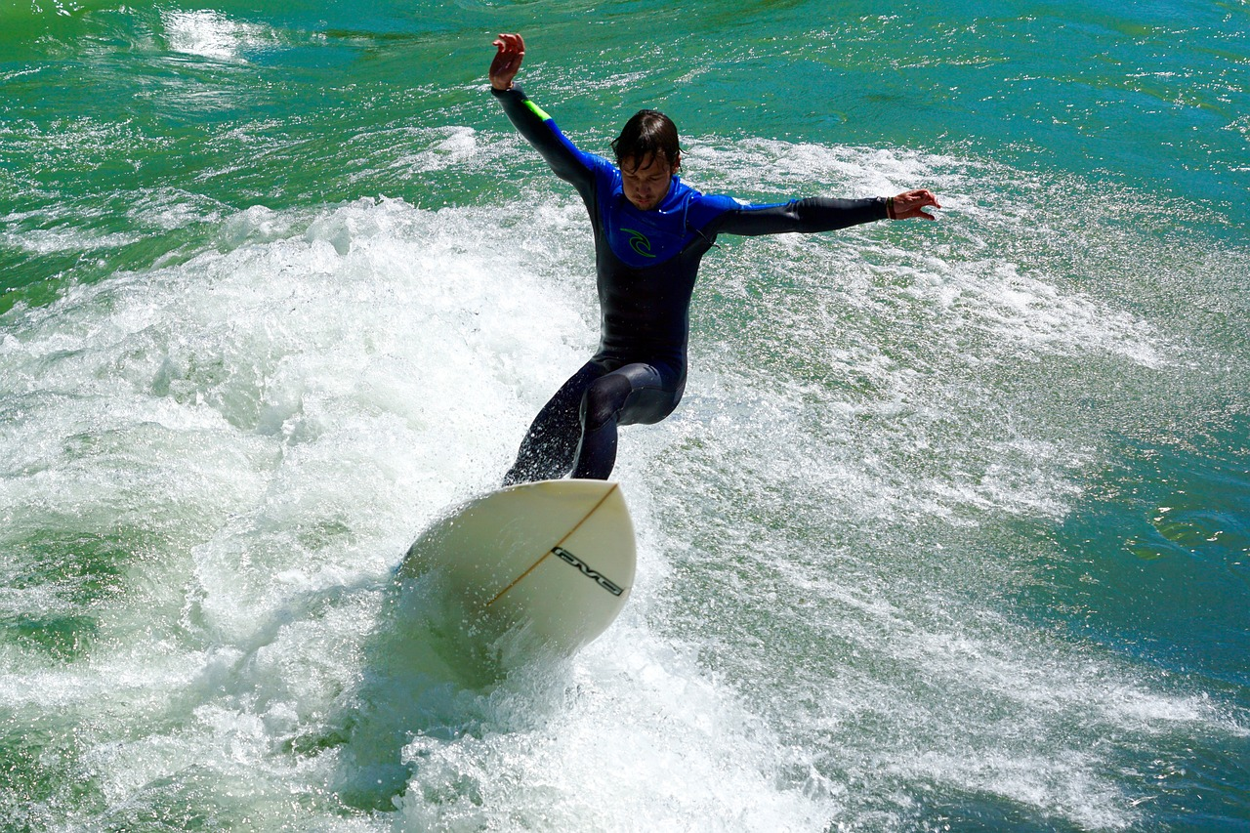
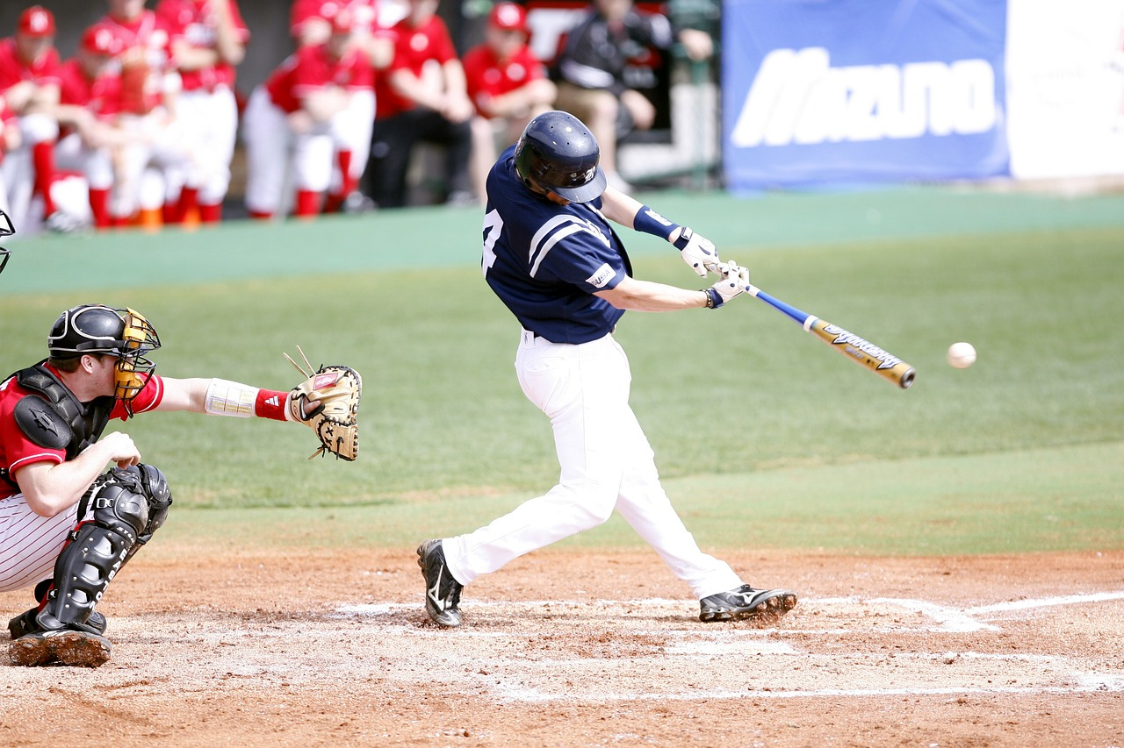
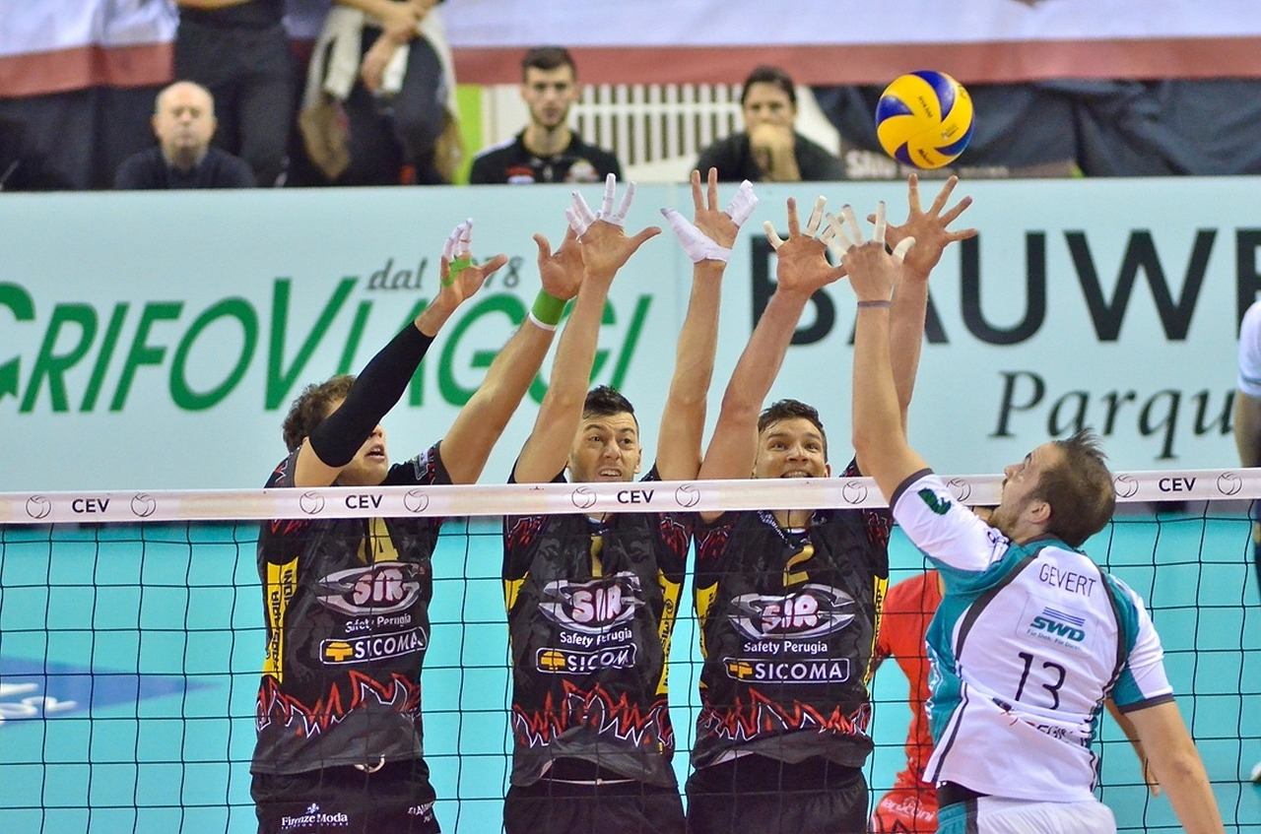
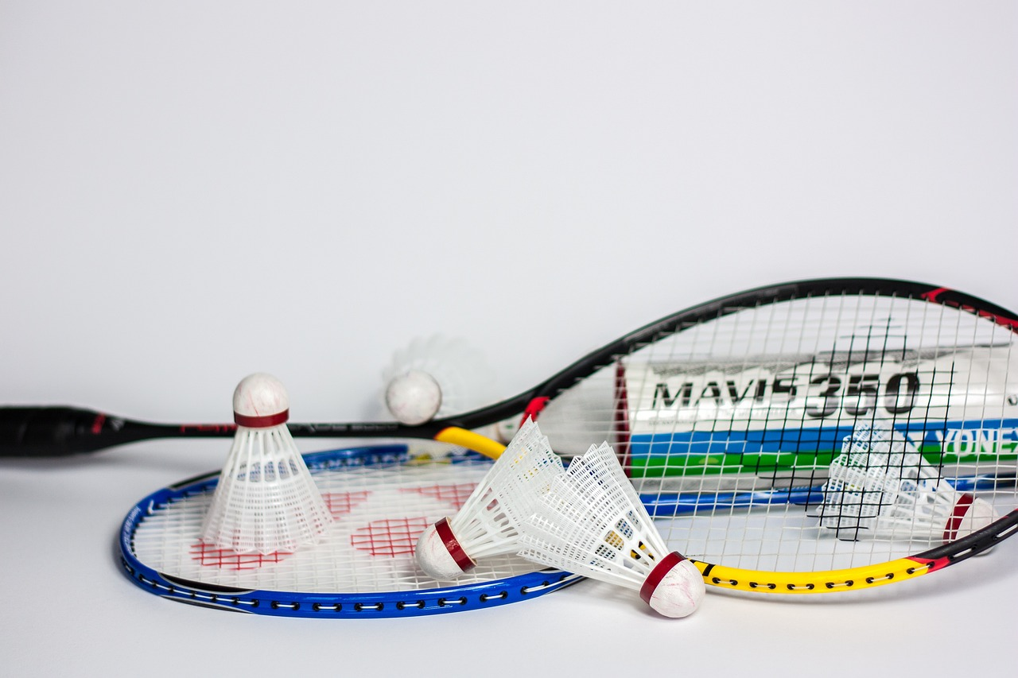
What sports are they?
Swimming
Horse riding
Golf
Tennis
2
3
4
1
Surf
Baseball
Volleyball
Badminton
5
6
7
8

Slide 7
What sports are missing?
Swimming
Horse riding
Golf
Tennis
2
3
4
1
Surf
Baseball
Volleyball
Badminton
5
6
7
8

Slide 8
What sports are missing?
Swimming
Horse riding
Golf
Tennis
2
3
4
1
Surf
Baseball
Volleyball
Badminton
5
6
7
8

Slide 9
What sports are missing?
Swimming
Horse riding
Golf
Tennis
2
3
4
1
Surf
Baseball
Volleyball
Badminton
5
6
7
8

Slide 10
What sports are missing?
Swimming
Horse riding
Golf
Tennis
2
3
4
1
Surf
Baseball
Volleyball
Badminton
5
6
7
8

Slide 11
2
Practice

Slide 12


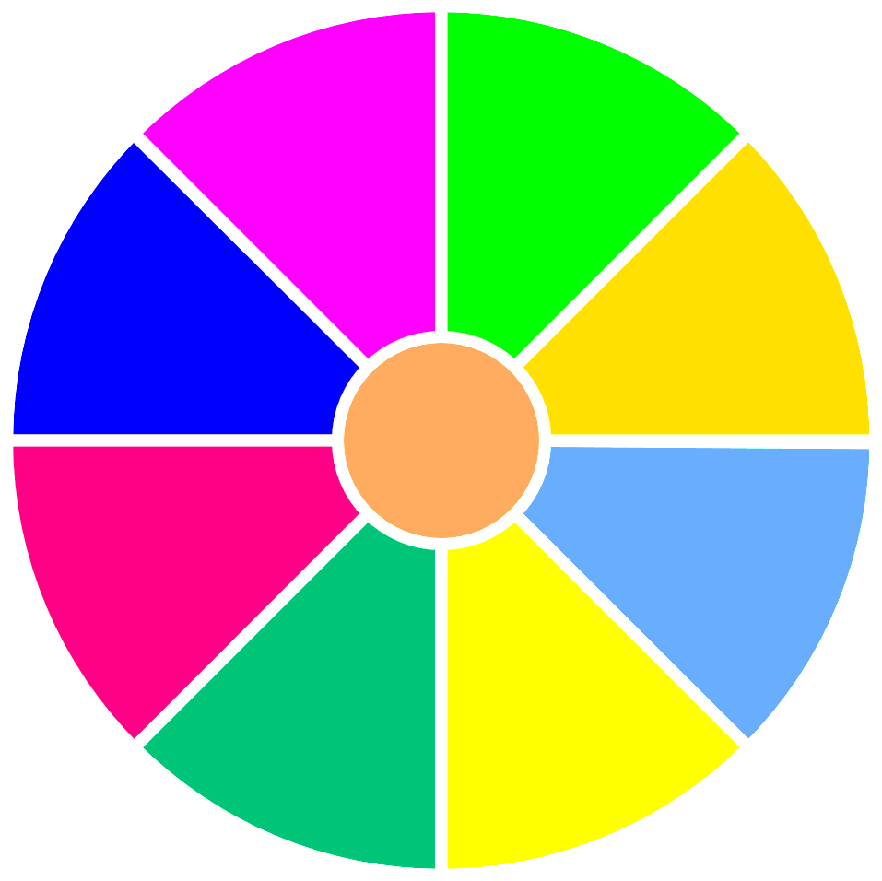
The lucky wheel
0 stars
1 star
4 stars
2 stars
Stop
1
2
3
2 stars
5 stars
4
5
6
1 star
3 stars
Spin
Next
Notes:
T clicks numbers to choose questions, clicks Spin to spin the wheel, clicks Stop to stop the wheel.

Slide 13
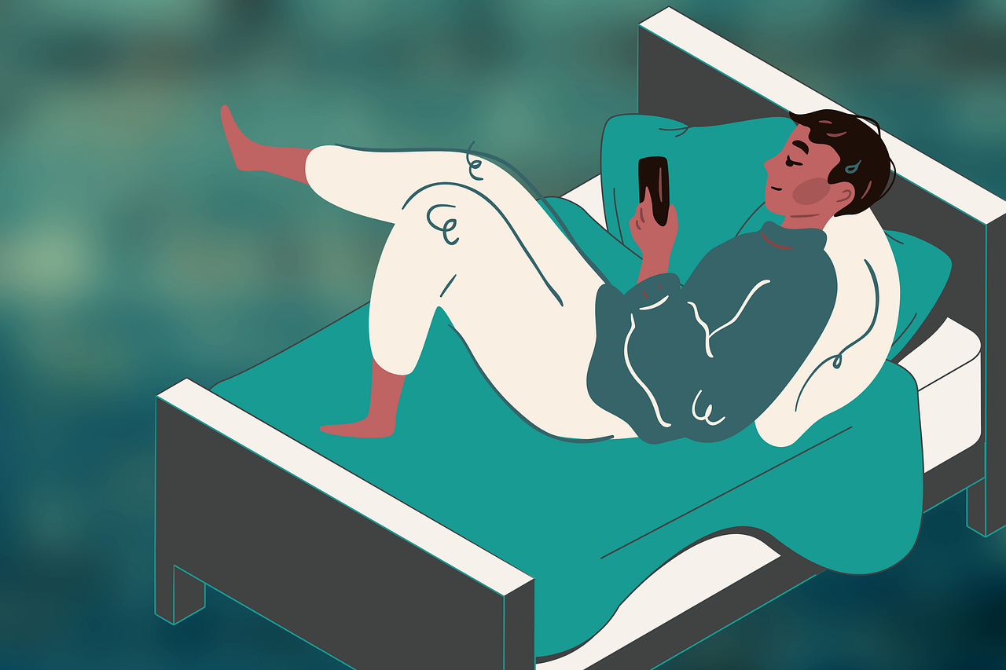
Back
Order the words to make a sentence
their/much/shouldn’t/ use/People/smartphones/too
People shouldn’t use their smartphones too much.

Slide 14
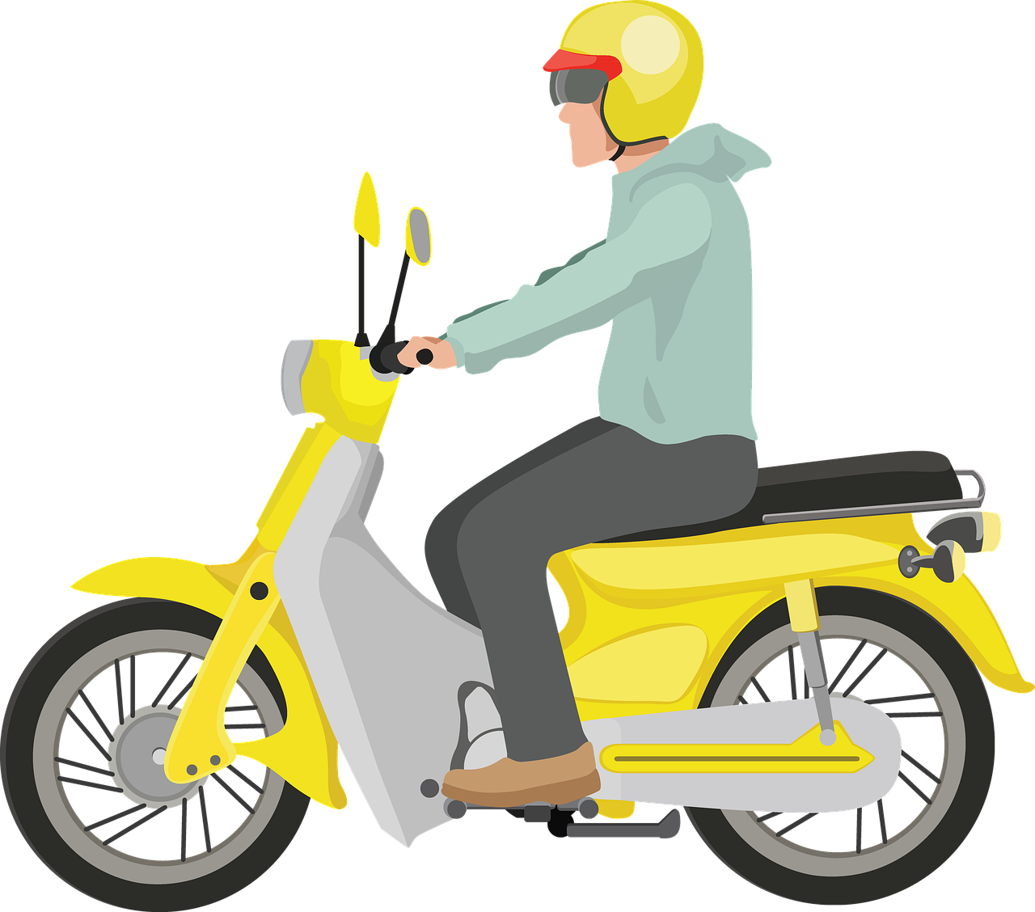
Back
Order the words to make a sentence
You/helmet/when/a/motorbike/
wear/should/riding/your
You should wear a helmet when riding your motorbike.

Slide 15
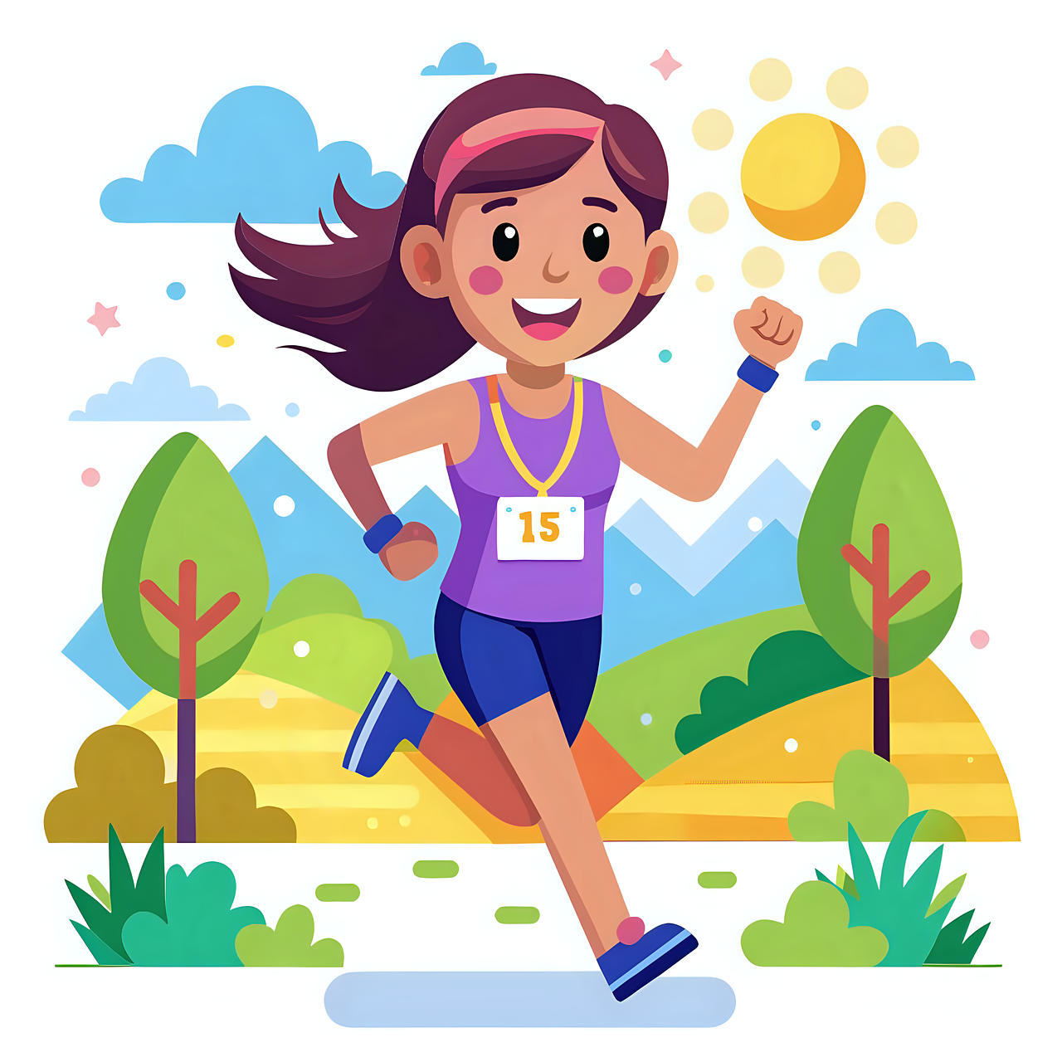
Back
Look and write
is running
She ____________ at the moment. (run)

Slide 16
Back
Look and write
are riding the horses
They ___________________ at present. (ride the horses)

Slide 17

Back
Odd one out
1. prepare
taekwondo
prepare
2. taekwondo
3. excited
excited
champion
4. champion

Slide 18
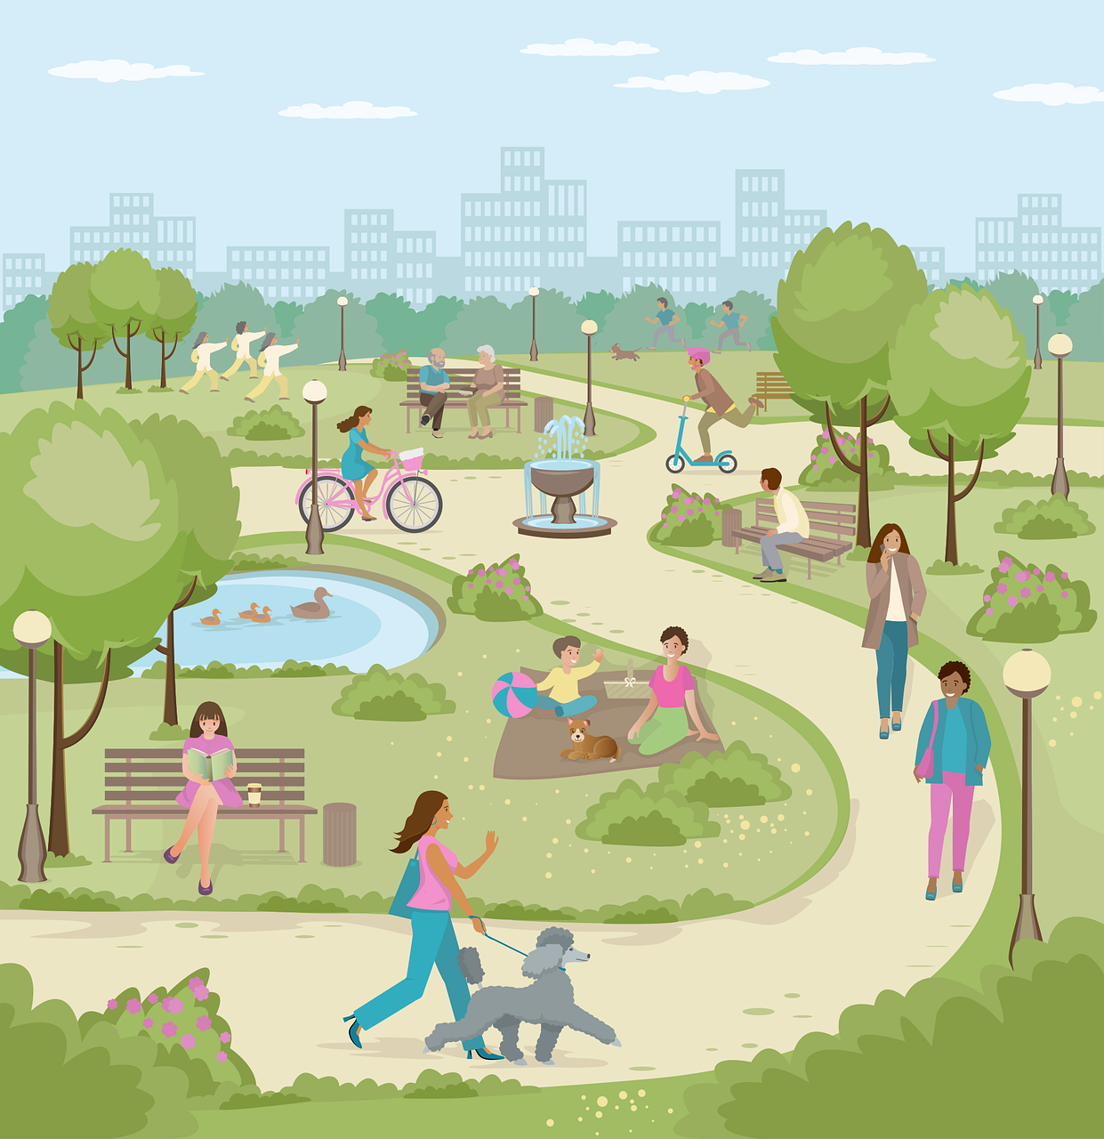
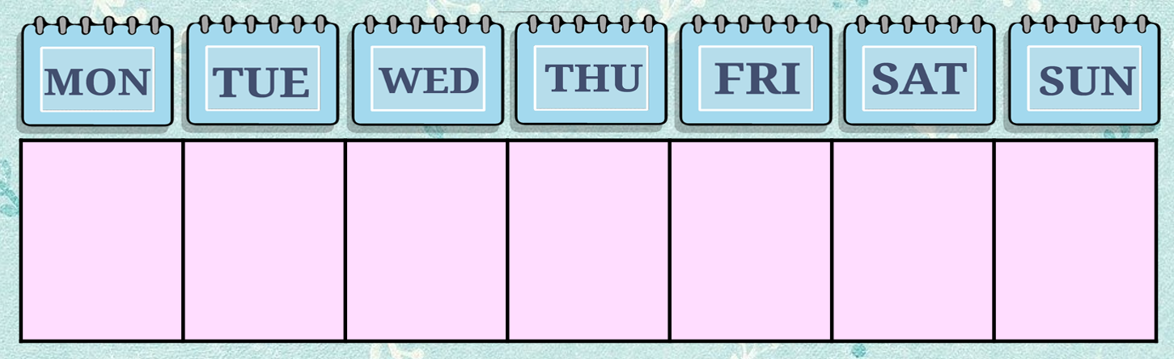
Back
Look and write
✓
✓
My family has outdoor activities
______________.
twice a week

Slide 19
3
Production

Slide 20
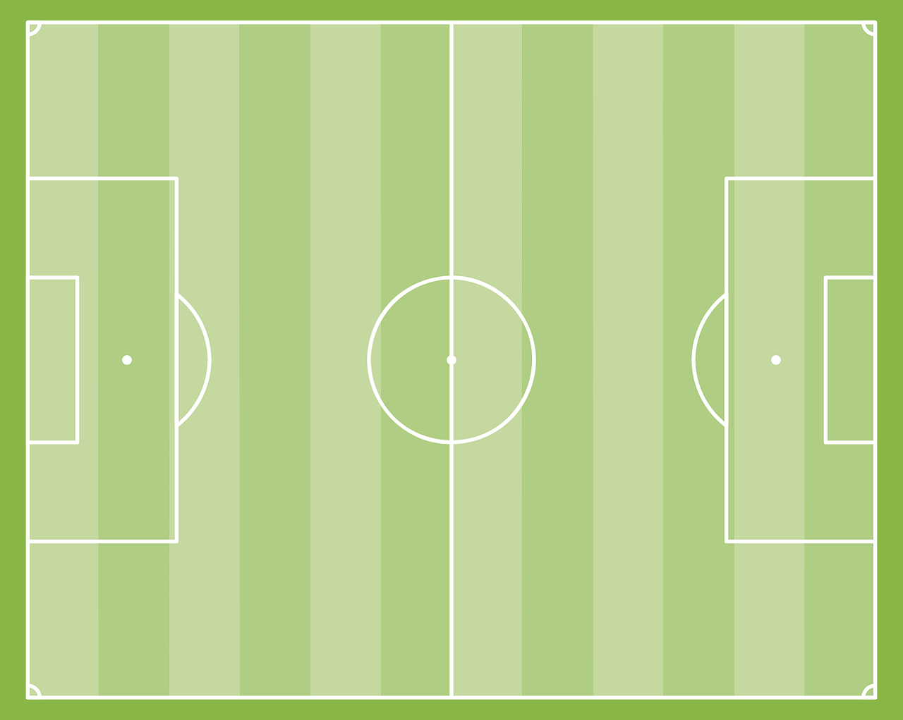
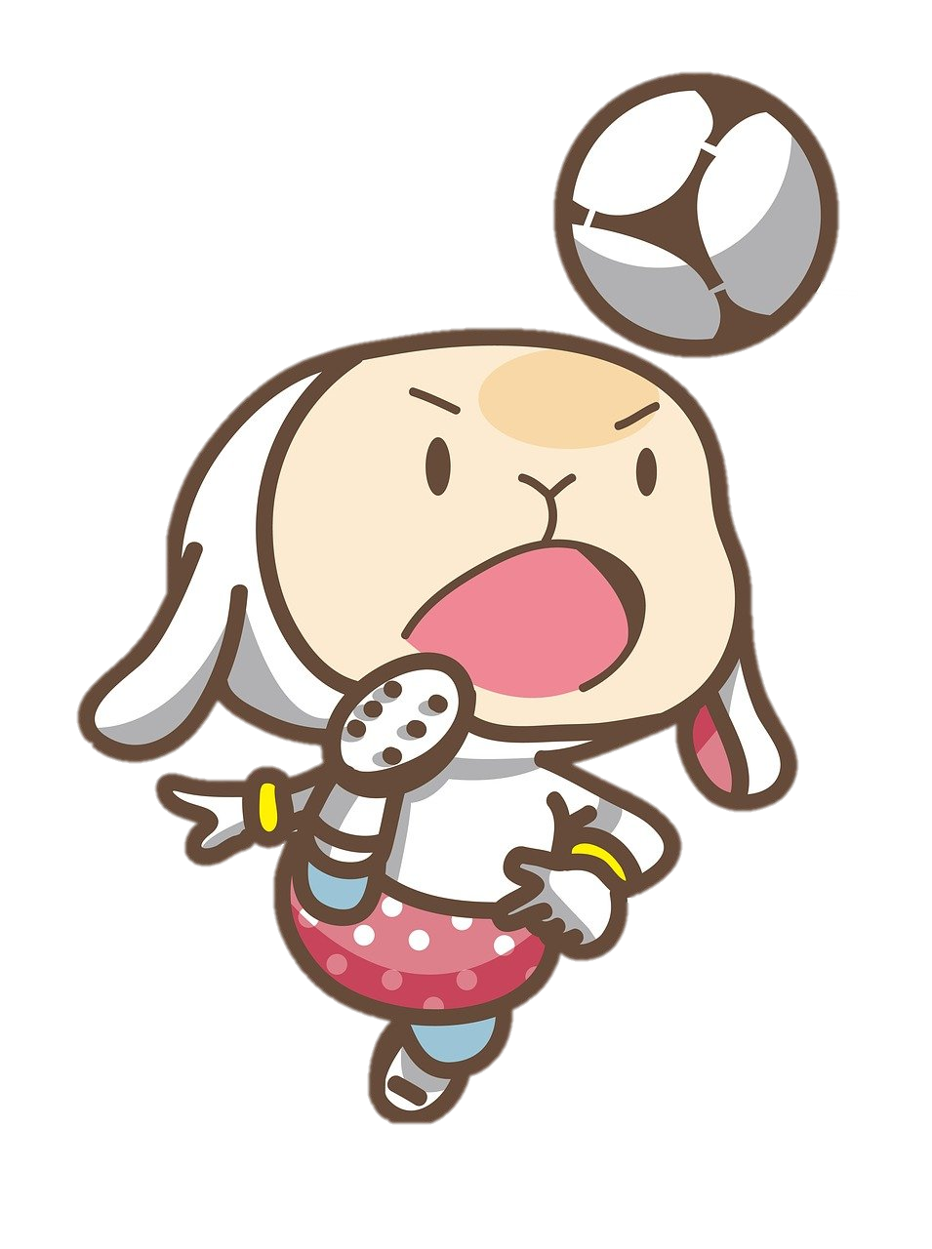

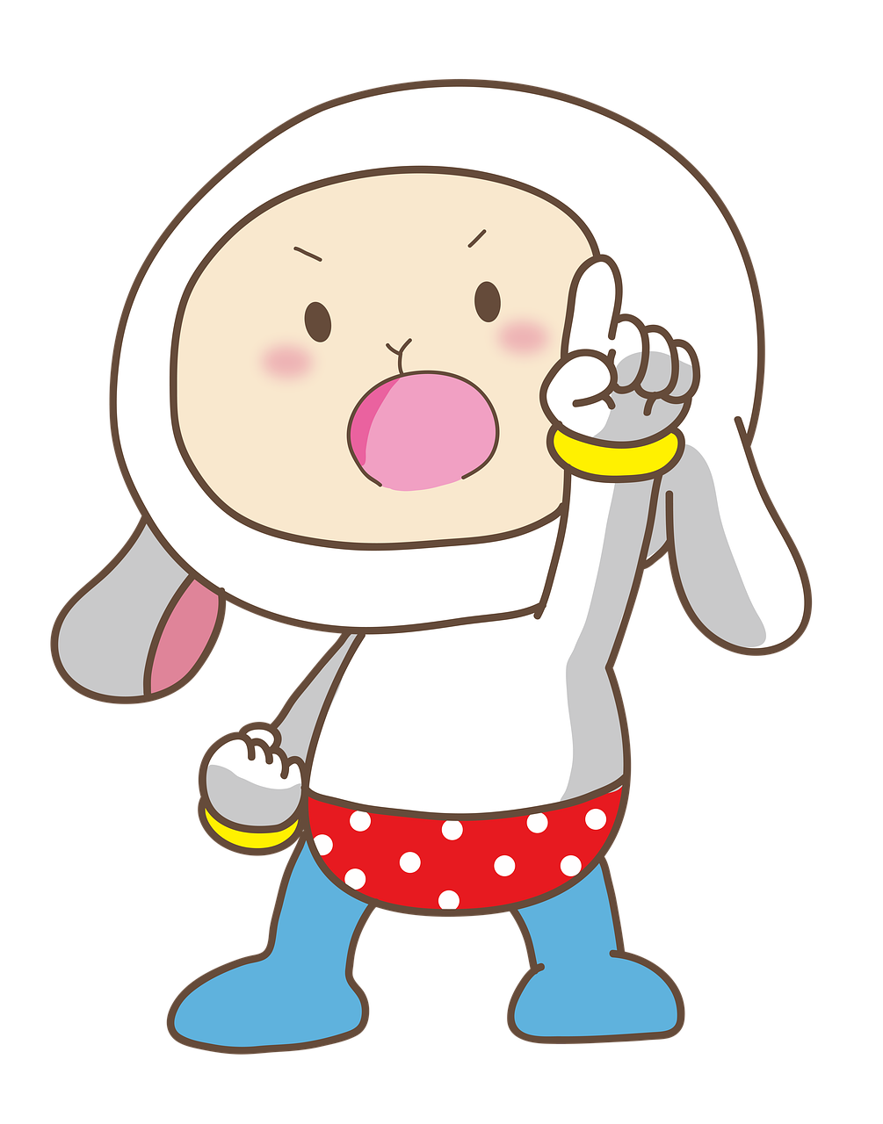
Work in groups of four.
Think about a sport and how to stay safe when playing it.
Together, make a poster with at least four instructions.
1 When we play football, we should learn to control our movement.
2 We should…
3 We shouldn’t push other players.
4 We shouldn’t…

Slide 21

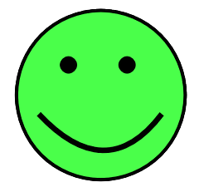
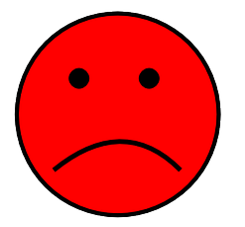
How to stay safe when playing sport
Should
- Learn to control our movement
- Warm up carefully
Shouldn’t
- Push other players.
- Drink too much water before playing.

Slide 22
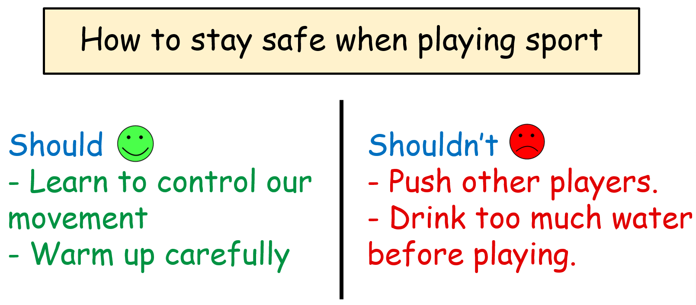
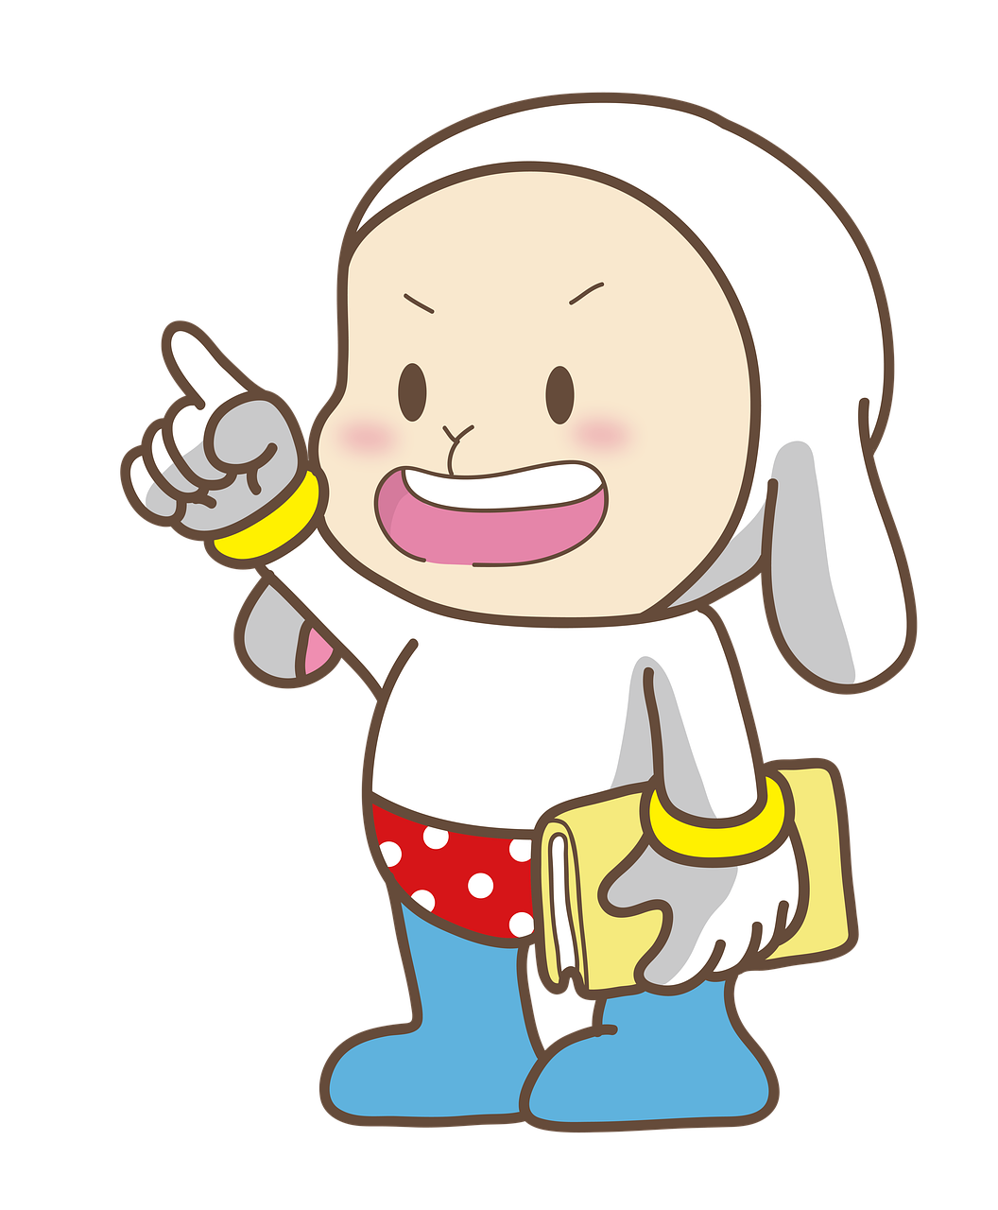
- When we play football, we should learn to control our movement.
- We should warm up carefully.
- We shouldn’t push other players.
- We shouldn’t drink too much water before playing.

Slide 23
4
Wrap-up &
Assessment

Slide 24

Read and write
twice
every
should
shouldn’t
am jogging
three
Hi, this is my timetable. I go to school (1)______ weekday. I play football (2)______ a week, because we (3)_______ often do outdoor activities. At the moment, I (4)_________ in the playground. I only watch TV (5)_____ times a week, 30 minutes each time because children (6) ______ watch TV for a long time.

Slide 25

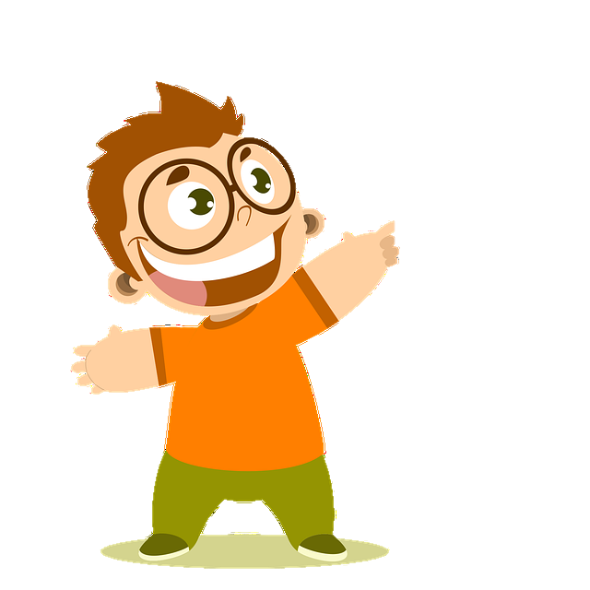
Wrap-up
Unit 7: Sports
Fun time & Project
What have we learnt today?
Review: Present continuous, should – shouldn’t, adverbs of frequency (once, twice, three times, four times)
Project: Making instructions on how to keep safe when playing sports

Slide 26

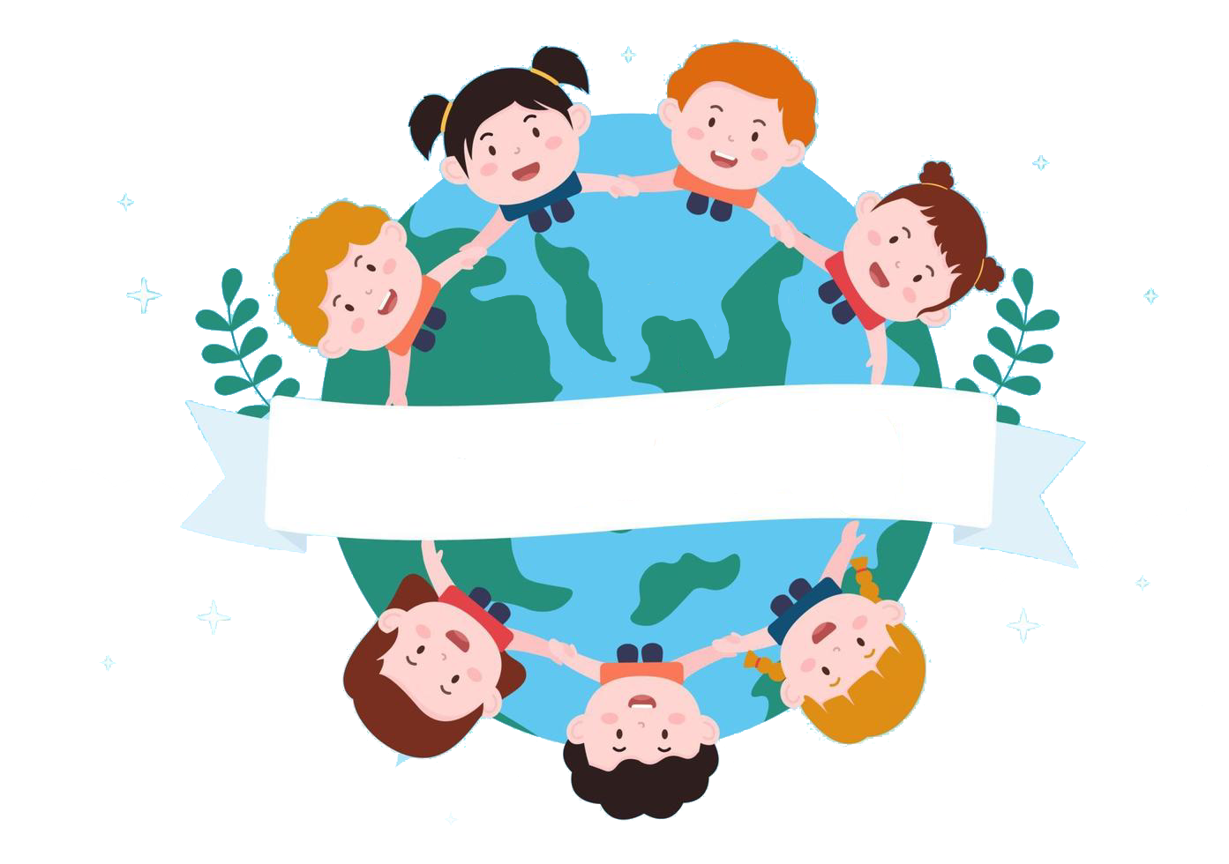
Thank you
& goodbye!

