Slide 1












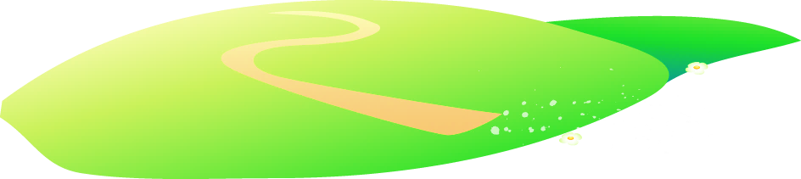







Notes:
Để nguyên trang bìa như này, chỉ thay đổi tên bài trong quá trình làm. Logo của sách Wonderful World

Slide 2




Unit 10. REVIEW 5
PART 1

Slide 3

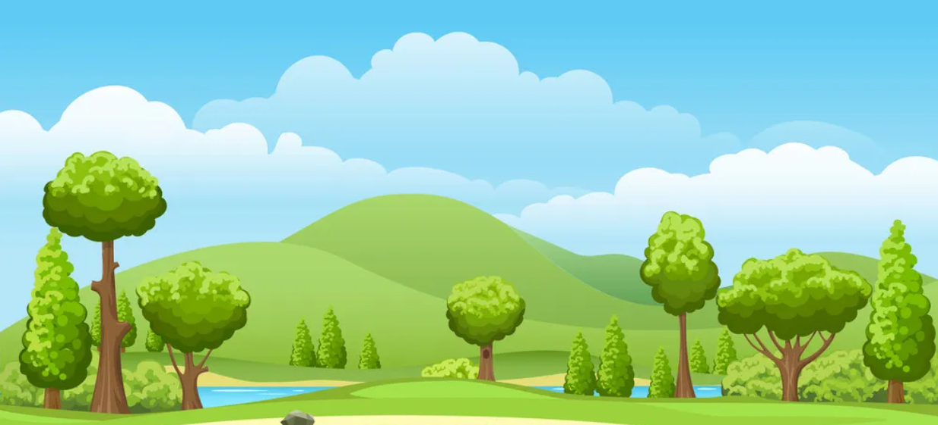
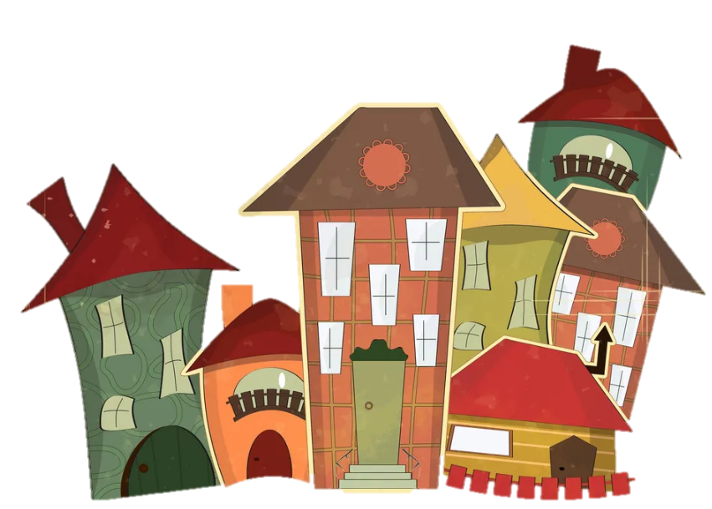
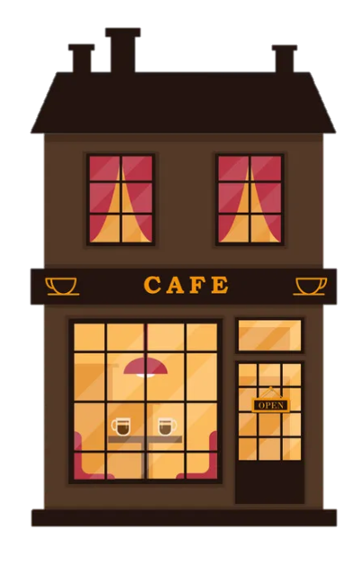
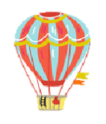

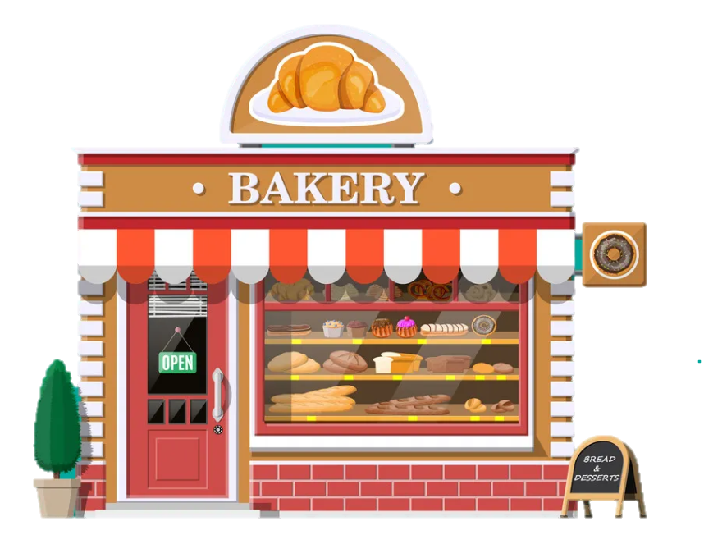

1
Warm Up

Slide 4
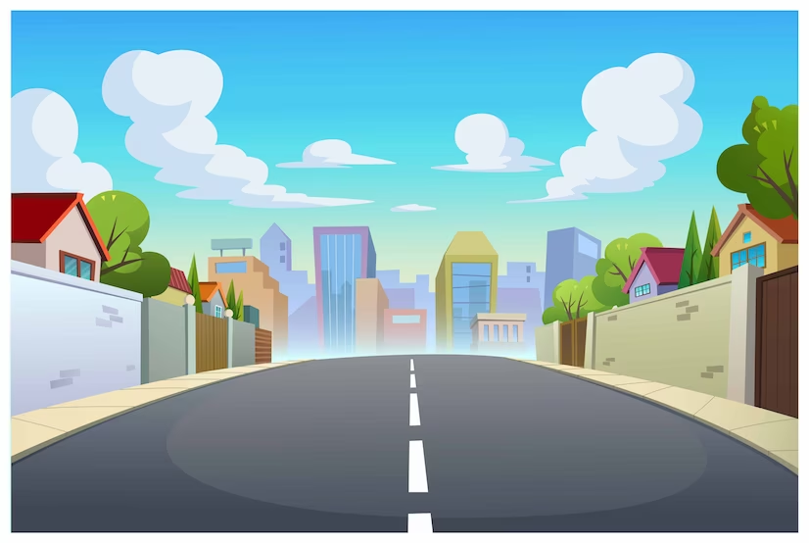

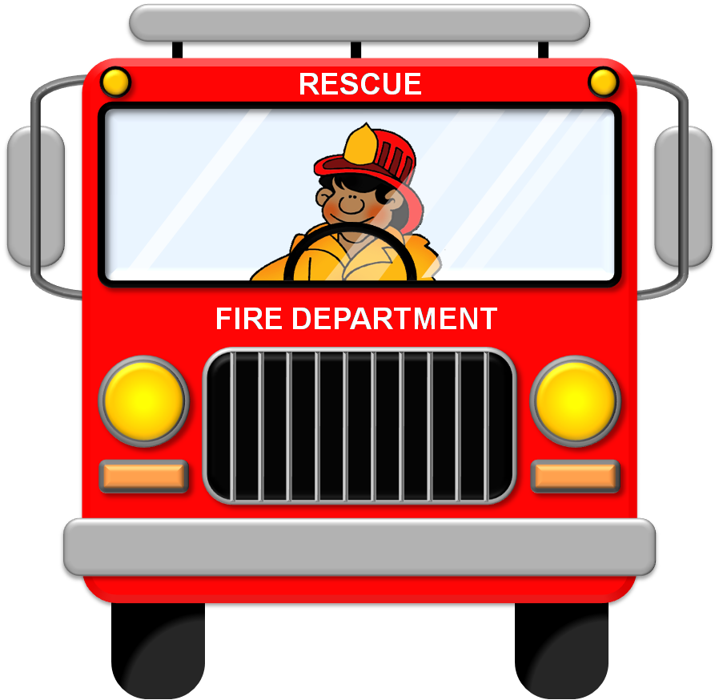
Review

Slide 5

WHERE´S THE FIRE?
START
Drive the fire engine to the fire

Slide 6
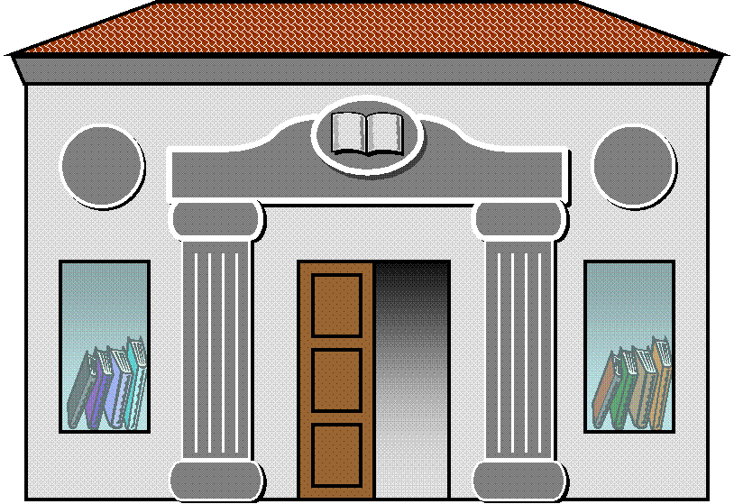
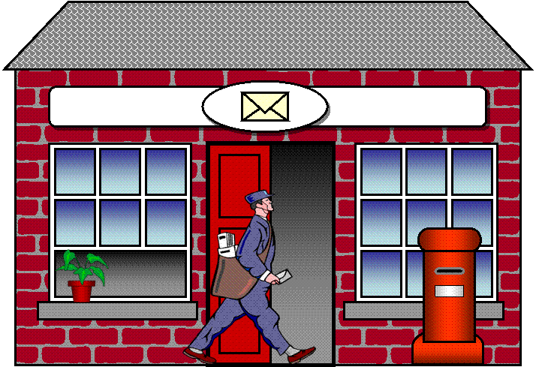
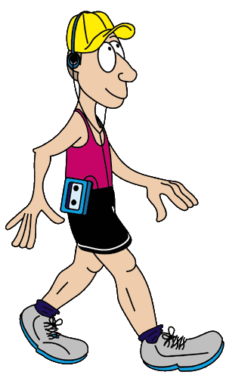
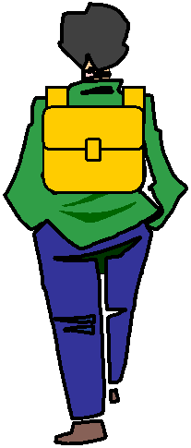

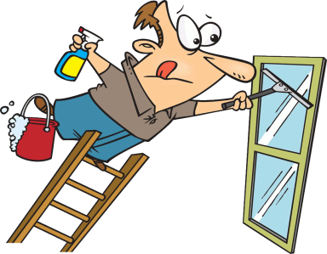
GPS
TURN RIGHT
Click on the arrows
Click on the arrows

Slide 7
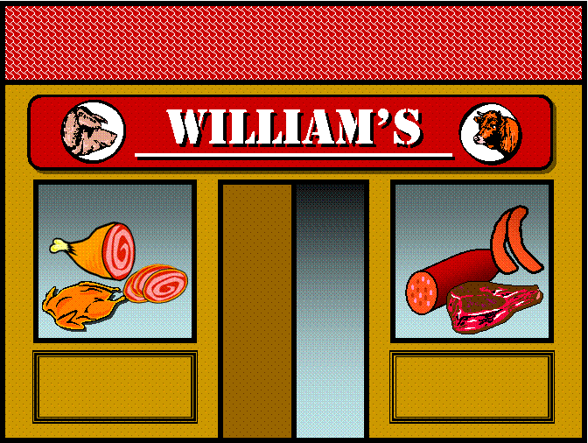
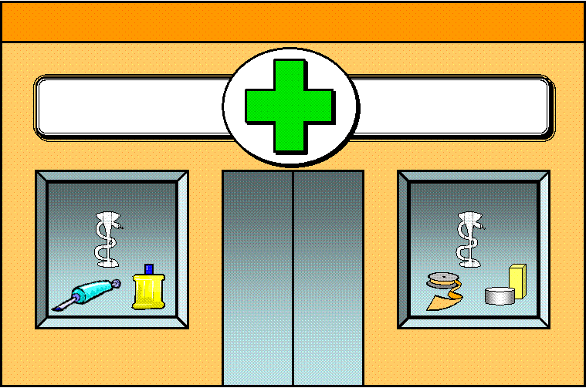
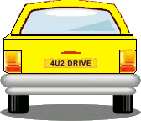

GPS
GO STRAIGHT
Click on the arrows

Slide 8
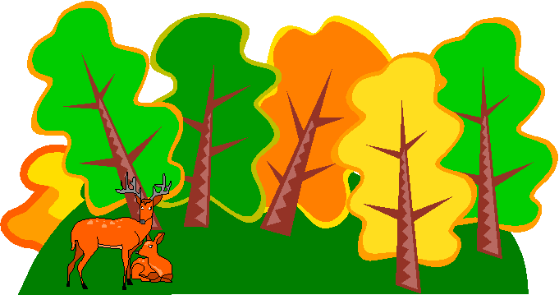



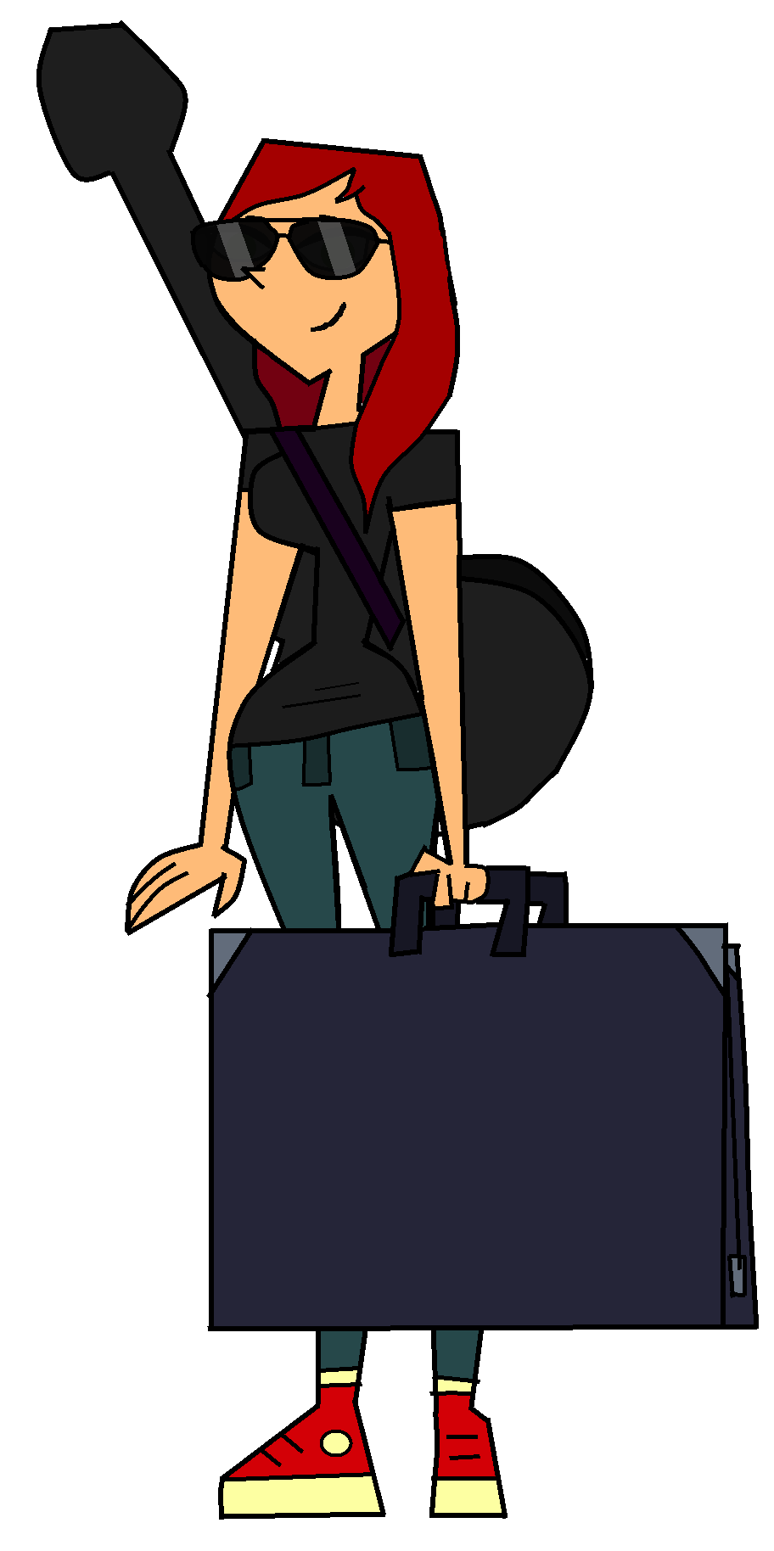
GPS
TURN LEFT
Click on the arrows

Slide 9

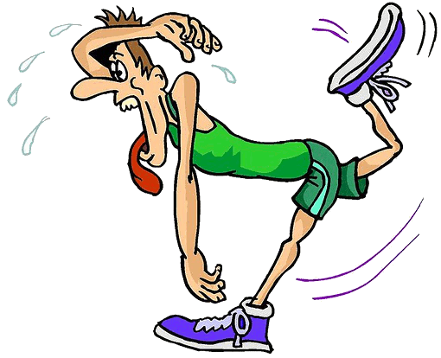
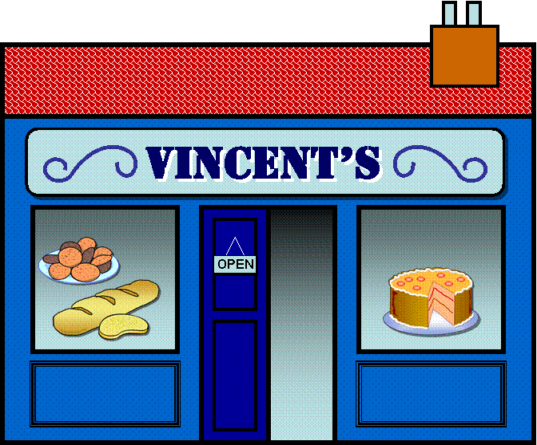
GPS
TURN RIGHT
Click on the arrows

Slide 10
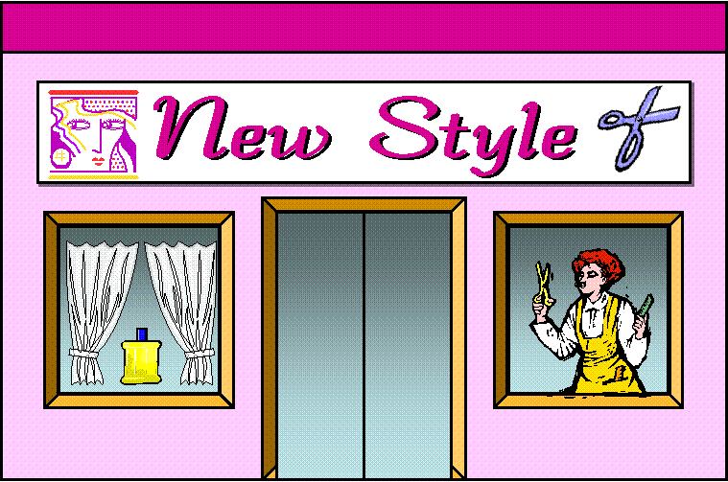
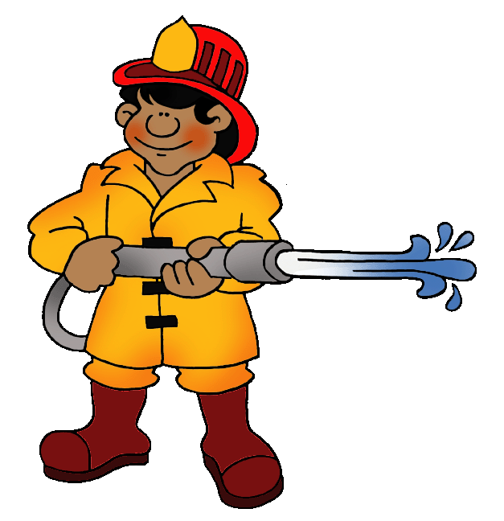
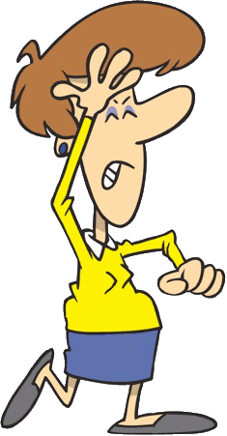
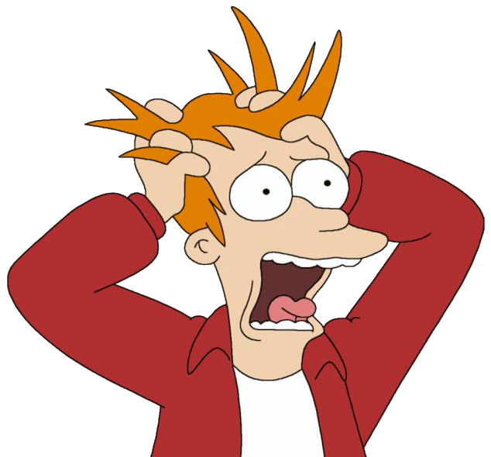
GPS
HERE WE ARE!

Slide 11

2
Practice

Slide 12
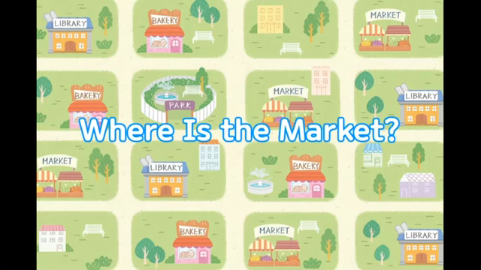

Slide 13

1. We buy vegetαbles αt the supermαrket / fountαin.
2. To go to the trαin stαtion, turn / cross right on First street.
3. The bookshop is on Bα Trieu street / bus stop.
4. The post office is opposite / next the shopping centre.
1. Circle.

Slide 14
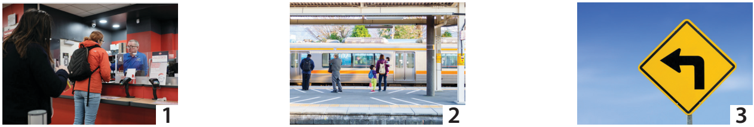
Post office
2. Point and say.
Train station
Turn left

Slide 15
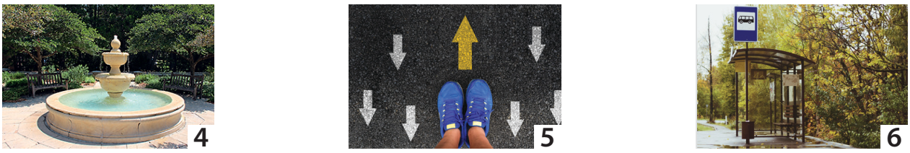
Fountain
2. Point and say.
Go straight
Bus stop

Slide 16
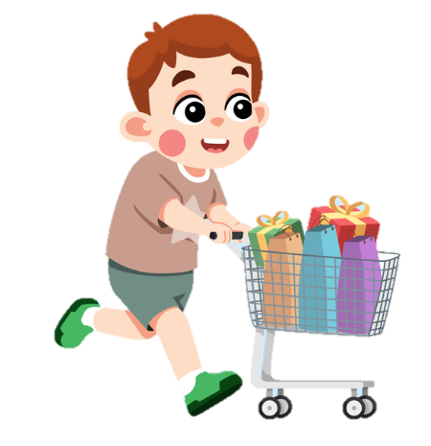
3
Production

Slide 17
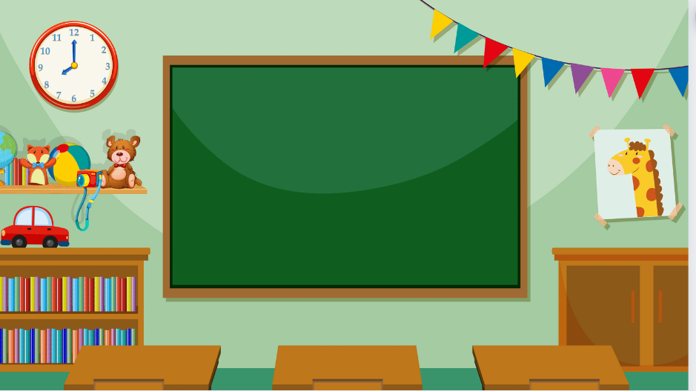
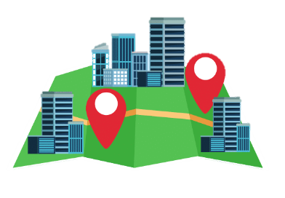
Look at the map and ask.

Slide 18
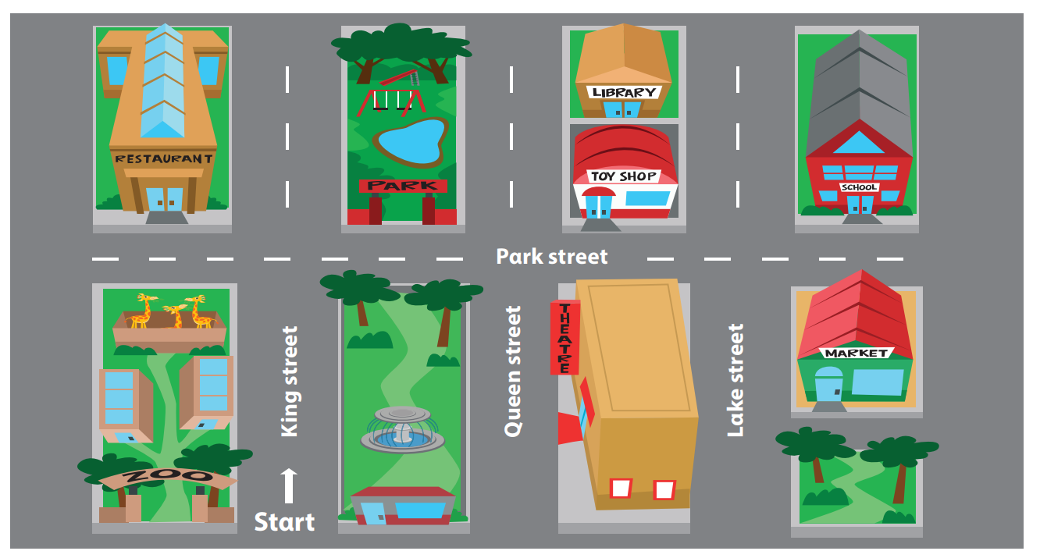

Slide 19

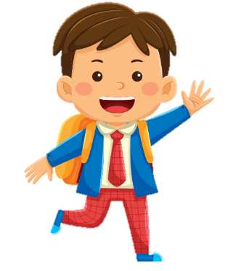
How do we get to
the park?
We go strαight on King street, αnd
then turn right. The park is between the restaurant and the toy shop.

Slide 20
How do we get to school?
We go strαight on King street, αnd
then turn right. The school is opposite the market.

Slide 21
How do we get to the restaurant?
We go strαight on King street, αnd
then turn left. The restaurant is opposite the zoo.

Slide 22
How do we get to the toy shop?
We go strαight on King street, and
then turn right. The toy shop is opposite the theatre.

Slide 23
How do we get to the library?
We go strαight on King Street, and turn right, then turn left at the toy shop. The library is behind the toy shop.

Slide 24
5
Assessment

Slide 25
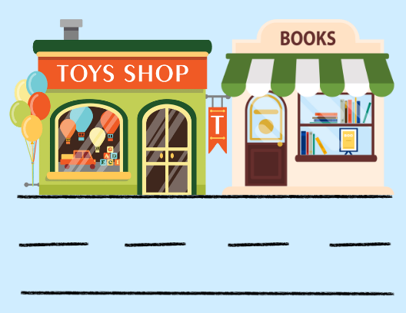

1. The toy shop is ( next to/ opposite) the book shop.
Underline the correct prepositions.
2. The fountain is ( on/ in front of ) the museum.

Slide 26
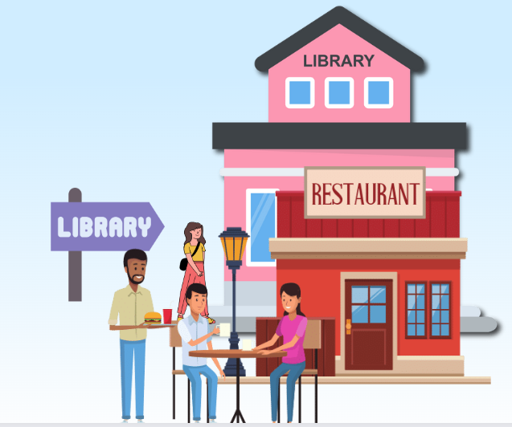
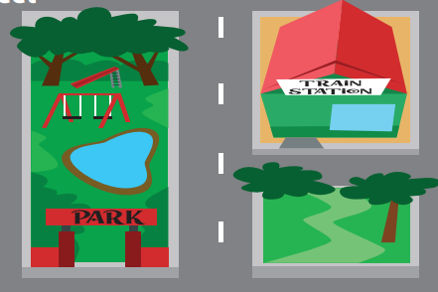
3. The library is ( behind/ in front of ) the restaurant .
4. The train station is ( opposite/ next to ) the park.

Slide 27

Thank You
Good Bye !

