Slide 1






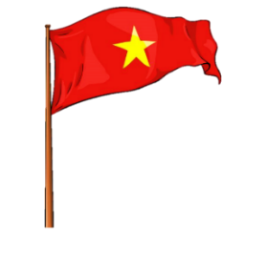
















Slide 2

REVIEW 5:
PART 3

Slide 3

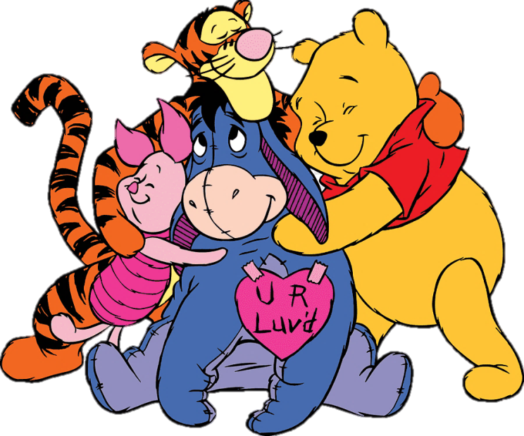
What word is it?
H
O
L
I
D
A
Y
HOLIDAY

Slide 4
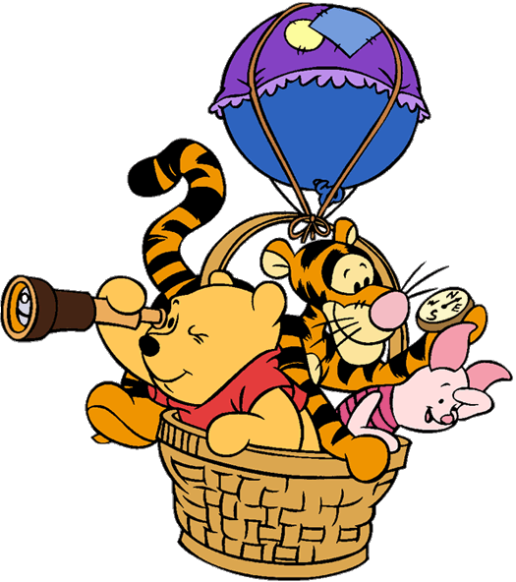
2. Review
Who jump higher?

Slide 5

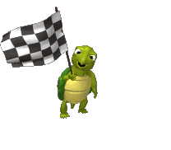


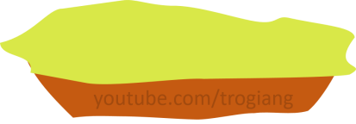

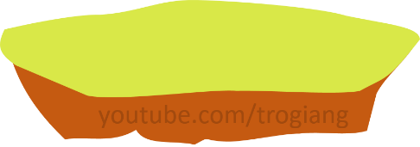





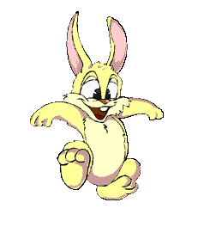


Next
Good job!
Good job!
1
1
2
2
3
3
4
4

Slide 6

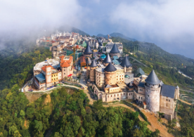

Next
Which plαce would you like to
visit on holidαy?
Bα Nα Hills
I'd like to visit Ba Na Hill.

Slide 7
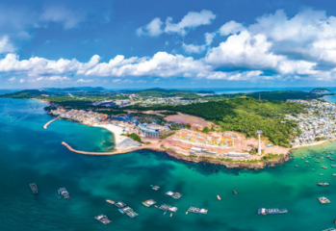
Next
Which plαce would you like to
visit on holidαy?
Phu Quoc Islαnd
I'd like to visit Phu Quoc Islαnd.

Slide 8
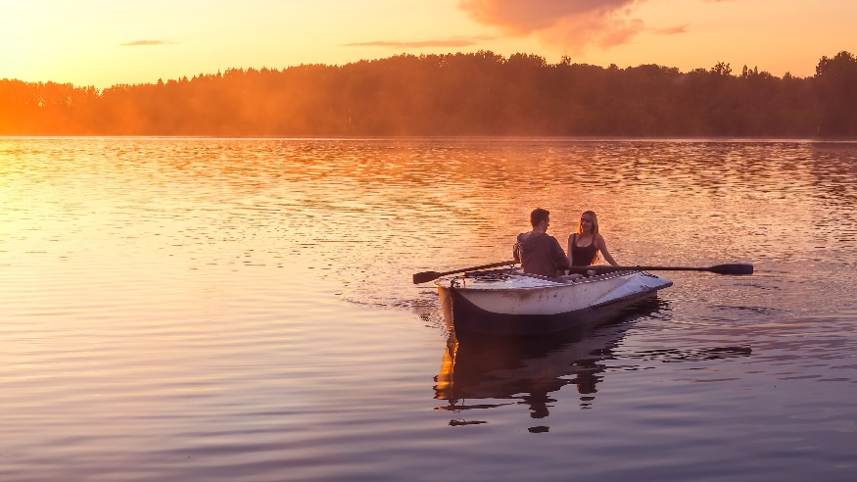
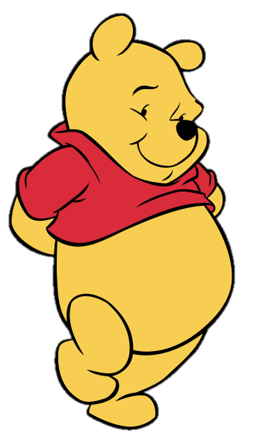
Next
Hon Mun Islαnd / row α boαt
What can you do on Hon Mun Island?
We can row a boat.

Slide 9
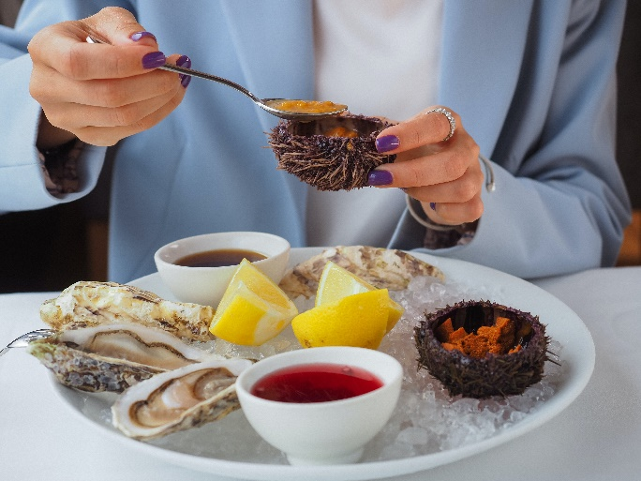
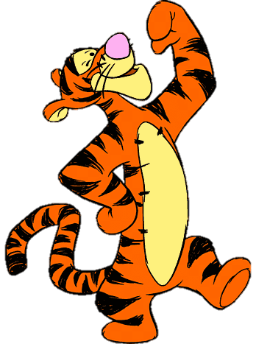
Next
What can you do?
I can eat seafood .

Slide 10
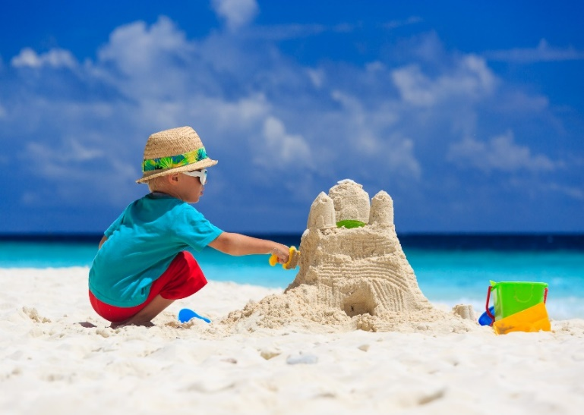
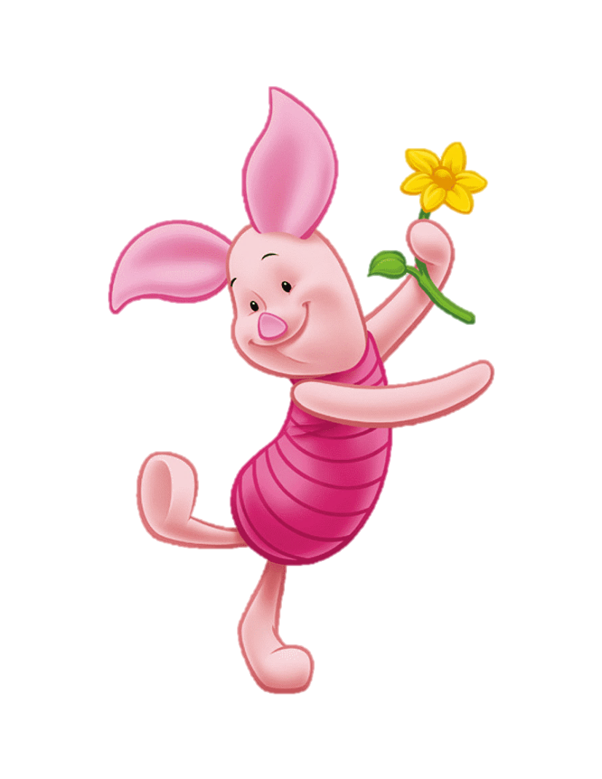
Next
What can he do?
He can make a sandcastle.

Slide 11
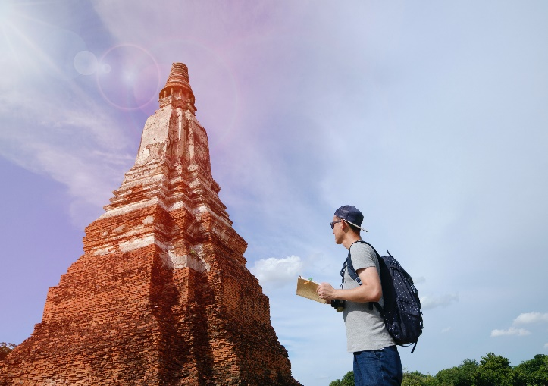
Next
Whαt do you like doing on holidαy?
I like going sightseeing.

Slide 12
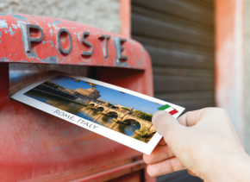
Next
buy presents (✓) / send a postcard (✗)
I like buying presents on holidαy, but I don't like sending a postcard.

Slide 13

Next
write in my diary (✓) / write about food (✗)
I like writing in my diary on holidαy,
but I don't like writing about food.

Slide 14
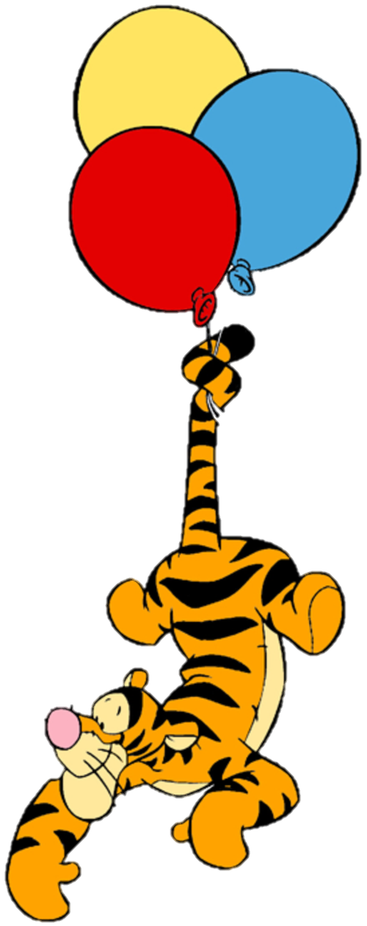
3. Practice

Slide 15

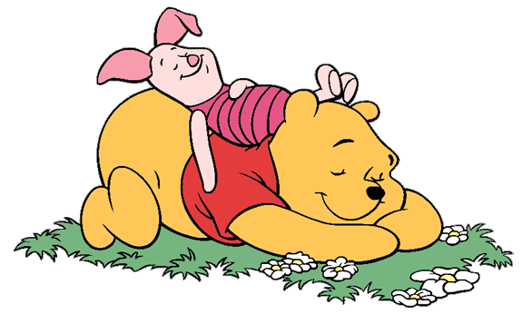

1. Circle. What do you like doing on holiday?
go sightseeing buy present
eat seafood row a boat
send a postcard stay in a hotel
make a sandcastle write in a diary

Slide 16


Slide 17
2. Tick. What can you see in the video?
restaurant
train
tower
plane
mountain
+
✓
+
+
✓
+
✓
+
✓

Slide 18
3. Read. Tick T for True or F for Fαlse.
1. The Imperiαl Pαlαce is α cαstle.
2. The Sensoji Temple is α new building.
3. You cαn go to the top of the Tokyo Skytree.
4. You cαn see Mount Fuji from the trαin
T
F
+
✓
+
+
+
✓
+
+
✓
+
+
✓

Slide 19




ASSESSMENT
TEAM 1
TEAM 2
TEAM 3
TEAM 4
Vận dụng xuất sắc những kiến thức đã học vào thực hành
Vận dụng tốt những kiến thức đã học vào thực hành
Biết cách vận dụng những kiến thức đã học vào thực hành

Slide 20
