Slide 1













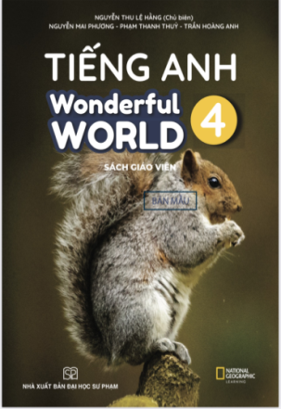








Slide 2




Unit 8 - Lesson 3 – Period 3

Slide 3


1. Warm up
Listen to a song
Notes:
(Teacher shows a black and white picture. Ss have to guess what colour it is.)
- Divide the class into 4 groups
- Set the game rules.
- Ask students to look and guess.
- Award the best groups

Slide 4


Slide 5
2.Presentation
Task 7
Listen and repeat.
Notes:
Dấu câu

Slide 6






7. Listen and repeat.
/z/
Use
Use

Slide 7
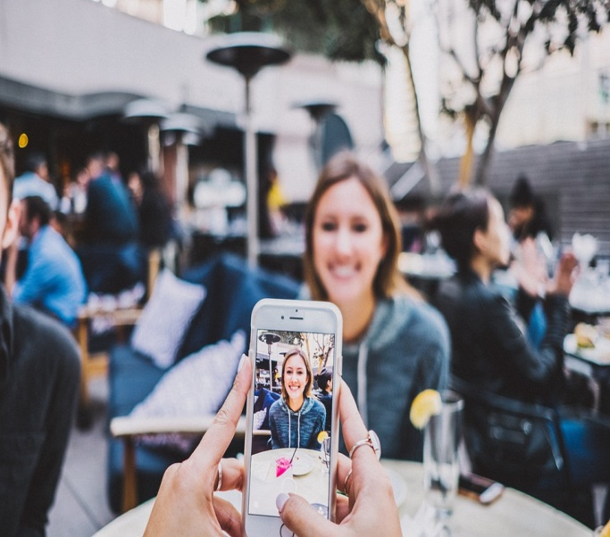
7. Listen and repeat.
/m/
Make
Make

Slide 8

7. Listen and repeat.
I can use my phone at home. I can make videos on my phone.
I can use my phone at home. I can make videos on my phone.

Slide 9
! Game time !
Choose correct answer
Notes:
Sts choose the correct answer

Slide 10

I sometimes ____ the tablet.
uses
use

Slide 11
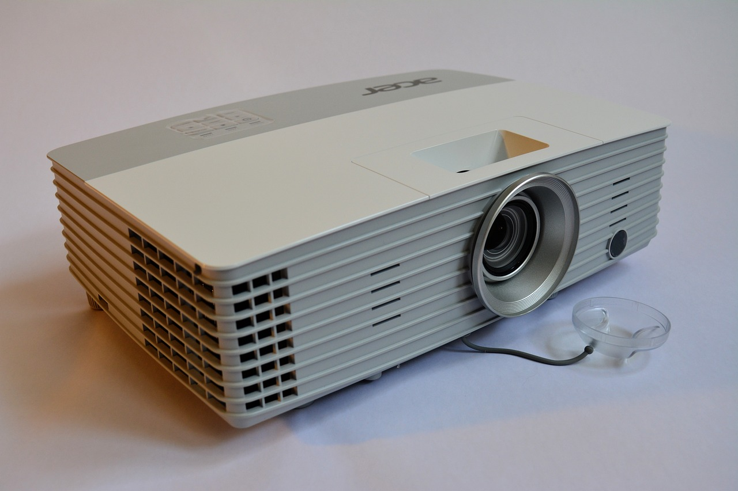
Teacher can use the ______.
projector
speaker

Slide 12
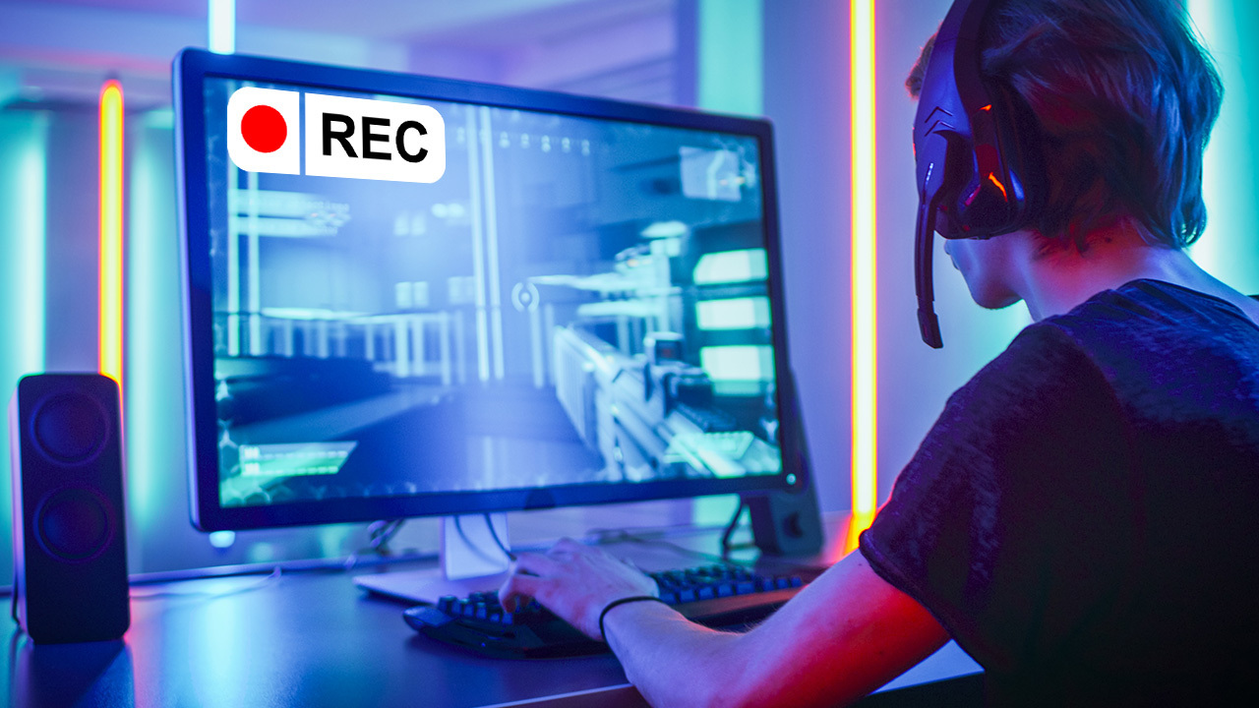
He can _____ videos on his computer.
take
make

Slide 13
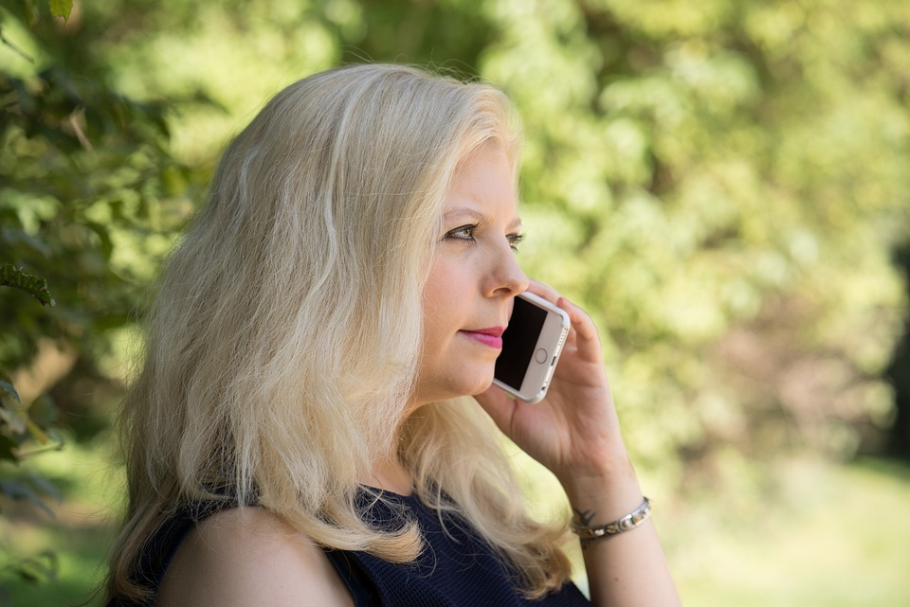
Anna always makes _____ calls.
phone
computer

Slide 14
3.Practice
Task 9 Say it!
Notes:
Dấu câu

Slide 15
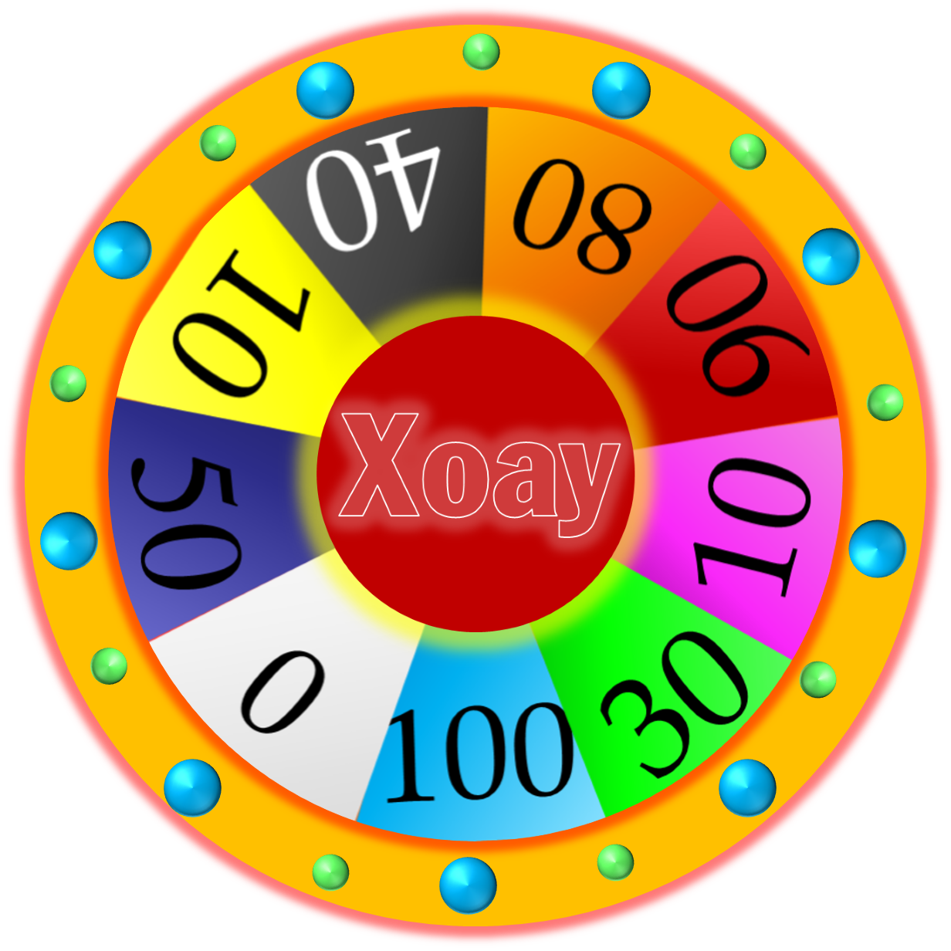





WHEEL OF FORTUNE
30
20
1
2
40
10
50
80
3
4
60
70
Next
START
Notes:
CLICK Start để quay => click vào vòng quay để dừng.
Next sang production

Slide 16

Say it!
He can ______ on the computer.
BACK
A. make videos. B. take photos.
He can make videos on the computer.

Slide 17
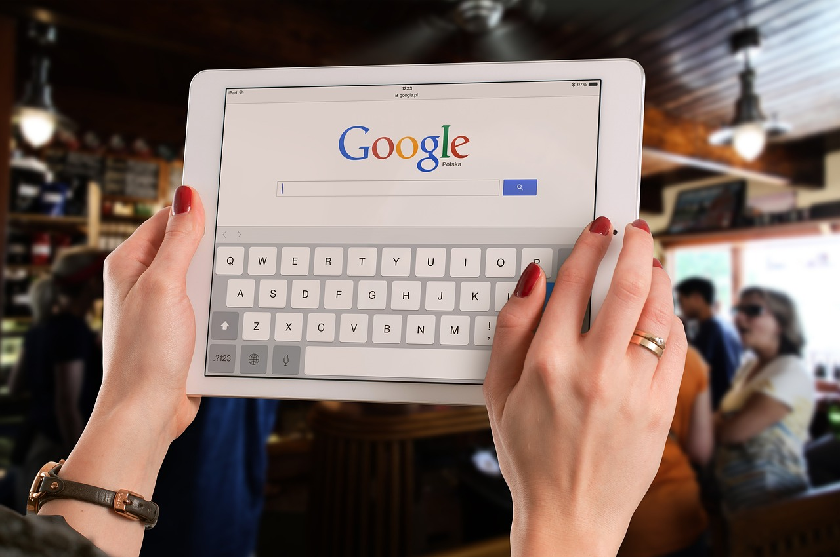
Say it!
Lizzie _______ uses her tablet at school.
BACK
A. always B. sometimes
Lizzie sometimes uses her tablet at school.

Slide 18
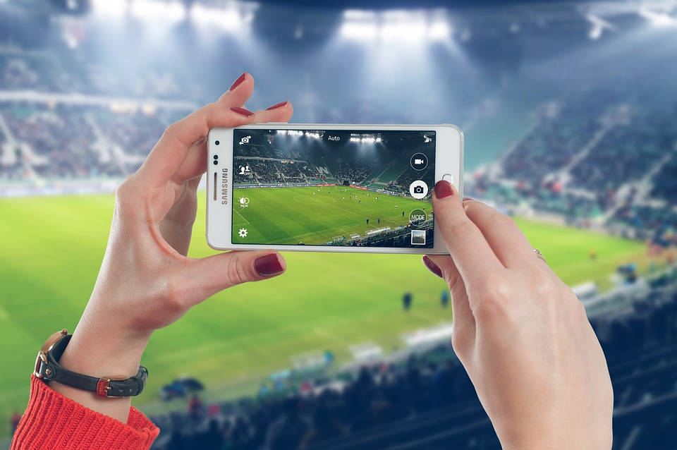
Say it!
Mary always takes photos with her _____.
BACK
A. smartphone B. tablet
Mary always takes photos with her smartphone.

Slide 19
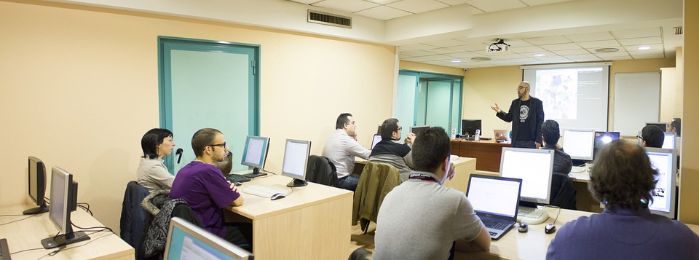
Say it!
______________can use the computer lab.
BACK
A. Teachers B. Teachers and students
Teachers and students can use the computer lab.

Slide 20
4 Production
Task 8 Listen and chant.
Notes:
Dấu câu

Slide 21



8
Listen and chant.

Slide 22


Z,z,z
Use, Use, Use
I can use my phone!
I can use my phone!
M, m, m
Make, make, make
I can make videos!
I can make videos!

Slide 23


Sing along
Z,z,z
Use, Use, Use
I can use my phone!
I can use my phone!
M, m, m
Make, make, make
I can make videos!
I can make videos!

Slide 24
5 Assessment

Slide 25
Matching Game
1. He can make
a.videos on his phone.
2.She sometimes
b.a big computer lab.
3.We have got
c.use the speaker.
4.Teachers can
d.uses her tablet.
1
A
2
D
3
B
4
C

Slide 26
6 Wrap up
Notes:
Đây k phải là extra, đây là hđ 3 của bài

Slide 27

VOCABULARY:
Use : /z/
Make: /m/
STRUCTURE
I can use my phone.
I can make videos.

Slide 28




Thank you & goodbye!

