Slide 1


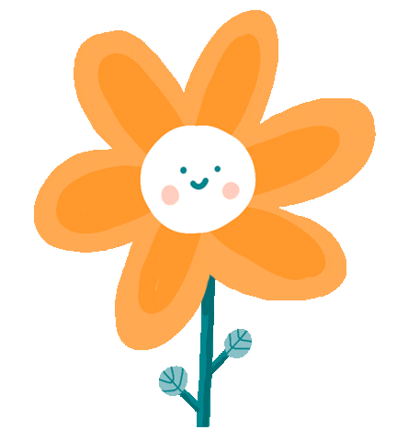

END-OF-SEMESTER REVIEW

Slide 2
01
Warm-up
Let’s sing a song: A Sam sam sam
( youtobe).

Slide 3
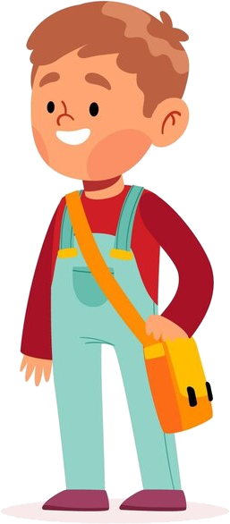
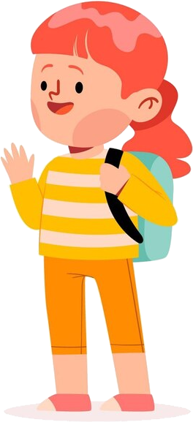

Family and friends - Vocabulary
Lesson 1 | Lesson 2 | Lesson 3
clever, crazy about, different, funny, loud, quiet, same | come out of, keep warm, leave, parents, penguin, carefully, happily, well | curly, dark, fair, long, short, straight

Slide 4
Family and friends - Grammar
And vs But | Adjective vs Adverbs | Possessive ‘s vs s’
- Both Becky and Emma are crazy about technology. - Becky is quiet, but Emma is loud. | 1. Adjective + noun: She is a happy girl. 2. Verb + adverb: The cat dances happily. | 1. This camera belongs to my aunt. => This is my aunt’s camera. 2. That yellow balloon belongs to my cousins. => My cousins’ balloon is yellow.

Slide 5
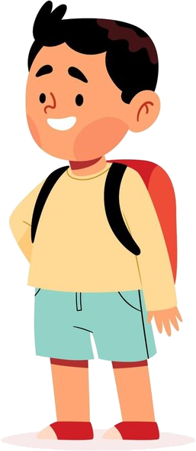
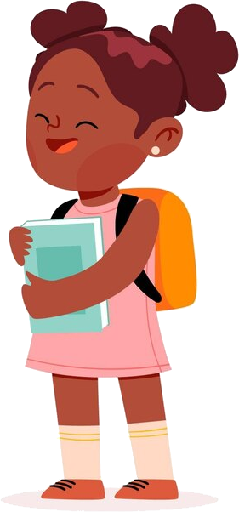
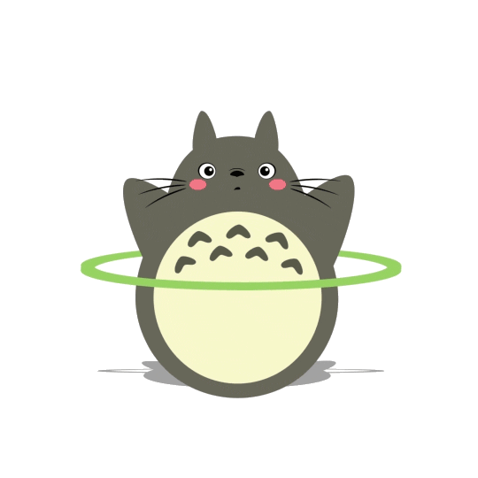
My favourite things - Vocabulary
Lesson 1 | Lesson 2 | Lesson 3
computer, piece, puzzle, photo, typewriter | country, globe, map, moving, scare, spider, inside, outside, above, below, in the middle of | puppet, violin

Slide 6
My favourite things - Grammar
Past simple with to be | And vs But
- I / He / She / It + was - You / We / They + were Ex: Tom: When you _____ seven years old, what _____ your favourite thing, Mary? Mary: It _____ my kite. Tome: What _____ it like? Mary: It _____ colourful. | - Ann and Jim are crazy about technology. - The camera is new, but it isn’t good.
were
was
was
was
was

Slide 7
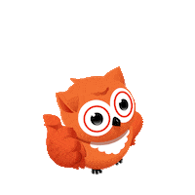
School life - Vocabulary
Lesson 1 | Lesson 2 | Lesson 3
exercise, fitness centre, practice, problem, solution | do homework, go to science clubs, have fun, play a musical instrument, walk to school, wear a uniform | - do arts and crafts, take care of plants, - always, never, often, sometimes, usually

Slide 8
School life - Grammar
Present simple affirmative | Time expression | Present simple negative, interrogative
The present simple: - habits, things that we do regularly (daily routine) Ex: I go to school every day. - facts, things that are always or usually true: Ex: The Earth goes around the sun. | - every day / week / month / year - once / twice / three times a week - in the morning / afternoon / evening - on Monday / Friday - Always / usually / often / sometimes / never | - Do + I / you / we / you / they + V + O? => Yes, I / you / we / you / they + do. => No, I / you / we / you / they + don’t. - Does + he / she / it + V + O? => Yes, he / she / it + does. => No, he / she / it + doesn’t.

Slide 9
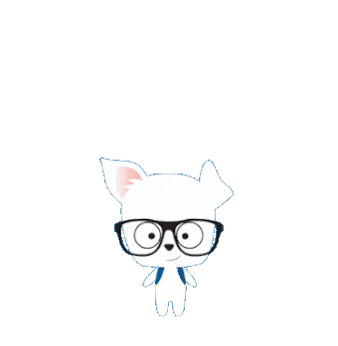
Free time - Vocabulary
Lesson 1 | Lesson 2 | Lesson 3
collect stamps, go ice-skating, make a paper bird, play the piano, read comic books, watch movies | amusement park, bookshop, cinema, restaurant, sports centre | eat a big meal, go bowling, ride the roller coaster, wood

Slide 10
Free time - Grammar
like, enjoy be good at | Can (permission) | Verb forms
- like / love / enjoy + V-ing Ex: I like playing football. He likes playing football. - be + good at + V-ing Ex: You are good at singing. She is good at singing. | Can is used for: - ability: S + can/can’t + V infinitive + … - polite requests: Can + S + V infinitive +…? Yes, S can. No, S can’t. | - Do + I / you / we / you / they + V + O? => Yes, I / you / we / you / they + do. => No, I / you / we / you / they + don’t. - Does + he / she / it + V + O? => Yes, he / she / it + does. => No, he / she / it + doesn’t.

Slide 11

Celebrations - Vocabulary
Lesson 1 | Lesson 2 | Lesson 3
bonfire, celebration, colourful, festival, powder, throw | lantern, lion dance, lunar month, mooncake, Mid-Autumn Festival, parade | last month, last year, memory
same
loud

Slide 12
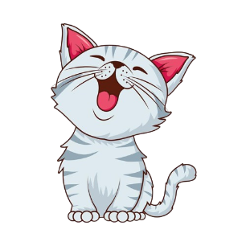
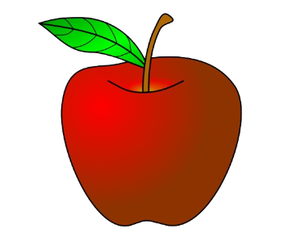
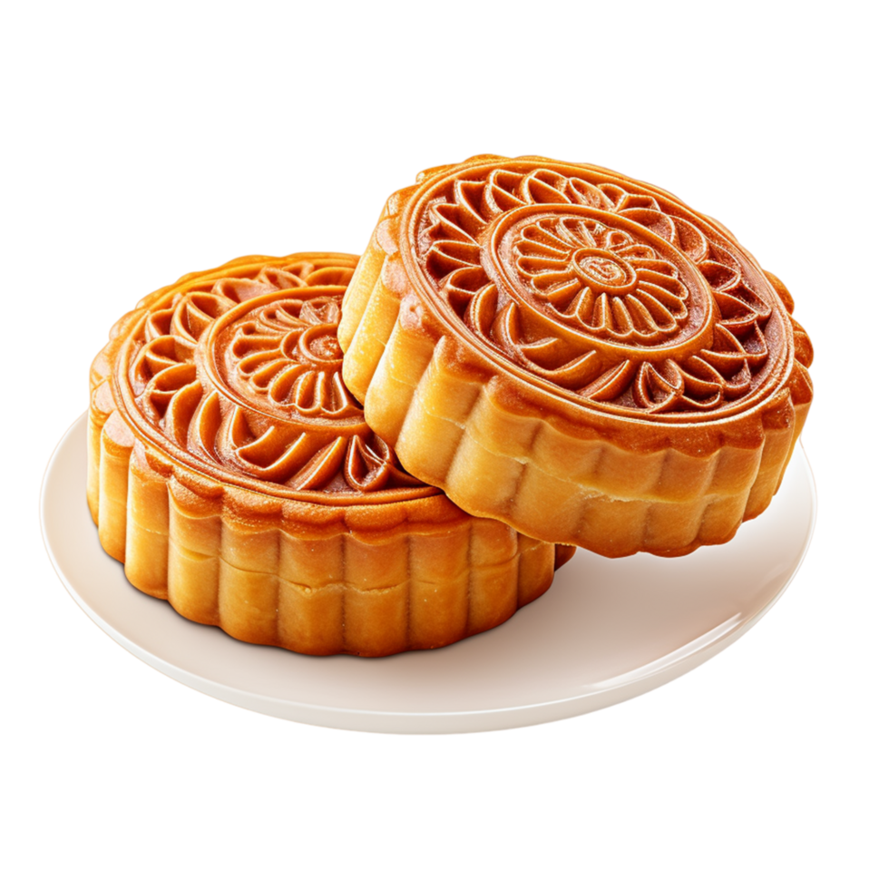
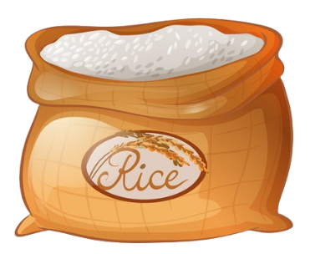

Celebrations - Grammar
Imperative, let’s | Countable and uncountable nouns | Irregular verbs in Past simple
- Let’s do something …! ✔ - Don’t do something …! x | - Countable nouns - Uncountable nouns | go => went have => had do / does => did
a cat
an apple
mooncakes
rice
some rice
two cups of beer
beer

Slide 13
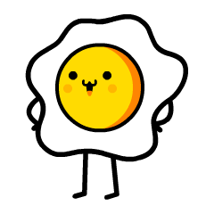
Food - Vocabulary
Lesson 1 | Lesson 2 | Lesson 3
bread, butter, chocolate, cupcake, salad, spaghetti | crispy, delicious, salty, sour, spicy, sweet, tasty | bowl, cereal, meatball, piece, plate, slice, broccoli, cucumber, hamburger

Slide 14
Food - Grammar
Much, many, a lot of, a few, a little | A bowl of … A piece of…
 | A bowl of rice A piece of pizza A plate of salad A glass of water A slice of bread
Uncountable nouns | Countable nouns
much a lot of a little | many a lot of a few
Affirmative | Negative | Questions
many a lot of a little a few | many much a lot of | many much

Slide 15
Pronunciation
Unit 1 | Unit 2 | Unit 3
Word stress: in two-syllable nouns and adjectives, normally the stress will be on the first syllable. Ex: mother, father, clever, happy | Word stress: in three-syllable words, the stress can be on the second syllable. Ex: expensive, fantastic, computer, banana | Pronunciation patterns of “es, s” endings: - go -> goes /z/ - start -> starts /s/ - dance -> dances /iz/

Slide 16
Pronunciation
Unit 4 | Unit 5 | Unit 6
/w/ and /h/ sound of w- words: - we /wi:/ - where /weə(r)/ - who /huː/ | Silent letters: - answer /ˈɑːnsə(r)/ - what /wɒt/ - sandwich /ˈsænwɪtʃ/ - science /ˈsaɪəns/ - Wednesday /ˈwenzdeɪ/ | Word stress: in three-syllable words, the stress can be on the first or second syllable. Ex: chocolate, hamburger, tomato, potato

Slide 17
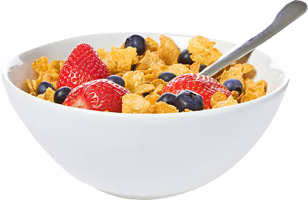

Would you like a ___ of cereal, Mai?
a. bowl
b. cup
c. slice
BACK

Slide 18
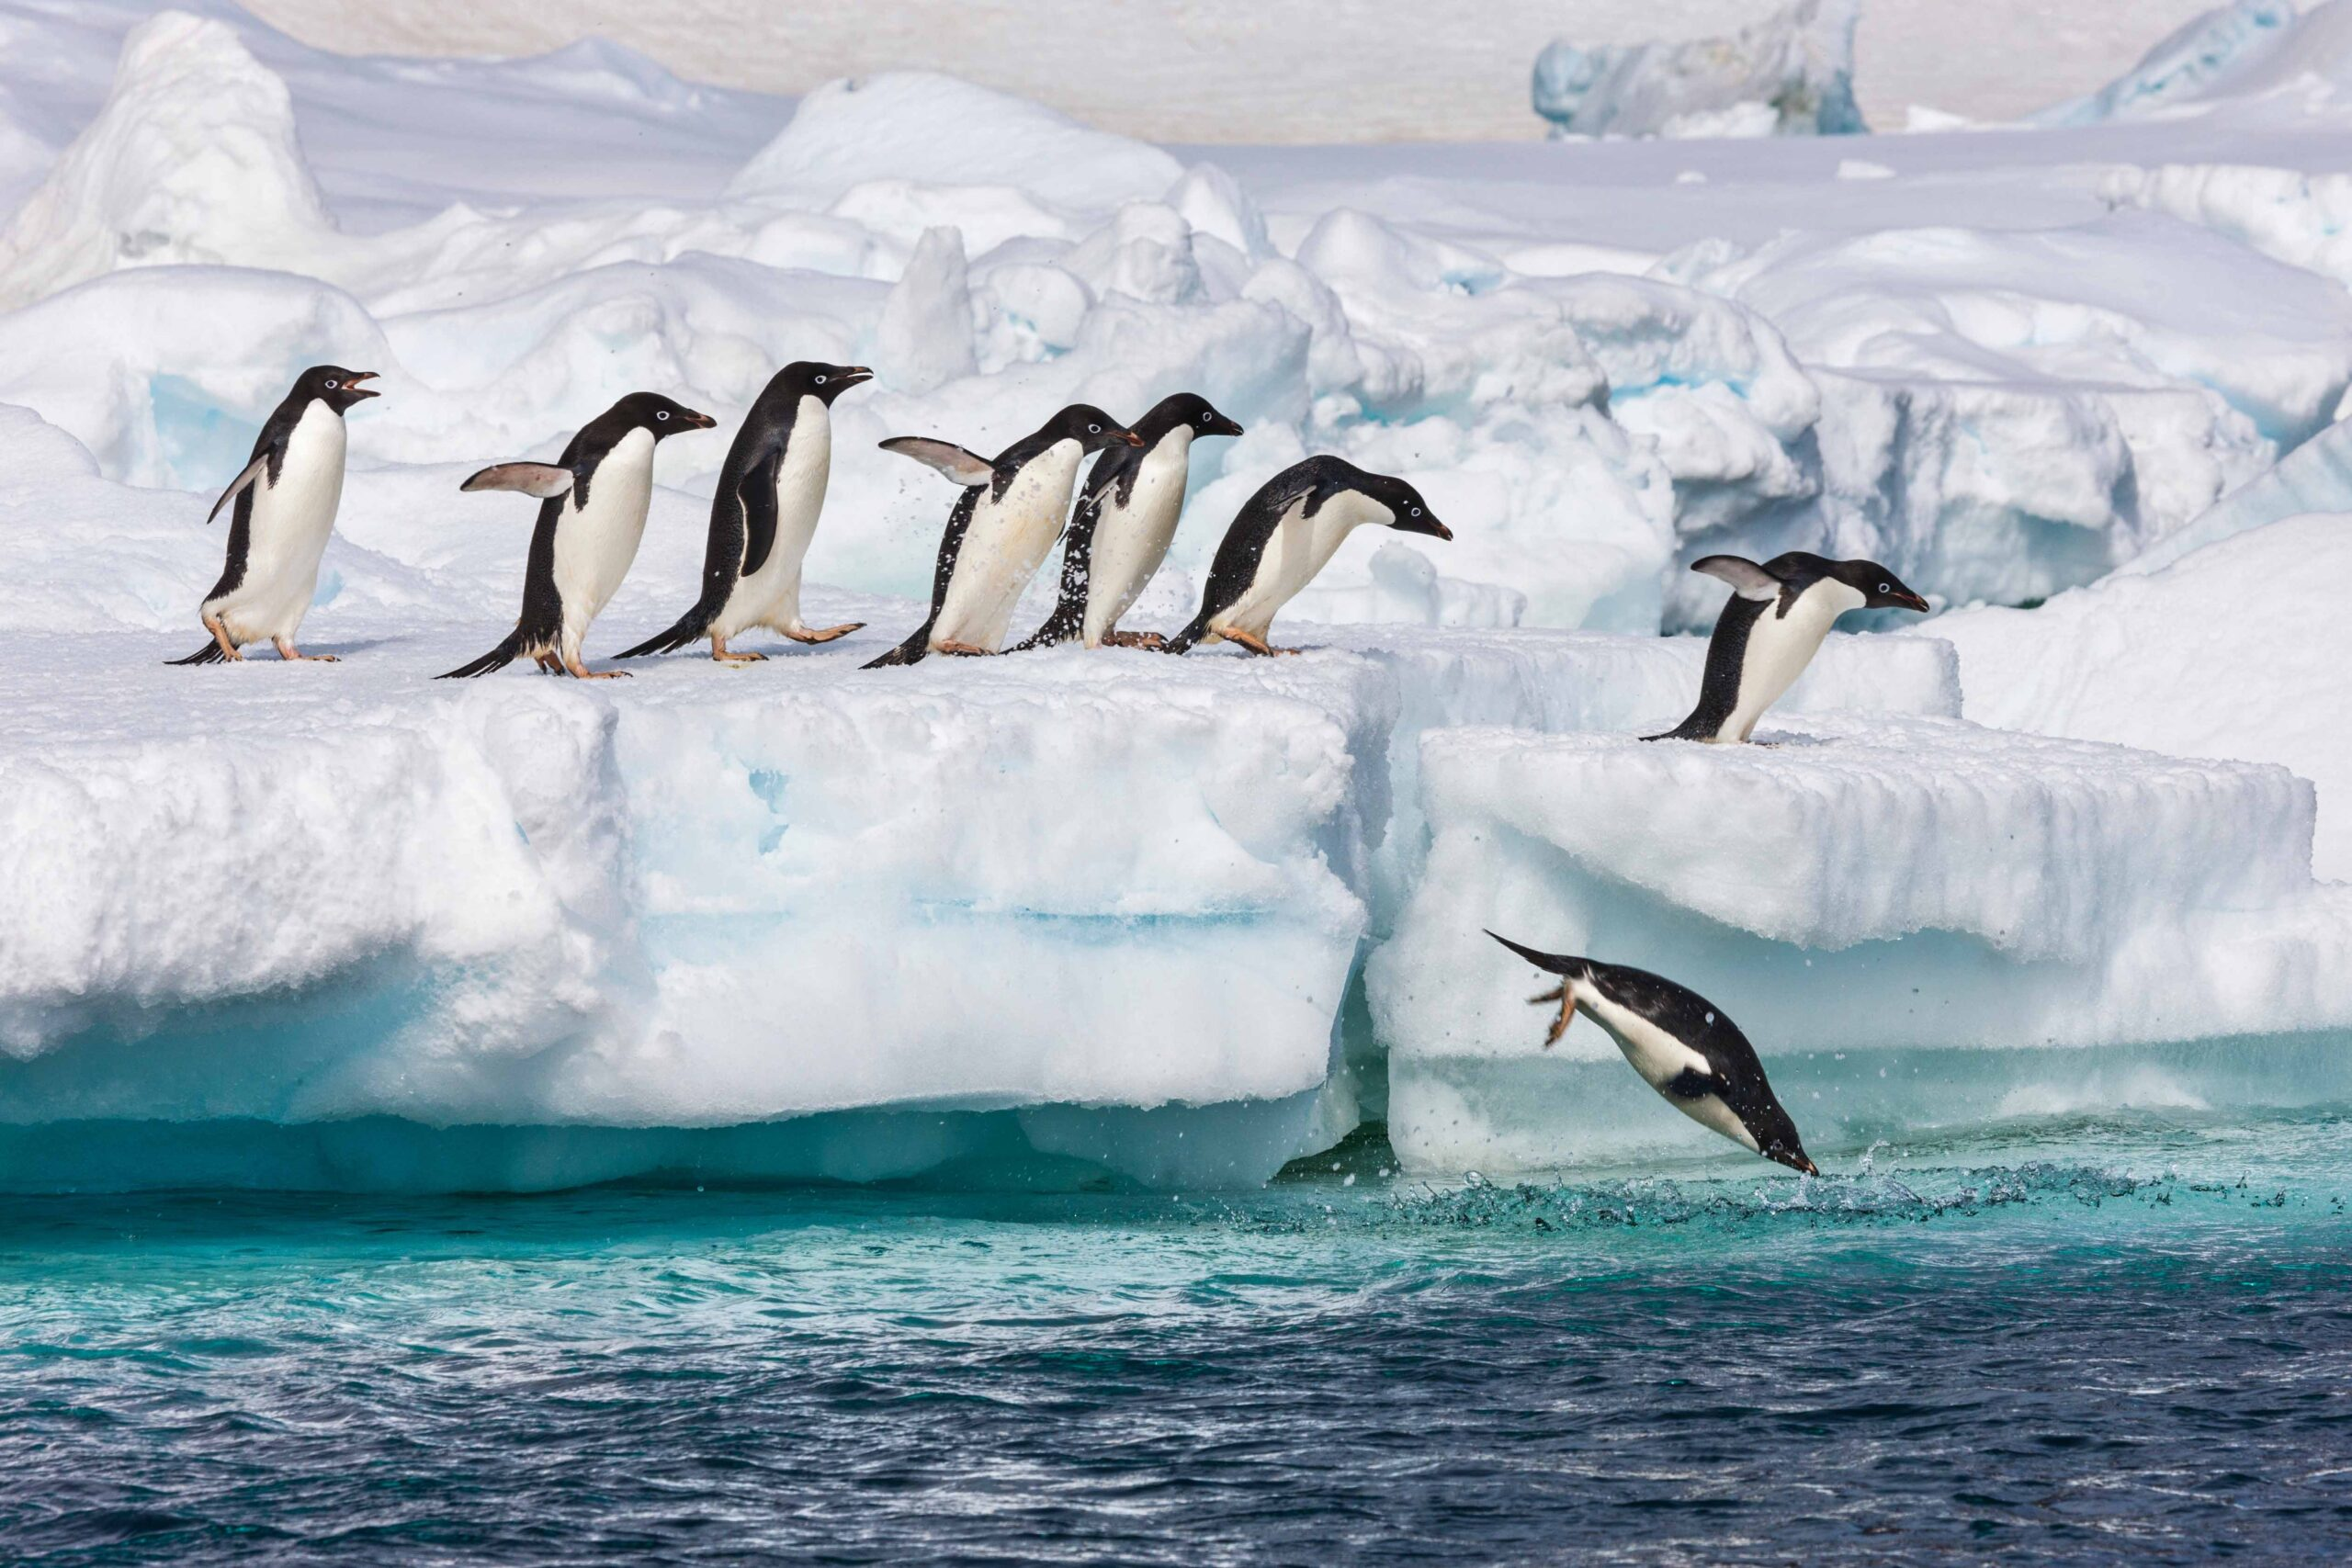
Penguins can swim very____.
a. better
b. good
c. well
BACK

Slide 19
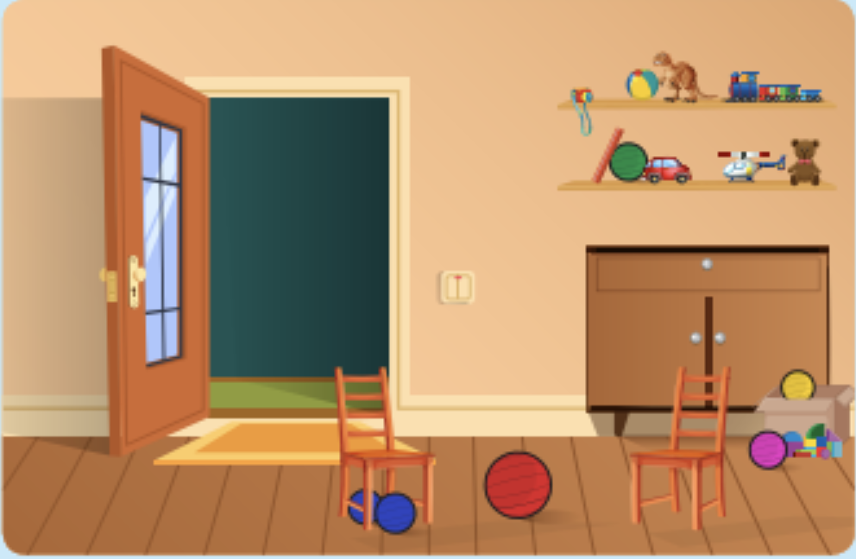
Two blue balls are ___ the chair.
a. behind
b. below
c. in front of
BACK

Slide 20
Circle the odd one out
a. fitness centre
b. cold
c. windy
BACK

Slide 21
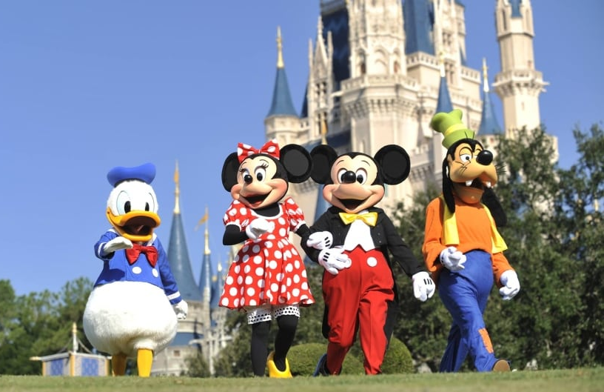
Let’s ____ to the amusement park.
a. to go
b. go
c. going
BACK

Slide 22
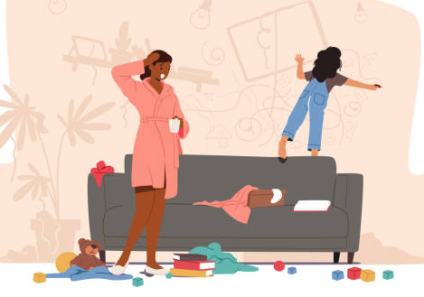
____ throw the paint at the wall of the living room.
a. Do
b. Don’t
c. Doesn’t
BACK

