Slide 1
Unit 5: CELEBRATIONS
Lesson 3: Activity 7-8-9-10

Slide 2

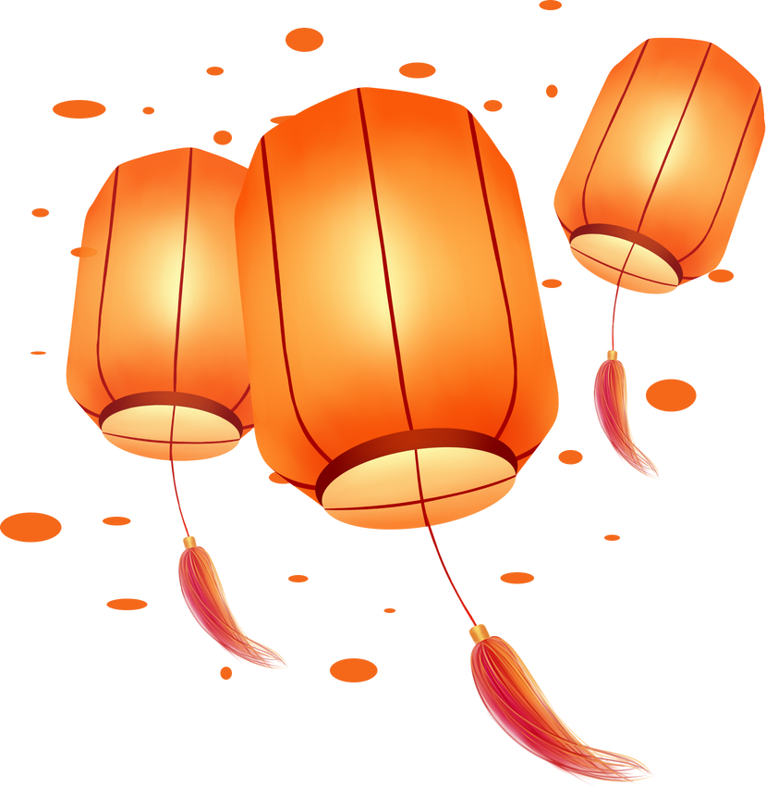




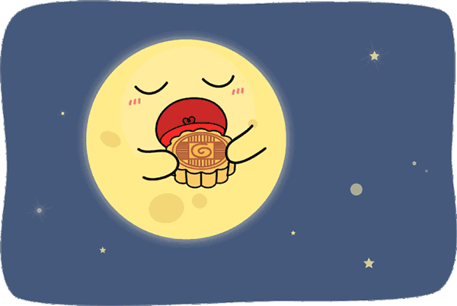



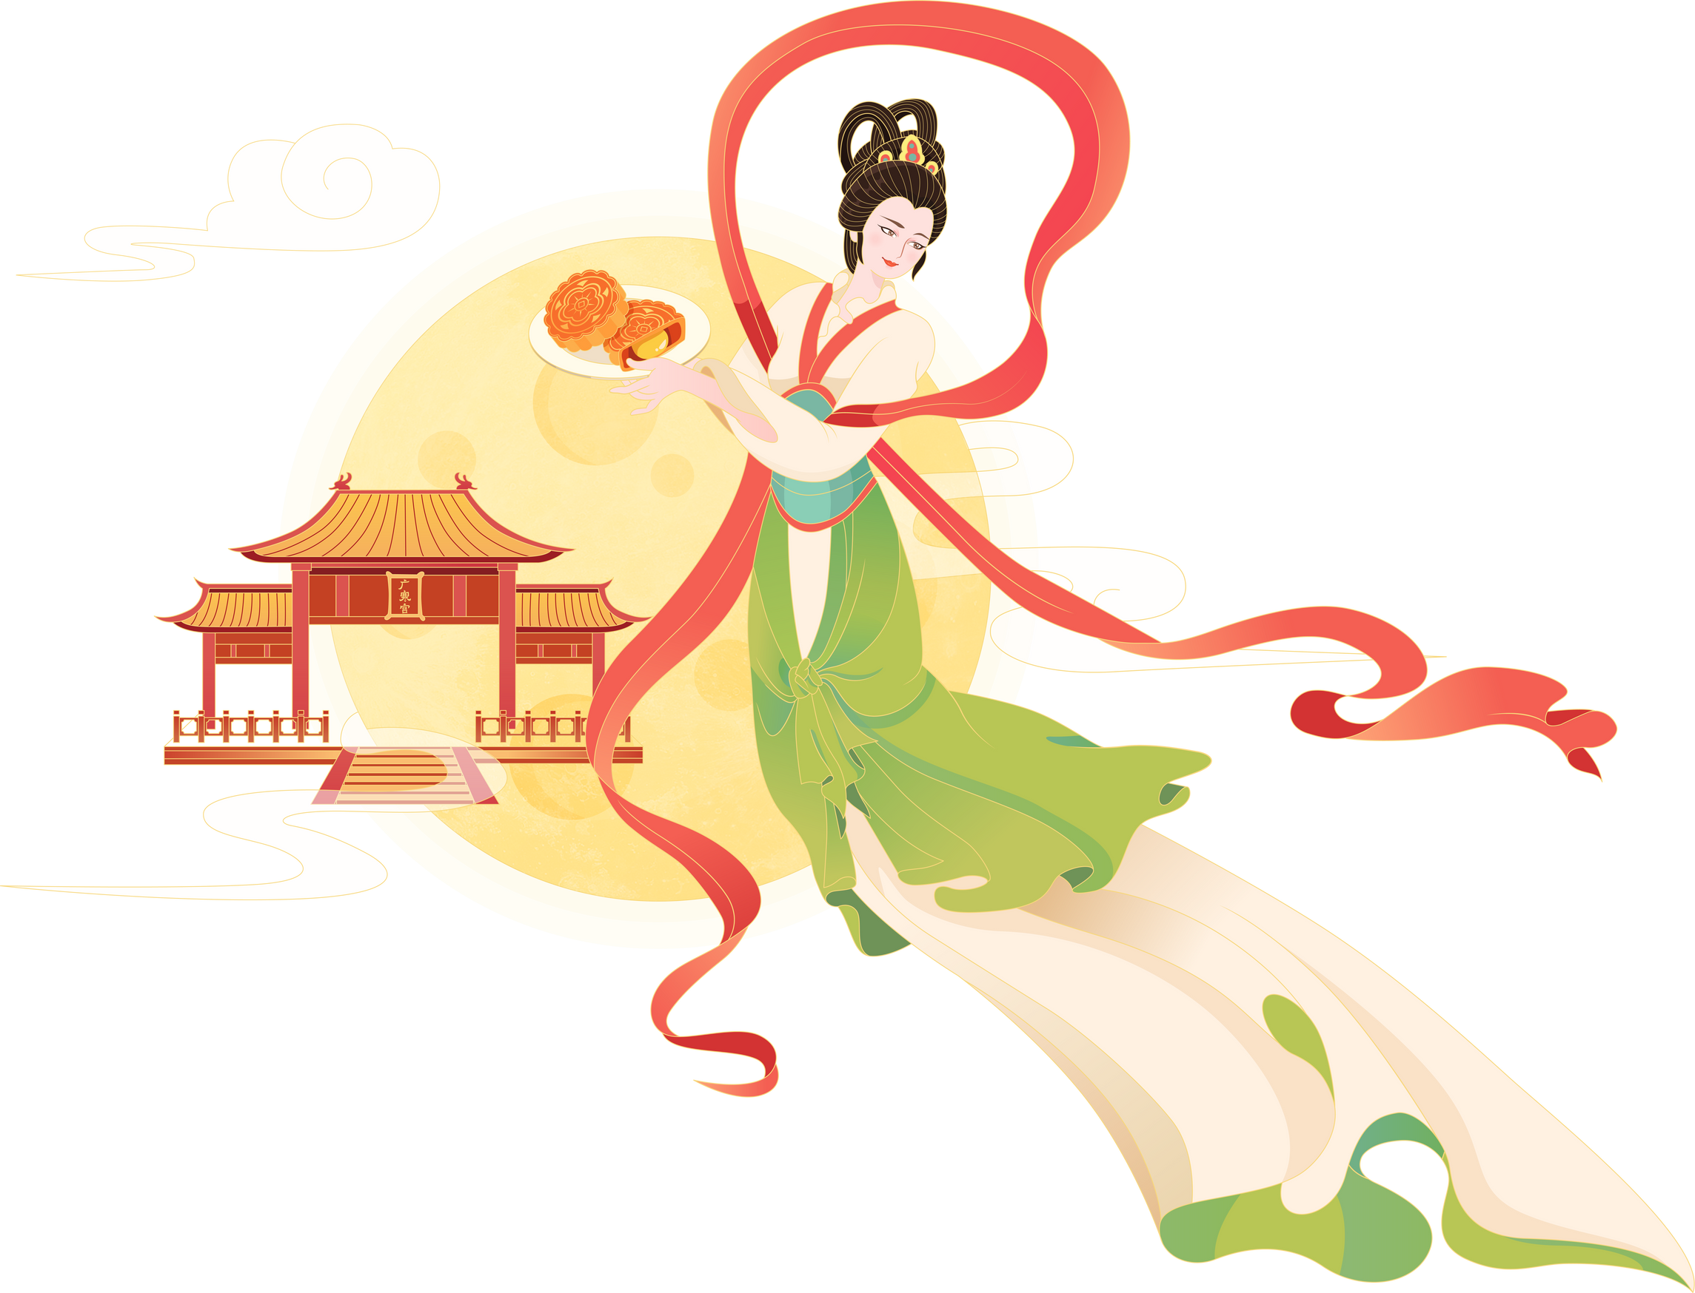

Which one is the past form of the verb ‘eat’?
A. ate
B. eat
C. eating
Notes:
Click button Check để xem đáp án
Click button Next để chuyển sang slide tiếp theo

Slide 3

What did you do last weekend?
A. I go to a bookshop.
B. I went to a bookshop.

Slide 4

Which one is the past tense verb?
A. have
B. has
C. had

Slide 5

What did you do yesterday?
A. I did my homework.
B. I do my homework.

Slide 6
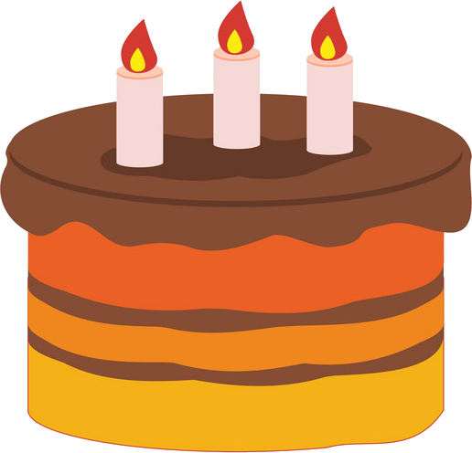
When was your birthday?
A. My birthday is yesterday.
B. My birthday was yesterday.

Slide 7
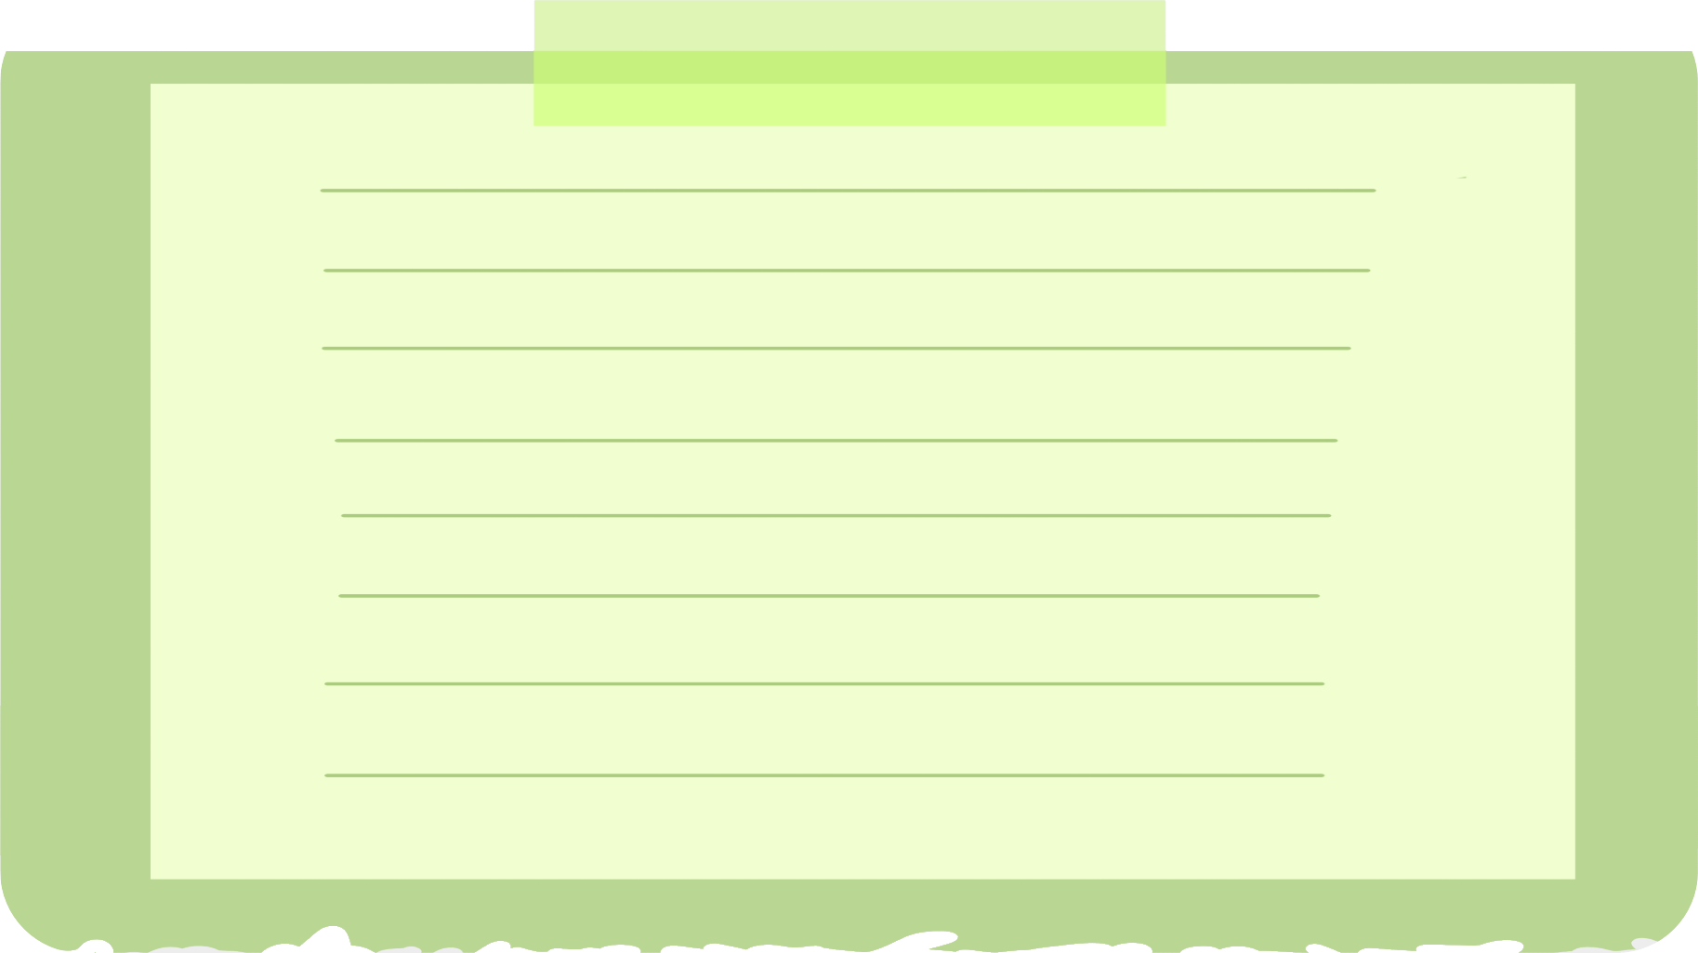


What are “silent letters”?
A silent letter in a word is one that is written but not pronounced, such as the "b" in "doubt“.
How do you pronounce … ?
What are silent letters?
give
/ɡɪv/
bomb
/bɒm/
climb
/klaɪm/
science
/ˈsaɪəns/
vehicle
/ˈviːəkl/
island
/ˈaɪlənd/

Slide 8
7 Listen and repeat.
answer
scientist
what
Wednesday
sandwich
climb
handsome
wrong

Slide 9
8 Listen and circle the silent letters.
why
friend
listen
where
two
know
write
half
Christmas

Slide 10

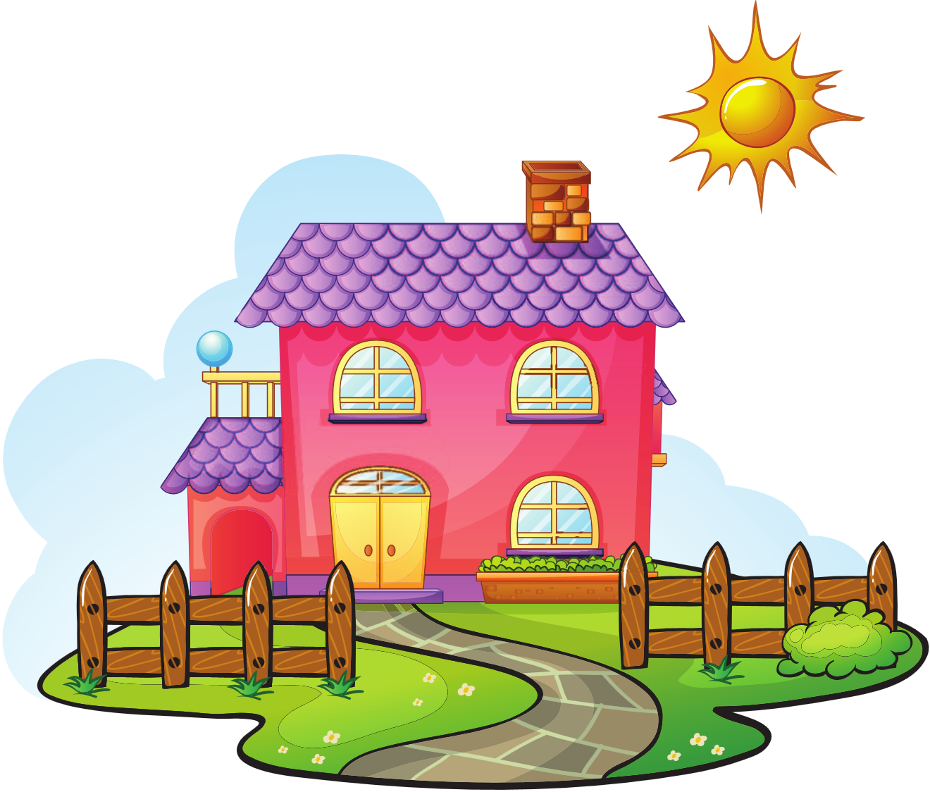


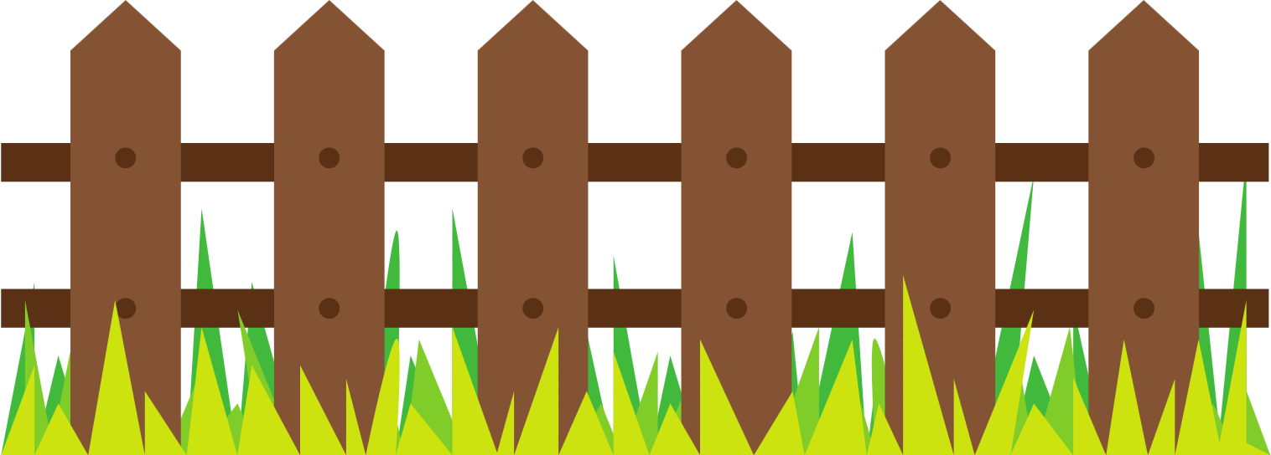
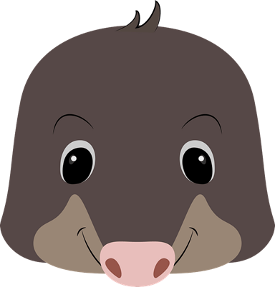
In which word is the letter “w” silent?
answer
why
Wednesday

Slide 11
In which word is the letter “a” silent?
head
apple
rat

Slide 12
In which word is the letter “k” silent?
key
know
kitchen

Slide 13
In which word is the letter “i” silent?
sit
finish
friend

Slide 14
In which word is the letter “d” silent?
desk
drink
Wednesday

Slide 15
In which word is the letter “h” silent?
how
hour
hand

Slide 16
In which word is the letter “g” silent?
finger
pig
sign

Slide 17
In which word is the letter “l” silent?
talk
police
listen

Slide 18
In which word is the letter “b” silent?
lab
climb
tab

