Slide 1
Unit 6:
My Hobby
Lesson 2 – Task 7, 8, 9

Slide 2
1
2
3
4
5
6
7
8
9
Exit

Slide 3
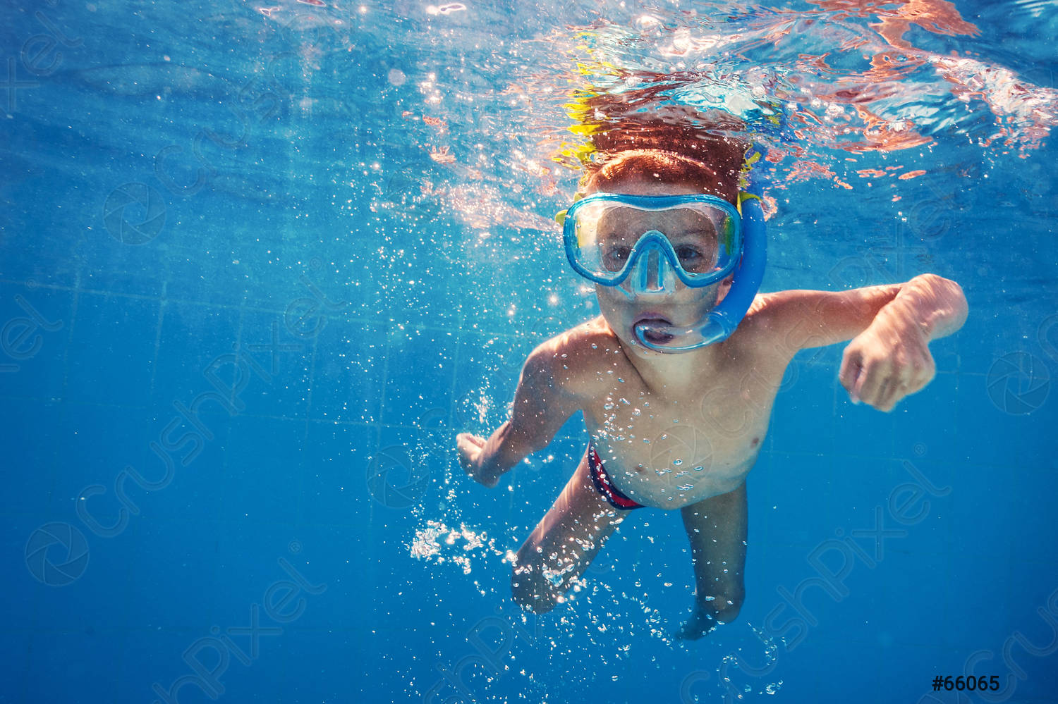
✓
can swim
He _______ .
Back

Slide 4

✗
can’t read
A dog ________ .
Back

Slide 5

✓
She _________ .
can colour
Back

Slide 6

✗
He ________ .
can’t cook
Back

Slide 7

✗
can’t sing
He _______ .
Back

Slide 8
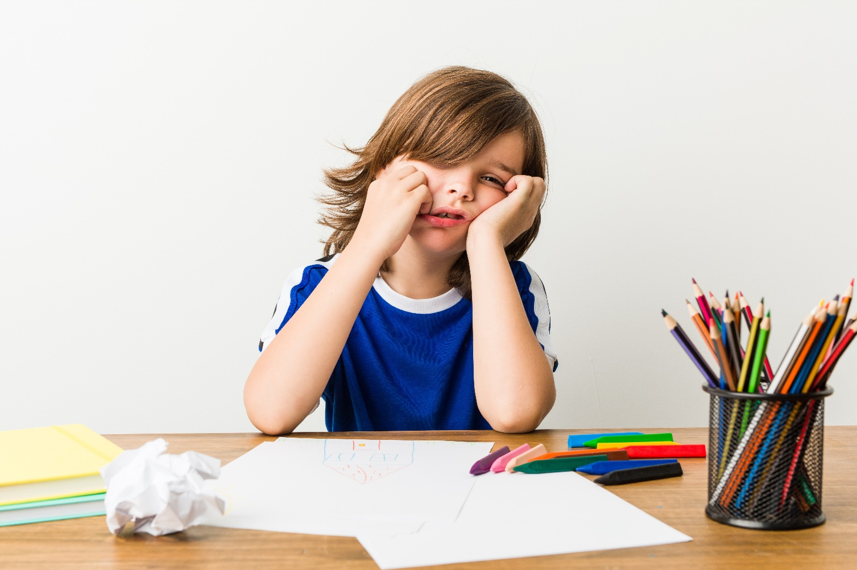
✗
He ________ .
can’t paint
Back

Slide 9

can dance
They _______ .
Back

Slide 10

Lucky star !!!!
Back

Slide 11


Task 7 Listen and tick.
✓
1 Pocket can paint.
T
F
T
✓
2 Pocket can colour.
F
T
✓
3 Pocket can sing and dance.
F
T
✓
4 People can’t buy his paintings.
F

Slide 12
Pocket Warhol,
3 years old,
from Canada.
1 He can paint.
2 He can’t colour between the lines.
3 He can’t sing, dance or speak.
4 People can buy his paintings.
Notes:
Bấm vào câu để nghe lại

Slide 13

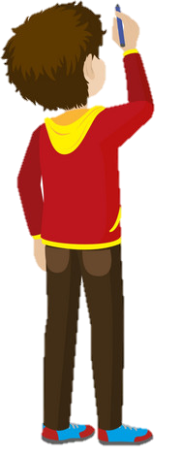
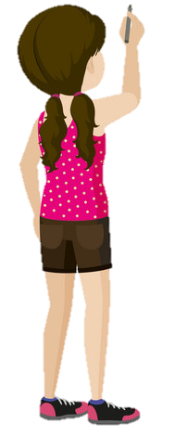
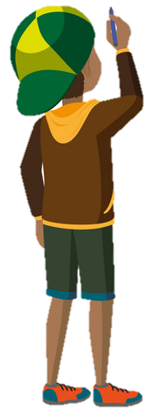

3 PRACTICE WRITING
Who ‘s faster? game.
paint
dance
colour
sing
cook
paint
paint
pai
sin

Slide 14
3 PRACTICE WRITING
Task 8 Write.
paint
colour
1 Pocket the monkey can _______ , but he can’t ________ .
2 I can _______ , but I can’t _______.
3 My friend can ________ , but he can’t ________ .
4 My mum can ________ , but she can’t ________ .
Notes:
HOẠT ĐỘNG TƯƠNG TÁC

Slide 15


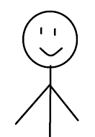


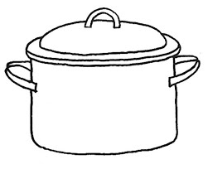
I can speak English, but I can’t dance.
Hello
Me
My mum can cook but she….
My mum
My dad
……

Slide 16
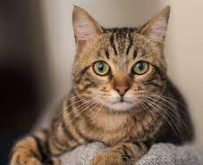
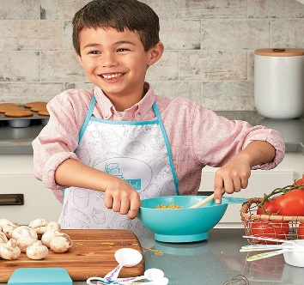
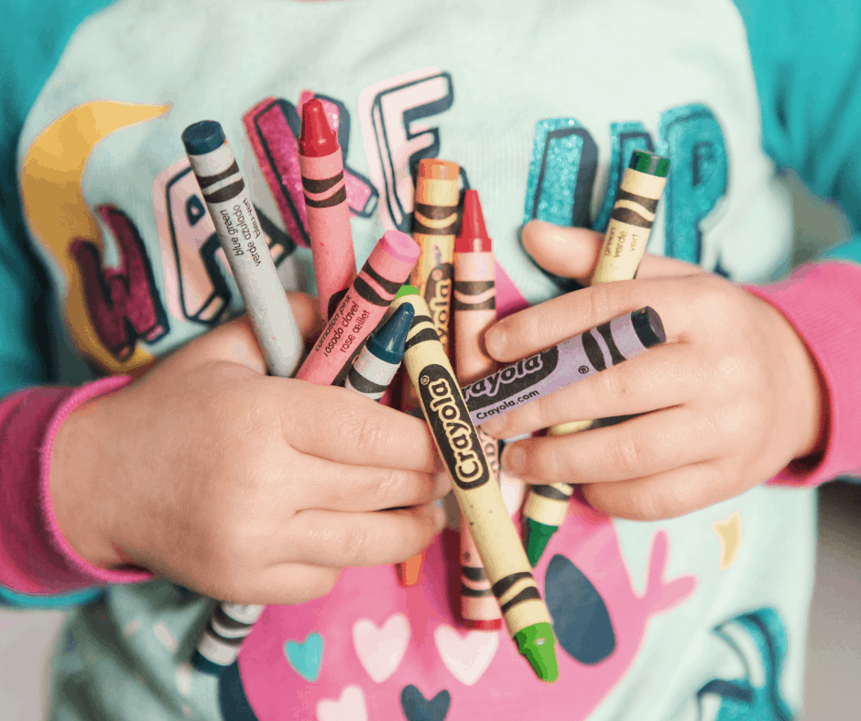
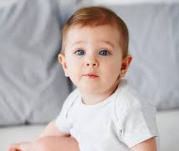
5 ASSESSMENT
Look, read and circle
1 This is my cat. He can/can’t sing.
2 My brother is Tom. He can/can’t cook.
3 I can/can’t colour. I have new crayons.
4 My baby is 1 year old. She can/ can’t read.
Notes:
HOẠT ĐỘNG TƯƠNG TÁC

