Slide 1
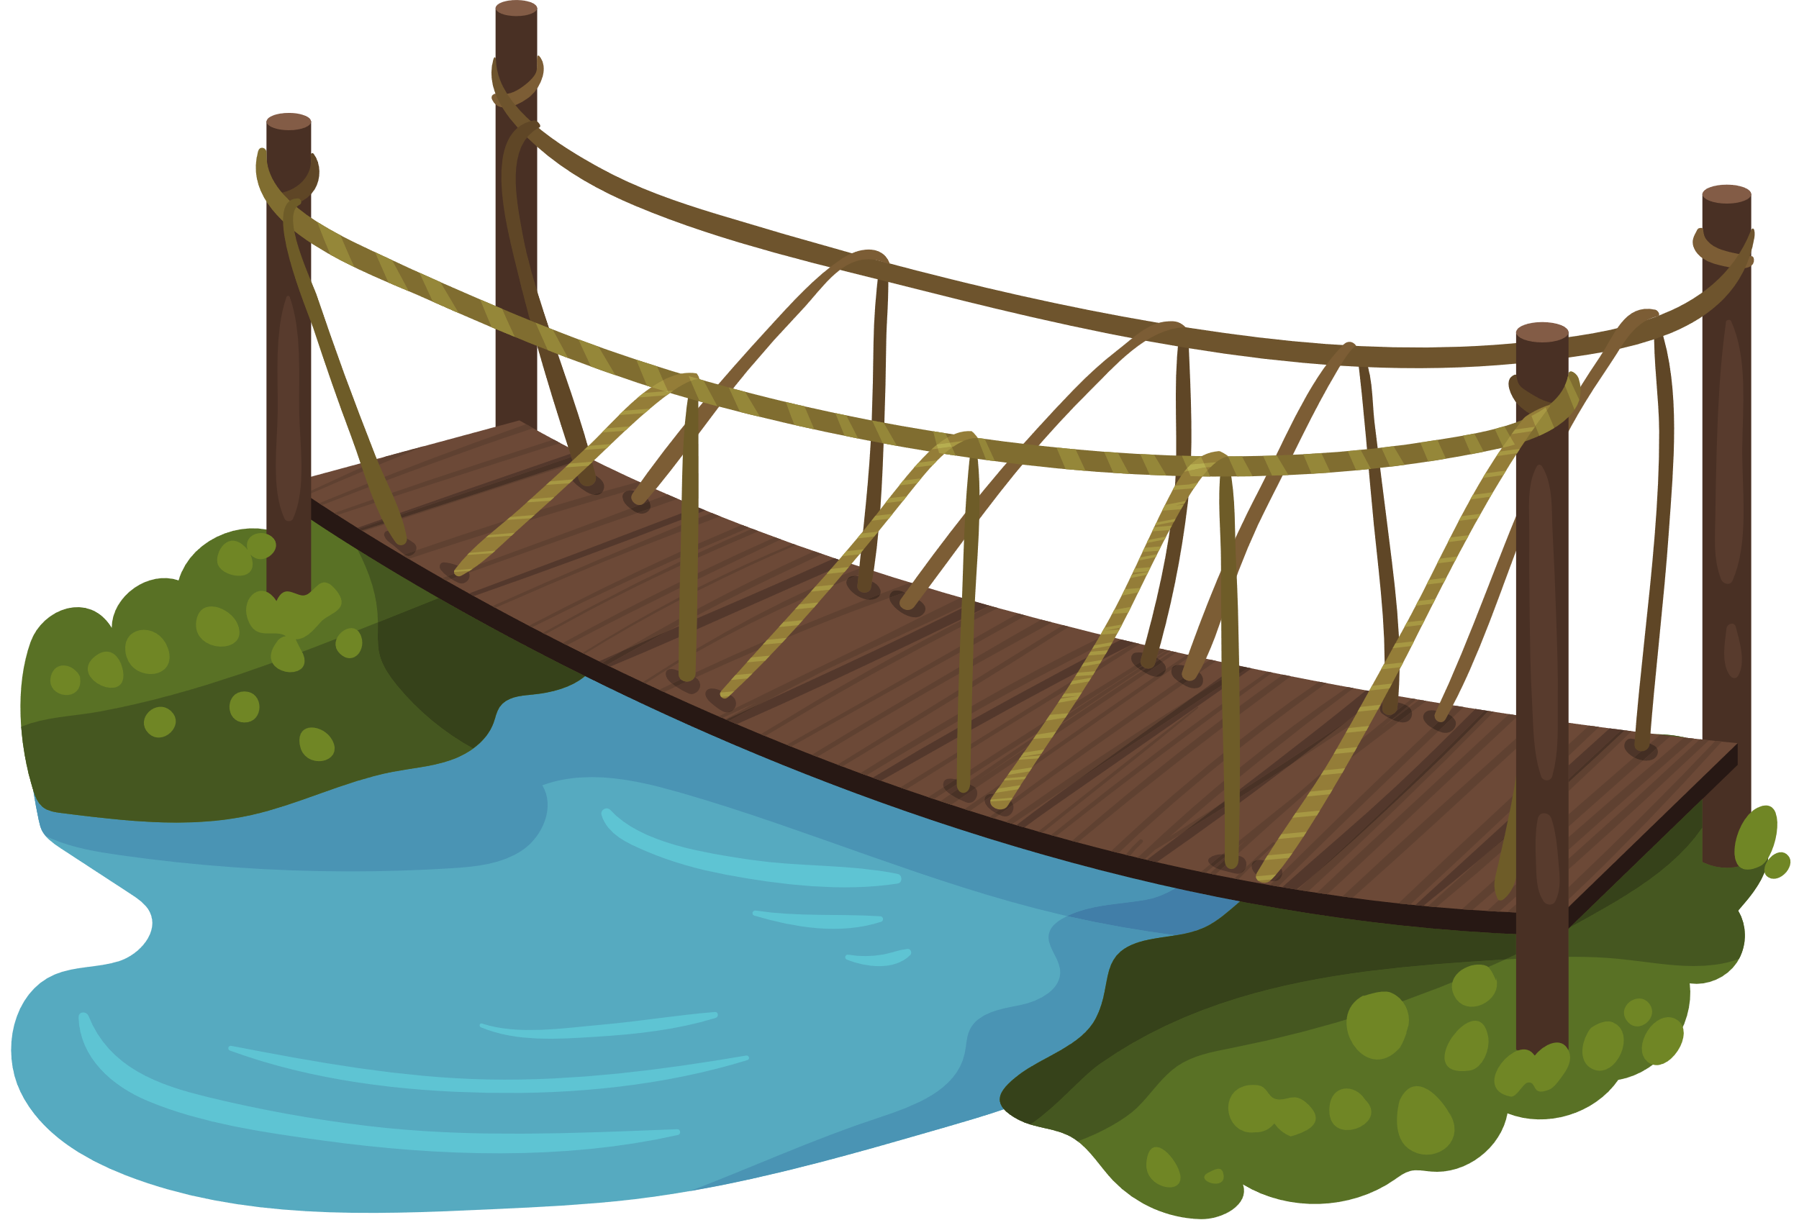
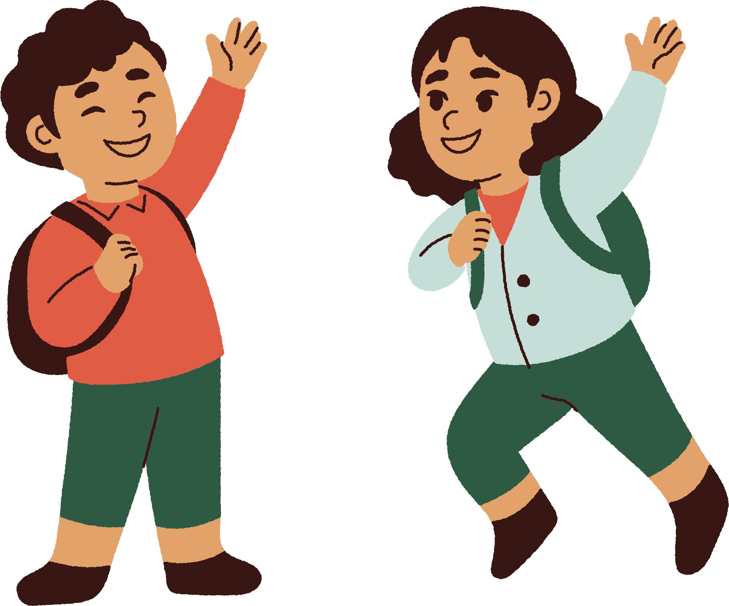

Unit 8
People and Places
LESSON 1/p4,5,6

Slide 2

1/ ………………. Did he go last summer?
What
When
Where

Slide 3

a. played
b. plays
c.Playing
2/ They ………………. Basketball with their friends
yesterday .

Slide 4
3/ What did she do …………………..?
a. Now
b.lastnight
c. today

Slide 5
4.Who did you go on holiday lastweekend …..?
a.in
b.to
c. With

Slide 6


5.How did they go to Ho Chi Minh last month ?
a. bike plane
b. by plane
c. buy plane

Slide 7
6. I …………at home last weekend.?
a.was
b.am
c. were

Slide 8
7.Did they go to school last sunday ?
a. No, they didn’t not
b. No, they didn’t
c. No. They didn’t

Slide 9
4/Listen and tick
( Video on The Web)

Slide 10


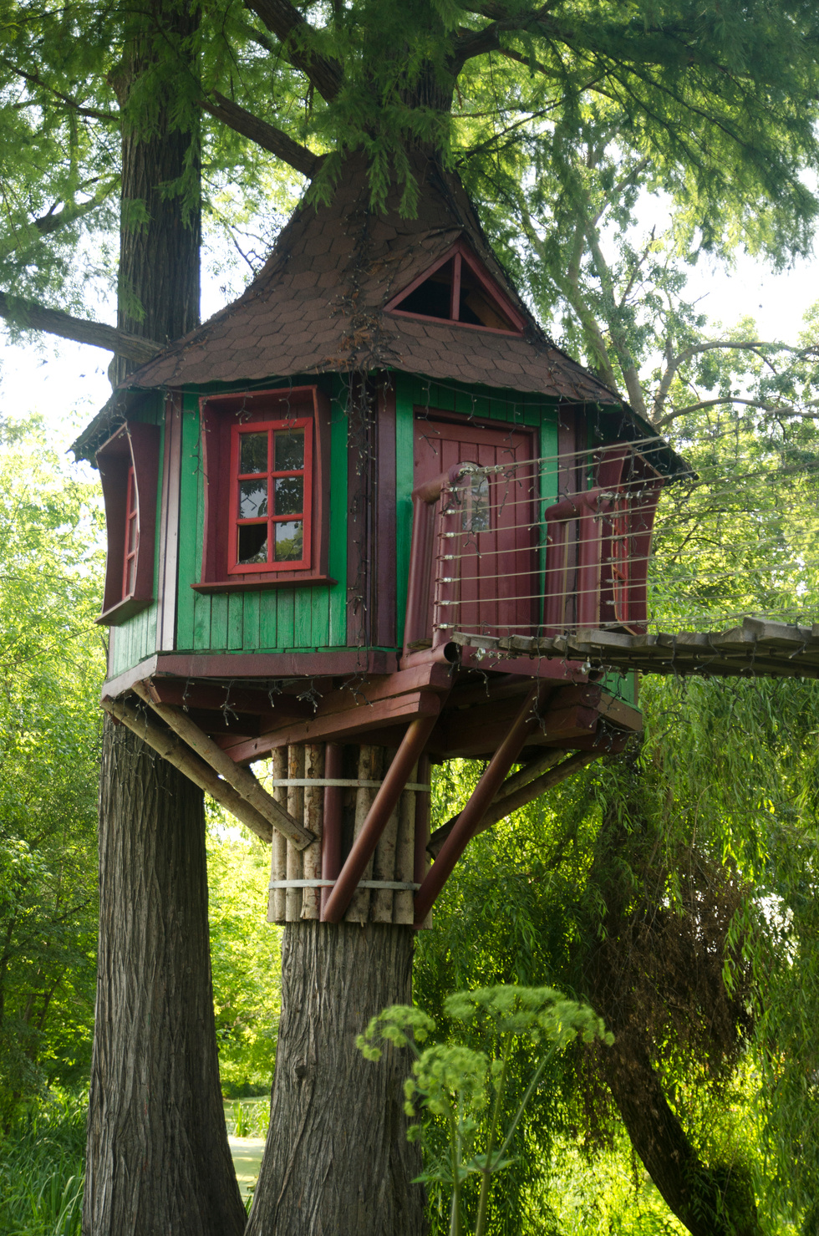
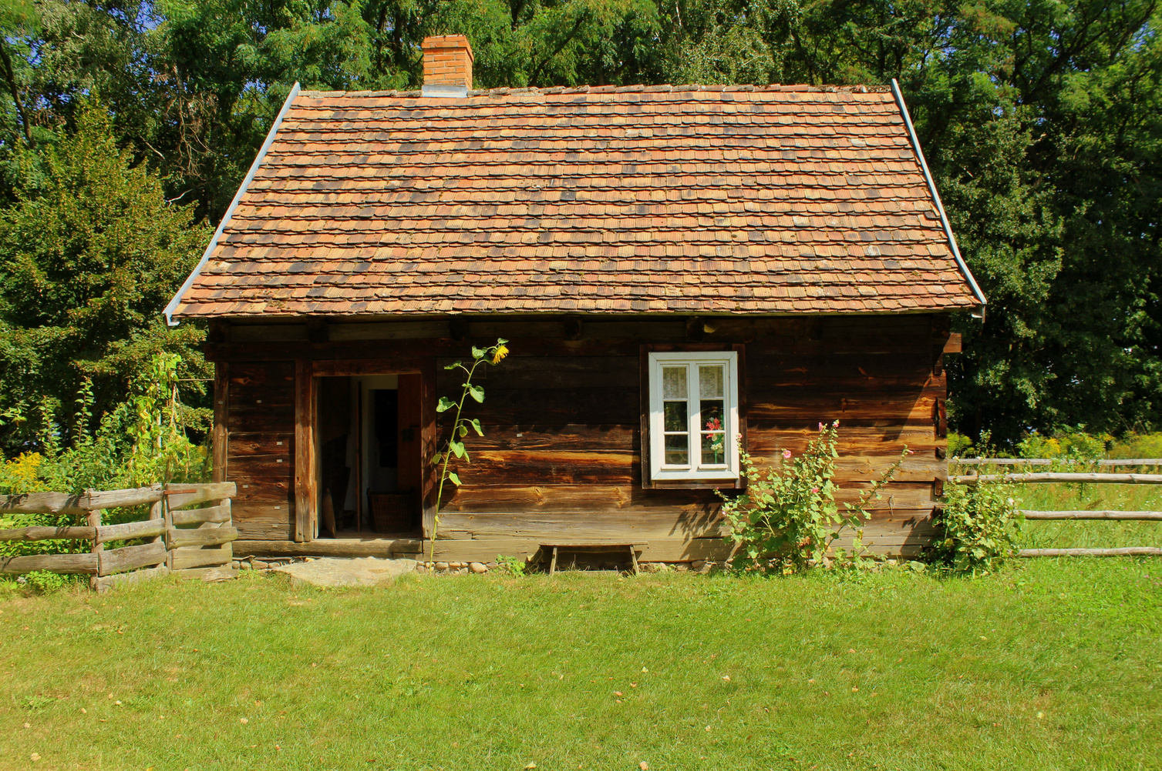



Listen and read. Then look and tick (✓) or cross (✘).
A: Would you like to live in a treehouse?
B: Yes, I would. I love exploring the nature
Notes:
Bấm vào ngôi nhà để quay lại trang chủ

Slide 11
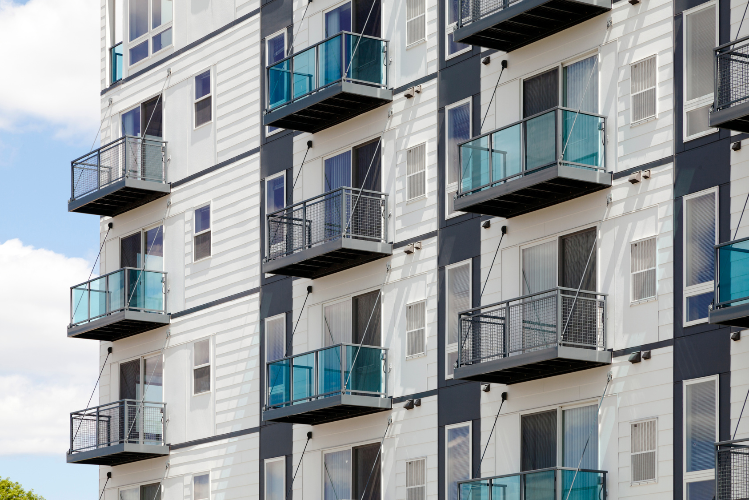
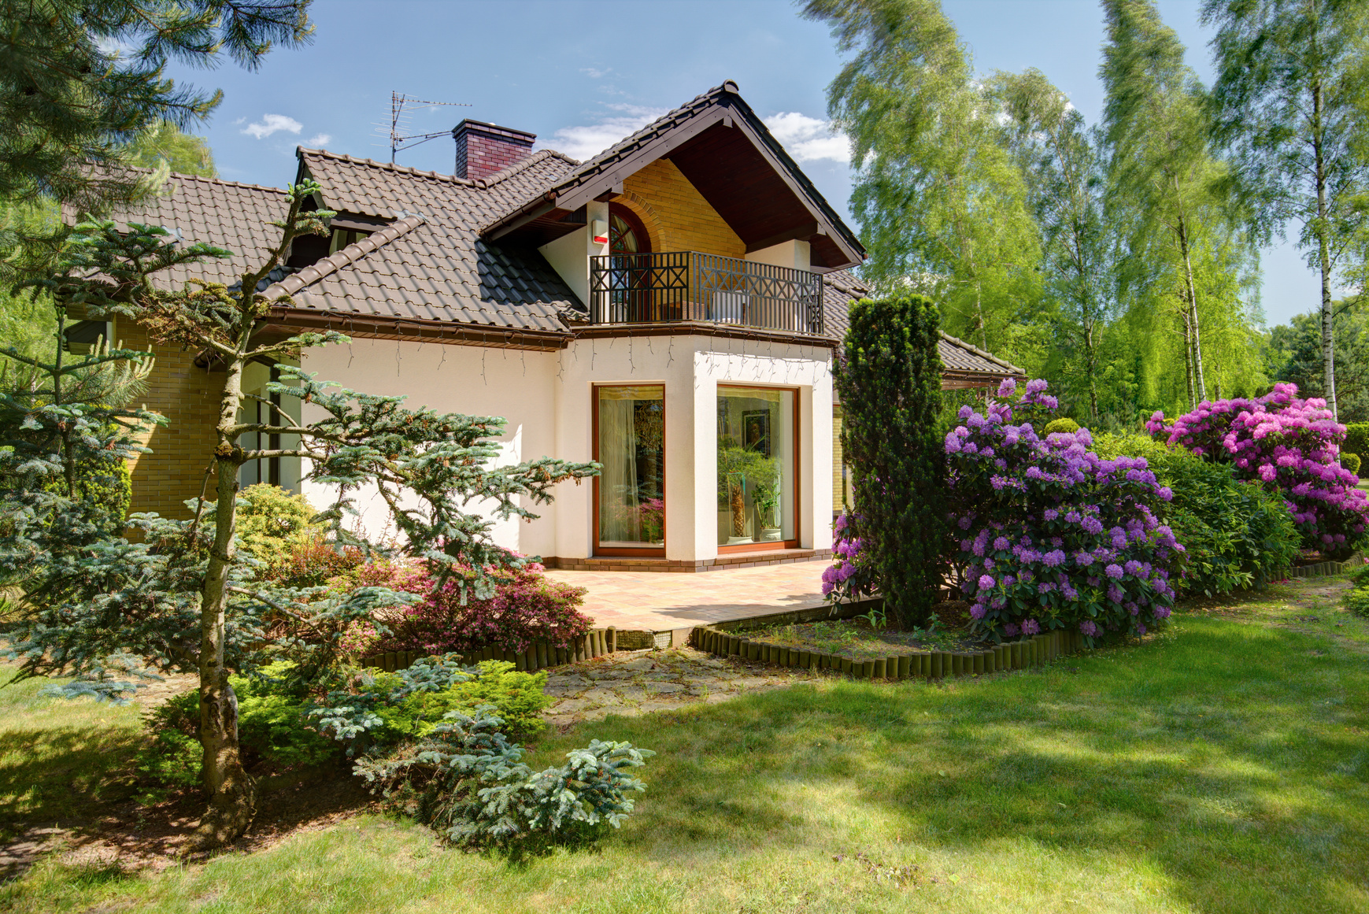
Listen and read. Then look and tick (✓) or cross (✘).
A: Would you like to live in an apartment?
B: No, I wouldn’t. I’d like to live in a house with a garden , so I can plant a lot of flowers in my garden.
Notes:
Bấm vào ngôi nhà để quay lại trang chủ

Slide 12
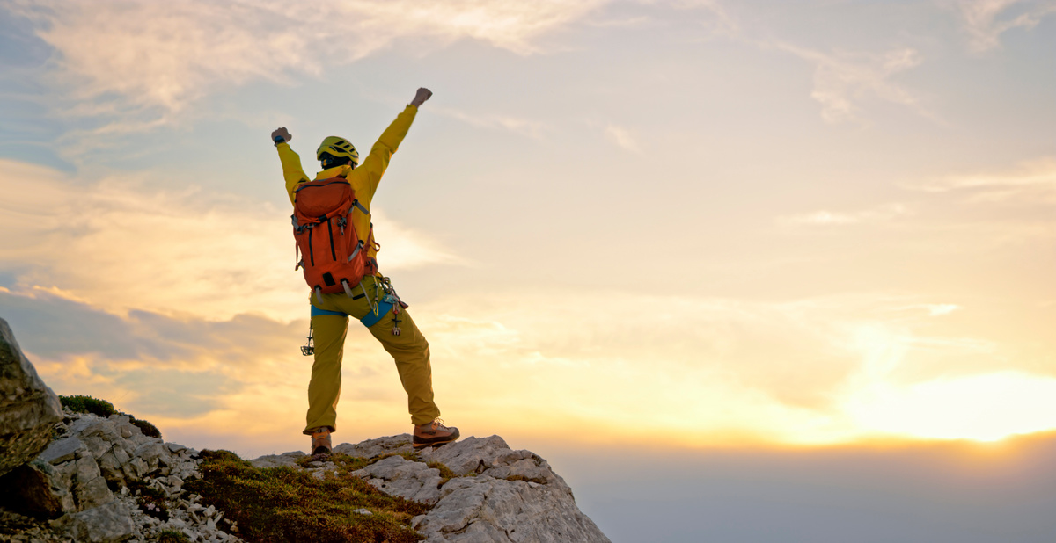
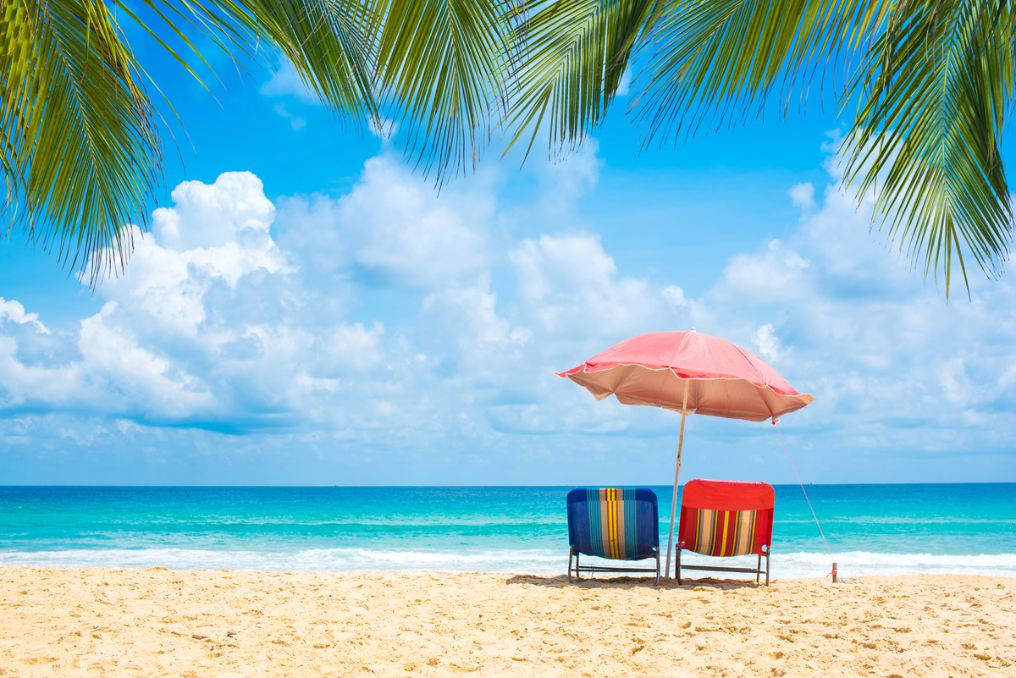
Listen and read. Then look and tick (✓) or cross (✘).
3 A: Which place would you like to go on your holiday, to a mountain or to a beach?
B: I’d like to go to the beach.
A: Why would you like to go to the beach?
B: Because I’d like to build sandcastles and swim in the sea.
Notes:
Bấm vào ngôi nhà để quay lại trang chủ

Slide 13

5 Listen and circle
1.Would Nam like to live in a boathouse?
a Yes, he would. b No, he wouldn’t.
2 How many floors would Mia like to have in her dream house?
a three floors b two floors
3 Which place would Linda like to visit in the city?
a Thu Le Zoo b Dam Sen Park
4 Why would Mai like to go to the mountains?
a Because she’d like to go camping. b Because she’d like to go hiking.
5 Why would Binh like to live in a cottage by the sea?
a Because he’d like to go fishing and swim in the sea.
b Because he’d like to build sandcastles and swim in the sea

