Slide 1
UNIT 10. OUR WORLD
LESSON 2 . Task 4 5 6

Slide 2
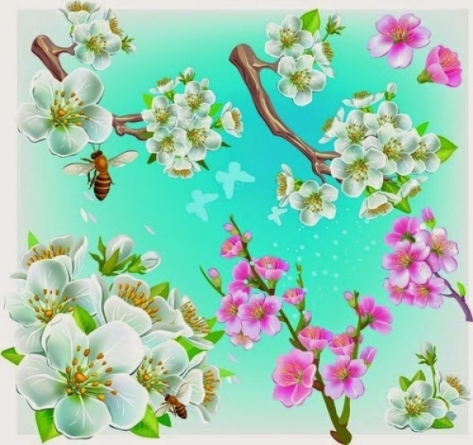
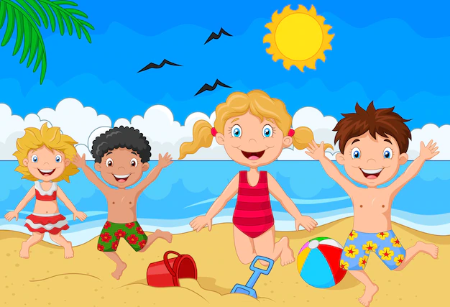
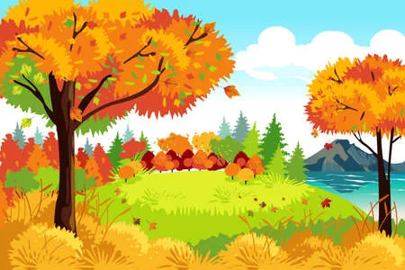
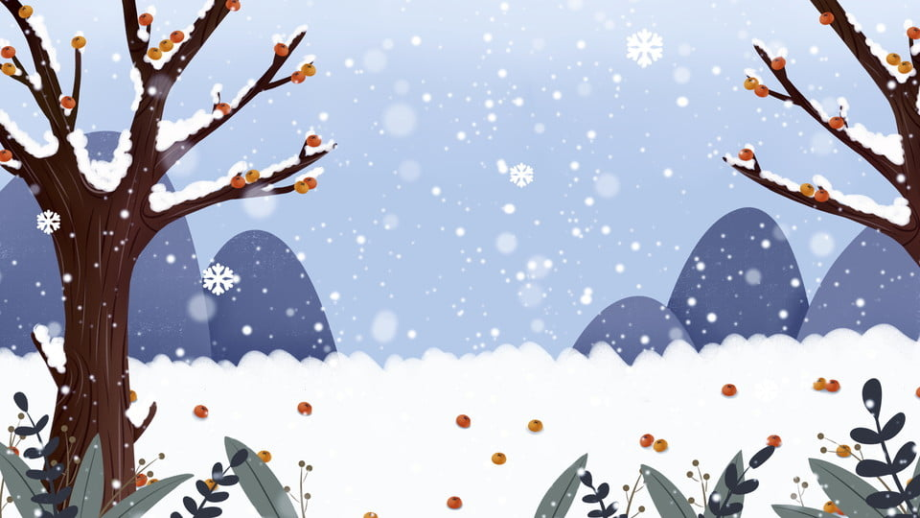
spring
summer
autumn
winter

Slide 3

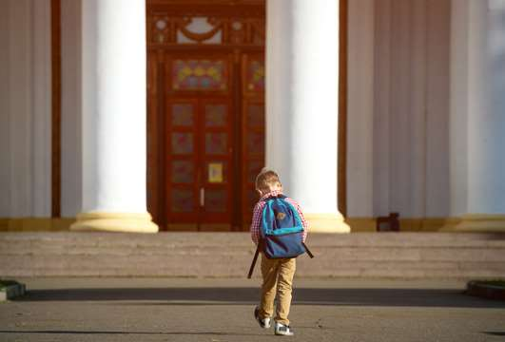
Listen and choose
A. winter
B. summer
summer
Do you go to school in ………………….?

Slide 4

Look and choose. Then listen and check .
A. Yes, I do.
B. No, I don’t.
Do you go to school in summer?

Slide 5
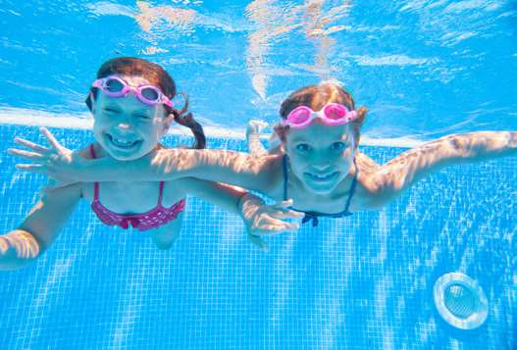

Look and choose. Then listen and check .
Do they swim in winter?
No, they don’t.
Yes, they do.

Slide 6
Task 4. Listen and repeat.
2. Do they swim in winter?
1. Do you go to school in summer?
- Yes, I do .
- No, they don’t.

Slide 7


MAGIC PENCIL GAME
START

Slide 8

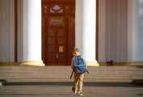


I
1.Do you go to school in summer ? No, ……don’t. .
I
You

Slide 9

They
2.____ swim in the pool in summer.
She
They

Slide 10
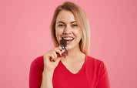
eat
3. I _______chocolate in winter.
eat
drink

Slide 11
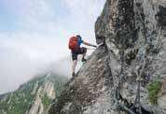
I do
4. Do you climb the rock ? Yes, ……….. .
I don’t
I do

Slide 12
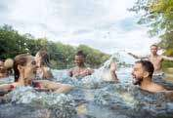
5. Do they swim in the river in winter ? - ____, they don’t.
No
Yes
No

Slide 13
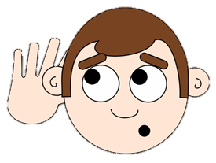

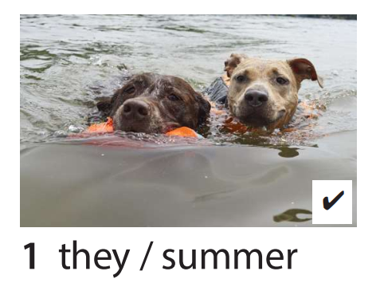
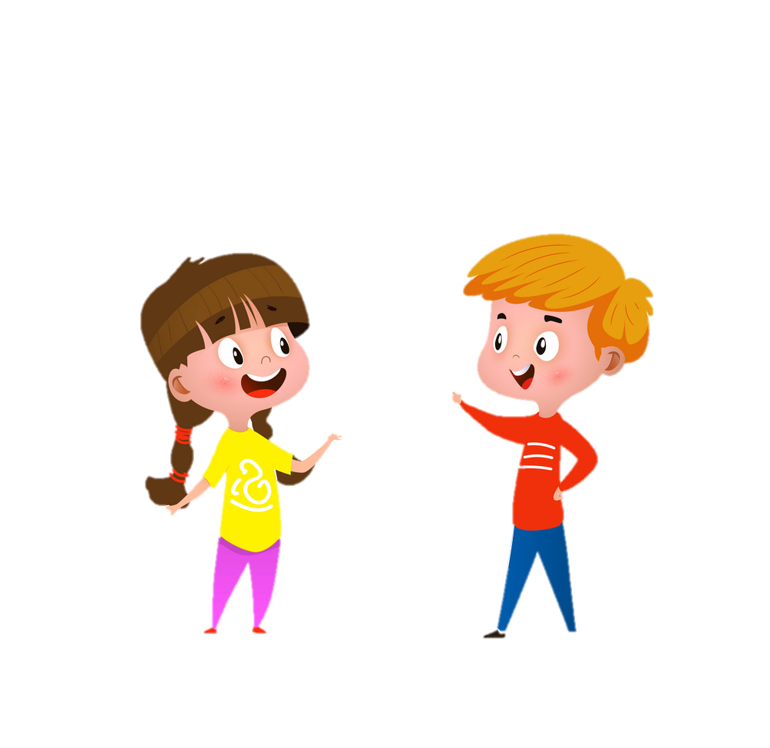

5. Look and say
Yes, they do.
Do they swim in summer?
No, they don’t.

Slide 14
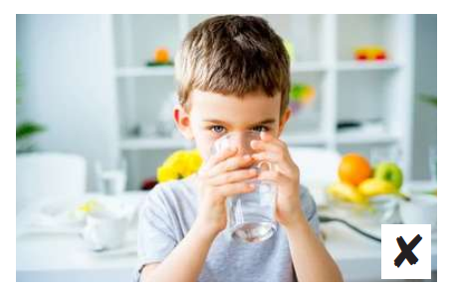
5. Look and say
No, I don’t.
Do you drink cold water in summer?
Yes, I do.

Slide 15
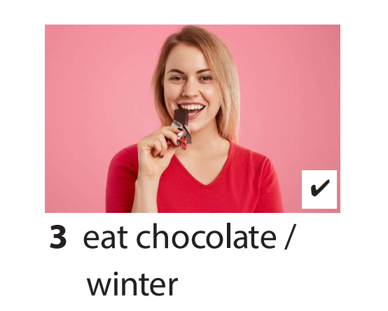
5. Look and say
Yes, I do.
Do you eat chocolate in winter ?
No, I don’t.

Slide 16
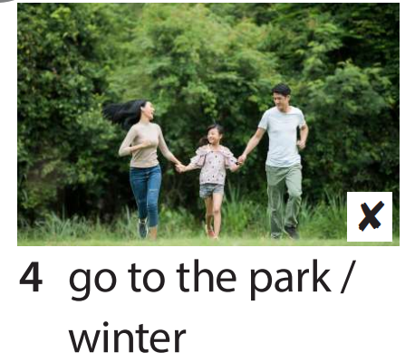
5. Look and say
No, they don’t.
Do they go to the park in winter ?
Yes, they do.

Slide 17
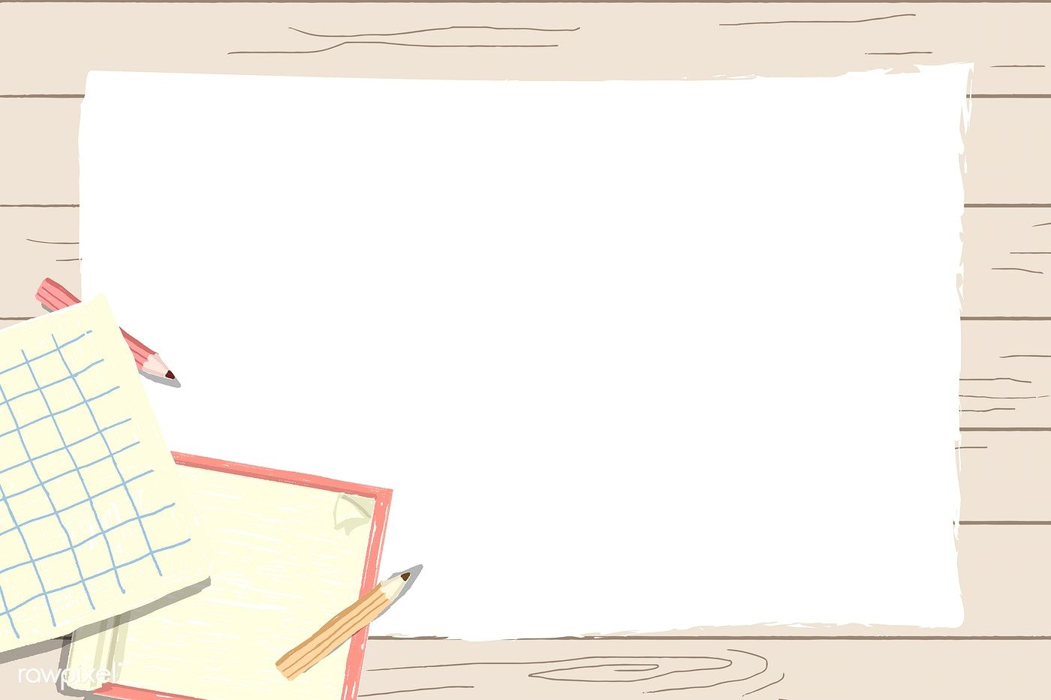
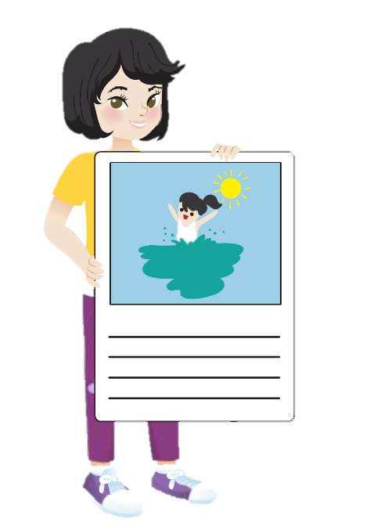
Draw your favourite season and the activities.
My favorite season is... I…….in the …..

Slide 18
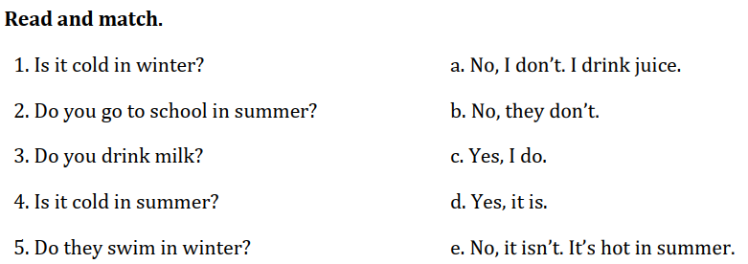
Notes:
HOẠT ĐỘNG TƯƠNG TÁC

