Slide 1



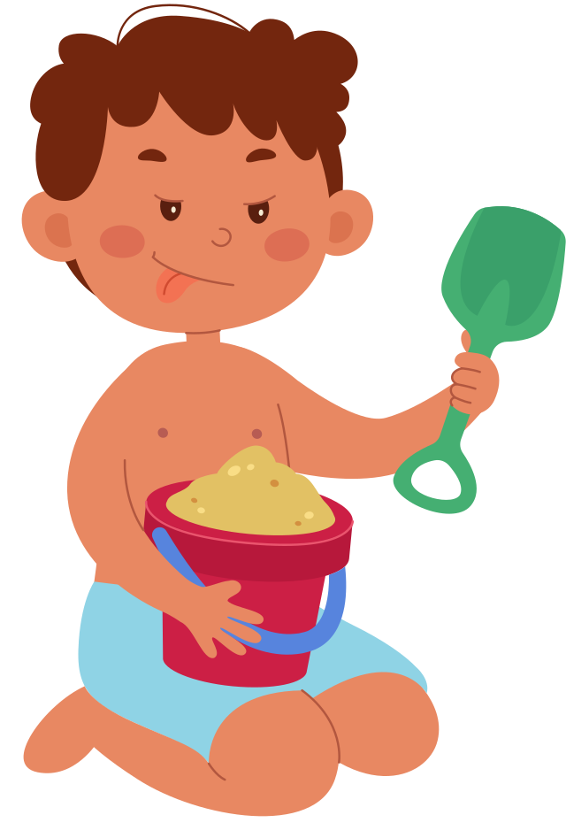




REVIEW 5: PART 1

Slide 2

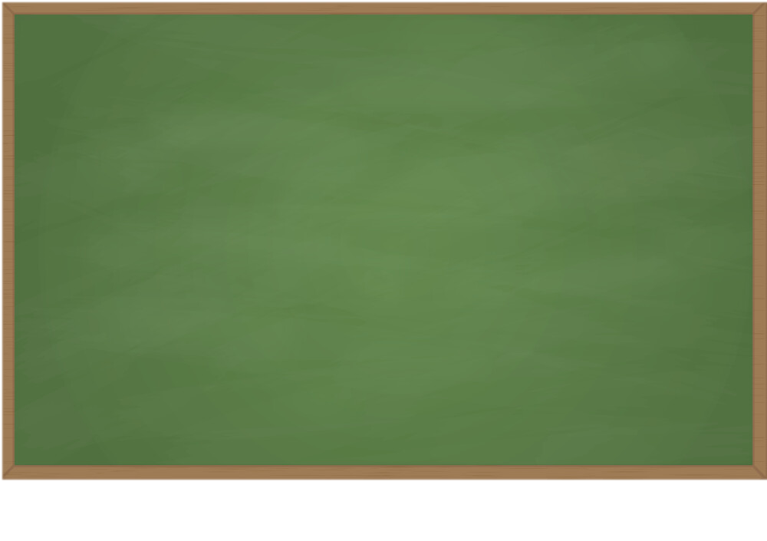
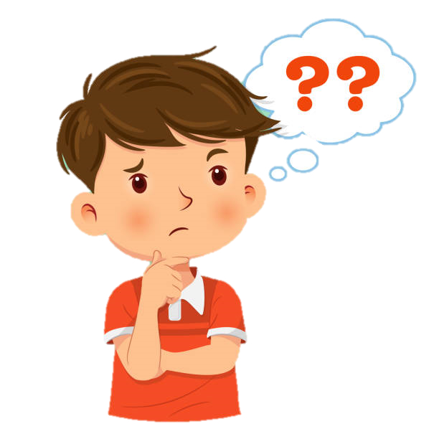


Play game: Back to the board
lock
lock

Slide 3
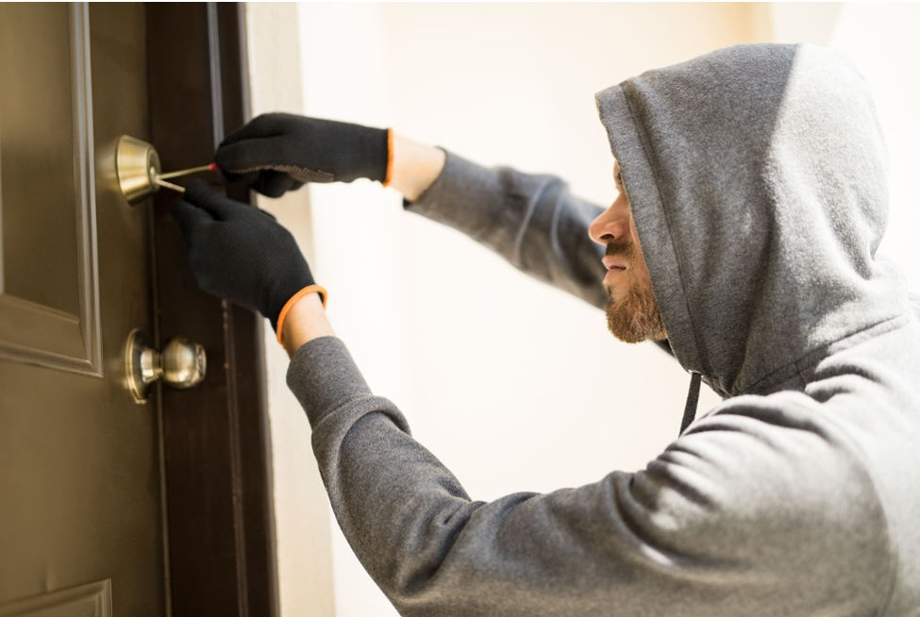
Play game: Back to the board
crime
crime

Slide 4
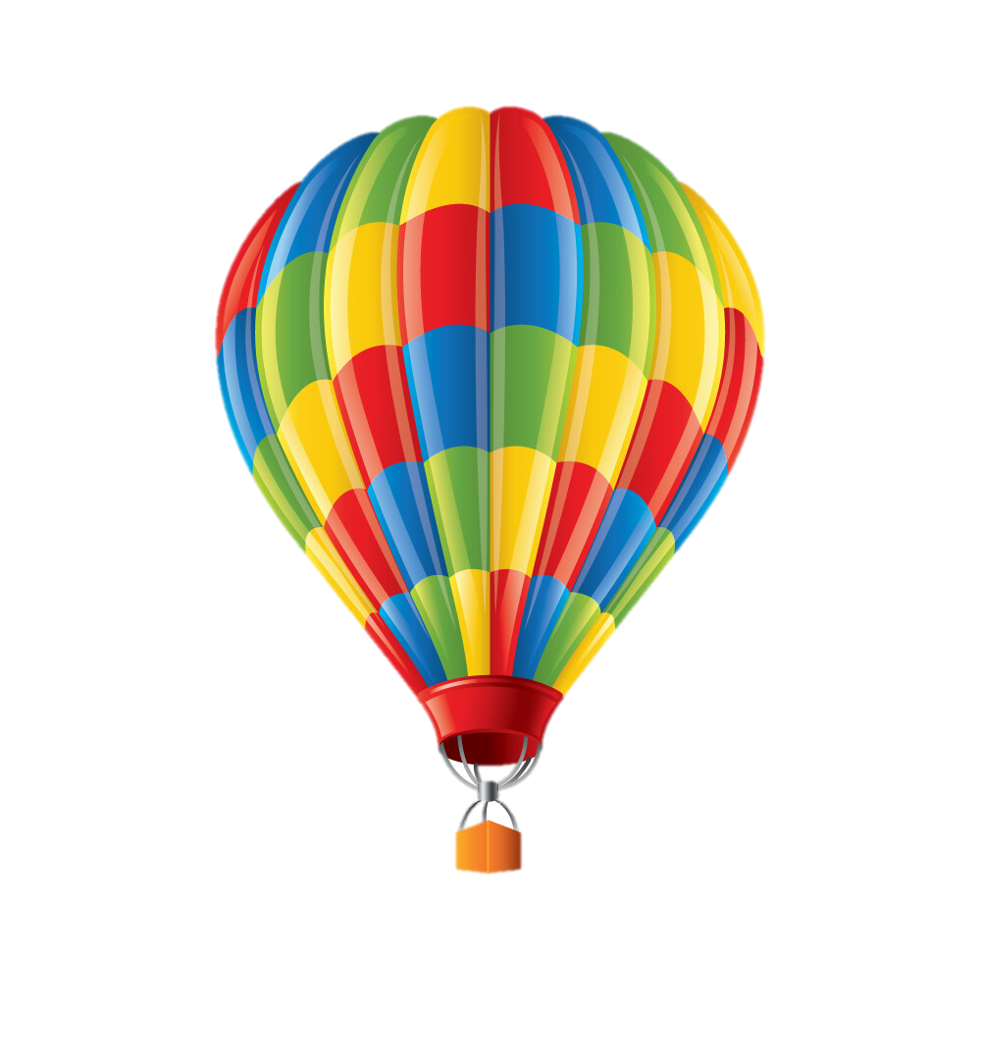
Play game: Back to the board
hot-air balloon
hot-air balloon

Slide 5
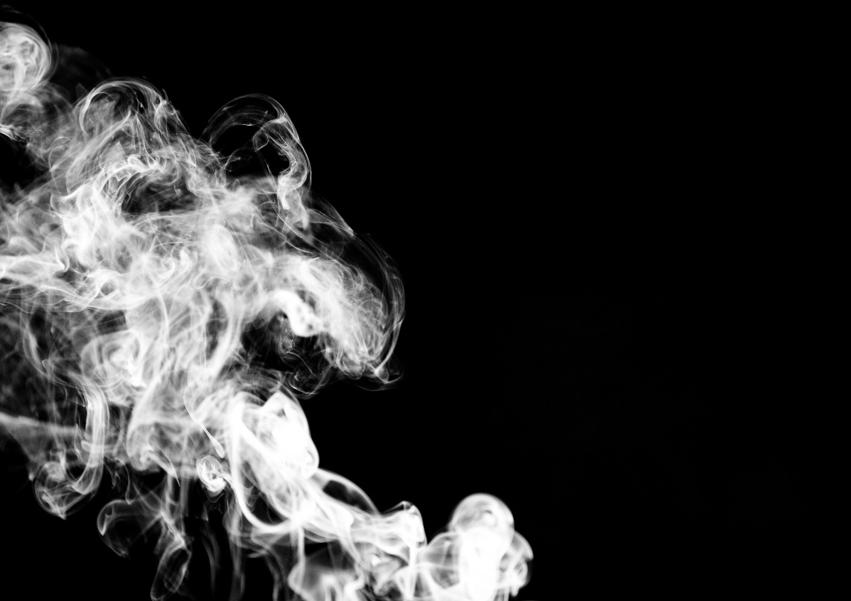
Play game: Back to the board
smoke

Slide 6
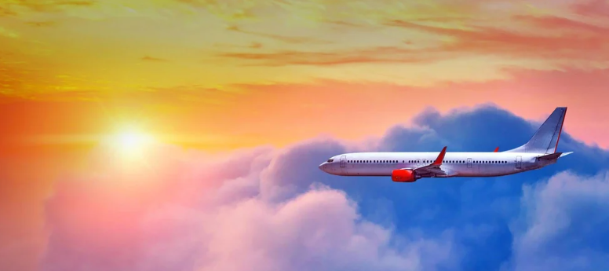
Play game: Back to the board
flight

Slide 7
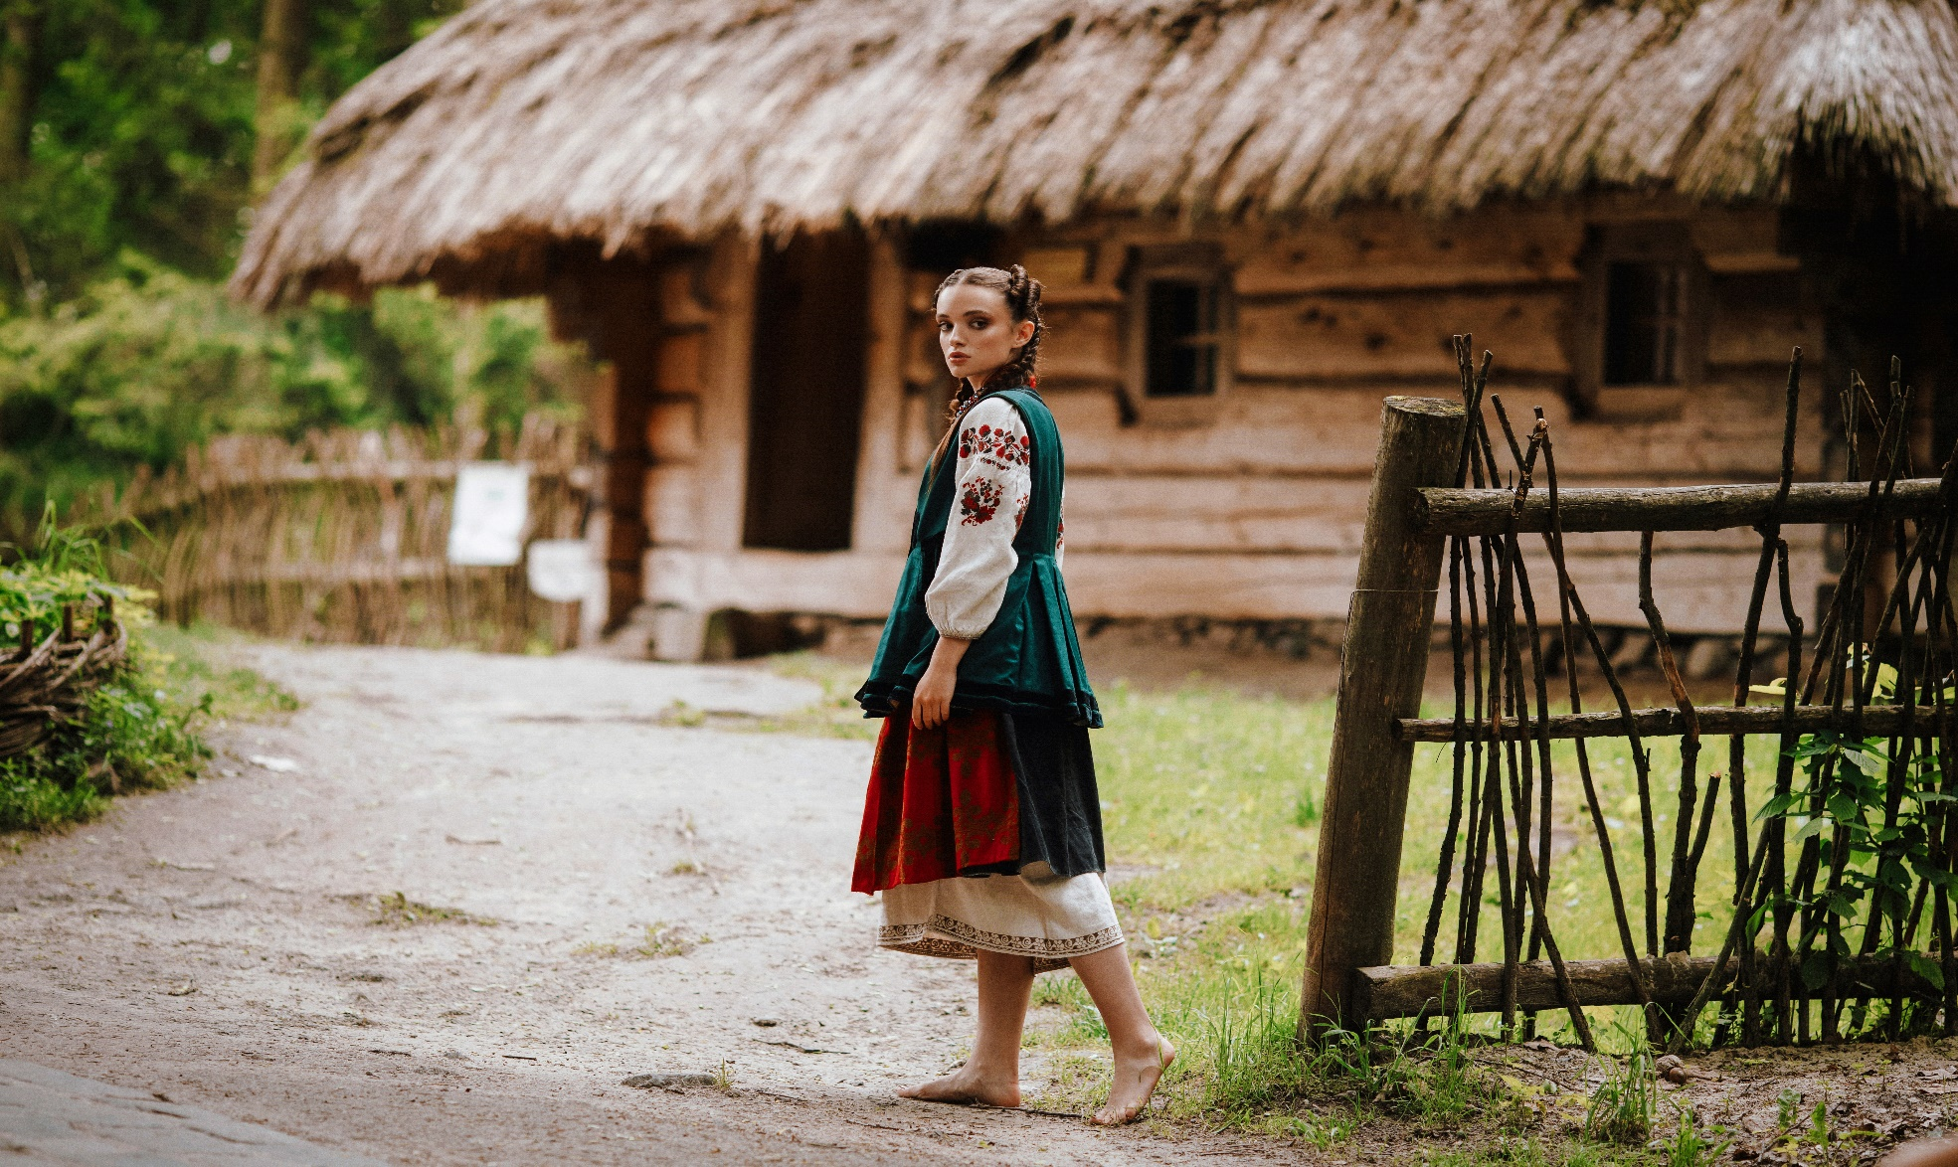

Play game: Back to the board
villager

Slide 8
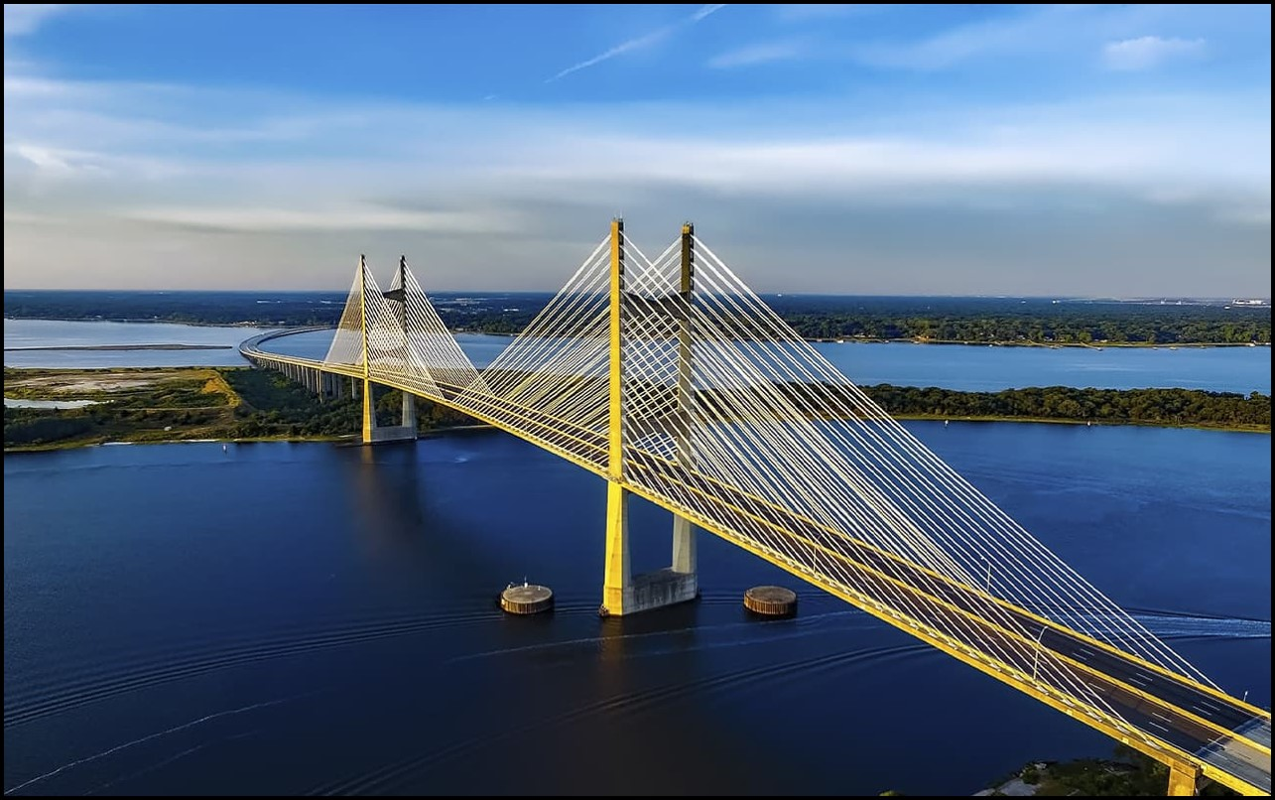
Play game: Back to the board
bridge

Slide 9
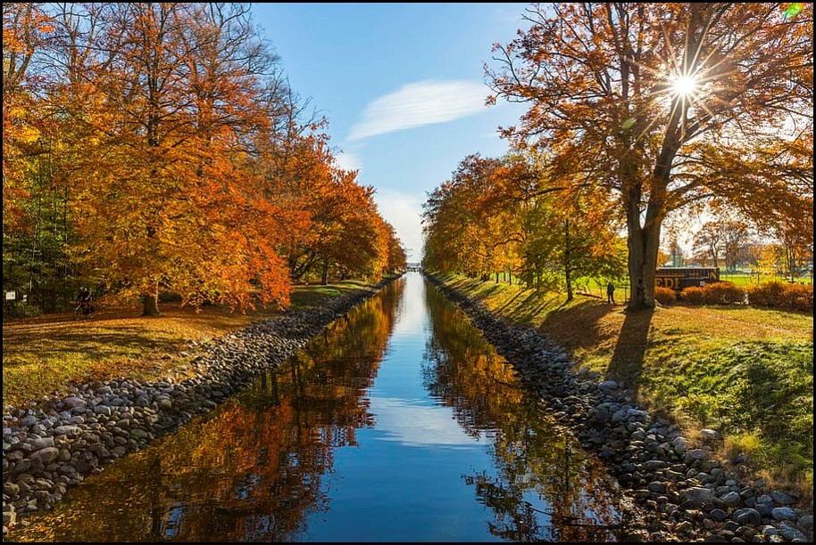
Play game: Back to the board
canal

Slide 10
Past simple tense: Summary
buy
bought
Irregular verbs
have
had
cut
cut

Slide 11
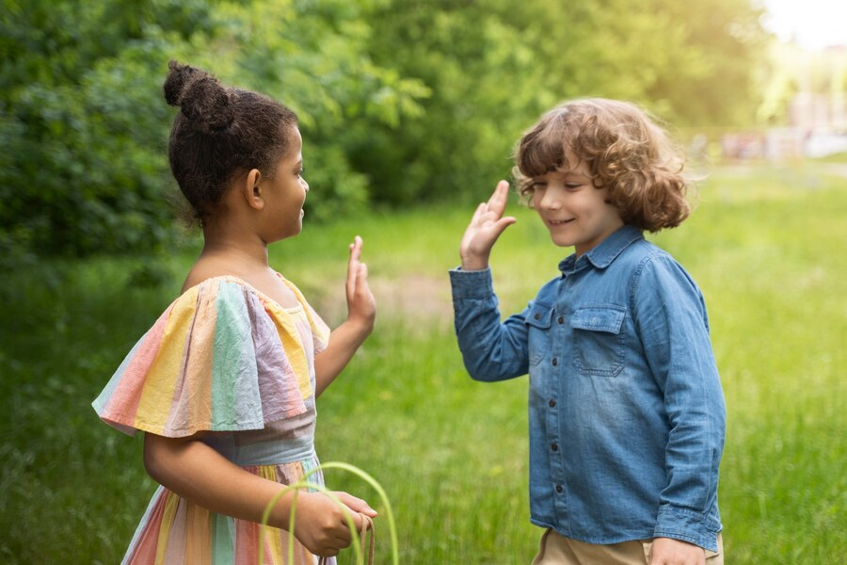
1 Read and choose the best answer.
1 Mia: Hi, Peter! Did you enjoy
your trip last summer?
Peter:
a It was great.
b What a lovely day!
c It’s Saturday!

Slide 12
1 Read and choose the best answer.
2 Mia: How did you travel?
Peter:
a There were five of us.
b We went by bus.
c The car was so fast.

Slide 13
1 Read and choose the best answer.
3 Mia: Was the weather good?
Peter:
a Well done!
b Yes, it was warm there.
c It is so good.

Slide 14
1 Read and choose the best answer.
4 Mia: Did you take any photos?
Peter:
a No, I don’t like.
b No, thank you.
c Yes, a lot.

Slide 15
1 Read and choose the best answer.
5 Mia: Who did you go with?
Peter:
a I went there by car.
b My parents.
c Tom is my best friend.

Slide 16
2 Fill each gap with a word from the box.
beautiful delicious interesting difficult special
Dear Joe,
I’m having a great time in Amsterdam! It’s a city with a very (1) __________ history. There are a lot of (2)___________ buildings and parks. Yesterday, we cycled around the city centre. It wasn’t (3)__________because Amsterdam has got (4)____________ roads just for bikes! This morning, we had breakfast at a cafe near our hotel. The food was(5)_________ .
See you soon!
Emil
interesting
beautiful
difficult
special
delicious

Slide 17
3 Write a postcard to a friend from a city you know. Use the plan below. Remember to use adjectives to describe nouns.
Dear...,
I’m having a great time in...! The city is a very...
The city has got... . There are (a lot of)...
Yesterday, I / we...
Last night, / This morning, I / we...
See you soon!
(your name)

Slide 18
Who's Faster?
1. Whom did he/she write this letter to?
2. How did he/she go?
3. Who did he/she go with?
4. What did they see/do in……… ?
5. Where did he/she go on holidays this summer?
6. How was the food?
Notes:
- Sau khi 1 số Hs giơ tay đứng lên đọc bưu thiếp mà hs đã viết ở bài 3. Gv hỏi Hs 1 số câu hỏi phía dưới để kiểm tra kỹ năng nghe và nhớ thông tin của Hs.

